Slide 1
Auroral Electron Transport using the Monte Carlo Method
Solomon 1993

Slide 2
Introduction – Monte Carlo Method
Using random number generation in problems
Finance
Elementary Particle physics
Etc.
Results can give information that relate to probability densities and can be transformed to other useful quantities.

Slide 3
Overview
This paper
Looks for new algorithm for calculation of energetic fluxes in the atmosphere (~600 km peak)
Compares results with other methods used to obtain same information and determine usefulness
This presentation
Understand what is needed to use Monte Carlo simulation in this context.
Determine why Monte Carlo simulation is useful in this problem.

Slide 4
Methodology
3 dimensions
One field aligned spatial dimension
Pitch angle
Energy
Assumptions
E field acceleration, magnetic field curvature and gravity have NO effect.
Electrons confined to spiral paths
Wave-plasma interactions unimportant in the thermosphere

Slide 5
Methodology
Electron introduce into the “top” of a model atsmosphere (~ 600 km)
Start with E0 and α0
Electron is subject to qsuedo-random (random walk) collision events resulting in:
New pitch angle
New energy
New altitude

Slide 6



Computation – Stage 1 (Before collision)
Electrical depth (similar to optical depth in Beer-Lambert Law)
Distance and electron will move before collision.
r random number between 0 and 1.
Change in altitude then calculated accounting for current pitch angle and magnetic field angle.
Species and specific state transitions also determined randomly

Slide 7
Computation – Stage 2 (Collision)
Primary electron energy reduced by interaction type (sum?)
Collision type then computed randomly by weighted products of cross sections and density at the collision location.
A. Ionization
B. Elastic
C. Excitation
D. Dissociation

Slide 8




Computation – Stage 2A (Ionization Collision)
If collision is ionizing, secondary electron produced
Isotropically random pitch angle assigned
Random energy assigned by
Then solve for Es giving
Where r is uniformly random from 0 to rmax

Slide 9
Computation – Stage 2B,2C & 2D (Other Collisions)
B. Elastic
Ei = Ef
New pitch angle calculated from expressions and parameters in Porter and Jum [1978] and Porter et al. [1987].
C. Excitation and D. Dissociation
Cross sections obtained from a variety of laboratory and/or theoretical sources (no details in paper)

Slide 10
Computation – Stage 3 (After Collision)
Record new energy for primary electron Ep and secondary electron Es.
Go back to Stage 1 calculation starting at altitude change for both electrons and repeat. Do this for future bifurcated generations.
Retire a branch when electron is thermalized (E < 0.25 eV) or electron exits upper boundary.
Repeat for 10^4 to 10^5 primary electrons corresponding to Maxwellion, Gaussian, or isotropic energy distribution.

Slide 11
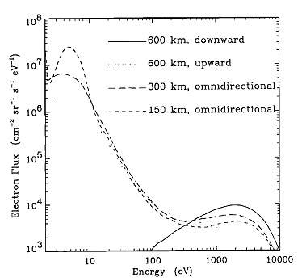
Results
Fluxes counted by each altitude level crossing within each energy and pitch angle bin.
Counts then normalized to specified total energy flux.
1 erg cm^-2 s^-1
Maxwellian energy,
E0 = 2 keV
Isotropic pitch angle distribution

Slide 12
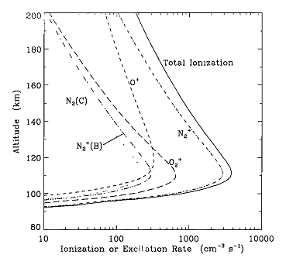
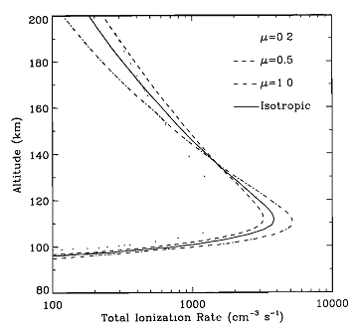
Results
Excitation, dissociation, and ionization rates are obtained by accumulating event counts at each altitude level.
Ionization and Excitation rate
Maxwellian energy,
E0 = 2 keV
Isotropic pitch angle distribution
Second graph for total Ionization rate for different energy distributions

Slide 13
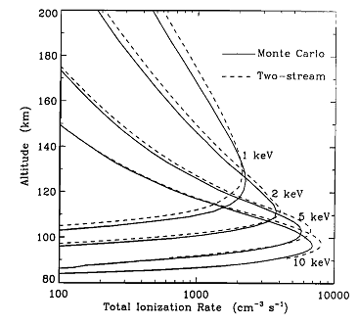
Comparison to other calculations
Comparison to two-stream method.
“photoeclectron algorithm”
Solomon et al. [1988] and Solomon[1989]
Ionization rate over multiple energies in good agreement.

Slide 14
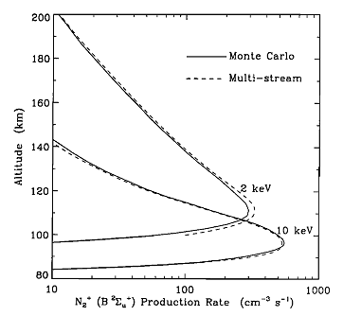
Comparison to other calculations
Compared with multistream method
Strickland et al [1989]
Production rate in good agreement as well.

Slide 15
Conclusion (For Monte Carlo Method)
Monte Carlo method can simulate multiple random parameters in a simulation.
Efficient method of calculation for multivariable problems that require random numbers in multiple steps.

