Slide 1
(Platform to test methods to maximize (minimize) functions)
By Armand Gutiérrez Arumi
Python project

Slide 2
Introduction
Necessity to maximize(minimize) functions
  [difficult to derivate, complex, …]
Multiple requirements
e.g.
  Find certain dimensions of box to get maximum area with given restrictions
  Find optimal evolution
  Find binding sites of a protein
  ...

Slide 3
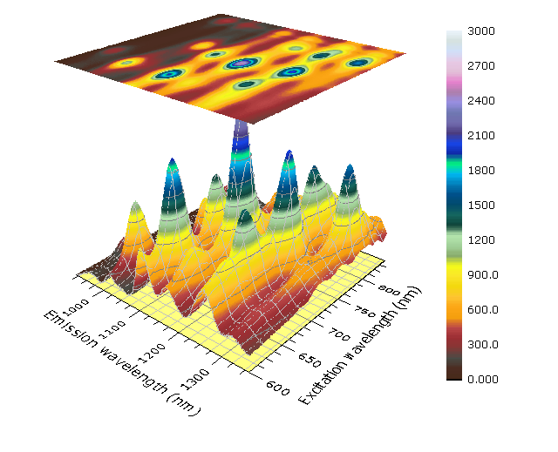
Proposed application
Desired to simulate the different algorithms visually
Use of cantour plots (2D maps)

Slide 4
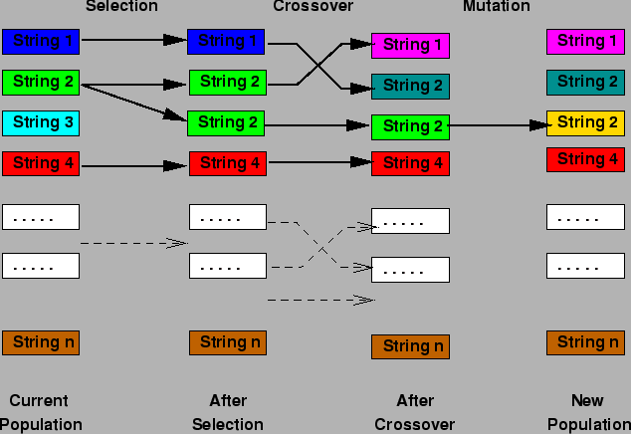
Algorithms
Genetic algorithm (summarized ...)
  Several operations between individuals

Slide 5
Algorithms
Macro evolutionary algorithm
  Based on extintion patterns in macroevolution
  God to avoid spend so much time in minimum locales
  Creates relations from species
  If its a purely ones, the matrix relations must be implemented (it works better if there a local full of picks)

Slide 6
Methods
We implemented 4 algorithms:
  Genetic algorithm
  Pseudo Macro evolutionary algorithm
  Mixed algorithm
  Random :)

Slide 7
Demo

Slide 8
Technical points
Python libraries :
  matplotlib
  wxPython for GUI
  Numpy
Some caution with:
  Non bloquing GUI (use of threads)
Software Life Cycle :
  Use of GIT (collaborative oriented)

Slide 9
Technical points
Core entities :
parameters
Population
Individuals
Fitness_algorithm
Terrain
FunctionXY

Slide 10
Technical points
Python libraries :
  matplotlib
  wxPython for GUI
  Numpy
Some caution with:
  Non bloquing GUI (use of threads)
Software Life Cycle :
  Use of GIT (collaborative oriented)

Slide 11
Further work
Add new features
  Implement other methods
  the posibility of do statistics (when visually we see that some method works, )
  Export the selected simulation into google chart (instead a kind of .dcd)
  Library of landscapes (functions) to perform packed simulations
Correct bugs (GUI) … is a very preliminary version, there are a lot! (is a git project :) )
Improve the widget system (GUI) – appear the proper params for each algorithm.

Slide 12
Conclusions
Nice platform to start to play with algorithms
It could decide you to go for a certain algorithms for your kind of problems
Each algorithm has its strengths:
  Macroevolutionary algorithm to take into account if the distance is penalized
  Genetic algorithm converges rapidly (instead it stays to a minimum(maximum) local
  …
It provides a very preliminary step to develope new algorithms and see how it works in an easy way

Slide 13
Conclusions
Comparation between core methods
Genetic Algorithms | Macro evolutionary algorithm
- local minimal - quick converge - core easy to implement but infinite posibilities to improve | - global - more difficult to converge core easy to implement but infinite posibilities to improve

