Slide 1
Human resources management in a company
Universitatea din Craiova, Facultatea de Automatică, Calculatoare și Electronică, Departamentul de Calculatoare si Tehnologia Informației
Marcu Andrei Cristian
Supervisors:
Prof. Dr. Ing. Liana Stănescu
Asist. Drd. Ing. Petcușin Felix Alin

Slide 2
Motivation
I chose to develop this application mainly because it's something that can be adapted and applied to a real-life use case.
Also, the topic is very close to my personal area of expertise, I work with many of these technologies and develop similar solutions on a daily basis.

Slide 3
Technologies
ASP.NET Core
React
React Material UI
Entity Framework Core
SQL Server
Devexpress Scheduler

Slide 4
Modules
The human resources management application, called “HRDesk” is made up of the following modules:
Leave request module
Day off request module
Hardware request module
Team module
Holiday calendar module
Booking module
Meetings module
Manage request module
Manage organization module
Employees module

Slide 5

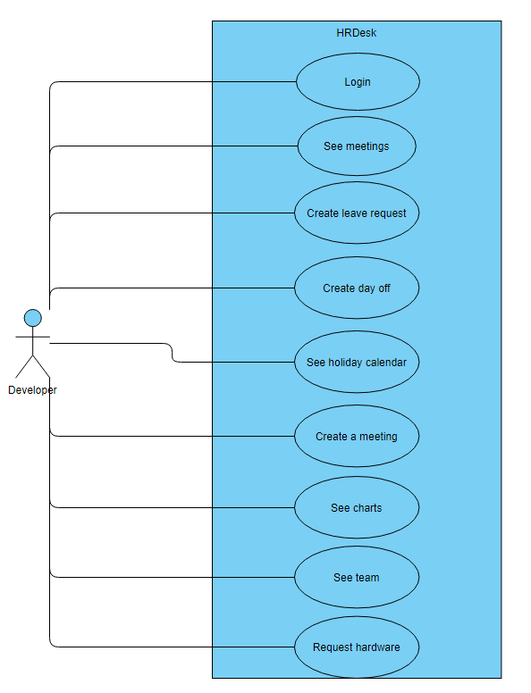
Example use case for an employee
User permissions are not constrained by a role. The permissions of the user can be customized in any way. Developer is not an actual role, it’s for demonstration purposes only.

Slide 6
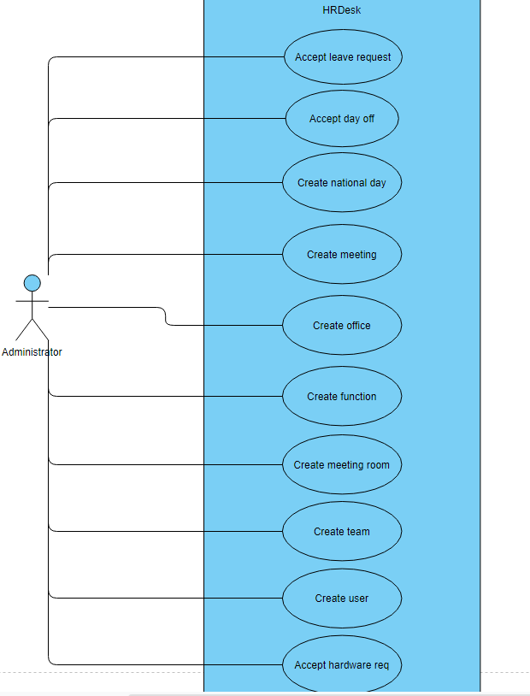
Example use case for a manager
User permissions are not constrained by a role. The permissions of the user can be customized in any way. Administrator is not an actual role, it’s for demonstration purposes only.

Slide 7
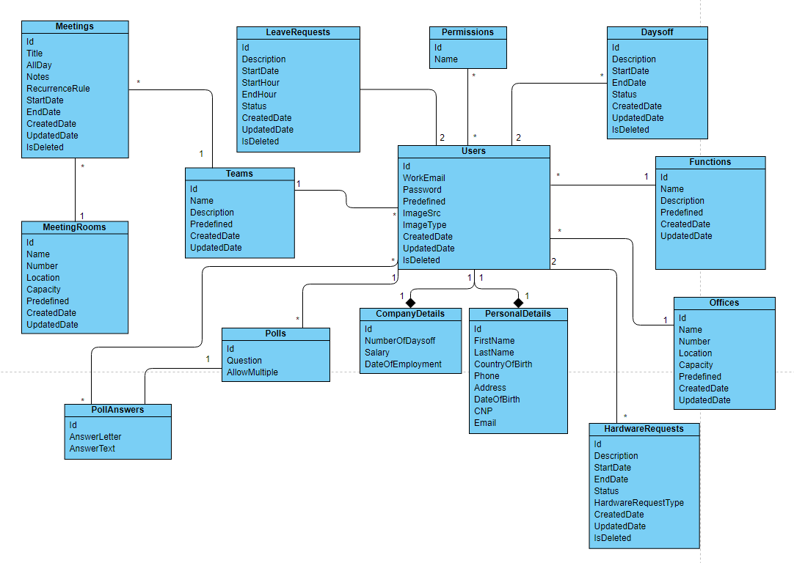
Database structure

Slide 8
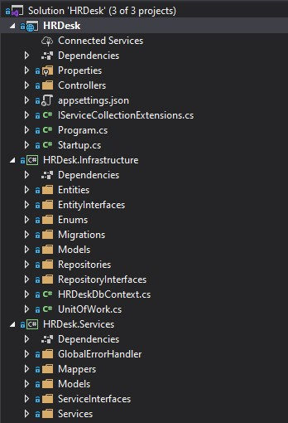
Backend solution structure
The solution is made up of three projects:
HRDesk – The startup project of the REST API. Contains the controllers and the service registration class.
HRDesk.Infrastructure – It’s the project that handles the relation between the REST API and the database. Contains the Entities, Repositories, Unit of works, Migrations and the DbContext of the application.
HRDesk.Services – Contains the actual logic of the application, the mappers between entities and DTO models and useful middleware.
The flow is the following: The client makes a request which is caught by the controller in project no.1. Then the controller calls the specific service from project no.3. After the operations are done the service calls project no.2 to update the database if needed.

Slide 9
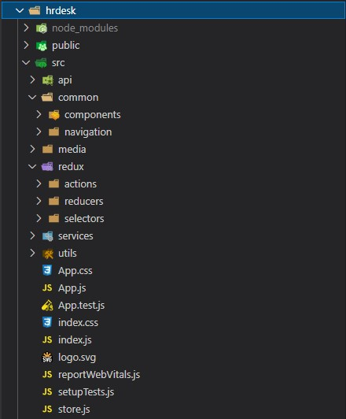
Frontend solution structure
Node_modules: The dependencies of the project. This folder is not uploaded on GitHub but can be automatically retrieved by running the command npm install since all dependencies are specified in the package.json file.
Src: The actual code of the application. Components folder contains all the React UI Components. A component is made out of three files:
ComponentGeneral: The React and JSX code of the component
ComponentContainer: The container of the component, which contains the logic for Redux calls.
ComponentStyles: The styling of the component
Media: Media files that are not stored in the database, for example the login picture
Redux: React Redux actions, reducers and selectors.
Services: Services with logic that is shared between multiple components

Slide 10
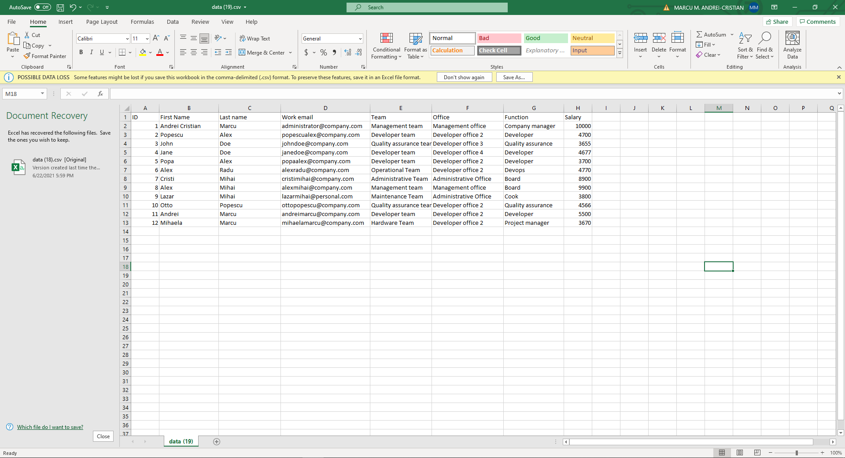
Reports
From HRDesk UI interface the manager can generate Excel reports about different data like employees, leave requests, holiday requests, hardware requests. These come in handy in keeping data history inside the company.

Slide 11
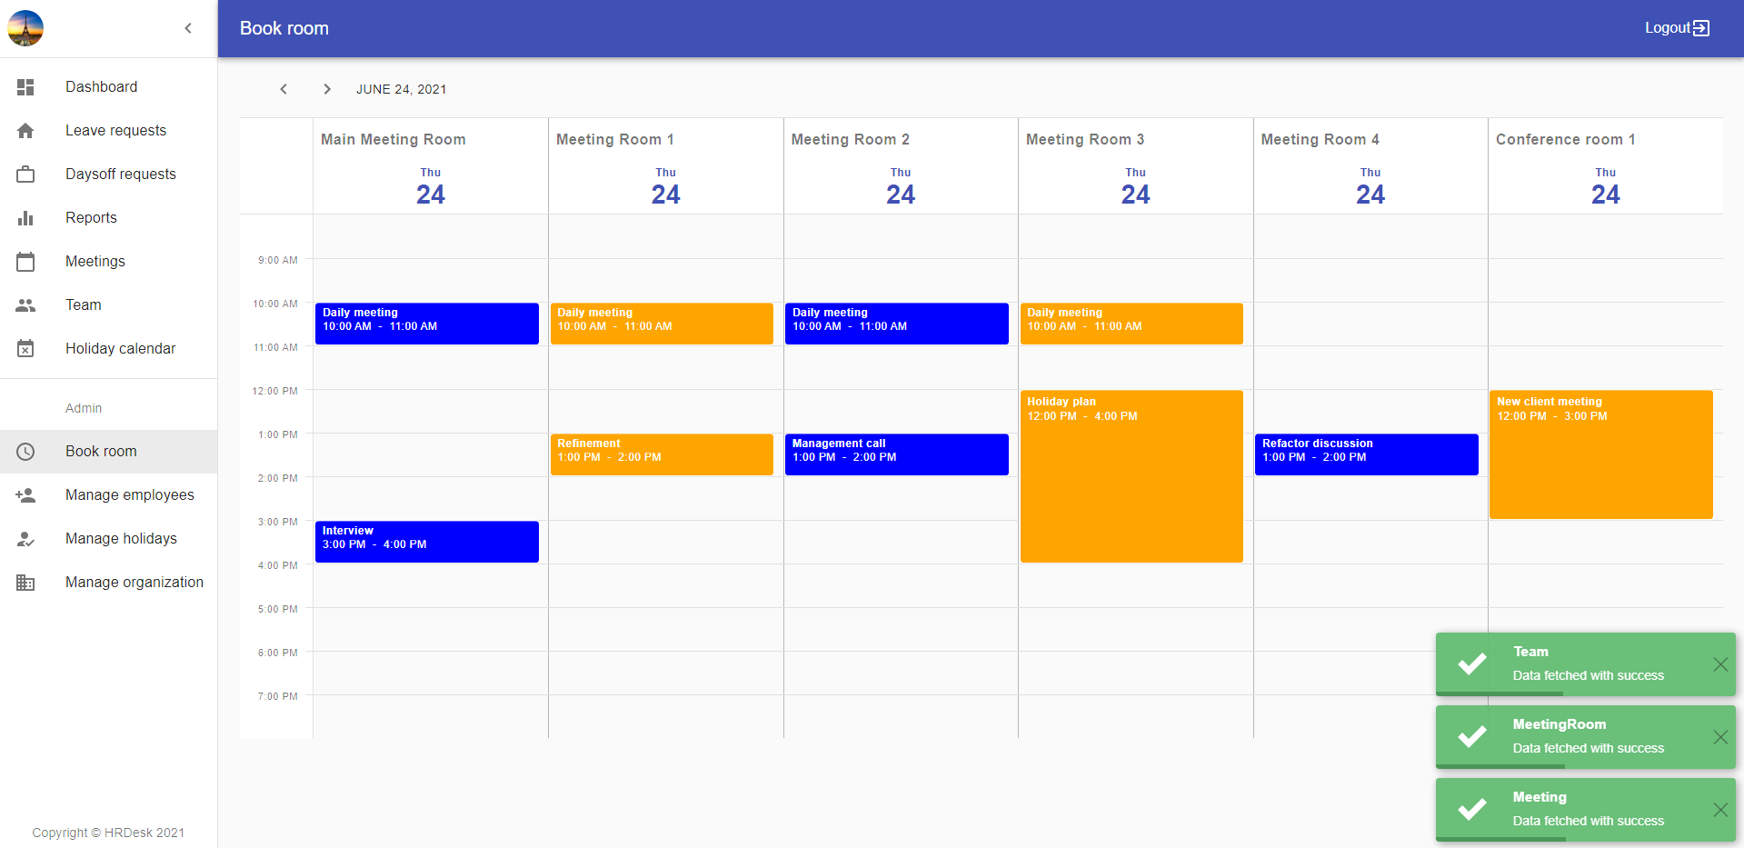
Schedulers
As stated earlier on the presentation, I’ve used the Devexpress Scheduler in my application. This can be found on the following modules: Booking and Holiday calendar. This scheduler was adapted to the topic of the application, the booking of the meetings rooms in the application and the display of team members’ holidays and national days off.

Slide 12
Coding conventions
I’ve tried to respect the coding conventions all over the application. Meaning that the SOLID principles were a target since the beginning of the application, the frontend components were made as simple as possible for reusability purposes.
I’ve used the Repository pattern on backend to avoid duplicate code for CRUD Methods.
Also the Repository pattern was extended by Unit of Work pattern in order to remove the dependency on Entity Framework. The repositories are injected in the Unit of Work, and the Unit of Work will be used all over the application. Thanks to this we don’t need to inject multiple repositories in one service, since the Unit of Work contains an instance of each repository.

Slide 13
Security
The authorization is made using Json Web Token(JWT). The token is valid for 30 days and it’s stored in the local storage (if the “remember me” option is checked) otherwise in the session storage.
All the calls made to the REST Api require the token from the frontend. Except the one for login. The token is automatically attached to the request by an axios middleware.
When the user logs in the permissions are stored in redux state. Based on these permissions the user sees the available menu items. In case the user tries to access a component directly from URL he will be redirected to the access denied page by the routing component.
Sensitive data like passwords is encrypted in the database.

Slide 14
Future of HRDesk
The application can be extended in the future by adding additional modules, like polls, chat system, internal competitions, internal project storage(using Azure or a similar cloud provider), interview quiz, media player.
Also, the website is mobile responsive, but some components are impossible to be adapted for a mobile device. For example the employees grid, which contains more than 10 columns, causing a scroll on mobile devices. Maybe in the future, a possible improvement would be to replace the Grid component with one that is mobile friendly (or an actual application for mobile).

Slide 15
Thank you!
Demo time

