Slide 1
Tenants association -UnitTests-
Marcu Andrei Cristian
Tolgoi Dragos Cristian
Calina Florin Daniel
Matei Alexandru Cristian
CEN

Slide 2
Tests
The tests were made with MSTest.
The tests can be found in the project names TenantsAssociation.ApplicationLogic.Tests
We used Moq in order to simulate dependencies calls.(For example repositories)

Slide 3
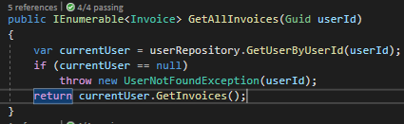
GetAllInvoices unit tests(InvoiceService)
GetAllInvoices is a method that returns all invoices of an user. If the user doesn’t exist the method will throw an UserNotFoundException

Slide 4
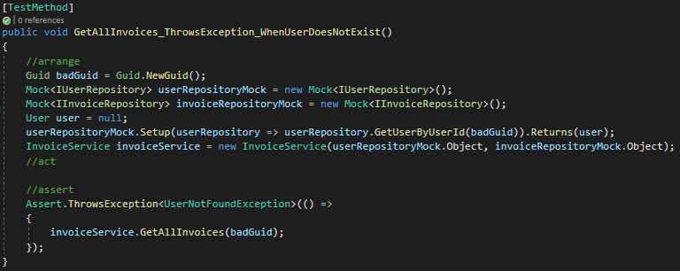
GetAllInvoices unit test 1
This test checks the case when the user doesn’t exist, so the repository will return null and the service will throw UserNotFoundException

Slide 5
GetAllInvoices unit test 2
This test checks the case when user exists, and it has at least one apartment, and that apartment has at least one invoice. So the method should return at least one invoice.

Slide 6
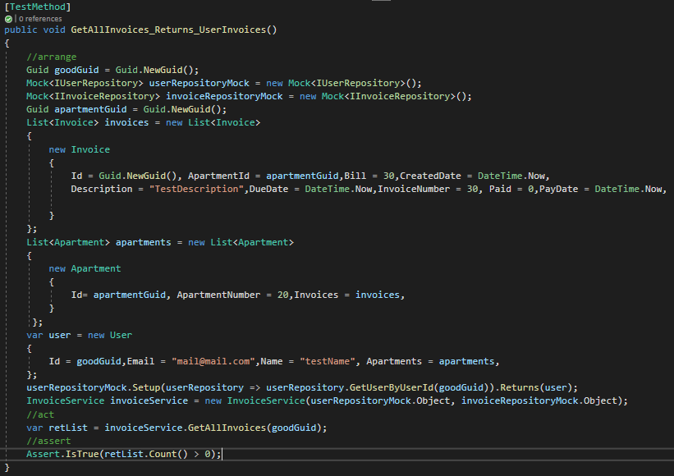
GetAllInvoices unit test 2

Slide 7
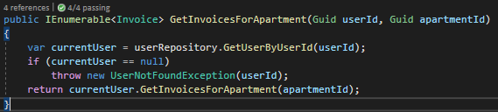
GetInvoicesForApartment unit tests(InvoiceService)
GetInvoicesForApartment is a method that returns all invoices of an apartment. If the user doesn’t exist the method will throw an UserNotFoundException

Slide 8
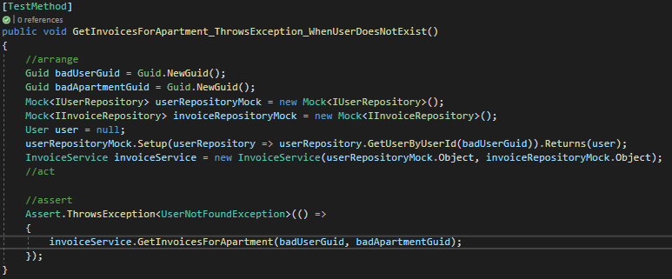
GetInvoicesForApartment unit test 1
This test checks the case when the user doesn’t exist, so the repository will return null and the service will throw UserNotFoundException

Slide 9
GetInvoicesForApartment unit test 2
This test checks the case when user exists, and it has at least one apartment, and that apartment has at least one invoice. So the method should return at least one invoice.

Slide 10
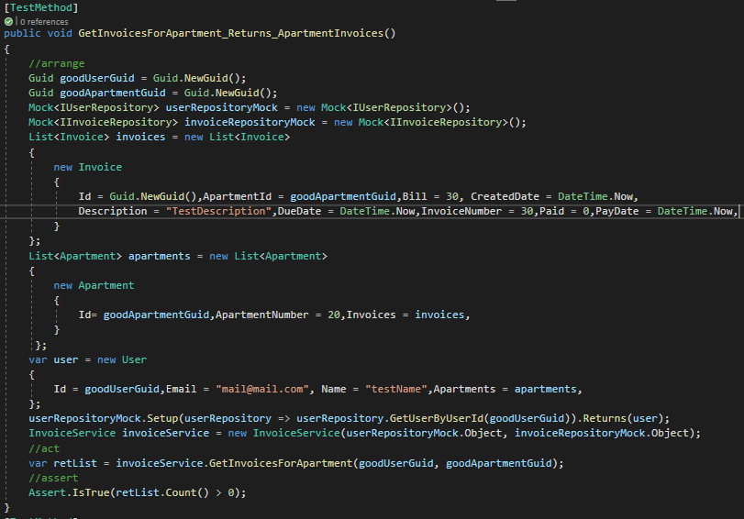
GetInvoicesForApartment unit test 2

Slide 11
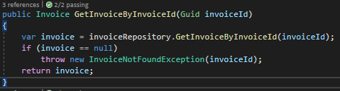
GetInvoiceByInvoiceId unit tests(InvoiceService)
GetInvoiceByInvoiceId searches an invoice by invoiceId and returns it when found, otherwise throws an InvoiceNotFoundException

Slide 12
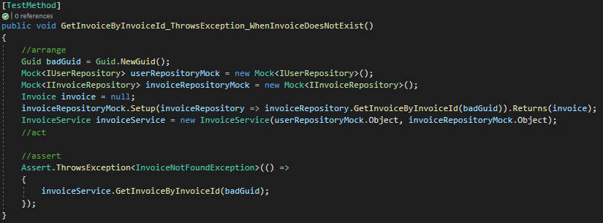
GetInvoiceByInvoiceId unit test 1
This test checks the case when the invoice doesn’t exist, so the repository will return null and the service will throw InvoiceNotFoundException

Slide 13
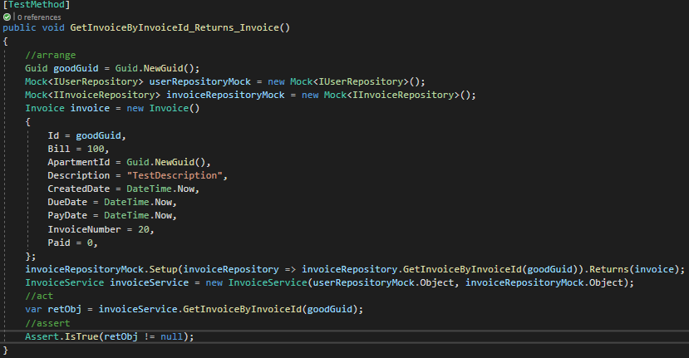
GetInvoiceByInvoiceId unit test 2
This is the case when the invoice exists and the method will return the invoice.

Slide 14
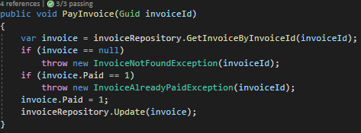
PayInvoice unit tests(InvoiceService)
PayInvoice is a method that changes the Paid state of an invoice. The paid value is initially 0, the method will change this to 1. It throws InvoiceNotFoundException when the exception doesn’t exist and InvoiceAlreadyPaidException when the value of Paid flag is already 1.

Slide 15
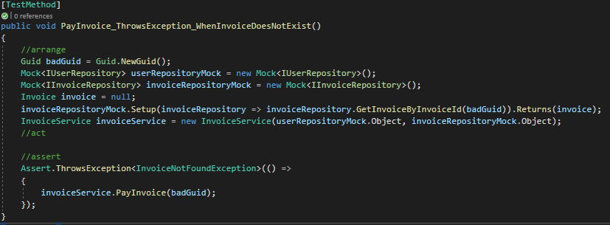
PayInvoice unit test 1
This test checks the case when the invoice doesn’t exist, so the repository will return null and the service will throw InvoiceNotFoundException

Slide 16
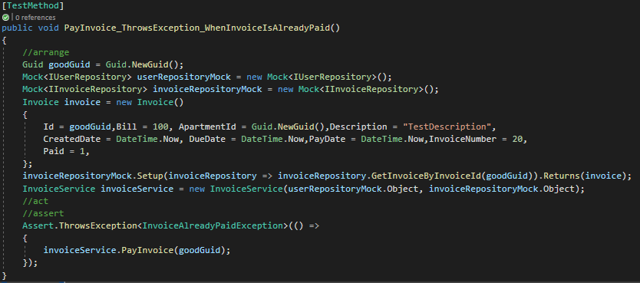
PayInvoice unit test 2
This test checks the case when the invoice exists, so the repository will return it but it was already paid so the service will throw InvoiceAlreadyPaidException

Slide 17
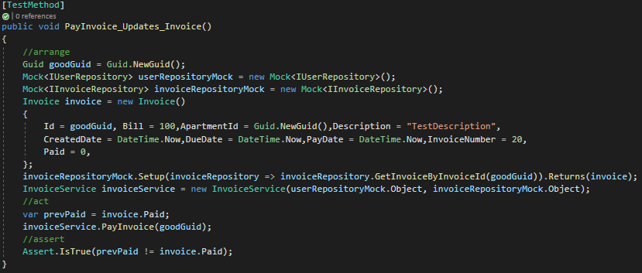
PayInvoice unit test 3
This test checks the case when the invoice exists, so the repository will return it but and the invoice isn’t paid. The service will modify the Paid flag from 0 to 1.

Slide 18

Register unit test
Register is a method that can register an user to the website. If the user already has an account the method will throw an UserAlreadyExistsException

Slide 19
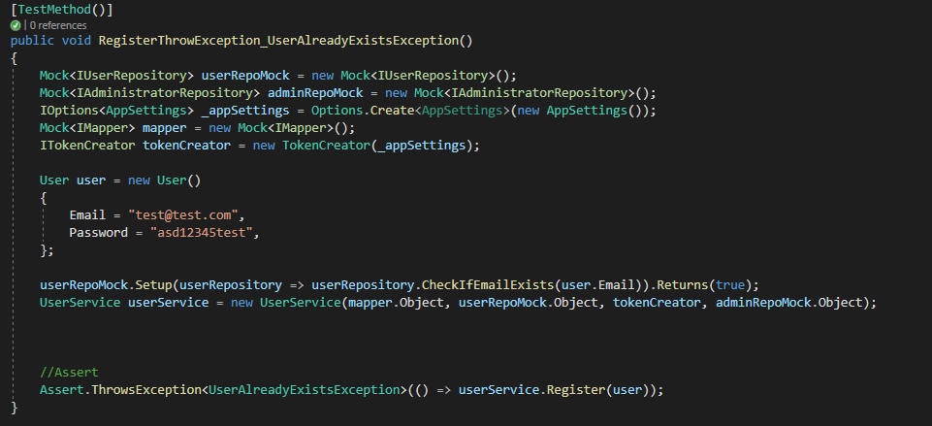
Register unit test 1
This test checks the case when the user already exists and it will throw an UserAlreadyExistsException

Slide 20
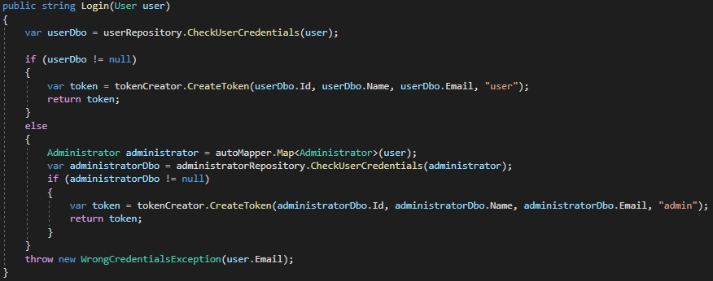
Login unit test
Login is a method that can login an user or an administrator to the website. If the credentials are wrong than this method will throw an WrongCredentialException

Slide 21
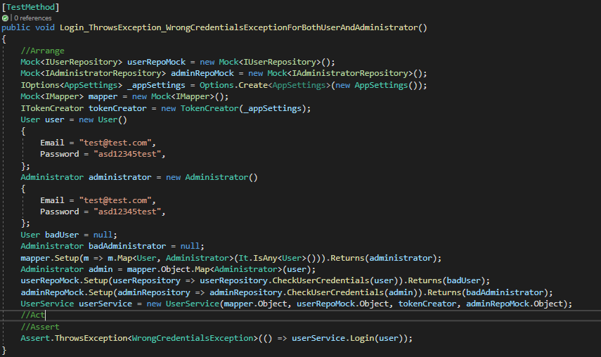
Login unit test 1
This test checks the case when both the user and the administrator credential are wrong and will throw WrongCredentialsException

Slide 22
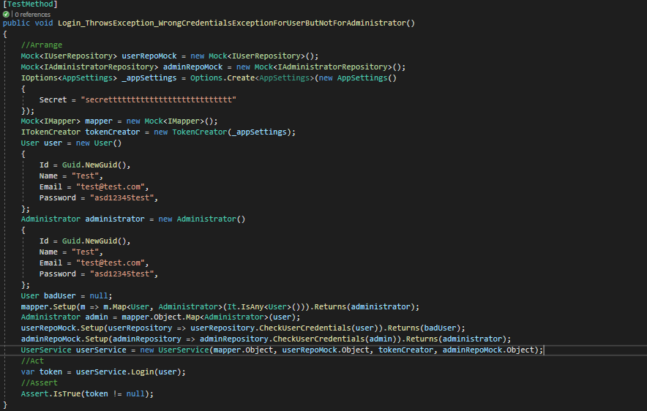
Login unit test 2
This test checks the case when only and the user credential are incorrect but the administrator credentials are good so the method will return the administrator

Slide 23
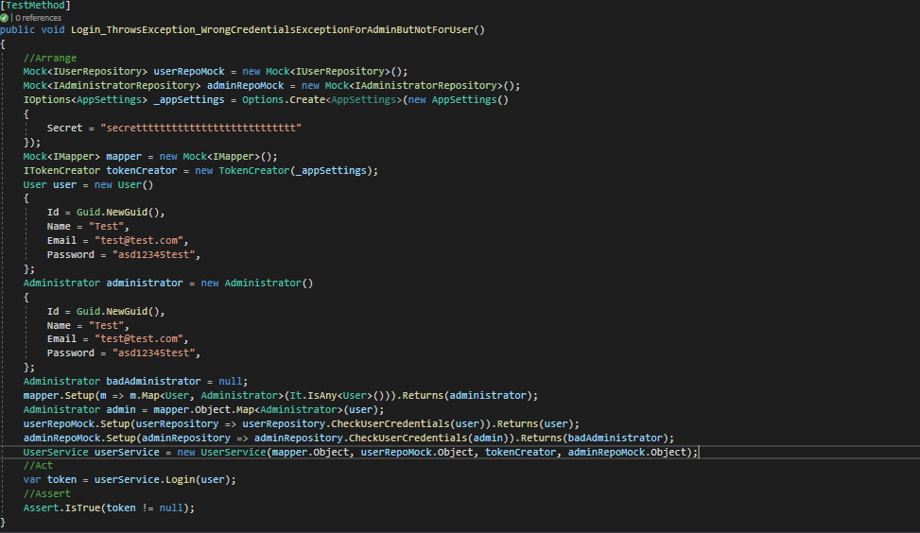
Login unit test 3
This test checks the case when only and the administrator credential are incorrect but the user credentials are good and so the method will return the user.

Slide 24
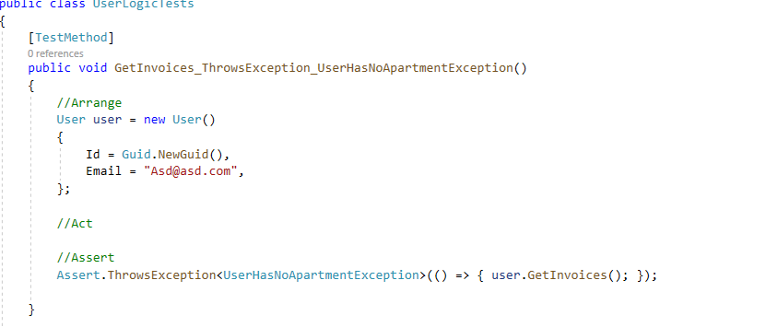
UserModel GetInvoice unit test1
This test checks the exception when user don't have aparatments , so he can't have invoices.

Slide 25
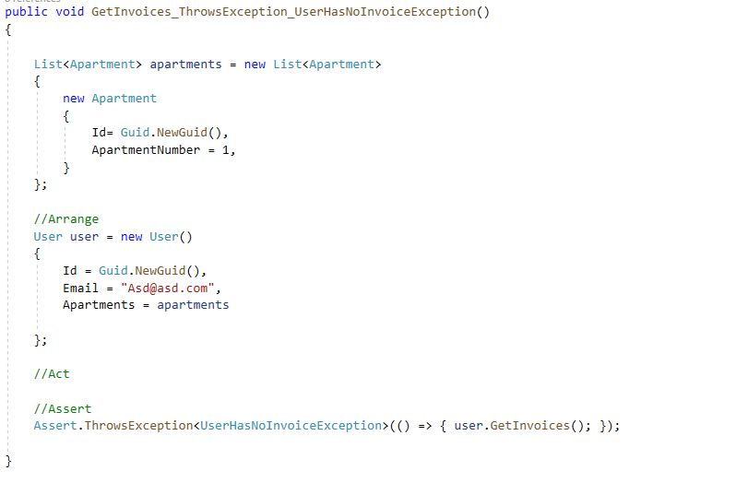
UserModel GetInvoice unit test2
This test checks the exception when user don't have invoices

Slide 26
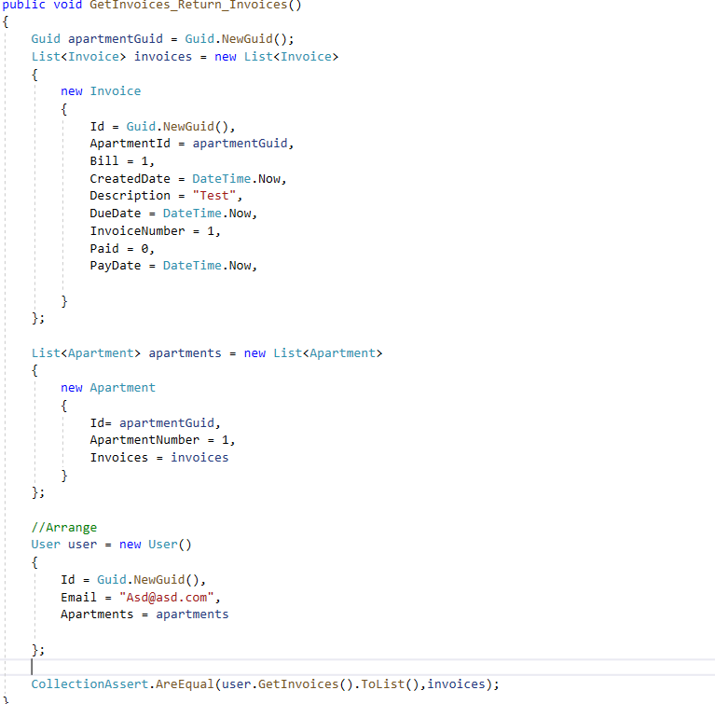
UserModel GetInvoice unit test3
This test checks if the methods returns the right data.

Slide 27
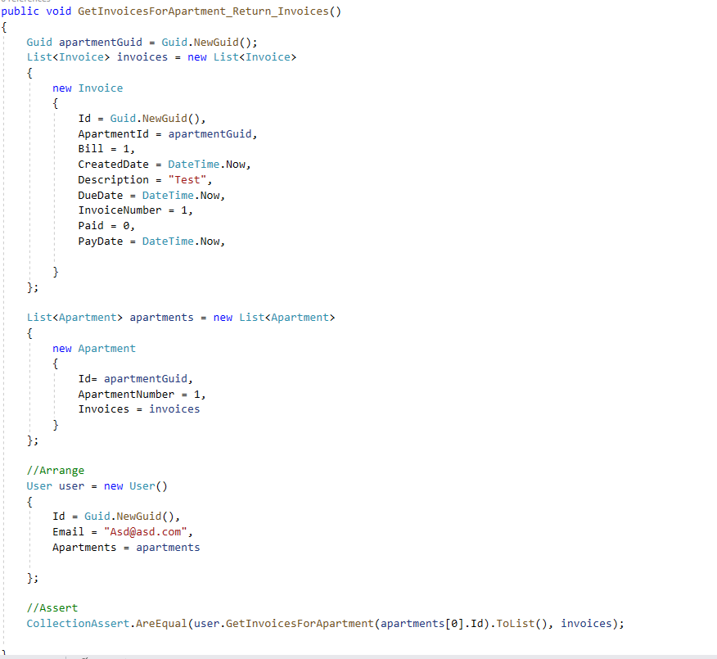
UserModel GetInvoiceForApartment unit test1
This test checks if the method return the right invoices for the current apartment.

Slide 28
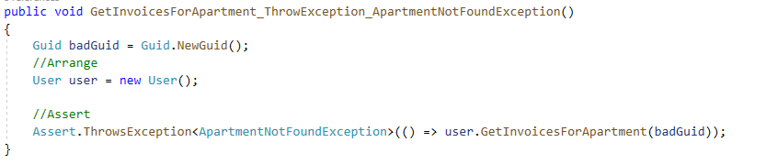
UserModel GetInvoiceForApartment unit test2
This test check the exception throw when apartment don't exist.

