Slide 1
Tenants association
Website Presentation
CEN
-Marcu Andrei Cristian-
-Tolgoi Dragos Cristian-
-Calina Florin Daniel-
-Matei Alexandru Cristian-

Slide 2
The presentation will be split in two:
User interface & interactions
Administrator interface & interactions

Slide 3
User interface & interactions
When the user will access the website he will have to chose between log-in or to register if he does not have an account .
In the register page user will be able to register providing an valid email and password(username is optional).
In the login page user will be able to login if he provides correct credentials . If the login succedes the user will be redirected to the dashboard-user page.

Slide 4
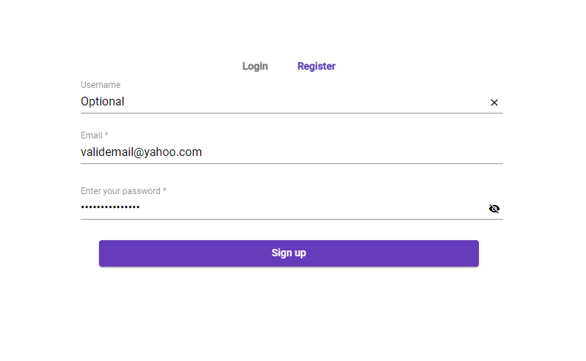
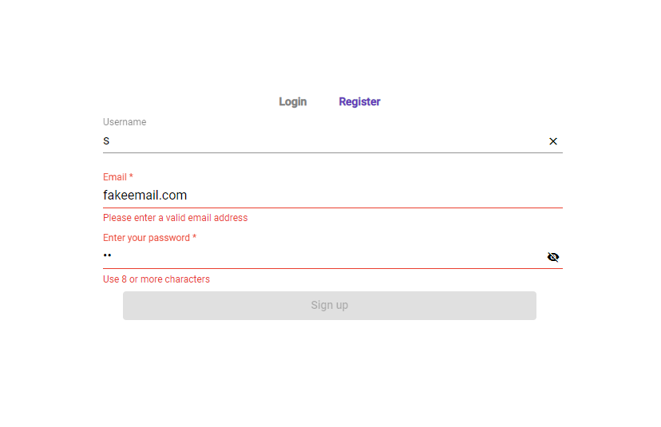
Register page
Incorrect password and e-mail
Valid email and password(register button enabled)

Slide 5
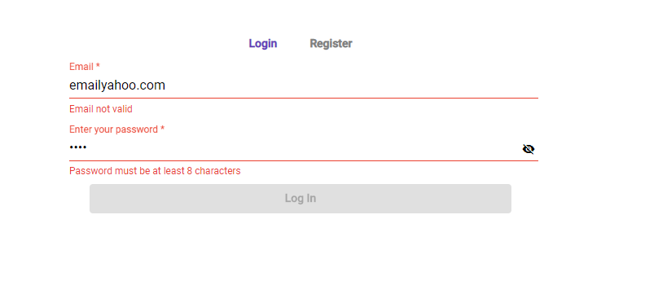
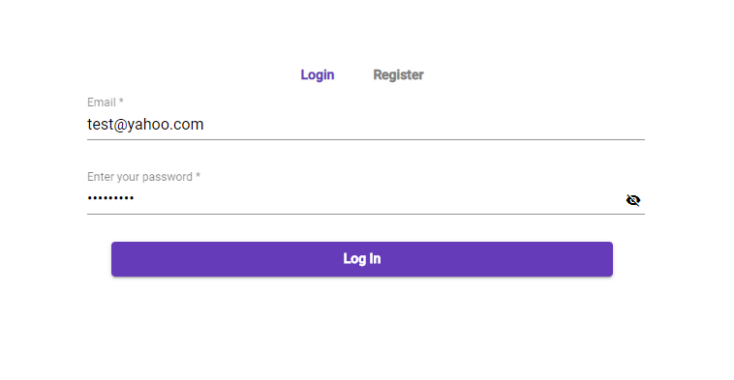
Login page
Incorrect email and password
Valid email and password

Slide 6
Dashboard-user page
In this page user will be able to:
See news posted by the administrator.
See all overdue invoices.
Vote in a poll created by the administrator.

Slide 7
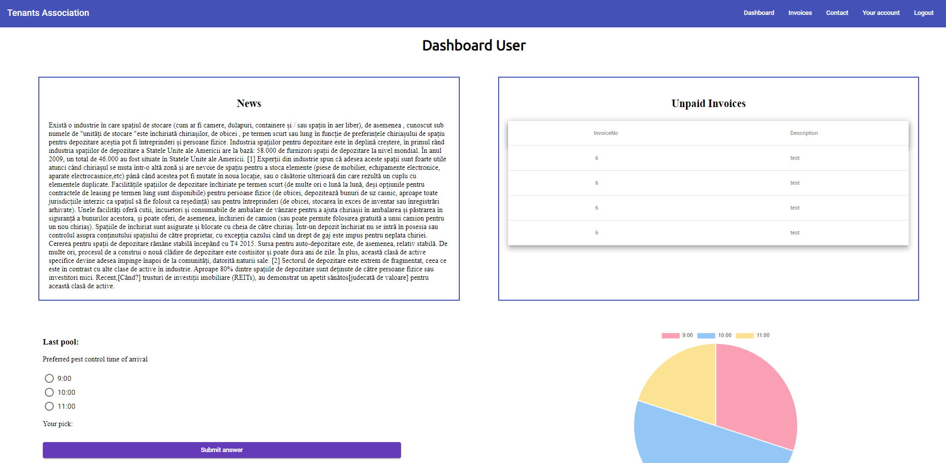

Slide 8
Invoice-user page
In this web-page the user will be able:
See an overview of the invoices( invoice number, a short description(electricity bill , water bill, etc), the date at which the bill was created , the due date , the cost of the bill , check if it is paid and more details. The user can click on the “more details” button and he will have access to new details(invoice id, apartment id, paid date) and an option to pay the bill if it is not paid.

Slide 9
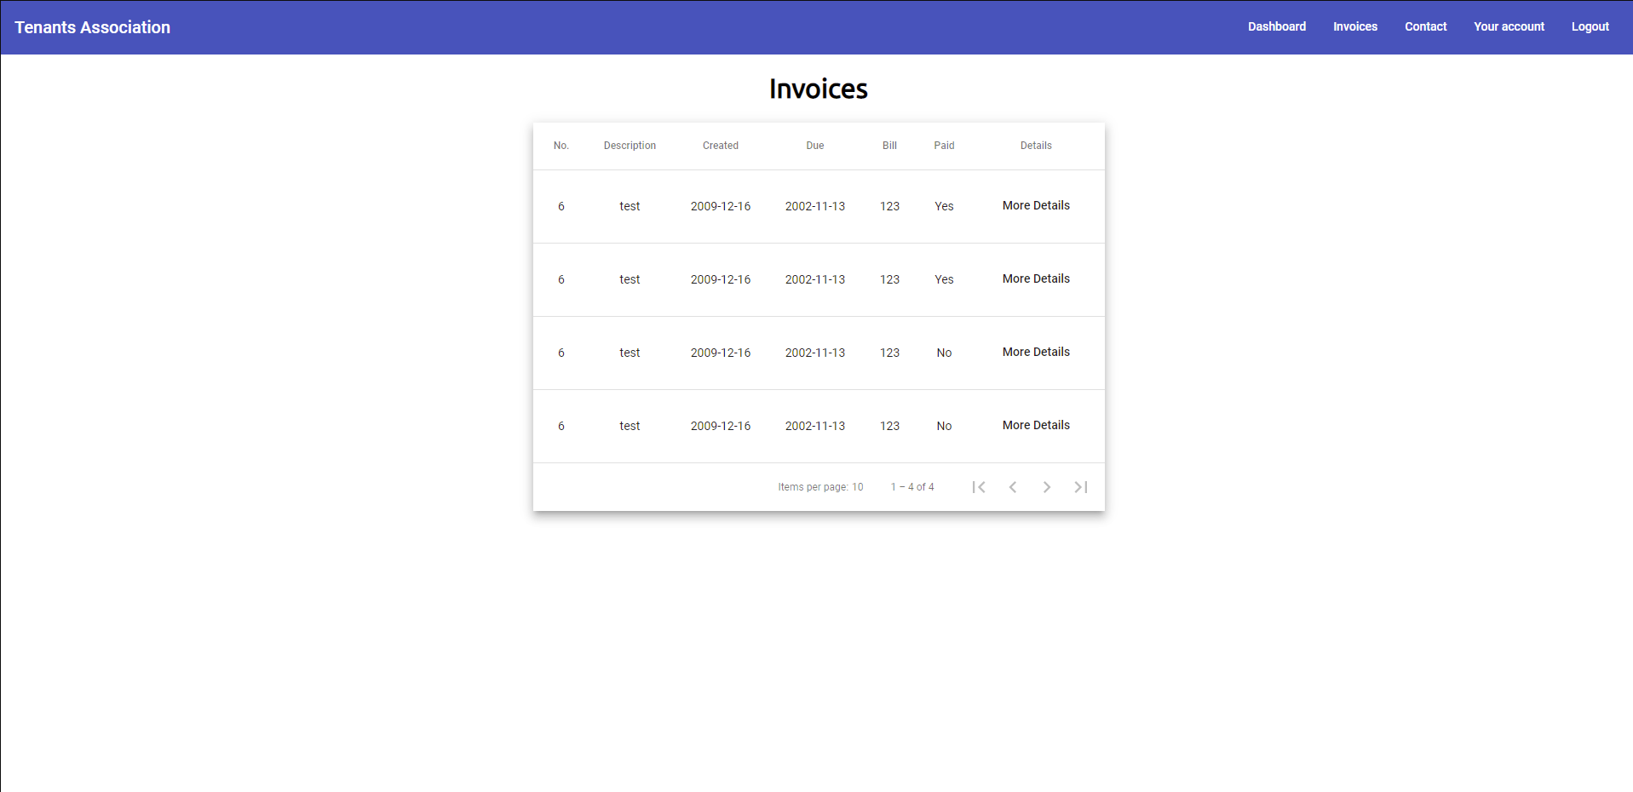
Invoice-user

Slide 10
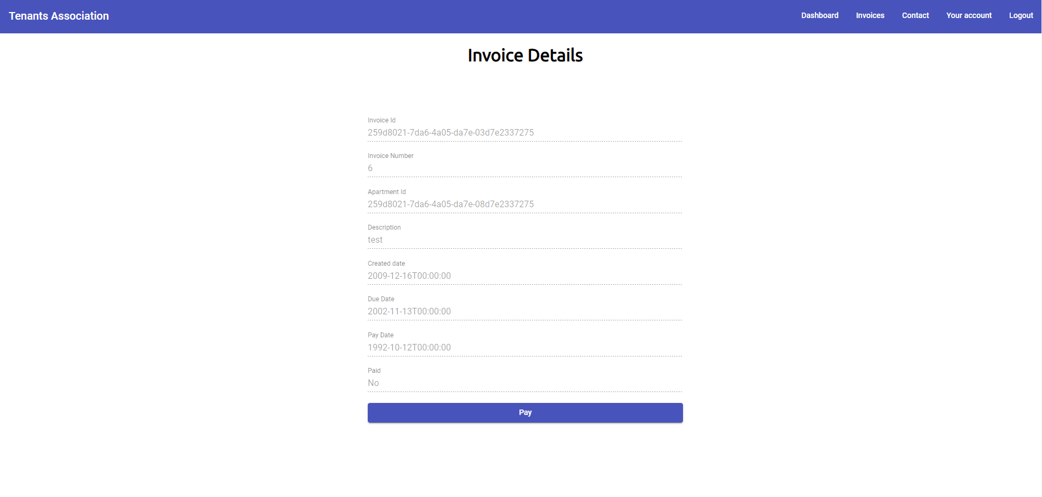
Invoice-user-detail-unpaid

Slide 11
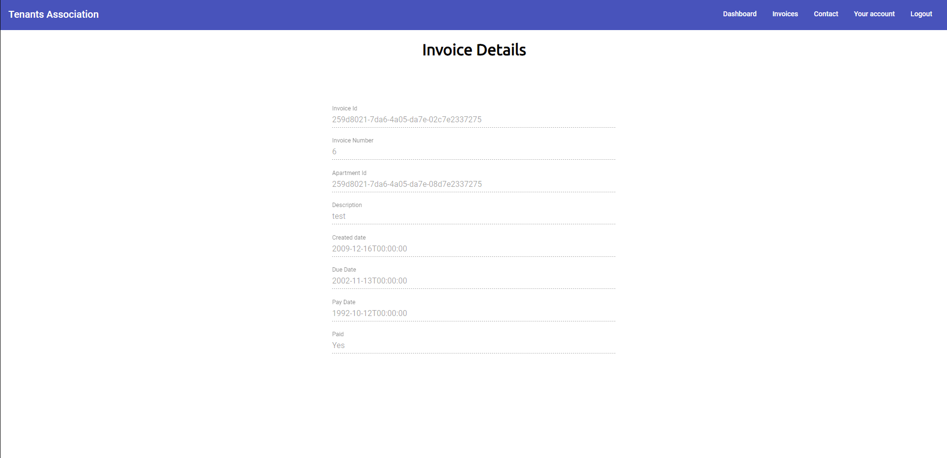
Invoice-user-detail-paid

Slide 12
Contact-user page
In this page the user will have the possibility to contact an administrator via text message.

Slide 13
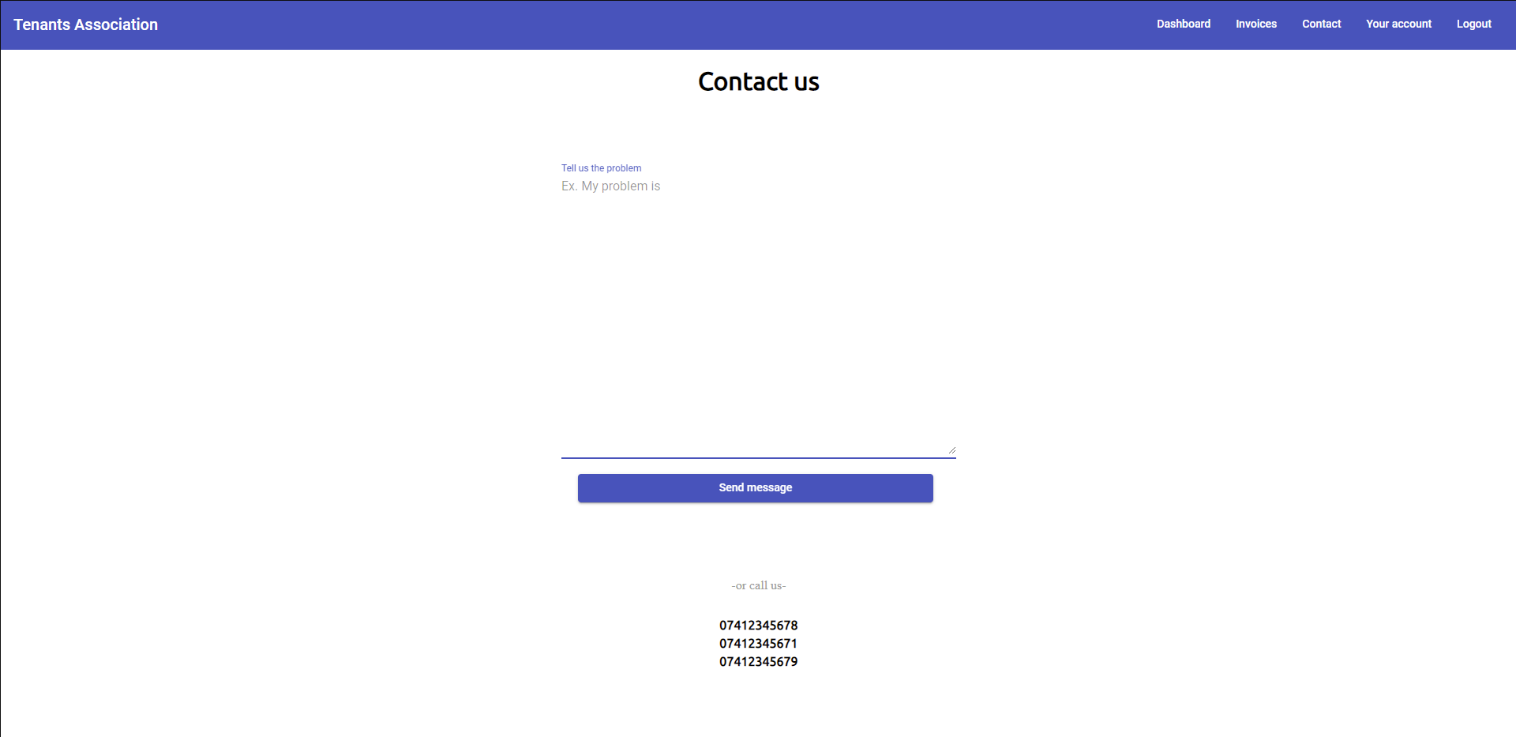
Contact-page

Slide 14
Your account-user page
In the page user will be able to:
Add a new username or change the current one.
Change the current e-mail address.
Change the password providing the existent one.

Slide 15
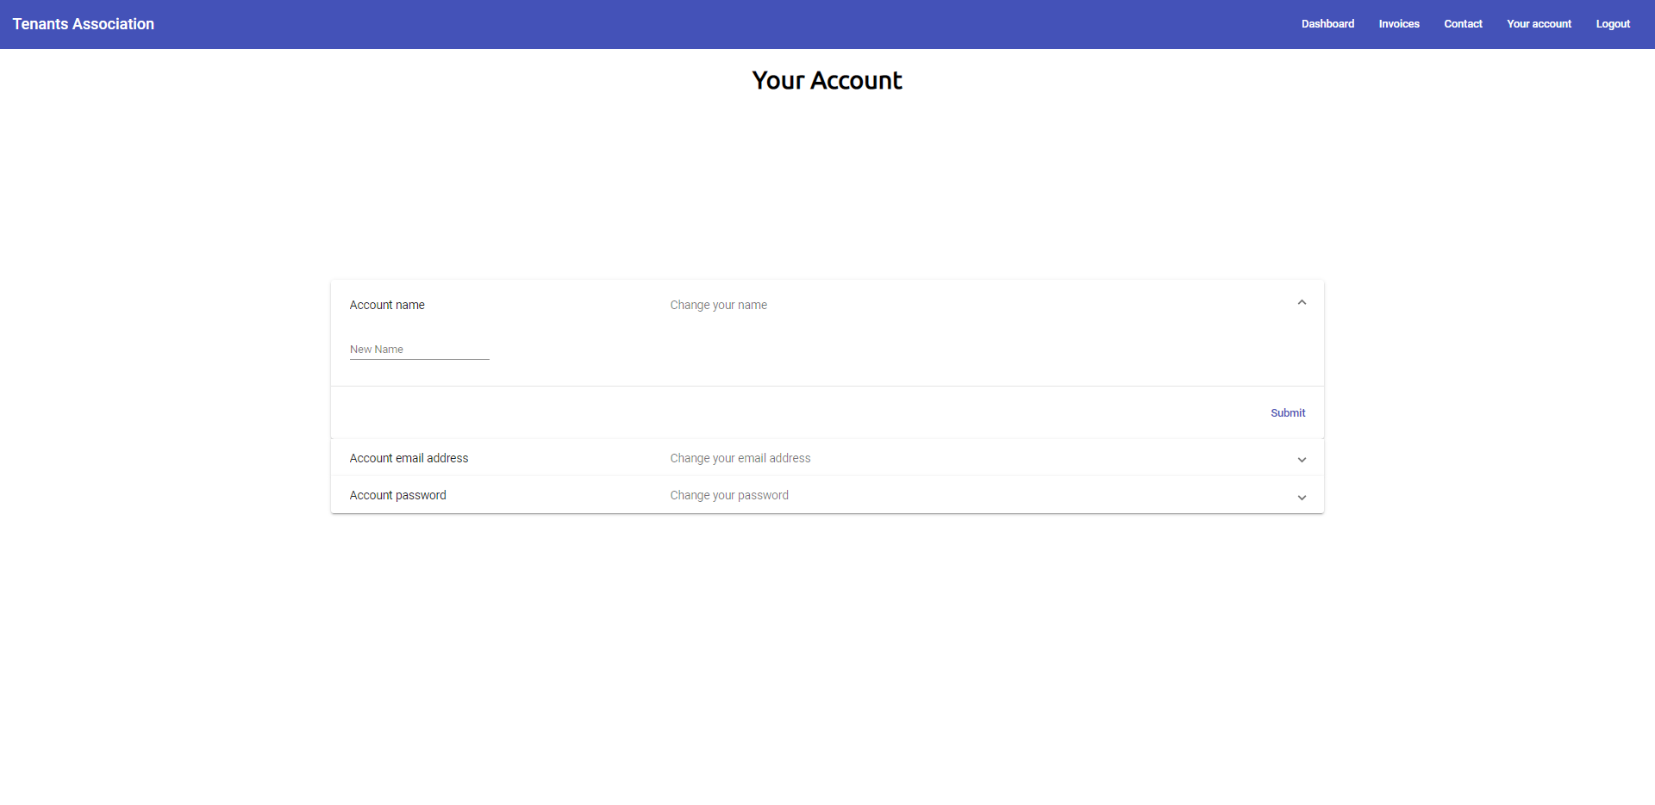
New name

Slide 16
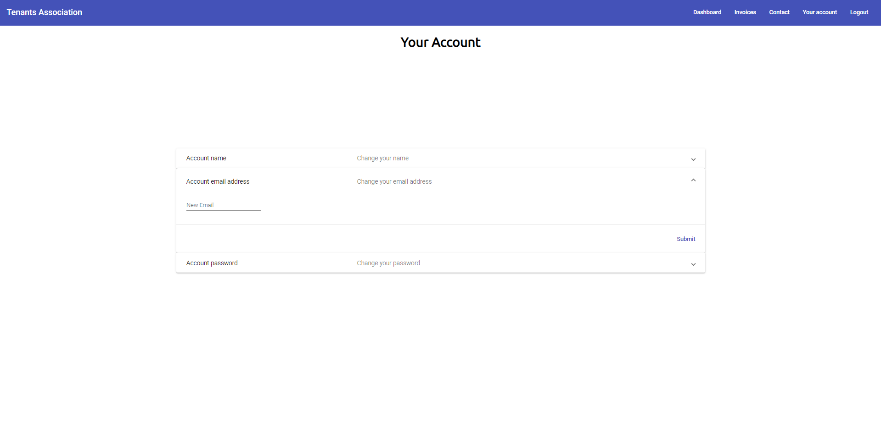
New email

Slide 17
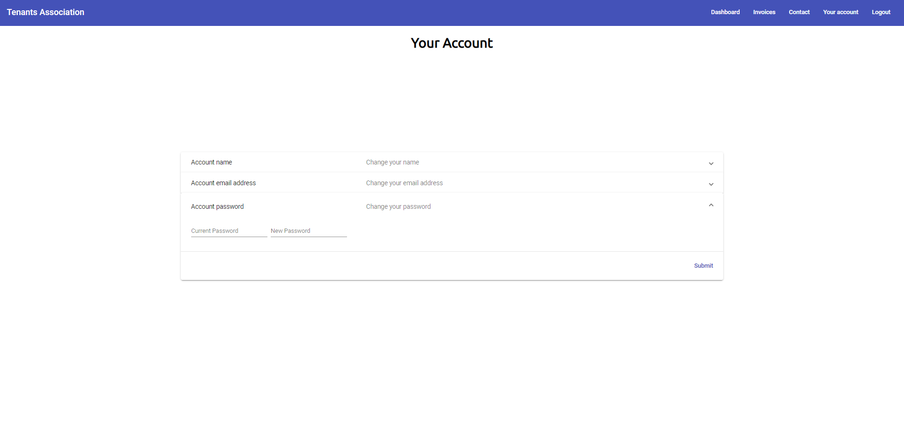
New password

Slide 18
Administrator interface & interactions
The administrator will be able to log in from the login page which is the same as the user’s one. The authentication system can check if the credentials correspond to an admin and will be able to log in the administrator. After the log in is successful the administrator will be redirected to the dashboard-admin page.

Slide 19
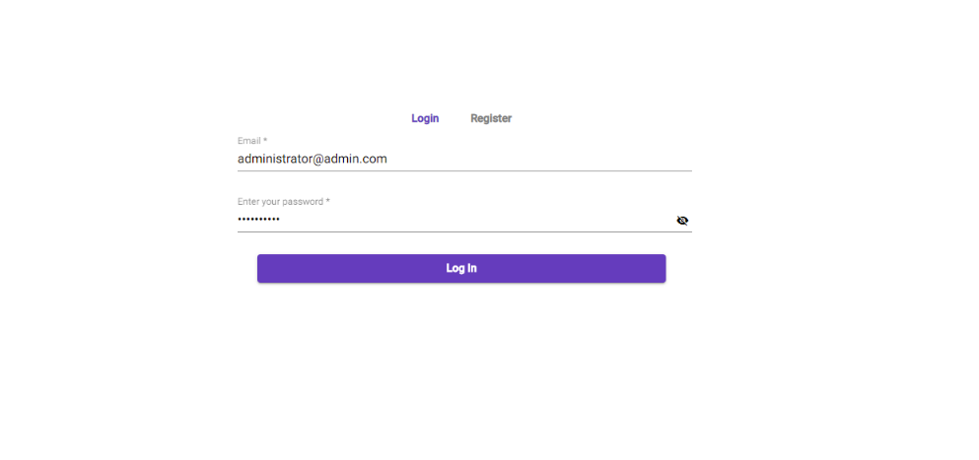
Login-administrator

Slide 20
Dashboard administrator
In this page the administrator will be able to see the messages sent from users (user-contact), create a new user , add an invoice for specific users, create a poll and send a message to users.

Slide 21
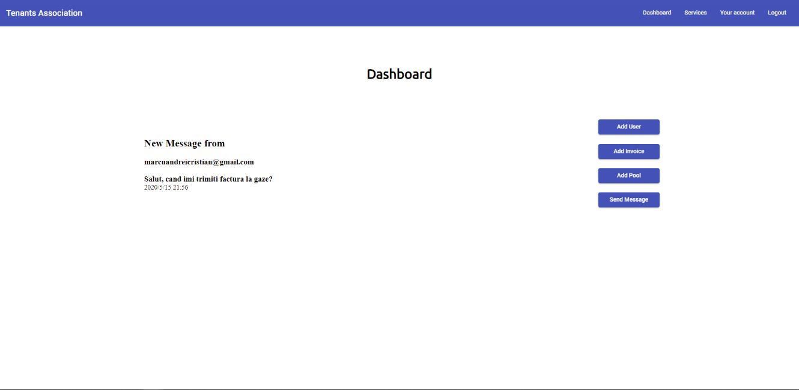

Slide 22
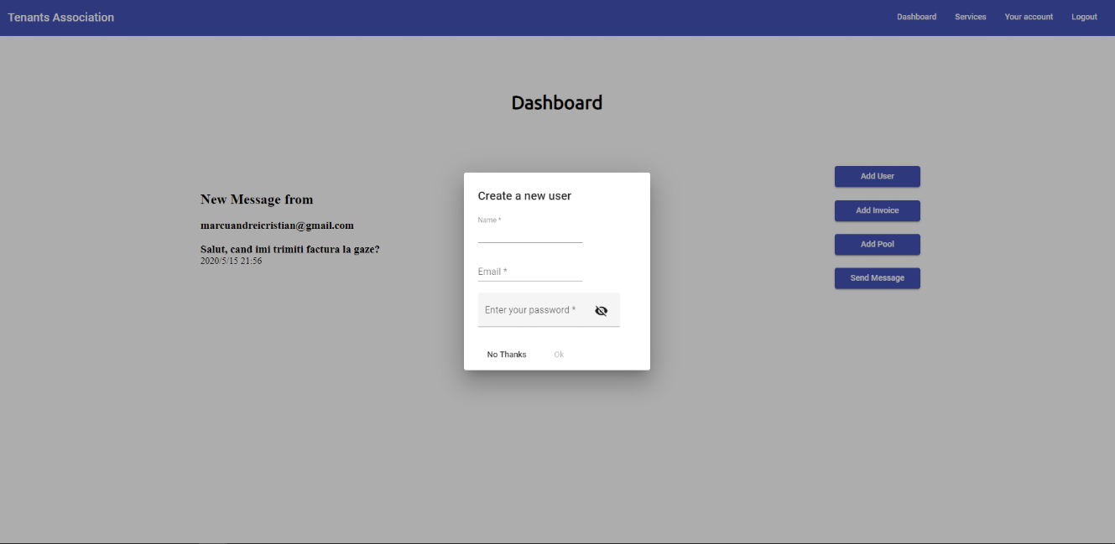

Slide 23
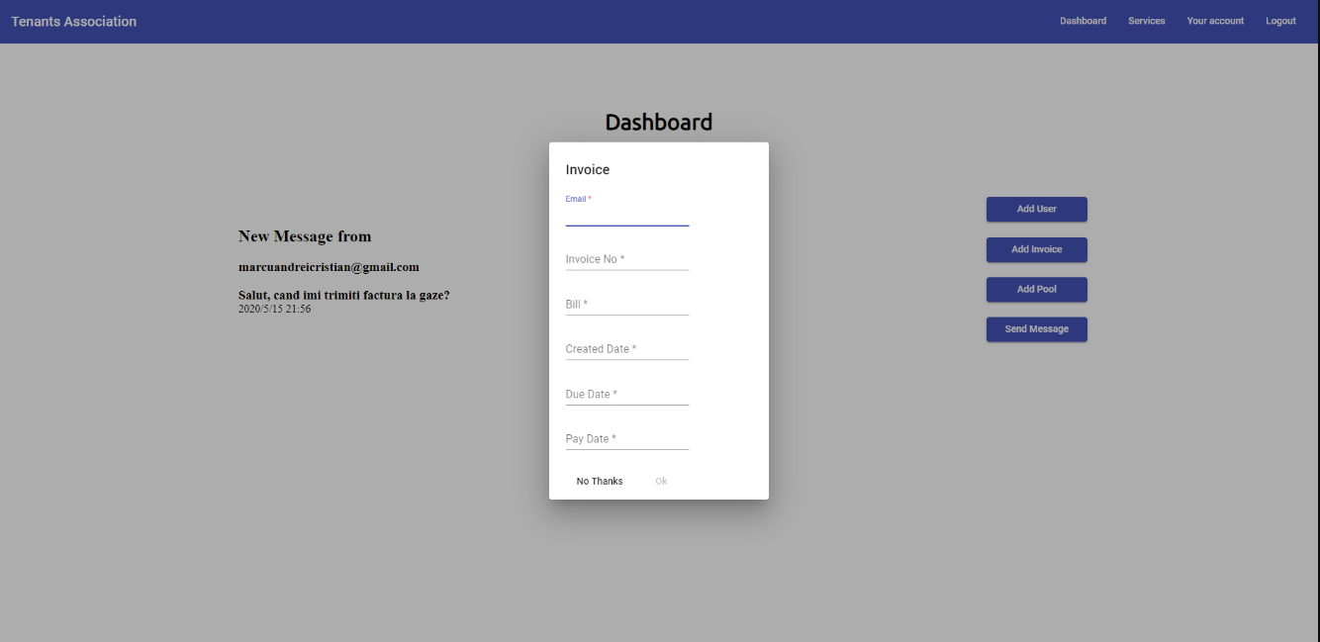

Slide 24
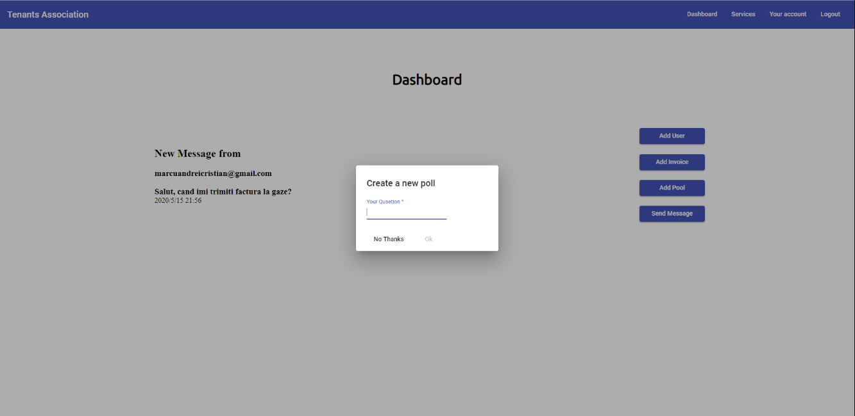

Slide 25
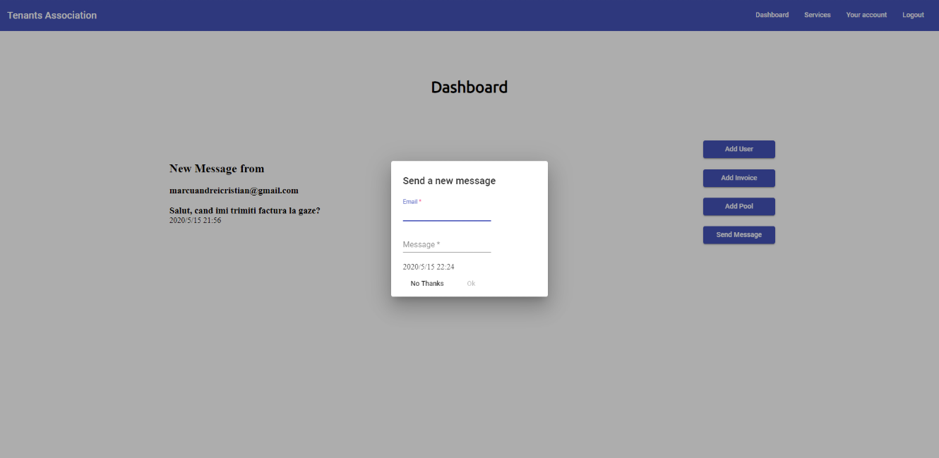

Slide 26
User Servicies-administrator
In this page the administrator will be able to all users, their e-mail address and apartment number. The edit will allow the administrator to change the apartment number.

Slide 27
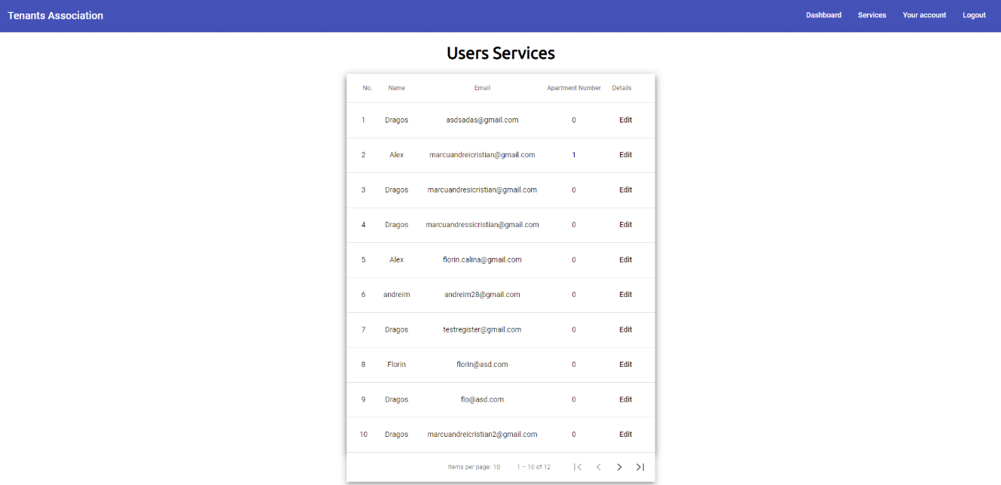
User-services-administrator

Slide 28
Your account-administrator
This page has the same functionalities as the user’s one

Slide 29
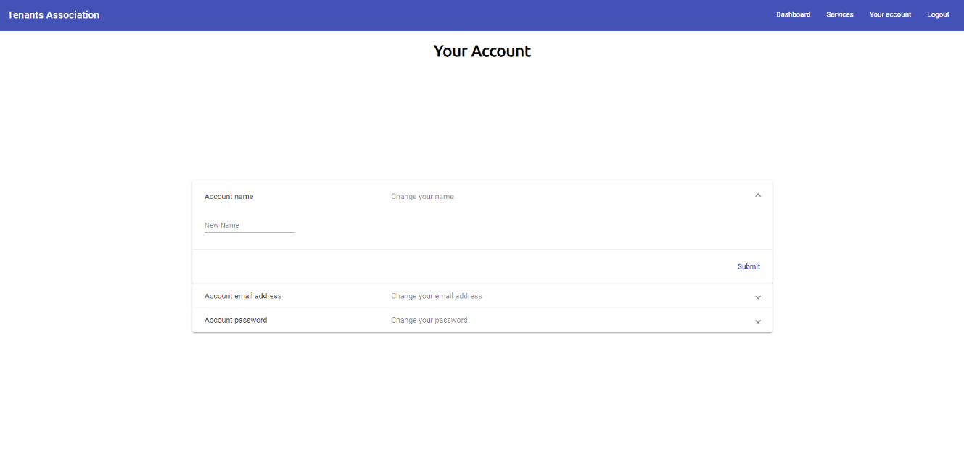
Your-account-administrator

