Slide 1
implementation of diffie hellman
Almandub

Slide 2
What is Diffie-Hellman?
Diffie-Hellman is a way of generating a shared secret between two people in such a way that the secret can't be seen by observing the communication.
That's an important distinction: You're not sharing information during the key exchange, you're creating a key together.

Slide 3
How does it works?
First, Alice (sender)publish two prime number g and p to be the public key
Second, Alice will choose a number (a) to be his private key (keep it secret )
Third, Alice compute g^a mod p then send that to Bob (reciver).
Forth, Bob going to do the same choose a number (b) to be his private key and compute g^b mod p and send that to Alice.
Finally, both of them compute massage M with their private key as M^a mod p for Alice and M^p mod p for Bob the results going to be the same as a shared key

Slide 4
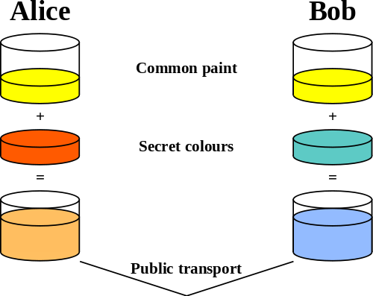
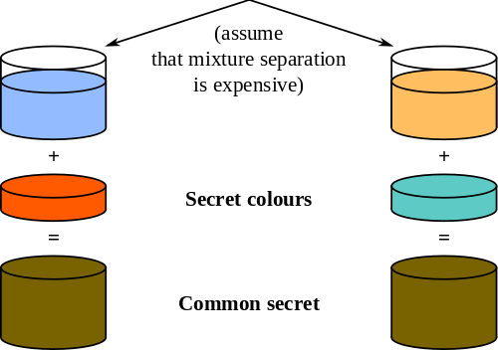
diffie hellman

Slide 5
Where does it use ?
This is particularly useful because you can use this technique to create an encryption key with someone, and then start encrypting your traffic with that key.
And even if the traffic is recorded and later analyzed, there's absolutely no way to figure out what the key was, even though the exchanges that created it may have been visible.

Slide 6
How I implement diffie hellman
I use python and library socket.
Alice start as server and send the public key and his calculation to Bob.
Bob the client will send his calculation of the public key and his private key.
then Alice and Bob will receive the massages and compute the shared key.

Slide 7
Output example

Slide 8
Weak Diffie-Hellman and the Logjam Attack
Logjam attack against the TLS protocol. The Logjam attack allows a man-in-the-middle attacker to downgrade vulnerable TLS connections to 512-bit export-grade cryptography. This allows the attacker to read and modify any data passed over the connection. The attack is reminiscent of the FREAK attack, but is due to a flaw in the TLS protocol rather than an implementation vulnerability, and attacks a Diffie-Hellman key exchange rather than an RSA key exchange.
Threats from state-level adversaries. Millions of HTTPS, SSH, and VPN servers all use the same prime numbers for Diffie-Hellman key exchange. Practitioners believed this was safe as long as new key exchange messages were generated for every connection. However, the first step in the number field sieve—the most efficient algorithm for breaking a Diffie-Hellman connection—is dependent only on this prime. After this first step, an attacker can quickly break individual connections.

Slide 9
conclusion
Definition of Diffie-Hellman.
How the algorithm works.
Where it can be helpful.
The implementation.
Output example.

