Slide 1


Google Cloud Platform
2017. 10.
정 상 용

Slide 2


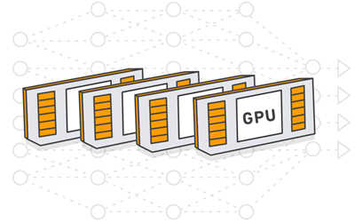
Cloud Platform의 타깃 고객
Beginner
Professional
단위 기능으로
사용하려는 고객
역량 있지만
인력이 부족한 고객
(Serverless Arch.)
GPU 인스턴스만
필요한 고객
Cloud ML
API
Cloud Machine Learning
학습/튜닝/서빙 환경
GPU Instance

Slide 3
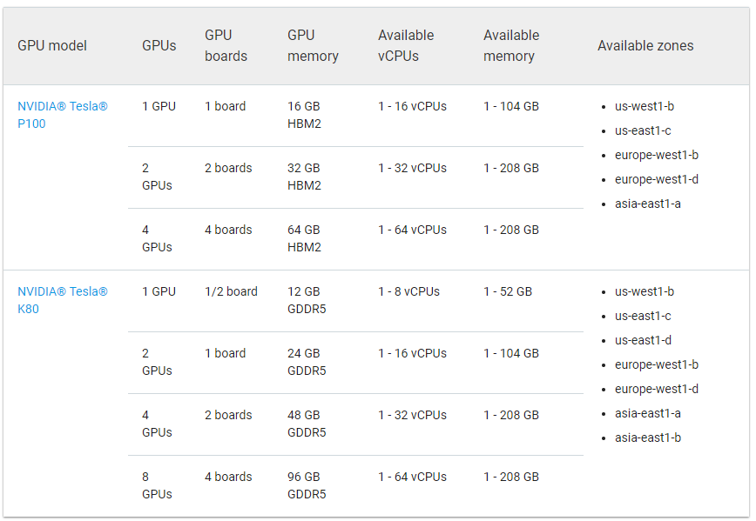
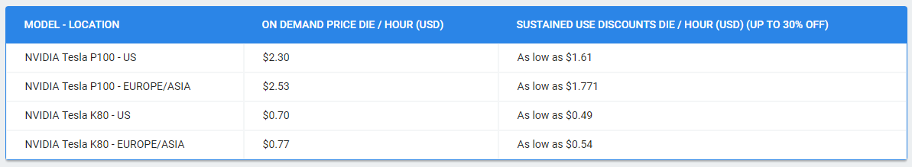
Google Compute Engine – Add GPU Instance
Google
Compute
Engine
VM
Instance

Slide 4
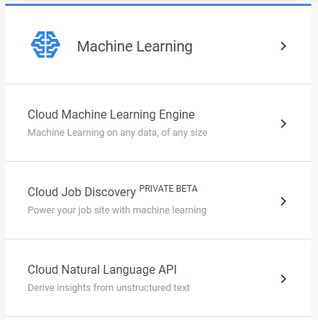
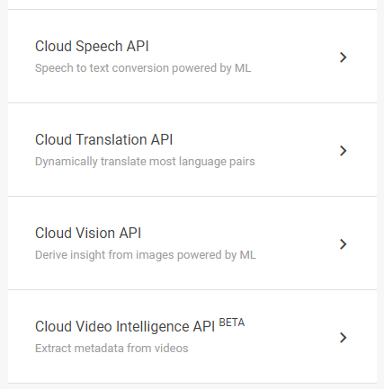
Google Machine Learning APIs

Slide 5
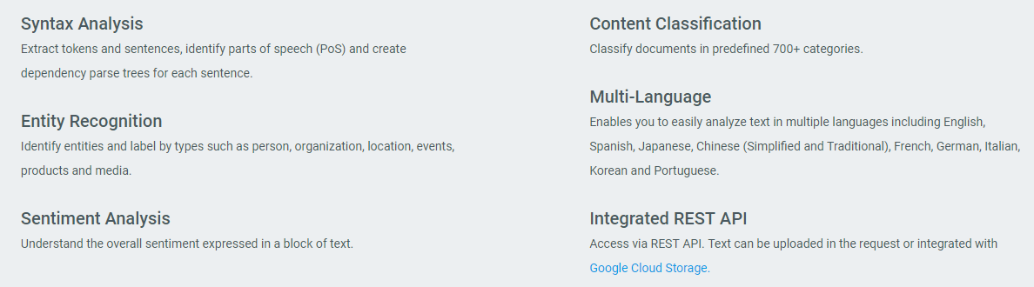
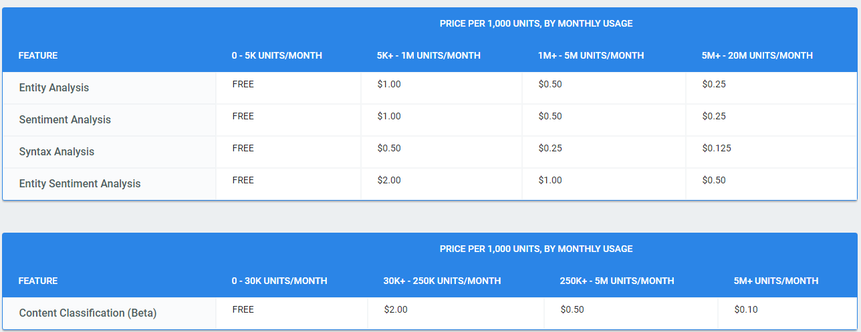
1) Cloud Natural Language API
English, Spanish, Japanese, Chinese, French, German, Italian, Korean, Portuguese.

Slide 6
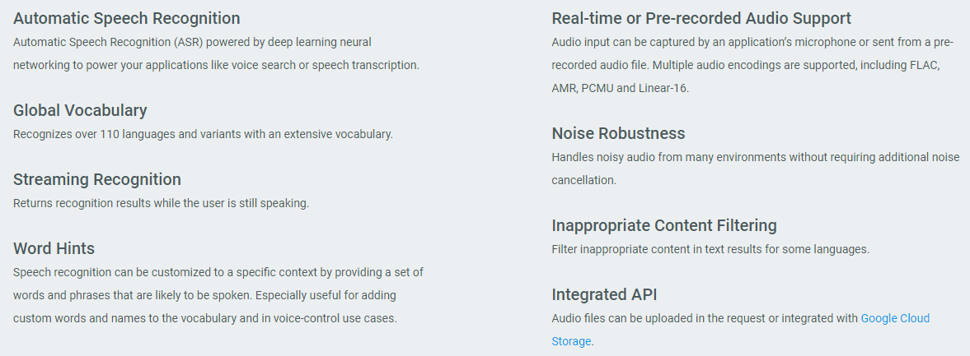
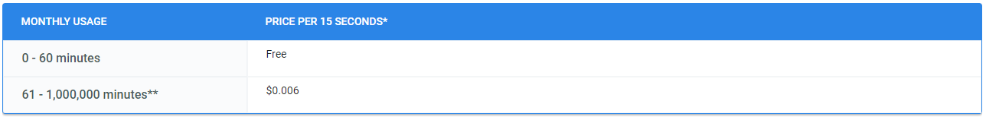
2) Cloud Speech API

Slide 7
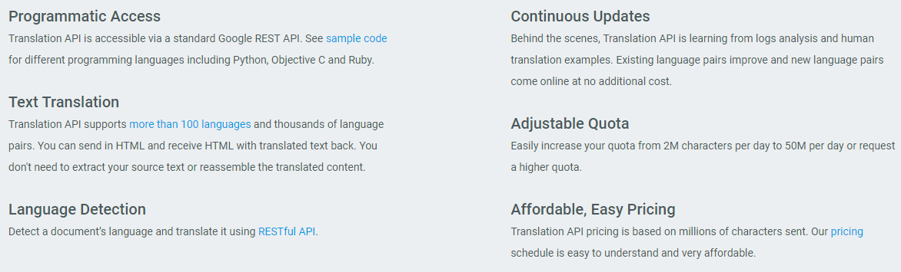
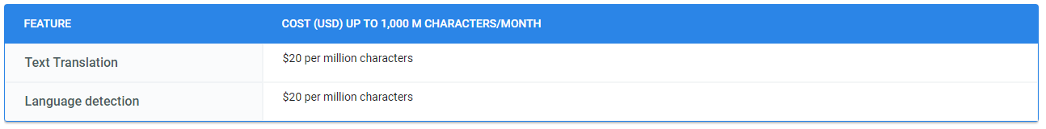
3) Cloud Translation API

Slide 8
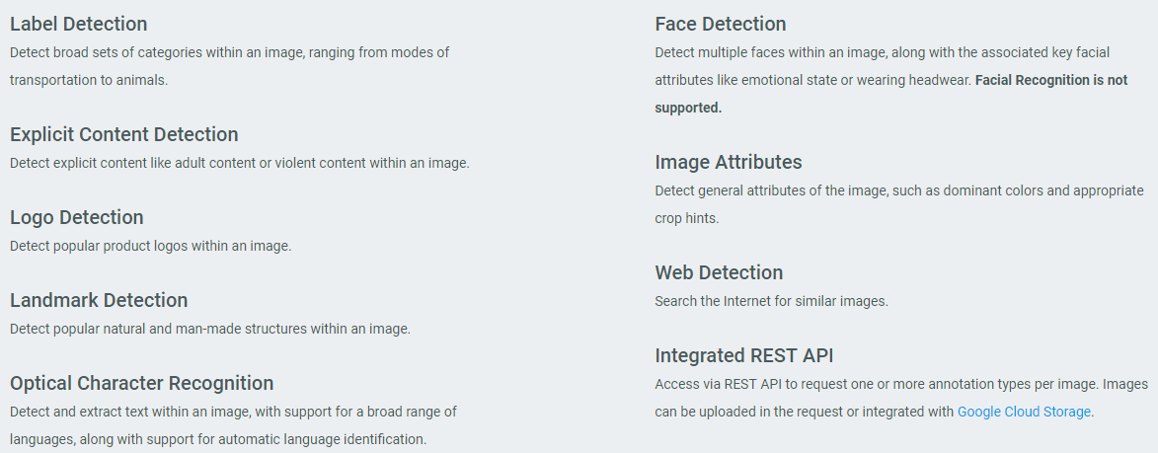
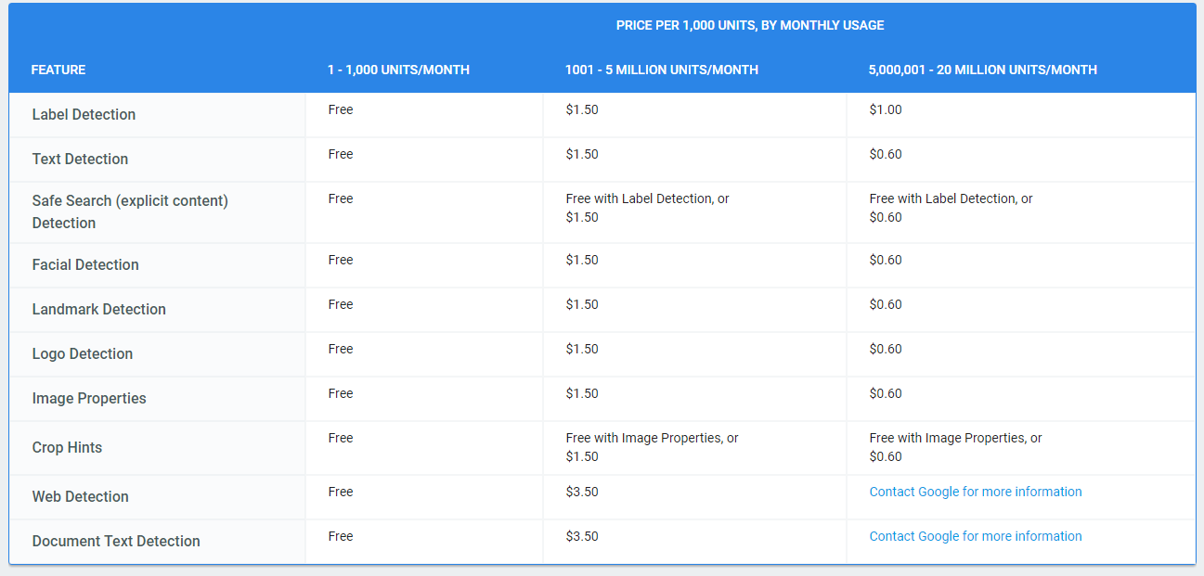
4) Cloud Vision API

Slide 9
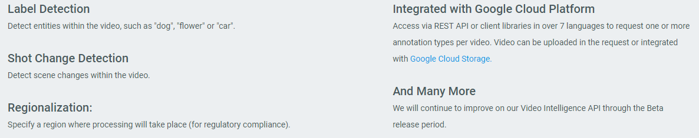
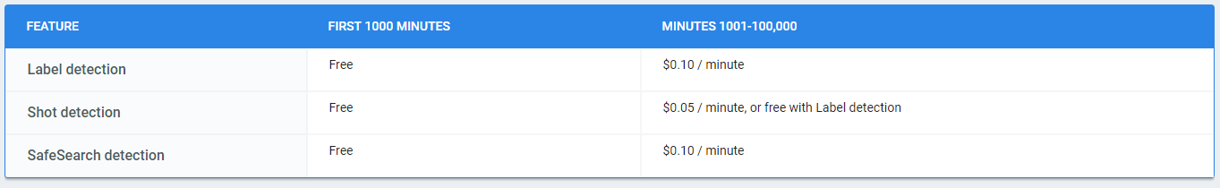
5) Cloud Video Intelligence API
https://cloud.google.com/video-intelligence/#demo

Slide 10
Google Cloud Machine Learning 서비스 소개
김성훈 교수의 소개
https://www.youtube.com/watch?v=EIRD3HAp-QQ

