Slide 1
Simulating Self-Avoiding Polymers
physics760: Computational Physics
Alexandros Mylanos, Mandus Aldag

Slide 2
Structure

Slide 3

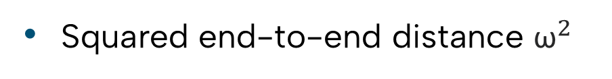

Observables of interest
Squared end-to-end distance ${\text{ω}}^{2}$
Squared radius of gyration: $S^{2}=\frac{1}{N}\sum_{k=1}^{N}{{\left|\vec{r_{k}}−{\vec{r}}_{mean}\right|}^{2}}$
Critical exponents: $\left\langle {\text{ω}}^{2}\right\rangle ∝N^{2ν}, \left\langle {\text{S}}^{2}\right\rangle ∝N^{2ν}$
$$∝N^{−p}$$
Acceptance rate f
Autocorrelation time $τ_{int}$
$$∝N^{q}$$

Slide 4
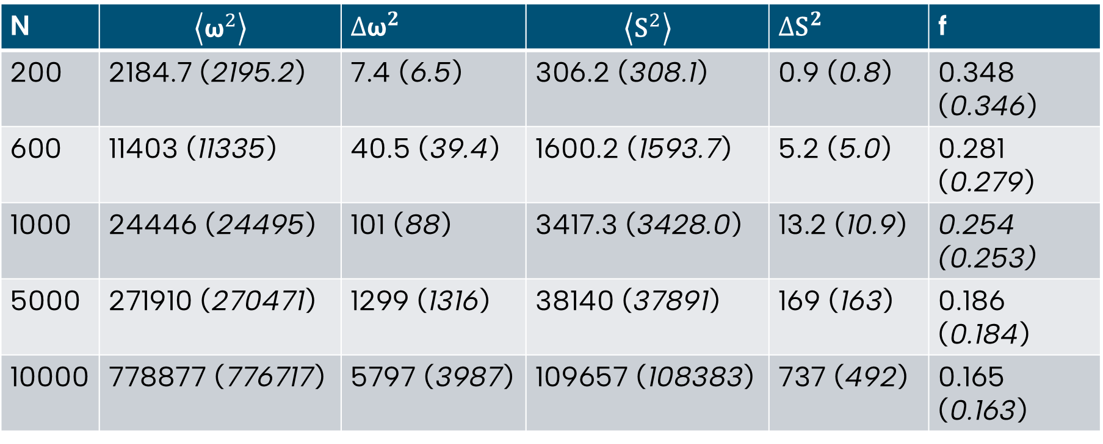
Results in 2D
19 simulations with different polymer chain lengths à ${10}^{6}$ iterations
N | $$\left\langle {\text{ω}}^{2}\right\rangle$$ | ${∆\text{ω}}^{2}$ | $$\left\langle {\text{S}}^{2}\right\rangle$$ | ${∆\text{S}}^{2}$ | f
200 | 2184.7 (2195.2) | 7.4 (6.5) | 306.2 (308.1) | 0.9 (0.8) | 0.348 (0.346)
600 | 11403 (11335) | 40.5 (39.4) | 1600.2 (1593.7) | 5.2 (5.0) | 0.281 (0.279)
1000 | 24446 (24495) | 101 (88) | 3417.3 (3428.0) | 13.2 (10.9) | 0.254 (0.253)
5000 | 271910 (270471) | 1299 (1316) | 38140 (37891) | 169 (163) | 0.186 (0.184)
10000 | 778877 (776717) | 5797 (3987) | 109657 (108383) | 737 (492) | 0.165 (0.163)

Slide 5
Binning analysis to obtain the standard errors
Squared end-to-end distance ${\text{ω}}^{2}$
Squared radius of gyration: $S^{2}=\frac{1}{N}\sum_{k=1}^{N}{{\left|\vec{r_{k}}−{\vec{r}}_{mean}\right|}^{2}}$
Critical exponents: $\left\langle {\text{ω}}^{2}\right\rangle ∝N^{2ν}, \left\langle {\text{S}}^{2}\right\rangle ∝N^{2ν}$
$$∝N^{−p}$$
Acceptance rate f
Autocorrelation time $τ_{int}$
$$∝N^{q}$$

