Slide 1
Simulating Self-Avoiding Polymers
physics760: Computational Physics
Alexandros Mylonas, Mandus Aldag

Slide 2
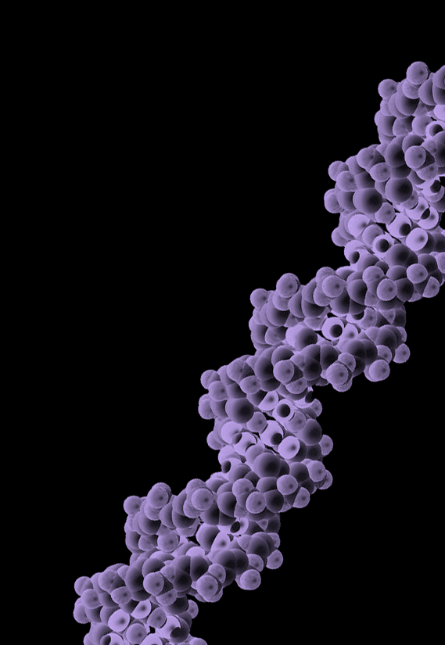
Introduction
A polymer chain is a long, repeating sequence of molecules called monomers, which are chemically bonded together.

Slide 3
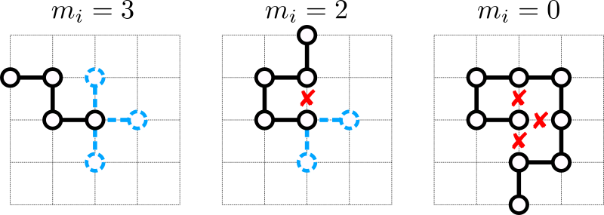
Introduction
Polymer chains can be modeled using random walk algoritms, especially Self Avoiding Walk (SAW)

Slide 4
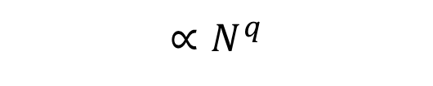
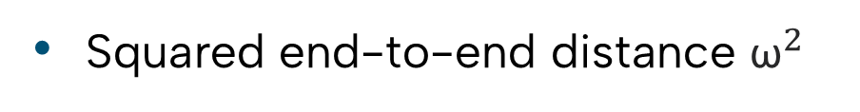
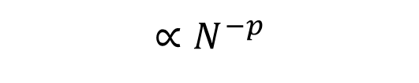
Observables of interest
Squared end-to-end distance ${\text{ω}}^{2}$
Squared radius of gyration: $S^{2}=\frac{1}{N}\sum_{k=1}^{N}{{\left|\vec{r_{k}}−{\vec{r}}_{mean}\right|}^{2}}$
Critical exponents: $\left\langle {\text{ω}}^{2}\right\rangle ∝N^{2ν}, \left\langle {\text{S}}^{2}\right\rangle ∝N^{2ν}$
$$∝N^{−p}$$
Acceptance rate f
Autocorrelation time $τ_{int}$
$$∝N^{q}$$

Slide 5
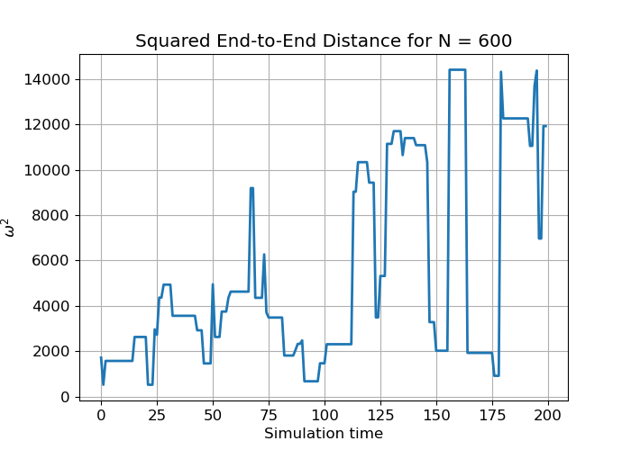
Binning analysis to obtain the standard errors and $τ_{int}$
Example trajectory:

Slide 6
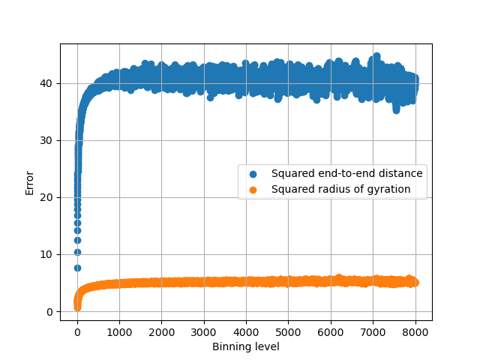
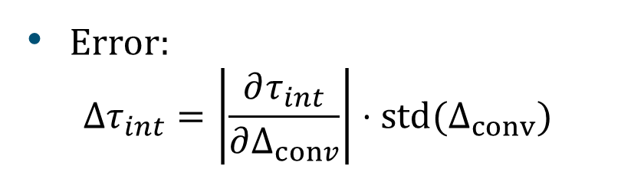
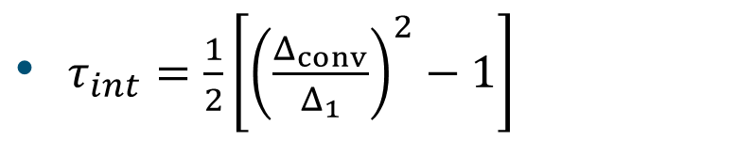
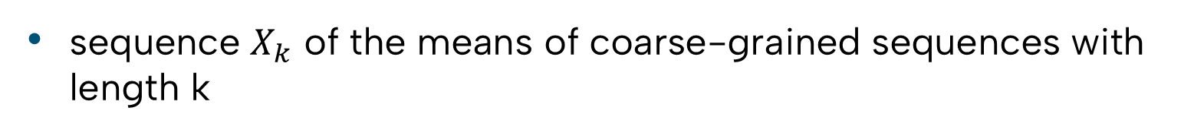
Binning analysis to obtain the standard errors and $τ_{int}$
sequence $X_{k}$ of the means of coarse-grained sequences with length k
error $Δ_{k}=\frac{std\left(X_{k}\right)}{\sqrt{M_{k}}}$ converges with higher binning levels
$τ_{int}=\frac{1}{2}\left[{\left(\frac{Δ_{conv}}{Δ_{1}}\right)}^{2}−1\right]$
Error:
$$Δτ_{int}=\left|\frac{∂τ_{int}}{∂Δ_{conv}}\right|⋅std(Δ_{conv})$$

Slide 7
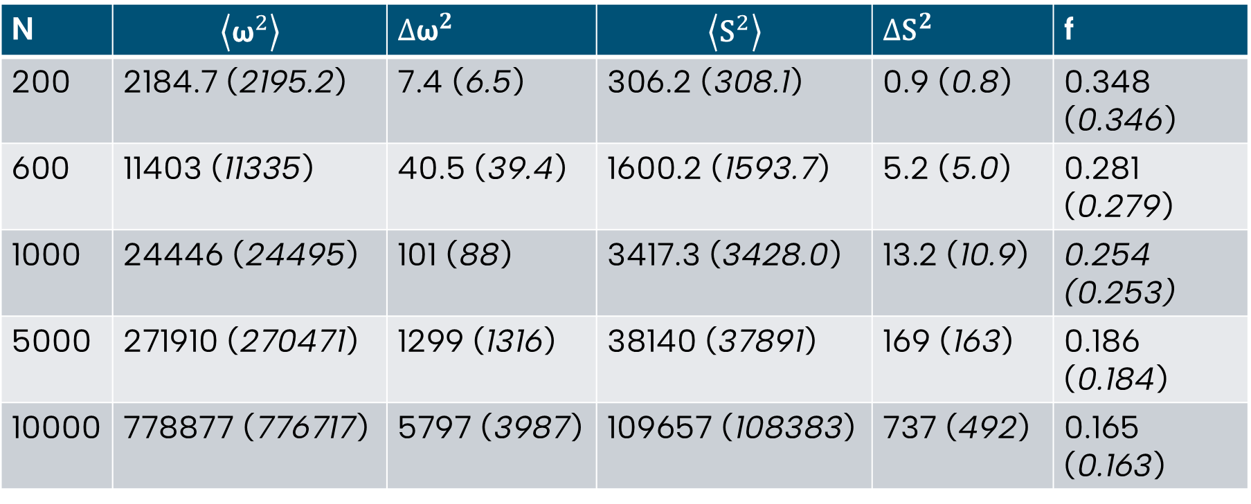
Results in 2D
19 simulations with different polymer chain lengths à ${10}^{6}$ iterations
N | $$\left\langle {\text{ω}}^{2}\right\rangle$$ | ${∆\text{ω}}^{2}$ | $$\left\langle {\text{S}}^{2}\right\rangle$$ | ${∆\text{S}}^{2}$ | f
200 | 2184.7 (2195.2) | 7.4 (6.5) | 306.2 (308.1) | 0.9 (0.8) | 0.348 (0.346)
600 | 11403 (11335) | 40.5 (39.4) | 1600.2 (1593.7) | 5.2 (5.0) | 0.281 (0.279)
1000 | 24446 (24495) | 101 (88) | 3417.3 (3428.0) | 13.2 (10.9) | 0.254 (0.253)
5000 | 271910 (270471) | 1299 (1316) | 38140 (37891) | 169 (163) | 0.186 (0.184)
10000 | 778877 (776717) | 5797 (3987) | 109657 (108383) | 737 (492) | 0.165 (0.163)
Madras, N., Sokal, A.D. The pivot algorithm: A highly efficient Monte Carlo method for the self-avoiding walk. J Stat Phys 50, 109–186 (1988)

Slide 8
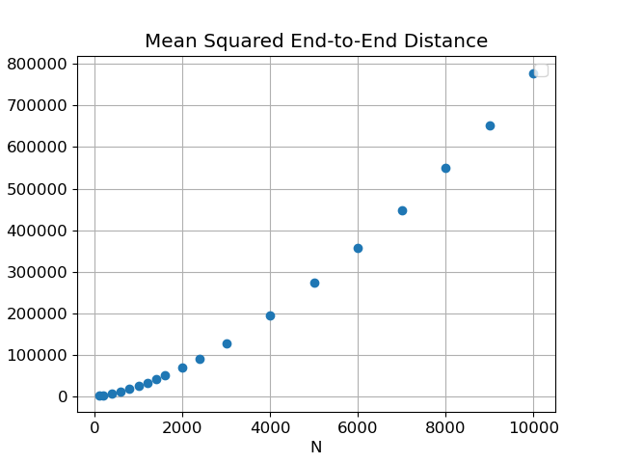
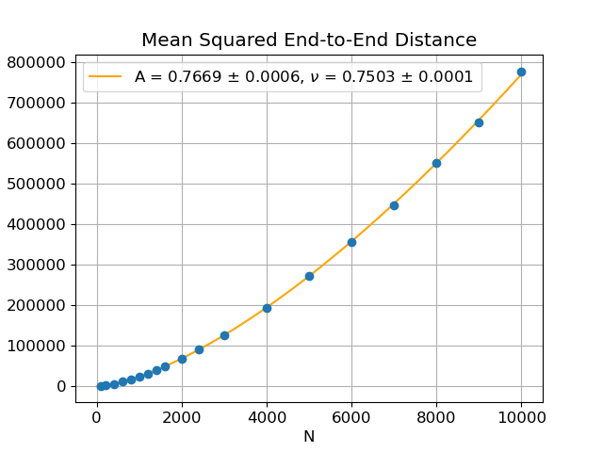
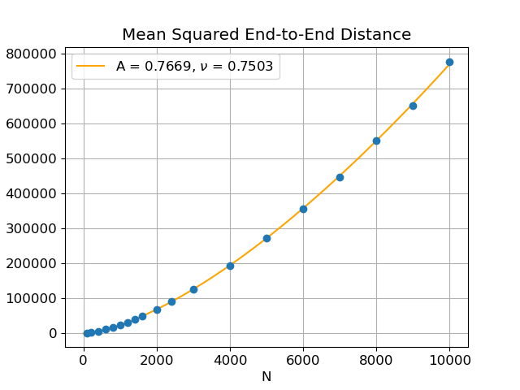
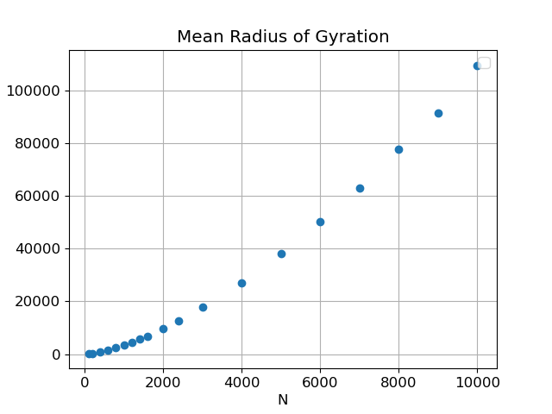
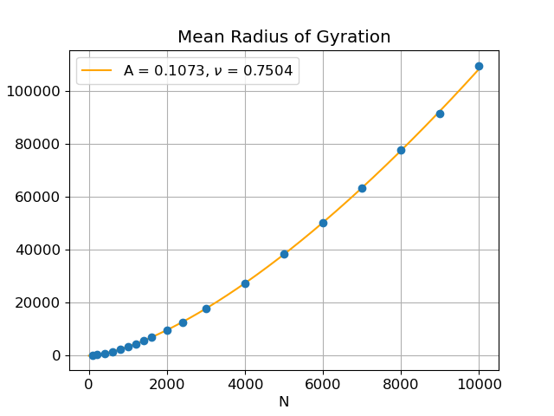
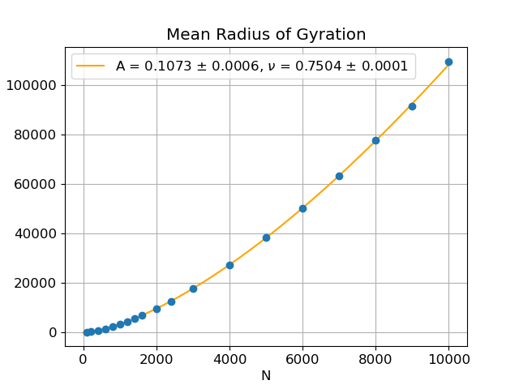
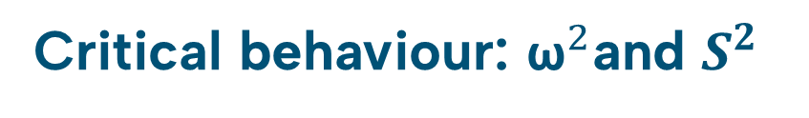
Critical behaviour: ${\text{ω}}^{2}$and $S^{2}$
Fit function: $A⋅N^{2ν}$
Close to believed value: $ν=\frac{3}{4}$

Slide 9
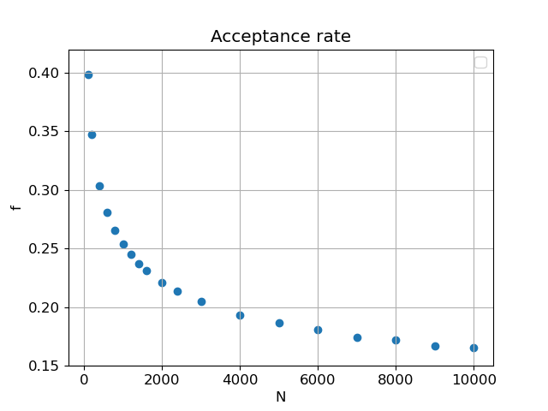
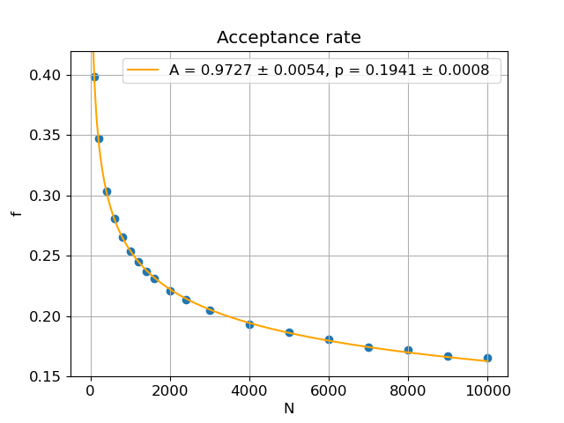
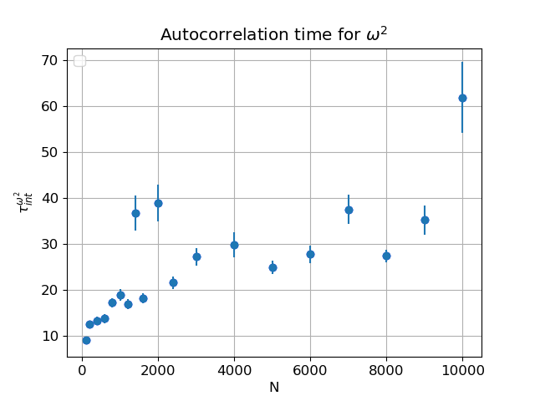
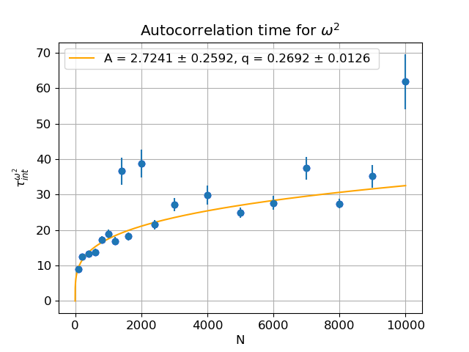
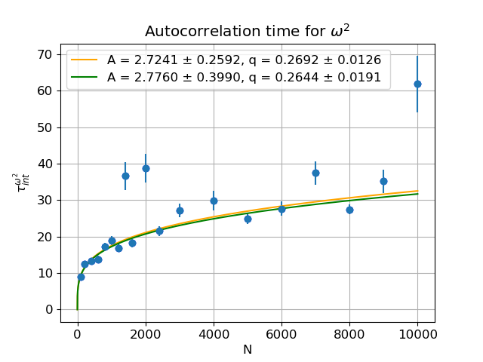
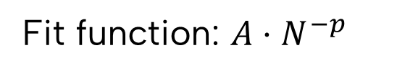
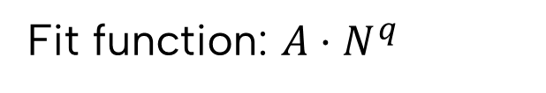
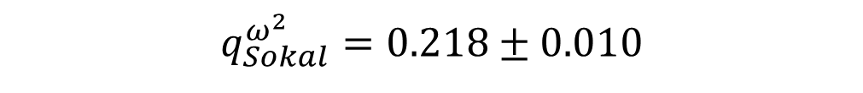
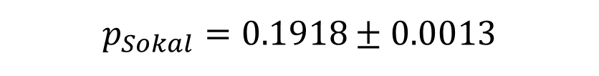
Critical behaviour: acceptance rate f and $τ_{int}$
Fit function: $A⋅N^{−p}$
Fit function: $A⋅N^{q}$
$$p_{Sokal}=0.1918±0.0013$$
$$q_{Sokal}^{ω^{2}}=0.218±0.010$$

Slide 10
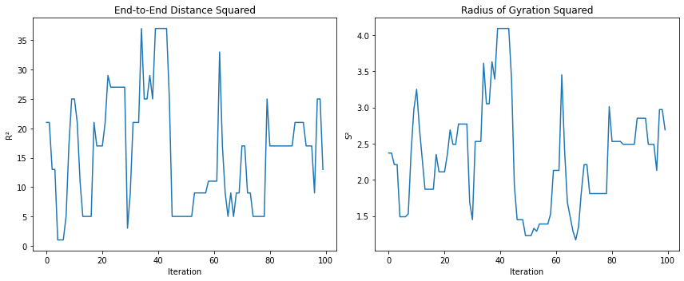
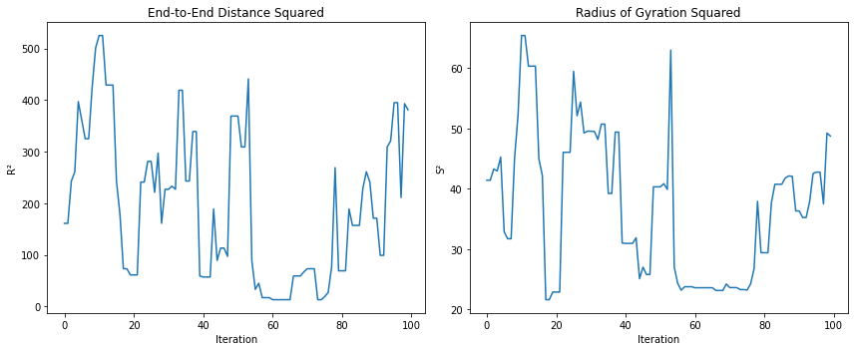
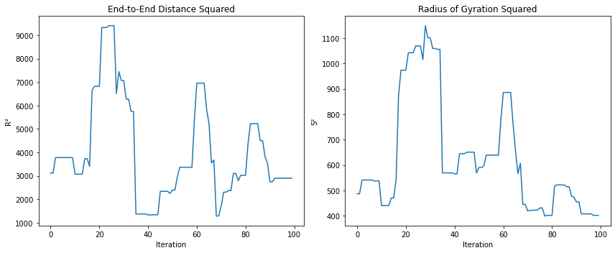
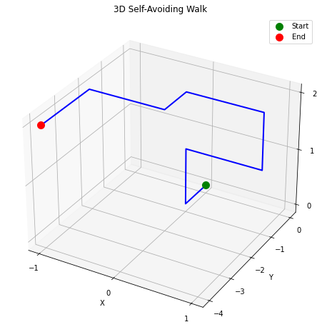
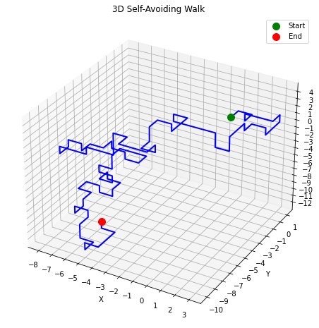
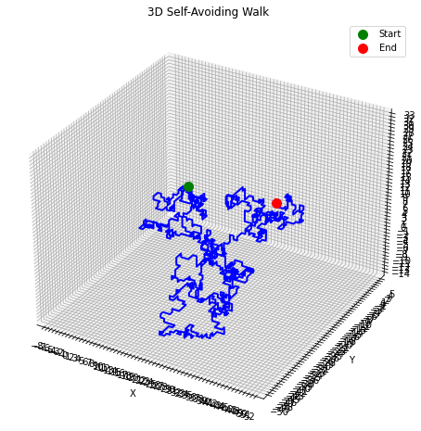
Outlook for the report
Simulations in 3D
$$N=10$$
$$N=100$$
$$N=1000$$

Slide 11
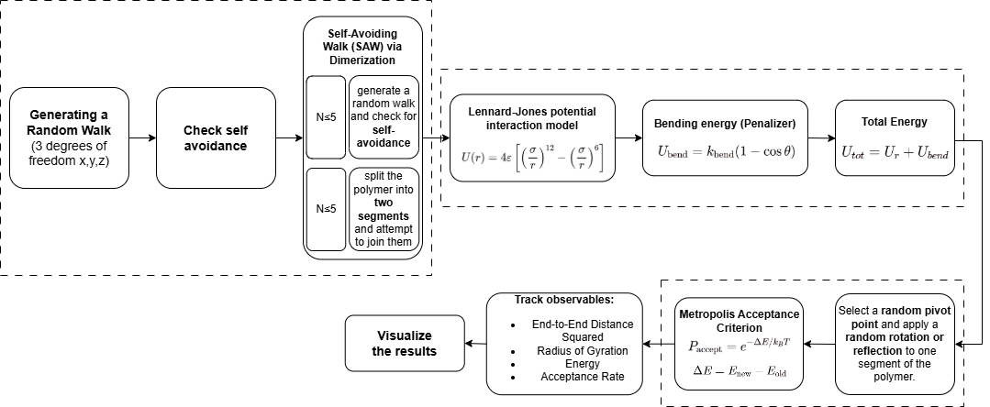
Outlook for the report
Simulations in 3D including interactions

Slide 12
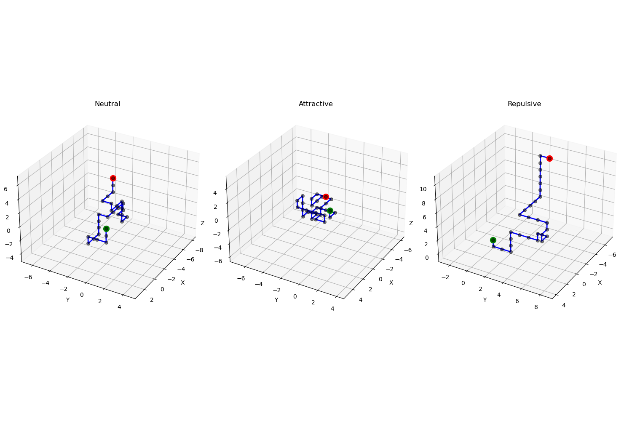
Outlook for the report
Simulations in 3D including interactions

