Slide 1
Growing SIPs on the web: where we lose users and what to test
Analytics, competitor view, test roadmap and tracking fixes | Motilal Oswal AMC | October 2026
Notes:
Data window for all NVECTA numbers: 14 Sep to 14 Oct 2026 unless stated. Competitor evidence: scheduled page snapshots (desktop) plus public pages.

Slide 2
SIP growth leaks at three points we can test
11% vs 24%
2.7%
40-60%
of users who start a purchase choose SIP: apps vs website
of SIP-calculator visitors (267k) reach any login page
of app autopay mandates fail, against about 24% on web
What we propose
Seven tests: two on pre-login pages (calculator, fund pages), five after login (login hand-off, SIP default, mandate recovery, cancel-save, first-SIP prompt)
Nine tracking fixes first, so every test can be read and SIPs can be traced from the first page view
Confirm that tests can run after login before committing to tests 3 to 7
Source: NVECTA analytics, 14 Sep to 14 Oct 2026. Percentages are of users in the period.

Slide 3
What the data says
Where SIP intent is lost, before and after login

Slide 4
Few purchase starters choose SIP, and apps choose it least
33,975 users started a purchase in 30 days; 5,125 (15%) reached the SIP step
Apps hold 66% of purchase starts, so the biggest SIP-choice gap sits there
Once on the SIP step, website users move to the payment step at 74%; Android at 59%
Our tests are web-first (website and m-site); app parity follows
Source: NVECTA saved funnel 3137 (purchase start to SIP step) split by Platform. Despite its name the funnel covers all platforms.

Slide 5
Paid mobile search drives the traffic, landing on a few pages
88%
of visitors arrive from paid search
90%
browse on the mobile site (m-site)
2.6%
of visitors are identified users
Source: NVECTA page_view by Page Url (events), Traffic Source and Platform (users), 14 Sep to 14 Oct 2026. Visitors = 2.04M users; 3.8M page-view events.

Slide 6
Calculator and fund-page visitors disappear at the login gate
From the SIP calculator (267,573 users)
267,573
7,318 (2.7%)
207
79
56
view the SIP calculator
reach a login page
start a purchase
reach the SIP step
are charged
From fund pages (1,456,070 users)
1,456,070
19,819 (1.4%)
1,539
1,132
view a fund page
reach a login page
reach the SIP step
are charged
Read these as a floor, not a rate: visitors are anonymous on the www site and known only after login, so most journeys cannot be joined across the two sites today.
Source: NVECTA temporary funnels, 7-day window, steps not strictly ordered. 'Charged' counts any successful payment, not only SIP.
Notes:
The calculator funnel's login step uses page views containing 'login'. The 'login' event itself shows 1 user because web uses login_completed and apps use login_with_otp.

Slide 7
App mandates fail more often; cancels keep pace with new SIPs
1,351
37%
users hit an autopay failure in 30 days
finish the web bank-mandate flow (527 of 1,434)
2,253
32%
cancelled a SIP in 30 days; 483 paused
of new folios make a first SIP within 7 days
Over 90 days: 5,213 autopay successes against 4,306 cancellations, but since 12 Sep cancels match or exceed new autopay successes on many days.
Source: NVECTA mf_autopay_failure/success, mf_upi_autopay_success, mf_sip_cancel_success, mf_sip_pause_success; folio to first SIP funnel. Event-user counts are indicative.

Slide 8
How peer AMCs handle the same three pages
Home, SIP calculator and defence fund page: HDFC, Axis, Aditya Birla Sun Life and ICICI Prudential

Slide 9
Peers let visitors start a SIP on the page itself
Page / signal | MOAMC (own) | Axis MF | ABSL MF | ICICI Pru MF | HDFC MF
Home: SIP block | None seen; 'Invest' in header | SIP calculator widget | 'SIP with ABSL MF' section | 'Invest', no SIP block | Not scraped
Home: guided start | 'Call back', 'WhatsApp us' | 'Great for Beginners', 'Start Here' | 'Get Investment Plan' | 'Speak to an expert' | Not scraped
Calculator: invest button | 'Start SIP' on a fund card | 'Invest Now' under result | 'Calculate' only | 'Start Investing' under result | Not scraped
Calculator: quick amounts, modes | Not seen | Goal or SIP-amount modes | Amount, months, return | Amount chips; SIP, Lumpsum, SWP tabs | Not scraped
Fund page: amount entry above fold | 'Invest Now', SIP/Lumpsum toggle | Panel: SIP tab, amount, +500/+1000 | Panel: SIP and lumpsum amounts | 'New Investment' panel | Not scraped
Fund page: minimum SIP shown | Not detected | Not stated in panel | Min Rs 500 | Min Rs 100 | Not scraped
Fund page: frequency, debit date | Not detected | 'SIP debit day' | Not in panel | Monthly, quarterly, weekly; dates | Not scraped
Fund page: SIP simulator | Past-performance calculator | Not seen | Not seen | Fund simulator (SIP) | Not scraped
Testing tool detected | None seen | Adobe Target | Adobe Target | Adobe Target | Not scraped
Green = clear SIP path on the page Amber = partial Red = not seen on the page Grey = not scraped / neutral
Source: page snapshots, 14 Oct 2026 (desktop, 3 fresh sessions per page). HDFC blocks automated access (robots.txt) and was not scraped. Snapshots show page content, not performance.
Notes:
Caveats: snapshots are desktop only (90% of our traffic is mobile). The full-page screenshots of our own pages were captured with the mega-menu open, so above-the-fold content on our pages should be confirmed by hand on a phone. The home Quick Actions section was not itemised in the snapshot. HDFC disallows automated access in robots.txt, so it was skipped. Axis, ABSL and ICICI run Adobe Target; ICICI home hero and ABSL home fund cards varied between sessions (likely carousel rotation or personalisation, not a confirmed test).

Slide 10
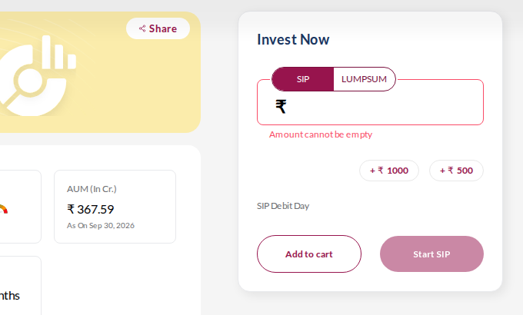
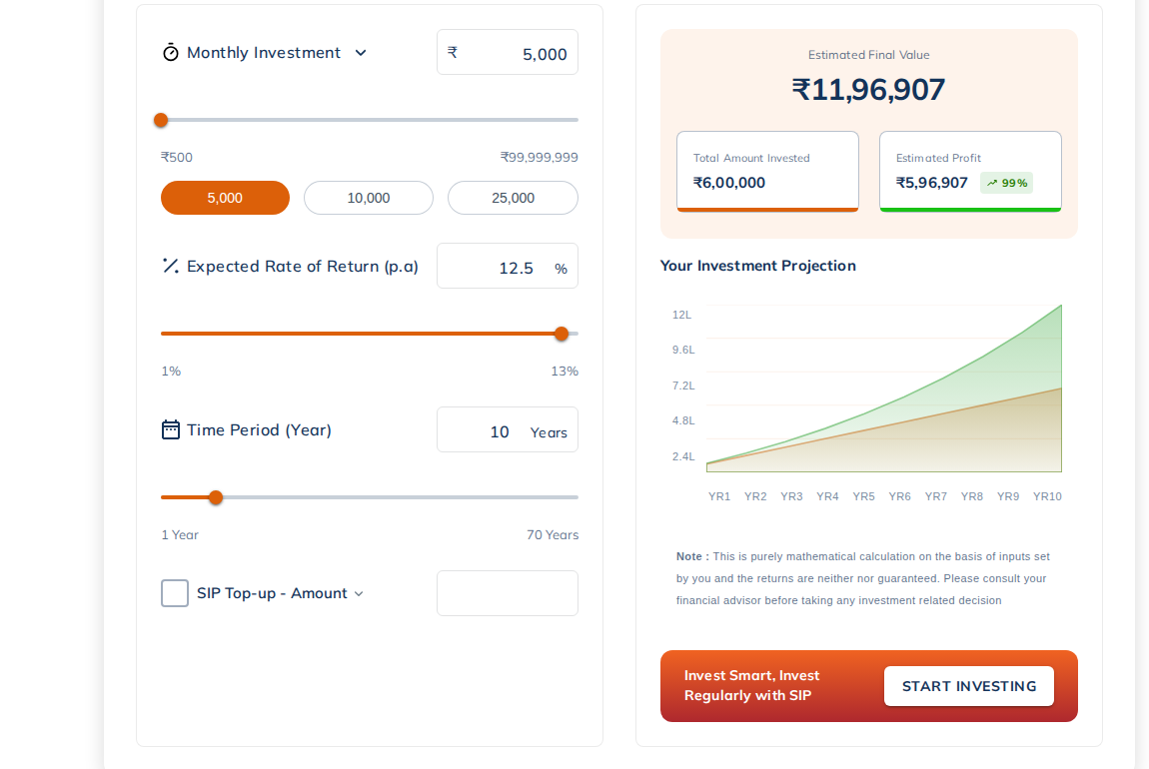
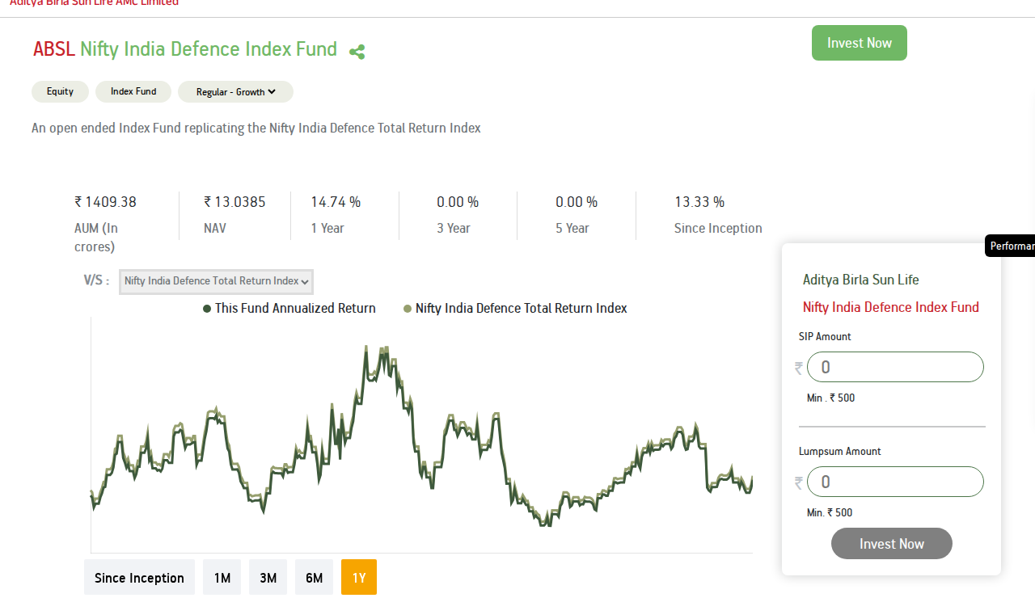
Three peers let visitors start a SIP on the public page
Axis MF: invest panel on the fund page
ICICI Pru MF: plan built on the page
ABSL MF: SIP and lumpsum amounts side by side
SIP tab first, amount box, +Rs 500 / +Rs 1,000 chips, SIP debit day
Calculator result ends in 'Invest Now'; home has a calculator widget
Calculator: amount chips, SIP / Lumpsum / SWP tabs, 'Start Investing' under result
Fund page: 'New Investment' panel (min Rs 100, frequency, dates) and a fund simulator
Floating panel with SIP amount and lumpsum amount (min Rs 500) and 'Invest Now'
Home has a 'SIP with ABSL MF' section; one-click UPI AutoPay for SIPs since 2023
HDFC MF: not scraped (robots.txt). Public pages show a calculator hub (SIP, step-up, goal, top-up) and an active HDFC Defence Fund; capture by hand for the deck if needed.
Source: page snapshots and screenshots, 14 Oct 2026 (desktop); HDFC pages via public search results. ABSL UPI AutoPay: ABSL press release, Dec 2023.

Slide 11
Seven tests, from the page to the payment
Each card: observation (analytics and competitors), hypothesis, test and expected uplift

Slide 12
Roadmap: pre-login tests first, post-login once confirmed
# | Test | Where | Stage | Expected uplift per month | Effort | Priority
T1 | SIP calculator: plan-linked 'Start this SIP' button | SIP calculator (m-site first) | Pre-login | +60 to 125 SIPs | Low | High
T2 | Fund pages: SIP amount panel above the fold (sticky on mobile) | Defence Index Fund first, then 3 more | Pre-login | +115 to 230 SIPs | Low-Med | High
T3 | Login hand-off: 'Continue your SIP' with fund and amount kept | Login pages to invest purchase | Post-login | +150 to 290 SIPs | Med | High
T4 | Purchase start: SIP preselected for SIP-intent entries | Invest purchase start (website, m-site) | Post-login | +205 to 340 SIPs | Med | Medium
T5 | Autopay: UPI AutoPay first, retry and 30-minute follow-up | Register autopay and journey | Post-login | +270 to 400 mandates | Med | High
T6 | Cancel-save: pause, lower amount or new date before cancel | Cancel subscription page | Post-login | +225 to 340 SIPs kept | Low-Med | Medium
T7 | New folio: 'Start your first SIP' card and 24-hour journey | Folio confirmation and journeys | Post-login | +70 to 145 SIPs | Low | Medium
Uplifts are hypotheses sized from this month's volumes; they overlap and must not be added together. Final sizing needs a sample-size check once tracking is fixed.

Slide 13
T1 Calculator result ends in a plan-linked 'Start this SIP'
Pre-login | SIP calculator (m-site first)
OBSERVATION
Analytics
The SIP calculator is the top page: 350k views and 267,573 users in 30 days. Only 2.7% reach a login page. The step-up calculator gets just 28k views.
Competitors
ICICI and Axis end the calculator result with an invest button under the plan ('Start Investing', 'Invest Now'); ICICI adds amount chips. Our page has a 'Start SIP' on a generic 'Most bought fund' card. ABSL has none.
HYPOTHESIS
If the result ends with a button tied to the plan the visitor just built ('Start this Rs X/month SIP'), as ICICI and Axis do, more visitors will act, because the plan they built becomes step one of purchase.
TEST
Control: today's page ('Start SIP' on a generic fund card). Variant: button under the result that carries amount and tenure into the invest flow, plus a 'See step-up' link. Primary metric: calculator to login or invest click. Guardrail: calculator use per session.
EXPECTED UPLIFT
+15-30%
relative lift in calculator to login (2.7% to 3.1-3.5%): about +1,100-2,200 login visits, +60-125 SIPs a month
Mock to add
Notes:
Sizing: login visits x 7.8% reach the SIP step x 73.6% charged (fund-page path ratios used as a proxy). 1,100*0.0574=63; 2,200*0.0574=126.

Slide 14
T2 SIP amount panel above the fold on fund pages
Pre-login | Defence Index Fund first, then 3 more
OBSERVATION
Analytics
Eight fund pages draw 130k-318k views each (Special Opportunities 318k, Defence Index 284k). Only 1.4% of 1.46M fund-page users reach a login page.
Competitors
Axis, ABSL and ICICI all put an amount panel above the fold on fund pages (ICICI min Rs 100, ABSL min Rs 500). Ours shows 'Invest Now' and a SIP/Lumpsum toggle; no amount or minimum detected.
HYPOTHESIS
Letting visitors pick an amount on the page, with SIP as the default tab and the minimum shown, as Axis, ABSL and ICICI do, lowers the commitment barrier and shortens the path from reading to starting, especially on mobile where 90% of traffic arrives.
TEST
Control: current page ('Invest Now', SIP/Lumpsum toggle). Variant: SIP-first panel with amount chips, minimum and debit date; on mobile a sticky 'Start SIP' bar opens it. Primary: fund page to login or invest click. Guardrail: lumpsum starts, bounce.
EXPECTED UPLIFT
+10-20%
relative lift in fund page to login (1.4% to 1.5-1.6%): about +2,000-4,000 login visits, +115-230 SIPs a month across 8 pages
Mock to add
Notes:
Sizing: 19,819 login visits from fund pages x 10-20% x 5.74% (7.8% SIP step x 73.6% charged). A single page delivers a fraction of the total.

Slide 15
T3 Login remembers the SIP the visitor wanted
Post-login | Login pages to invest purchase
OBSERVATION
Analytics
Login pages draw 117k + 62k views and 84k SSO views. Of users reaching login from fund pages, 7.8% (1,539 of 19,819) reach the SIP step. Web and apps use different login events.
Competitors
Axis and ICICI collect the SIP amount (plus debit day or dates) on the public fund page, so the plan exists before sign-in. ABSL offers one-click UPI AutoPay for SIPs.
HYPOTHESIS
Remembering the fund, amount and SIP choice through login, and returning the visitor to that step with a 'Continue your SIP' message, cuts the drop between login and the SIP step.
TEST
Control: generic login, lands on invest home. Variant: intent banner on login and a deep link to the prefilled SIP step after sign-in. Primary: login to SIP step. Needs developer work to carry parameters from www to invest.
EXPECTED UPLIFT
+1-2 pts
on login to SIP step (7.8% to 8.8-9.8%): about +150-290 SIPs a month
Mock to add
Notes:
Sizing: 19,819 x 1-2 points = 198-396 more SIP-step users x 73.6% charged = 146-292.

Slide 16
T4 SIP preselected for SIP-intent visitors
Post-login | Invest purchase start (website, m-site)
OBSERVATION
Analytics
Only 15% of purchase starters reach the SIP step: website 24%, m-site 19%, apps 10-11%. Website and m-site add up to about 11,700 purchase starts a month.
Competitors
Axis's fund panel opens on the SIP tab with a debit-day field. ABSL lists the SIP amount above the lumpsum amount.
HYPOTHESIS
Preselecting SIP, with lumpsum one tap away, for visitors who arrived from a SIP-intent entry (calculator, 'Start SIP' bar) raises SIP selection without lowering total purchases.
TEST
Control: current default. Variant: SIP preselected for SIP-intent entries only. Primary: share choosing SIP. Guardrails: total purchase completion, lumpsum value.
EXPECTED UPLIFT
+3-5 pts
on SIP choice (22.7% to 25.7-27.7%): about +350-585 SIP-step users, +205-340 SIPs a month
Mock to add
Notes:
Sizing: 11,678 web purchase starts x 3-5 points x 58.1% (web SIP step to Charged: 1,638/2,818). Watch cannibalisation of lumpsum.

Slide 17
T5 Recover failed autopay mandates
Post-login | Register autopay and journey
OBSERVATION
Analytics
1,351 users hit an autopay failure in 30 days. Failure rate is about 40-60% in apps against about 24% on web. Only 37% finish the web bank-mandate flow (527 of 1,434).
Competitors
ABSL launched one-click UPI AutoPay for SIPs (Dec 2023); UTI MF added SIP mandates through UPI apps (2025); AssetPlus defaults to Rs 15,000 per SIP.
HYPOTHESIS
Offering UPI AutoPay first, with a one-tap retry or alternative right after a failure, recovers users who would otherwise abandon the SIP.
TEST
Control: current mandate screen and error. Variant: UPI AutoPay first, 'Try another way' retry, and a WhatsApp or push nudge within 30 minutes. Primary: mandate success per attempt. Guardrails: payment errors, support tickets.
EXPECTED UPLIFT
20-30%
of failed mandates recovered: about +270-400 mandates a month
Mock to add
Notes:
Sizing: 1,351 x 20-30%. Failure rate range depends on whether UPI autopay successes are counted (60% vs 40% in apps). Fix tracking fix 6 first.

Slide 18
T6 Offer pause or a lower amount before cancel
Post-login | Cancel subscription page
OBSERVATION
Analytics
2,253 users cancelled a SIP in 30 days against 483 pauses (about 5 to 1). The cancel page has 3,038 views. Over 90 days, 4,306 cancels against 5,213 autopay successes.
Competitors
Post-login flows are not visible to our page snapshots, so there is no peer reference yet. A hands-on walkthrough of peer apps would fill this gap.
HYPOTHESIS
Many cancels come from a temporary cash-flow or amount problem, not loss of intent. Showing pause, reduce-amount and change-date options before the final cancel turns some cancels into pauses.
TEST
Control: current cancel confirmation. Variant: three-option step (pause 1-3 months, lower amount, change date) with 'Cancel anyway' kept. Primary: cancel completion rate among cancel-page visitors. Guardrail: complaints, compliance wording.
EXPECTED UPLIFT
10-15%
of cancels saved: about +225-340 SIPs kept a month
Mock to add
Notes:
Sizing: 2,253 cancels x 10-15%. Compliance review of any retention wording is needed.

Slide 19
T7 Prompt a first SIP right after folio creation
Post-login | Folio confirmation and journeys
OBSERVATION
Analytics
1,811 new folios in 30 days; 32% make a first SIP within 7 days (583) and 52% make any first transaction. The average time to first SIP is 12.4 hours.
Competitors
Axis home carries 'Great for Beginners' and 'Start Here'; ABSL home has 'Get Investment Plan' and 'Start Planning'. Axis also publishes a guide to starting a SIP with Rs 100.
HYPOTHESIS
A first-SIP prompt shown on folio confirmation, then repeated by WhatsApp or push within 24 hours, converts early intent into SIPs.
TEST
Control: folio confirmation then invest home. Variant: 'Start your first SIP' card with a preset amount, plus messages at 1, 12 and 24 hours. Primary: first SIP within 7 days.
EXPECTED UPLIFT
+4-8 pts
on first SIP within 7 days (32% to 36-40%): about +70-145 SIPs a month
Mock to add
Notes:
Sizing: 1,811 folios x 4-8 points.

Slide 20
Nine tracking fixes, in plain language, to do before testing
Fix | What is wrong and the simple fix | What it unlocks
1. Know who is logged in | Only 2.6% of visitors are identified. Tell the tracker who the user is right after login on the invest site. | Joins calculator visits to purchases
2. One login event | Web sends login_completed, apps send login_with_otp. Use one event plus a platform tag. | Clean login rates
3. One payment-success event | Web OTP to success looks like 35% on one event and 89% on Charged. Send the same success event everywhere. | Removes a false web drop-off
4. Label every purchase | Charged has no platform and does not say SIP or lumpsum. Add both, plus fund and amount. | SIP count by source
5. Add detail to SIP events | SIP events carry no fund, amount, frequency or step-up flag. | SIPs by fund and amount
6. One mandate result event | Bank mandate and UPI autopay report differently. Add mandate type and failure reason. | True failure rate, recovery
7. Keep campaign source across sites | Carry UTM and click ids from www to invest. | Credits SIPs to paid search
8. Record the test variant | Add experiment id and variant to key events. | Needed to read any test
9. Check guest tracking | Guest pages show about 500 users, too few for 90% mobile traffic. Verify the tags fire. | Pre-login visibility
Evidence: NVECTA user type, platform and event breakdowns, 14 Sep to 14 Oct 2026; saved funnels 3137 and 3178.

Slide 21
Before testing after login, we need three answers
For NVECTA
For Motilal Oswal AMC
Can web campaigns or A/B tests render on the invest site, which is a single-page app? Is a visual editor supported, or do variants need developer work?
Can a variant be assigned by segment or traffic split and reported against SIP events?
Can identity carry across the www and invest sites without a second login?
Is the tracking code on every invest route, and is the user id sent right after login? Why are only 2.6% of users identified?
Can the team add the missing properties (fund, amount, platform, SIP or lumpsum, mandate type) to the SIP and payment events?
Who owns the invest release cycle, and what is the earliest slot for tests 3 to 7?
Pre-login tests (1 and 2) need none of this and can start as soon as the tracking fixes for variant and source are live.

Slide 22
Next steps: fix tracking, launch two pre-login tests, unlock the rest
1
2
3
4
Week 1
Weeks 2-3
Weeks 3-5
Week 6+
Agree tracking fixes with dev; get answers on post-login testing; capture a hands-on SIP walkthrough on mobile web
Launch T1 (calculator) and T2 (Defence fund page); confirm baselines and sample sizes
Build T3 to T5 once identity and variant tracking are live; start T6 and T7 journeys
Read results, scale winners to other fund pages and to the apps
Timeline is indicative and depends on the answers to the post-login questions.

