Slide 1
Growing SIPs on the web: findings and test recommendations
Motilal Oswal AMC | October 2026

Slide 2
Summary: high SIP intent before login, too little of it converts
2.7%
24% vs 11%
40-60%
of SIP-calculator visitors (267k) reach any login page
of purchase starters choose SIP: website vs apps
of app autopay mandates fail, against about 24% on web
What we found
What we recommend
Traffic is paid, mobile and concentrated on the SIP calculator and a few fund pages
Peers end the calculator with a button on the result and show a SIP amount on fund pages; we do not
After login, mandates fail and cancels outnumber pauses 5 to 1
The SIP base is large and small-ticket: 2.8M investors, median SIP Rs 1,001
Five pre-login tests on the calculator and fund pages, mocked up and ready to build
Eight personalised nudges, before and after login, most runnable now as NVECTA journeys
2-3 tests a week, so SIP is the first problem in an ongoing programme
Source: NVECTA analytics, 14 Sep to 14 Oct 2026; competitor page snapshots, 14 Oct 2026.

Slide 3
Who arrives and where: paid, mobile, a few pages
Traffic
Engagement
2.04M visitors in 30 days; 88% arrive from paid search
90% browse on the mobile site; apps hold 66% of purchase starts
SIP calculator: 350k views, 267,573 users, 99% paid search, 91% mobile
Eight fund pages draw 130k to 318k views each; the login page 117k
Only 2.6% of visitors are identified across the site (57% on the invest site)
33,975 users started a purchase; 5,125 (15%) reached the SIP step
SIP choice: website 24%, m-site 19%, Android 11%, iOS 10%
Website: 14.5% of purchase starters reach a Charged event; m-site 8.8%
97% of calculator visitors never reach a login page in the same journey
Step-up calculator gets 28k views, 8% of the SIP calculator's
Source: NVECTA page views by Page Url, Traffic Source and Platform; saved funnels 3137 and 3178; 14 Sep to 14 Oct 2026. Charged may include non-SIP payments.

Slide 4
Engagement by city tier and age: metros and 30+ investors lead
By city tier
By age (known users)
Tier | Visitors | Purchase starts | SIP step
Metros and NCR | 42% | 74% | 16.5%
Tier-2 cities | 36% | 19% | 14.0%
Smaller towns | 21% | 7% | 13.7%
Age | Purchase starts | SIP step | SIP step %
23-29 | 2,392 | 346 | 14.5%
30-39 | 7,912 | 1,344 | 17.0%
40-50 | 9,177 | 1,545 | 16.8%
What it tells us
Metros are 42% of visitors but 74% of purchase starts. Tier-2 and smaller towns bring 57% of visitors and convert far less, so paid spend there is a candidate for tighter targeting
The youngest cohort (23-29) chooses SIP least: 14.5% against about 17% for ages 30-50, although SIP is their natural product
SIP investors concentrate in the Midcap Fund (1.58M of 2.82M, 56%), yet paid landing pages are thematic and index funds: Special Opportunities 318k views, Defence 284k, Midcap 130k
Gulf and Singapore cities give 5.6% of purchase starts (about 1,900), a ready NRI audience
Source: NVECTA, 14 Sep to 14 Oct 2026. City is IP-based (small-town names are often mobile-carrier gateways); the top 100 cities cover 59% of visitors, so tier-2 and smaller-town purchase starts are understated. Age covers known users in the three age segments. Midcap Fund = scheme code FM.

Slide 5
Pre-login journey: where visitors drop and where we test
Arrive
Land
Build a plan
Login gate
SIP step (invest)
2.04M
267k + 1.46M
97% leave
2.7% | 1.4%
1,539
visitors; 88% from paid search, 90% on mobile
users on the SIP calculator and on fund pages
of calculator users never reach login in the same journey
reach a login page from the calculator | from fund pages (7,318 | 19,819)
reach the SIP step from fund pages (7.8% of login arrivals); 1,132 are charged
★ T2, T5 fund first screen
★ T1 button names the plan
★ P7, P8 bring them back
★ T4 calculator inputs
★ T6 save the plan
★ marks a test or nudge from the roadmap. Login-page changes are not proposed in this round.
Source: NVECTA temporary funnels, 7-day window, steps not strictly ordered; a floor, because www visitors are anonymous until login. Charged counts any successful payment.

Slide 6
Post-login journey: SIP set-up, mandate, retention
Login to purchase
SIP, payment, OTP
Autopay mandate
Running SIP base
Cancel or pause
New folio
33,975
3,402
1,351
2.8M
2,253
28%
users start a purchase; 5,125 (15%) reach the SIP step
reach payment, 3,072 OTP; web 91% reach Charged, apps 71-87%
users hit a failure; app failure rate 40-60% vs 24% on web
SIP investors a month; median SIP Rs 1,001, average Rs 2,720; 56% digital
cancelled vs 483 paused; 1,622 left the cancel page without cancelling
of 1,811 new folios make a first SIP within 24 hours; 32% in 7 days
★ P1 restart a dormant SIP
★ P4 fix my autopay
★ P2 raise your SIP
★ P5 pause or lower
★ P3 start your first SIP
★ P6 add a second SIP
★ marks a personalised nudge from the roadmap; most can run now as NVECTA journeys.
Source: NVECTA saved funnels 3137, 3178, autopay, cancel, pause and folio funnels; transaction_new (all channels) for the SIP base, 14 Sep to 14 Oct 2026. Event-user counts are indicative.

Slide 7
What investors worry about, and what it means for our pages
Signal | Evidence | What it means for us
First drawdown for new investors | Nifty fell 5.3% in one March 2026 week; 486 of 556 schemes were negative in FY26 (as reported); stoppage ratio above 100% in Mar-Apr | Reassurance next to the button (T5)
Small, young SIPs churn most | Under-35s opened 40% of new SIPs in 2025 (Bain, Groww via IBEF); churn is concentrated in newer, smaller accounts | Low entry amounts, mobile-first (T1, T2, T4)
Long-running SIPs are thinning | Accounts older than 5 years fell 11.2% to 1.06 crore (as reported) | Retention nudges: raise, pause, second SIP (P2, P5, P6)
Our own behaviour shows it too | Cancels beat pauses 5 to 1; 40-60% of app mandates fail; 1,622 left the cancel page | Commitment fear and payment friction are real (P4, P5)
Backdrop: record Rs 32,490 crore of SIP inflow in September 2026, yet the stoppage ratio is 78.5% (95.5% in May). Money keeps flowing, but new and small SIPs are fragile. Retail has not left equities; the risk is at the margin.
Source: media reports of AMFI data and surveys (Angel One, Sahi, IBEF, Upstox, Business Standard, DSIJ), 2026; NVECTA behavioural data. Media figures are not independently verified.
Notes:
First-party survey verbatims are not included: NVECTA holds 2,375 feedback-survey and 3,426 NPS responses in 90 days; survey IDs are needed to read them.

Slide 8
Peers put the invest step on the page; we already match on mobile
Page / signal | MOAMC (own) | Axis | ABSL | ICICI Pru | SBI | Nippon
Home: SIP block or button | No SIP block; 'Invest' only | SIP calculator widget | 'SIP with ABSL MF' section | 'Invest'; expert help | 'Invest Now'; no SIP block | 'Start a SIP' button
Home: guided start | 'Call back', 'WhatsApp us' | 'Great for Beginners' | 'Get Investment Plan' | 'Speak to an expert' | 'Talk to us' | 'Guide me now'
Calculator: invest button on the plan | Sticky 'Start SIP' (mobile); plan link unconfirmed | 'Invest Now' under result | 'Calculate' only | 'Start Investing' under result | PAN box and 'Start Now' | 'Invest Now' on step-up only
Calculator: presets and modes | Prefilled Rs 10,000, sliders | Goal or SIP-amount modes | List: step-up, cost of delay, goal | Amount chips; SIP, Lumpsum, SWP | Goal-based ('I want to make') | SIP / Lumpsum switch
Calculator: SIP FAQs on page | FAQ section | Explainers | None seen | Explainers | 'Can I pause / modify a SIP?' | Explainers
Fund page (desktop): amount above the fold | 'Invest Now', SIP/Lumpsum toggle | Panel: SIP tab, amount, chips | Panel: SIP and lumpsum amounts | 'New Investment' panel | 'Invest' button only | Login / Quick Invest only
Fund page: minimum SIP shown | Not detected | Not stated in panel | Min Rs 500 | Min Rs 100 | Rs 500 on page | Not detected
Fund page (mobile): invest button on first screen | 'Invest Now' + '6.5L have invested' | Sticky 'Invest Now' | Sticky 'Invest Now' | Panel below first screen | 'Invest' button | 'Invest Now' button
Testing tool detected | None seen | Adobe Target | Adobe Target | Adobe Target | None seen | Adobe Target
Green = clear SIP path on the page Amber = partial Red = not seen on the page Grey = neutral
Source: page snapshots, 14 Oct 2026 (desktop and phone viewport, 3 fresh sessions per page). Axis and Nippon SIP landing pages are blocked to scrapers; HDFC was dropped (robots.txt). Snapshots show content, not performance.
Notes:
Caveats: ratings are judgements from captured page text and screenshots. Our full-page desktop screenshots were captured with the mega-menu open, so above-the-fold desktop content on our pages should be confirmed by hand. SBI and Nippon have no defence fund, so their flagship small-cap page is compared. ABSL home fund cards and ICICI home hero differed between sessions (likely rotation or personalisation, not a confirmed test).

Slide 9
Six learnings from how peers handle SIP
Peers end the calculator with a button
Peers collect contact details early
Peers answer SIP worries on the page
ICICI ('Start Investing'), Axis ('Invest Now') and SBI ('Start Now') put a button right under the result. Ours is a sticky 'Start SIP' that does not show the plan. Test T1.
SBI asks for PAN next to 'Start Now'; Axis offers a call-back form; ABSL offers 'Get Investment Plan'. We ask for nothing until login. Test T6.
SBI's calculator page answers 'Can I pause my SIP?', 'Can I modify the amount?' and 'Can I renew?'. Test T5.
Peers show an amount and the minimum
Peers offer more calculator options
Most peers are already A/B testing
On fund pages Axis, ABSL and ICICI let visitors enter a SIP amount; minimums are Rs 100 to Rs 500. Ours asks for no amount. Test T2.
ICICI has amount chips and SIP / lumpsum / SWP tabs, ABSL lists step-up and goal tools, SBI has a Rs 1 crore goal calculator. Test T4.
Axis, ABSL, ICICI and Nippon run Adobe Target; ABSL's home cards and ICICI's hero change between visits. SBI and we show no tool, so we can start ahead of SBI.
Source: page snapshots, 14 Oct 2026 (desktop and mobile). Peer choices show what others do, not what wins; each learning becomes a test.

Slide 10
Test recommendations: five pre-login tests, mocked up
# | Test | Where | Week | Build / run | Expected uplift a month | What we need from the client
T1 | Calculator button names the plan | www SIP calculator (mobile first) | 1 | 1 day / 7-14 days | +60 to 125 SIPs | Confirm what today's 'Start SIP' passes to the invest site
T2 | SIP-first first screen on fund pages | Fund pages, mobile first (Defence Index first) | 1 | 1-2 days / 7-14 days | +115 to 230 SIPs | Minimum SIP per fund; how the amount is passed to the invest flow
T5 | Reassurance next to the SIP button | Fund pages, mobile first | 1 | 1 day / 14 days | +45 to 95 SIPs | Compliance approval of the wording; confirm the pause and stop policy
T4 | Calculator: presets, step-up and a clear outcome | www SIP calculator (mobile first) | 2 | 2 days / 14 days | +40 to 85 SIPs | Approve default return presets (8-13%) and illustration wording
T6 | Save the SIP plan | www SIP calculator (mobile first) | 2 | 2-3 days / 14 days | +55 to 160 SIPs | Consent text and approved WhatsApp and email templates
T2 and T5 change the same fund-page first screen, so they run together as an A/B/C. T4 runs after T1 so the effects stack. All five are website changes with a 1-3 day build.
Uplifts are hypotheses sized from this month's volumes; T1, T4 and T5 share the calculator and must not be added. Sample size: about 26k users per arm for the calculator, about 52k for one fund page.

Slide 11
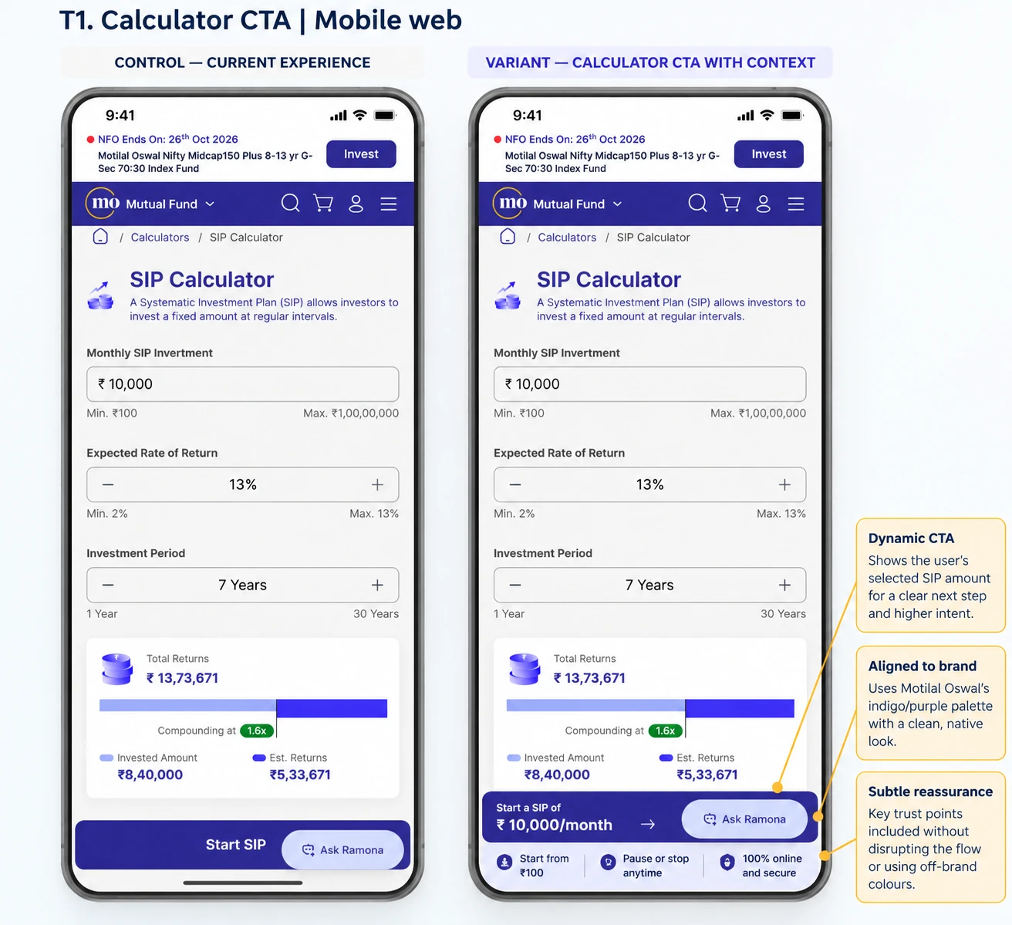
T1 Calculator button names the plan
OBSERVATION
Analytics The SIP calculator is our top page: 267,573 users in 30 days, 99% from paid search and 91% on mobile. Only 2.7% reach a login page.
Competitors ICICI, Axis and SBI end the calculator with a button under the result. Ours is a sticky 'Start SIP' that does not show the plan.
HYPOTHESIS
A button that states the plan ('Start a SIP of Rs 10,000/month'), with 'Start from Rs 100, pause or stop anytime, 100% online' beneath it, raises clicks because visitors see what they are committing to.
TEST
Control: sticky 'Start SIP'. Variant: dynamic button with the chosen amount plus three trust points. Primary: calculator to login or invest click. Guardrail: calculator use per session.
EXPECTED UPLIFT
relative lift in calculator to login (2.7% to 3.1-3.5%): about +1,100-2,200 login visits and +60-125 SIPs a month
+15-30%
Notes:
Sizing: login visits x 5.74% (7.8% reach the SIP step x 73.6% charged, from the fund-page path). About 26k users per arm detects +15% relative; the calculator gets about 62k users a week.

Slide 12
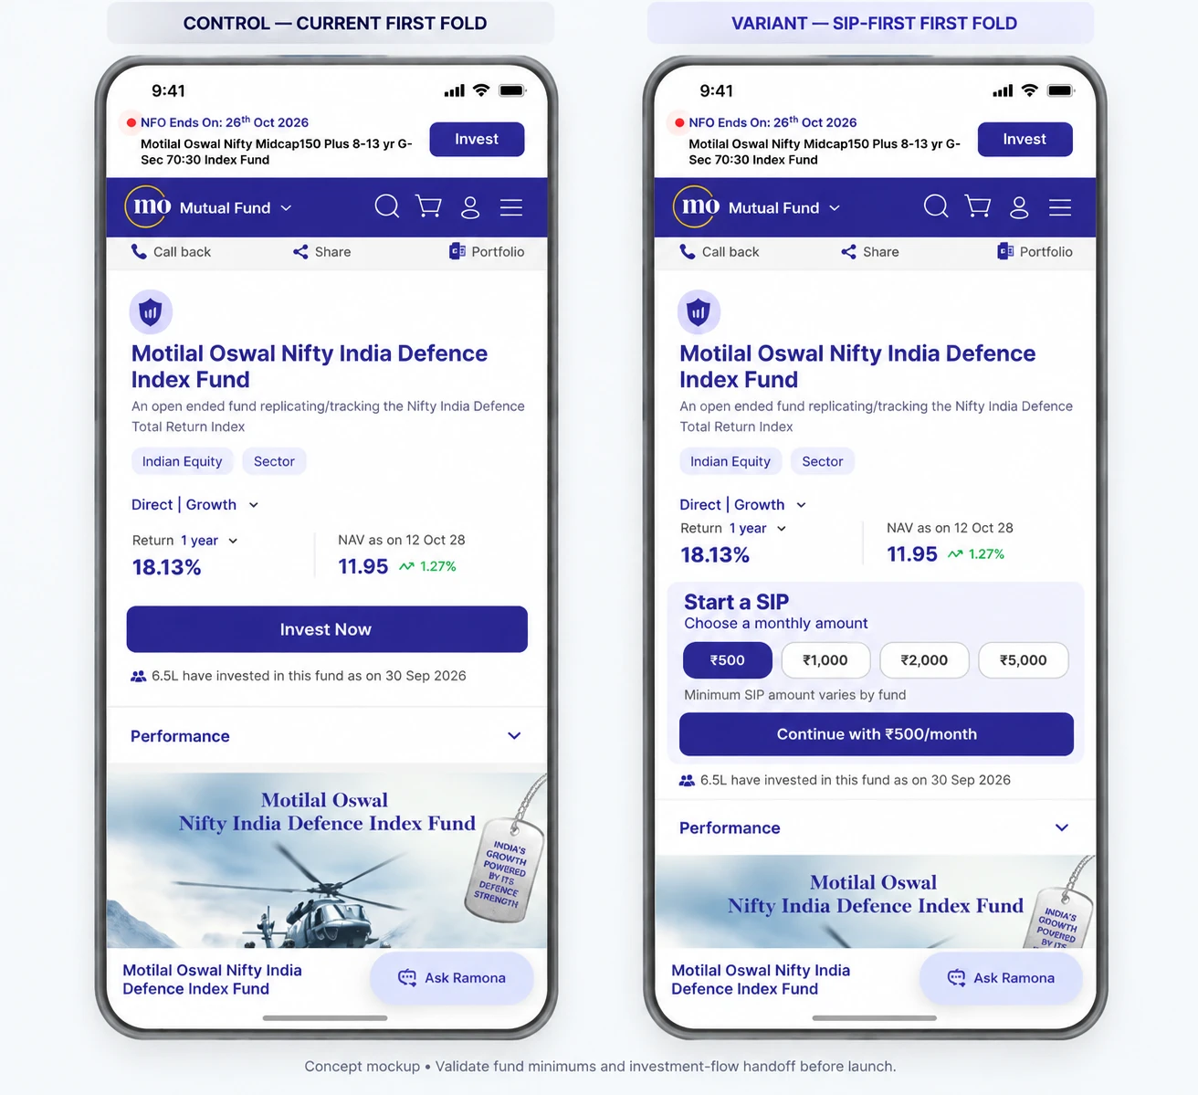
T2 SIP-first first screen on fund pages
OBSERVATION
Analytics Eight fund pages draw 130k-318k views each. Only 1.4% of 1.46M fund-page users reach a login page, and 'Invest Now' asks for no amount.
Competitors Axis, ABSL and ICICI let desktop visitors enter a SIP amount (minimum Rs 100-500). SBI and Nippon show only 'Invest'.
HYPOTHESIS
Choosing a monthly amount on the first screen (Rs 500 / 1,000 / 2,000 / 5,000) makes starting a SIP feel small and concrete, and carries the amount into the invest flow.
TEST
Control: 'Invest Now'. Variant: 'Start a SIP' block with amount chips and 'Continue with Rs 500/month'. Primary: fund page to login or invest click. Guardrail: lumpsum starts. Check each fund's minimum first.
EXPECTED UPLIFT
relative lift in fund page to login (1.4% to 1.5-1.6%): about +2,000-4,000 login visits and +115-230 SIPs a month across 8 pages
+10-20%
Notes:
Sizing: 19,819 login visits from fund pages x 10-20% x 5.74%. One page delivers a fraction. About 52k users per arm at the 1.36% baseline; the Defence page gets about 66k views a week. T2 and T5 share the fund page: run as A/B/C.

Slide 13
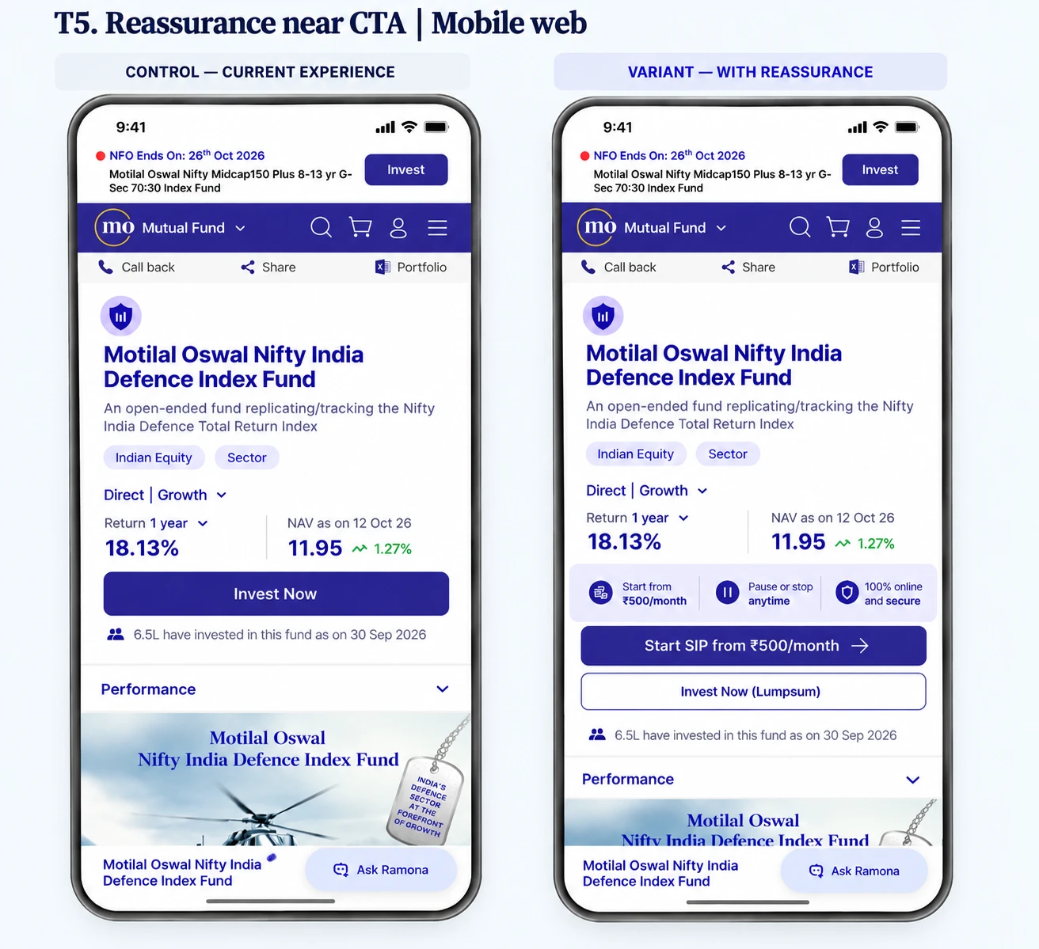
T5 Reassurance next to the SIP button
OBSERVATION
Analytics Cancels outnumber pauses 5 to 1 (2,253 vs 483). The SIP stoppage ratio was above 100% in March and April 2026 and is still 78.5% in September.
Competitors SBI's calculator page answers 'Can I pause my SIP?'. Axis publishes a guide to starting a SIP with Rs 100.
HYPOTHESIS
New investors fear locking in during a volatile market. A strip saying 'Start from Rs 500/month, pause or stop anytime, 100% online and secure' beside a SIP-first button lowers that fear.
TEST
Control: 'Invest Now'. Variant: trust strip, primary 'Start SIP from Rs 500/month', secondary 'Invest Now (Lumpsum)'. Primary: fund page to login or invest click. Guardrail: lumpsum starts. Runs with T2 as A/B/C.
EXPECTED UPLIFT
relative lift in page to login across calculator and fund pages: about +800-1,600 login visits and +45-95 SIPs a month
+3-6%
Notes:
Sizing: (7,318 + 19,819) login visits x 3-6% x 5.74%. Compliance must approve 'pause or stop anytime'.

Slide 14
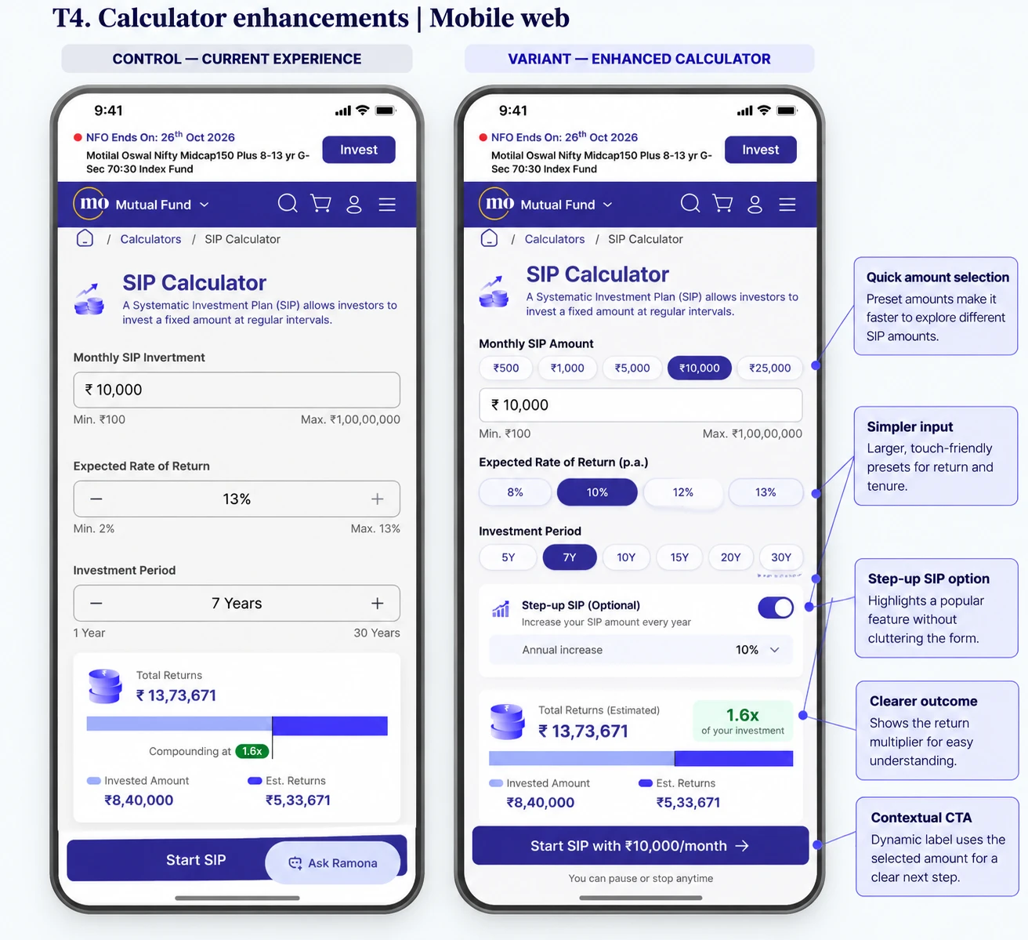
T4 Calculator: presets, step-up and a clear outcome
OBSERVATION
Analytics 91% of calculator users are on mobile and type into an open form. Step-up lives on a separate page with 28k views, 8% of the SIP calculator's.
Competitors ICICI has amount chips and SIP / lumpsum / SWP tabs; ABSL lists step-up, cost-of-delay and goal tools; SBI has a Rs 1 crore goal calculator.
HYPOTHESIS
Tap-to-select amount, return and period, an optional step-up switch and a '1.6x your investment' outcome help more visitors complete a plan and see a bigger result, so more reach the button.
TEST
Control: sliders and open fields. Variant: preset chips, step-up (10% a year), outcome multiple and the dynamic button. Primary: plans completed and button clicks. Run after T1.
EXPECTED UPLIFT
relative lift in calculator to login on top of T1: about +730-1,460 login visits and +40-85 SIPs a month
+10-20%
Notes:
Sizing: 7,318 x 10-20% x 5.74%. Medium-low confidence; depends on T1.

Slide 15
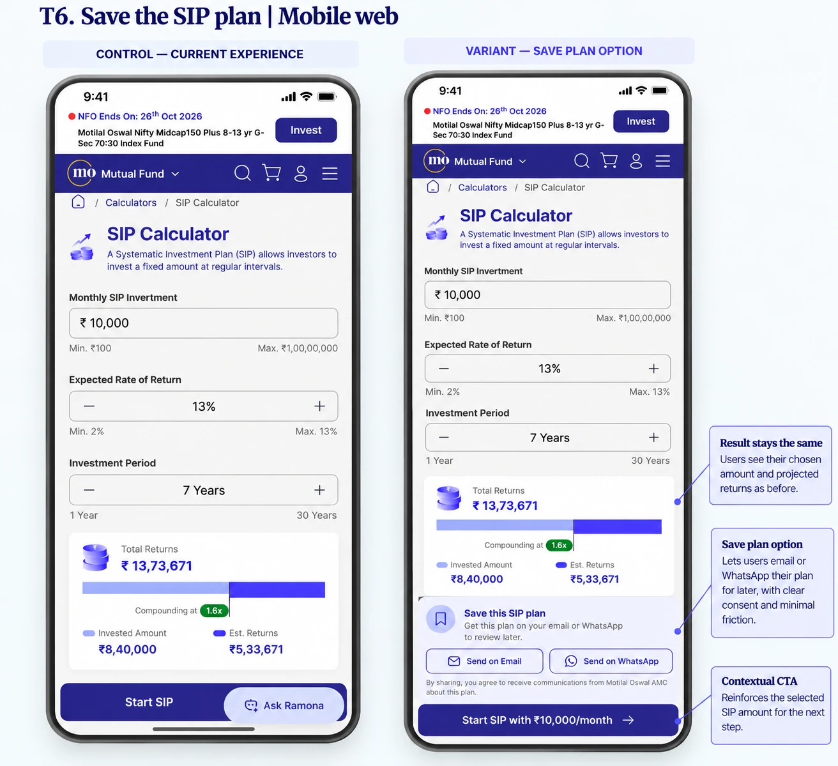
T6 Save the SIP plan
OBSERVATION
Analytics 267,573 calculator users in 30 days and 97% never reach a login page. We already send WhatsApp (64), RCS (23) and email (145) campaigns a month, so a saved plan can be followed up in NVECTA.
Competitors SBI asks for PAN beside 'Start Now' inside its calculator; Axis offers 'Get a Quick Call'; ABSL offers 'Get Investment Plan'.
HYPOTHESIS
Visitors who built a plan but are not ready to log in will take it with them if offered it by email or WhatsApp. A follow-up journey then brings some of them back to start the SIP.
TEST
Control: no capture. Variant: 'Save this SIP plan' with Send on Email / Send on WhatsApp and a consent line; follow-ups at 1 hour, 1 day and 3 days. Primary: capture rate, then SIPs within 14 days.
EXPECTED UPLIFT
capture of calculator users (2,700-5,300 leads); if 2-3% start a SIP within 14 days: about +55-160 SIPs a month
1-2%
Notes:
Assumes capture of 1-2% and 2-3% conversion of captured leads; both to be confirmed in week one. Consent and data-protection wording needed.

Slide 16
Personalisation: the signals we already hold
Explicit
Implicit
what the investor has told us or we have verified
what the investor does
Age band (segments for 23-29, 30-39 and 40-50 already exist)
City and region; Direct or regular channel
KYC status; preferred channel and consent
Holdings and AUM band, including holdings at other AMCs (data lake segments)
Investor zone and scheme on every transaction (56% of SIP investors sit in Digital Sales)
Funds and pages viewed, visit frequency, campaign and keyword that brought them ("Recently Visited Fund" journey already has 489k entries)
SIP history on every transaction: SIP or lumpsum, amount, scheme (3.97M SIP instalments from 2.8M investors in 30 days; median Rs 1,001)
Failures and friction: autopay failure, payment failure, cancel-page visit
Engagement: email opens, WhatsApp reads, RFM tier, market-fall cohort
Source: NVECTA segment list (about 250 segments), journeys and events, Oct 2026. SIP amount and type sit on the transaction_new event; SIP start date and active status do not.

Slide 17
Eight nudges, before and after login, most runnable now
# | Nudge | Audience today (NVECTA) | Signal | Where | What it takes | Uplift a month | Wk
P1 | Restart your SIP | No transaction in 90+ days: 4.76M (4.58M on WhatsApp). Logged in, idle 30 days: 68k | Implicit: last login, last transaction | Invest home card; WhatsApp or push | Journey now; on-page card needs invest team | Each 0.1% response = 4,800 restarts | 3
P2 | Raise your SIP | SIP investors: 2.8M a month, median SIP Rs 1,001; 1.58M in Digital Sales | Implicit: SIP amount, scheme | Debit-day message; invest home card | Journey now (SIP debit journey exists); start date needed for 6+ months | Each 0.1% response = 2,800 raised SIPs | 4
P3 | Start your first SIP | New folio, no SIP yet: 1,811 a month | Implicit: folio created | Folio confirmation; message within 1 hour | Journey now; on-page card needs invest team | +70-145 SIPs | 2
P4 | Fix my autopay | Autopay or mandate failure: 1,351 users a month | Implicit: failure event | WhatsApp or push within 30 minutes | Journey now (event already received) | +270-400 mandates | 3
P5 | Pause or lower, don't cancel | Cancel-page visitors: 1,622. Market-fall cohort: 519k | Implicit: cancel page view; market-fall segment | Message after the visit; cancel step | Message now; 3-option step needs invest team | +225-340 SIPs kept | 3
P6 | Add a second SIP | AUM of Rs 1 lakh or more: 42k; one-fund holders | Explicit and implicit: AUM, holdings | Invest home; email | Journey now (AUM and holding segments exist) | Each 1% response = 420 second SIPs | 4
P7 | Welcome back, start your SIP | Repeat visitors on www: 31k on one fund page in 7 days, 99% anonymous | Implicit: fund viewed, frequency, campaign | www banner naming the fund viewed | Needs www change; NVECTA web campaign to confirm | If 1-2% start a SIP: +310-630 on that page | 4
P8 | Finish your SIP | SIP high-intent users: 265k, only 39k reachable (15%) | Implicit: SIP high-intent segment | WhatsApp, push, email | Journey now | If 1-2% of the 39k finish: +390-770 | 1
P7 is a pre-login banner on www; the rest are messages or on-page cards. Audiences are NVECTA segment counts, Oct 2026. 'Each 0.1%' shows the scale of one response-rate point, not a forecast; the other uplifts assume the stated rate.

Slide 18
What we need from your team to measure and personalise
Need | Why it matters | Used by
Set platform on transaction_new and Charged | Platform is blank on all 2.8M SIP investors, so SIPs cannot be split by website, m-site or app | All tests
Send fund, amount, frequency and step-up with the SIP step events | Lets us read tests by fund and amount and personalise by SIP size | T2, T4, P6
One result event for autopay (bank and UPI) with a failure reason | Gives a true failure rate and a recovery trigger | P4
Carry campaign source from www to the invest site | Credits SIPs to paid search | T1, T2, T6
SIP start date and active or stopped status per investor | Finds SIPs that have run 6+ months and SIPs that lapsed | P2, P5
Evidence: NVECTA event and attribute lookups, Oct 2026. transaction_new already carries SIP or lumpsum, amount, scheme, city and zone.

Slide 19
Next steps: 2-3 tests a week, SIP first
1
2
3
4
Week 1
Week 2
Week 3
Week 4
Launch T1 and the T2/T5 A/B/C; start P8 retargeting; confirm client inputs and the data needs
Launch T4 and T6; start the P3 first-SIP journey
Start P1, P4 and P5 journeys; read the week-1 tests
Start P2, P6 and P7; scale winners; choose problem two for the same cadence
After SIP, the same cadence moves to the next problem: mobile-site conversion (90% of visitors, 8% of purchase starts), new-folio activation, NFO and lumpsum payment failures.
Cadence follows the 1-3 day build time and the commitment of 2-3 tests a week per client.

