Slide 1

DAV 5400 Final Project Proposal - Bike Sharing Service
Team members: Sun Hee Park, Manling Yang

Slide 2
Motivation
Today, there are many ride-sharing companies that offer users to share car rides, or ride electric scooters or bikes. However, bike sharing is the worthiest of notice to be analyzed now and even for the future. It is because people face practical and realistic problems when sharing and cars and electric scooters which do not exist when people share bikes, about insurance or driver’s license. This is why people would like to use bike-sharing.
There are some companies offer the bike-sharing in the city. Understand the bike-sharing situation is beneficial for people to find the best station to begin and end of bike-sharing usage.
In addition, our major is Data Analyze and Virtualization. I may work for the bike-sharing company in the future. Practices more.

Slide 3
Research Questions
Along with increasing number of Bike-Sharing users, companies want to analyze their customer's data. They want to conduct marketing based on users who are mostly using the service. We expected that the companies assume main factors as ‘location’, 'time', 'age', and 'gender' for analyzing their data.
In addition, we are also going to compare popularity in using this service in two cities - Chicago and New York. Thus, the questions that we take into account are:
When (specific time) do people mostly use bike-sharing service, such as month, weekday and day?
Which age range of is mostly using bike-sharing service?
Which gender is the main users in both city?
Which station is the most popular one?
Which city is more popular to use the bike sharing services?
Notes:
research question focus on where and when is the most people would like to use the bike-sharing

Slide 4
Used Data
The first data set('Chicago-Divvy-2016') is a SQL file.
The second data ('NYC-BikeShare-2016') is a CSV file
Both files are from Kaggle.

Slide 5
Approach
Read the dataset, sql and csv files from Github
Cleaned up the dataset
Analysis each attribute of datasets in statistical summary and graphs, including bar plot and box plot.
Combined two dataset and made analysis, focused on comparison.
Made a conclusion.
Notes:
Read the dataset, sql and csv from Github
Clean up the dataset
Analysis each attributes of datasets in statistical summary and graphs, including bar plot and box plot.
Combine two dataset and make analysis, focus on comparison.
Make a conclusion.

Slide 6
11 Attributes of two data sources (sql and csv)
Trip duration: Time in second
Start time: Time to start to use bike sharing services
Stop time: Time to stop to use bike sharing services
Bike id: the id of bike
From station id: The id of the bike station for people star to use bike sharing services
From station name: The name of the bike station for people star to use bike sharing services
To station id: The id of the bike station for people stop to use bike sharing services
To station name: The name of the bike station for people stop to use bike sharing services
User type: the type of bike users
Gender: the gender of bike users
Birth_year: the birth year of bike users

Slide 7
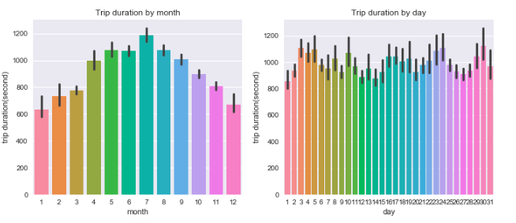
Bike-sharing data from Chicago
People in Chicago seems like that they mostly used the bike-sharing services on July in 2016.
They also mostly used the bike-sharing services at the beginning of the month and at the end of the month.
Notes:
People in Chicago seems like that they mostly used the bike-sharing services on July in 2016.
They also mostly used the bike-sharing services at the beginning of the month and at the end of the month.

Slide 8
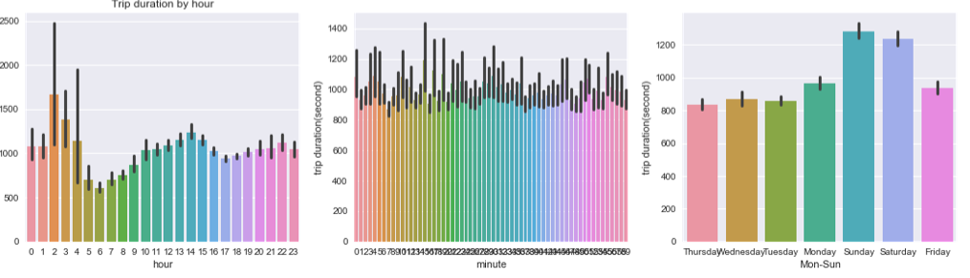
Bike-sharing data from Chicago
According to the charts above, we could know that people usually used this service during Saturday and Sunday longer than weekday.
Notes:
According to the charts above, we could know that people usually used this service during Saturday and Sunday longer than weekday.

Slide 9
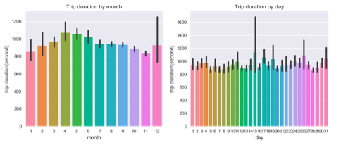
Bike-sharing data from New York City
Unlike people in Chicago, people in New York City seems like that they mostly used the bike-sharing services on April and May in 2016. They also mostly used the bike-sharing services at the middle of the month. This result is really different with the previous result from chicago.
Notes:
Unlike people in Chicago, people in New York City seems like that they mostly used the bike-sharing services on April and May in 2016. They also mostly used the bike-sharing services at the middle of the month. This result is really different with the previous result from chicago.

Slide 10
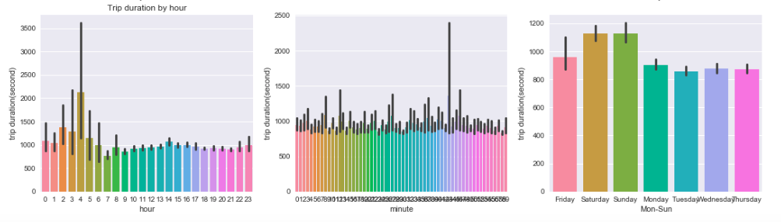
Bike-sharing data from New York City
According to the charts above, we could know people usually used this service during the weekend longer than weekday. This result is same with Chicago.
Notes:
According to the charts above, we could know people usually used this service during the weekend longer than weekday. This result is same with Chicago.

Slide 11
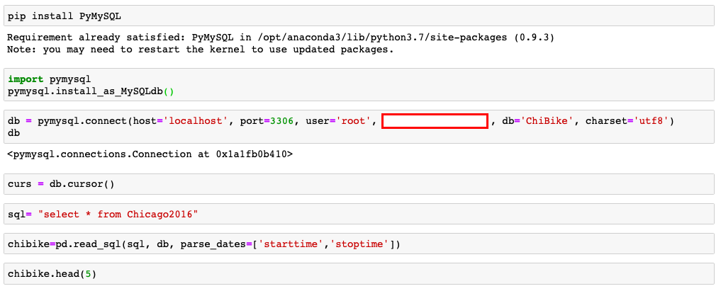
The most hard part we encountered with the final project was

Slide 12
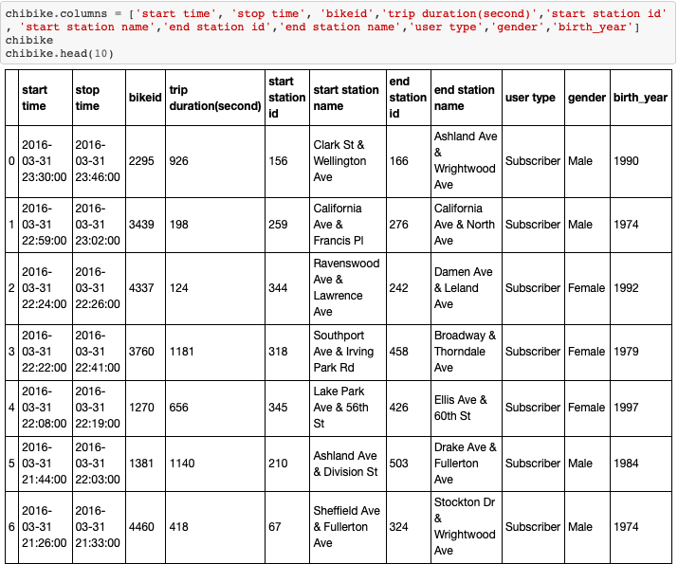

Slide 13
References
https://www.kaggle.com/samratp/bikeshare-analysis#Chicago-Divvy-2016.csv
https://www.bbc.com/news/uk-48106617
https://www.walkuplawoffice.com/2019/06/19/2019-electric-scooter-helmet-laws-in-california/
https://www.washingtonpost.com/technology/2019/01/25/electric-scooters-send-more-people-hospital-than-bicycles-walking-new-study-finds/

Slide 14
Thank you for watching our presentation

