Slide 1
News Sentiment Analysis Tool
Analyze Perception from Online News
Presented by: Mandar Kishore More
Course: DLBDSME01

Slide 2
Project Objective
Goal:
Develop a tool that fetches recent news articles for a company and classifies their sentiment.
Use Case:
Marketing uses this tool to track how the company is perceived.

Slide 3
Chosen Technologies
Languages & Frameworks:
- Python
- Streamlit
- NewsAPI
- NLTK (VADER)
- HuggingFace Transformers (BERT)
- Pandas

Slide 4
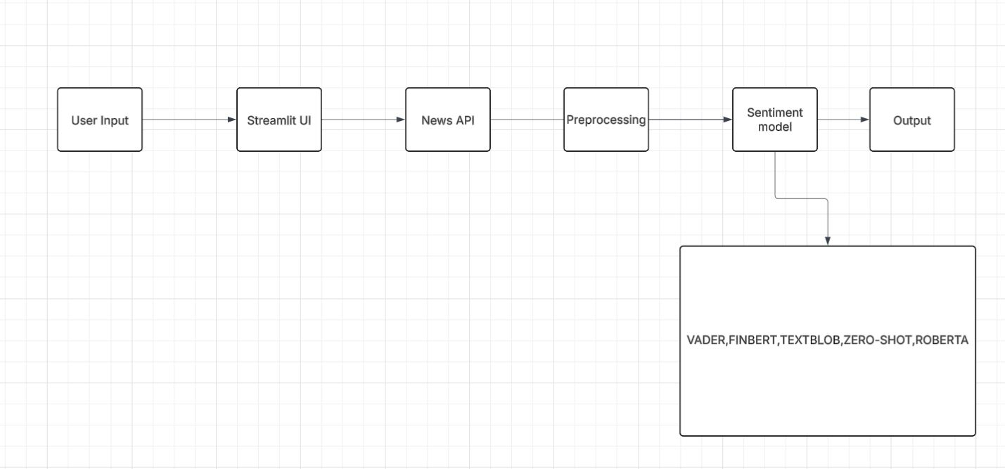
System Architecture

Slide 5
Preprocessing
Steps:
- Lowercase conversion
- Remove punctuation
- Remove stop words
- Normalize text
Reason:
Improves model consistency and accuracy.

Slide 6
Sentiment Models
Model
VADER
Roberta
FinBert
Zero-shot
Textblob

Slide 7
Sample Output
Screenshot suggestions:
- Streamlit interface with input
- Results table with sentiments
- Bar chart of sentiment counts
Shared screenshot in different pdf

Slide 8
Validation & Evaluation
Methods:
- Manual Validation
- VADER vs BERT vs FINBERT vs ZERO-SHOT vs TEXTBLOB output comparison
- Error inspection
Planned Improvements:
- Labeling UI
- Performance Tracking

Slide 9

Reflection & Iteration
Challenges:
- Ambiguous headlines
- API limits
- Model disagreements
Solutions:
- Preprocessing
- Two model toggle
- Article limit

Slide 10

Next Steps & Conclusion
Next Steps:
- Add feedback loop
- Support multiple news APIs
- Cloud deployment
Conclusion:
Tool meets requirements with live crawling, dual-model sentiment analysis, and UI.

