Slide 1
Target Detection & Knowledge Learning for Domain-restricted Question Answering
Mengdi Zhang, Tao Huang, Yixin Cao, Lei Hou
Knowledge Engineering Group, Dept. of Computer Science and Technology, Tsinghua University

Slide 2
Outline
Motivation & Challenges
Approach
Experiment
Conclusion

Slide 3
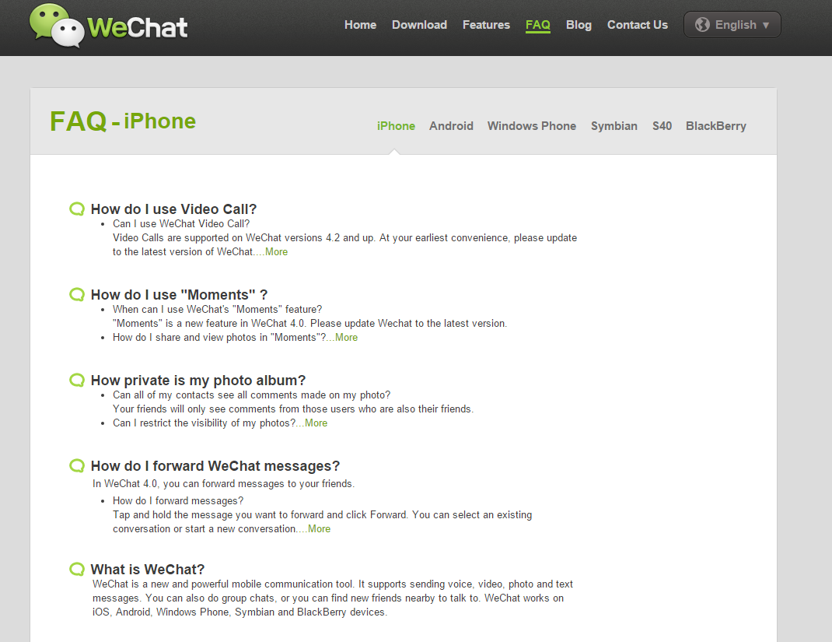
Motivation
  Frequently Asked Question(FAQ)
  FAQs, are listed questions and answers, all supposed to be commonly asked
  in some context, and pertaining to a particular topic. (definition from Wikipedia)
Company FAQ page

Slide 4
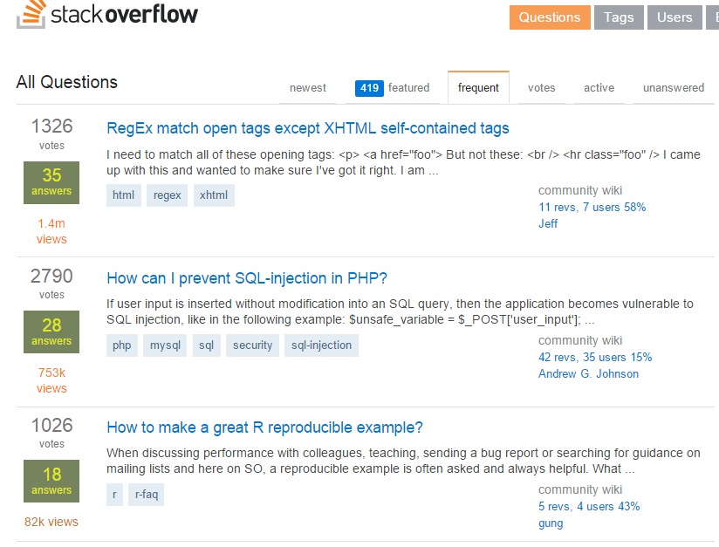
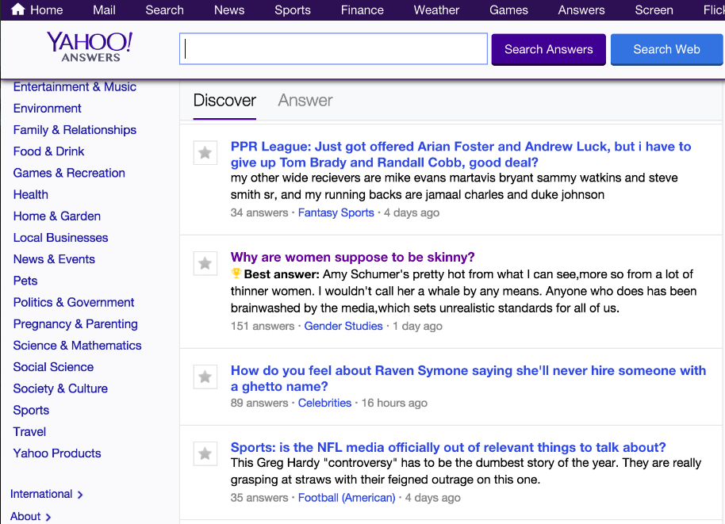
Motivation
  Question Answering Community
Stack Overflaw
Yahoo! Answers

Slide 5
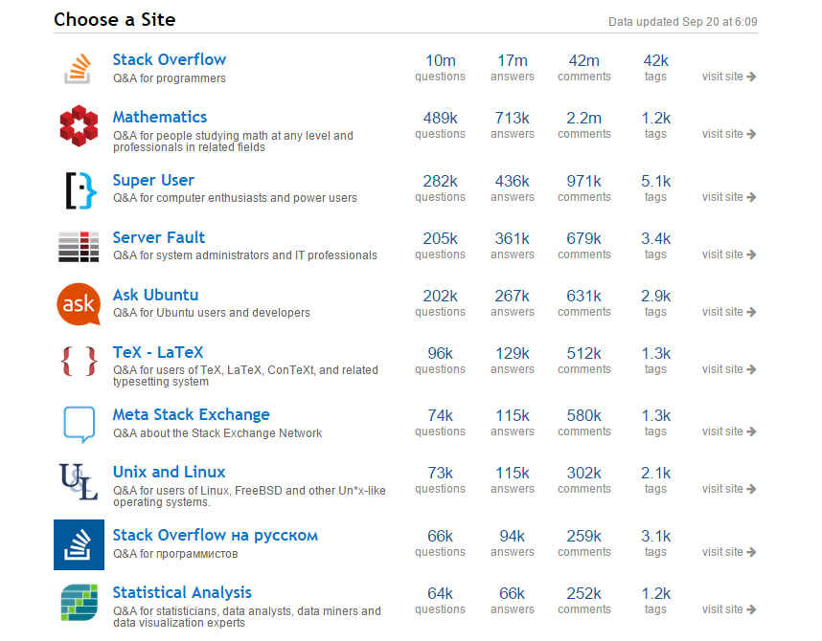
Motivation
_{(StackExchange)}

Slide 6
Motivation
Data gets bigger. (10M+)
Question gets more domain specific. (Products, Coding, etc)
We need an automatic
domain-restricted FAQ answering framework!

Slide 7
Motivation
The Domain Restricted FAQ Answering Task
  Definition 1: QA Pair
    Pair of <Question, Answer>, provided by expert, listed in FAQ set .
  Definition 2: User’s query
    The question asked by user
  Problem 1: FAQ Retrieval
    Given a user query, return the best matched answer from the FAQ set.
Not an easy task

Slide 8
Challenges
_{Question Understanding}
Casual Forms:
  Short
    网银密码忘了
  Informal
    朋友在国外，我可以打电话到银行给他汇钱吗？(from user)
    电话银行对外转账是否支持外币？(from expert)
Diverse Expressions:
  Vocabulary Gap between user and expert
    花钱吗 vs 收费
  Expression variation among users
    花钱吗，要钱吗，有多贵
Special Domain Restriction:
  Domain Knowledge: unavailable and expensive
    95566电话银行
    U盾密码
Notes:
different textual expression of a same meaning
To conclusion, there are 2 problems( next page)

Slide 9
Challenges
How to understand the intension of user?
    朋友在国外，我可以打电话到银行给他汇钱吗？
    手机银行需要花钱吗
How to conquer the domain knowledge?
    95566电话银行
    U盾密码

Slide 10
Challenges
Lexical Form:
  Short : ambiguous
  Informal : hard to parse
Content: Vocabulary Gap between User and Expert
    花钱 vs 收费
  Expression Variation among Users
    花钱，要钱，有多贵
Special Domain Restriction:
  Domain Knowledge: unavailable and expensive
    95566电话银行
    U盾密码
Parsing
Knowledge Base

Slide 11
Challenges
Parser works badly in short & informal text.
KB is too expensive to construct.
Prefer a cheap but effective solution.
Let’s jump into the data.

Slide 12
Observation
The FAQ set:
  通过个人网上银行的跨行快汇功能可否向农业银行汇款？
  通过个人网上银行的跨行快汇功能可否向平安银行汇款？
  个人网上银行中“购买基金”在什么位置？
  如何通过个人网上银行查询工银e支付的转账明细？
One step closer:
  通过个人网上银行的跨行快汇功能可否向农业银行汇款？
  通过个人网上银行的跨行快汇功能可否向平安银行汇款？
  个人网上银行中“购买基金”在什么位置？
  如何通过个人网上银行查询工银e支付的转账明细？

Slide 13




Observation
Vocabulary Space of Specific Domain(e.g. Bank)
Specific Domain Terms
Open Domain Terms
FAQ Corpus
Categories
Stop
Words
Domain Knowledge
Normal
Expression
Properties
  Example: 如何通过个人网上银行查询工银e支付的转账明细？

Slide 14
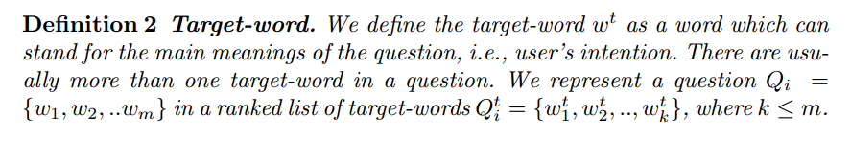
Problem Definition
  Example:
  通过个人网上银行的跨行快汇功能可否向农业银行汇款？

Slide 15
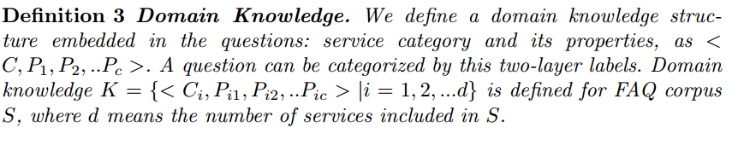
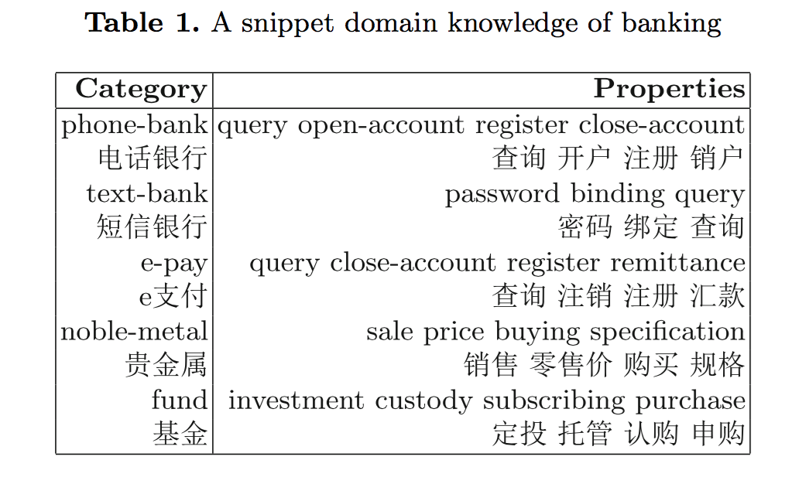
Problem Definition
  Example:

Slide 16
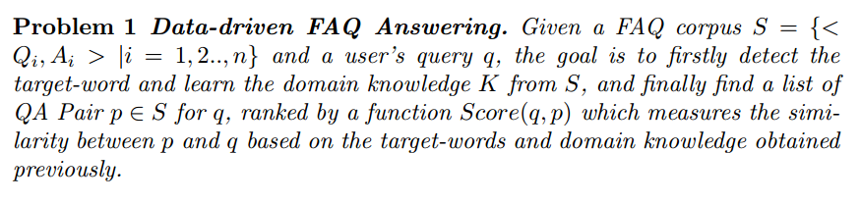
Problem Definition

Slide 17
Main Tasks
Task 1. Target-word Detection
  Logistic Regression Classification
Task 2. Domain Knowledge Learning
  FAQ Clustering
  Terminology Extraction
Task 3. Answer Retrieval
  Query Classification
  Target-word Based BM25 Ranking

Slide 18
Framework
Semi-automated Domain-restricted
FAQ Answering Framework (SDFA)

Slide 19
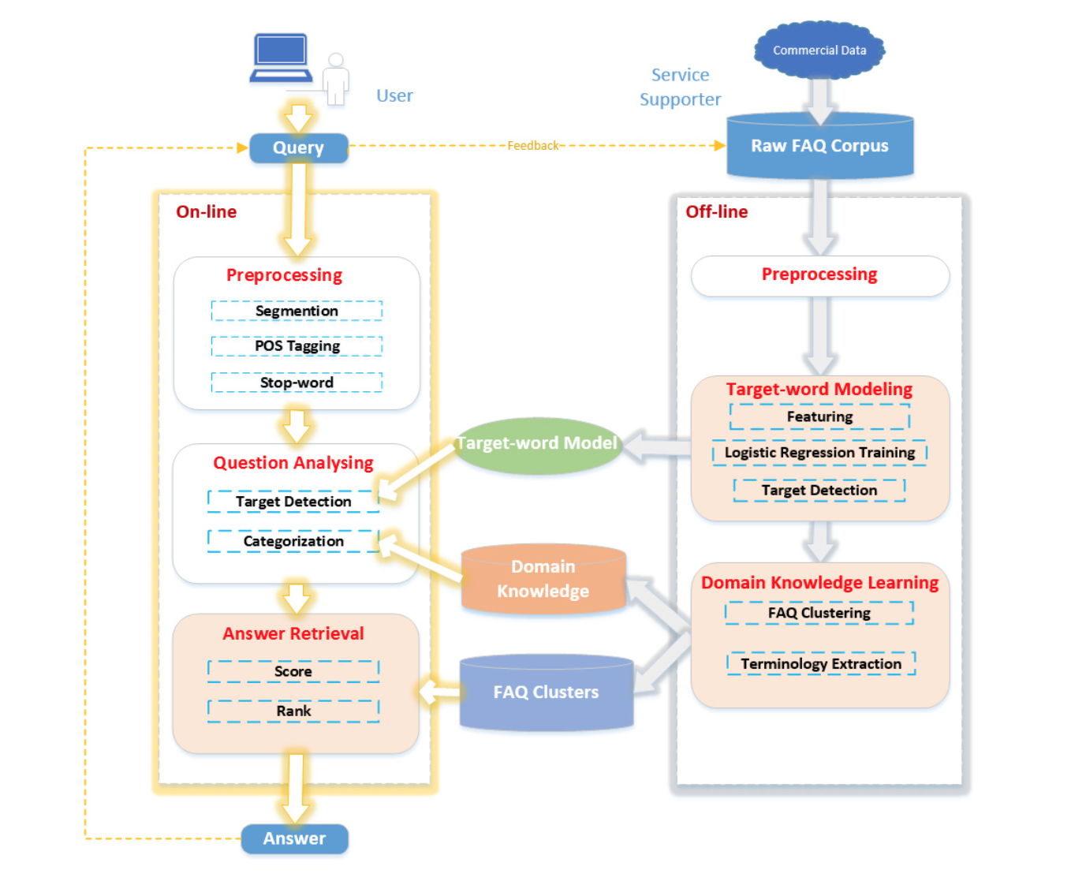

Slide 20
Main Tasks
Task 1. Target-word Detection
  Logistic Regression Classification
Task 2. Domain Knowledge Learning
  FAQ Clustering
  Terminology Extraction
Task 3. Answer Retrieval
  Query Classification
  Target-word Based BM25 Ranking

Slide 21
Target-word Detection
Supervised Classification
  Logistic Regression
  Word Features
Ask three student to label the Target-word
training set.
Lexical Features | Semantic Features
BOW Position Length Term Frequency in Corpus | POS tag of Wi-1 POS tag of Wi POS tag of Wi+1

Slide 22
Main Tasks
Task 1. Target-word Detection
  Logistic Regression Classification
Task 2. Domain Knowledge Learning
  FAQ Clustering
  Terminology Extraction
Task 3. Answer Retrieval
  Query Classification
  Target-word Based BM25 Ranking

Slide 23
Domain Knowledge Learning
Step 1: Cluster the FAQ set
  partition the corpus into categories
    DBSCAN
Step 2: Extract the terminology
  distill the two-layer terminology structure of a service
    Top-1 target-word of the cluster => category
    Top-N target-words of the cluster => properties
    Manually check again, guided by the target-words

Slide 24
Main Tasks
Task 1. Target-word Detection
  Logistic Regression Classification
Task 2. Domain Knowledge Learning
  FAQ Clustering
  Terminology Extraction
Task 3. Answer Retrieval
  Query Classification
  Target-word Based BM25 Ranking

Slide 25
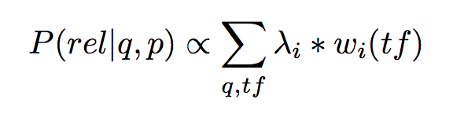
Answer Retrieval
Step1: Categorize user’s query based on domain knowledge
  the relevant documents should have the same categories and properties
Step2: Find the related QA Pair by the target-word based BM25 algorithm.
  overlap target-word will be rewarded
  different target-word will be punished
Notes:
To be specific, if the
term is a target word of the question, it will be rewarded; otherwise, when the
term that only occurs in the QA pair is also a target word, it will be punished.
To differentiate the importance of standard question and extended question

Slide 26
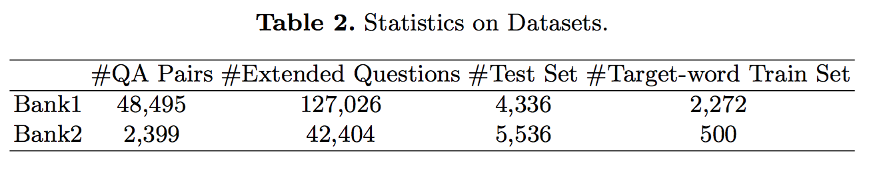
Experiment
Data
  Two Chinese Bank FAQ Corpus

Slide 27
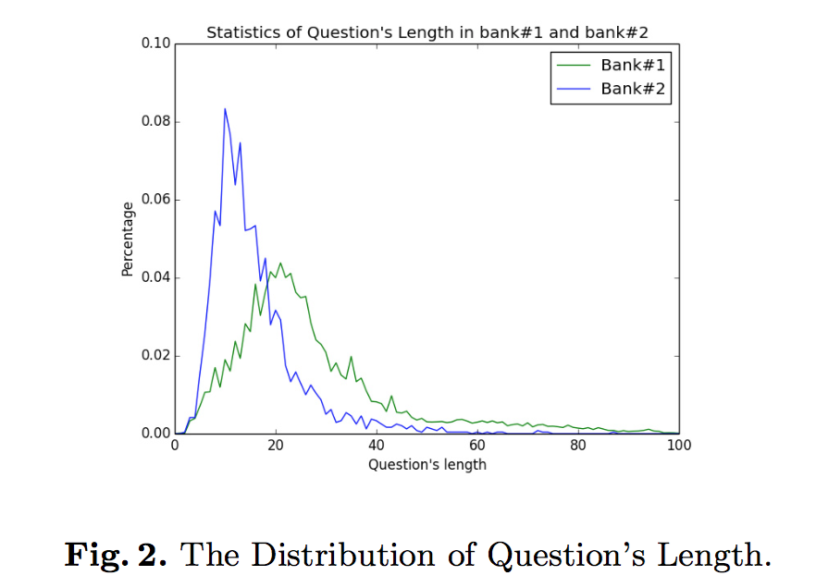
Experiment
Data
  Two Chinese Bank FAQ Corpus
Notes:
Average: In our corpora, the average question lengths are about 20 and 10 Chinese characters
respectively

Slide 28
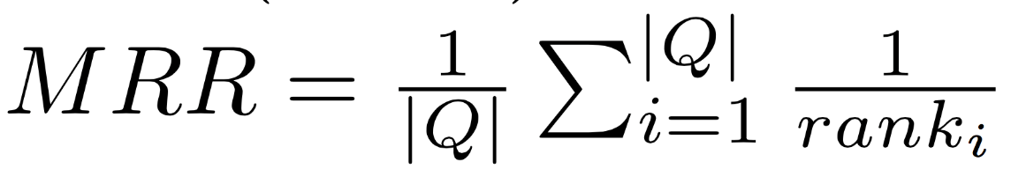
Experiment
Evaluation Measures
  Precision @1
  Precision @5
  Mean Reciprocal Rank(MRR)

Slide 29
Experiment
Experiments Design
  Baseline:
    Cosine
    BM25
  Target-word Model Testing:
    BM25 vs BM25t
  Domain Knowledge Validation:
    BM25t vs BM25t+Class
  Whole Framework:
    BM25t+Class+Punish
Notes:
To be specific, if the
term is a target word of the question, it will be rewarded; otherwise, when the
term that only occurs in the QA pair is also a target word, it will be punished.
To differentiate the importance of standard question and extended questi

Slide 30
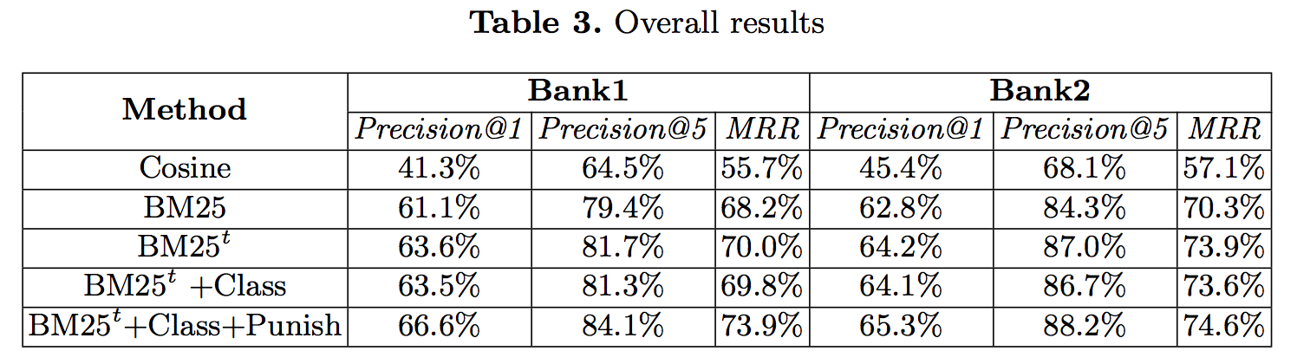
Experiment
Result

Slide 31
Conclusion
A semi-automatic FAQ answering framework: SDFA
  Score the target-word to detect user’s intention
  Cluster the FAQ corpus to learn a light-weight domain-knowledge structure
  Rank QA pairs by target-word based BM25
Data-driven fashion
  Sometime, the data itself carries abundant knowledge, good enough for the end-to-end application.
Notes:
In our research, we propose a semi-automatic domain-restricted FAQ answering
framework SDFA, without relying on any external resources. SDFA detects the
targets of questions to assist both the fast domain knowledge learning and the
answer retrieval. The proposed framework has been successfully applied in real
project on bank domain. Extensive experiments on two large datasets demonstrate the effectiveness and efficiency of the approaches.

Slide 32
Thank you. Question?

