Slide 1
Using Data Analytics to Inform and Improve WTWY Fundraising and Outreach
Matt Ryan

Slide 2
THE PROBLEM
01
02
03
MOTIVATION
OBJECTIVES
GOALS
WTWY is looking to expand their expand their reach, raise awareness, and attract a large gala turnout
Use the data available to us to provide unique insights into our problem
Provide actionable recommendations based on our newfound understandings

Slide 3
METHODOLOGY
Start with our dataset:
  NYC subway turnstile data from Jan 2021 to Aug 2021
Tools:
  SQLAlchemy to bring the data in
  Pandas and numpy to sanitize and manipulate our data
  Matplotlib to visualize our data
  SQLite for higher level data exploration

Slide 4
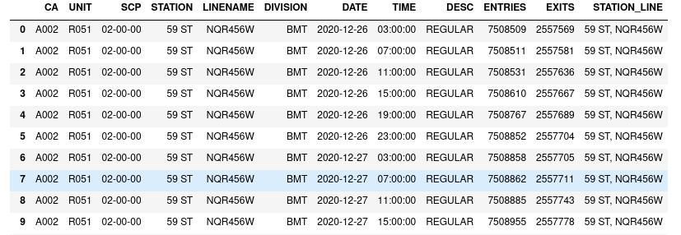
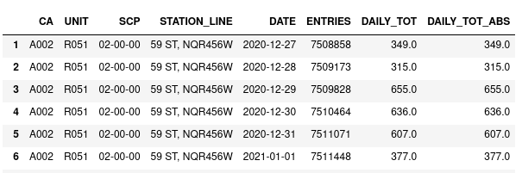
METHODOLOGY
RAW DATA
NEW DATA
DATA MAGIC
(EDA CLEANING AND MANIPULATION)

Slide 5
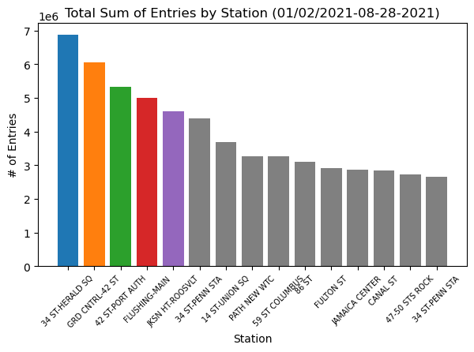
RESULTS

Slide 6
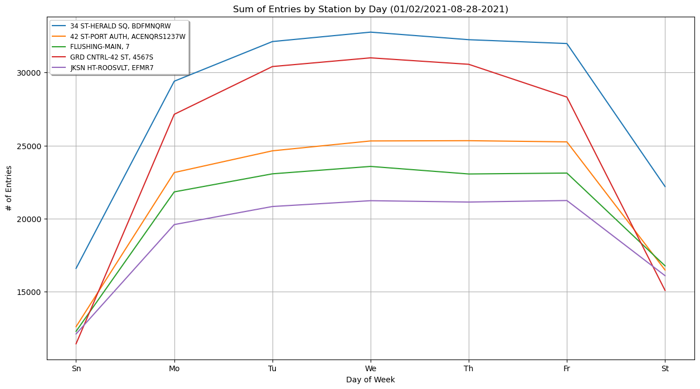
RESULTS

Slide 7
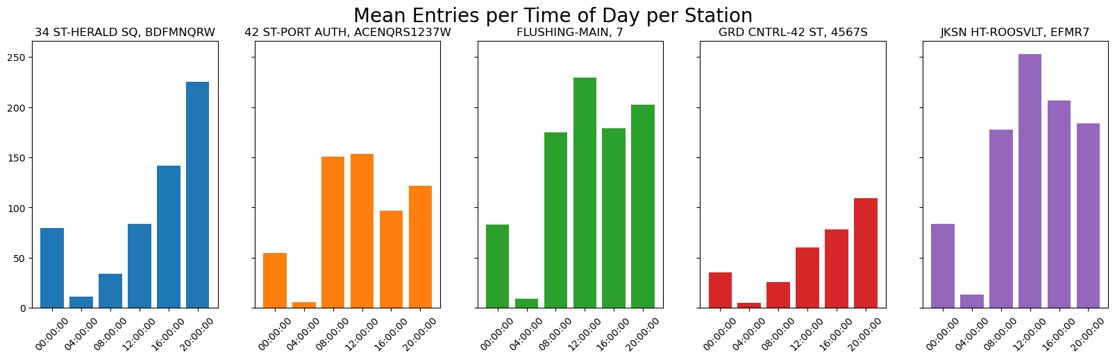
RESULTS

Slide 8
CONCLUSIONS
Target the 5 high volume stations with street teams
The middle/end of the work week is consistently high volume across all 5 stations
Focus night teams on 34 St – Herald; Flushing – Main and Jksn Ht – Roosevelt see big influxes around noon

Slide 9
FUTURE WORK
Further sanitization of data
Deeper investigation into trends or relation to events
Potential to tie in US Census Data
  Look to areas with higher women/men ratios
  Using median income by zipcode to target deeper pockets or people who might need a leg up

Slide 10
THANK YOU

Slide 11
APPENDIX
RESOURCES
Github Repo
MTA Data

