Slide 1

PREDICTING THE WIN
CLASSIFICATION UNIT
OF METIS DSML -
MATT RYAN
2021

Slide 2
OVERVIEW

Slide 3
OVERVIEW
THE GAME
League of Legends is one of the most popular video games in the world, with a reported monthly active player-base of ~115 million players as of 2020 and a peak concurrent player-count in Sept. 2021 of over 2 million players
THE SPORT
As an e-sport, League of Legends has shown immense growth over the past decade, with the 2020 League of Legends World Championship finals reaching a peak concurrent viewership of 49.5 million viewers
THE DATA SCIENCE APPLICATION
With traditional sportscast level viewership, we want traditional sportscast professionalism. To strengthen the analytics tools available to the casting team, we want to design an application that predicts the probability that a team will win a game based on the current in-game conditions
Notes:
-how big it is, 115 million
-similarly as an esport growth over past 10 years, compare to super bowl
- Provide another tool in the tool shed of casting team to analyze games
try to hit in 1:15 minute

Slide 4
METHODOLOGY

Slide 5

DATA
METHODOLOGY
Initial data:
11,604 pro games from 2021
12 data-points per game
138,528 data-points
122 columns
After EDA/cleaning:
10,538 games
2 data-points per game, one from each team’s perspective
14 features, describing state of game at 15 minutes
Notes:
- Quick overview of initial data
Feature selection/engineering
15 mins

Slide 6
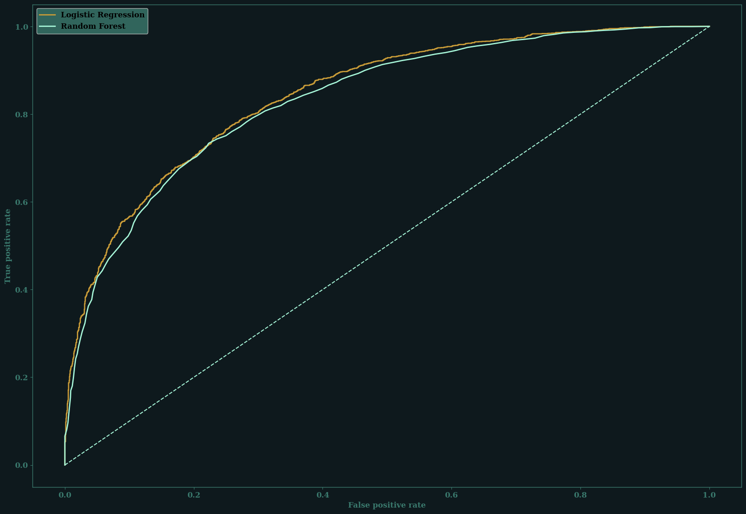
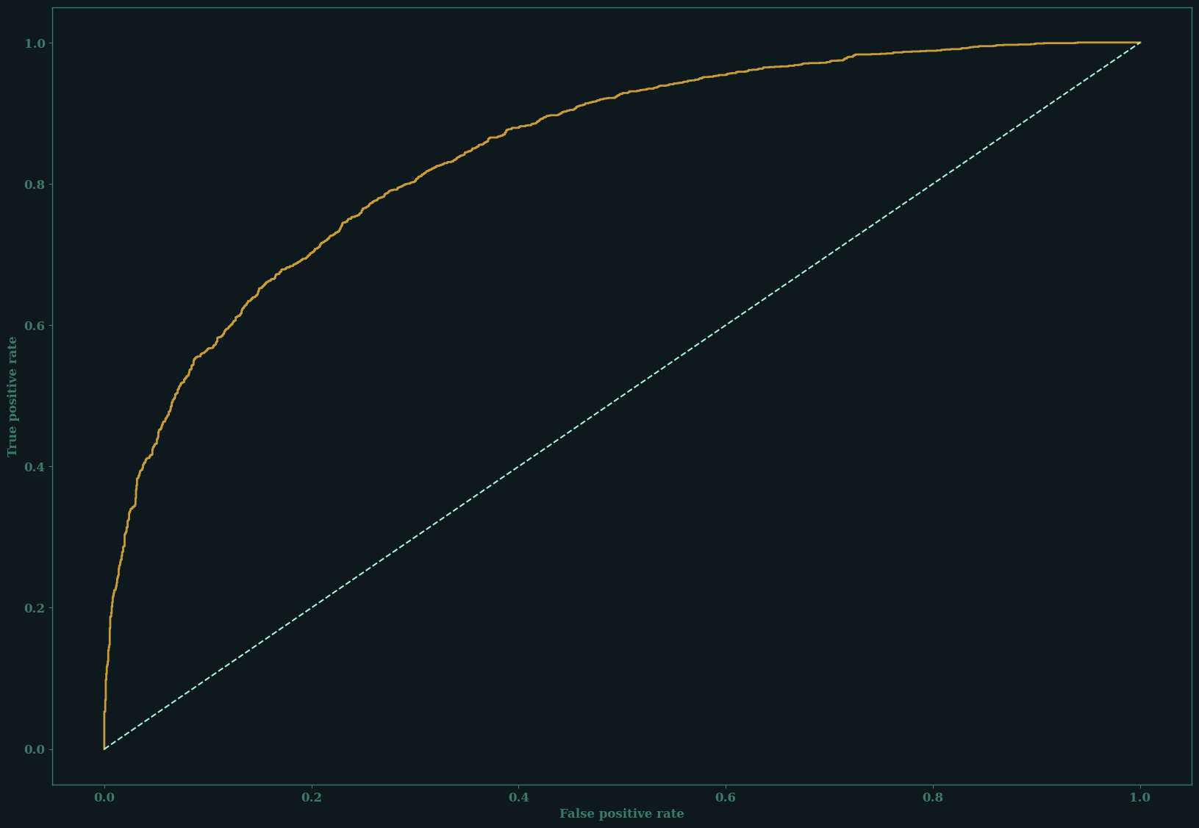
MODELING
ROC Curve
METHODOLOGY
Started with a simple logistic regression model predicting hard classifications
After using cross-validation to determine the best level of complexity, our model was trained on our training data
Decision threshold was set at 50%
Notes:
Hit by 2:45
Strengths of each model

Slide 7
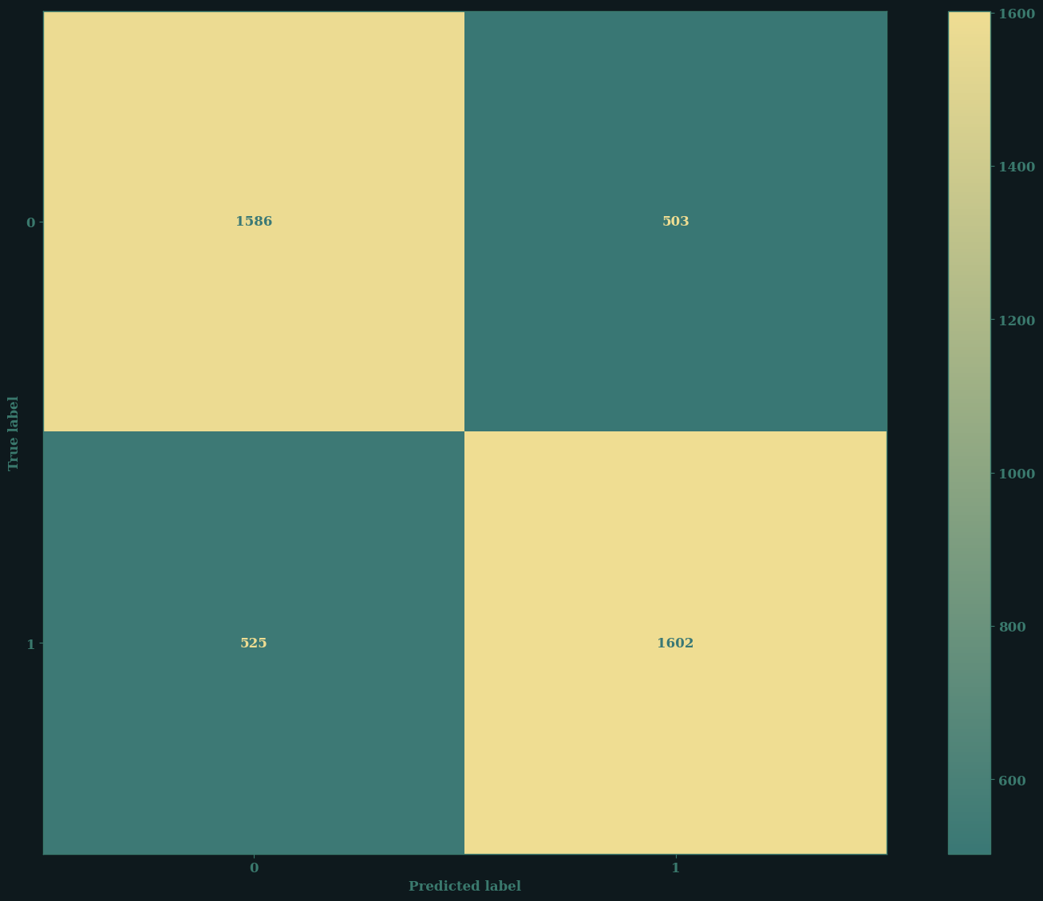
EVALUATION
Confusion Matrix
METHODOLOGY
Using a standard 50% decision threshold, our models accuracy was 76%
Roughly equal distribution of false positives and false negatives

Slide 8
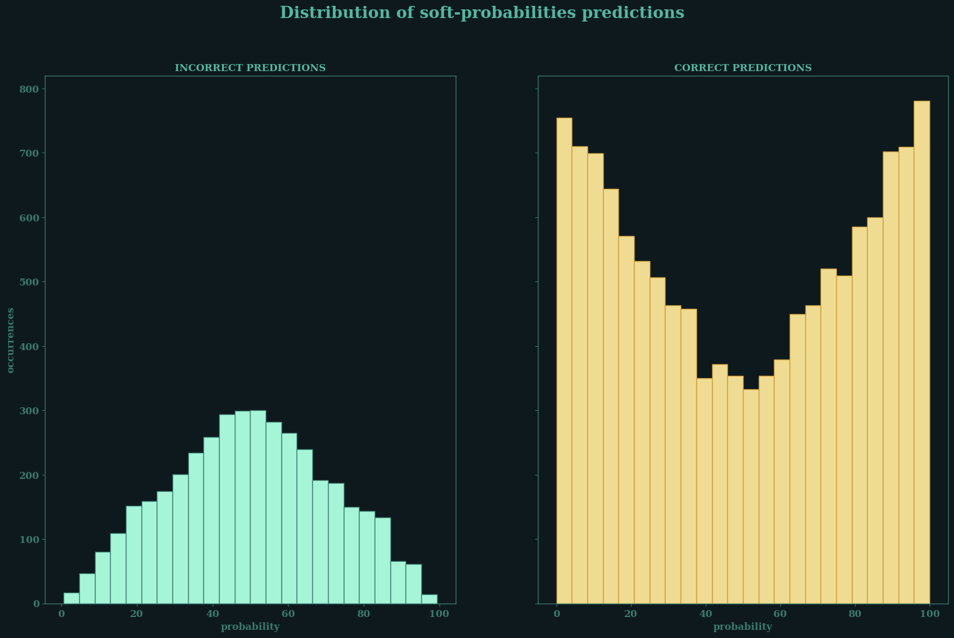
EVALUATION
METHODOLOGY
Most incorrect predictions centered around 50% probability
False positives had a mean predicted probability of ~67%
False negatives had a mean predicted probability of ~34%
Notes:
Hit by 4:15-4:30

Slide 9
ANALYSIS

Slide 10
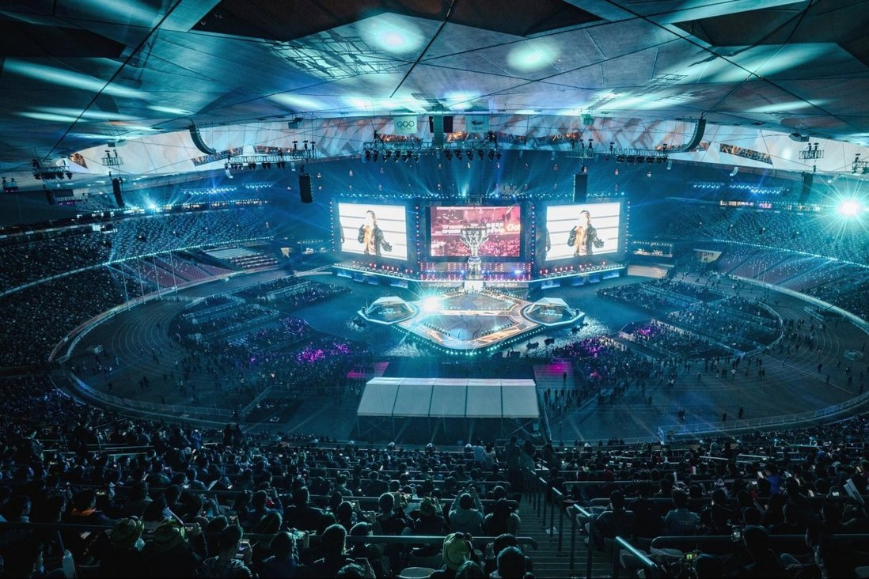
TAKEAWAYS
ANALYSIS
We are confident this tool can be used by e-sports casters in assessing games, with any level of inaccuracy allowing for interesting discussion by casters
LOOKING FORWARD
Dive deeper into false positives and negatives
Use stats at 10 minutes to assess win probability at earlier in the game
Potential to implement this model on all player-base games to help inform game balance decisions
Notes:
Closing thoughts, confident it would be a good tool,
- level of accuracy provides credibility

Slide 11

CONTACTS
CLOSING
matthewryan33@gmail.com
/maneaterrbug
/matt-mcg-ryan
THANK YOU

Slide 12
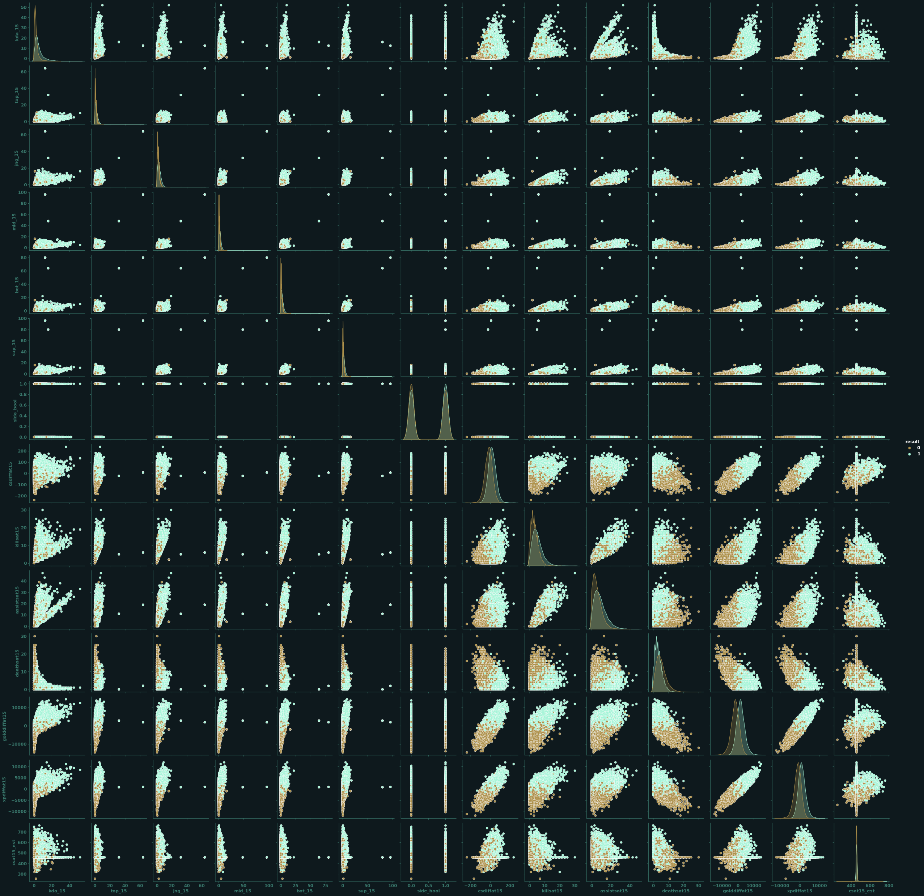
APPENDIX

Slide 13
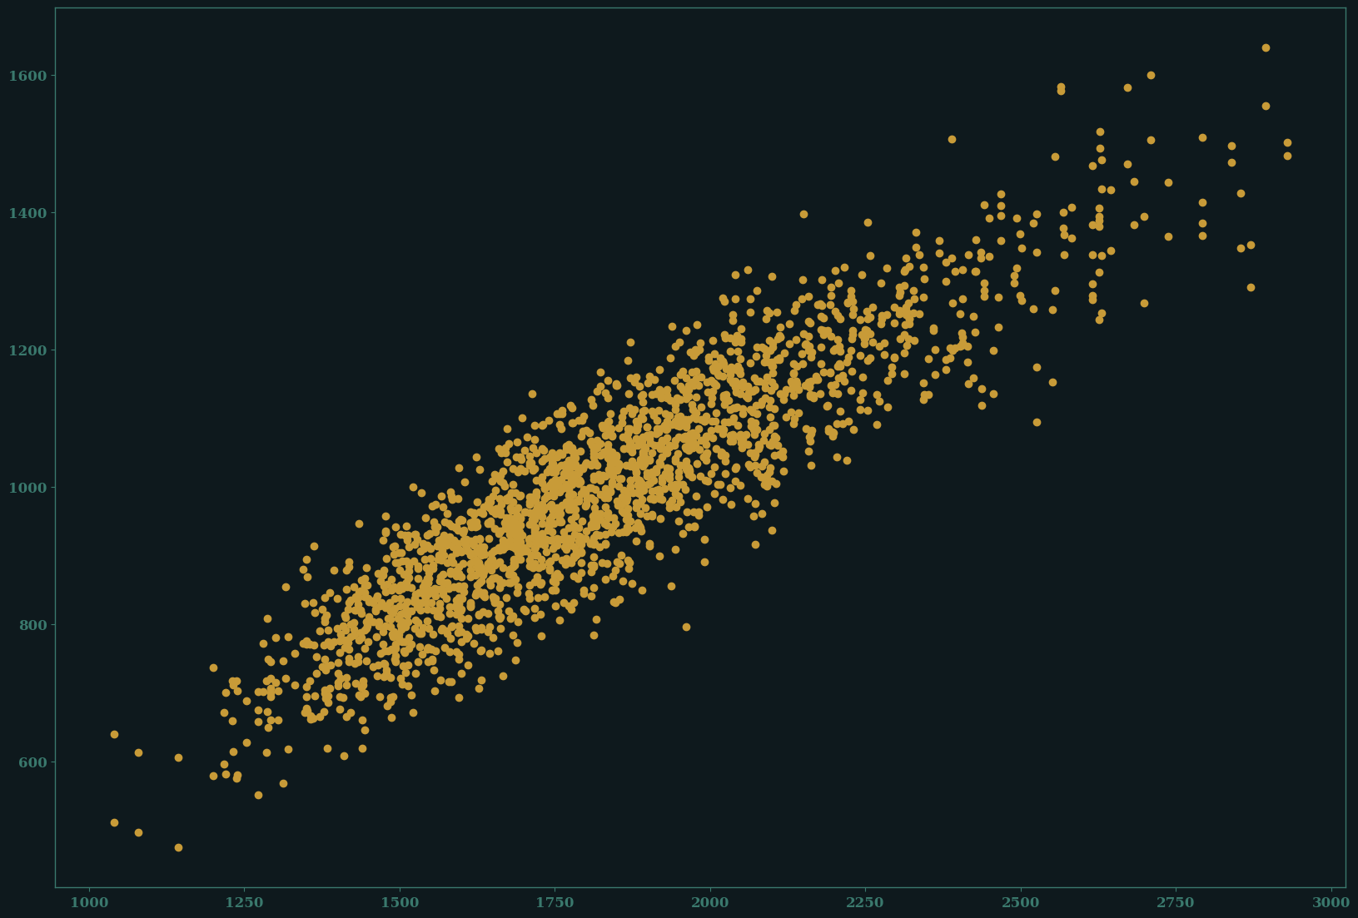
APPENDIX II
Lin_reg coef = .5088

