Slide 1
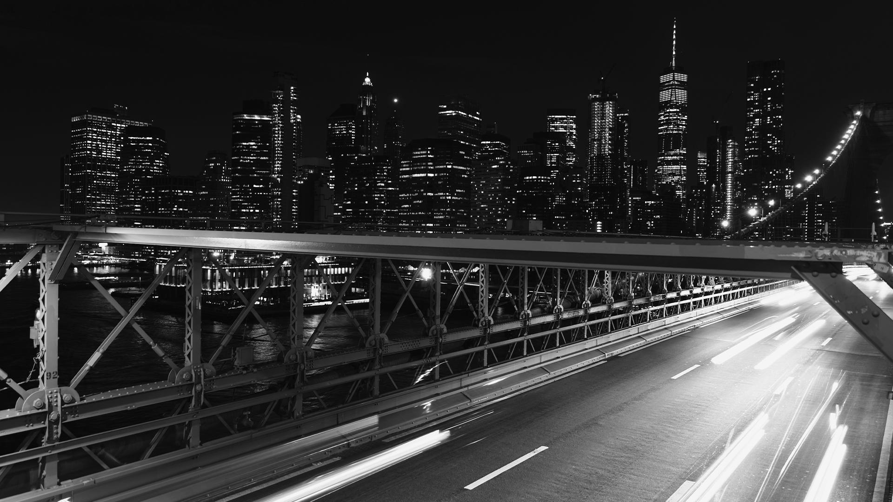
TRANSPORT APP
Here is where your route begins

Slide 2
CONTENTS OF THIS TEMPLATE
Here’s what you’ll find in this Slidesgo template:
A slide structure based on a pitch deck, which you can easily adapt to your needs. For more info on how to edit the template, please visit Slidesgo School or read our FAQs.
An assortment of pictures that are suitable for use in the presentation can be found in the alternative resources slide.
A thanks slide, which you must keep so that proper credits for our design are given.
A resources slide, where you’ll find links to all the elements used in the template.
Instructions for use.
Final slides with:
The fonts and colors used in the template.
More infographic resources, whose size and color can be edited.
Sets of customizable icons of the following themes: general, business, avatar, creative process, education, help & support, medical, nature, performing arts, SEO & marketing, and teamwork.
You can delete this slide when you’re done editing the presentation.

Slide 3
01
Problem vs. Solution
02
All About the Product
03
Market and Competition
04
Our Business Model
Here you could describe the topic of the section
Here you could describe the topic of the section
Here you could describe the topic of the section
Here you could describe the topic of the section

Slide 4
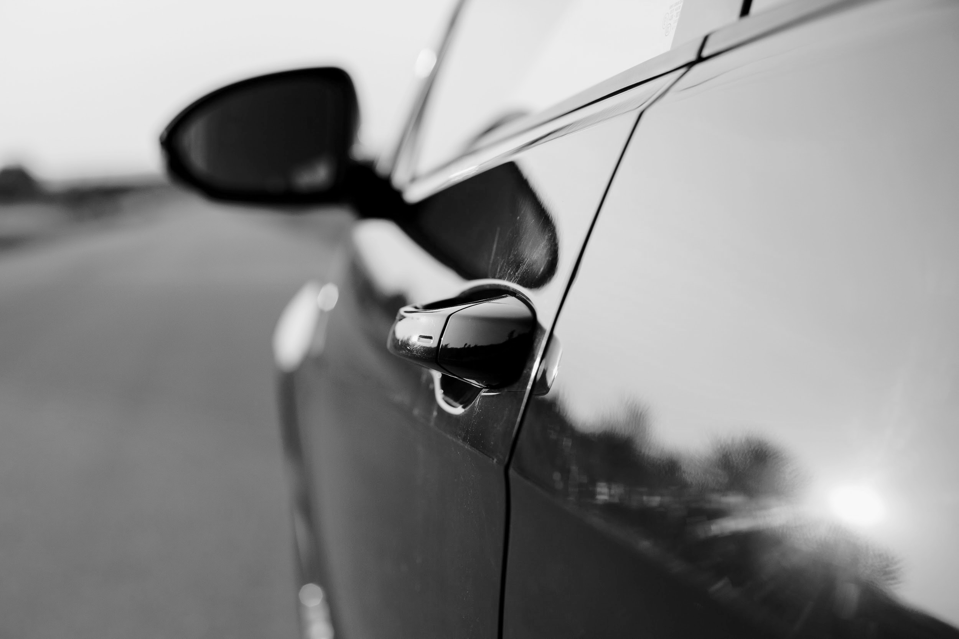
INTRODUCTION
Mercury is the closest planet to the Sun and the smallest one in the Solar System—it’s only a bit larger than the Moon. The planet’s name has nothing to do with the liquid metal

Slide 5
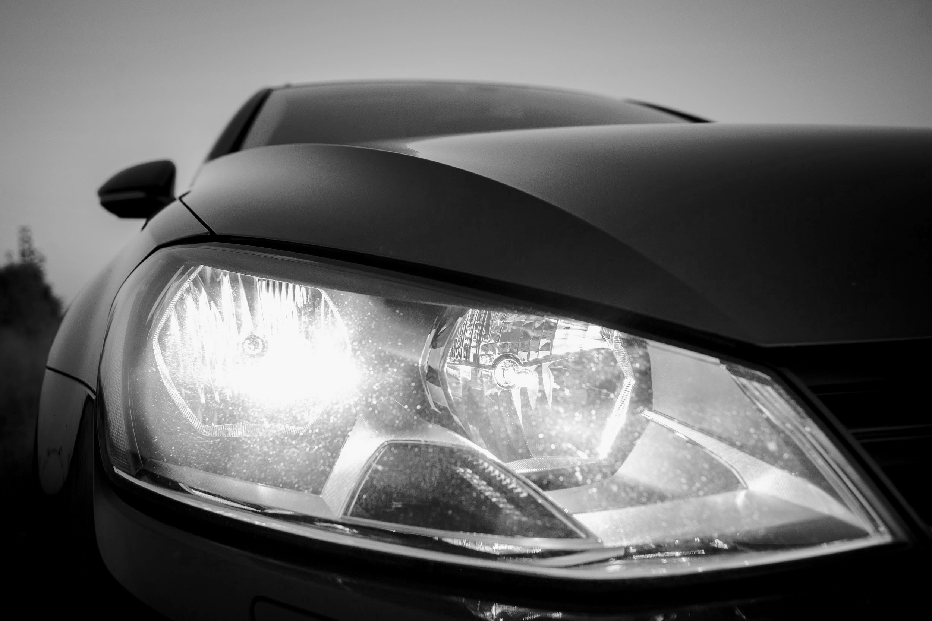
01
PROBLEM VS. SOLUTION
You could enter a subtitle here if you need it

Slide 6
OUR COMPANY
TRANSPORT APP
Mercury is the closest planet to the Sun and the smallest one in the Solar System—it’s only a bit larger than the Moon. The planet’s name has nothing to do with the liquid metal

Slide 7
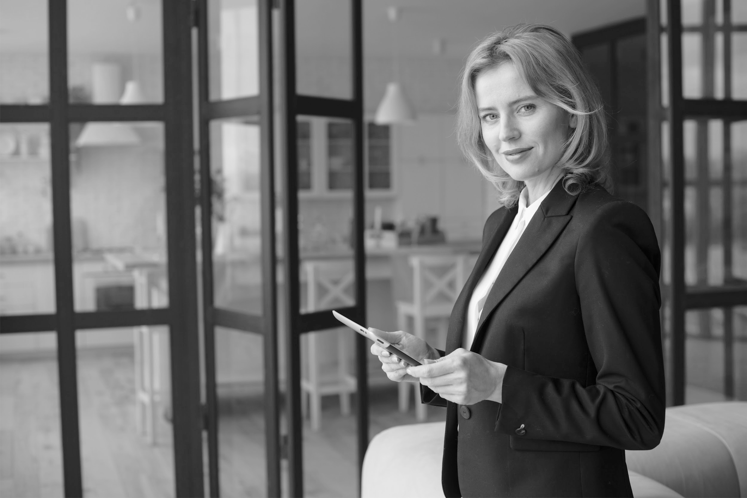

OUR TEAM
Jenna Doe
Jane Patterson
You can replace the image on the screen with your own
You can replace the image on the screen with your own

Slide 8
PROBLEM
Mercury is the closest planet to the Sun and the smallest one in the Solar System—in fact, it’s only a bit larger than the Moon. Contrary to popular belief, the planet’s name has nothing to do with the liquid metal, since Mercury was named after the Roman messenger god

Slide 9
THEM
US
Jupiter is a gas giant, the biggest planet in the Solar System and the fourth-brightest object in the sky
Venus has a beautiful name and is the second planet from the Sun. It’s
terribly hot, even hotter than Mercury

Slide 10
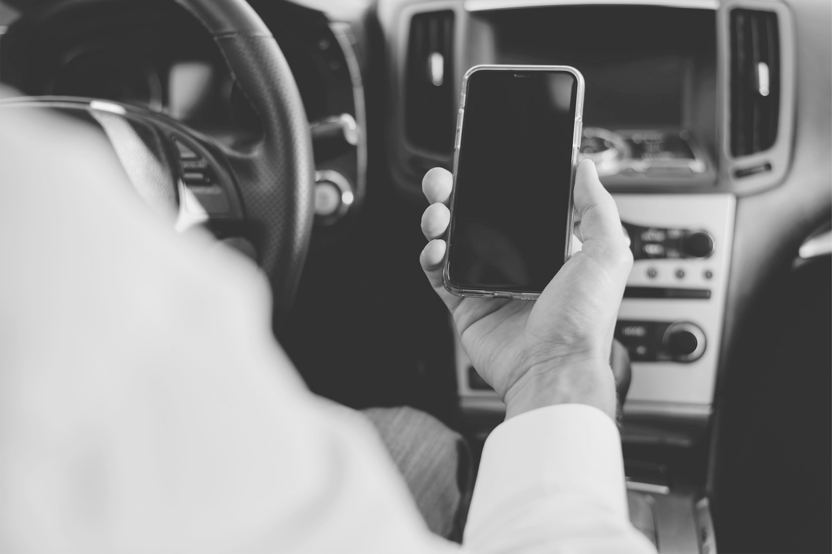
SOLUTION
Venus has a beautiful name and is the second planet from the Sun. It’s terribly hot—even hotter than Mercury—and its atmosphere is extremely poisonous. It’s the
second-brightest natural object in the night sky after the Moon

Slide 11
SWOT ANALYSIS
WEAKNESSES
THREATS
STRENGTHS
OPPORTUNITIES
Venus is the second planet from the Sun
Saturn is a gas giant and has several rings
Despite being red, Mars is actually a cold place
Jupiter is the biggest planet in our Solar System

Slide 12
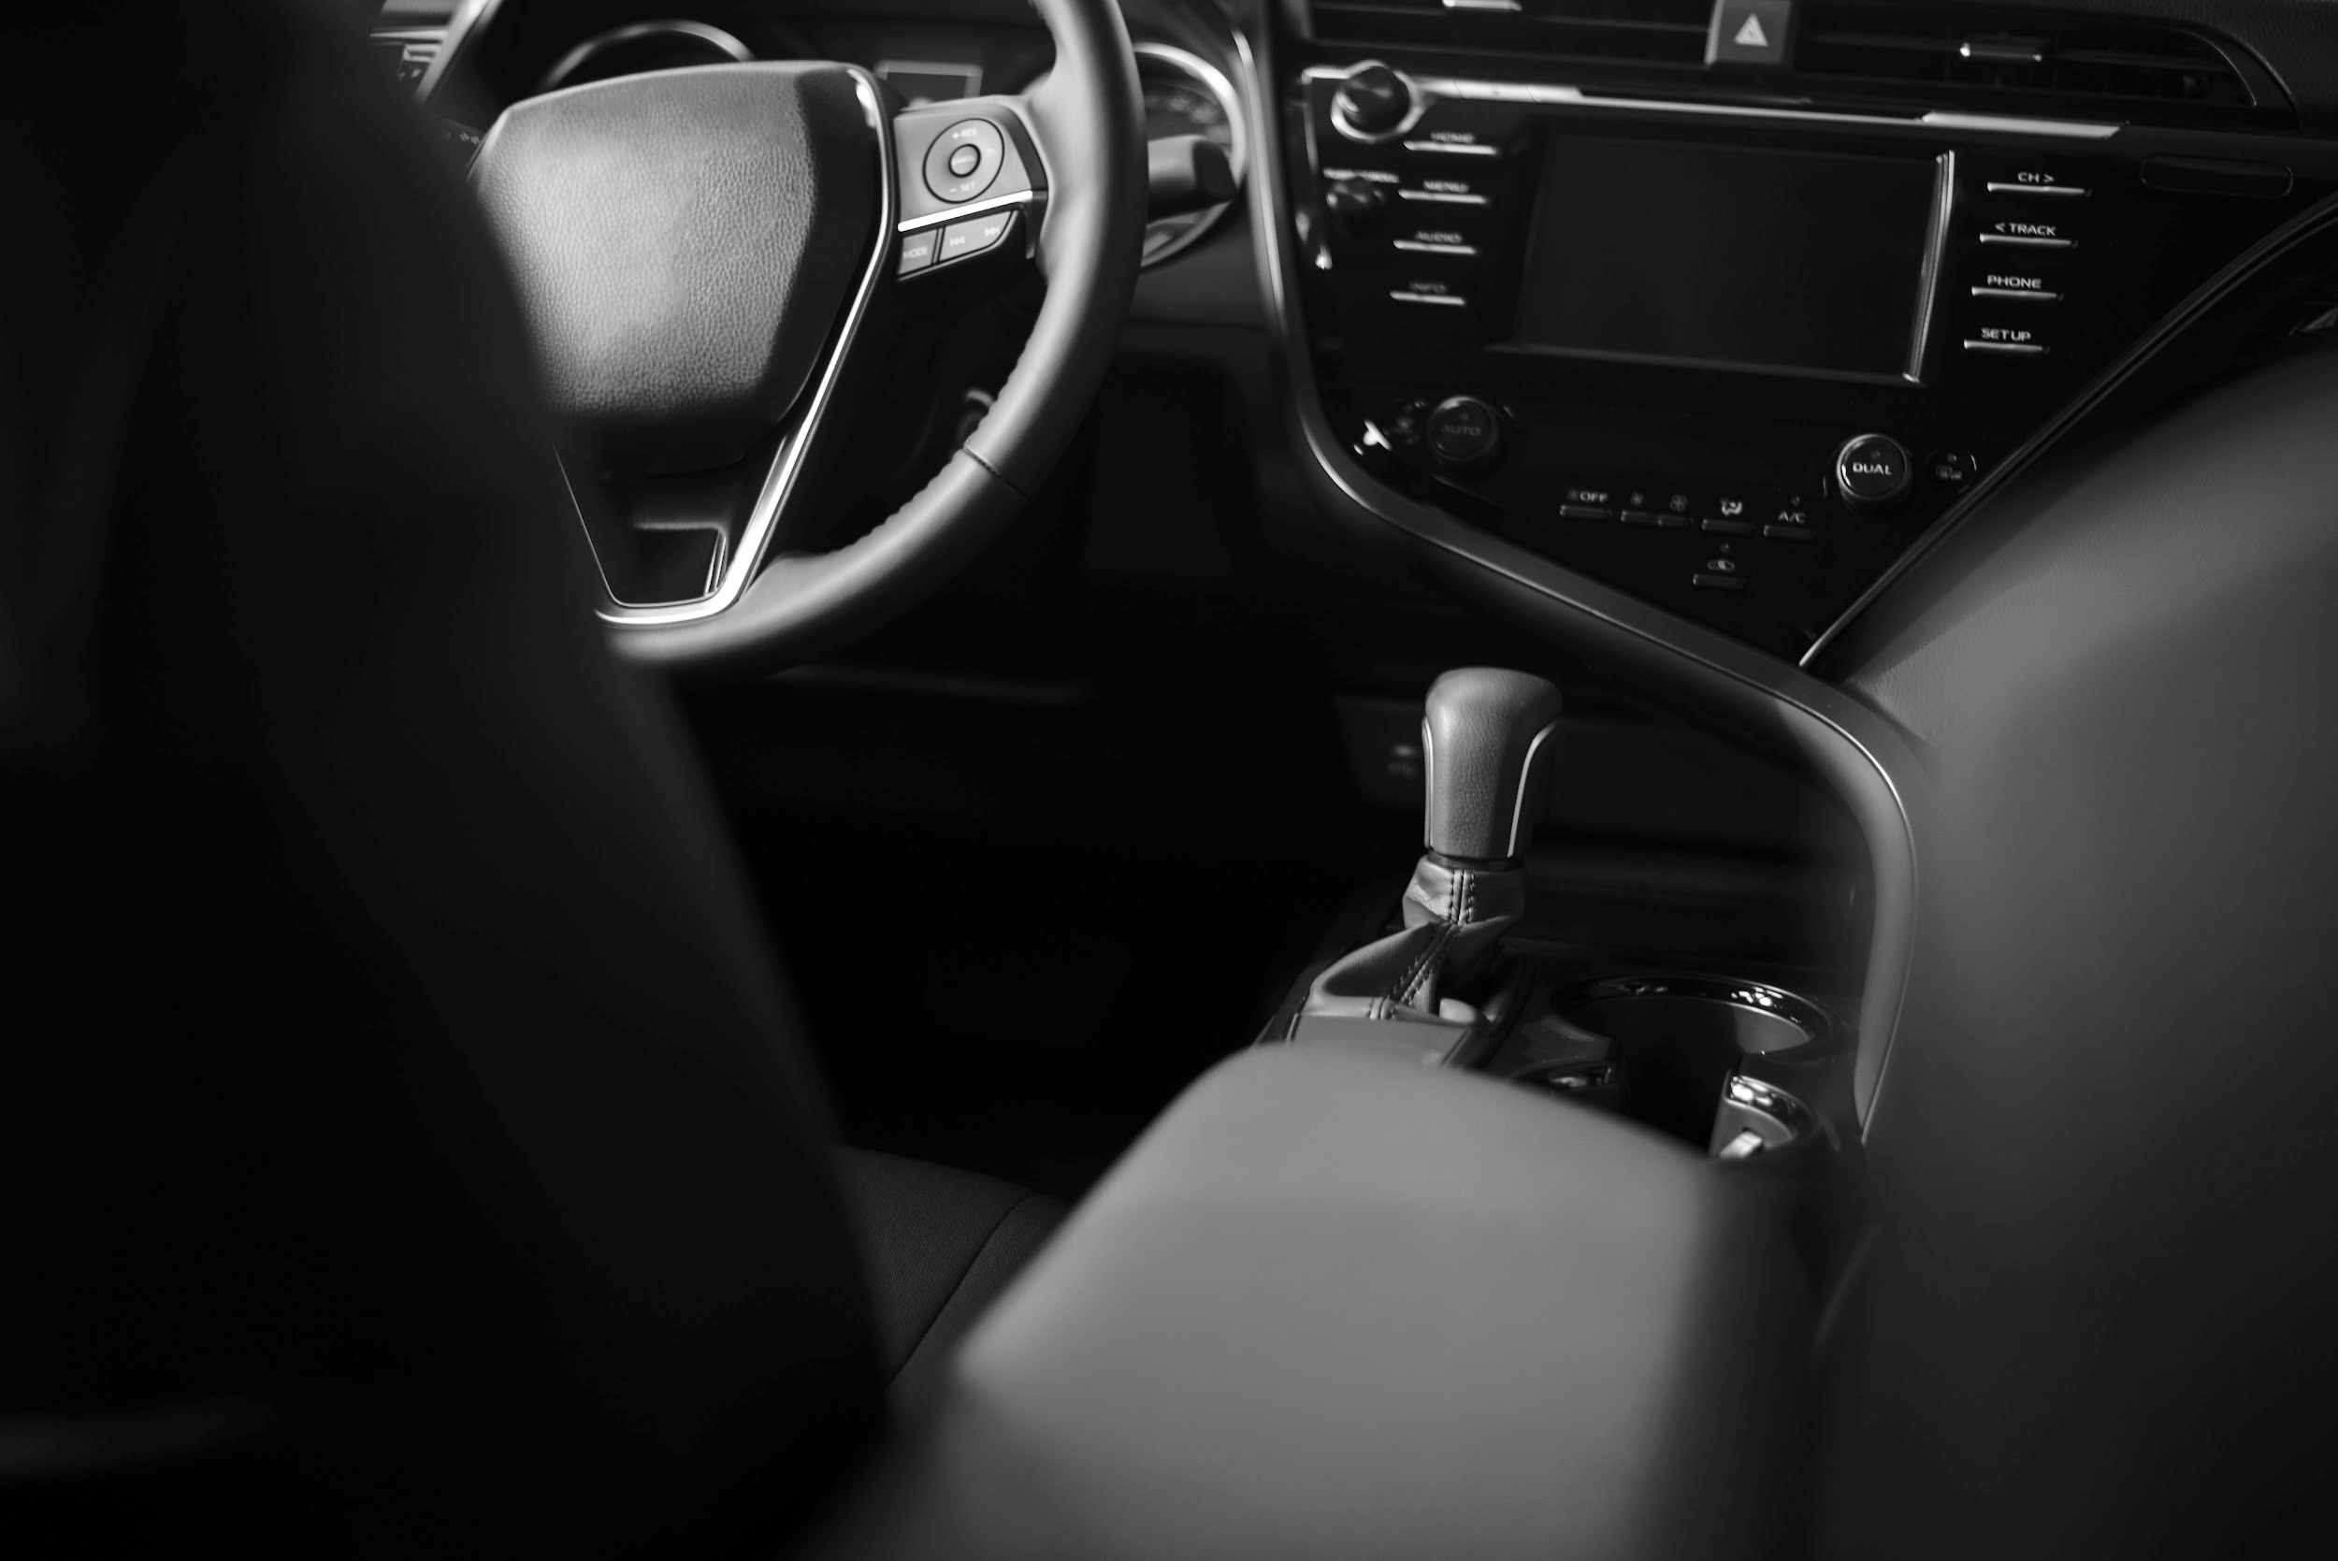
PRODUCT OVERVIEW
Saturn is a gas giant and has several rings
Here you can list the features of the transport app
Here you can list the features of the transport app
Here you can list the features of the transport app
Here you can list the features of the transport app

Slide 13
OUR PLANS
BASIC
PRO
PREMIUM
Feature 1
Feature 2
Feature 3
Feature 1
Feature 2
Feature 3
Feature 1
Feature 2
Feature 3
$19.99
$39.99
$79.99

Slide 14
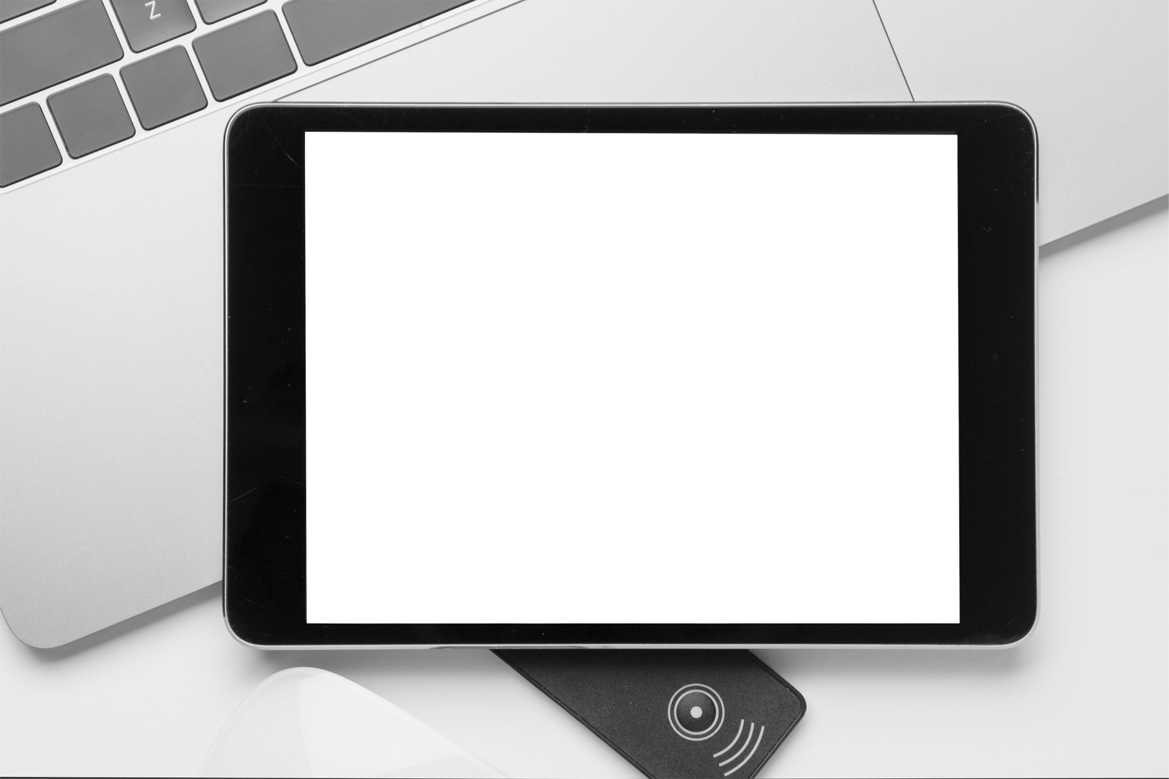
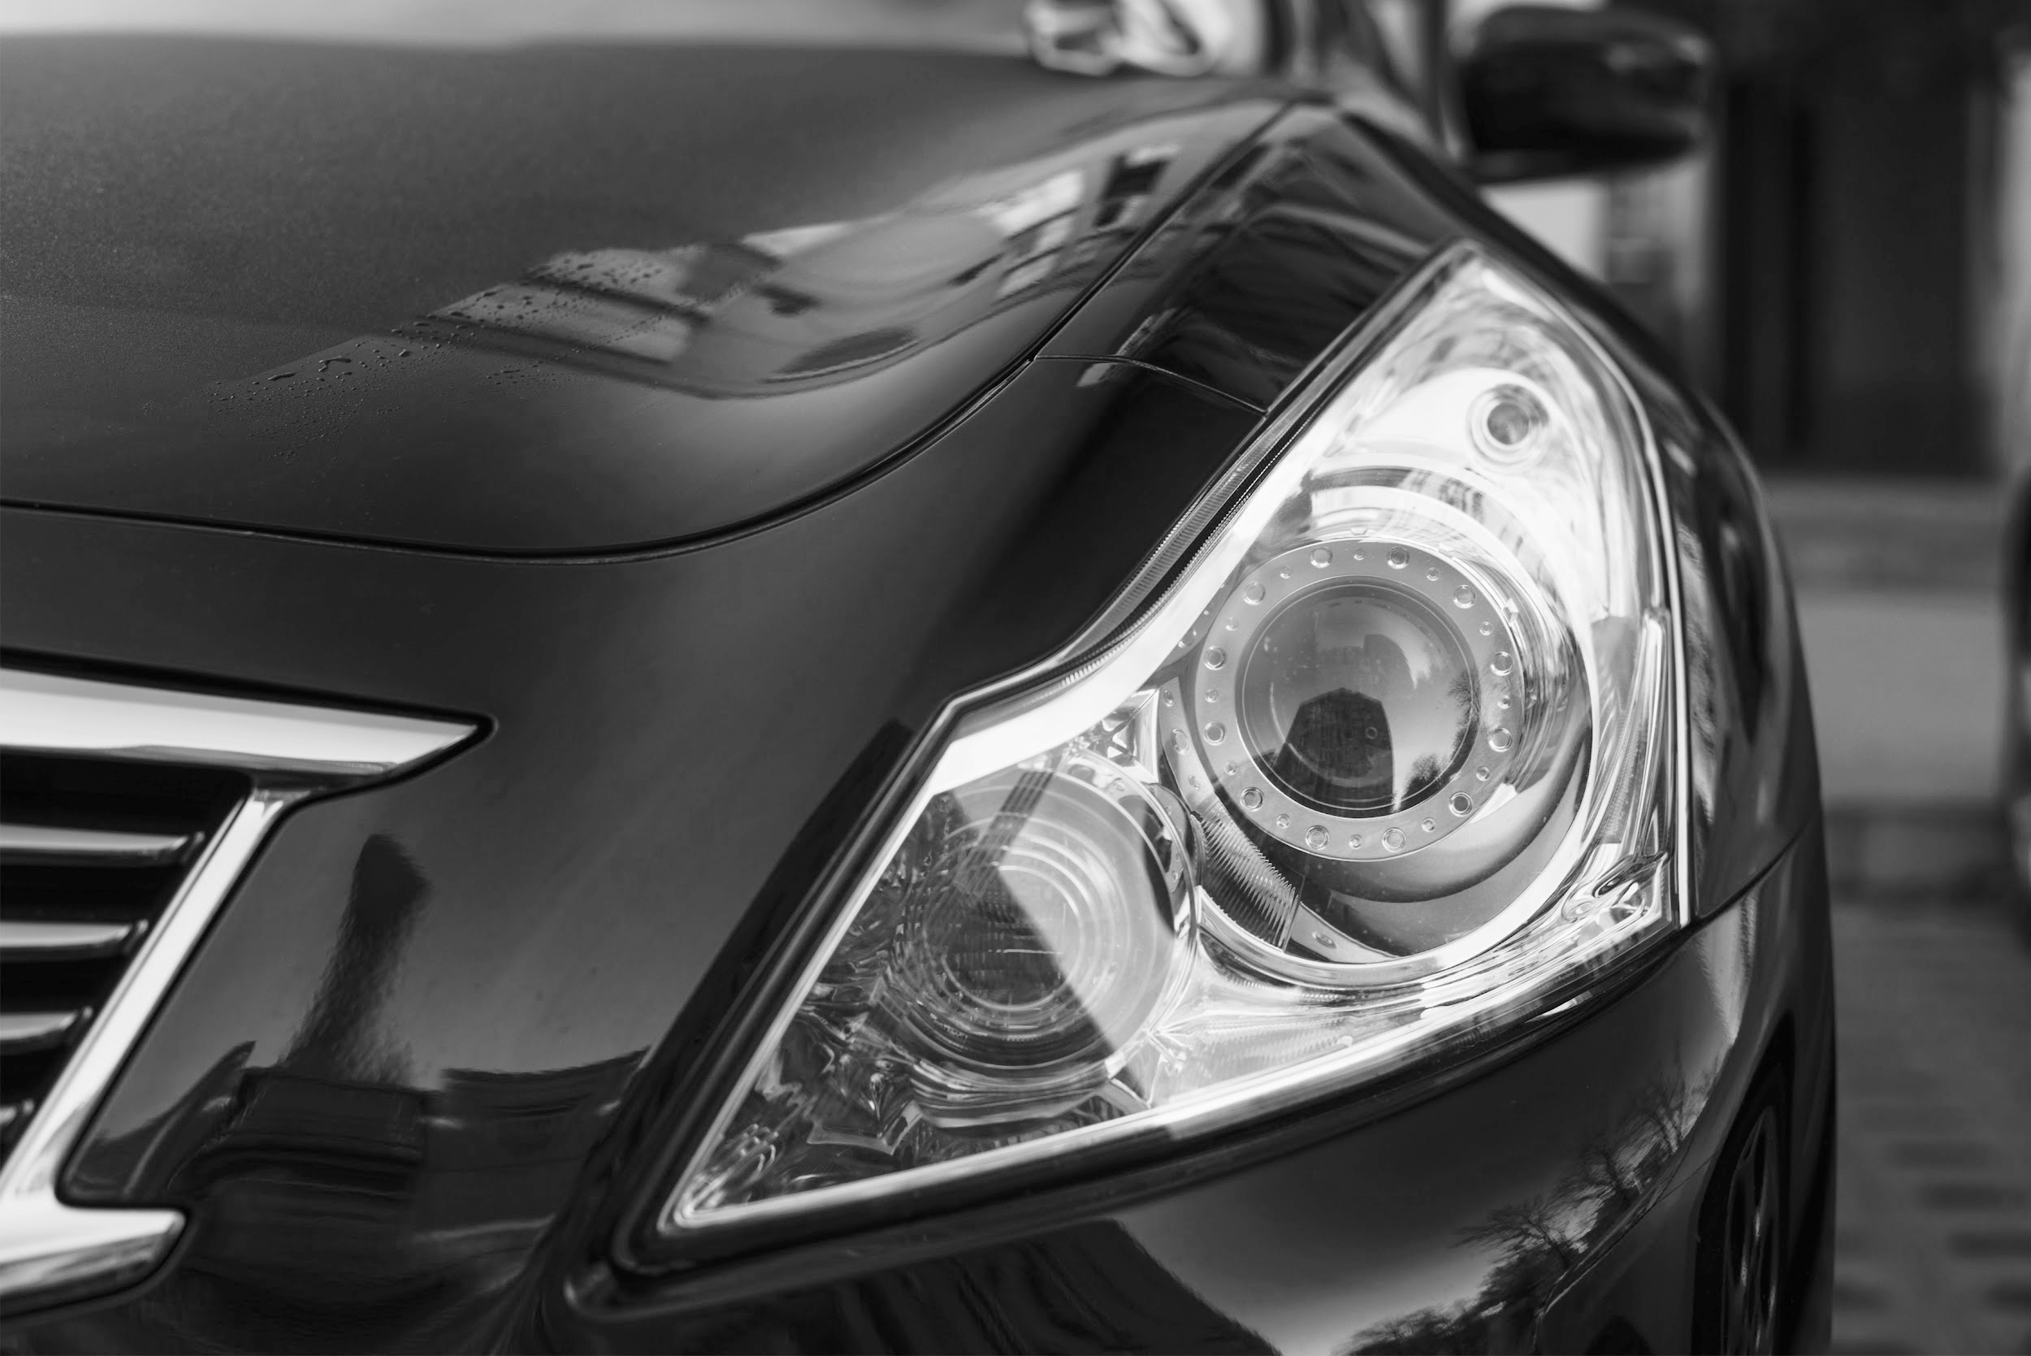
PRODUCT DEMO
Insert your multimedia content here

Slide 15
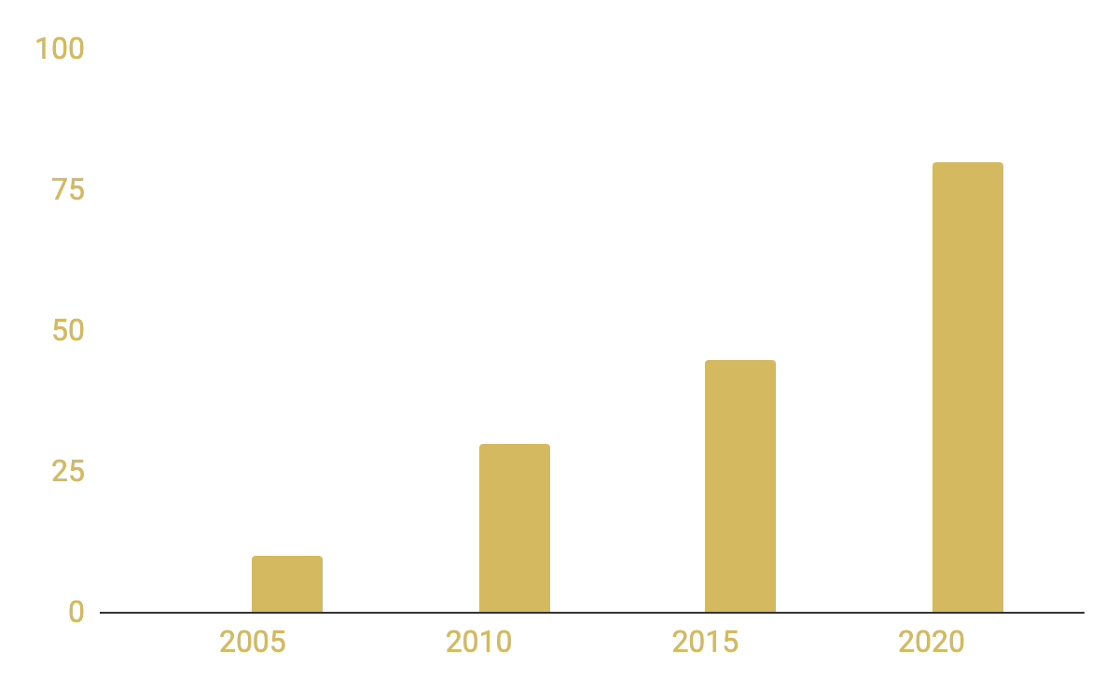
TRACTION
3,000,000
12,000
3,000
Conventional Transports
Transport App
Total app downloads
Registered users
To modify this graph, click on it, follow the link, change the data and paste the new graph here
Uses per day

Slide 16
CASE STUDY
Challenge
Results
Solutions
Despite being red, Mars is actually a cold place full of iron oxide dust
Jupiter is a gas giant and the biggest planet in the Solar System
Saturn is the ringed planet, composed mostly of hydrogen and helium

Slide 17
REVIEWS
—HELENA JAMES
—JOHN SMITH
—TIMMY JIMMY
“Mercury is the closest planet to the Sun and the smallest one in the Solar System”
“Despite being red, Mars is actually a cold place full of iron oxide dust”
“Venus has a beautiful name and is the second planet from the Sun. It’s terribly hot”

Slide 18
AWARDS
2012
2019
Innovation Award
Best Apps’ Choice
Saturn is composed mostly of hydrogen and helium
Jupiter is a gas giant and the biggest planet in the Solar System

Slide 19
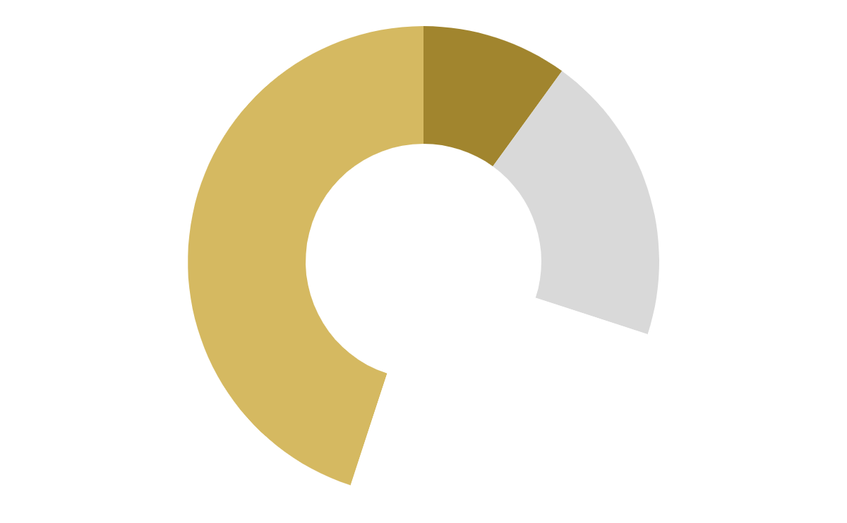
MARKET SIZE
10%
20%
45%
25%
Despite being red, Mars is a cold place
Venus is the second planet from the Sun
Mercury is the closest
planet to the Sun
Saturn is composed of hydrogen and helium
To modify this graph, click on it, follow the link, change the data and paste the new graph here

Slide 20
89.300.000
Big numbers catch your audience’s attention

Slide 21
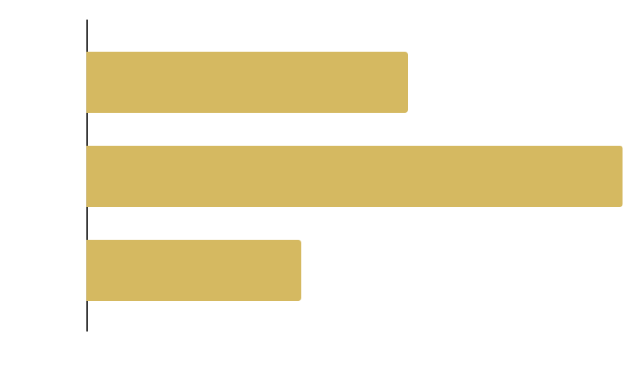
TARGET
AGE & GENDER
WORK
$50,000
Average salary per customer

Slide 22
COMPETITORS
COMPANY | Mercury | Venus | Mars
FOUNDATION | 2010 | 2012 | 2017
DESCRIPTION | Mercury is the closest planet to the Sun | Venus is the second planet from the Sun | Despite being red, Mars is a cold place

Slide 23
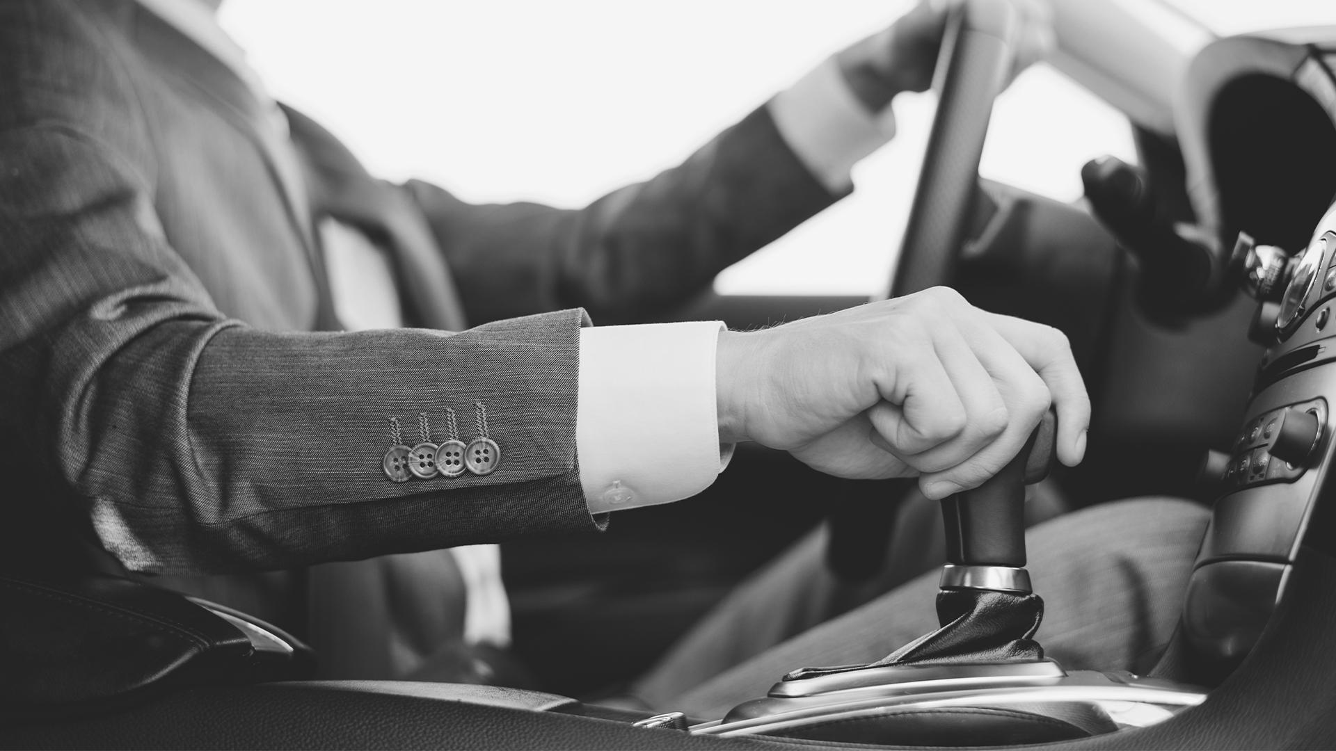
A Picture Is Worth a Thousand Words

Slide 24
BUSINESS MODEL
Marketing
Training
Assessment
Technology
Despite being red,
Mars is cold
Venus has a
beautiful name
Earth is the planet where we live on
Pluto is now a dwarf planet

Slide 25
WHERE THE APP IS USED MORE
2012
2020

Slide 26
TIMING
DAY 1
DAY 2
DAY 3
DAY 4
Despite being red, Mars is cold
Venus has a beautiful name
Pluto is now a dwarf planet
Earth is the planet we live on

Slide 27
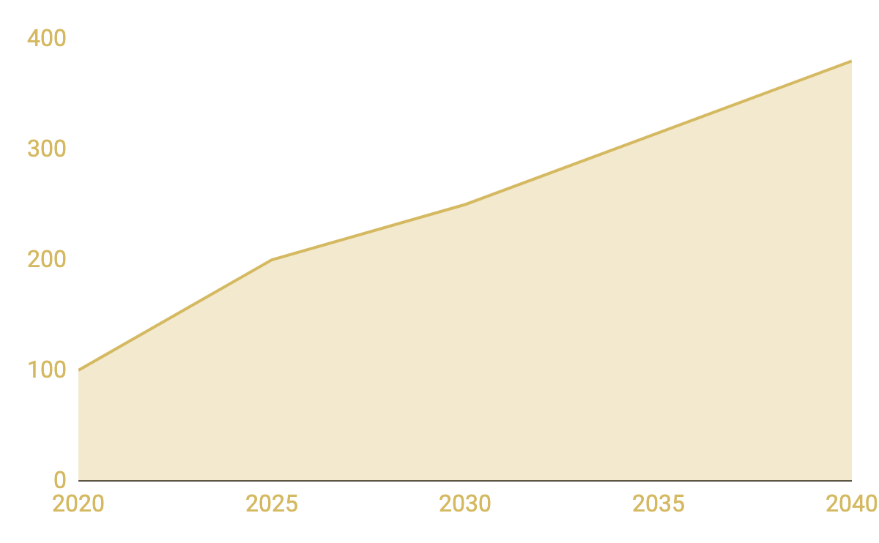
PREDICTED GROWTH
Edit the Graph!
App users
Just click on it, follow the link, change the data and paste the resulting graph here

Slide 28
REVIEW
Mercury
Venus
Mars
Jupiter
Saturn
Neptune
Mercury is the closest planet to
the Sun
Venus has a beautiful name, but it’s terribly hot
Despite being red, Mars is actually a cold place
It’s a gas giant and the biggest planet in the Solar System
Saturn is composed mostly of hydrogen and helium
Neptune is the farthest planet from the Sun

Slide 29
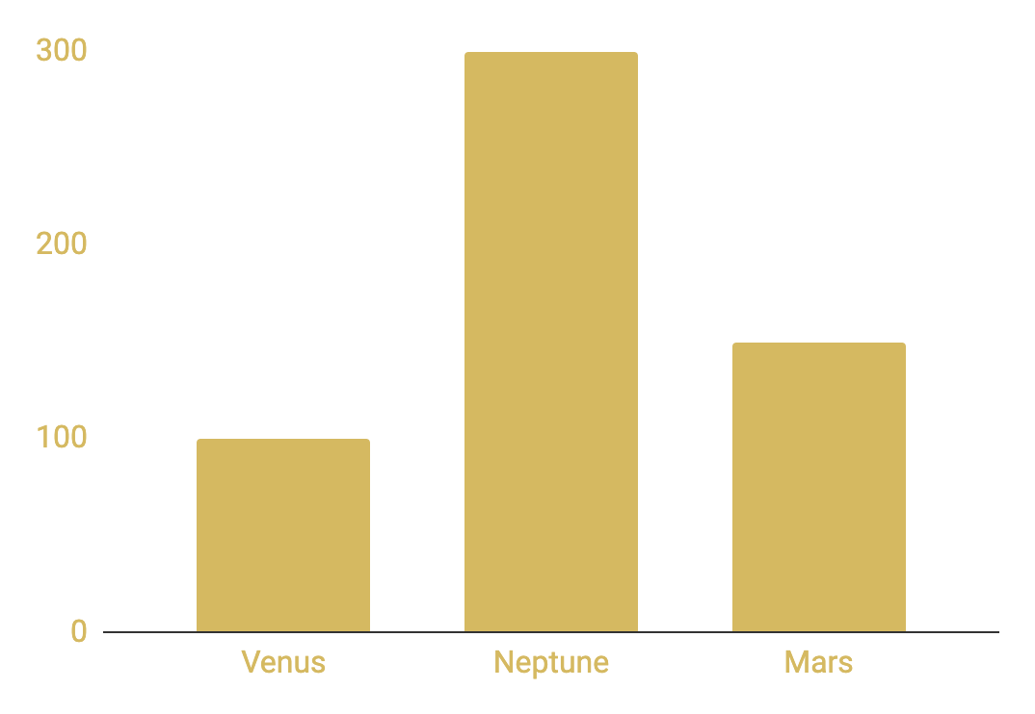
INVESTMENT
Venus
Neptune
Mars
Venus has a beautiful name, but it’s terribly hot
It’s the farthest planet from the Sun
To modify this graph, click on it, follow the link, change the data and paste the new graph here
Despite being red, Mars is actually a cold place

Slide 30
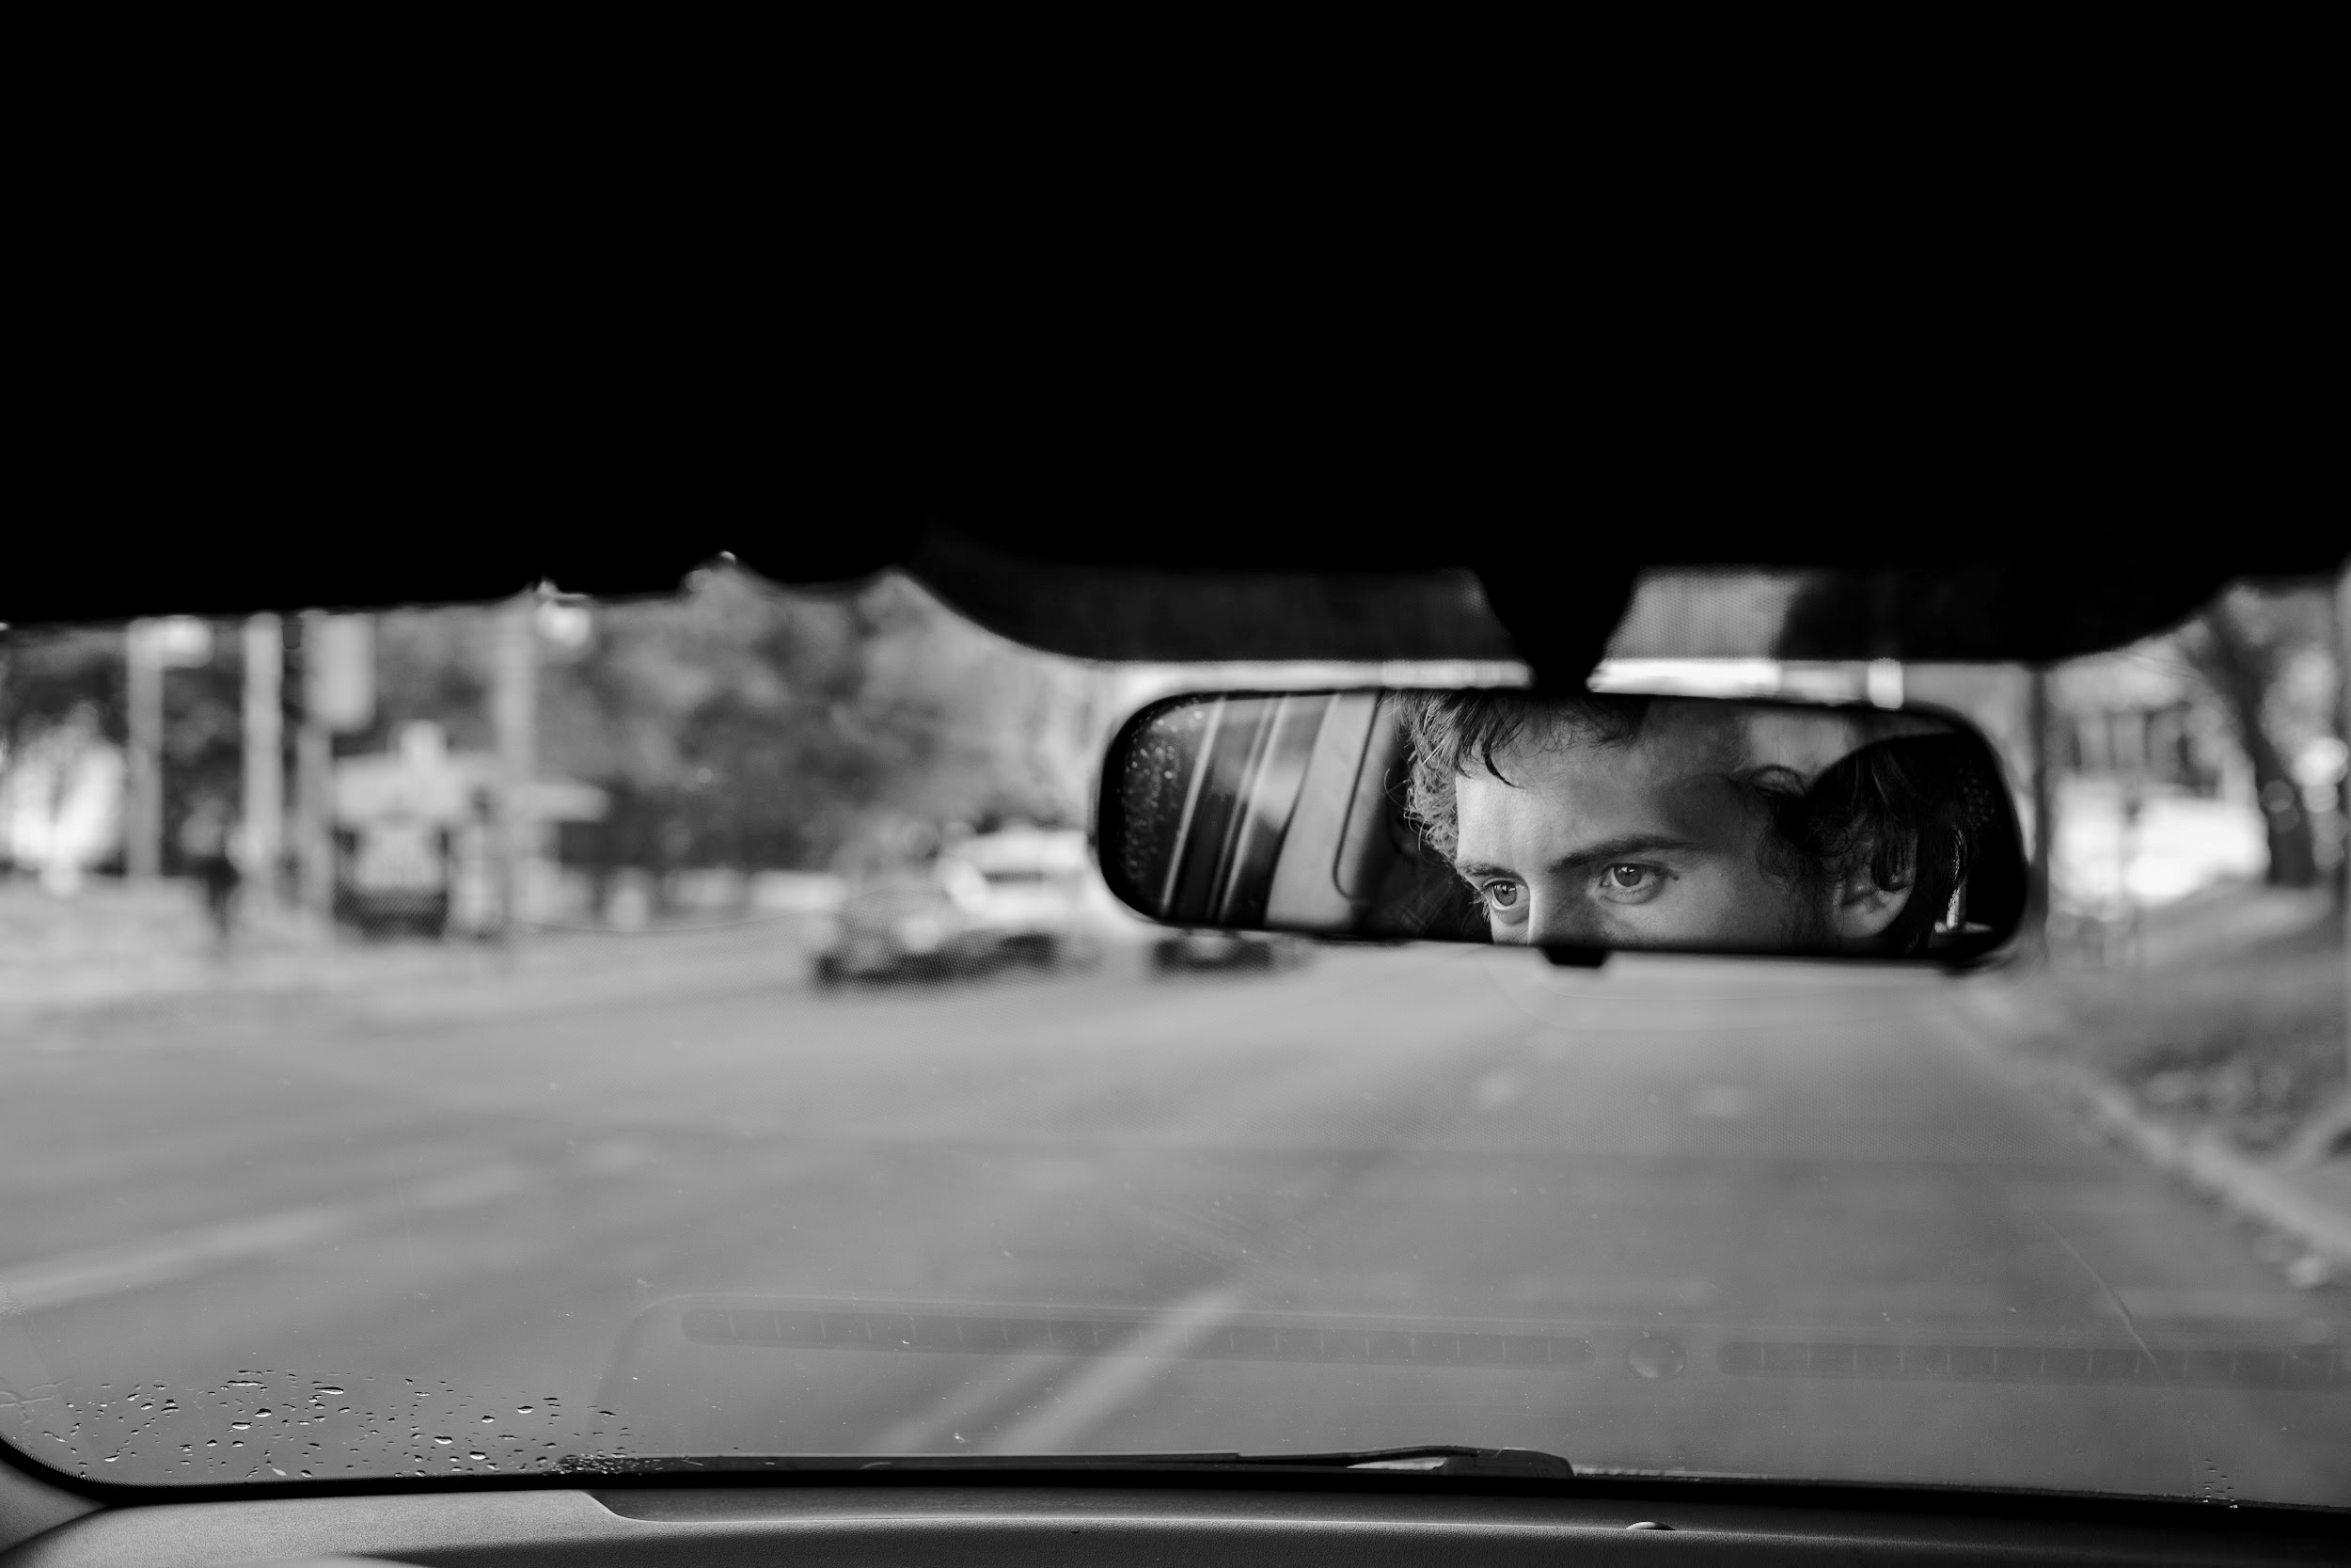
THANKS!
Do you have any questions? youremail@freepik.com
+91 620 421 838
yourcompany.com
Please keep this slide for attribution.

Slide 31
ALTERNATIVE RESOURCES
Man figure seen in man silhouette washing a rearview mirror
Young woman with a car and a suitcase
Car riding on the road with headlights on
Close-up man at steer wheel checking phone
Close-up man trying car navigation
City light blurred bokeh background
Close up of car in dealership
Low angle smiley woman stepping out of car
Close-up rearview mirror in sunshine
Close up of man driving car
Close-up female hand holding car keys
Car side on the background of sunset reflexion
Close-up new car for selling interior view
Rear view of businessman driving the car

Slide 32
RESOURCES
Did you like the resources on this template? Get them for free at our other websites:
PHOTOS:
Beautiful closeup headlights of a black car
Side view car dealer talking over phone
Close-up tablet above laptop mock-up
High angle new car interior view
Professional working woman smiling
Blond business woman using tablet
Close-up of businessman driving the car
Motion blur bridge with cars at night
Car side on the background of sunset reflexion
VECTORS:
Pin map company card

Slide 33
Instructions for use
In order to use this template, you must credit Slidesgo by keeping the Thanks slide.
You are allowed to:
- Modify this template.
- Use it for both personal and commercial projects.
You are not allowed to:
- Sublicense, sell or rent any of Slidesgo Content (or a modified version of Slidesgo Content).
- Distribute Slidesgo Content unless it has been expressly authorized by Slidesgo.
- Include Slidesgo Content in an online or offline database or file.
- Offer Slidesgo templates (or modified versions of Slidesgo templates) for download.
- Acquire the copyright of Slidesgo Content.
For more information about editing slides, please read our FAQs or visit Slidesgo School:
https://slidesgo.com/faqs and https://slidesgo.com/slidesgo-school

Slide 34
Fonts & colors used
This presentation has been made using the following fonts:
Montserrat
https://fonts.google.com/specimen/Montserrat
#d5b961
#000000
#ffffff

Slide 35
Use our editable graphic resources...
You can easily resize these resources without losing quality. To change the color, just ungroup the resource and click on the object you want to change. Then, click on the paint bucket and select the color you want. Don’t forget to group the resource again when you’re done.

Slide 38
JANUARY
FEBRUARY
MARCH
APRIL
MAY
JUNE
PHASE 1
Task 1
Task 2
PHASE 2
Task 1
Task 2
JANUARY
FEBRUARY
MARCH
APRIL
PHASE 1
Task 1
Task 2

Slide 41
...and our sets of editable icons
You can resize these icons without losing quality.
You can change the stroke and fill color; just select the icon and click on the paint bucket/pen.
In Google Slides, you can also use Flaticon’s extension, allowing you to customize and add even more icons.

Slide 42
Educational Icons
Medical Icons

Slide 43
Business Icons
Teamwork Icons

Slide 44
Help & Support Icons
Avatar Icons

Slide 45
Creative Process Icons
Performing Arts Icons

Slide 46
Nature Icons

Slide 47
SEO & Marketing Icons

Slide 48


