Slide 1

Optimizing Used Car Listing Quotations
Matt Ryan

Slide 2

01
INTRODUCTION

Slide 3
INTRODUCTION
Motivation
Objectives
Goals
To overhaul used car listing/quotation process, seeking maximum efficiency and accuracy
Leverage existing used car listing data to build an informed predictive model
Implement our predictive tool into production to begin stream-lining the quotation process

Slide 4

02
METHODOLOGY

Slide 5
FRAMEWORK
LISTINGS
APPLY VARIETY OF DIFFERENT REGRESSION MODELS TO VIABLE LISTINGS TO ‘TRAIN’ OUR TOOL
EACH LISTING REPRESENTS ONE CAR AND ITS FEATURES AND SPECIFICATIONS

Slide 6

THE DATA
Web-scraped from carmax.com
Encompasses a wide range of models, makes, and classes
1,293 car listings

Slide 7

02
RESULTS

Slide 8
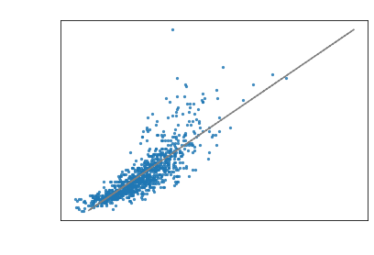
PRICE RANGE AS A FACTOR
What is an acceptable price range?
Conical shape = BAD
After filtering for strongly price-correlated features, we determined a regularized model is most effective for price <=$25,000

Slide 9
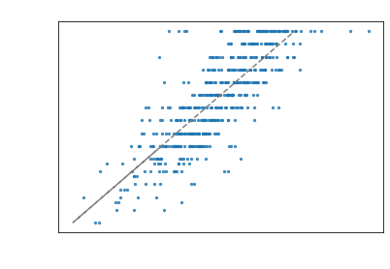
A REWORKED MODEL
16
$1,540.54
0.62
Features
Mean Absolute Error
R2

Slide 10
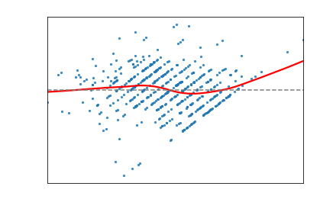
A REWORKED MODEL

Slide 11

KEY FEATURES
Mileage
Year
Horsepower
MPG

Slide 12
LOOKING FORWARD
Investigate modeling techniques that can account for behavior above $25k
Investigate our features, potentially bring in more features

Slide 13

Thank You

Slide 14

THANKS!
Please keep this slide for attribution.

