Slide 1
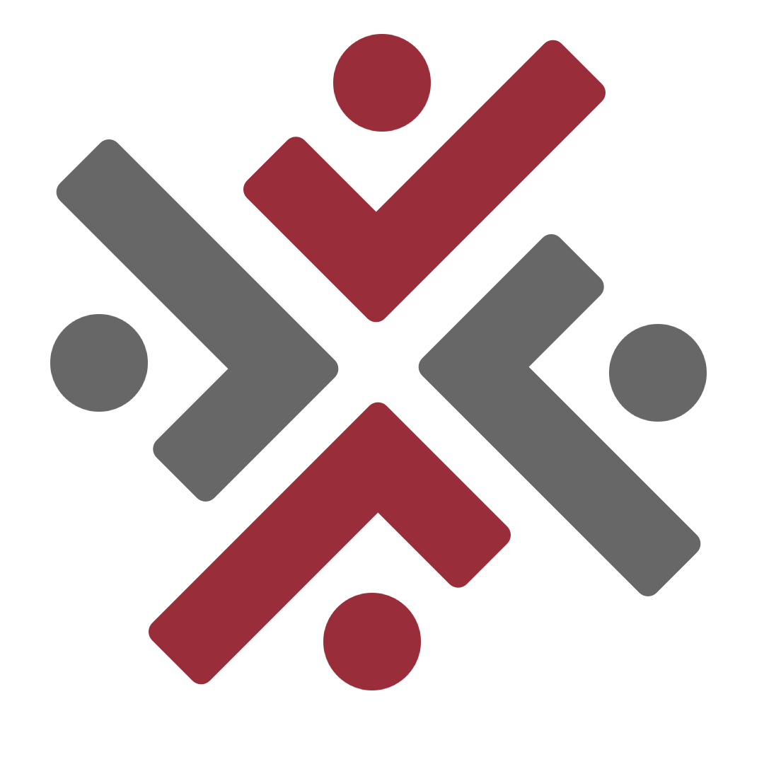
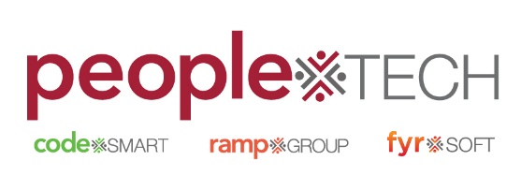
Agile and waterfall Methodology
A Quest Global Company

Slide 2
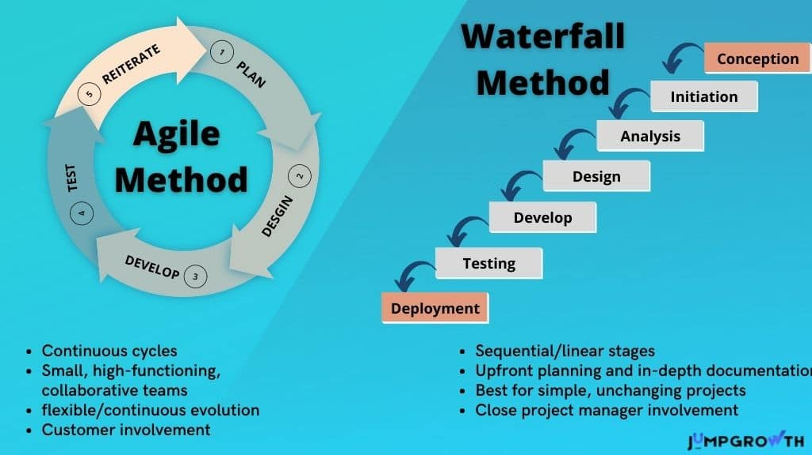
Understanding Development Methodologies
Software development methodologies are frameworks guiding how teams develop, deliver, and maintain software.
Agile: Iterative, flexible, and adaptive.
Waterfall: Linear, sequential, and rigid.
Choosing the right methodology affects project success, quality, and time-to-market.

Slide 3
Agile Methodology Overview
Responds to Change Efficiently:
Prioritizes flexibility to accommodate evolving customer needs or market trends.
Continuous Delivery of Valuable Software:
Ensures frequent updates and improvements to maintain relevance and user satisfaction.
Customer Feedback Drives Development:
Regular feedback loops to refine and align the product with user expectations.
Team Collaboration:
Encourages close teamwork across all roles to enhance efficiency and innovation.
Time-Boxed Iterations:
Uses short development cycles (sprints) to deliver measurable progress.
Real-world usage: Ideal for dynamic, fast-paced industries like software startups or mobile app development.

Slide 4
Agile Manifesto: Core Values
Individuals and Interactions: Over processes and tools.
Emphasizes collaboration and communication among team members.
Encourages a culture where people are valued over rigid workflows.
Working Software: Over comprehensive documentation.
Prioritizes delivering functional products to users quickly.
Documentation is maintained, but the focus remains on tangible results.
Customer Collaboration: Over contract negotiation.
Involves the customer throughout the development process.
Facilitates real-time feedback and adjustments to meet expectations.
Responding to Change: Over following a plan.
Adapts to evolving requirements and market conditions.
Ensures the product remains relevant and competitive.

Slide 5
Agile Principles
Key Principles:
Deliver Frequently:
Emphasizes regular delivery of working software, favoring shorter development cycles for faster feedback.
Sustainable Development:
Maintains a consistent pace that the team can sustain indefinitely without burnout.
Face-to-Face Communication:
Prioritizes direct communication as the most efficient and clear method of collaboration.
Regular Reflection:
Teams periodically review their processes to identify improvements and optimize performance.
Embrace Change:
Welcomes changing requirements, even late in the development process, to enhance the product's relevance.
Measure Progress by Working Software:
Uses functioning deliverables as the primary indicator of progress, ensuring practical results.

Slide 6
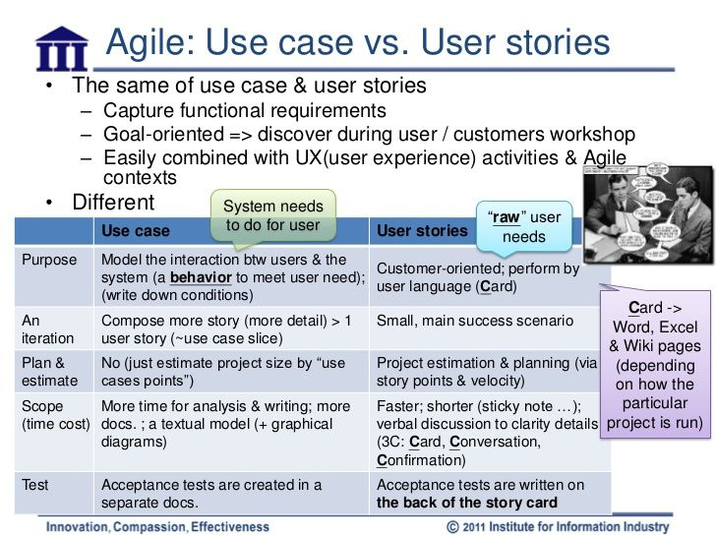
User Stories in Agile
Definition:
Short, user-focused descriptions of features or functionality to capture requirements.
Key Characteristics:
User-Centric: Focus on user needs and goals.
Simple: Concise and easy to understand.
Independent: Standalone, not dependent on others.
Valuable: Deliver clear value to users and businesses.
Testable: Include acceptance criteria for validation.
Prioritized: Ranked by importance and business goals.
Purpose:
Drive development process and align with user needs.
Enable iterative development and continuous feedback.

Slide 7
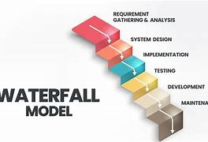
Waterfall Methodology Overview
Definition:
A sequential, linear approach where each phase is completed before moving to the next.
Phases:
Requirement Gathering: Document all project needs upfront.
Design: Create detailed system architecture.
Implementation: Develop and code the solution.
Verification: Test to ensure requirements are met.
Maintenance: Provide ongoing support and updates.

Slide 8
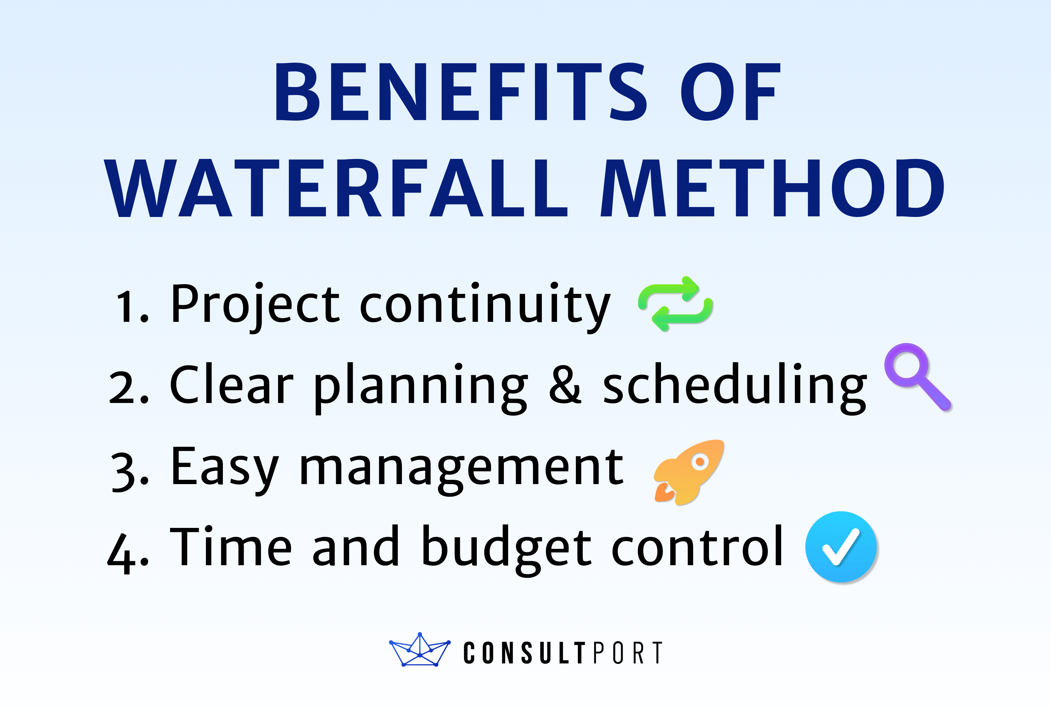
Key Features of Waterfall
Predictability:
Defined phases ensure clarity in timelines and deliverables.
Documentation-Driven:
Each phase requires comprehensive documentation.
Minimal Changes Allowed:
Changes are difficult and costly after development begins.
Case Study Example:
Building an ERP system for a regulated government agency, where compliance and structured processes are essential.

Slide 9
Agile vs. Waterfall: Key Differences
Aspect | Agile | Waterfall
Flexibility | Adapts to evolving requirements | Fixed once the project begins
Phases | Iterative and overlapping | Sequential
Delivery | Frequent, small releases | Delivered as a complete package
Testing | Ongoing during development | Done after all development is complete
Risk Management | Managed incrementally with each iteration | Managed near the end of the process
Customer Involvement | High, with regular feedback loops | Minimal, usually only during initial and final phases
Documentation | Light and adaptive | Heavy and detailed
Team Structure | Cross-functional and collaborative | Hierarchical and siloed
Cost Changes | Easier to accommodate | Expensive and difficult
Project Type | Suited for dynamic and evolving projects | Ideal for fixed, well-defined projects

Slide 10
Advantages of Agile
Continuous Improvement: Regular retrospectives encourage teams to improve their processes and practices with each iteration.
Faster Problem Resolution: Due to the iterative nature, problems are identified early and can be addressed quickly.
Adaptability to Market Changes: Agile allows for quick pivoting in response to changing market conditions, technologies, or customer preferences.
Stakeholder Engagement: Regular reviews and sprint demos provide ongoing opportunities for stakeholders to provide feedback and stay aligned with project progress.
Improved Transparency and Communication: Daily stand-ups and sprint reviews foster open communication within the team and with external stakeholders, ensuring all parties are well-informed.
Focus on High-Value Features: Agile focuses on delivering the most valuable features first, ensuring that customer needs are met early on.
Enhanced Innovation: The flexibility of Agile encourages creative problem-solving and innovative solutions as teams are not constrained by rigid requirements.
Easier Maintenance: With smaller, incremental releases, it's easier to maintain and update the software without disrupting the whole system.
Reduced Time Wastage: Frequent feedback and testing ensure that developers stay on track, preventing unnecessary rework and wasted efforts.
Scalability: Agile frameworks, such as SAFe and Scrum, can be scaled to work for large, enterprise-level projects, ensuring alignment across multiple teams.
Better Risk Management: Regular reassessments allow teams to manage and mitigate risks more effectively than in traditional models like Waterfall.

Slide 11
Advantages of Waterfall
Clear and Defined Phases: Each phase has specific goals and deliverables, providing structure and clarity to the project timeline.
Predictable Outcomes: The linear approach and detailed documentation make it easier to predict the project scope, timeline, and cost.
Easier Project Tracking: Progress is easy to monitor since each phase must be completed before the next, making it simpler to track milestones.
Well-Documented Process: The extensive documentation at each stage helps ensure everyone is on the same page, making it easier to onboard new team members or work with external vendors.
Ideal for Fixed Budgets and Deadlines: Since all requirements are defined upfront, it’s easier to estimate the resources, budget, and timeline accurately.
Quality Assurance Focused: QA and testing phases are separate from development, allowing for detailed and rigorous testing of the final product before deployment.
Low Risk of Scope Creep: The fixed nature of the project plan limits changes, reducing the risk of scope creep and ensuring the project stays on track.
Best for Regulatory or Compliance Projects: Waterfall’s structured approach is ideal for projects in regulated industries where each phase must meet strict compliance standards (e.g., healthcare, finance, government).
Clear Roles and Responsibilities: Waterfall's structure often involves clearly defined roles and responsibilities, which can help ensure that all team members know their tasks at each phase.

Slide 12
Waterfall Challenges
Limited Flexibility: Once a phase is completed, it is difficult to go back and make changes, limiting adaptability to new insights or market changes.
Late Discovery of Issues: Since testing happens after development is complete, defects and design flaws might only be discovered later in the process, leading to higher correction costs.
Lack of Customer Involvement: Customers are usually involved at the start for requirement gathering and at the end for final delivery, reducing opportunities for ongoing feedback and collaboration.
Increased Cost for Changes: Any changes to the project after development has started are difficult to implement and can lead to significant delays and increased costs.
Potential for Scope Creep: While scope is defined upfront, if stakeholders request changes during the process, it can lead to scope creep due to lack of ongoing evaluation and feedback.
Overemphasis on Documentation: Extensive documentation in each phase can slow down progress and make the process cumbersome, especially if frequent changes are needed.
Inflexible for Uncertain or Evolving Projects: Waterfall is not suitable for projects where the requirements are unclear or evolve over time, as it doesn't accommodate changes once development begins.
Misalignment with Business Needs: If the project scope changes or business needs evolve during the development phase, Waterfall's rigid structure can misalign the final product with the current needs.
High Initial Planning Overhead: Waterfall requires a comprehensive and detailed plan upfront, which can be time-consuming and costly before the project even begins.
}

Slide 13
Agile Challenges
Requires experienced teams familiar with Agile principles and practices.
May lead to scope creep if not managed carefully, as continuous changes can affect timelines and costs.
Relies heavily on continuous customer involvement, which may not always be feasible, especially in projects with busy stakeholders.
Difficult to apply in industries with strict regulations or long approval cycles due to the iterative nature of development.
Managing multiple priorities can be challenging without clear focus on the most important tasks.
Maintaining consistent velocity may be difficult as teams adapt to changing requirements or priorities.

Slide 14
Agile Frameworks
Scrum:
Sprints: Short, time-boxed iterations to deliver product increments.
Daily Stand-ups: Daily meetings to discuss progress and obstacles.
Kanban:
Visual Workflow: Uses boards to manage and track work through different stages.
WIP Limits: Restricts the number of tasks in each stage to avoid overload.
Extreme Programming (XP):
Test-Driven Development (TDD): Writing tests before code to ensure quality.
Pair Programming: Two developers collaborate on the same code for better quality and knowledge sharing.
SAFe (Scaled Agile Framework):
Scaling Agile: A framework for applying Agile across large organizations.
Program Increment (PI): Delivers features through iterations across multiple teams.
Lean Development:
Waste Reduction: Eliminates non-value-added activities and delays.
Continuous Improvement: Focuses on iterative improvement based on feedback.

Slide 15
Comparison Table for Decision Making
When to Use | Agile | Waterfall
Project Type | Complex, evolving requirements | Simple, well-defined requirements
Timeline | Iterative releases and updates | Fixed, linear with clear milestones
Team Experience | Experienced, cross-functional teams | Teams with less experience, structured roles
Budget | Flexible, adapts as the project evolves | Strict, with predefined costs and scope

Slide 16
Conclusion
Agile suits projects with evolving requirements and focuses on flexibility and customer feedback.
Waterfall is ideal for projects with clear, stable requirements and emphasizes predictability and detailed planning.
The choice between Agile and Waterfall depends on the project’s complexity, timeline, and industry standards.
Agile offers faster delivery and greater adaptability, but may lack predictability in some cases.
Waterfall provides a clear, structured approach but can struggle with changes once development is underway.

Slide 17

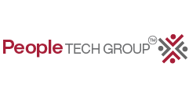
Thank you..

