Slide 1
CREATING CONNECTION BETWEEN DIFFERENT VIRTUAL MACHINES IN A VIRTUAL NETWORK USING CLOUD
By
B.Rohan (15831A1205)
B.Swathi (15831A1206)
B.Maneesha (15831A1207)
Under the Guidance of
Dr.P.Subramanian
Professor
Department of Information Technology

Slide 2
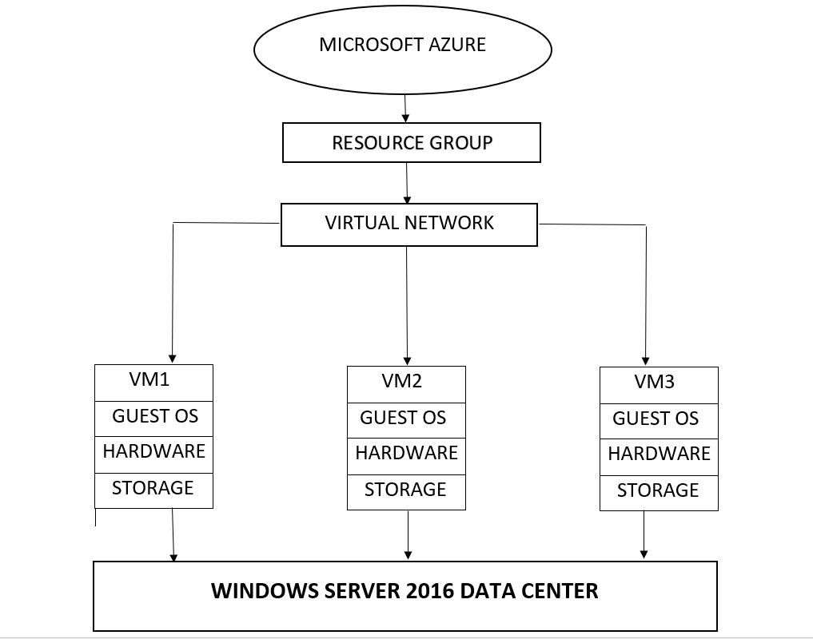
SYSTEM ARCHITECTURE

Slide 3
Resource Group
Resource groups are the central unit in system Automation for multi platforms.
They are logical containers for a collection of resources that can be treated as one logical instance.
You can use resource groups to control all of their members collectively.

Slide 4
Virtual Network
Virtual network is a technology that facilitates the control of one or more remotely located computers or servers over the Internet.
The centralization of control reduces the cost and complexity of operating and maintaining hardware and software compared with administering numerous separate devices in widely separated geographical locations.

Slide 5
Virtual machine
A virtual machine is a software program or operating system that not only exhibits the behaviour of a separate computer but also capable of performing tasks such as running applications and programs like a separate computer.
A virtual machine usually known as a guest is created with in another computing environment referred as a “host”.

Slide 6
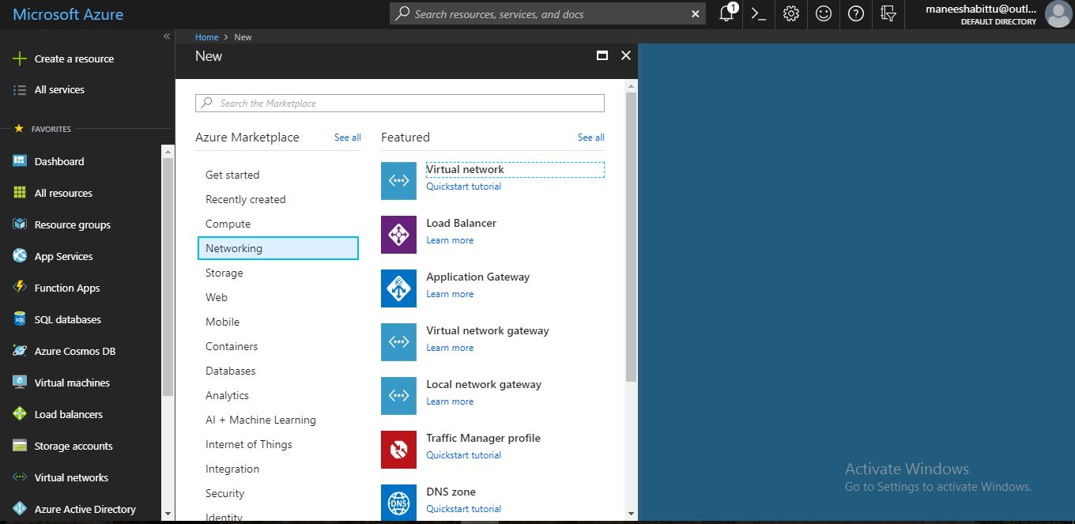
Virtual network:
First a virtual network is created in order to make connection between virtual machines after logging into Microsoft Azure Account.

Slide 7
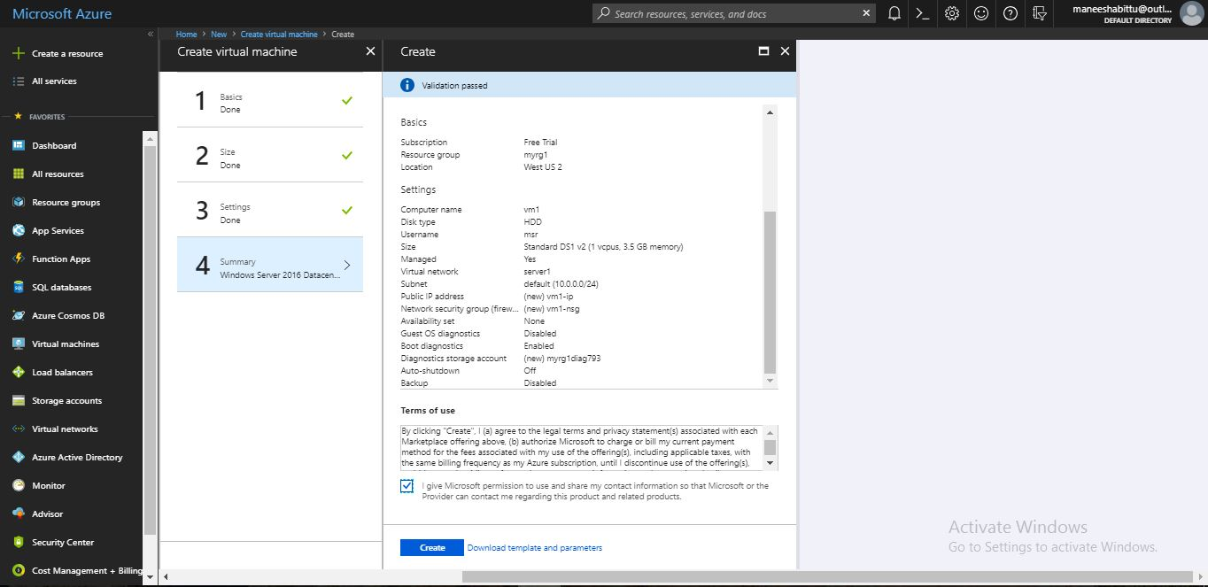
Virtual machine 1:
Virtual Machine 1is created by using resource group that was created during virtual network.

Slide 8
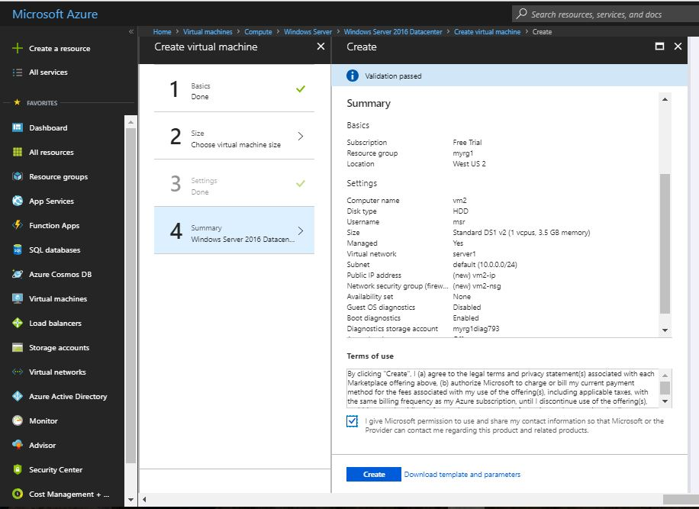
Virtual Machine 2:
Virtual Machine 2 is also created by using existing resource group.

Slide 9
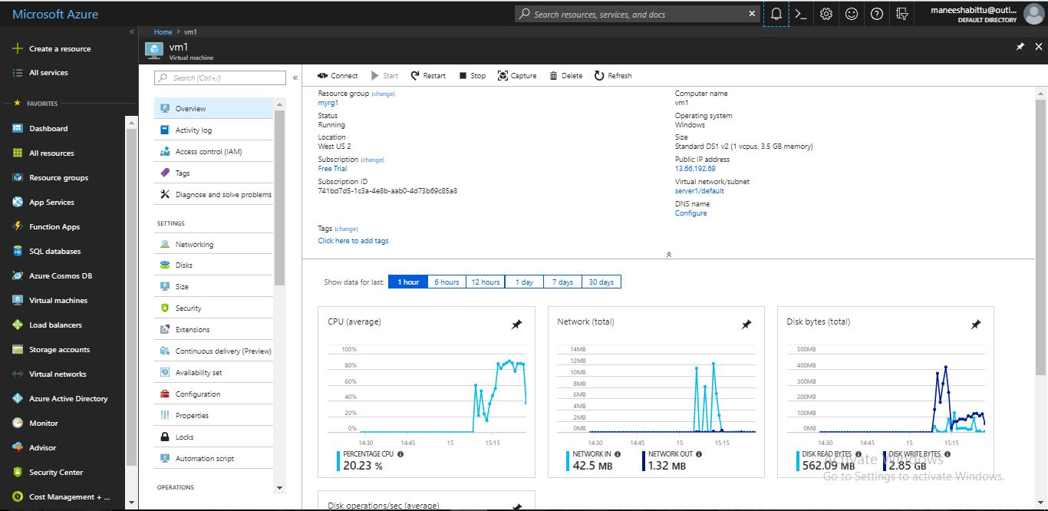
Overview of Virtual machine 1:
It contains entire description about the virtual machine like location ,resource group , public address etc.

Slide 10
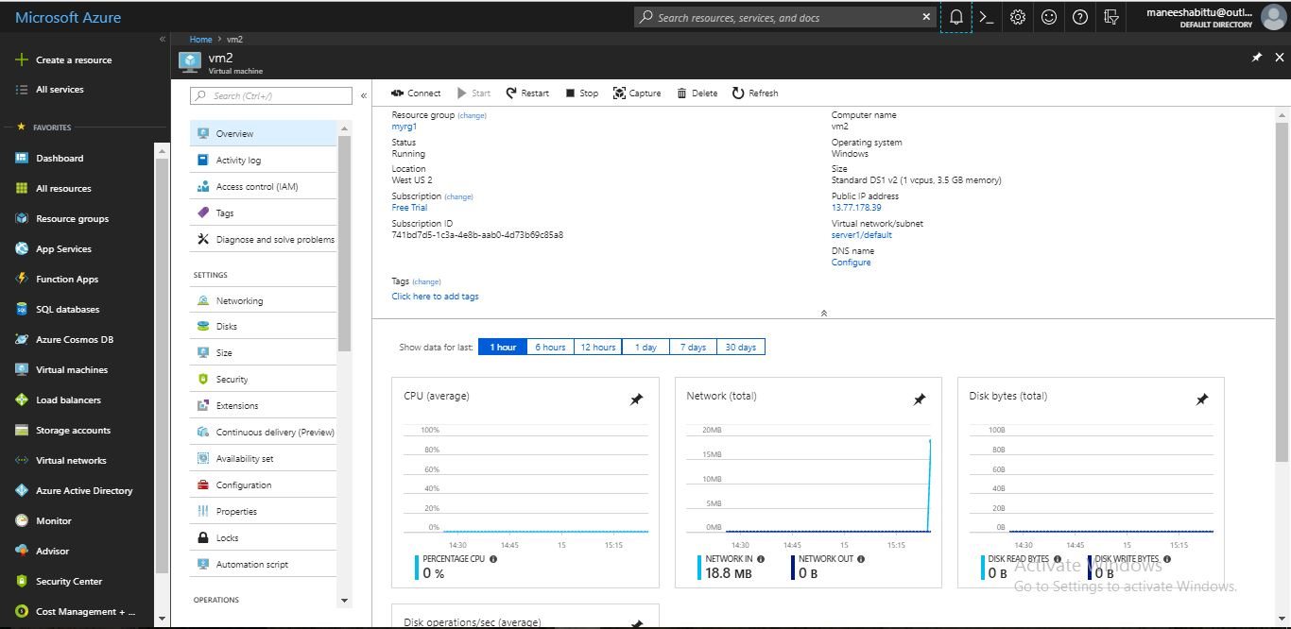
Overview of Virtual machine 2:
It contains entire description about the virtual machine like location ,resource group , public address etc.

Slide 11
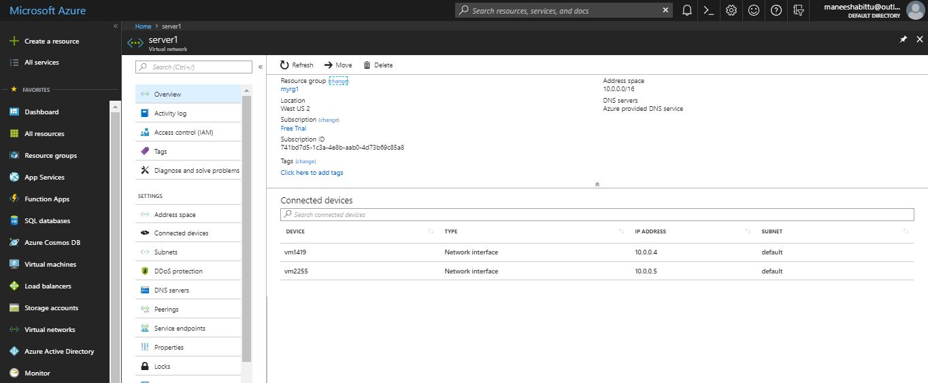
Overview of Virtual Network:
It contains entire description about virtual network like address space, resource group , location etc.

Slide 12
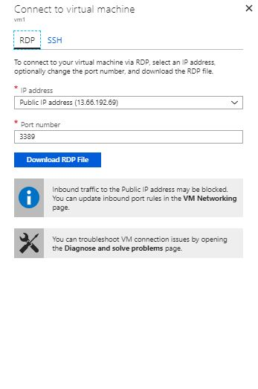
RDP files
Download RDP files for both virtual machines.

Slide 13
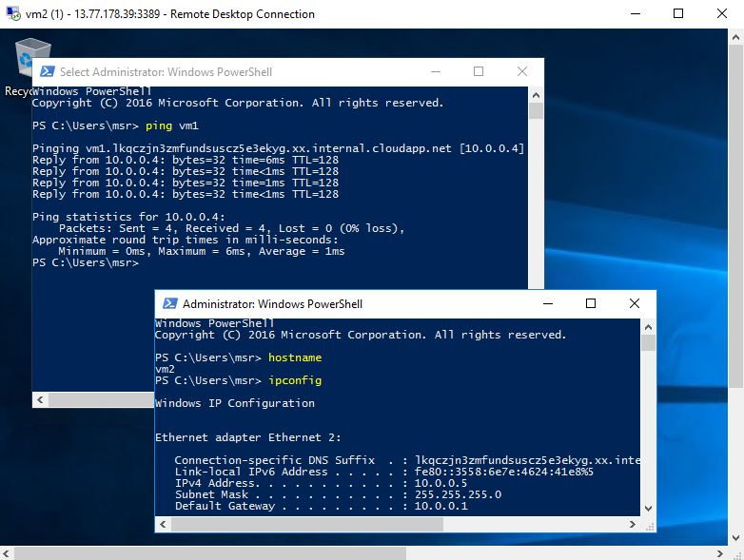
Connection:
Open powershell in remote desktop and provide required commands in order to make a connection between virtual machines.

Slide 14
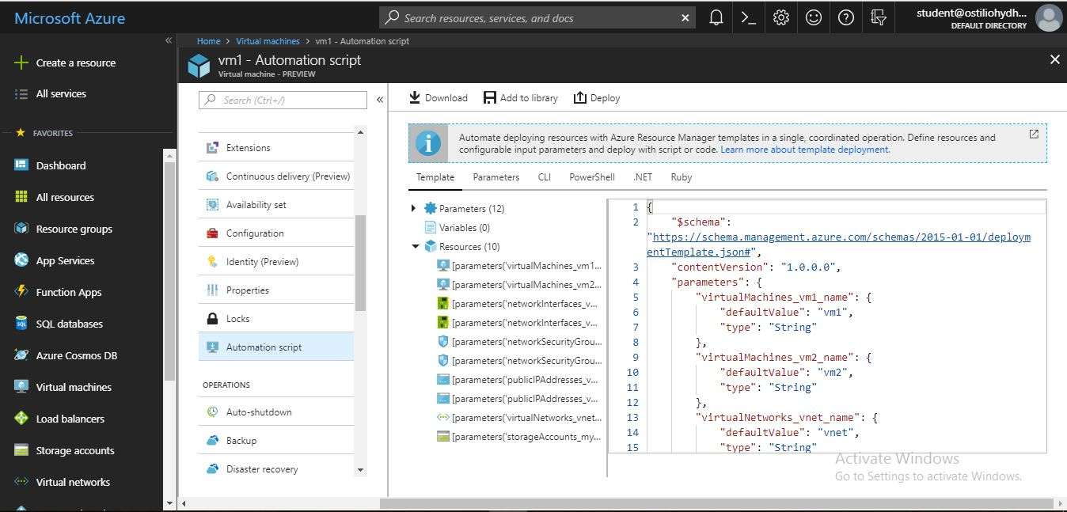
JSON code
It is the code used to declare all the attributes that are used to create virtual machines and virtual network.

Slide 15
Thank you

