Slide 1
IDS Project
[UE17CS203]
Data Set : IBRD Statement of Loans
Team Name: AIM
AARYA ARUN (PES1201700009)
MANEESHA S (PES1201700024)
INDU ANUHYA R (PES1201700795)

Slide 2
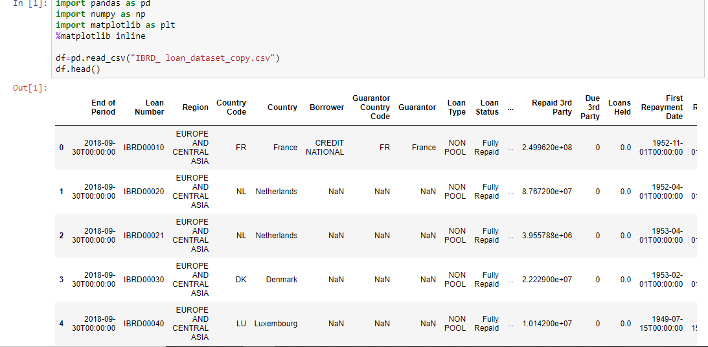
Data Set

Slide 3
Why this data set?
A. How well it meets the criteria mentioned in the guidelines?
We have chosen IBRD Statement of Loans Data as our dataset. The dataset contains 8710 rows and 33 columns, out of which
13 are numeric data columns and the remaining columns are categorical. The dataset also contains minimum of 4% NaN values.
Thus, the chosen dataset meets all the criteria for being called a good
dataset as per the guidelines.
B. No of attributes (columns) and rows (tuples)
As mentioned earlier, our dataset contains 33 attributes and 8710 rows(tuples).
C. How much value do the attributes contribute?
It’s the attributes due to which we are able to understand the loan pattern and policy, transaction pattern,
interest rate in the World Bank, information about how many levels the money is transferred to, in order to reach the borrower etc.
D. Missing Values, NANs
About 4% of NaN values are found in Project ID, Project Name columns and nearly 5% NaNs in Borrower, Guarantor Country etc
attributes.
E. Categorical and Numerical column presence
There are 13 numerical attributes and 20 categorical attributes in our dataset. Also, we have dropped few unnecessary columns
that doesn’t provide any useful information regarding the loan statements, or have already been specified along with other
attributes or have the same meaning as of other attributes. Such columns are dropped to make the dataset look neater, and
less clumsy.

Slide 4
Data Cleaning
A. Identification of missing data.
There are values missing in Borrower, Guarantor, Project ID, Project Name etc., attributes. Also there are 0s as
values to certain numerical attributes that does not enable the attribute to be normally distributed.
B. Missing data is categorical/numeric and how well are missing values replaced. (Min of methods mentioned
in the guidelines (More weightage)
Missing data in categorical columns are replaced by the value in the cell right above it for cleaning purpose.
Missing values in numerical columns are replaced by the mean of that column for better normalization and tidying
the dataset.
The 0s in few numeric columns are of no use for us and also affect normalization and standardization which
is overcome by replacement of such 0s with NaNs that are further replaced by the mean of the respected column.
C. If they have tried some different methods for missing values, well and good.
Interpolation of Cancelled Amount attribute for analysing that all the NaNs need not be filled or replaced
with some other values for interpreting the behaviour of cancelled amount for a certain part of data. (from
index 4-16)

Slide 5
Data Cleaning
D. If they have chosen to drop any attribute instead of replacing it, valid reason for it. (Since attribute dropping should have strong reasons and one cannot simply attribute as it may carry important info pertaining to individual tuples)
We have dropped 'Currency of Commitment', 'Due 3rd Party', 'Loans Held', 'Agreement Signing Date', 'Board Approval Date’, 'Effective Date (Most Recent)', 'Closed Date (Most Recent)', 'Last Disbursement Date', 'Undisbursed Amount', 'Disbursed Amount', 'Country Code', 'Guarantor Country Code',' Exchange Adjustment', 'Borrower's Obligation', 'Due to IBRD', 'Repaid 3rd Party', 'Sold 3rd Party' (17 attributes) as these attributes do not contribute to the transaction history or loan history of world bank directly.
As per the dataset before cleaning, the “currency of commitment” attribute was 100% null which is not a good sign for data cleaning as that column is nowhere useful.
“Due 3rd Party”, “Due to IBRD” etc attributes had many 0s as their values which can directly be calculated as the difference of “Sold 3rd Party” and “Repaid 3rd Party” attributes itself or can be understood by the “Exchange Adjustment” or through other relevant columns. There need not be specific columns for just representing 0s.
Also, as we are concerned just about the normalization of data and to understand the behaviour of loan data, we already have many timestamps in our dataset and thus removing few timestamps related to already dropped columns would not affect our dataset. Thus, we have dropped “Agreement Signing Date”, “Board Approval Date”, “Effective Date”, “Closed Date” and “Last Disbursement Date” attributes. The less the timestamps more uniform is the data and is related to common time values and more is the dependence of data on a common timestamp. This decreases the irregularity of the data.
We have dropped “Country Code” and “Guarantor Country Code” attributes as we are not referring to these columns anywhere else in the dataset and if necessary, the “Country Name” and “Guarantor Country Name” are present in the cleaned dataset as well, which can be used to refer to that particular country and its information.
As data related to 3rd party is not much necessary and since “Borrower’s Obligation” attribute depends on 3rd party information we have dropped “Borrower’s Obligation” as well.

Slide 6
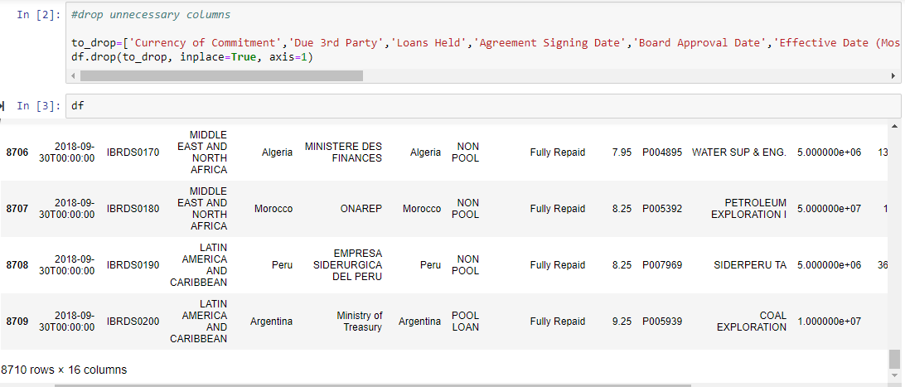
Data after dropping columns

Slide 7
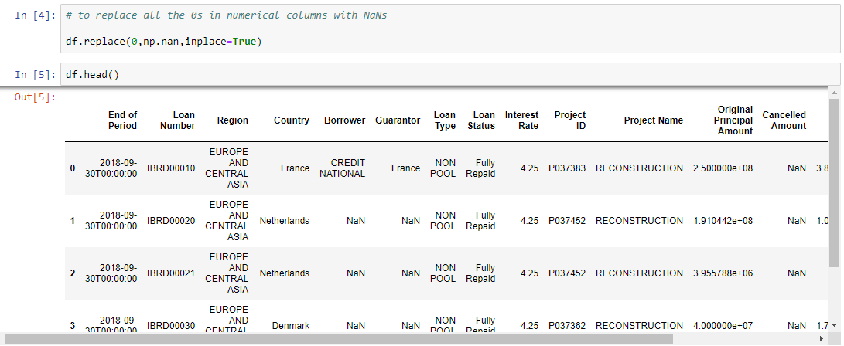
Replacing 0s with NaNs

Slide 8
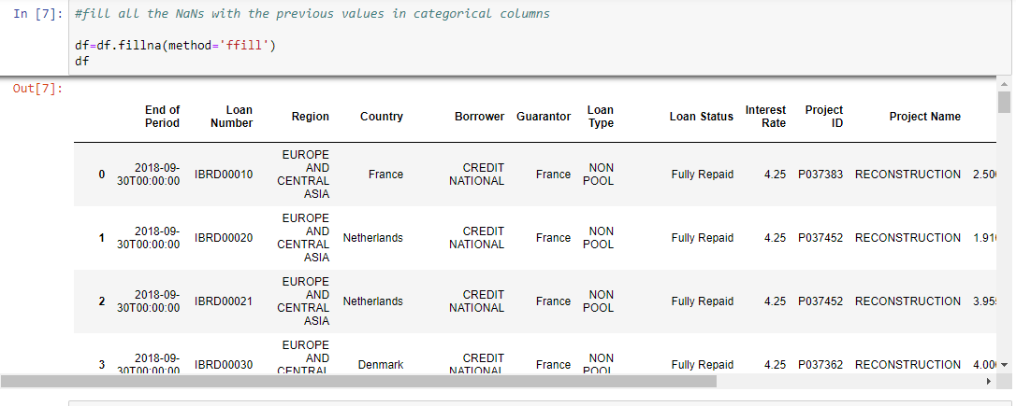
Filling NaNs in categorical columns with previous values

Slide 9
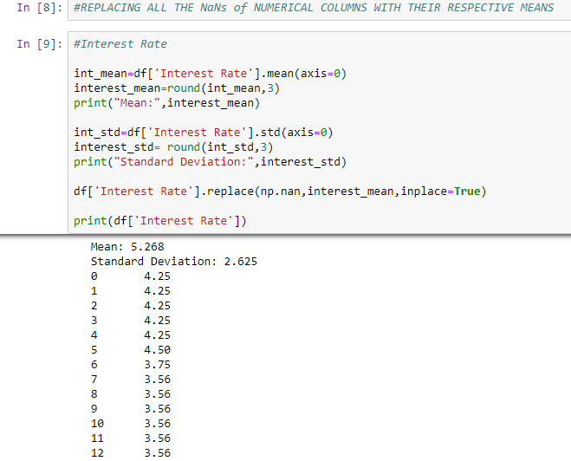
Filling NaNs in numerical columns with mean values

Slide 10
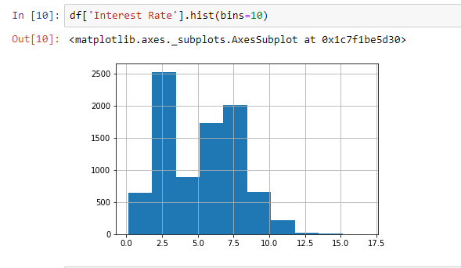
Interest Rate

Slide 11
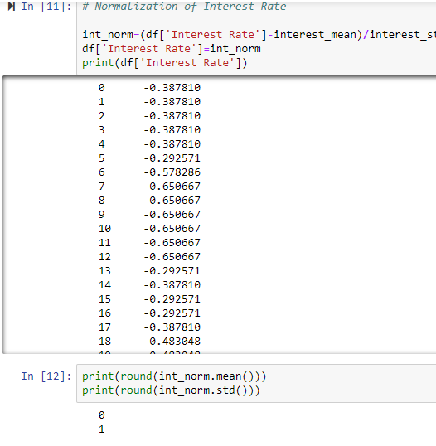
Interest Rate after normalization

Slide 12
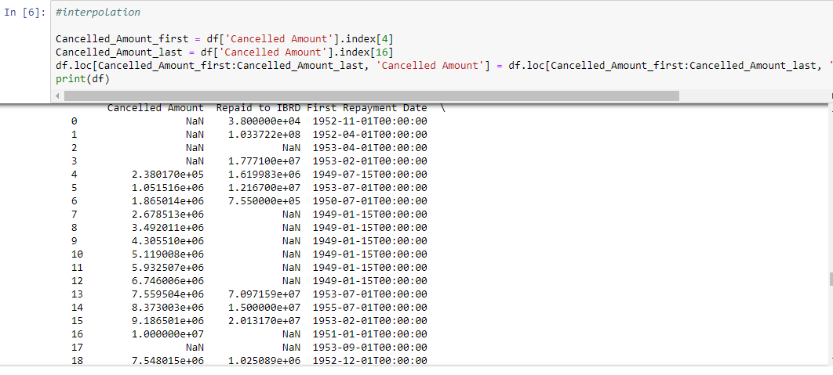
Interpolation

Slide 13
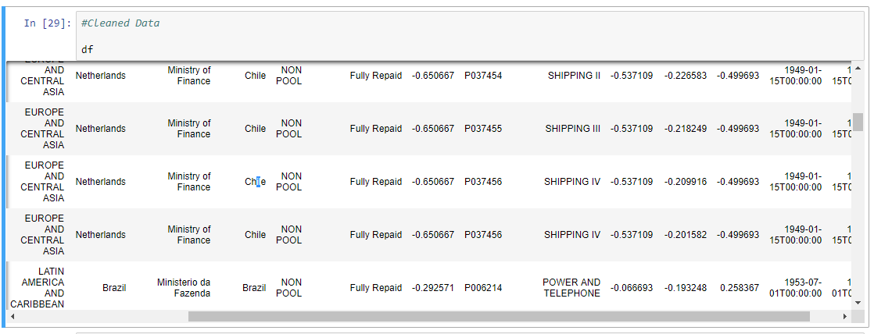
Normalized Data

Slide 14
Data Visualisation
Targets: Interest Rates, Loan Status

Slide 15
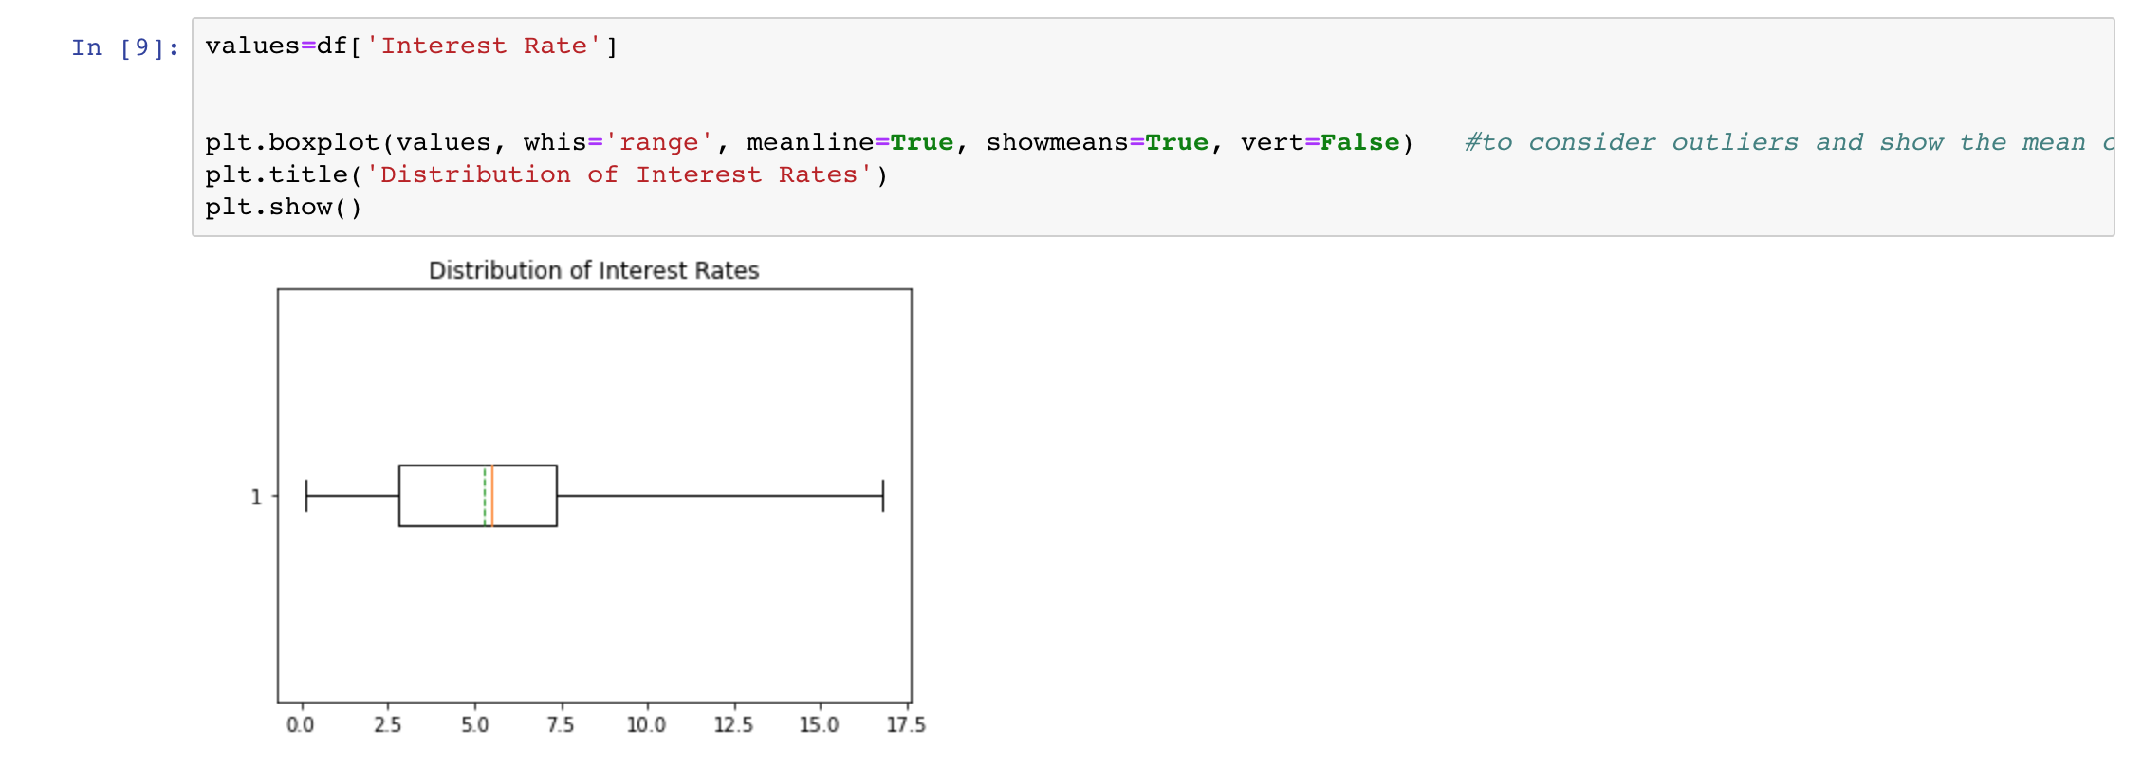
Box plot

Slide 16
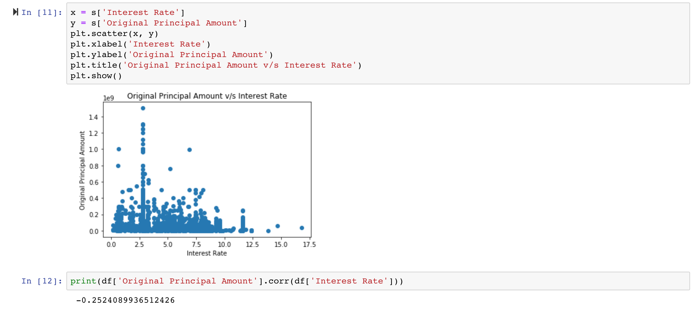
Scatter plot

Slide 17
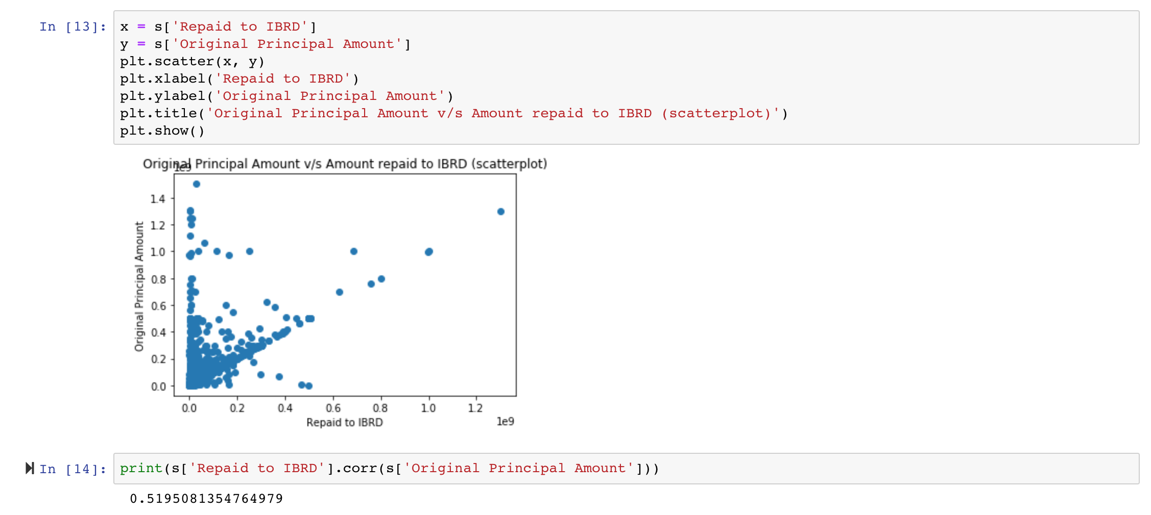
Scatter plot

Slide 18
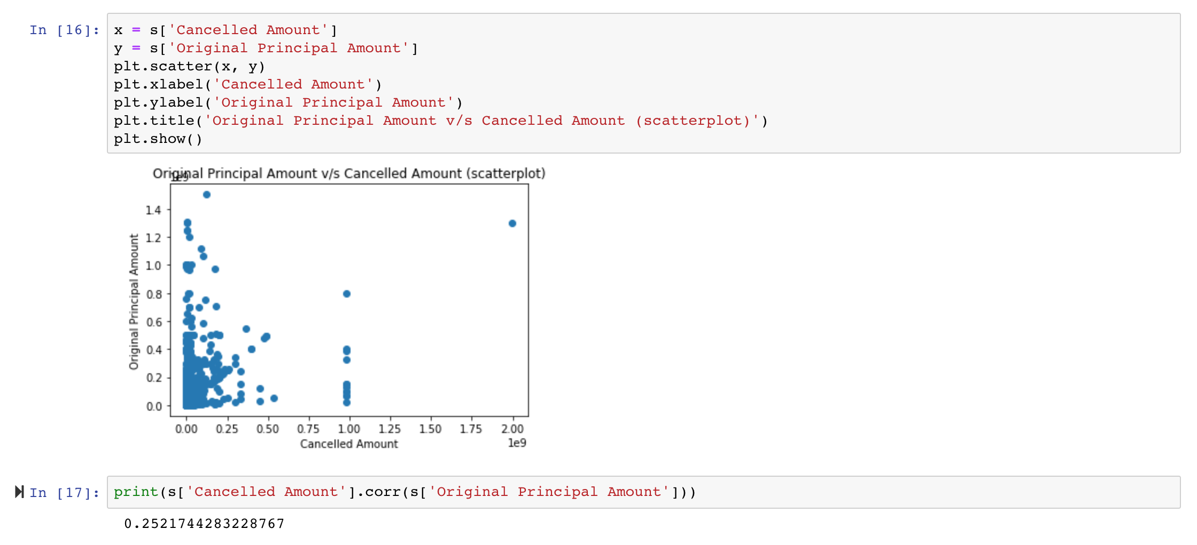
Scatter plot

Slide 19
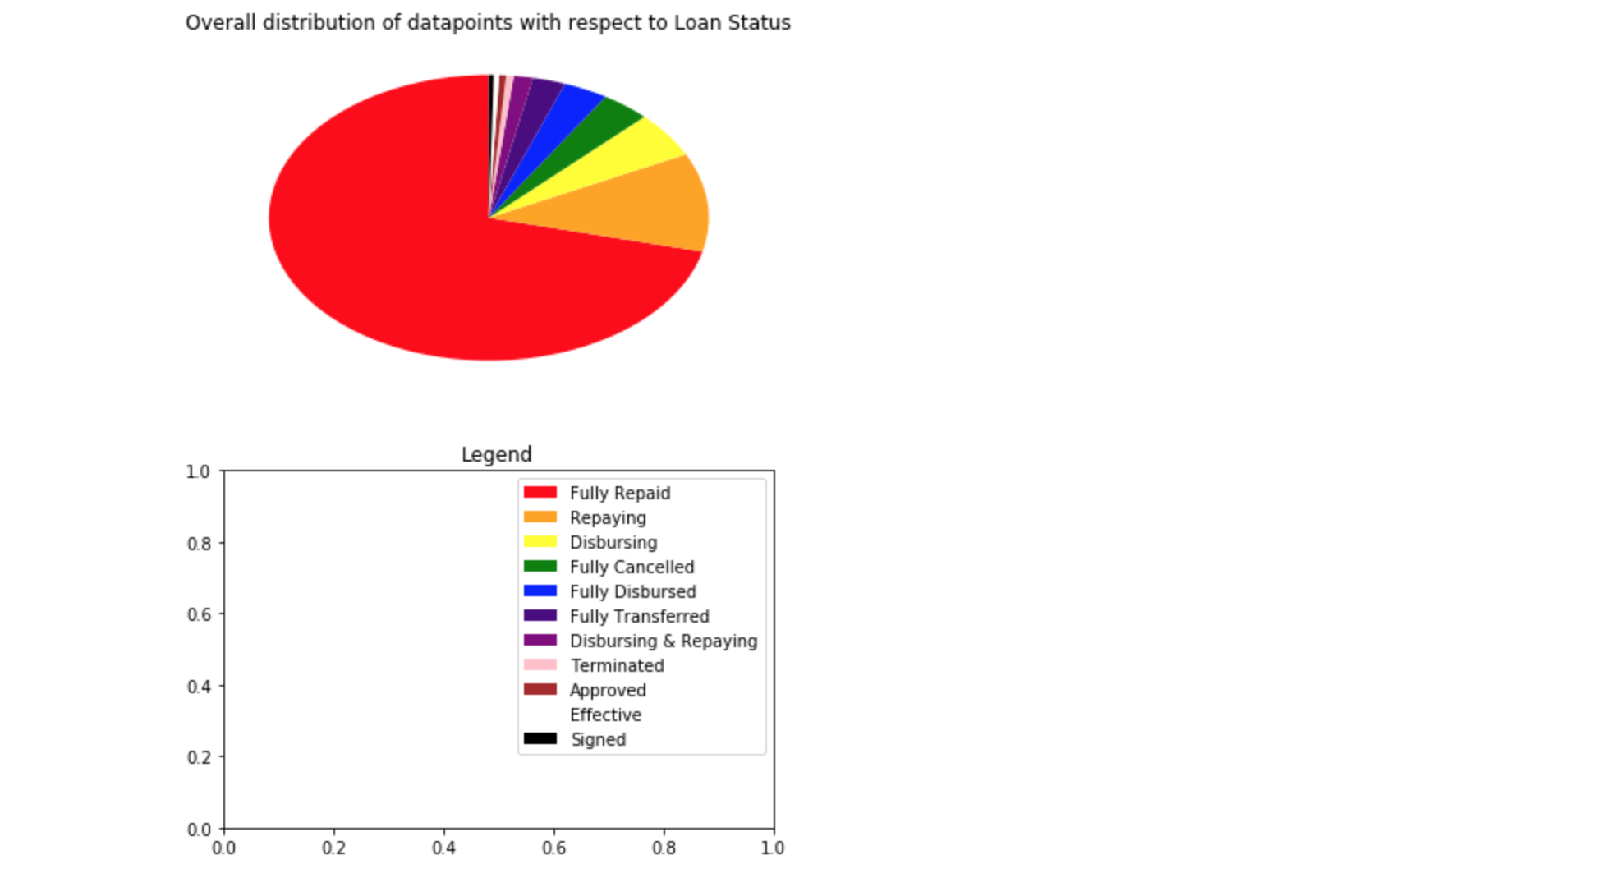
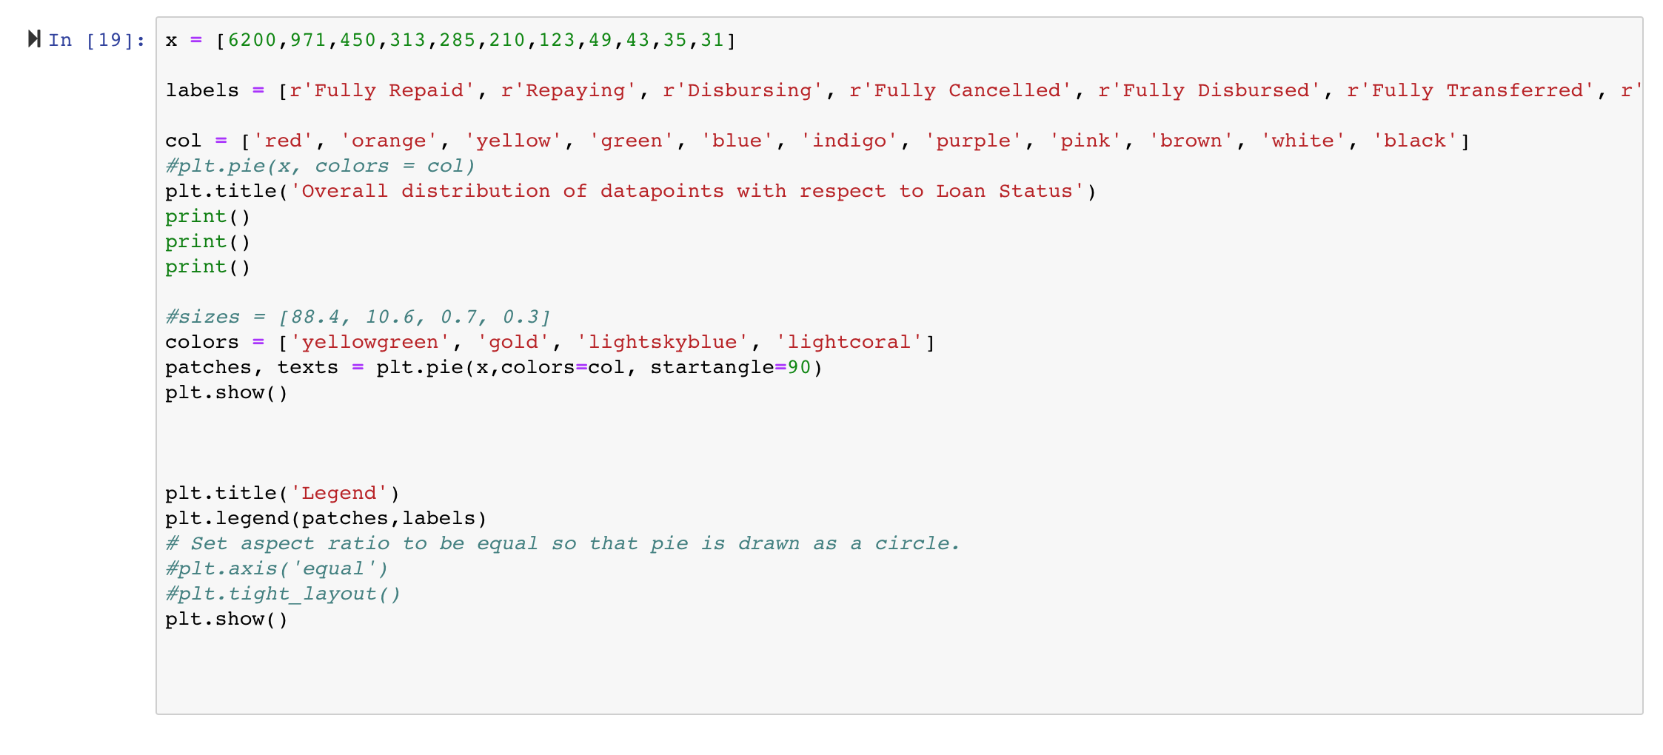
Pie Chart

Slide 20
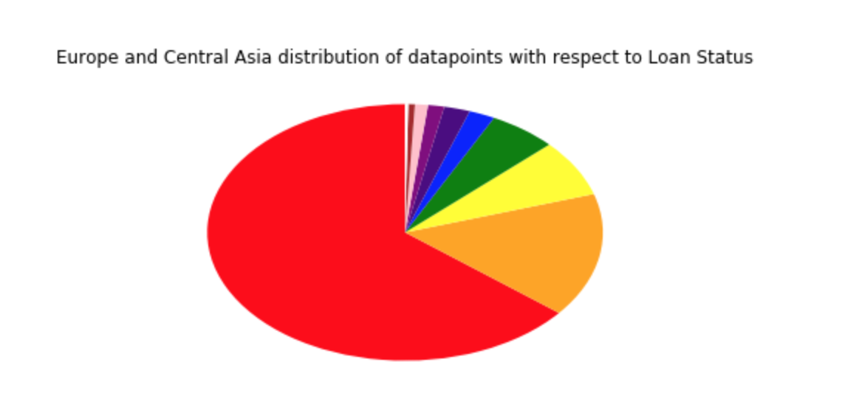
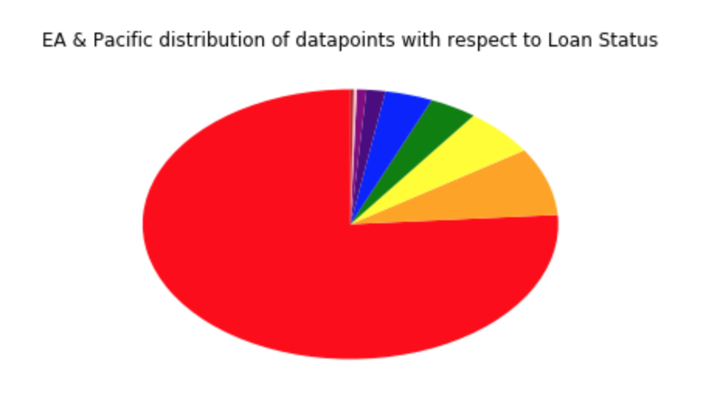
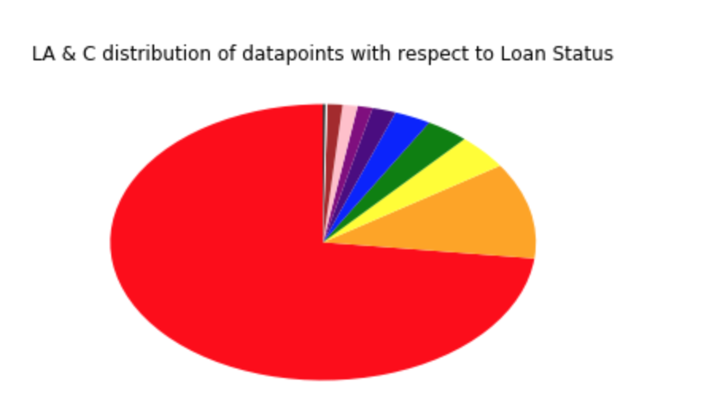
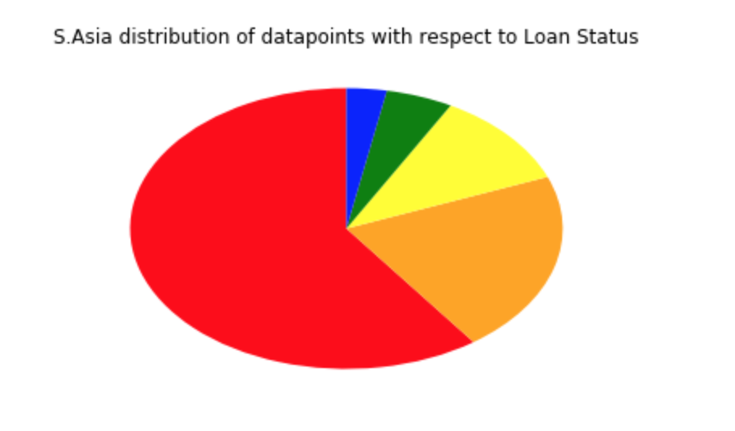
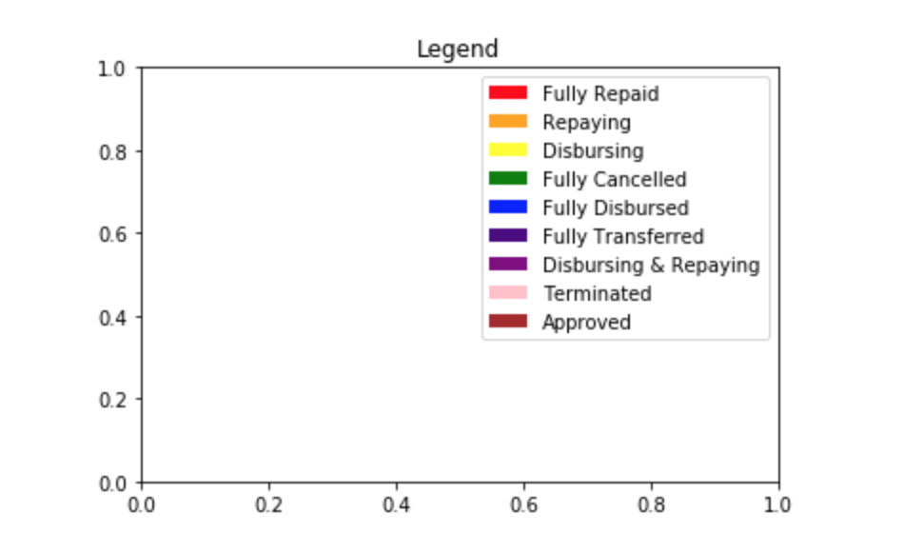

Slide 21
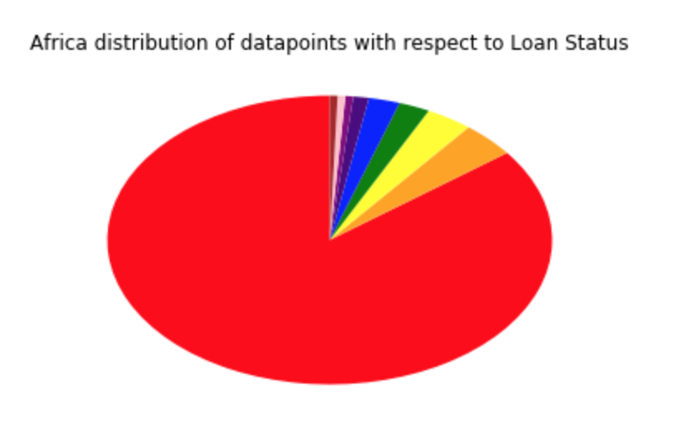
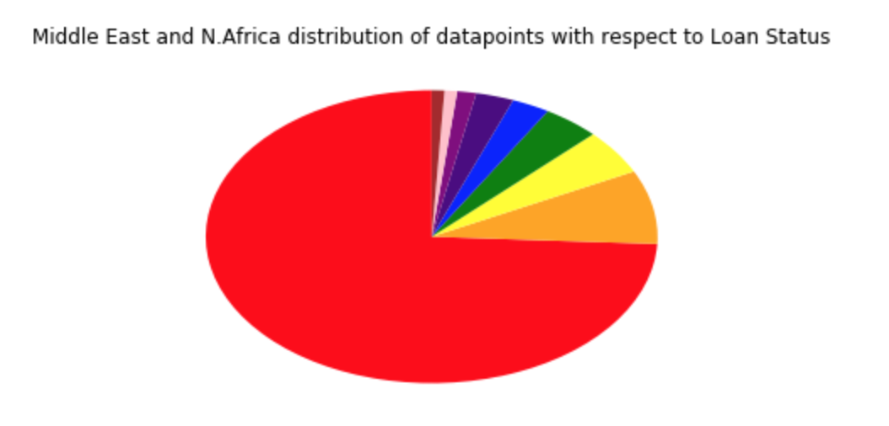

Slide 22
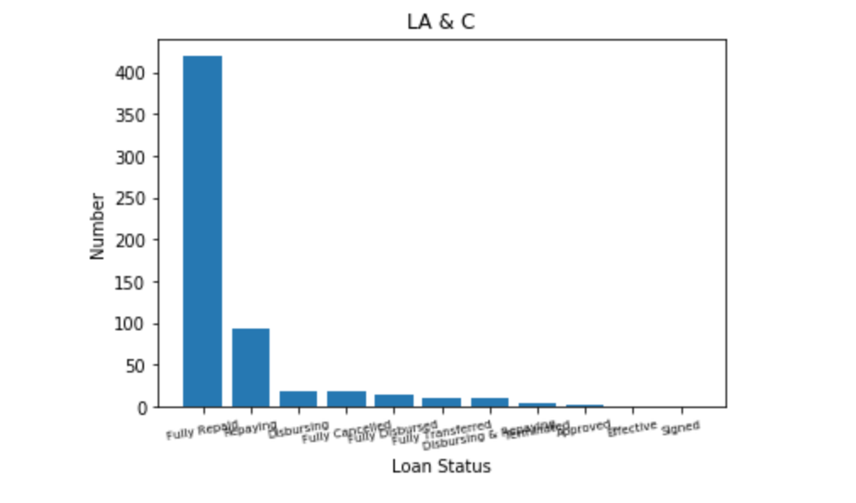

Slide 23
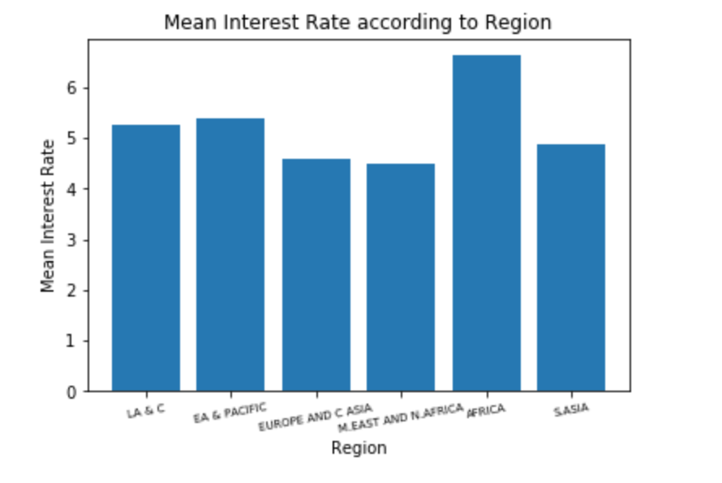
Bar Graph

Slide 24
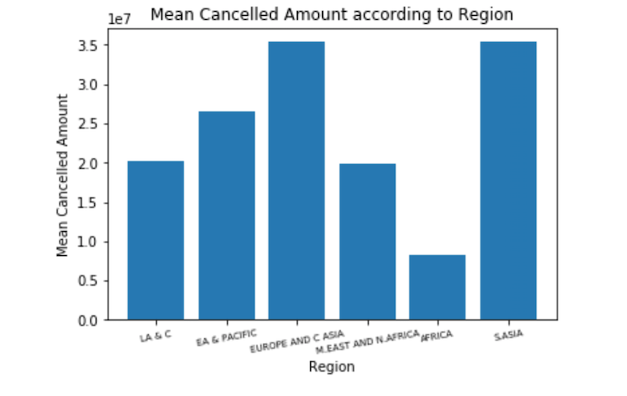
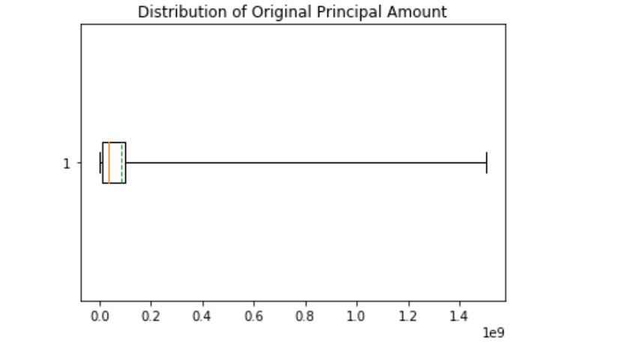
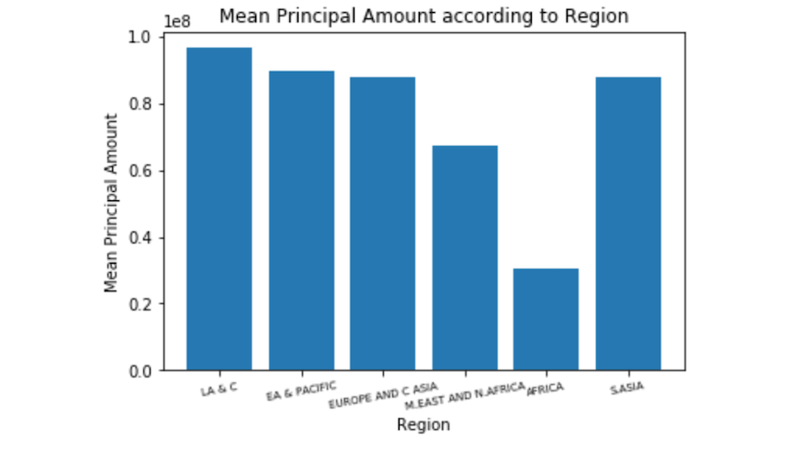
Principle and cancelled amount visualization

Slide 25
Hypothesis Testing
2 sided hypothesis test Performed on Interest rate column
NULL hypothesis: Population mean= 6.028
Alternate hypothesis: Population mean != 6.028
alpha value= 0.05
actual z value : 1.9599639845400545
hypothesis z value : 0.7116184375208856
Conclusion: Failed to reject NULL Hypothesis

Slide 26
Hypothesis Testing
1 sided hypothesis test Performed on Interest rate column
NULL hypothesis: Population mean <= 6.028
Alternate hypothesis: Population mean > 6.028
alpha value= 0.05
actual z value : 1.6448536269514729
hypothesis z value : 0.7116184375208856
Conclusion: Failed to reject NULL Hypothesis

Slide 27
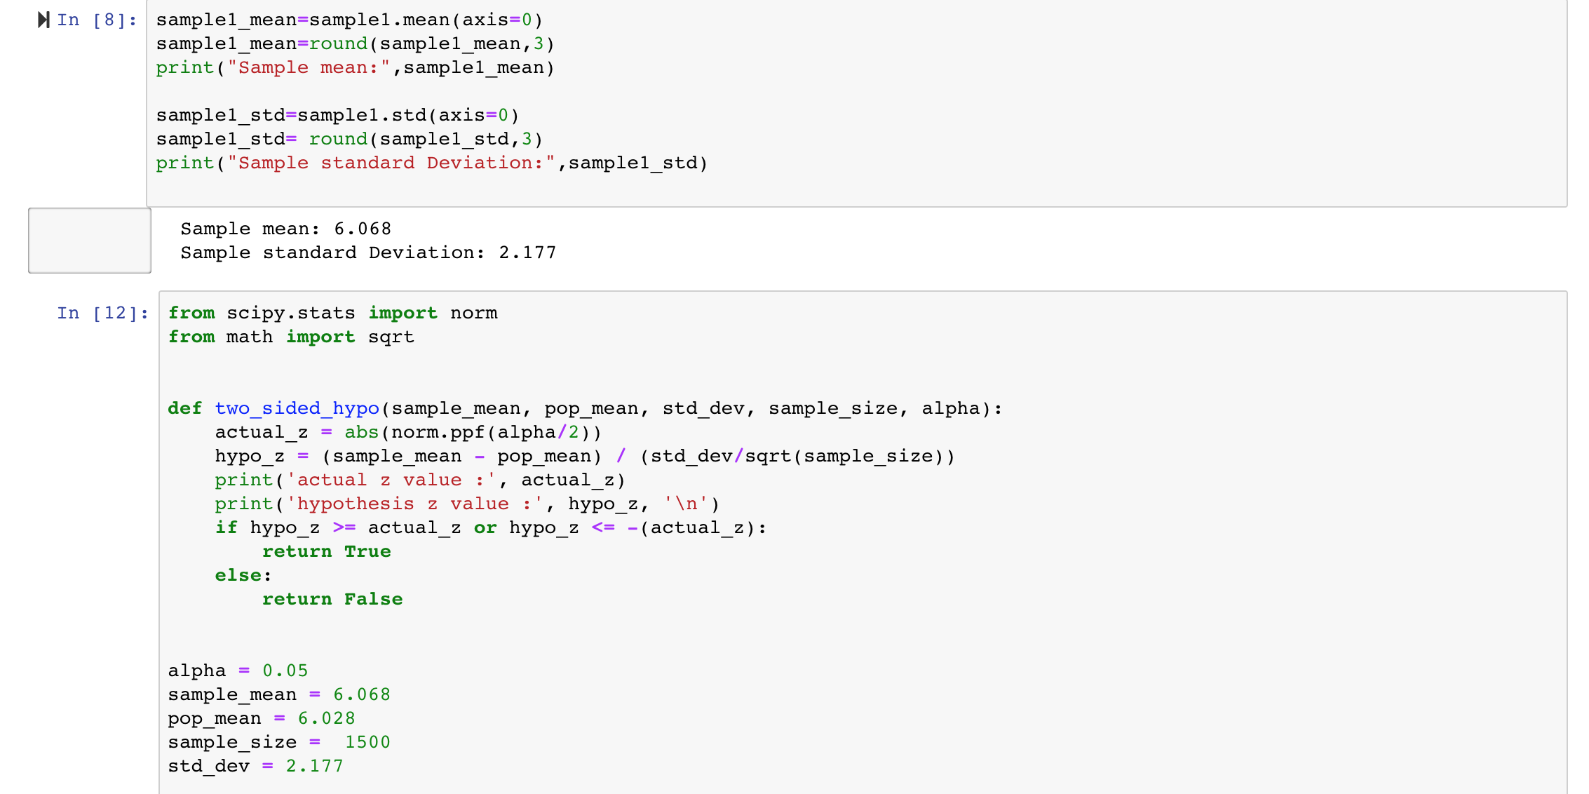
Hypothesis testing

Slide 28
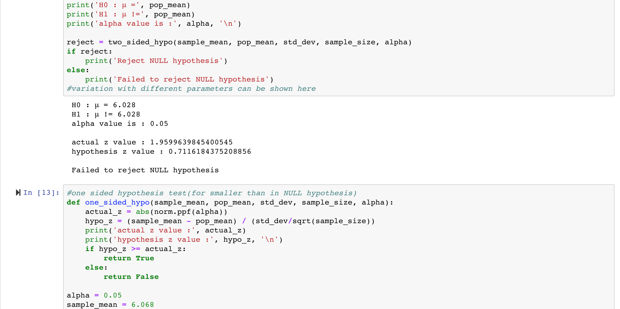
Hypothesis testing

Slide 29
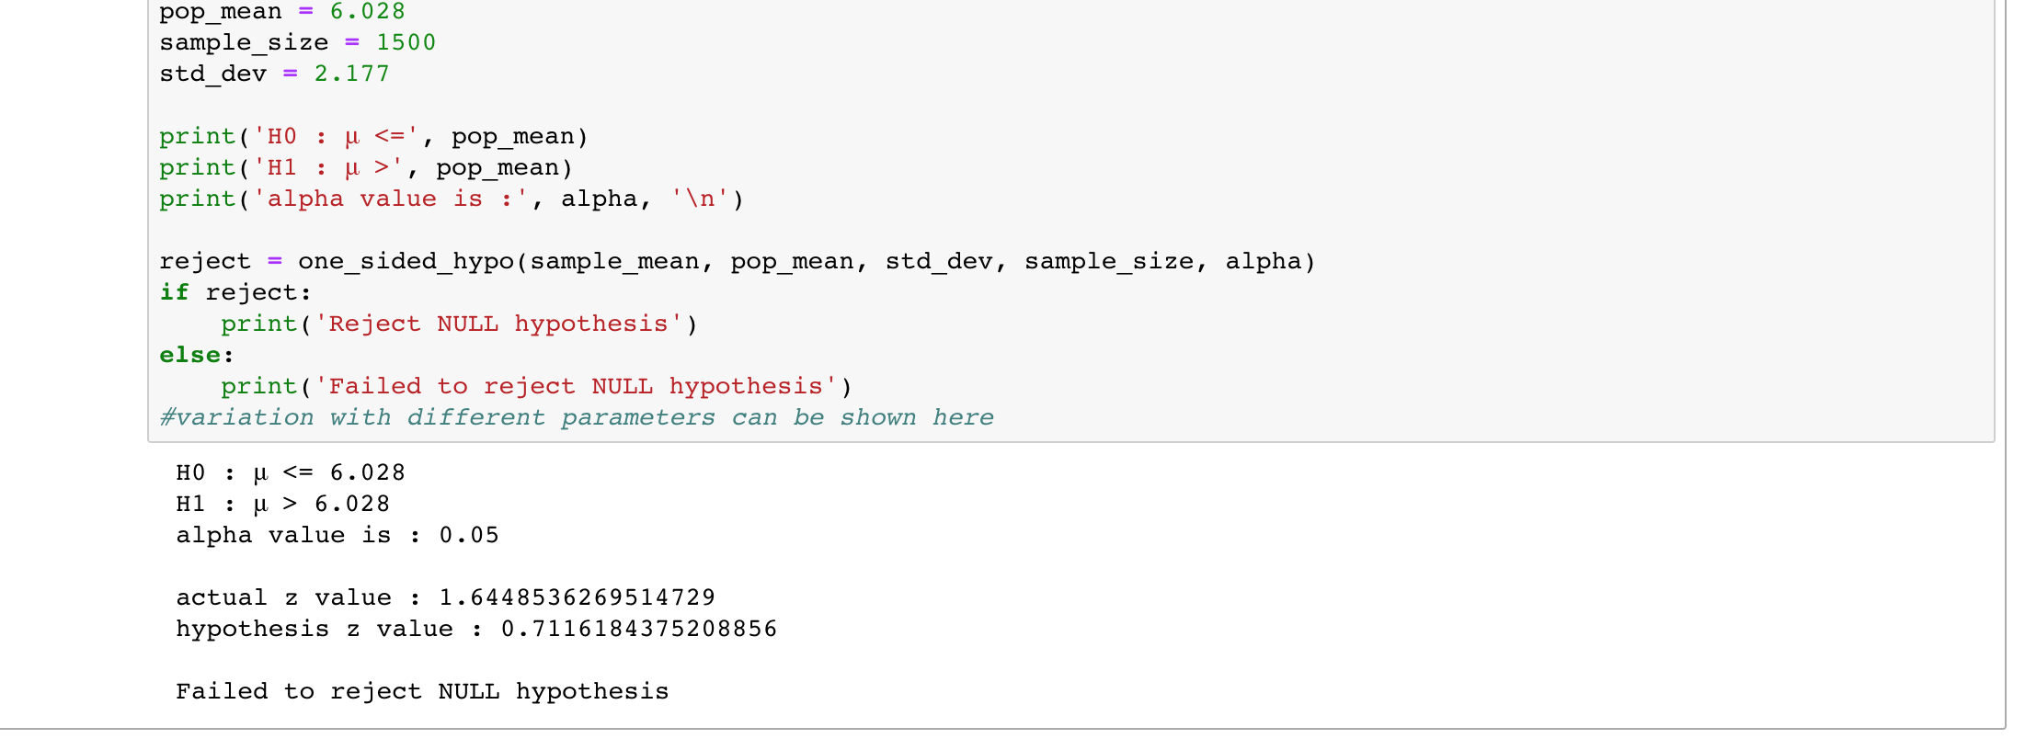
Hypothesis testing

Slide 30
Thank You

