Slide 1
MATLAB END SEMESTER MINI - PROJECT
PES1201700024 : MANEESHA S
PES1201700795 : INDU ANUHYA RALLABHANDI

Slide 2
SPEECH RECOGNITION USING MATLAB

Slide 3
OBJECTIVES
The main purpose of our project is to check if the speech of a given audio file matches with that of an audio file present in our sample. We run a code using MATLAB which compares the speech of a given test file to that of all the audio files in the sample, to check whether it is matched or not.
This is useful in the real world for voice based password locks and similar applications.
This is a very basic feature, whose complex versions are implemented in Apple’s SIRI or Amazon’s ALEXA.

Slide 4
WORK DONE
Our project uses a code to check if the speech of a set of audio files match or mismatch. We have a set of sample files and a set of test files.
When the code is run, a single test file is tested against the sample files and is checked if the speech matches.
If it matches, it says “matched” along with the test audio file. If it is a mismatch, it says “mismatched”.
Also the code is designed to produce graphs for comparison of sound waves of test file against every sample file.
All the audio files are voice recordings from the people we know.
We asked a few people from our friends and family to record movie dialogues in their own voices, without any background noise.

Slide 5
WORK DONE
We have used all of the recordings for our sample set and created our test file such that it is a recording containing the same speech as that in one of the sample files we already have.
We have 100 audio files in our sample and about 10 audio files in our test set.

Slide 6
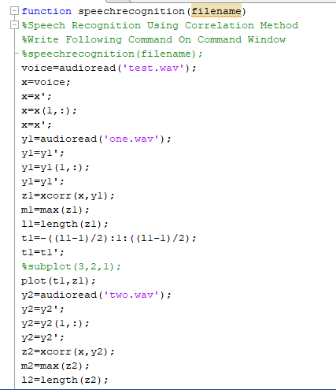
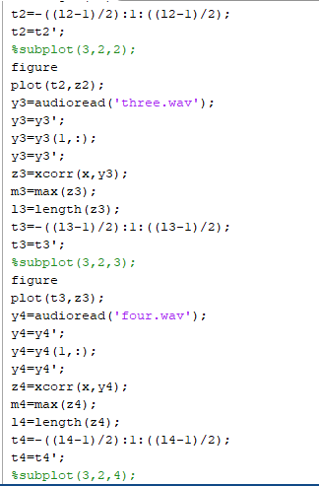
CODE

Slide 7
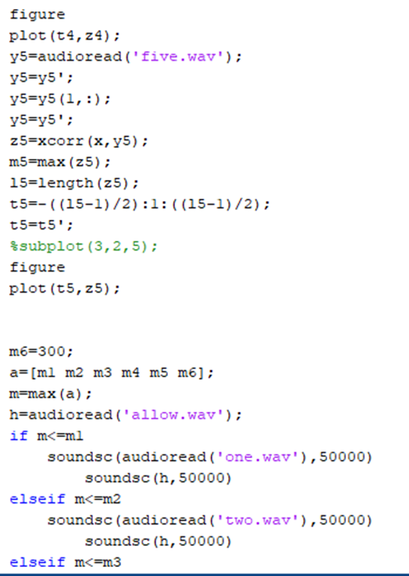
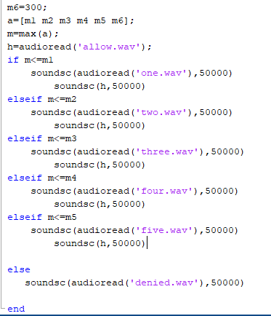
CODE

Slide 8
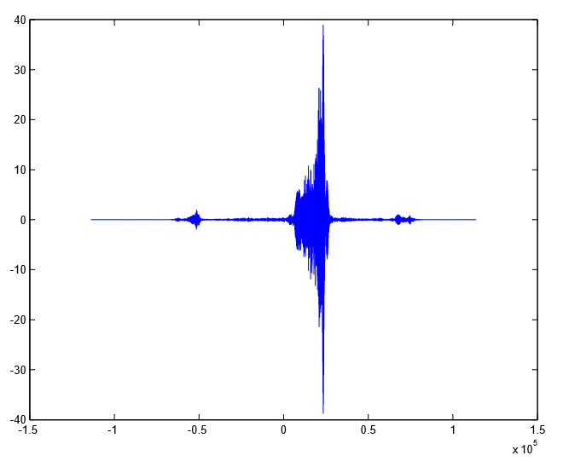
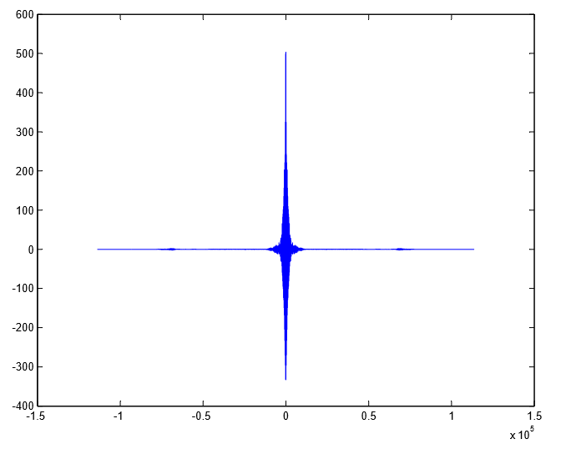
GRAPHS

Slide 9
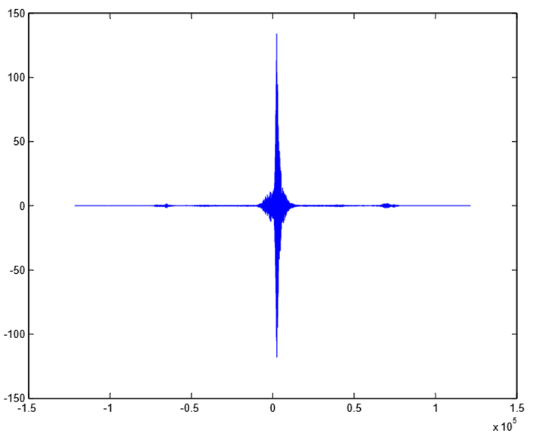
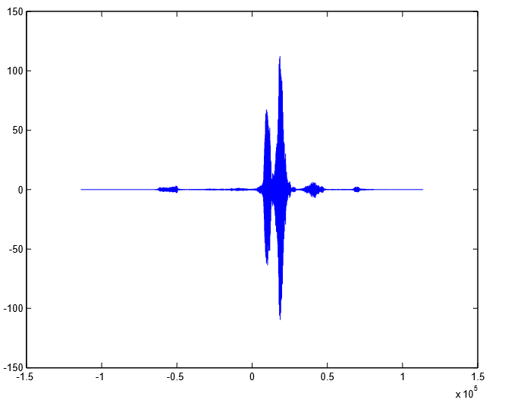
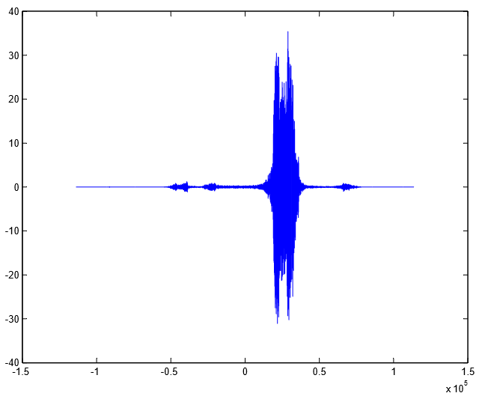

Slide 10
RESULTS AND DISCUSSIONS
The present code when the 2 audio files (the test file and the sample file), are exactly, the same. The files need to be of the exact same length with exact number of pauses at corresponding positions.
Any difference in the 2 files (even in milliseconds), results in a mismatch.
When the 2 files are exactly the same: in terms of speed, length and content; the output is a match. The voices of the 2 audios can be different as long as the length, speed and content are exactly the same.

Slide 11
FUTURE WORKS
The scope for the improvement in our project is that it has too many constraints to match the speeches, which need to be changed. Changing the code, to deduce a match for the 2 audios only based on the speech irrespective of the speeds, voice, number of pauses, length etc., is part of our future work.

