Slide 1
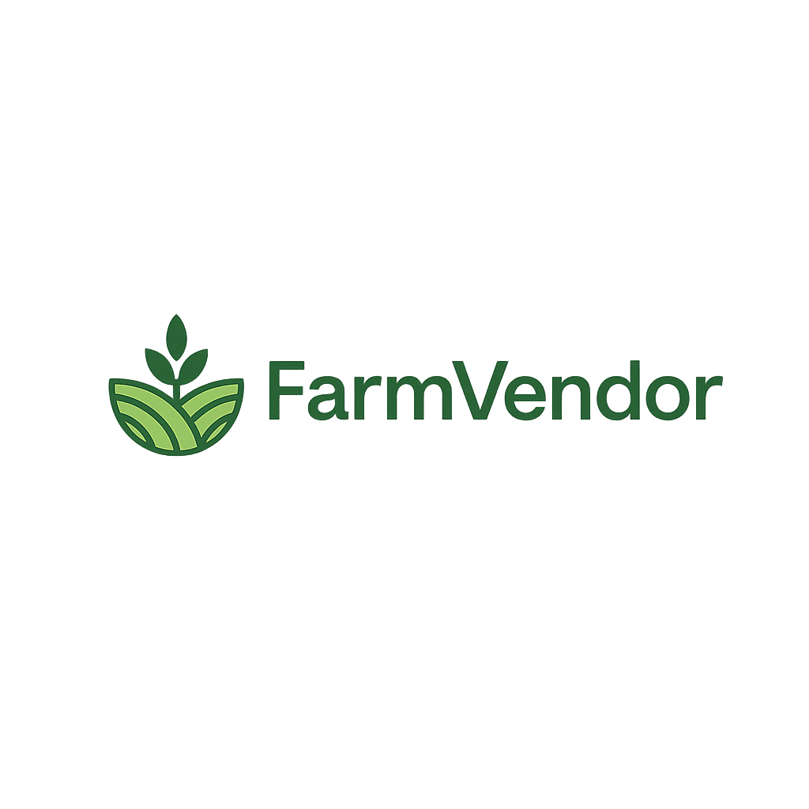
A Role- Based Digital Platform for Farmer-Vendor Coordination with Demand Forecasting and vendor optimization
Maneesha Eeshwara
300392759
CSIS 4495 003

Slide 2
Background
Limited coordination between farmers and vendors in supply chains
Demand uncertainty leads to overproduction and food waste
Vendors experience stock shortages due to poor demand visibility
Decisions are based on manual estimation rather than data
Lack of forecasting and intelligent decision-support systems

Slide 3
Research Methods
Literature review of agricultural supply‑chain systems
Data‑driven analysis using historical and synthetic demand data
Forecasting model comparison (Moving Average vs. ML.NET SSA)
Full‑stack system design with real‑time integration
Scenario‑based evaluation and usability testing

Slide 4
Key Features
• Authentication
• Inventory management
• Demand requests
• Dispatch module
• Forecasting
• Chat
• Analytics

Slide 5
System Architecture
React Frontend
ASP.NET Core Backend
SQL Server DB
ML.NET Forecasting
SignalR Chat

Slide 6
Technology Stack
Frontend: React, Chart.js
Backend: ASP.NET Core, EF Core
DB: SQL Server
ML: ML.NET SSA
Other: SignalR, Unsplash API

Slide 7
Forecasting Approach
• Moving Average
• ML.NET SSA
• Time-series analysis
• Lookback + Horizon based prediction

Slide 8
Project Novelty
• Forecast + Recommendation integration
• Decision-support system
• Relationship scoring
• Real-time analytics

Slide 9
System UI
• Dashboard
• Forecast charts
• Inventory with images
• Dispatch interface

Slide 10
Challenges
• ML integration
• Data limitations
• Chart rendering issues
• API integration
• SignalR auth issues

Slide 11
Lessons Learned
• Clean architecture
• Debugging skills
• Handling real data
• Iterative development
• ML + business logic

Slide 12
Conclusion & Demo
• Intelligent system built
• Improved decision-making
• Ready for demo

