Slide 1

A Role- Based Digital Platform for Farmer-Vendor Coordination with Demand Forecasting and vendor optimization
Maneesha Eeshwara
300392759
CSIS 4495 003

Slide 2

Background
Limited coordination between farmers and vendors in supply chains
Demand uncertainty leads to overproduction and food waste
Vendors experience stock shortages due to poor demand visibility
Decisions are based on manual estimation rather than data
Lack of forecasting and intelligent decision-support systems

Slide 3
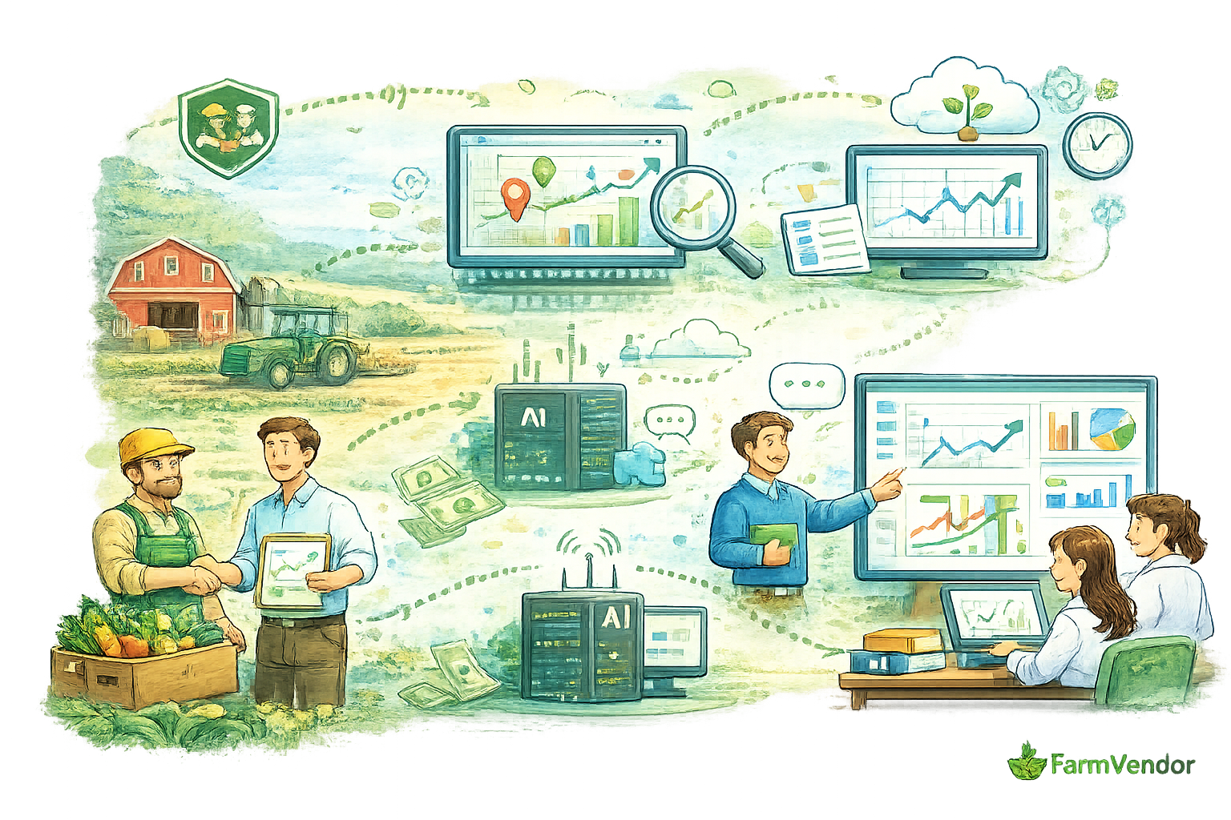
Research Methods
Literature review of agricultural supply‑chain systems
Data‑driven analysis using historical and synthetic demand data
Forecasting model comparison
Full‑stack system design with real‑time integration
Scenario‑based evaluation and usability testing

Slide 4

Key Features
Evolution
Phase 1 Problem Definition
Identified coordination gaps Defined system scope
Phase 2 Core Development
Auth, inventory, demand, dispatch Role-based dashboards
Phase 3 Research & Forecasting
Moving Average baseline ML.NET SSA forecasting
Phase 4 Intelligence
Vendor recommendation Relationship scoring
Phase 5 Final Integration
SignalR chat UI/UX, testing, docs
Transitioned from manual coordination to data‑driven decisions
Introduced forecasting and intelligent recommendations
Enabled real‑time collaboration between farmers and vendors

Slide 5
Research Novelty
Forecast‑Driven Decision Support Integrated demand forecasting directly into dispatch planning and vendor selection rather than treating forecasting as a standalone analytics task.
Cold‑Start‑Aware Forecasting Approach Demonstrated how simulated and incrementally collected data can support early‑stage forecasting when large historical datasets are unavailable.
Comparative Forecasting Research Implemented and evaluated both Moving Average and ML.NET SSA models to study forecasting behavior and impact on decision‑making.
Multi‑Factor Vendor Recommendation Designed a recommendation model that combines forecasted demand, inventory availability, geographical distance, and historical relationships.
Human‑in‑the‑Loop System Design Emphasized interpretability and user control by supporting recommendations rather than full automation, aligning with real agricultural decision practices.

Slide 6
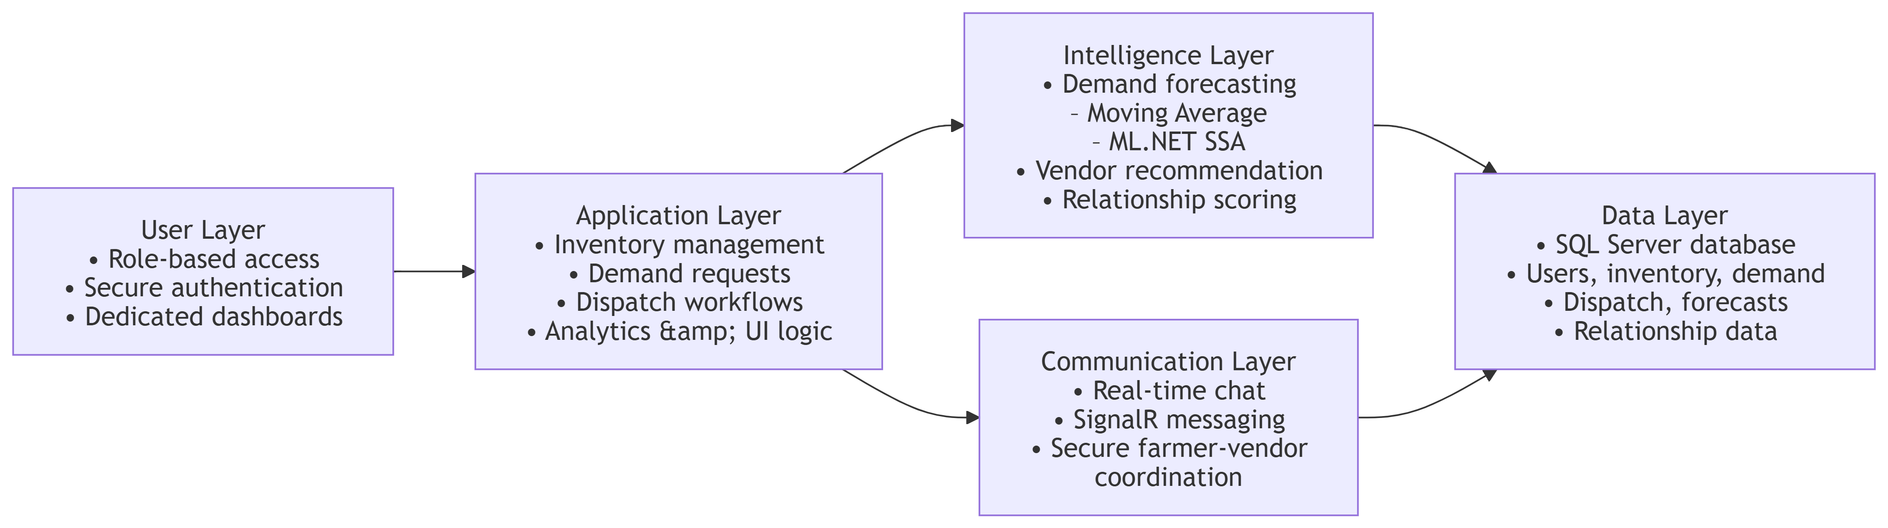
System framework

Slide 7
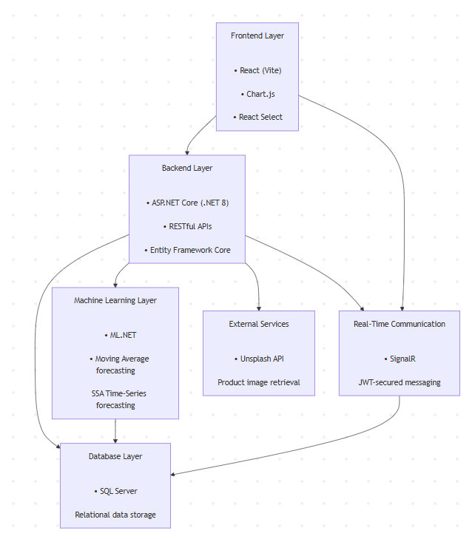
Tech Stack
Frontend (User Interface) React (Vite), custom CSS dashboard styling, JWT handling (localStorage), chart visualization
Backend (Server & APIs) ASP.NET Core (.NET 8), RESTful APIs, ASP.NET Identity + JWT, SignalR
Database Layer SQL Server (LocalDB), Entity Framework Core, core tables (Users, DemandRequest, InventoryLot, DemandForecast, Dispatch)
Machine Learning ML.NET (SSA time‑series forecasting), historical demand‑based prediction
APIs & Integration Forecast APIs, Recommendation API, Search APIs, Postman testing
Development Tools Visual Studio / VS Code, Git & GitHub, Postman, SSMS

Slide 8

Challenges
Implementing ML.NET SSA forecasting required sufficient and realistic historical data
Synchronizing frontend (React) and backend (ASP.NET Core) changes caused integration challenges
Handling JWT authentication and SignalR real-time communication issues
Ensuring forecast data correctly displayed in dashboard and charts
Managing database schema updates without breaking existing features

Slide 9
Lessons learned
Machine learning success depends heavily on data quality and proper data preparation, not just algorithms
Importance of iterative development, debugging, and continuous testing
Strong understanding of full-stack integration (API + UI + database) is critical
User experience (UI/UX) significantly impacts system effectiveness and adoption
System flow need to be cleared before developing database

Slide 10
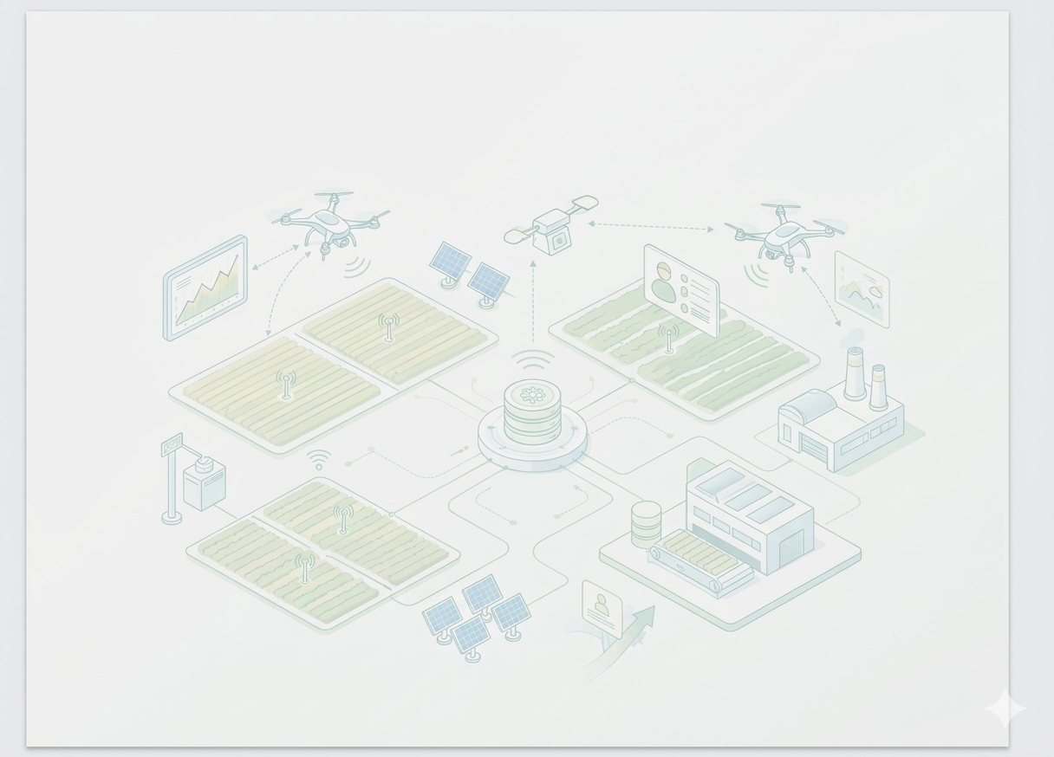
Conclusion
Successfully developed FarmVendor, a role-based platform for farmer–vendor coordination
Integrated ML.NET SSA forecasting to enable data-driven demand prediction
Designed a vendor recommendation system combining demand, inventory, distance, and relationship factors
Implemented real-time communication (SignalR) to improve coordination
Achieved a transition from a transactional system → intelligent decision-support platform

Slide 11
Thank you

