Slide 1
Data Structures and Algorithms Design DSECLZG519

Slide 2
Webinar #1
DSECLZG519 – Exploring applications of Stacks & Amortized Analysis

Slide 3
Agenda for Webinar
Applications of Stacks
Conversion of expression
Evaluation of postfix expression
Introduction to Amortized analysis

Slide 4
Forms of Expression
Arithmetic expressions can be written in 3 different forms or notations :
Infix Notation : Notation in which the operator symbol is placed in between its operands. Ex : A + B , C – D , A * D etc.
Pre-fix Notation : It is also called as Polish notation and refers to the notation in which the operator symbol is placed before its operands (when operator precedes the operands). Ex : +AB, -CD, *AD etc.
Post-fix Notation : It is also called as reverse polish notation and refers to the notation in which the operator symbol is placed after its operands (when operator follows the operands). Ex : AB+ , CD- , AD*

Slide 5
Forms of Expression
Examples :
The computer usually evaluates an arithmetic expression in infix notation in 2 steps. First, it converts the expression to postfix notation, and then it evaluates the postfix expression. Explore why it does this ?
In both these steps, the stack is used !! Let us examine how stack is used ☺
# | Infix | Prefix | Postfix
1 | (A+B) * C | *+ABC | AB+C*
2 | A + ( B * C ) | +A*BC | ABC*+
3 | A ^ B * C – D | - * ^ ABCD | AB ^ C * D -
4 | (A+B)/(C-D) | /+AB-CD | AB+CD-/

Slide 6
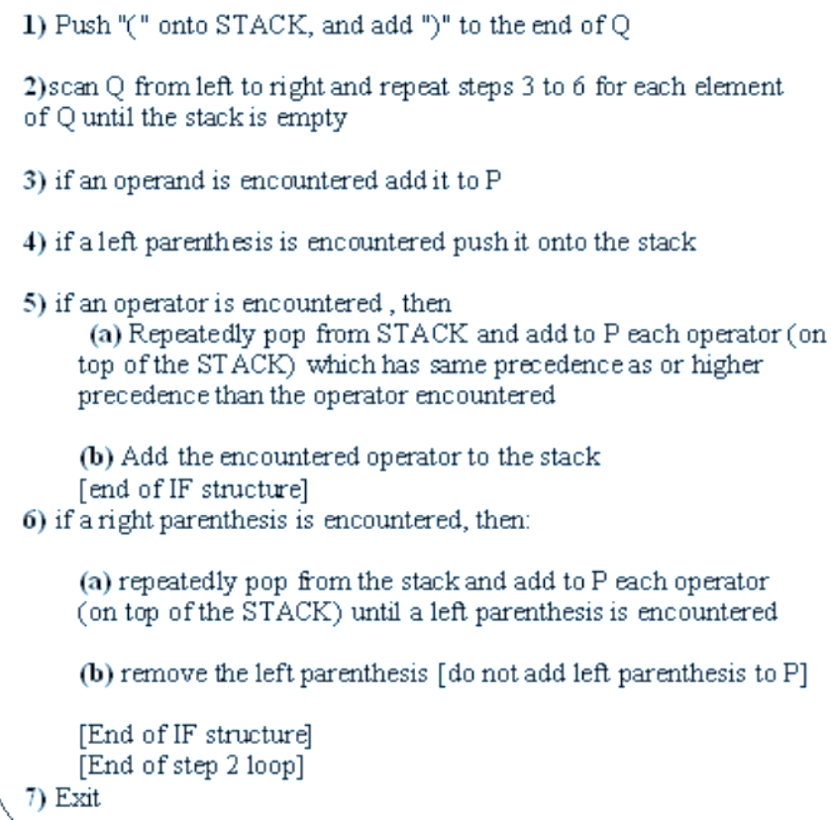
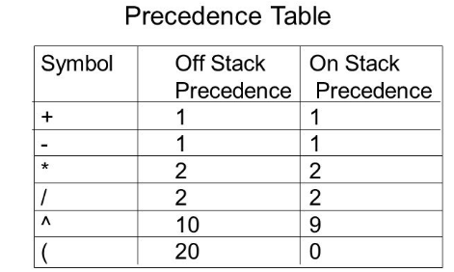
Algorithm: Infix to Postfix using Stack
The following algorithm transforms the infix expression Q into its equivalent postfix expression P.

Slide 7
Example 1: Infix to Postfix using Stack

Slide 8
Example 2 : Converting Infix to Postfix using Stack
Consider the infix expression Q to be A + B * C → A+B*C)
Hence, the postfix expression P is ABC*+
# | Symbol Encountered | Postfix String P (Output) | STACK Contents
1 |  |  | (
2 | A | A | (
3 | + | A | (+
4 | B | AB | (+
5 | * | AB | (+*
6 | C | ABC | (+*
7 | ) | ABC* | (+
8 | - | ABC*+ | (
9 | - | ABC*+ | Empty

Slide 9
Example 3: Converting Infix to Postfix using Stack
Consider the infix expression Q to be (A+B) * C ➔ (A+B) * C )
Hence, the postfix expression P is AB+C*
# | Symbol Encountered | Postfix String P (Output) | STACK Contents
1 |  |  | (
2 | ( |  | ((
3 | A | A | ((
4 | + | A | ((+
5 | B | AB | ((+
6 | ) | AB+ | (
7 | * | AB+ | (*
8 | C | AB+C | (*
9 | ) | AB+C* | Empty
10 | - | AB+C* | Empty

Slide 10
Appendix Exercise
1) Convert the following infix expressions into postfix
expressions using stack ( trace it as we did in class ) :
A+(B+C)*D
B+C-D/E*F
(A+B)+(C/D)*E
A+B*(C+D-E)*F
After you solve it, verify your answer by putting the infix expression in this tool : https://www.mathblog.dk/tools/infix-postfix-converter/

Slide 11
Algorithm: Evaluation of Postfix expression using Stack
Algorithm:
1) Add a right parentheses “)” at the end of the arithmetic expression F
2) Scan F from left to right and repeat step 3 and step 4 for each element of F until the sentinel “)” is encountered.
3) If an operand is encountered, put it onto stack
4) If an operator is encountered, then :
a. Remove the 2 top elements from the stack, where n1 is the top element and n2 is the next-to-top element.
b. Evaluate n2 n1
c. Place the result of (b) back on stack.
Endif
End of step 2 loop
5) Set value equal to the top element of stack.
6) Exit
X
X
X
: is any operator

Slide 12
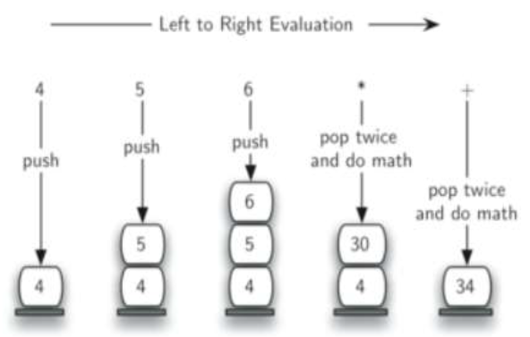
Example 1: Evaluation of Postfix expression using Stack
4 5 6*+

Slide 13
Example 2: Evaluation of Postfix expression using Stack
7 8 + 3 2 + /

Slide 14
Example 3: Evaluation of Postfix expression using stack
Evaluate AB+C-BA+C^- where A=1,B=2 and C=3
➔ 1 2 + 3 – 2 1 + 3 ^ - )
Symbol Encountered | N1 (top) | N2(2nd top) | Value = N2 op N1 | STACK
1 |  |  |  | 1
2 |  |  |  | 1 2
+ | 2 | 1 | 1+2 = 3 | 3
3 |  |  |  | 3 3
- | 3 | 3 | 3 -3 = 0 | 0
2 |  |  |  | 0 2
1 |  |  |  | 0 2 1
+ | 1 | 2 | 2+1 = 3 | 0 3
3 |  |  |  | 0 3 3
^ | 3 | 3 | 3^3 = 27 | 0 27
- | 27 | 0 | 0 – 27 = -27 | -27
) | - | - | -27 | Empty
Hence, the evaluation of this expression leads to the answer -27

Slide 15
Amortized Analysis
Amortized analysis is a method of analyzing the costs associated with a data structure that averages the worst operations out over time.
Often, a data structure has one particularly costly operation, but it doesn't get performed very often.
That data structure shouldn't be labeled a costly structure just because that one operation, that is seldom performed, is costly.
Ex : Amortized cost of a sequence of operations can be seen as expenses of a salaried person. The average monthly expense of the person is less than or equal to the salary, but the person can spend more money in a particular month by buying a car or joining a course etc.. In other months, he or she saves money for the expensive month.

Slide 16
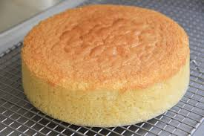
Amortized Analysis – Real Life Example
Let's say you want to make a cake for the bake sale. Cake-making is pretty complex, but it's essentially two main steps:
Mix batter (fast).
Bake in an oven (slow, and you can only fit one cake in at a time).
Mixing the batter takes relatively little time when compared with baking. Afterwards, you reflect on the cake-making process. When deciding if it is slow, medium, or fast, you choose medium because you average the two operations—slow and fast—to get medium.
Now let's say you wanted to make 100 cakes. You have two options for how to bake 100 cakes. You can mix the batter for a single cake, bake it, and repeat. Or, you can mix the batter for all 100 cakes, then bake all of them, one after another. Are these methods slow, medium, or fast?
Amortized analysis tells us that these two methods should both be described as "medium", even though you might have to bake 100 cakes sequentially. Even though you might have to work through 100 slow operations in a row, they were preceded by 100 fast operations, so the average is still medium.
Worst-case means that it is not possible to dream up a worse sequence of events. It doesn't make any sense, for instance, to skip the batter mixing operation and simply bake 100 cakes. That would be a slow baking process, but it doesn't make any sense, so it's not worth analyzing. The cake-baking process is a medium process because mixing cake batter and baking the cake have a logical ordering that cannot be reversed.

Slide 17
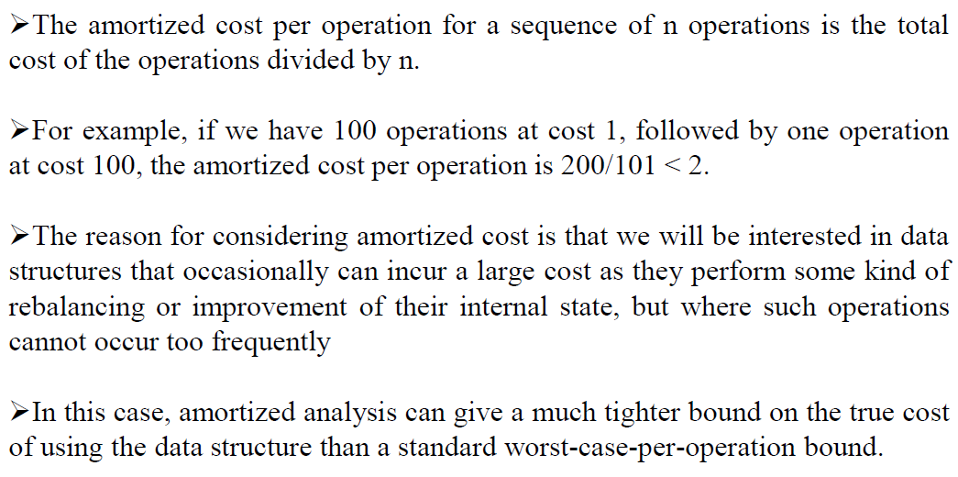
Amortized cost per operation

Slide 18
Amortized Analysis-Dynamic table
The idea is to increase size of table whenever it becomes full. Following are the steps to follow when table becomes full :
Allocate memory for a larger table of size, typically twice the old table.
Copy the contents of old table to new table.
Free the old table.
If the table has space available, we simply insert new item in
available space.

Slide 19
Amortized Analysis-Dynamic table
Cost
1
2
3 , 1
5,1,1,1
9
1
Insert item 1
Overflow
1 | 2
Insert item 2
Overflow
1 | 2 | 3 | 4
Insert item 3 and 4
Overflow
1 | 2 | 3 | 4 | 5 | 6 | 7 | 8
Insert item 5,6,7 and 8
Overflow
1 | 2 | 3 | 4 | 5 | 6 | 7 | 8 | 9
Analysis
The worst case cost of an insertion is O(n).
Worst case cost of n inserts is n * O(n) is O(n²).
BUT All insertions don’t take O(n) time!!!!

Slide 20
Amortized Analysis-Dynamic table
Analysis-Amortised cost (For inserting 9 elements)
= (1+2+3+1+5+1+1+1+9)/9
=((1+1+1+1+1+1+1+1+1) +( 1+2+4+8) )/9
=( n + (1+2+4+..+2^i))/n where 2^i <n
(if all operations are pushes then 2^i will be the largest power of 2 less than n, This sum is at most 2n − 1)
=(n + 2n − 1)/n
<=3n/n
<=3 is O(1)

Slide 21
Amortized Analysis Types
An amortized analysis is a strategy for analyzing a sequence of operations
To show that the average cost per operation is small, even though a single operation within the sequence might be expensive.
Even though we’re taking averages, however, probability is not involved!
An amortized analysis guarantees the average performance of
each operation in the worst case.
Three different approaches:
Aggregate method: brute force
Accounting method: assign costs to each operation so that it is
easy to sum them up while still ensuring that result is accurate
Potential method: a more sophisticated version of the accounting method

Slide 22

Until we cross paths again, Ciao!

Slide 23
Thank You for your time & attention !
Contact : parthasarathypd@wilp.bits-pilani.ac.in
Slides are Licensed Under : CC BY-NC-SA 4.0

