Slide 1
S1-23 DSECLZG532 Introduction to Data Science Webinar-2

Slide 2

The slides presented here are obtained from the authors of the books and from various other contributors. I hereby acknowledge all the contributors for their material and inputs.
I have added and modified a few slides to suit the requirements of the course.

Slide 3
Review of Concepts

Slide 4
Data Science Tasks...
Classification [Predictive]
Clustering [Descriptive]
Association Rule Discovery [Descriptive]
Sequential Pattern Discovery [Descriptive]
Regression [Predictive]
Deviation Detection [Predictive]

Slide 5
Major Tasks in Data Preprocessing
Data cleaning
Fill in missing values, smooth noisy data, identify or remove outliers, and resolve inconsistencies
Data integration
Integration of multiple databases, data cubes, or files
Data reduction
Dimensionality reduction
Numerosity reduction
Data compression
Data transformation and data discretization
Normalization
Concept hierarchy generation
BTW, Why should we preprocess data?

Slide 6
Correlation Analysis (Nominal Data)
χ² (chi-square) test
The larger the χ² (chi-square) value, the more likely the variables are related
The cells that contribute the most to the χ² value are those whose actual count is very different from the expected count
Correlation does not imply causality
# of hospitals and # of car-theft in a city are correlated
Both are causally linked to the third variable: population

Slide 7
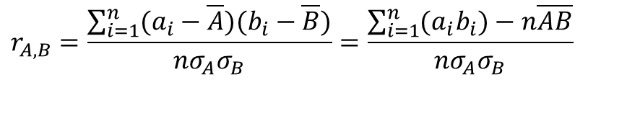
Correlation Analysis (Numeric Data)
Correlation coefficient (also called Pearson’s product moment coefficient)
where n is the number of tuples, and are the respective means of A and B, σ_{A} and σ_{B} are the respective standard deviation of A and B, and Σ(a_{i}b_{i}) is the sum of the AB cross-product.
If r_{A,B} > 0, A and B are positively correlated (A’s values increase as B’s). The higher, the stronger correlation.
r_{A,B} = 0: independent; r_{AB} < 0: negatively correlated
$$r_{A,B}=\frac{\sum_{i=1}^{n}{(a_{i}−\overline{A})(b_{i}−\overline{B})}}{nσ_{A}σ_{B}}=\frac{\sum_{i=1}^{n}{(a_{i}b_{i})−n\overline{A}\overline{B}}}{nσ_{A}σ_{B}}$$

Slide 8
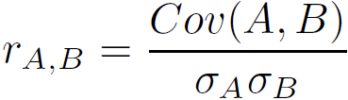
Covariance (Numeric Data)
Covariance is similar to correlation
where n is the number of tuples, and are the respective mean or expected values of A and B, σ_{A} and σ_{B} are the respective standard deviation of A and B
Positive covariance: If Cov_{A,B} > 0, then A and B both tend to be larger than their expected values
Negative covariance: If Cov_{A,B} < 0 then if A is larger than its expected value, B is likely to be smaller than its expected value
Independence: Cov_{A,B} = 0
Correlation coefficient:

Slide 9
Normalization
Min-max normalization: to [new_min_{A}, new_max_{A}]
Ex. Let income range $12,000 to $98,000 normalized to [0.0, 1.0]. Then $73,600 is mapped to
Z-score normalization (μ: mean, σ: standard deviation):
Ex. Let μ = 54,000, σ = 16,000. Then
Normalization by decimal scaling
Where j is the smallest integer such that Max(|ν’|) < 1

Slide 10
Simple Discretization: Binning
Equal-width (distance) partitioning
Divides the range into N intervals of equal size: uniform grid
if A and B are the lowest and highest values of the attribute, the width of intervals will be: W = (B –A)/N.
The most straightforward, but outliers may dominate presentation
Skewed data is not handled well
Equal-depth (frequency) partitioning
Divides the range into N intervals, each containing approximately same number of samples
Good data scaling
Managing categorical attributes can be tricky

Slide 11
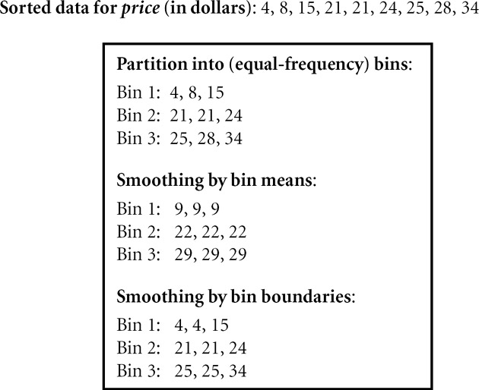
Binning Methods for Data Smoothing

Slide 12
A candidate took two exams - AIIMS PG and JIPMER PG. The summary statistics of the results for each exam are given below
He scored 172 in AIIMS PG and 37 in JIPMER PG. In which exam he did better?
Exam | Mean | Standard Deviation | Candidate Score
AIIMS PG | 151 | 10 | 172
JIPMER PG | 25.1 | 6.4 | 37

Slide 13
An engineering institution has conducted a poll on its students to assess their habits and study performances. In this survey it was found that out of 4500 students participated, 40% of them got first division and among them 2/3rd like sports and others don’t like sports. The remaining students secured Second division, and among them 45% of the students do not like sports. Using Chi square test, with a significance level of 0.05, establish the inference whether the performance of the students is related to their interest in movies

Slide 14
 | First | Second | Total
Likes sport | 1200 | 1215 | 2415
Does not like sports | 600 | 1485 | 2085
 | 1800 | 2700 | 4500

Slide 15
 | First | Second | Total
Likes sport | 1200 | 1215 | 2415
Does not like sports | 600 | 1485 | 2085
 | 1800 | 2700 | 4500
contingency table of expected values
 | First | Second
Likes sport | 2415x1800/4500=966 | 2415x 2700/4500 =1449
Does not like sports | 2085 x1800/4500 =834 | 2085 x 2700/4500 =1251
Apply the formula, χ² (chi square)= 203.89

Slide 16
Correlation and Covariance
Stock | Day 1 | Day2 | Day3 | Day4 | Day5
Infosys | 1365 | 1306 | 1232 | 1199 | 1134
TCS | 1941 | 1847 | 1745 | 1766 | 1425
Stock | Day 1 | Day2 | Day3 | Day4 | Day5
ACC | 1527 | 1338 | 1356 | 1583 | 1508
Ultratech | 4190 | 3802 | 3735 | 4110 | 3945
cov(infosys, tcs) 16074.55
cov(acc, ultratech) 18964.8
cor(infosys, tcs) 0.913
cor(acc, ultratech) 0.894

Slide 17
Basic Statistical Descriptions of Data
Motivation
To better understand the data: central tendency, variation and spread
Data dispersion characteristics
median, max, min, quantiles, outliers, variance, etc.
Numerical dimensions correspond to sorted intervals
Data dispersion: analyzed with multiple granularities of precision
Boxplot or quantile analysis on sorted intervals
Dispersion analysis on computed measures
Folding measures into numerical dimensions
Boxplot or quantile analysis on the transformed cube
Notes:
Note to self (MK): last part of slide does not clearly match slides that follow
Introduction slides:
In the current version, we only talk about numeric data. Can we add some materials about non-numeric data.
- text statistics, TF/IDF
- visualization of text statistics such as word cloud
- distribution of Internet (IN, SCC, OUT, …)
- visualization of social relationship (e.g., http://renlifang.msra.cn/)

Slide 18
Data Reduction

Slide 19
Data Reduction Strategies
Data reduction: Obtain a reduced representation of the data set that is much smaller in volume but yet produces the same (or almost the same) analytical results
Why data reduction? — A database/data warehouse may store terabytes of data. Complex data analysis may take a very long time to run on the complete data set.
Data reduction strategies
Dimensionality reduction, e.g., remove unimportant attributes
Numerosity reduction (some simply call it: Data Reduction)
Data compression

Slide 20
Data Reduction : Dimensionality Reduction
Curse of dimensionality
When dimensionality increases, data becomes increasingly sparse
Density and distance between points, which is critical to clustering, outlier analysis, becomes less meaningful
The possible combinations of subspaces will grow exponentially
Dimensionality reduction
Avoid the curse of dimensionality
Help eliminate irrelevant features and reduce noise
Reduce time and space required in knowledge discovery
Allow easier visualization
Dimensionality reduction techniques
Wavelet transforms
Principal Component Analysis
Supervised and nonlinear techniques (e.g., feature selection)
Notes:
20

Slide 21
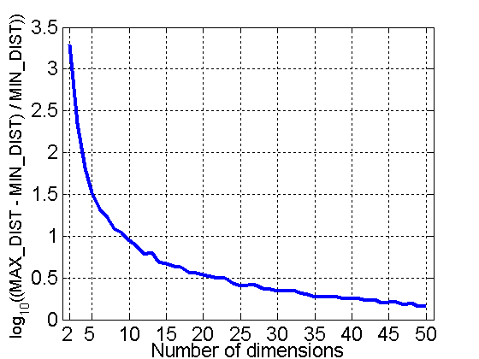
Curse of Dimensionality
When dimensionality increases, data becomes increasingly sparse in the space that it occupies
Definitions of density and distance between points, which are critical for clustering and outlier detection, become less meaningful
When dimensionality increases, data becomes increasingly sparse in the space that it occupies
Definitions of density and distance between points, which are critical for clustering and outlier detection, become less meaningful
Randomly generate 500 points
Compute difference between max and min distance between any pair of points

Slide 22
Principal Component Analysis (PCA)
Find a projection that captures the largest amount of variation in data
The original data are projected onto a much smaller space, resulting in dimensionality reduction.
x₂
e
x₁

Slide 23
Principal Component Analysis (Steps)
Given N data vectors from n-dimensions, find k ≤ n orthogonal vectors (principal components) that can be best used to represent data
Normalize input data: Each attribute falls within the same range
Compute k orthonormal (unit) vectors, i.e., principal components
Each input data (vector) is a linear combination of the k principal component vectors
The principal components are sorted in order of decreasing “significance” or strength
Since the components are sorted, the size of the data can be reduced by eliminating the weak components, i.e., those with low variance (i.e., using the strongest principal components, it is possible to reconstruct a good approximation of the original data)
Works for numeric data only

Slide 24
Attribute Subset Selection
Another way to reduce dimensionality of data
Redundant attributes
Duplicate much or all of the information contained in one or more other attributes
E.g., purchase price of a product and the amount of sales tax paid
Irrelevant attributes
Contain no information that is useful for the data mining task at hand
E.g., students' ID is often irrelevant to the task of predicting students' GPA

Slide 25
Heuristic Search in Attribute Selection
There are 2^{d} possible attribute combinations of d attributes
Typical heuristic attribute selection methods:
Best single attribute under the attribute independence assumption: choose by significance tests
Best step-wise feature selection:
The best single-attribute is picked first
Then next best attribute condition to the first, ...
Step-wise attribute elimination:
Repeatedly eliminate the worst attribute
Best combined attribute selection and elimination
Optimal branch and bound:
Use attribute elimination and backtracking

Slide 26
Data Reduction: Numerosity Reduction
Reduce data volume by choosing alternative, smaller forms of data representation
Parametric methods (e.g., regression)
Assume the data fits some model, estimate model parameters, store only the parameters, and discard the data (except possible outliers)
Ex.: Log-linear models—obtain value at a point in m-D space as the product on appropriate marginal subspaces
Non-parametric methods
Do not assume models
Major families: histograms, clustering, sampling, …

Slide 27
Sampling
Sampling: obtaining a small sample s to represent the whole data set N
Allow a mining algorithm to run in complexity that is potentially sub-linear to the size of the data
Key principle: Choose a representative subset of the data
Simple random sampling may have very poor performance in the presence of skew
Develop adaptive sampling methods, e.g., stratified sampling:
Note: Sampling may not reduce database I/Os (page at a time)

Slide 28
Types of Sampling
Simple random sampling
There is an equal probability of selecting any particular item
Sampling without replacement
Once an object is selected, it is removed from the population
Sampling with replacement
A selected object is not removed from the population
Stratified sampling:
Partition the data set, and draw samples from each partition (proportionally, i.e., approximately the same percentage of the data)
Used in conjunction with skewed data

Slide 29
Sampling: With or without Replacement
SRSWOR
(simple random
sample without
replacement)
SRSWR
Raw Data

Slide 30
Text Books
 | Author(s), Title, Edition, Publishing House
T1 | Tan P. N., Steinbach M & Kumar V. “Introduction to Data Mining” Pearson Education
T2 | Data Mining: Concepts and Techniques, Third Edition by Jiawei Han, Micheline Kamber and Jian Pei Morgan Kaufmann Publishers
 | Data Governance by John Ladley Morgan Kaufmann 2012
 | Exploratory Data Mining and Data Cleaning Tamraparni Dasu, Theodore Johnson, Wiley 2003

Slide 31
Thank You

