Slide 1
Introduction to Data Science Data Wrangling (Contd.)

Slide 2

The slides presented here are obtained from the authors of the books and from various other contributors. I hereby acknowledge all the contributors for their material and inputs.
We have added and modified slides to suit the requirements of the course.

Slide 3
Data Similarity/Dissimilarity

Slide 4
Measuring Data Similarity and Dissimilarity
Various proximity measures
Dissimilarity Matrix
Proximity Measures for Nominal Attributes
Proximity Measures for Ordinal Attributes
Proximity Measures for Binary Attributes
Symmetric Binary Attributes
Asymmetric Binary Attributes
Proximity Measures for Numeric Data
Proximity Measures for Mixed Types
Cosine Similarity

Slide 5
Similarity and Dissimilarity
Similarity
Numerical measure of how alike two data objects are
Value is higher when objects are more alike
Often falls in the range [0,1]
Dissimilarity (e.g., distance)
Numerical measure of how different two data objects are
Lower when objects are more alike
Minimum dissimilarity is often 0
Upper limit varies
Proximity refers to a similarity or dissimilarity

Slide 6
Data Matrix and Dissimilarity Matrix
Data matrix
n data points with p dimensions
Two modes
Dissimilarity matrix
n data points, but registers only the distance
A triangular matrix
Single mode

Slide 7
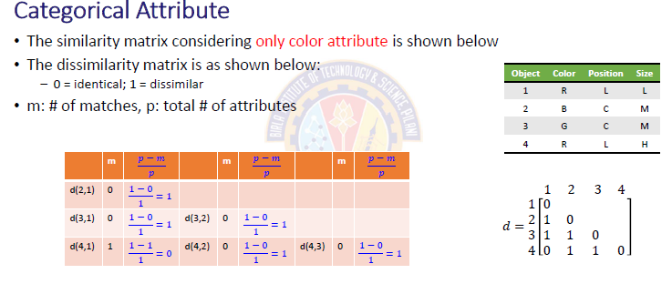
Proximity Measure for Nominal Attributes

Slide 8
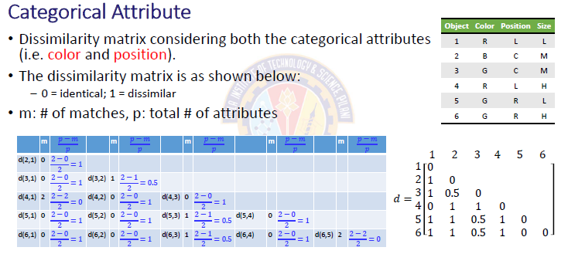
Proximity Measure for Nominal Attributes

Slide 9
Proximity Measure for Nominal Attributes
Can take 2 or more states, e.g., red, yellow, blue, green (generalization of a binary attribute)
Method 1: Simple matching
m: # of matches, p: total # of variables
Method 2: Use a large number of binary attributes
creating a new binary attribute for each of the M nominal states

Slide 10
Ordinal Variables

Slide 11
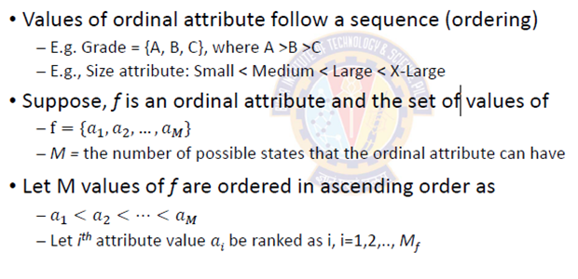
Proximity Measure For Ordinal Attributes

Slide 12
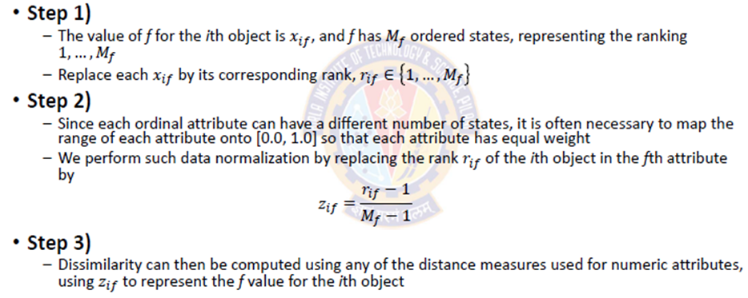
Proximity Measure For Ordinal Attributes

Slide 13
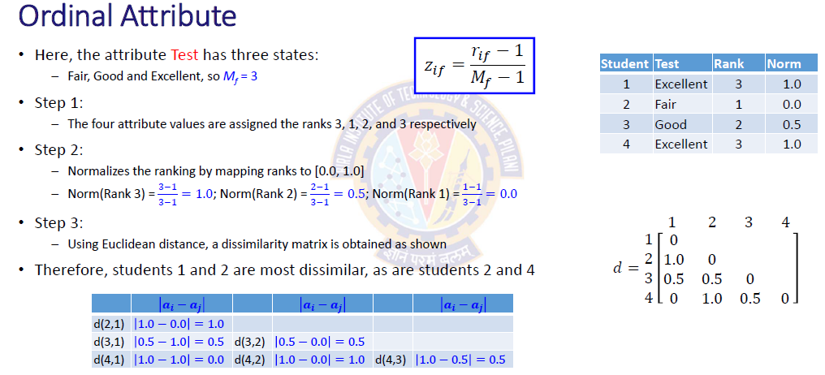
Proximity Measure For Ordinal Attributes

Slide 14
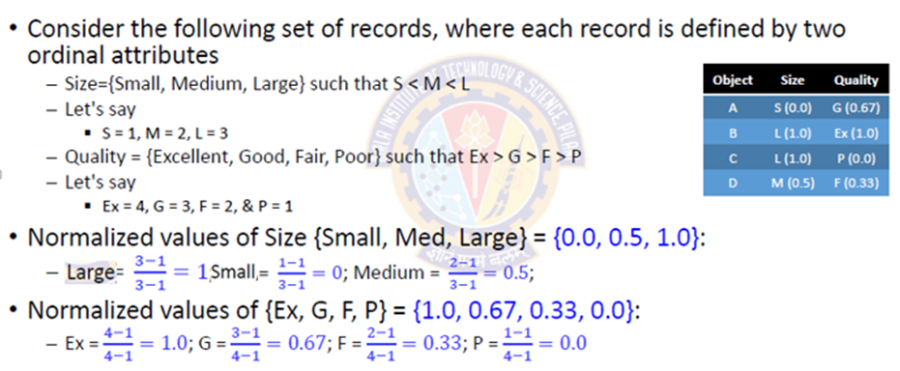
Proximity Measure For Ordinal Attributes

Slide 15
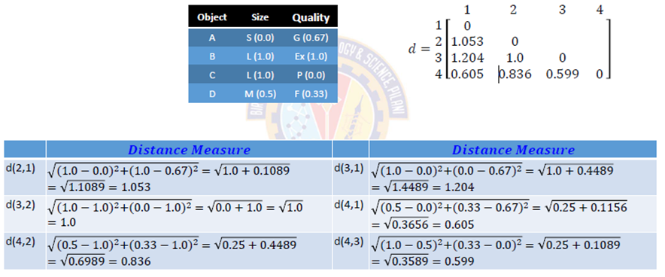
Proximity Measure For Ordinal Attributes

Slide 16
Ordinal Variables
An ordinal variable can be discrete or continuous
Order is important, e.g., rank
Can be treated like interval-scaled
replace x_{if} by their rank
map the range of each variable onto [0, 1] by replacing i-th object in the f-th variable by
compute the dissimilarity using methods for interval-scaled variables

Slide 17
Proximity Measure For Binary Attributes

Slide 18
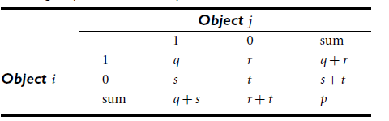
Proximity Measure For Binary Attributes
A contingency table for binary data
where q is the number of attributes that equal 1 for both objects i and j,
r is the number of attributes that equal 1 for object i but equal 0 for object j,
s is the number of attributes that equal 0 for object i but equal 1 for object j,
t is the number of attributes that equal 0 for both objects i and j.
The total number of attributes is p, where p = q+r+s+t .

Slide 19
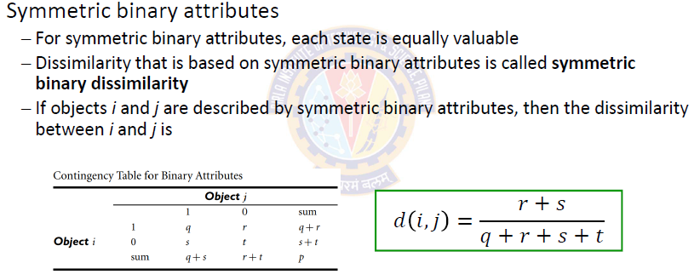
Proximity Measure For Binary Attributes

Slide 20
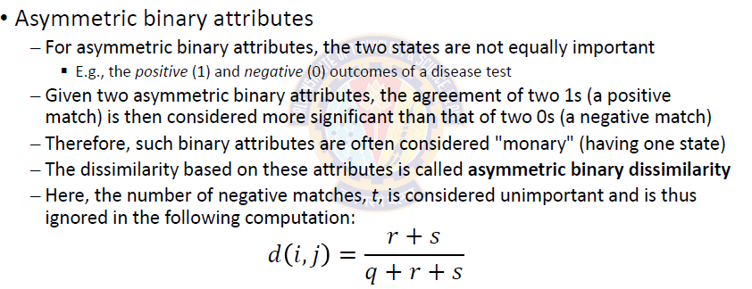
Proximity Measure For Binary Attributes

Slide 21
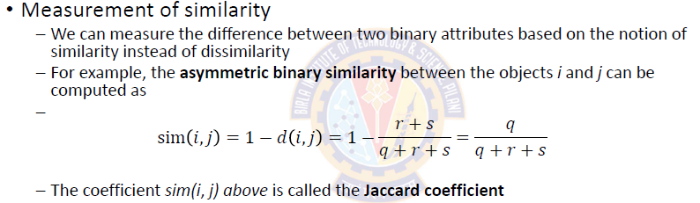
Proximity Measure For Binary Attributes

Slide 22
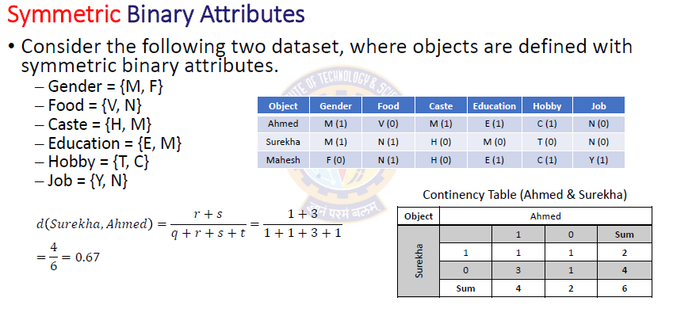
Proximity Measure For Binary Attributes

Slide 23
Jaccard Distance/Similarity
For each application, we first need to define what “distance” means.
Jaccard measures work with sets.
Jaccard distance/similarity
The Jaccard similarity of two sets is the size of their intersection divided by the size of their union: sim(C₁, C₂) = |C₁∩C₂|/|C₁∪C₂|
Jaccard distance: d(C₁, C₂) = 1 - |C₁∩C₂|/|C₁∪C₂|
3 in intersection
8 in union
Jaccard similarity= 3/8
Jaccard distance = 5/8

Slide 24
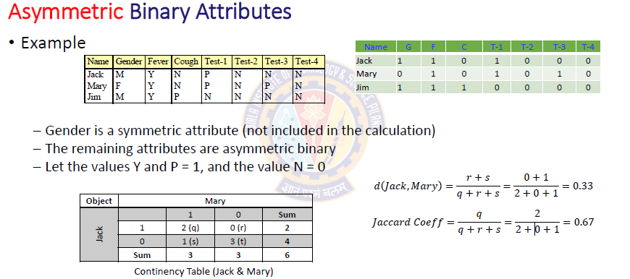
Proximity Measure For Binary Attributes

Slide 25



Proximity Measure For Binary Attributes
Distance measure for symmetric binary variables, dissimilarity:
Distance measure for asymmetric binary variables, dissimilarity:
Similarity between Asymmetric binary values is given by Jaccard coefficient:

Slide 26
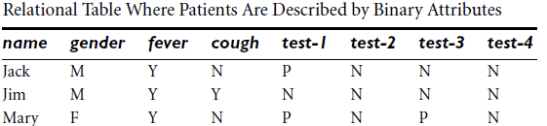
Proximity Measure For Binary Attributes
Example
Suppose that a patient record table contains the attributes name, gender, fever, cough, test-1, test-2, test-3, and test-4, where name is an object identifier, gender is a symmetric attribute, and the remaining attributes are asymmetric binary. Compute the dissimilarity matrix for asymmetric binary attributes

Slide 27
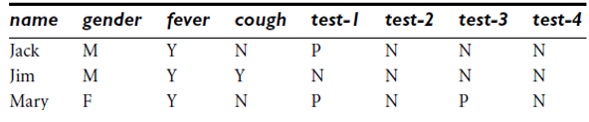
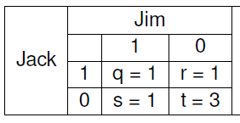
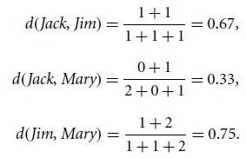
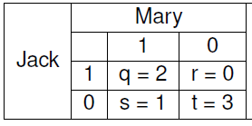
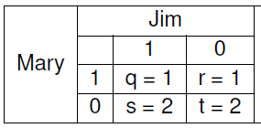
Proximity Measure For Binary Attributes
Example

Slide 28
Proximity Measure For Numeric Attributes

Slide 29
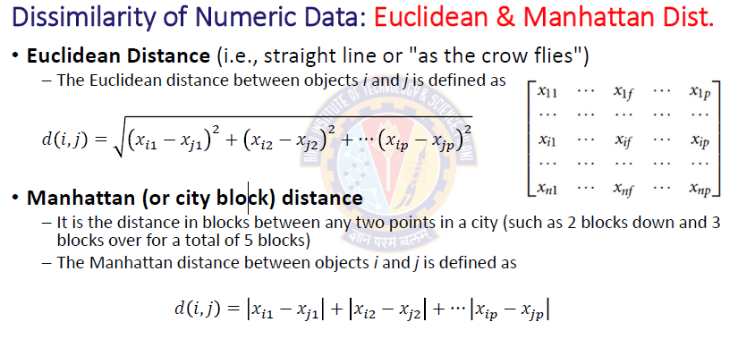
Proximity Measure For Numeric Attributes

Slide 30
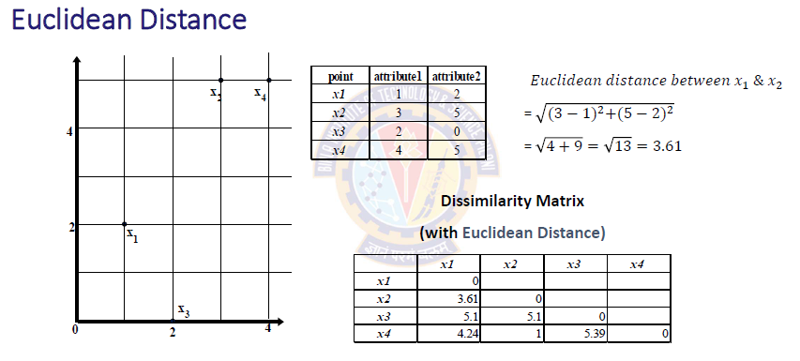
Proximity Measure For Numeric Attributes

Slide 31
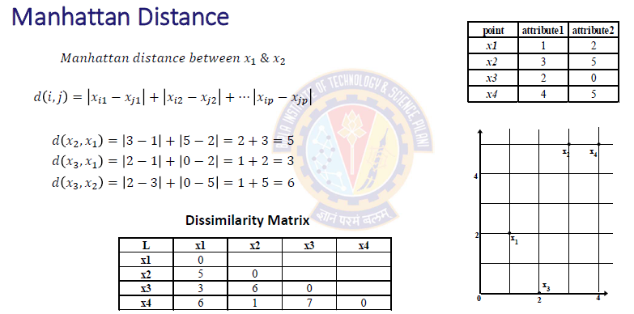
Proximity Measure For Numeric Attributes

Slide 32
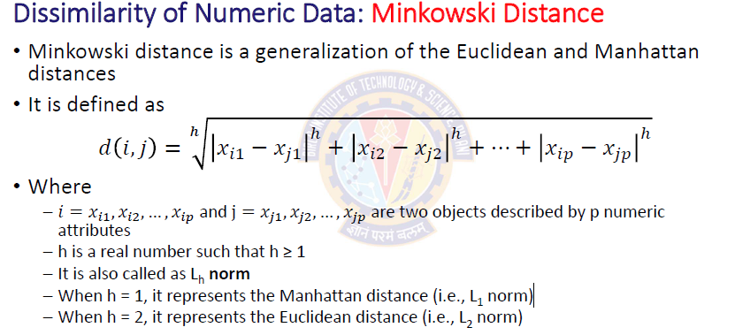
Proximity Measure For Numeric Attributes

Slide 33
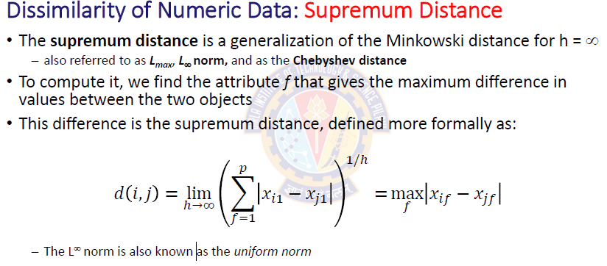
Proximity Measure For Numeric Attributes

Slide 34
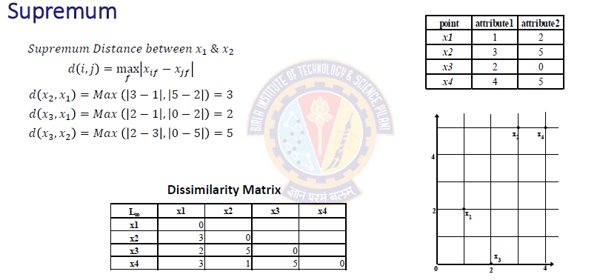
Proximity Measure For Numeric Attributes

Slide 35
Proximity Measure For Complex Objects

Slide 36
Proximity Measure For Complex Objects
A data object (or record or tuple) may contain all attribute types
Nominal, symmetric binary, asymmetric binary, numeric, ordinal
One will have to combine their effects

Slide 37
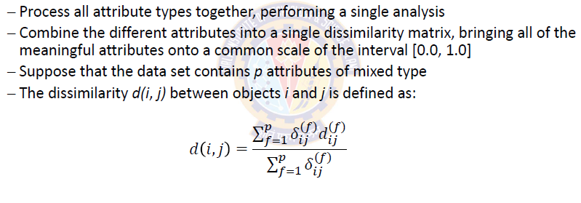
Proximity Measure For Complex Objects

Slide 38
Attributes of Mixed Type
A database may contain all attribute types
Nominal, symmetric binary, asymmetric binary, numeric, ordinal
One may use a weighted formula to combine their effects
f is binary or nominal:
d_{ij}^{(f)} = 0 if x_{if} = x_{jf} , or d_{ij}^{(f)} = 1 otherwise
f is numeric: use the normalized distance
f is ordinal
Compute ranks r_{if} and
Treat z_{if} as interval-scaled

Slide 39
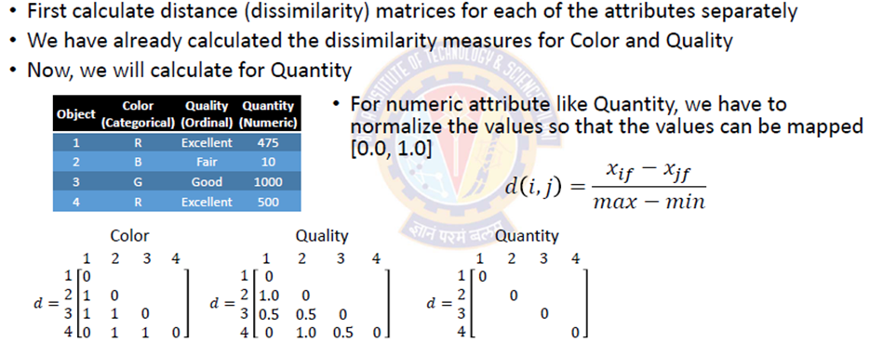
Proximity Measure For Mixed Type Attributes

Slide 40
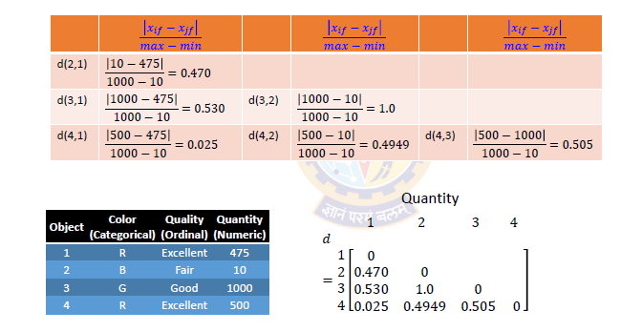
Proximity Measure For Mixed Type Attributes

Slide 41
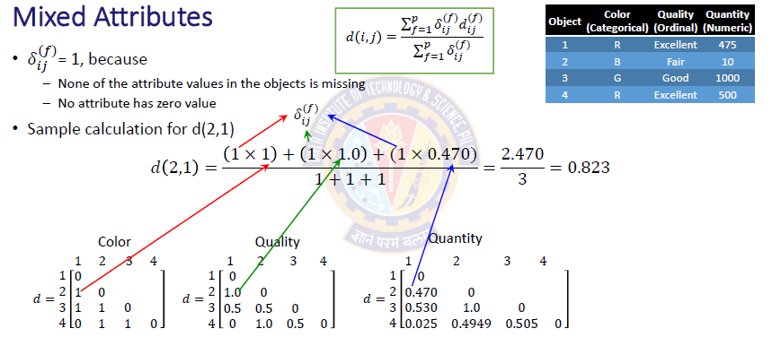
Proximity Measure For Mixed Type Attributes

Slide 42
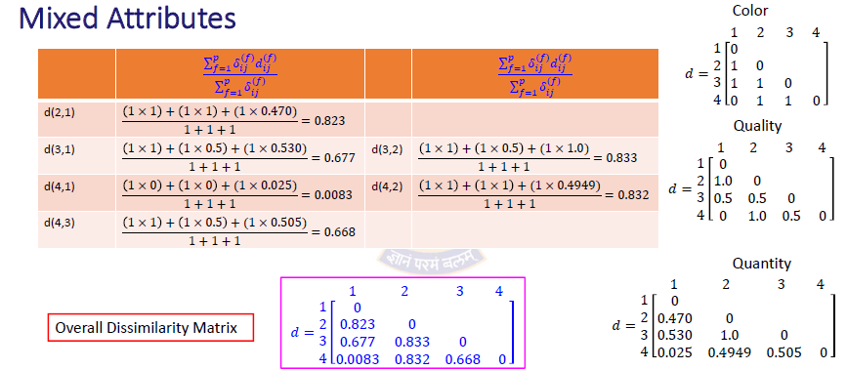
Proximity Measure For Mixed Type Attributes

Slide 43
Cosine Similarity

Slide 44
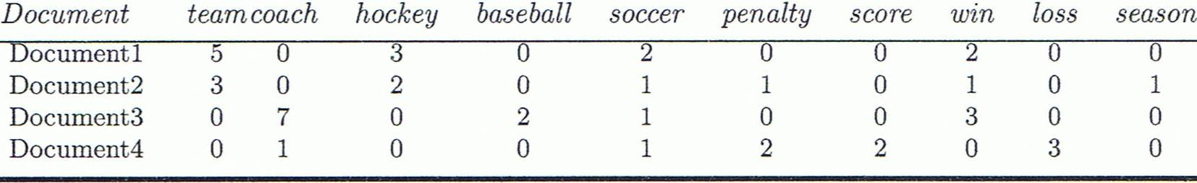
Cosine Similarity
A document can be represented by thousands of attributes, each recording the frequency of a particular word (such as keywords) or phrase in the document.
Other vector objects: gene features in micro-arrays, …
Applications: information retrieval, biologic taxonomy, gene feature mapping, ...
Cosine measure: If d₁ and d₂ are two vectors (e.g., term-frequency vectors), then
cos(d₁, d₂) = (d₁ • d₂) /||d₁|| ||d₂|| ,
where • indicates vector dot product, ||d||: the length of vector d

Slide 45
Example: Cosine Similarity
cos(d₁, d₂) = (d₁ • d₂) /||d₁|| ||d₂|| ,
where • indicates vector dot product, ||d|: the length of vector d
Ex: Find the similarity between documents 1 and 2.
d₁ = (5, 0, 3, 0, 2, 0, 0, 2, 0, 0)
d₂ = (3, 0, 2, 0, 1, 1, 0, 1, 0, 1)
d₁•d₂ = 5*3+0*0+3*2+0*0+2*1+0*1+0*1+2*1+0*0+0*1 = 25
||d₁||= (5*5+0*0+3*3+0*0+2*2+0*0+0*0+2*2+0*0+0*0)^{0.5}=(42)^{0.5} = 6.481
||d₂||= (3*3+0*0+2*2+0*0+1*1+1*1+0*0+1*1+0*0+1*1)^{0.5}=(17)^{0.5} = 4.12
cos(d₁, d₂ ) = 0.94
Notes:
09/09/25MK: New example (previous one was from Tan’s book).
Chapter 3: Statistics Methods
Co-variance distance
K-L divergence

Slide 47
Handling Numeric Data

Slide 48
Handling Numeric Data
Techniques are
Discretization – Convert numeric data into discrete categories Binarization – Convert numeric data into binary categories Normalization – Scale numeric data to a specific range Smoothing
which may remove noisy variations from the data. Techniques include binning, regression, and clustering.

Slide 49
Discretization
Convert continuous attribute into a discrete attribute.
Discretization involves converting the raw values of a numeric attribute (e.g., age) into
interval labels (e.g., 0–10, 11–20, etc.)
conceptual labels (e.g., youth, adult, senior)
Discretization Process
The raw data are replaced by a smaller number of interval or concept labels.
This simplifies the original data and makes the mining more efficient.
Concept hierarchies are also useful for mining at multiple abstraction levels.
Introduction to Data Science

Slide 50
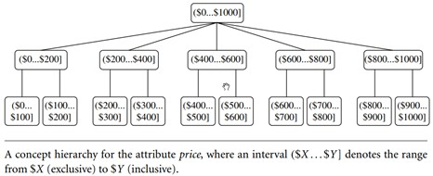
Concept Hierarchy
Divide the range of a continuous attribute into intervals. Interval labels can then be used to replace actual data values.
The labels, in turn, can be recursively organized into higher-level concepts. This results in a concept hierarchy for the numeric attribute.
Introduction to Data Science

Slide 51
Discretization Techniques
Discretization techniques can be categorized based on how the discretization is performed.
Supervised vs. Unsupervised discretization
If the discretization process uses class information, then we say it is supervised discretization. Otherwise, it is unsupervised.
Top-down discretization or Splitting
The process starts by first finding one or a few points (called split points or cut points) to split the entire attribute range. Then the process repeats recursively on the resulting intervals.
Bottom-up discretization or Merging
The process starts by considering all of the continuous values as potential split-points.
Removes some by merging neighborhood values to form intervals. Then recursively applies this process to the resulting intervals.

Slide 52
Discretization Techniques
Unsupervised discretization
⁾ Binning [ Equal-interval, Equal-frequency] (Top-down split)
⁾ Histogram analysis (Top-down split)
⁾ Clustering analysis (Top-down split or Bottom-up merge)
⁾ Correlation analysis (Bottom-up merge)
Supervised discretization
⁾ Entropy-based discretization (Top-down split)

Slide 53
Unsupervised Discretization
Class labels are ignored.
The best number of bins k is determined experimentally.
User specifies the number of intervals and/or how many data points to be included in any given interval.
Use Binning methods.

Slide 54
Discretization by Binning Methods
1
Equal Width (distance) binning
⁾ Each bin has equal width.
width = interval = ^{max − min}
#bins
⁾ Highly sensitive to outliers.
⁾ If outliers are present, the width of each bin is large, resulting in skewed data.
Equal Depth (frequency) binning
⁾ Specify the number of values that have to be stored in each bin.
⁾ Number of entries in each bin are equal.
⁾ Some values can be stored in different bins.
2

Slide 55
Binning Example
Discretize the following data into 3 discrete categories using binning technique.
70, 70, 72, 73, 75, 75, 76, 76, 78, 79, 80, 81, 53, 56, 57, 63, 66, 67, 67, 67, 68, 69, 70, 70.

Slide 56
Binning Example
Original Data | 53, 56, 57, 63, 66, 67, 67, 67, 68, 69, 70, 70, 70, 70, 72, 73, 75, 75, 76, 76, 78, 79, 80, 81
Method |  | Bin1 | Bin 2 | Bin 3
Equal | width= | [53, 62) = | [62, 72) = | [72, 81] =
Width | 81-53 = 28 | 53, 56, 57 | 63, 66, 67, 67, | 72, 73, 75, 75,
 | 28/3 = 9.33 |  | 67, 68, 69, 70, | 76, 76, 78,
 |  |  | 70, 70, 70 | 79, 80, 81
Equal | depth = | 53, 56, 57, 63, | 68, 69, 70, 70, | 75, 75, 76, 76,
Depth | 24 /3 = 8 | 66, 67, 67, 67 | 70, 70, 72, 73 | 78, 79, 80, 81
Introduction to Data Science

Slide 57
Discretization by Histogram Analysis
Histogram analysis is an unsupervised discretization technique because it does not use class information.
Histograms use binning to approximate data distributions and are a popular form of data reduction.
A histogram for an attribute, X, partitions the data distribution of X into disjoint subsets, referred to as buckets or bins.
If each bucket represents only a single attribute–value/frequency pair, the buckets are called singleton buckets.
Often, buckets represent continuous ranges for the given attribute.
The histogram analysis algorithm can be applied recursively to each partition in order to automatically generate a multilevel concept hierarchy.
Introduction to Data Science

Slide 58
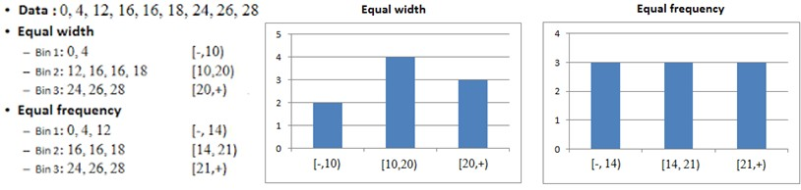
Discretization by Histogram Analysis
1
Equal Width Histogram
⁾ The values are partitioned into equal size partitions or ranges.
Equal Frequency Histogram
⁾ The values are partitioned such that each partition contains the same number of data objects.
2
Introduction to Data Science

Slide 59
Variable Transformation
Variable transformation involves changing the values of an attribute.
For each object (tuple), a transformation is applied to the value of the variable for that object.
1
Simple functional transformations Normalization
2

Slide 60
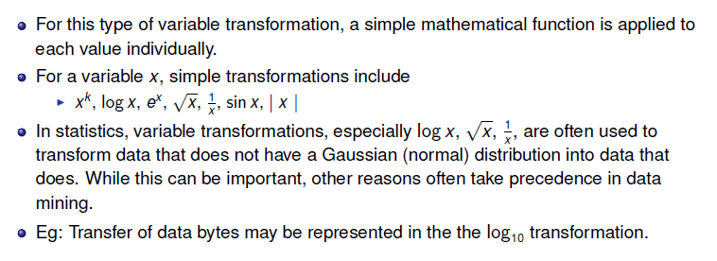
Simple Functional Transformation

Slide 61
Simple Functional Transformation
Variable transformations should be applied with caution since they change the nature of the data.
For instance, the transformation ¹ reduces the magnitude of values that are 1 or
x
larger, but increases the magnitude of values between 0 and 1.
To understand the effect of a transformation, it is important to ask questions such as:
⁾ Does the order need to be maintained?
⁾ Does the transformation apply to all values, especially negative values and 0?
⁾ What is the effect of the transformation on the values between 0 and 1?
Introduction to Data Science

Slide 62
Normalization
Normalizing the data attempts to give all attributes an equal weight.
The goal of standardization or normalization is to make an entire set of values have a particular property.
Normalization is particularly useful for:
⁾ classification algorithms involving neural networks.
normalizing the input values for each attribute in the training tuples will help speed up the learning phase.
⁾ distance measurements such as nearest-neighbor classification and clustering.
normalization helps prevent attributes with initially large ranges (e.g., income) from outweighing attributes with initially smaller ranges (e.g., binary attributes).
Introduction to Data Science

Slide 63
Why Feature Scaling?
Features with bigger magnitude dominate over the features with smaller magnitudes. Good practice to have all variables within a similar scale.
Euclidean distances are sensitive to feature magnitude.
Gradient descent converges faster when all the variables are in the similar scale. Feature scaling helps decrease the time of finding support vectors.

Slide 64
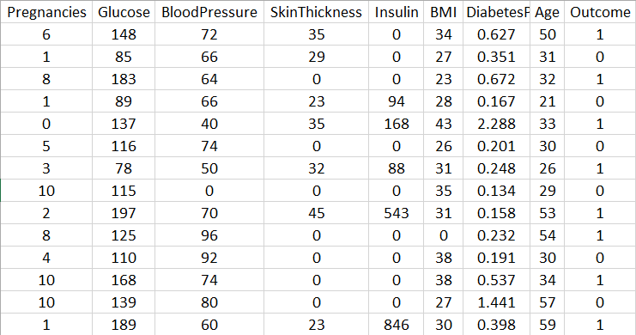
Why Feature Scaling?
For distance-based methods, normalization helps prevent attributes with initially large ranges (e.g., income) from out-weighing attributes with initially smaller ranges (e.g., binary attributes).
Introduction to Data Science

Slide 65
Algorithms Sensitive to Feature Magnitude
Linear and Logistic Regression Neural Networks
Support Vector Machines KNN
K-Means Clustering
Linear Discriminant Analysis (LDA) Principal Component Analysis (PCA)
Introduction to Data Science

Slide 66
Normalization
Scale the feature magnitude to a standard range like [0, 1] or [−1, +1] or any other. Techniques
⁾ Min-Max normalization
⁾ z-score normalization
⁾ Normalization by decimal scaling
Impact of outliers in the data ???

Slide 67
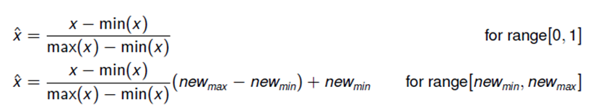
Min-Max Scaling
Min-max scaling squeezes (or stretches) all feature values to be within the range of
[0, 1].
Min-Max normalization preserves the relationships among the original data values.
It will encounter an ”out-of-bounds” error if a future input case for normalization falls outside of the original data range for X .
Introduction to Data Science

Slide 68
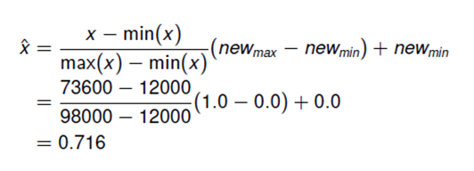
Min-Max Normalization
Suppose that the minimum and maximum values for the attribute income are $12,000 and
$98,000, respectively. The new range is [0.0,1.0]. Apply min-max normalization to value of
$73,600.
Introduction to Data Science

Slide 69
z-score Normalization
In z-score normalization (or zero-mean normalization), the values for an attribute, x , are normalized based on the mean µ(x ) and standard deviation σ(x ) of x .
The resulting scaled feature has a mean of 0 and a variance of 1. New range is [−3σ, +3σ].
_{xˆ =} x − µ(x )
σ(x )
z-score normalization is useful when the actual minimum and maximum of attribute X
are unknown, or when there are outliers that dominate the min-max normalization.
Introduction to Data Science

Slide 70
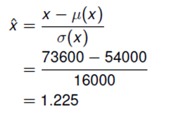
z-score Normalization
Suppose that the mean and standard deviation of the values for the attribute income are
$54,000 and $16,000, respectively. Apply z-score normalization to value of $73,600.
Introduction to Data Science

Slide 71
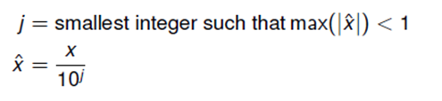
Decimal Normalization
Normalizes by moving the decimal point of values of attribute x .
The number of decimal points moved depends on the maximum absolute value of x . New range is [−1, +1].
Introduction to Data Science

Slide 72
Decimal Normalization
Example 1
CGPA | Formula | Normalized CGPA
2 | 2/10 | 0.2
3 | 3/10 | 0.3
Example 2
Bonus | Formula | Normalized Bonus
450 | 450/1000 | 0.45
310 | 310/1000 | 0.31
Example 3
Salary | Formula | Normalized Salary
48000 | 48000/100000 | 0.48
67000 | 67000/100000 | 0.67
Introduction to Data Science

Slide 73
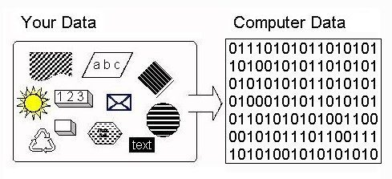
CATEGORICAL ENCODING
We need to convert categorical columns to numeric columns so that a machine learning algorithm understands it.
Categorical encoding is a process of converting categories to numbers.
Binarization maps a continuous or categorical attribute into one or more binary attributes.
Must maintain ordinal relationship.
Algorithms that find association patterns require that the data be in the form of binary attributes.
E.g., Apriori algorithm, Frequent Pattern (FP) Growth algorithm

Slide 74
CATEGORICAL ENCODING Techniques
One-hot encoding
Label Encoding
Introduction to Data Science

Slide 75
One-Hot Encoding
Encode each categorical variable with a set of Boolean variables which take values 0 or 1, indicating if a category is present for each observation.
One binary attribute for each categorical value. Advantages
⁾ Makes no assumption about the distribution or categories of the categorical variable .
⁾ Keeps all the information of the categorical variable .
⁾ Suitable for linear models.
Disadvantages
⁾ Expands the feature space.
⁾ Does not add extra information while encoding.
⁾ Many dummy variables may be identical, introducing redundant information .
⁾ Number of resulting attributes may become too large.
In multi-class classification, the class label is converted using one-hot encoding.
Introduction to Data Science

Slide 76
One-Hot Encoding Example
Assume an ordinal attribute for representing service of a restaurant:
(Awful < Poor < OK < Good < Great ) requires 5 bits to maintain the ordinal relationship.
Service Quality | X1 | X2 | X3 | X4 | X5
Awful | 0 | 0 | 0 | 0 | 1
Poor | 0 | 0 | 0 | 1 | 0
OK | 0 | 0 | 1 | 0 | 0
Good | 0 | 1 | 0 | 0 | 0
Great | 1 | 0 | 0 | 0 | 0
Introduction to Data Science
76 / 113

Slide 77
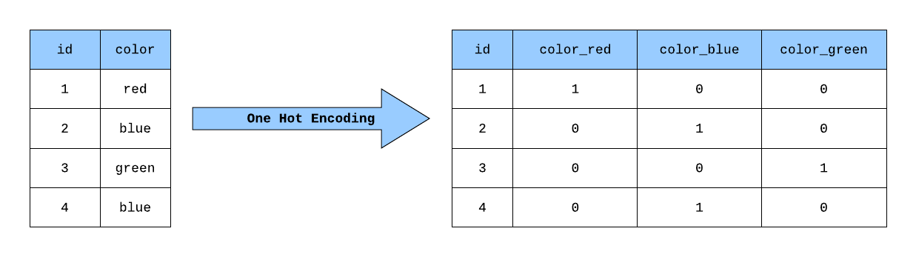
One-hot Encoding Example
Introduction to Data Science

Slide 78
Label Encoding
Replace the categories by digits from 1 to n (or 0 to n − 1, depending the implementation), where n is the number of distinct categories of the variable.
The categories are arranged in ascending order and the numbers are assigned. Advantages
⁾ Straightforward to implement.
⁾ Does not expand the feature space.
⁾ Work well enough with tree based algorithms.
Disadvantages
⁾ Does not add extra information while encoding.
⁾ Not suitable for linear models.
⁾ Does not handle new categories in test set automatically.
Used for features which have multiple values into domain. eg: colour, protocol types
Introduction to Data Science

Slide 79
Label Encoding Example
Assume an ordinal attribute for representing service of a restaurant: (Awful, Poor, OK, Good, Great)
Service Quality | Integer Value
Awful | 0
Poor | 1
OK | 2
Good | 3
Great | 4
Introduction to Data Science

Slide 80
Example for Proximity

Slide 81
Example
Based on the information given in the table below, find most similar and most dissimilar persons among them. Apply min-max normalization on income to obtain [0,1] range. Consider profession and mother tongue as nominal. Consider native place as ordinal variable with ranking order of [Village, Small Town, Suburban, Metropolitan]. Give equal weight to each attribute.
Name | Income | Profession | Mother tongue | Native Place
Ram | 70000 | Doctor | Bengali | Village
Balram | 50000 | Data Scientist | Hindi | Small Town
Bharat | 60000 | Carpenter | Hindi | Suburban
Kishan | 80000 | Doctor | Bhojpuri | Metropolitan

Slide 82
Solution
After normalizing income and quantifying native place, we get
d(Ram, Balram) = 0.67+1+1+(2-1)/(4-1)=3 d(Ram, Bharat) = 0.33+1+1+(3-1)/(4-1)=3
d(Ram, Kishan) = 0.33+0+1+(4-1)/(4-1) = 2.33 d(Balram, Bharat) = 0.33+1+0+(3-2)/(4-1)=1.67
d(Balram, Kishan) = 1+1+1+(4-2)/(4-1) = 3.67 d(Bharat, Kishan) = 0.67+1+1+(4-3)/(4-1) = 3
Most similar – Balram and Bharat; Most dissimilar – Balram and Kishan
Name | Income | Profession | Mother tongue | Native Place
Ram | 0.67 | Doctor | Bengali | 1
Balram | 0 | Data Scientist | Hindi | 2
Bharat | 0.33 | Carpenter | Hindi | 3
Kishan | 1 | Doctor | Bhojpuri | 4

Slide 83
Text Books
T1 | Introduction to Data Mining, by Tan, Steinbach and Vipin Kumar
T2 | Introducing Data Science by Cielen, Meysman and Ali
T3 | Storytelling with Data, A data visualization guide for business professionals, by Cole Nussbaumer Knaflic; Wiley
T4 | Data Mining: Concepts and Techniques, Third Edition by Jiawei Han and Micheline Kamber Morgan Kaufmann Publishers

Slide 84
Thank You

