Slide 1
Assignment 01 windchill
1. Create an Organization, Name it: Org_<YourLastName> 2. Create a user --> <YourLastName>_orgadmin 3. Make user: <YourLastName>_orgadmin as Organization Admin for the org you created in step 1 4. Login with <YourLastName>_orgadmin, make sure that user can access Organization link 5. Create two users in Org_<YourLastName>, name it: product_user001, library_user001, allcreator001 6. Make product_user001 as a product creator only, also add allcreator001 in product creator 7. Make library_user001 as a library creator only, also add allcreator001 in library creator 8. Login with product_user001 and create a product --> product001 9. Login with library_user001 and create a library --> library001 10. Create two more users(u001,u002) 11. make u001 as member of product001 12. make u002 as member of library001 13. Login as allcreator001 and ensure if he is able to create both prod and library 14. See what access u001 and u002

Slide 2
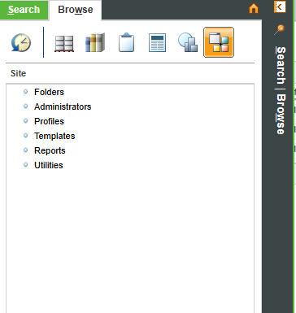
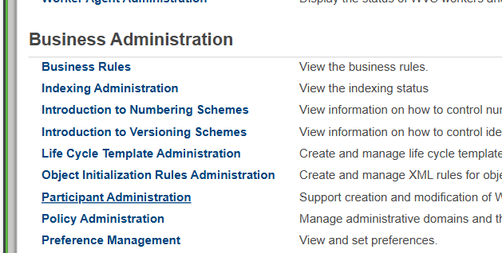
USERS
Users can be created at site level or organization level.
Each context administrator will have link to utilities.

Slide 3
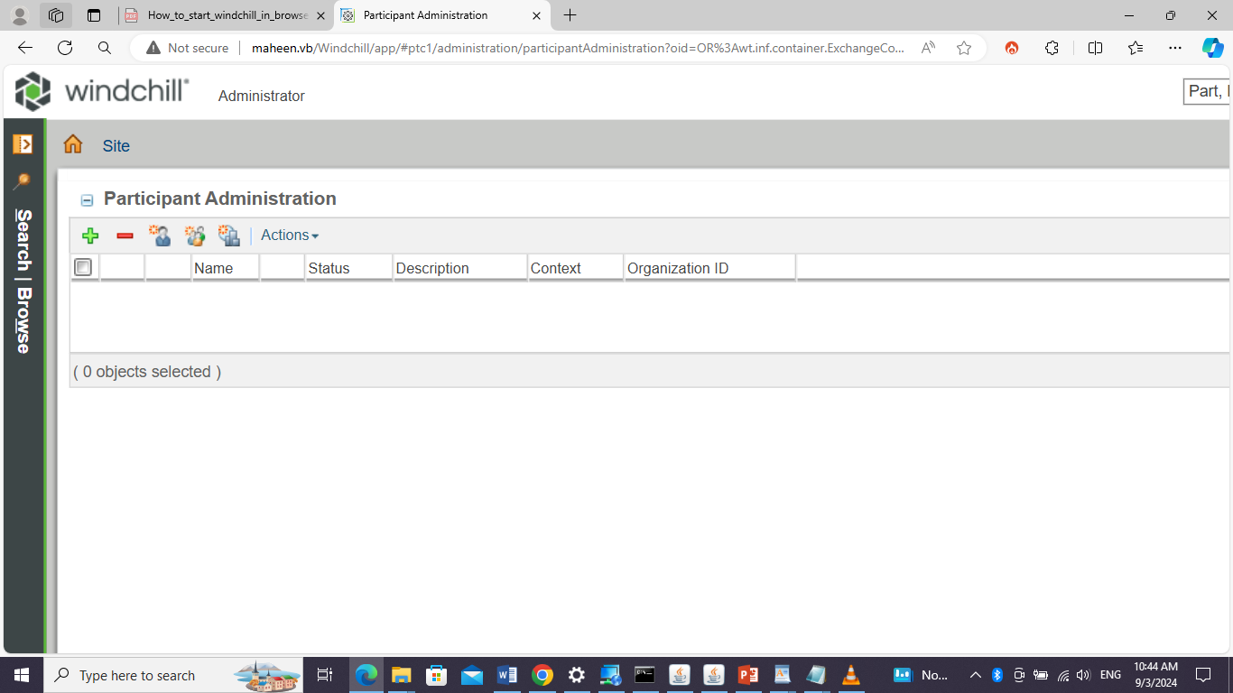
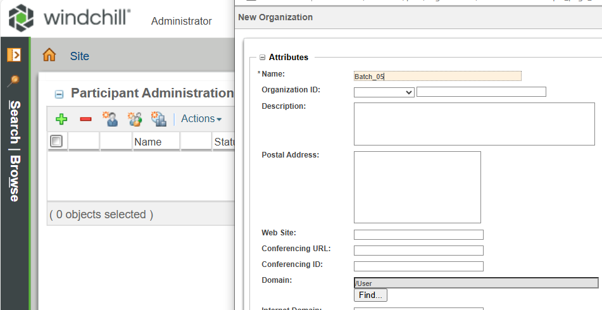
Create user, organization, Group. Creating organization

Slide 4

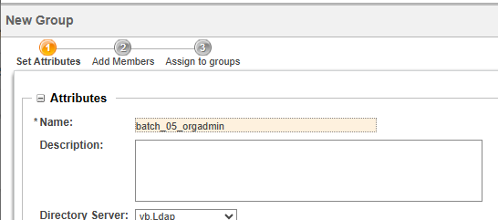
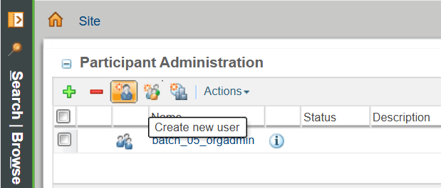
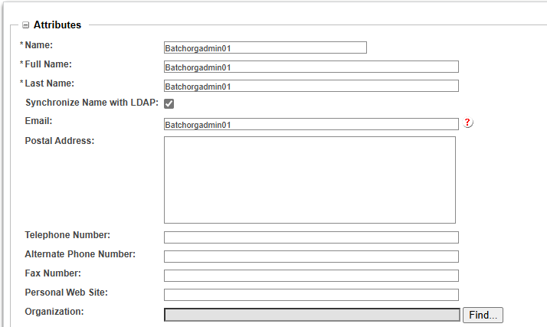
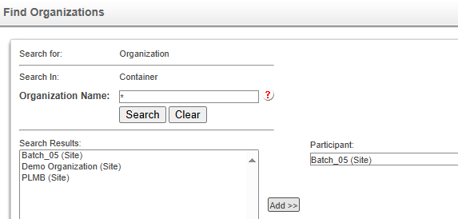
Creating group
Creating User and adding to organization

Slide 5
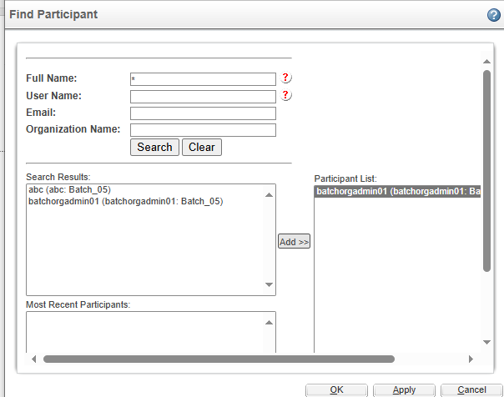
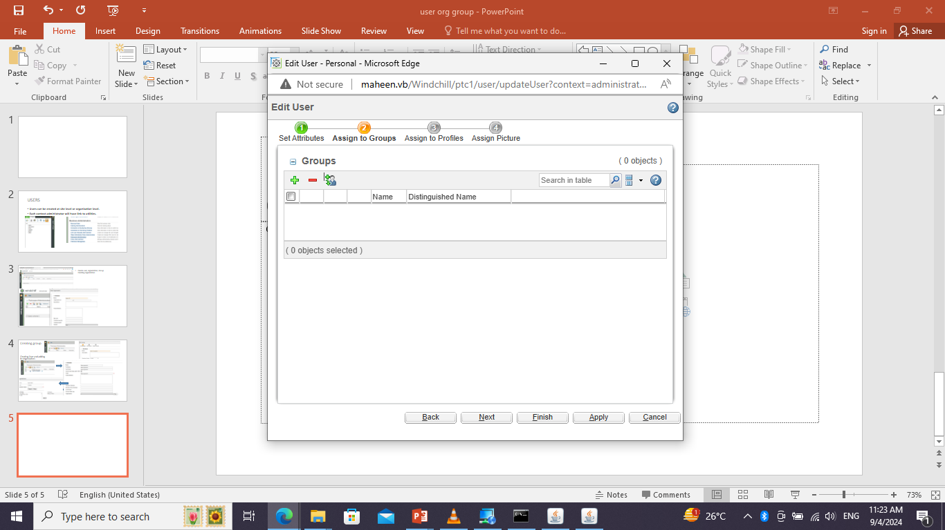
Assigning user to group
Note: USERS GROUPS, ORGANIZATION AND SITE IS KNOWN PRINCIPAL WHICH IS STORED IN DIRECTORY SERVER. AND AMONG THESE ORGANIZATION AND SITE ARE ONLY THE CONTAINERS

Slide 6
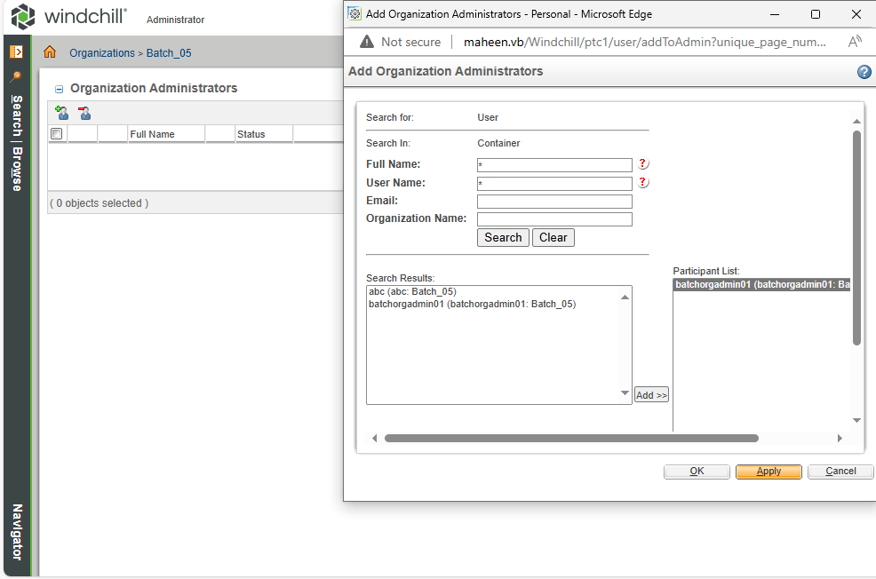

Slide 7
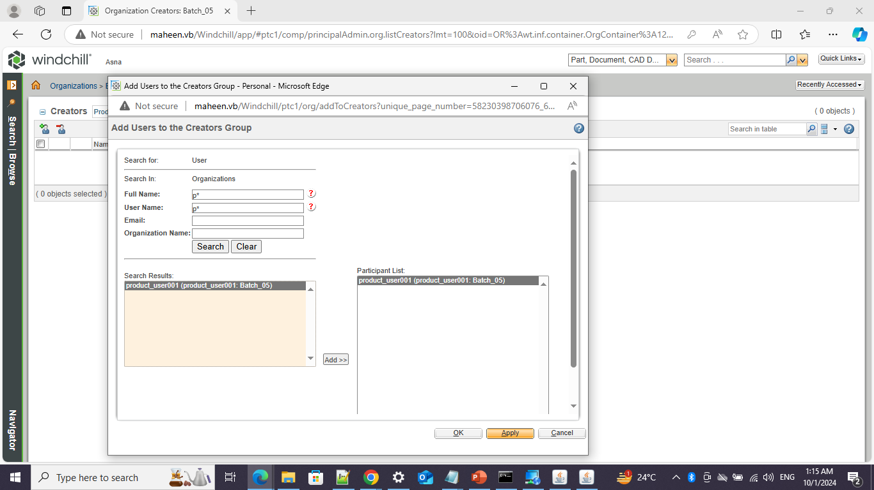
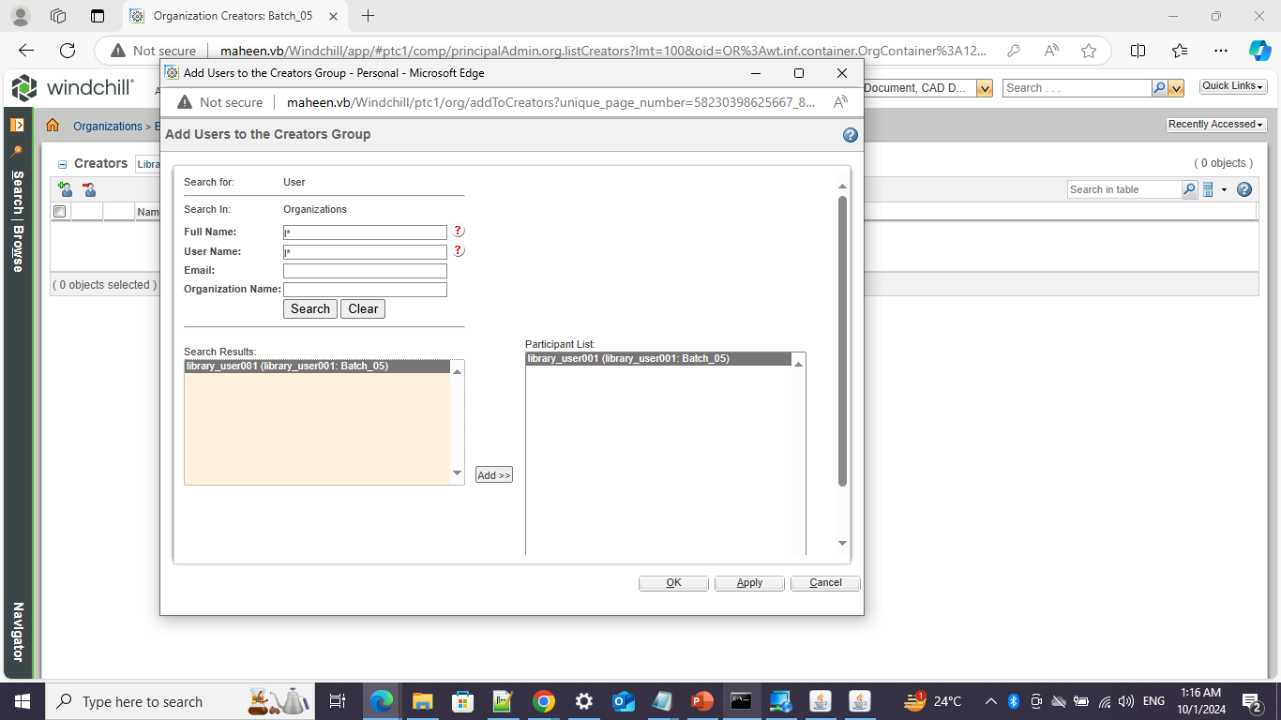
Creating product_user001 & library_user001

Slide 8
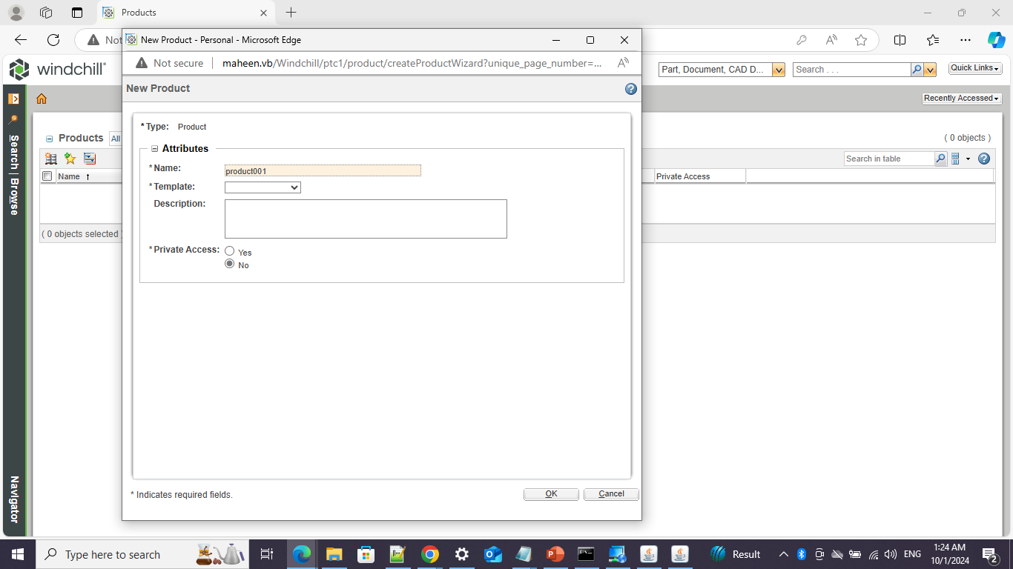
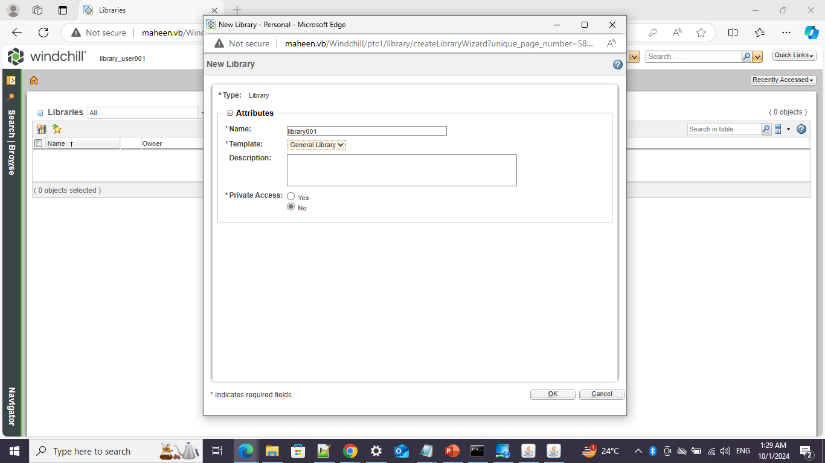
Create product001 & library001

Slide 9
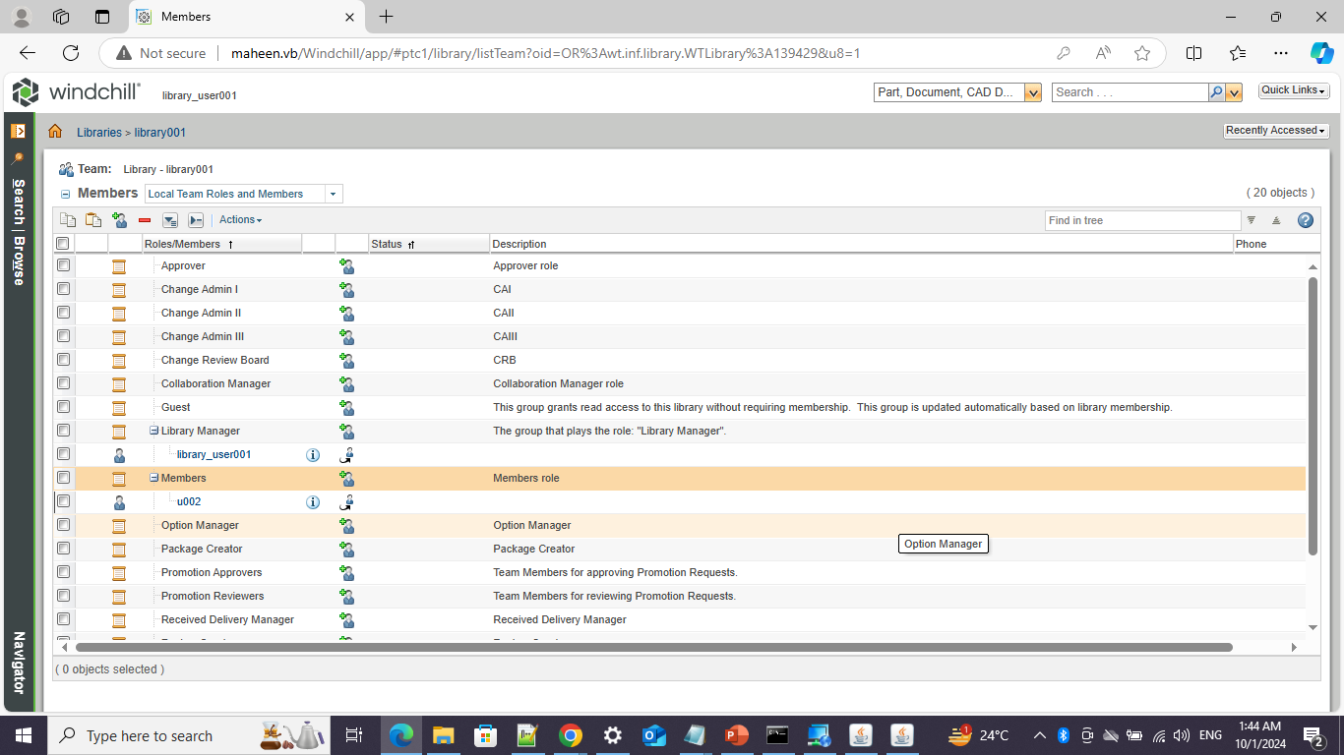
U001 &u002 to product and library members

