Slide 1










HTML Parsing
Text Extraction
Incomplete HTML to Raw Text
Tokenizer
POS Tagger
POS Filter
Custom Filter
Bigramming
Raw text to Doc Pipeline

Slide 2
Examples of Text Preprocessing
Any idea of deserialize mixed json string in gson?
Using GLSL to render a smooth reference grid on a plane
Compiler/language runtime vs. Middleware
Detect objects in an image opencv
RAP installation and necessary things to include while installation
Where can I find a reference of the CG shader language?
Vehicle segmentation and tracking
SSLHandshakeException using t3s weblogic
String.format in FreeMarker
NSNotification if data changes
How to project Lat/Lon coordinates on a panorama image?
How to attach metadata to LLVM IR using the C++ API?
How particular pixel to transparent in opencv python?
Failed to process JAR [jar:jndi:/localhost/ttsvr/WEB-INF/lib/activation.jar!/null] for TLD files
Converting EGLImageKHR to greyscale
Scroll SearchResponse not iterable when there are less results than the scrollSize setting
Estimating real world translation between two cameras through feature matching
['idea', 'deserialize', 'mix', 'json_string', 'gson']
['glsl', 'smooth', 'reference', 'grid', 'plane']
['compiler', 'language', 'runtime', 'vs.', 'middleware']
['detect', 'object', 'image', 'opencv']
['rap', 'installation', 'installation']
['reference', 'cg_shader', 'language']
['vehicle', 'segmentation', 'track']
['sslhandshakeexception', 't3s', 'weblogic']
['string.format', 'freemarker']
['nsnotification', 'datum']
['lat_lon', 'panorama', 'image']
['metadata', 'llvm_ir', 'c', 'api']
['pixel', 'transparent', 'opencv', 'python']
['jar', 'jar', 'jndilocalhost', 'ttsvr', 'web_inf', 'lib', 'activation.jarnull', 'tld', 'file']
['eglimagekhr', 'greyscale']
['scroll', 'searchresponse', 'iterable', 'result', 'scrollsize', 'set’]
['real_world', 'translation', 'camera', 'feature_match']

Slide 3
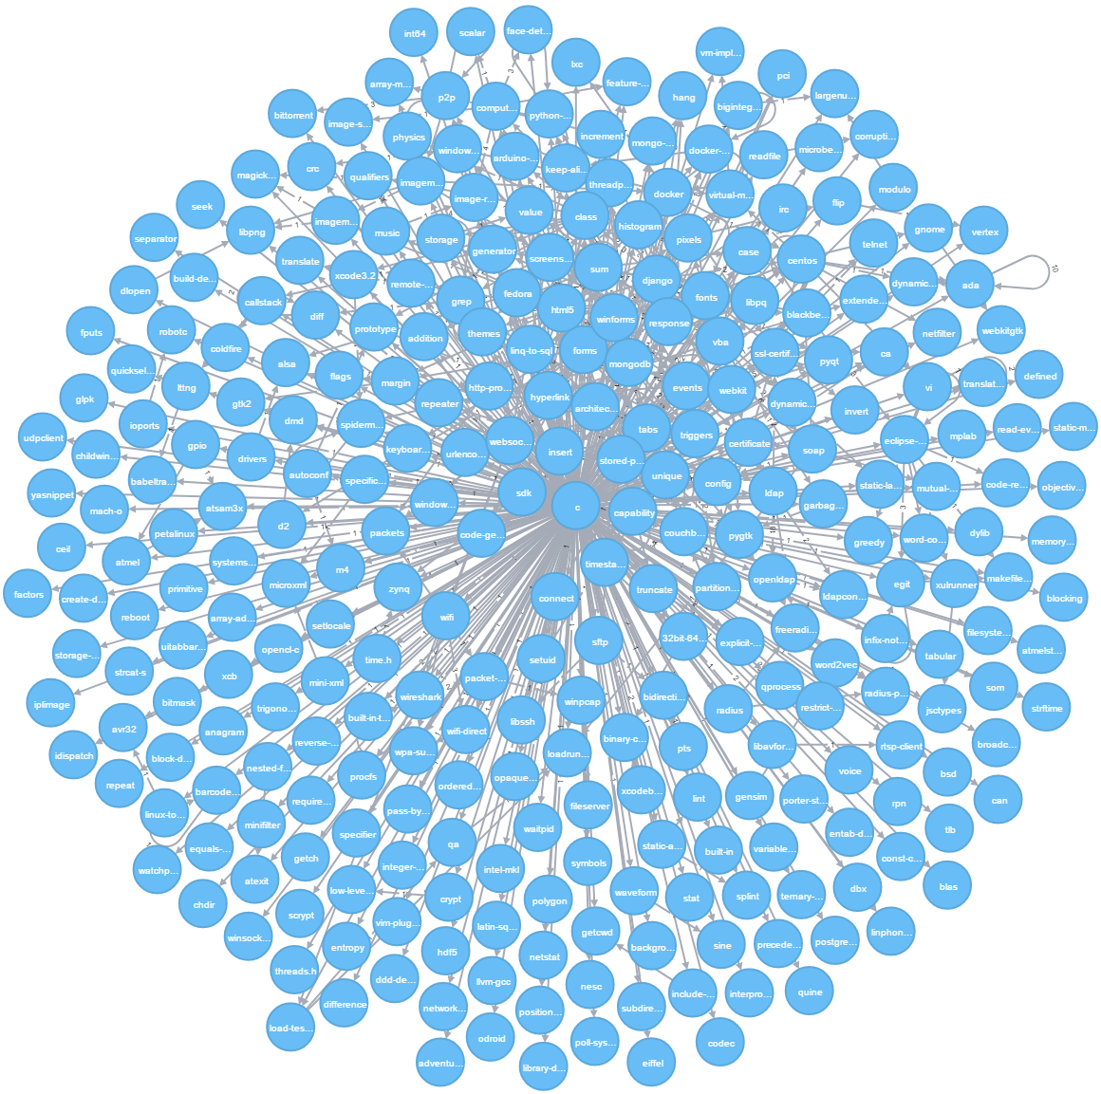

Slide 4










User Input Query
Query
Assistant
Project
Advisor
Analysis
Output

Slide 5
