Slide 1










HTML Parsing
Text Extraction
Incomplete HTML to Raw Text
Tokenizer
POS Tagger
POS Filter
Custom Filter
Bigramming
Raw text to Doc Pipeline

Slide 2
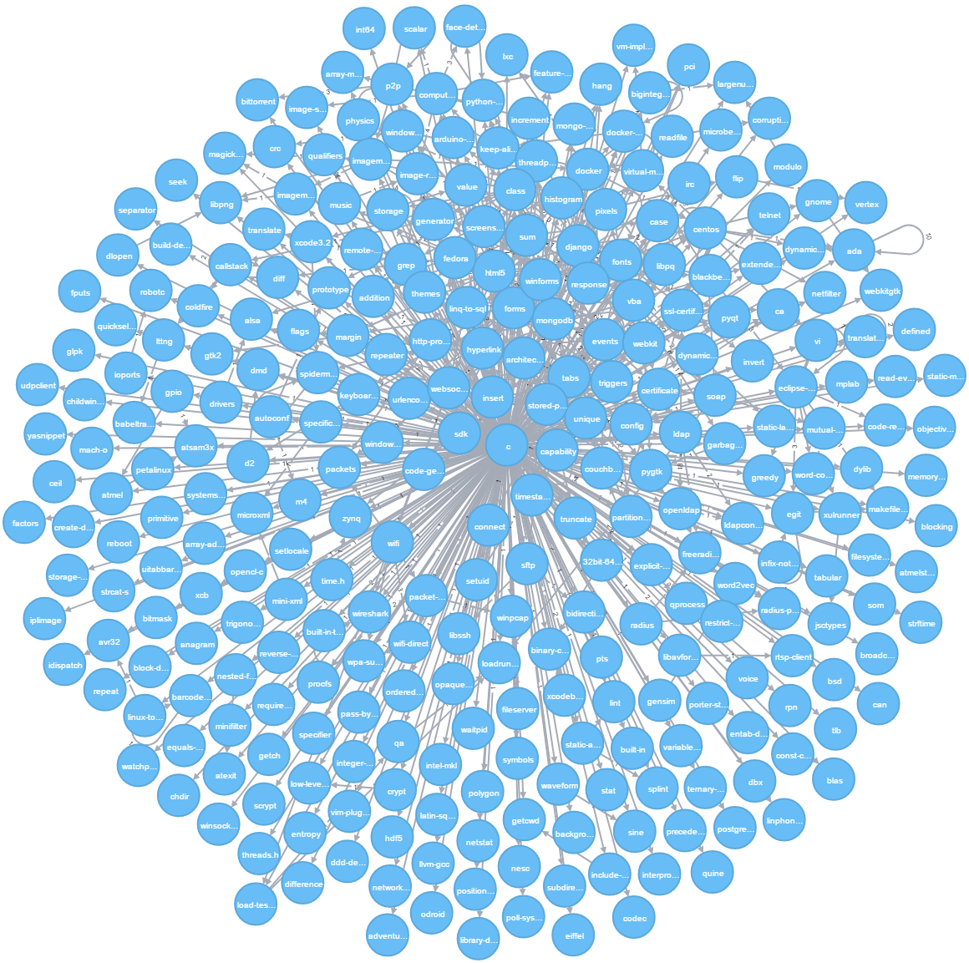

Slide 3










User Input Query
Query
Assistant
Project
Advisor
Analysis
Output

Slide 4
