Slide 1
Customer Churn Prediction Using Supervised Machine Learning Algorithms
Tamanna Manek (tm3734)
Ritik Lnu (rl4017)
Deepti Gouthaman (dg3781)

Slide 2
Introduction
Customer churn also known as "customer attrition”, is one of the biggest problems faced by the business these days as it directly impacts on operating, marketing and company budgets. It primarily represents the number of customers who stop buying from your business within a set time frame.
If we could figure out why a customer leaves and when they leave with reasonable accuracy, it would immensely help the organization to strategize their retention initiatives manifold.
In this model we will be predicting What is the likelihood of an active customer leaving an organization and what are key indicators of a customer churn.

Slide 3
Models
We will be using supervised learning to predict customer churn. A supervised machine learning algorithm generally analyzes the training data and produces an inferred function that in turn can be used for mapping new examples. Given that we have data on current and prior customer transactions in our dataset, this is a standardized supervised classification problem that tries to predict a binary outcome (Y/N).
Decision Tree Classifier
Random Forest Classifier
XGBoost

Slide 4
Data Collection
Our data set is from a credit card company, where we are able to review customer attributes such as geography (location), gender, age, tenure, balance, number of products they are subscribed to, their estimated salary and if they stopped the subscription or not (Exited).
We are using open-source reliable datasets from kaggle(https://www.kaggle.com/kmalit/bank-customer-churn-prediction/data).

Slide 5
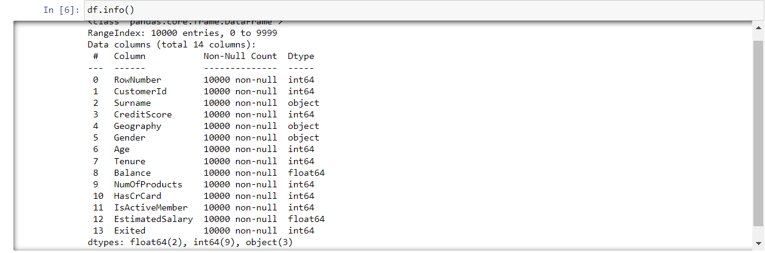
Any Missing Values?
We do not have any missing values in our data set.

Slide 6
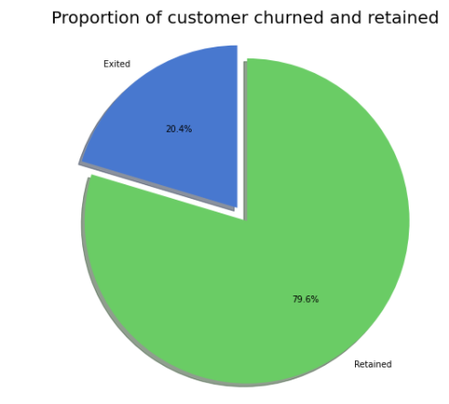
Proportion of Customer churned and retained

Slide 7
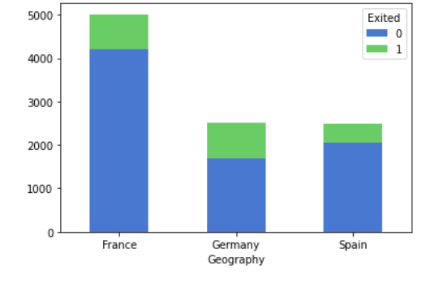
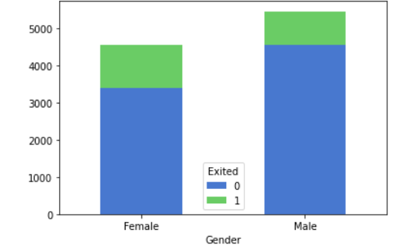
Categorical variables

Slide 8
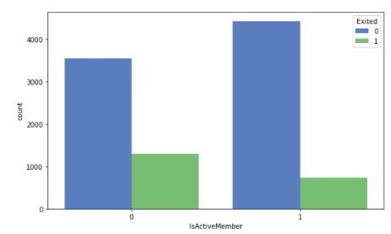
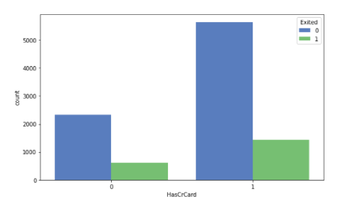
Categorical variables

Slide 9
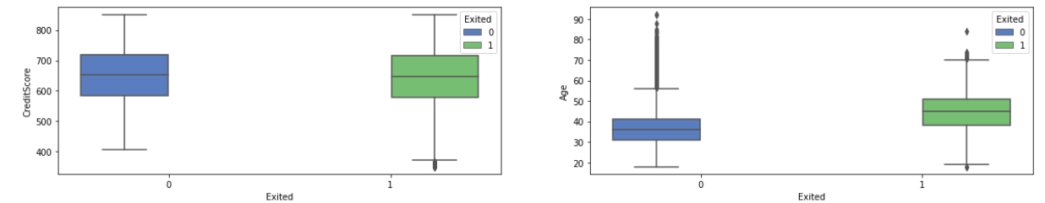
Relation between Exited and other variables

Slide 10
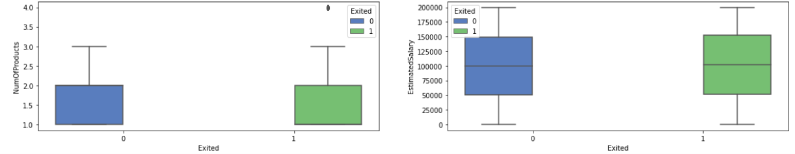
Relationship between Exited and Other variables

Slide 11
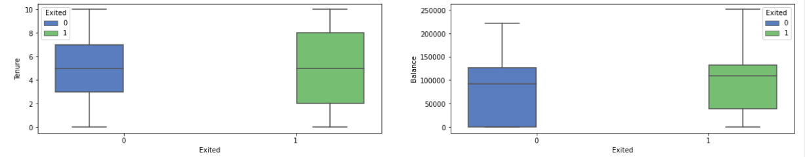
Relationship between Exited and other variables.

Slide 12
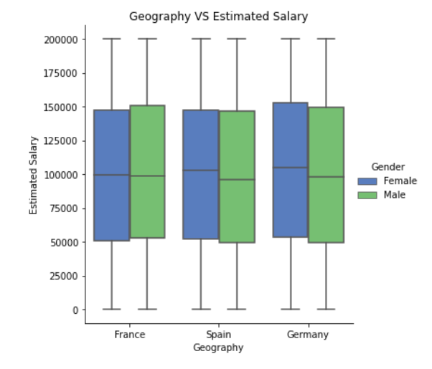
Explanatory Data Analysis

Slide 13
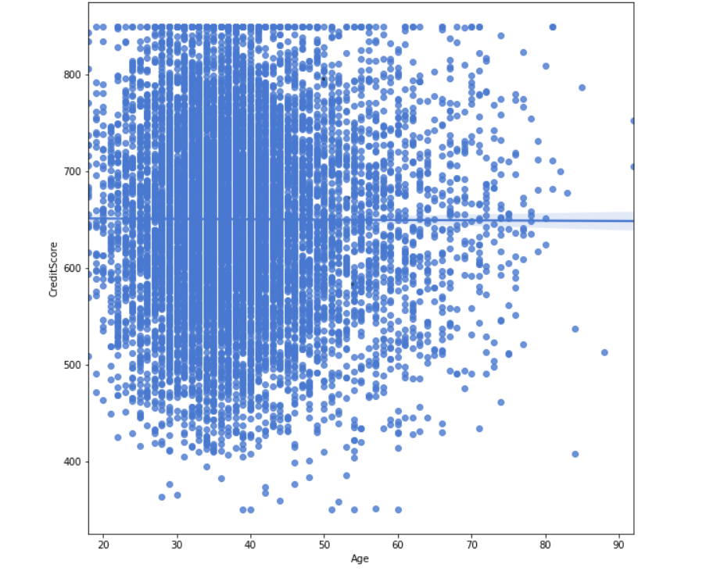
Explanatory Data Analysis

Slide 14
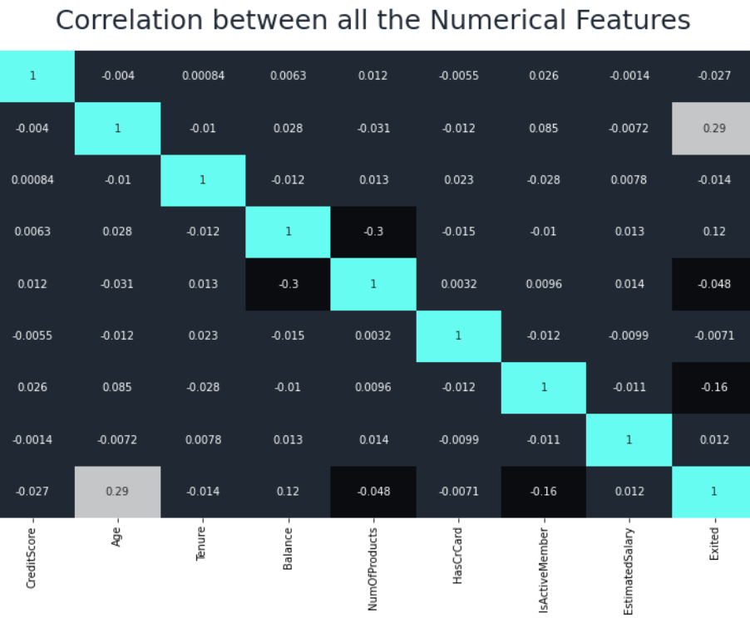
Correlation between Numerical Variables

Slide 15
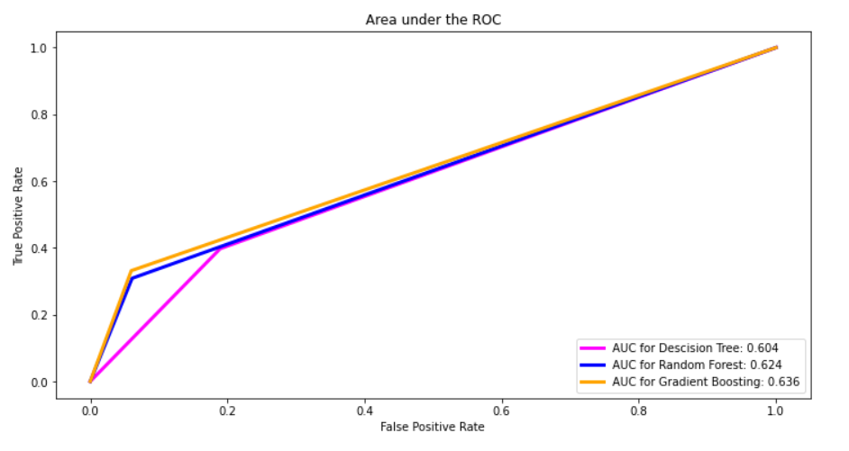
Area Under ROC

Slide 16
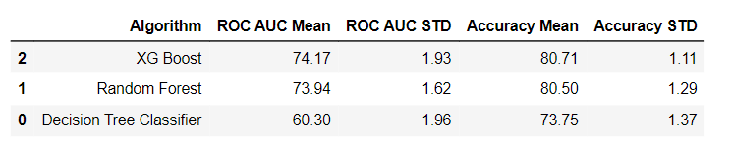
Comparison between different Models

Slide 17
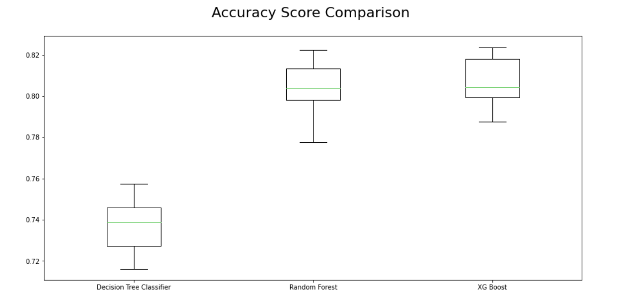
Accuracy Score Comparision

Slide 18
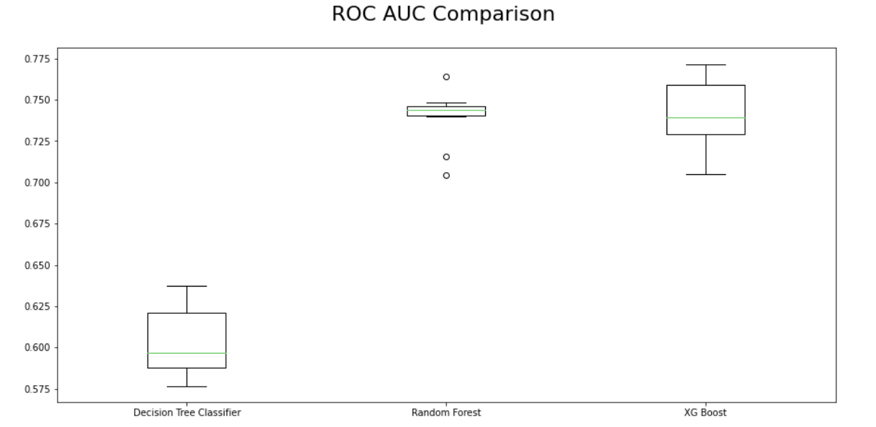
ROC AUC Comparison

Slide 19
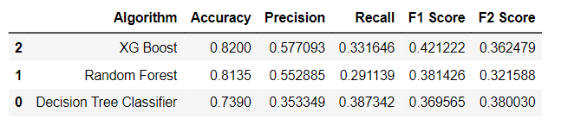
Model Evaluation Summary

Slide 20
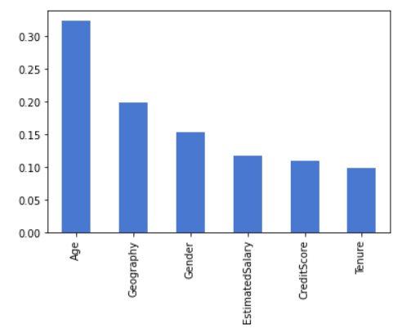
Important Features

Slide 21


