Slide 1




ADVANCED PROGRAMATION
“SECURE SHARE”
#YOUR FILES SHARED AND STORED WITH COMPLETE CONFIDENTIALITY...
BOUASRIA Chaima
AMEZIANE manel fatma
3th year, GR: 04
2025-2026

Slide 2

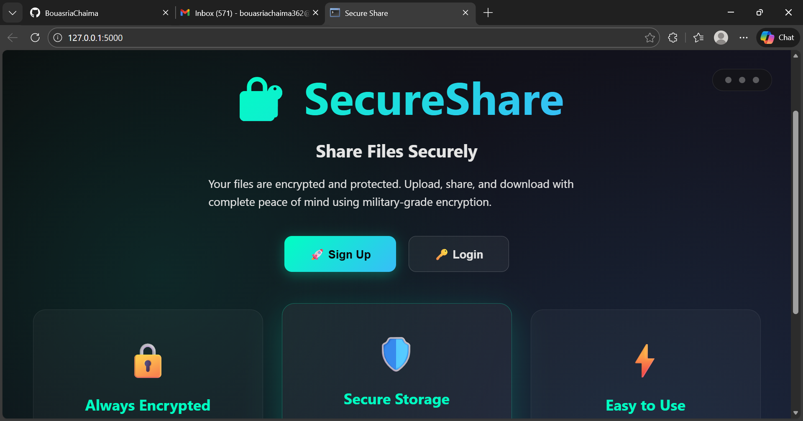

HOME PAGE
when the user enters the home page he chooses between login or sign up in the site
he can also use these 3 points at the top to go to these pages

Slide 3
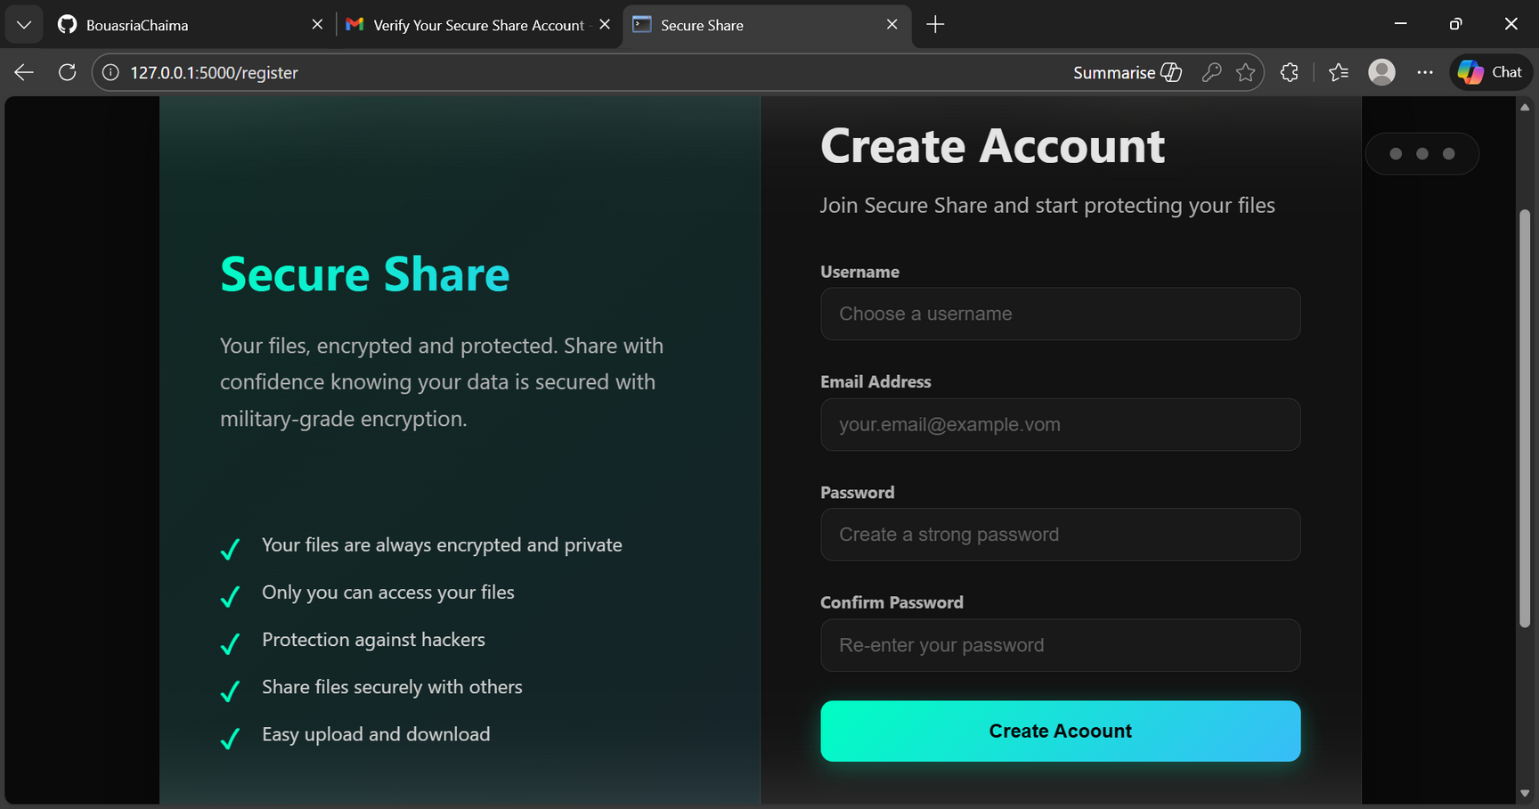
02
if the user creates a new account . the site prompts him to enter his information and then sends him a confirmation email containing a verification code ( it uses my email bouasriachaima362@gmail.com because i put it in the configuration and also adding a 3rd person code )

Slide 4
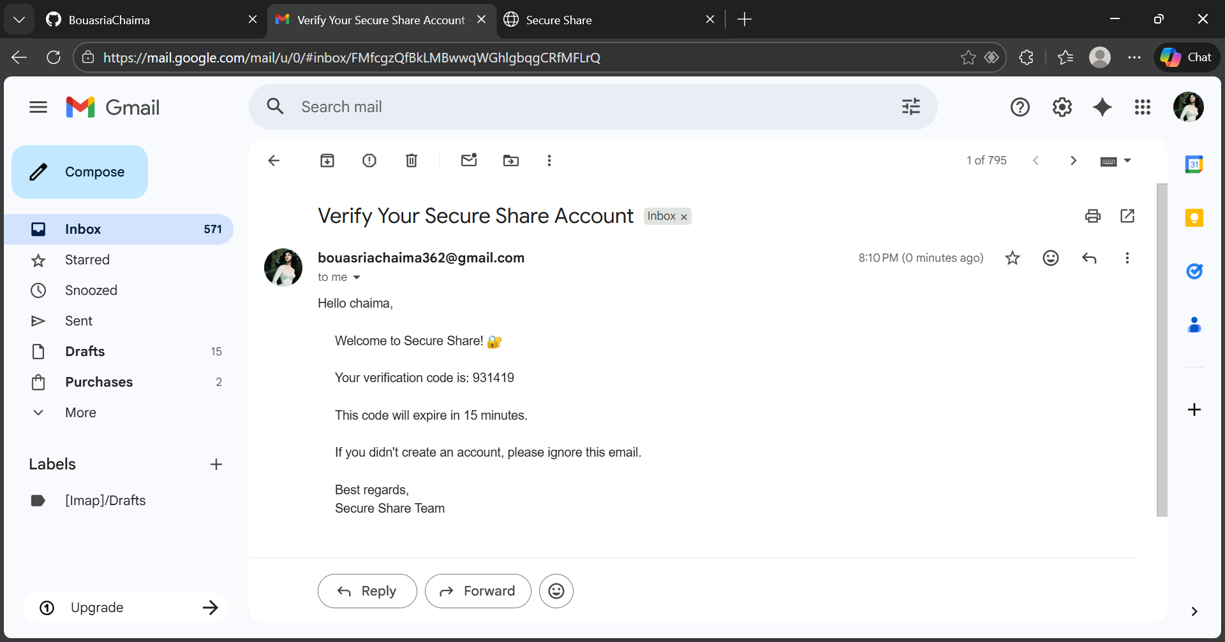

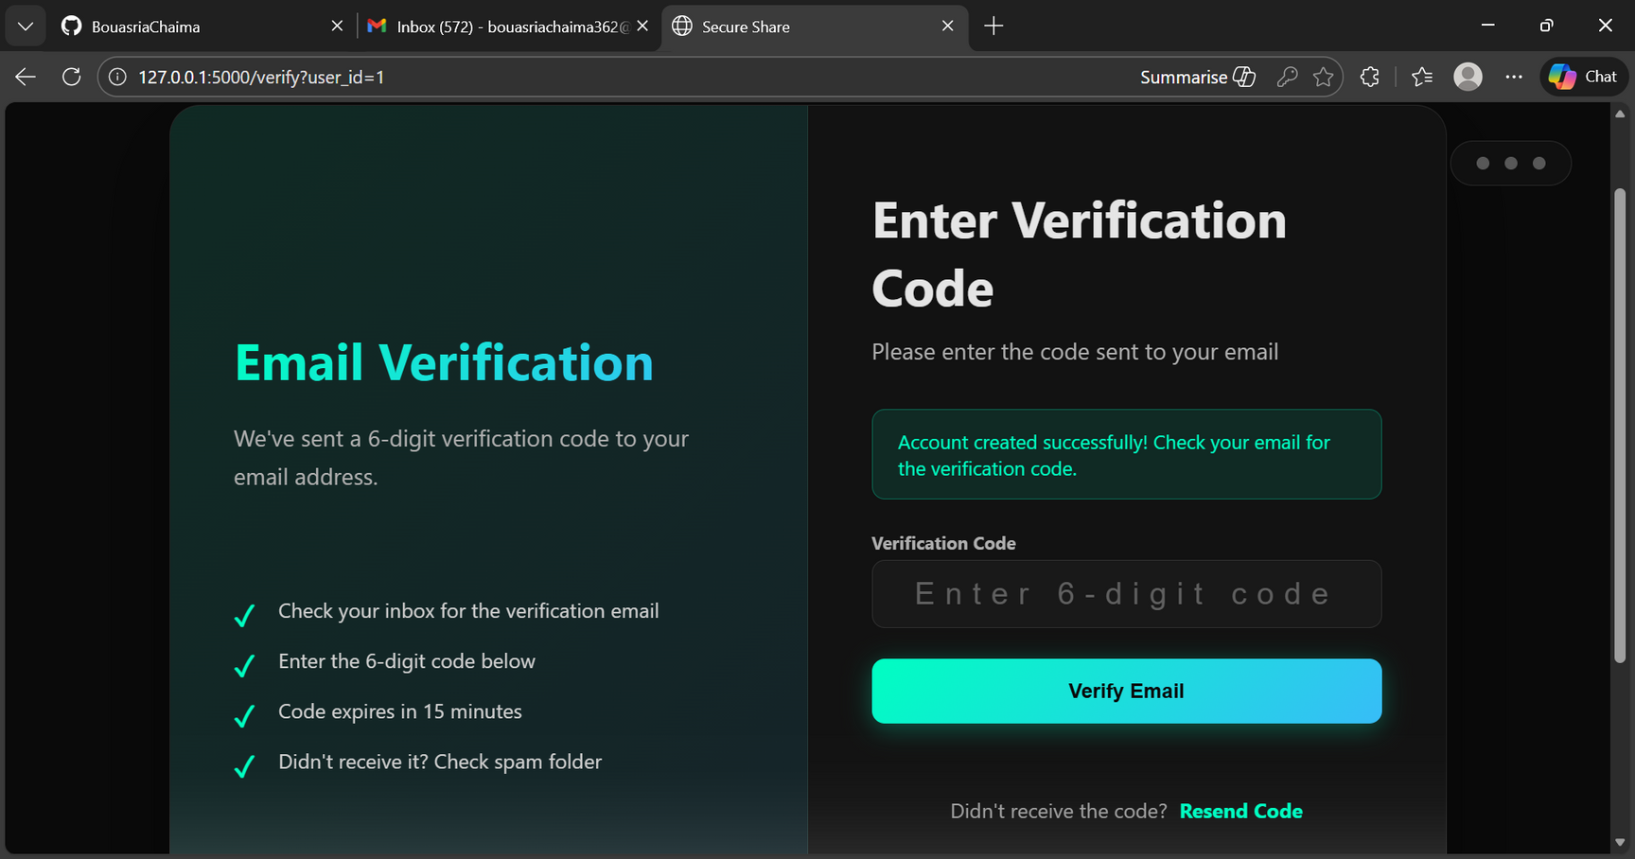
03

Slide 5
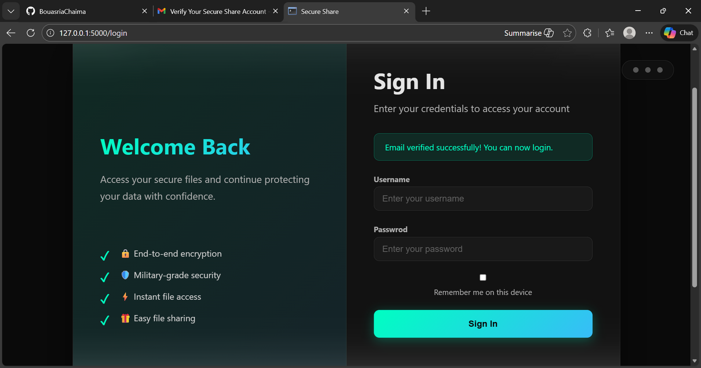
04
if the user has an account he can directly enter to his account

Slide 6
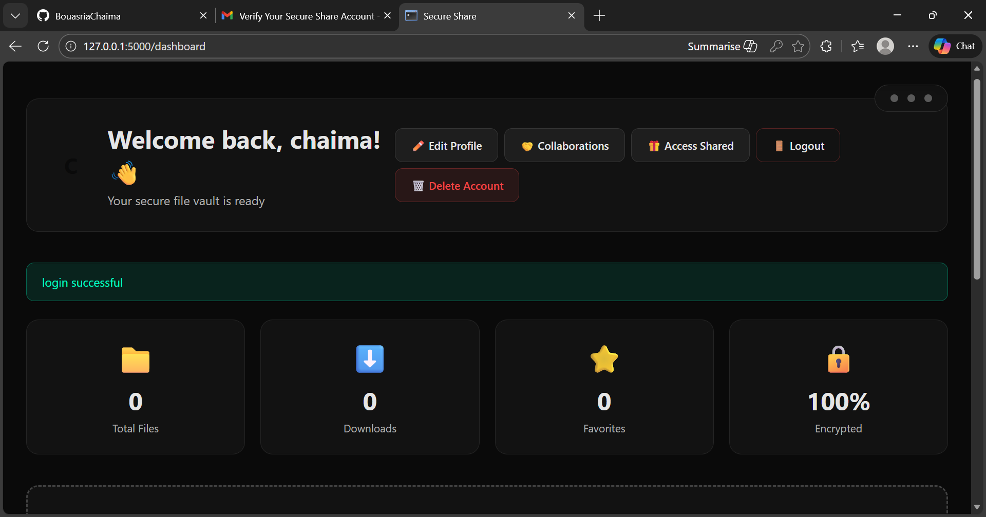

05
DASHBOARD
when the user enters to his account , he is directed to the dashbord where he finds his files and buttons to other pages
scroll

Slide 7
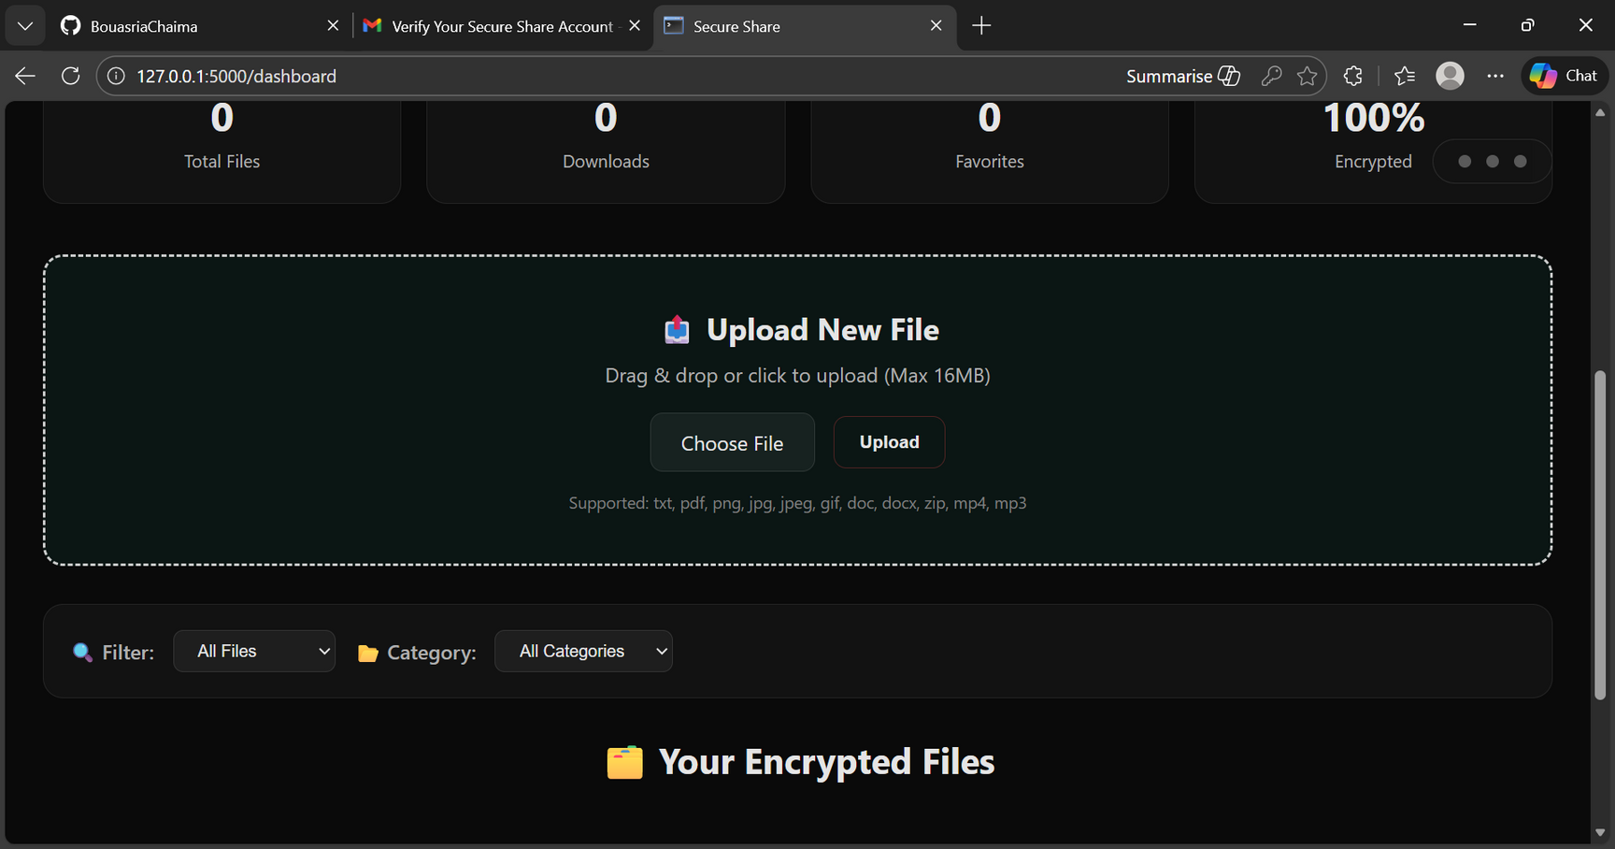
06
here the user can add a file and upload it to the site
here he can find his files ( files he already uploaded to the site , where he can add them to favorites , share them with other users , delete them and reupload them

Slide 8
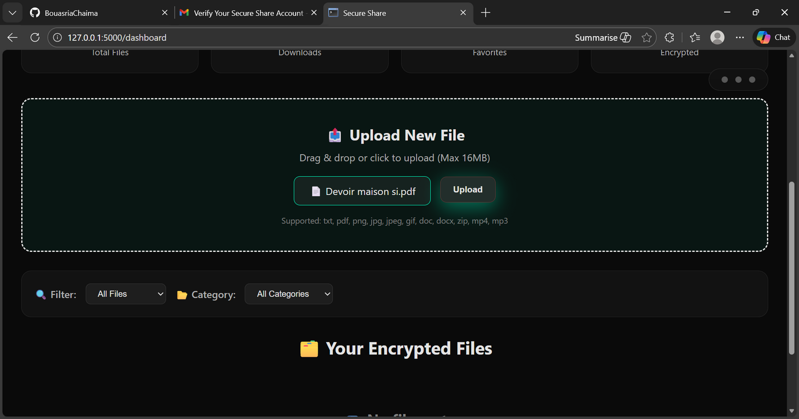
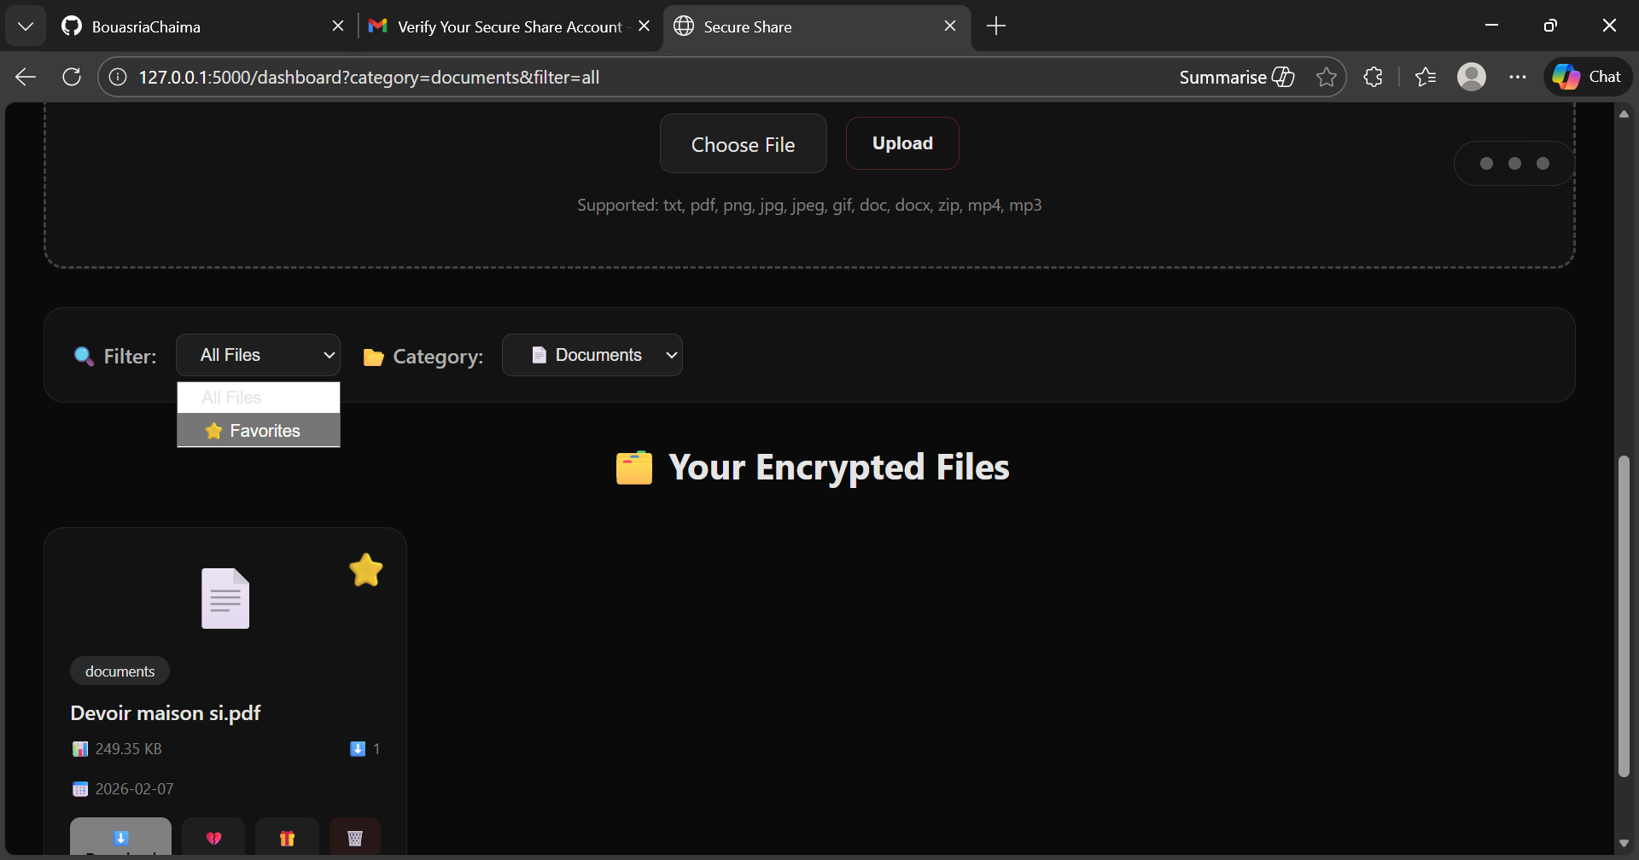
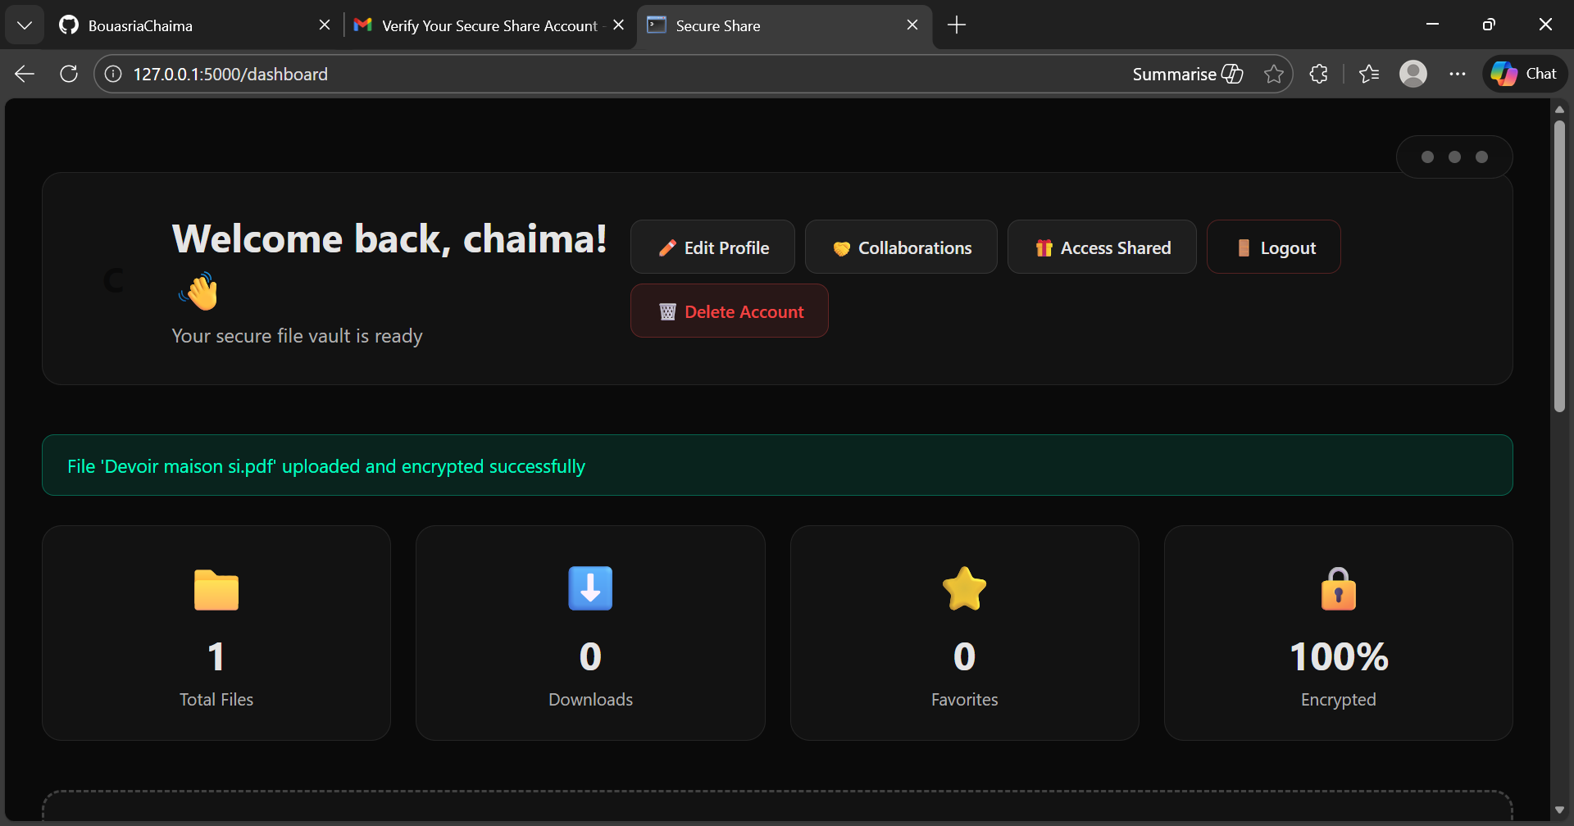
07
when the user chooses a file to upload and clicks on upload the file is uploaded and he can find it with the other files

Slide 9
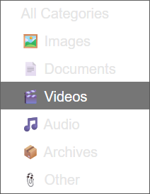

08
the user can filter the files by : favorites or categories( according to the extention of the file)
share the file
delete the file
toggle favorite

Slide 10
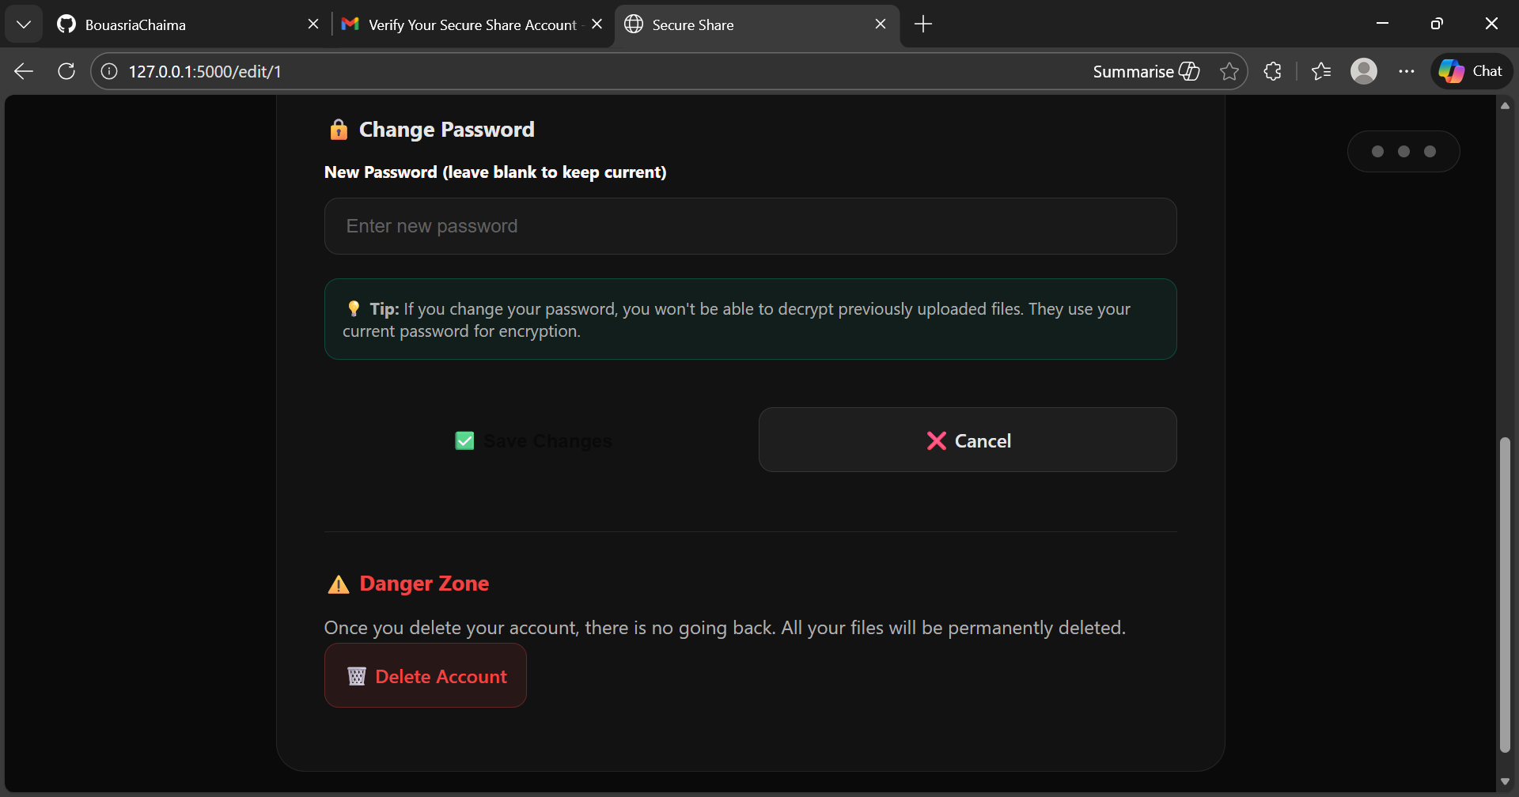
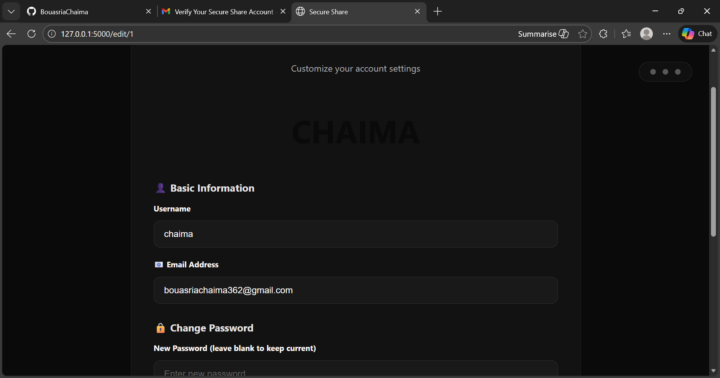



09
EDITING PAGE
scroll
delete the account
cancel the changes
save the changes

Slide 11
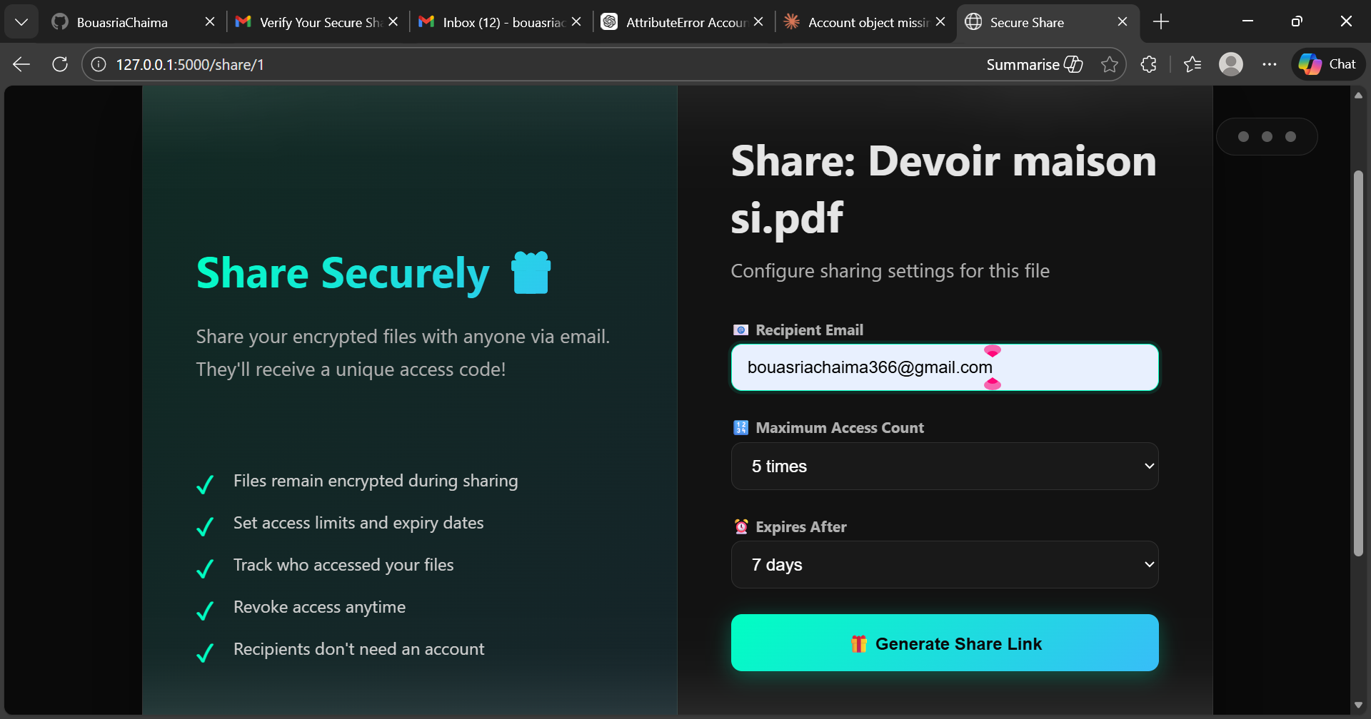
10
logout
delete account
SHARING FILE PAGE

Slide 12
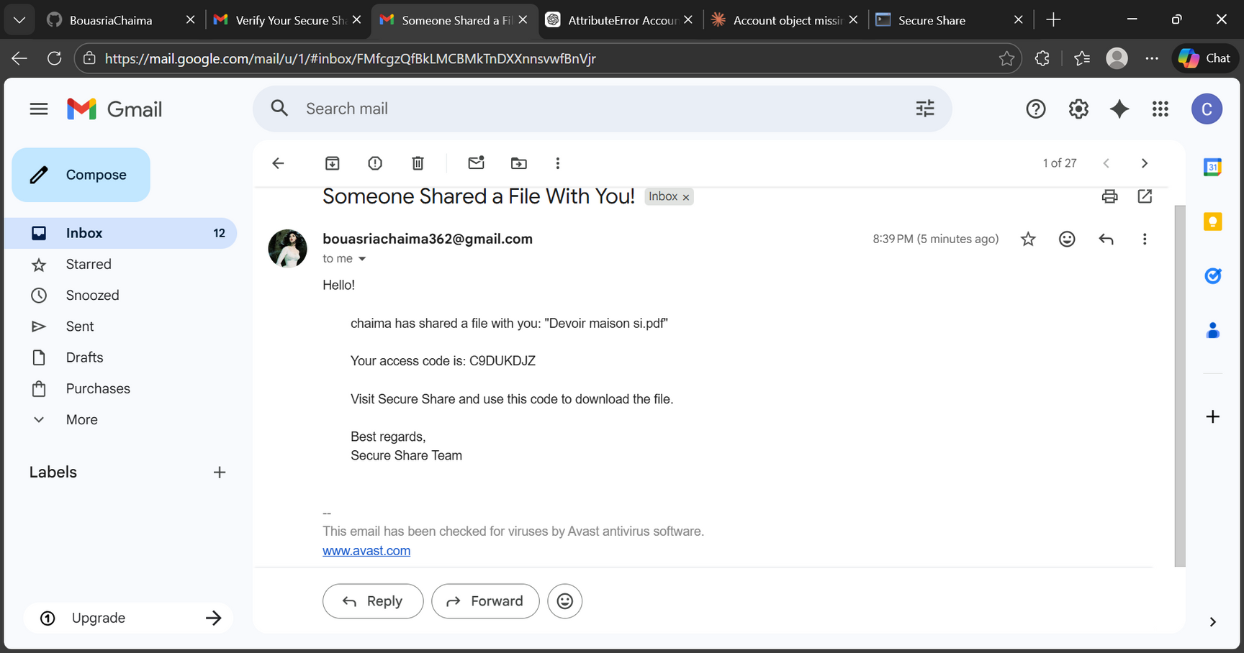
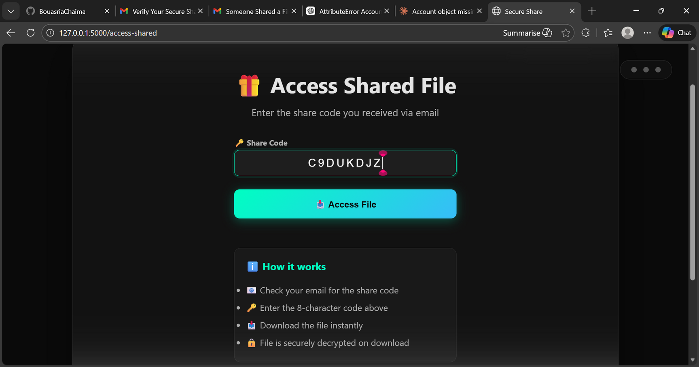
11
when the user shares a file with another user , secure share sends an email to the recipient whith an access code
the recipient user enters the sharing code to download the shared file

Slide 13
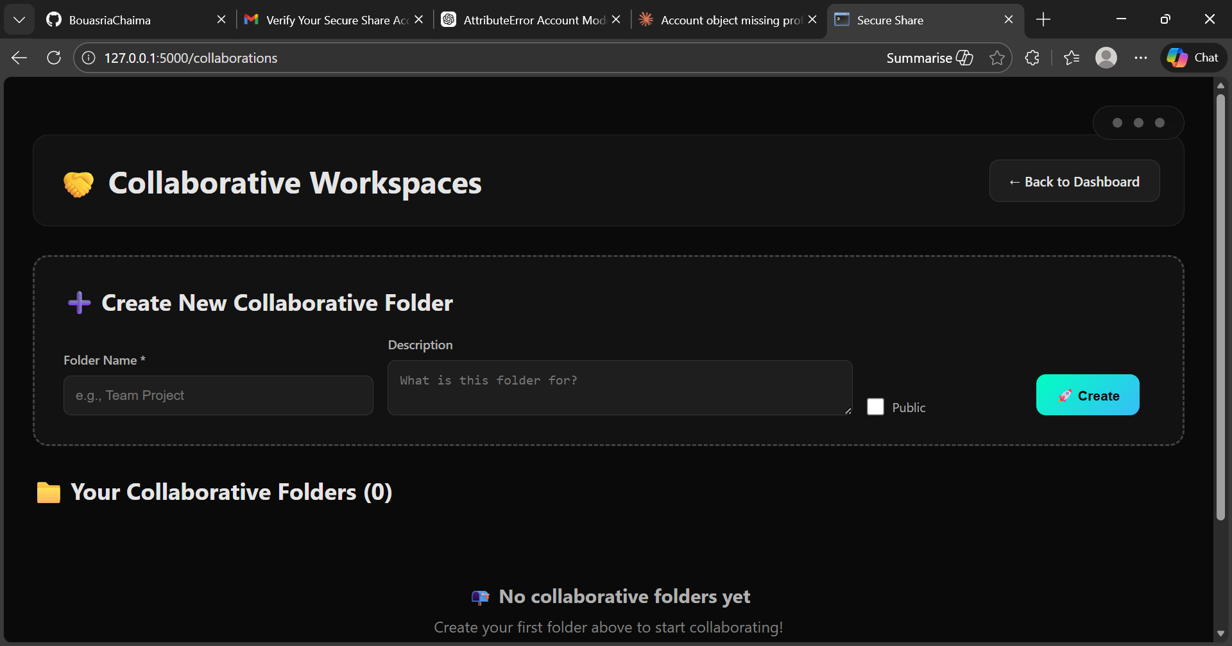
12
COLABORATIVE WORK PAGE
the user can create a new colaborative folder with other users

Slide 14
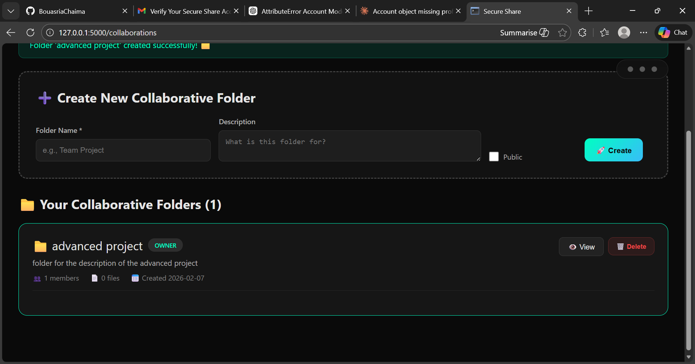
13
after creating the folder when he clicks on “view” we have

Slide 15
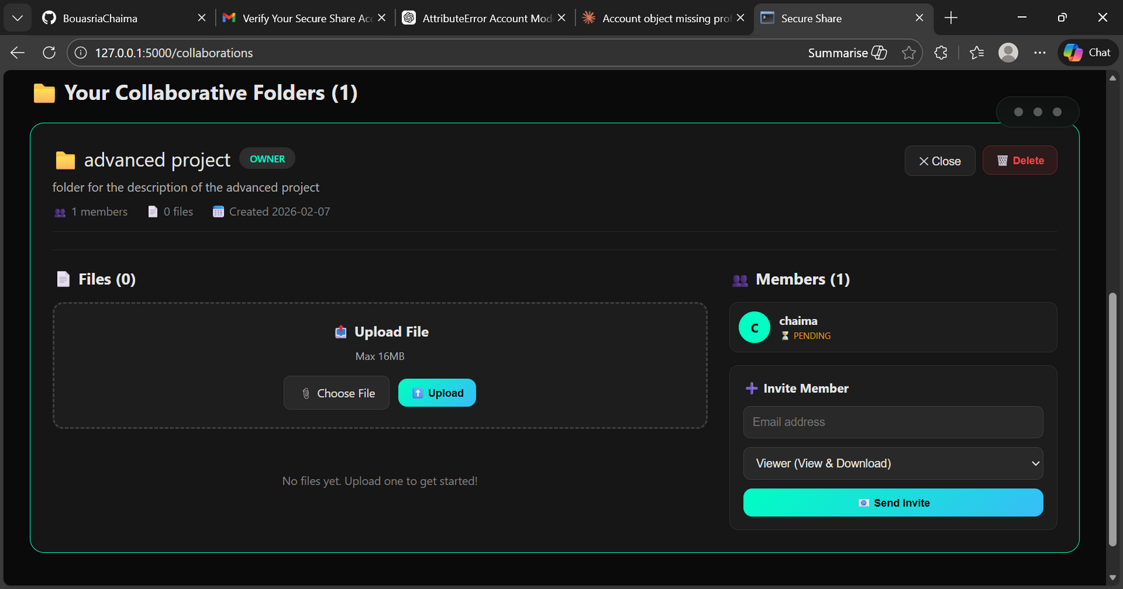
14
delete the folder

Slide 16


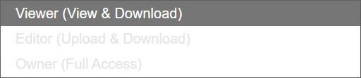
15
add files to the folder
here the user enters the email of the “user” he wanted to collaborate with , and the recipient recieve an email
here he can choose (owner) what the added user’s role can be

Slide 17
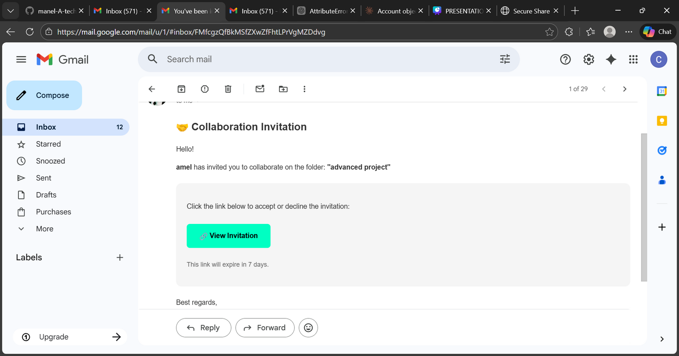

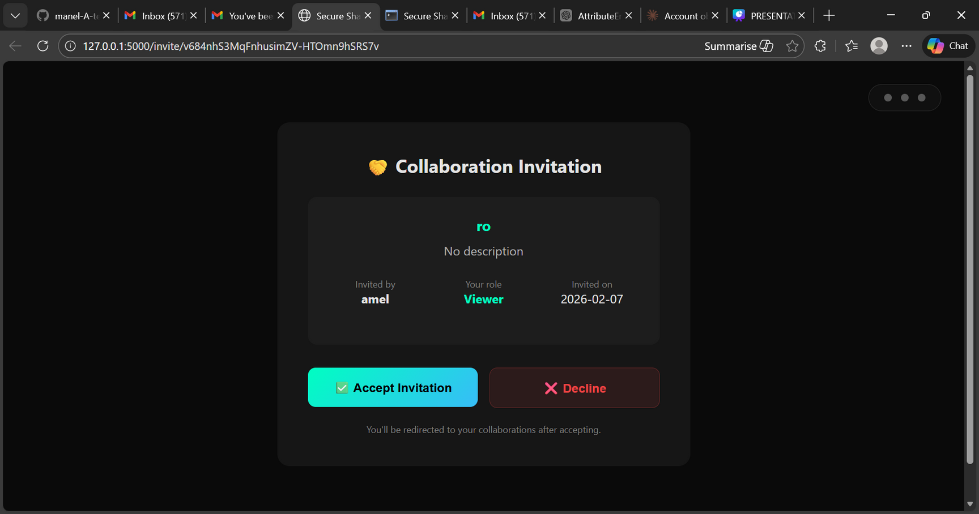
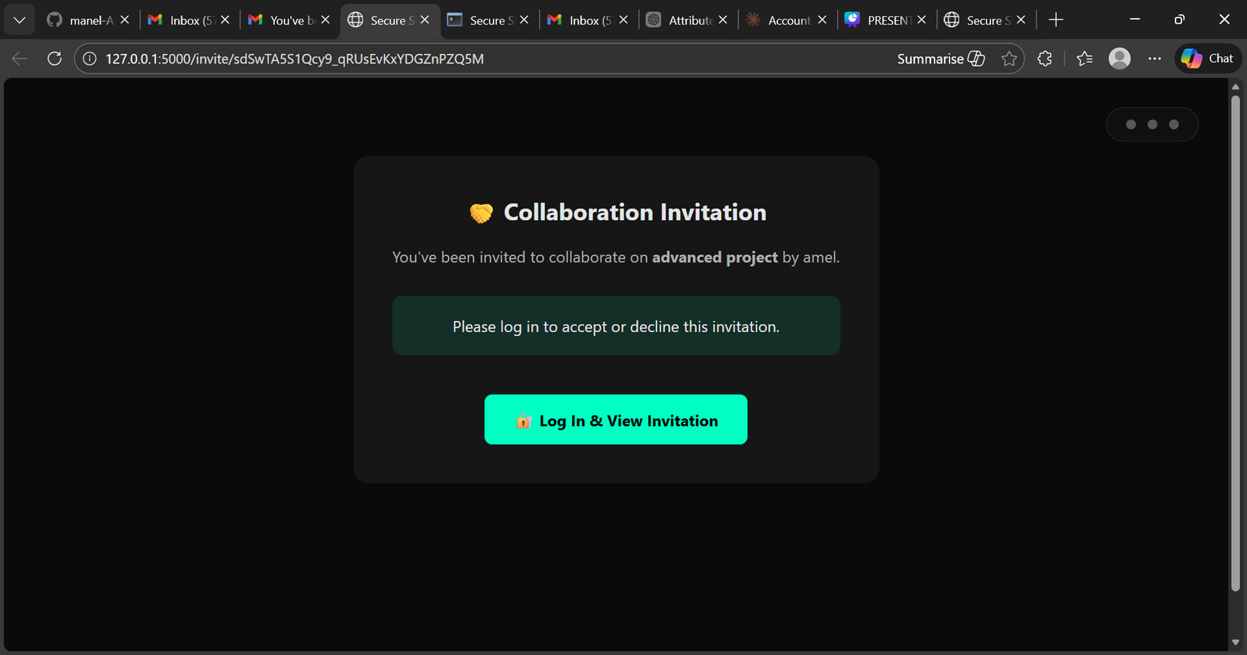
16

Slide 18
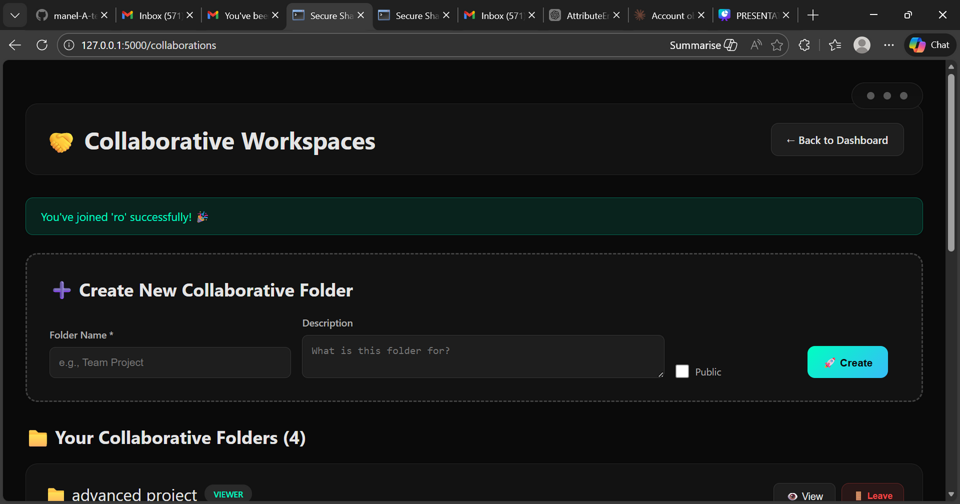
17
now the user has the folder in his collaborative folders

Slide 19
THANK YOU FOR YOUR ATTENTION

