Slide 1

Quantum Assisted Secure Multiparty Computation
Manuel Batalha dos Santos
Thesis defence
16 January 2025

Slide 2

Outline
Notes:
Outline:
Background: here we will discuss important primitives for MPC protocols. In particular, Oblivious Transfer, which is a very important primitive in boolean-based apprach, and Oblivious Linear Evaluation which is a generalization of Oblivious Transfer and can be used in the context of arithmetic-based MPC protocols.
Quantum and classical oblivious transfer: a comparison
Phylogenetic Trees
Oblivious Linear El

Slide 3
Outline
Motivation and outcomes
Notes:
Outline:
Background: here we will discuss important primitives for MPC protocols. In particular, Oblivious Transfer, which is a very important primitive in boolean-based apprach, and Oblivious Linear Evaluation which is a generalization of Oblivious Transfer and can be used in the context of arithmetic-based MPC protocols.
Quantum and classical oblivious transfer: a comparison
Phylogenetic Trees
Oblivious Linear El

Slide 4
Outline
Motivation and outcomes
Quantum and classical oblivious transfer
Notes:
Outline:
Background: here we will discuss important primitives for MPC protocols. In particular, Oblivious Transfer, which is a very important primitive in boolean-based apprach, and Oblivious Linear Evaluation which is a generalization of Oblivious Transfer and can be used in the context of arithmetic-based MPC protocols.
Quantum and classical oblivious transfer: a comparison
Phylogenetic Trees
Oblivious Linear El

Slide 5
Outline
Motivation and outcomes
Quantum and classical oblivious transfer
Private phylogenetic trees
Notes:
Outline:
Background: here we will discuss important primitives for MPC protocols. In particular, Oblivious Transfer, which is a very important primitive in boolean-based apprach, and Oblivious Linear Evaluation which is a generalization of Oblivious Transfer and can be used in the context of arithmetic-based MPC protocols.
Quantum and classical oblivious transfer: a comparison
Phylogenetic Trees
Oblivious Linear El

Slide 6
Outline
Motivation and outcomes
Quantum and classical oblivious transfer
Private phylogenetic trees
Quantum oblivious linear evaluation
Notes:
Outline:
Background: here we will discuss important primitives for MPC protocols. In particular, Oblivious Transfer, which is a very important primitive in boolean-based apprach, and Oblivious Linear Evaluation which is a generalization of Oblivious Transfer and can be used in the context of arithmetic-based MPC protocols.
Quantum and classical oblivious transfer: a comparison
Phylogenetic Trees
Oblivious Linear El

Slide 7
Motivation
SMC
Notes:
The motivation is Secure Multiparty Computation and there are currently
MPC protocols can be devided through several perspectives but here we will look from the point of view of its circuit architecture.
MPC protocols are based in either Boolean circuits or Arithmetic circuits

Slide 8
Motivation
SMC
Notes:
The motivation is Secure Multiparty Computation and there are currently
MPC protocols can be devided through several perspectives but here we will look from the point of view of its circuit architecture.
MPC protocols are based in either Boolean circuits or Arithmetic circuits

Slide 9
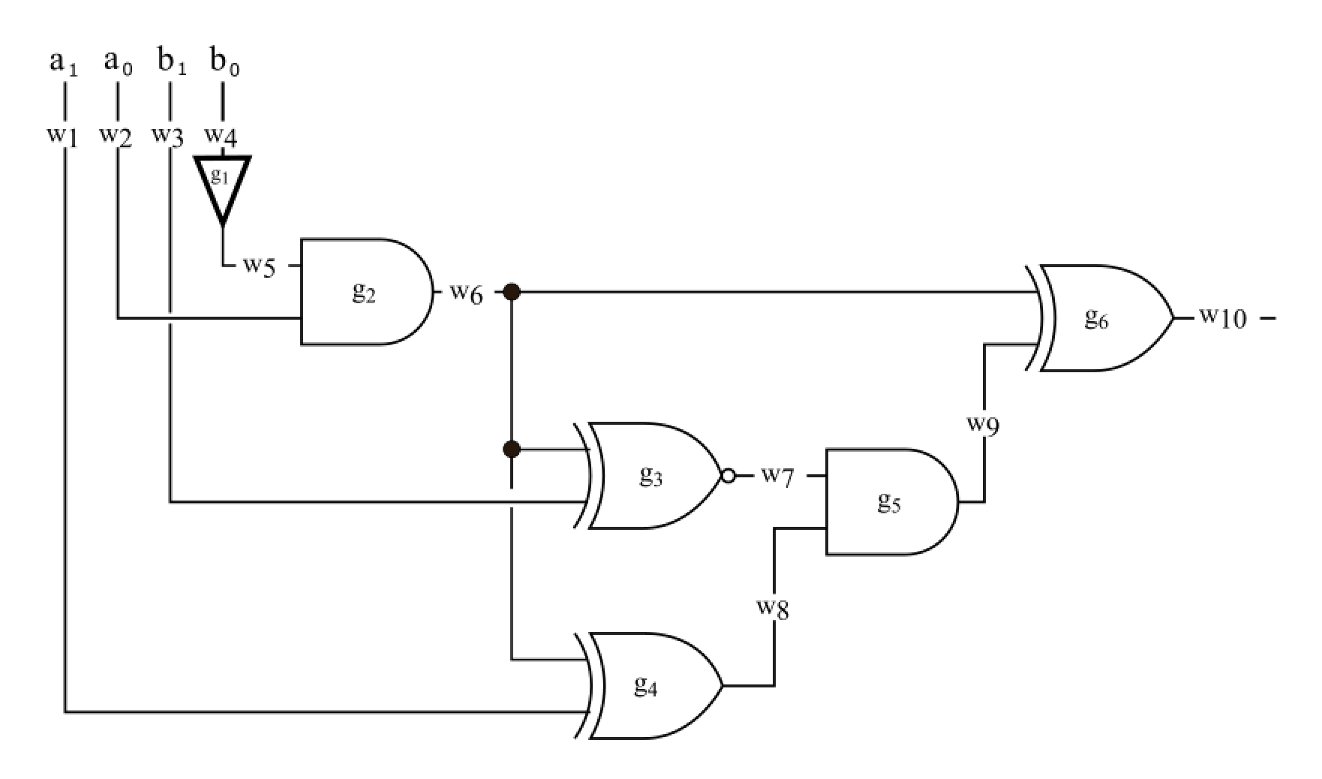
Motivation
SMC
Boolean
Notes:
The motivation is Secure Multiparty Computation and there are currently
MPC protocols can be devided through several perspectives but here we will look from the point of view of its circuit architecture.
MPC protocols are based in either Boolean circuits or Arithmetic circuits

Slide 10
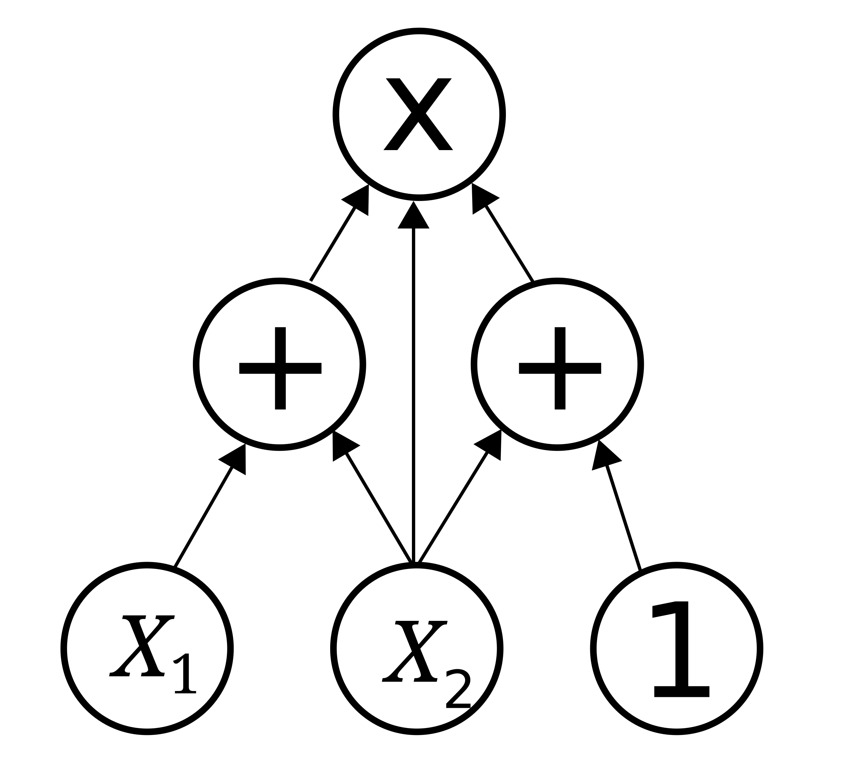
Motivation
SMC
Boolean
Arithmetic
Notes:
The motivation is Secure Multiparty Computation and there are currently
MPC protocols can be devided through several perspectives but here we will look from the point of view of its circuit architecture.
MPC protocols are based in either Boolean circuits or Arithmetic circuits

Slide 11
Motivation
SMC
Circuit
Notes:
The motivation is Secure Multiparty Computation and there are currently
MPC protocols can be devided through several perspectives but here we will look from the point of view of its circuit architecture.
MPC protocols are based in either Boolean circuits or Arithmetic circuits

Slide 12
Motivation
SMC
Primitive
Circuit
Notes:
The motivation is Secure Multiparty Computation and there are currently
MPC protocols can be devided through several perspectives but here we will look from the point of view of its circuit architecture.
MPC protocols are based in either Boolean circuits or Arithmetic circuits

Slide 13
Motivation
SMC
Oblivious Transfer
Primitive
Circuit
Notes:
The motivation is Secure Multiparty Computation and there are currently
MPC protocols can be devided through several perspectives but here we will look from the point of view of its circuit architecture.
MPC protocols are based in either Boolean circuits or Arithmetic circuits

Slide 14
Motivation
SMC
Oblivious Linear Evaluation
Oblivious Transfer
Primitive
Circuit
Notes:
The motivation is Secure Multiparty Computation and there are currently
MPC protocols can be devided through several perspectives but here we will look from the point of view of its circuit architecture.
MPC protocols are based in either Boolean circuits or Arithmetic circuits

Slide 15
Motivation
SMC
Classic
Classic
Oblivious Linear Evaluation
Oblivious Transfer
Primitive
Circuit
Notes:
The motivation is Secure Multiparty Computation and there are currently
MPC protocols can be devided through several perspectives but here we will look from the point of view of its circuit architecture.
MPC protocols are based in either Boolean circuits or Arithmetic circuits

Slide 16
Motivation
SMC
Quantum
Classic
Quantum
Classic
Oblivious Linear Evaluation
Oblivious Transfer
Primitive
Circuit
Notes:
The motivation is Secure Multiparty Computation and there are currently
MPC protocols can be devided through several perspectives but here we will look from the point of view of its circuit architecture.
MPC protocols are based in either Boolean circuits or Arithmetic circuits

Slide 17
Motivation
SMC
Quantum
Classic
Quantum
Classic
[BBCS’91]
Oblivious Linear Evaluation
Oblivious Transfer
Primitive
Circuit
Notes:
The motivation is Secure Multiparty Computation and there are currently
MPC protocols can be devided through several perspectives but here we will look from the point of view of its circuit architecture.
MPC protocols are based in either Boolean circuits or Arithmetic circuits

Slide 18
Motivation
SMC
Quantum
Classic
Quantum
Classic
[BBCS’91]
[FS’09]
[DFS+05] [WST’08] …
Oblivious Linear Evaluation
Oblivious Transfer
Primitive
Circuit
Notes:
The motivation is Secure Multiparty Computation and there are currently
MPC protocols can be devided through several perspectives but here we will look from the point of view of its circuit architecture.
MPC protocols are based in either Boolean circuits or Arithmetic circuits

Slide 19
Motivation
SMC
Quantum
Classic
Quantum
Classic
[BBCS’91]
[FS’09]
[DFS+05] [WST’08] …
[EGL’85] SimpleOT
…
Oblivious Linear Evaluation
Oblivious Transfer
Primitive
Circuit
Notes:
The motivation is Secure Multiparty Computation and there are currently
MPC protocols can be devided through several perspectives but here we will look from the point of view of its circuit architecture.
MPC protocols are based in either Boolean circuits or Arithmetic circuits

Slide 20
Motivation
SMC
Quantum
Classic
Quantum
Classic
[BBCS’91]
[FS’09]
[DFS+05] [WST’08] …
[EGL’85] SimpleOT
…
Oblivious Linear Evaluation
Oblivious Transfer
Primitive
Review
[YAV’22]
Circuit
Notes:
The motivation is Secure Multiparty Computation and there are currently
MPC protocols can be devided through several perspectives but here we will look from the point of view of its circuit architecture.
MPC protocols are based in either Boolean circuits or Arithmetic circuits

Slide 21
Motivation
SMC
Quantum
Classic
Quantum
Classic
[BBCS’91]
[FS’09]
[DFS+05] [WST’08] …
[EGL’85] SimpleOT
…
Oblivious Linear Evaluation
Oblivious Transfer
Primitive
Review
[YAV’22]
Circuit
Notes:
The motivation is Secure Multiparty Computation and there are currently
MPC protocols can be devided through several perspectives but here we will look from the point of view of its circuit architecture.
MPC protocols are based in either Boolean circuits or Arithmetic circuits

Slide 22
Motivation
SMC
Quantum
Classic
Quantum
Classic
[BBCS’91]
[FS’09]
[DFS+05] [WST’08] …
[EGL’85] SimpleOT
…
Oblivious Linear Evaluation
Oblivious Transfer
Primitive
Review
[YAV’22]
Circuit
Notes:
The motivation is Secure Multiparty Computation and there are currently
MPC protocols can be devided through several perspectives but here we will look from the point of view of its circuit architecture.
MPC protocols are based in either Boolean circuits or Arithmetic circuits

Slide 23
Motivation
SMC
Quantum
Classic
Quantum
Classic
[BBCS’91]
[FS’09]
[DFS+05] [WST’08] …
[EGL’85] SimpleOT
…
Oblivious Linear Evaluation
Oblivious Transfer
Primitive
libscapi
Review
[YAV’22]
Circuit
Notes:
The motivation is Secure Multiparty Computation and there are currently
MPC protocols can be devided through several perspectives but here we will look from the point of view of its circuit architecture.
MPC protocols are based in either Boolean circuits or Arithmetic circuits

Slide 24
Motivation
SMC
Quantum
Classic
Quantum
Classic
[BBCS’91]
[FS’09]
[DFS+05] [WST’08] …
[EGL’85] SimpleOT
…
Oblivious Linear Evaluation
Oblivious Transfer
Primitive
libscapi
Review
[YAV’22]
Circuit
Notes:
The motivation is Secure Multiparty Computation and there are currently
MPC protocols can be devided through several perspectives but here we will look from the point of view of its circuit architecture.
MPC protocols are based in either Boolean circuits or Arithmetic circuits

Slide 25
Motivation
SMC
Quantum
Classic
Quantum
Classic
[BBCS’91]
[FS’09]
[DFS+05] [WST’08] …
[EGL’85] SimpleOT
…
Oblivious Linear Evaluation
Oblivious Transfer
Primitive
libscapi
Review
[YAV’22]
Circuit
Application
Secure auctions
Secure voting
Notes:
The motivation is Secure Multiparty Computation and there are currently
MPC protocols can be devided through several perspectives but here we will look from the point of view of its circuit architecture.
MPC protocols are based in either Boolean circuits or Arithmetic circuits

Slide 26
Motivation
SMC
Quantum
Classic
Quantum
Classic
[BBCS’91]
[FS’09]
[DFS+05] [WST’08] …
[EGL’85] SimpleOT
…
Oblivious Linear Evaluation
Oblivious Transfer
Primitive
libscapi
Review
[YAV’22]
Circuit
Application
Secure auctions
Secure voting
Notes:
The motivation is Secure Multiparty Computation and there are currently
MPC protocols can be devided through several perspectives but here we will look from the point of view of its circuit architecture.
MPC protocols are based in either Boolean circuits or Arithmetic circuits

Slide 27
Motivation
SMC
Quantum
Classic
Quantum
Classic
[BBCS’91]
[FS’09]
[DFS+05] [WST’08] …
[EGL’85] SimpleOT
…
Oblivious Linear Evaluation
[NP’99]
TinyOLE
…
Oblivious Transfer
Primitive
libscapi
Review
[YAV’22]
Circuit
Application
Secure auctions
Secure voting
Notes:
The motivation is Secure Multiparty Computation and there are currently
MPC protocols can be devided through several perspectives but here we will look from the point of view of its circuit architecture.
MPC protocols are based in either Boolean circuits or Arithmetic circuits

Slide 28
Motivation
SMC
Quantum
Classic
Quantum
Classic
[BBCS’91]
[FS’09]
[DFS+05] [WST’08] …
[EGL’85] SimpleOT
…
Oblivious Linear Evaluation
[NP’99]
TinyOLE
…
Oblivious Transfer
Primitive
libscapi
Review
[YAV’22]
Circuit
Application
Secure auctions
Secure voting
Notes:
The motivation is Secure Multiparty Computation and there are currently
MPC protocols can be devided through several perspectives but here we will look from the point of view of its circuit architecture.
MPC protocols are based in either Boolean circuits or Arithmetic circuits

Slide 29
Motivation
SMC
Quantum
Classic
Quantum
Classic
[BBCS’91]
[FS’09]
[DFS+05] [WST’08] …
[EGL’85] SimpleOT
…
Oblivious Linear Evaluation
[NP’99]
TinyOLE
…
Oblivious Transfer
Primitive
libscapi
Review
[YAV’22]
Circuit
MASCOT
OT reduction
into SPDZ
Application
Secure auctions
Secure voting
Notes:
The motivation is Secure Multiparty Computation and there are currently
MPC protocols can be devided through several perspectives but here we will look from the point of view of its circuit architecture.
MPC protocols are based in either Boolean circuits or Arithmetic circuits

Slide 30
Motivation
SMC
Quantum
Classic
Quantum
Classic
[BBCS’91]
[FS’09]
[DFS+05] [WST’08] …
[EGL’85] SimpleOT
…
Oblivious Linear Evaluation
[NP’99]
TinyOLE
…
Oblivious Transfer
Primitive
libscapi
Review
[YAV’22]
MP-SPDZ
Circuit
MASCOT
OT reduction
into SPDZ
Application
Secure auctions
Secure voting
Notes:
The motivation is Secure Multiparty Computation and there are currently
MPC protocols can be devided through several perspectives but here we will look from the point of view of its circuit architecture.
MPC protocols are based in either Boolean circuits or Arithmetic circuits

Slide 31
Motivation
SMC
Quantum
Classic
Quantum
Classic
[BBCS’91]
[FS’09]
[DFS+05] [WST’08] …
[EGL’85] SimpleOT
…
Oblivious Linear Evaluation
[NP’99]
TinyOLE
…
Oblivious Transfer
Primitive
libscapi
Review
[YAV’22]
MP-SPDZ
Circuit
MASCOT
OT reduction
into SPDZ
Application
Secure auctions
Secure voting
Notes:
The motivation is Secure Multiparty Computation and there are currently
MPC protocols can be devided through several perspectives but here we will look from the point of view of its circuit architecture.
MPC protocols are based in either Boolean circuits or Arithmetic circuits

Slide 32
Motivation
SMC
Quantum
Classic
Quantum
Classic
[BBCS’91]
[FS’09]
[DFS+05] [WST’08] …
[EGL’85] SimpleOT
…
Oblivious Linear Evaluation
[NP’99]
TinyOLE
…
Oblivious Transfer
Primitive
libscapi
Review
[YAV’22]
MP-SPDZ
Circuit
MASCOT
OT reduction
into SPDZ
Application
Secure auctions
Secure voting
Notes:
The motivation is Secure Multiparty Computation and there are currently
MPC protocols can be devided through several perspectives but here we will look from the point of view of its circuit architecture.
MPC protocols are based in either Boolean circuits or Arithmetic circuits

Slide 33
Motivation
SMC
Quantum
Classic
Quantum
Classic
[BBCS’91]
[FS’09]
[DFS+05] [WST’08] …
[EGL’85] SimpleOT
…
Oblivious Linear Evaluation
[NP’99]
TinyOLE
…
Oblivious Transfer
Primitive
libscapi
Review
[YAV’22]
MP-SPDZ
Circuit
MASCOT
OT reduction
into SPDZ
Application
Secure auctions
Secure voting
Notes:
The motivation is Secure Multiparty Computation and there are currently
MPC protocols can be devided through several perspectives but here we will look from the point of view of its circuit architecture.
MPC protocols are based in either Boolean circuits or Arithmetic circuits

Slide 34
Outcomes
SMC
Quantum
Classic
Quantum
Classic
[BBCS’91]
[FS’09]
[DFS+05] [WST’08] …
[EGL’85] SimpleOT
…
Oblivious Linear Evaluation
[NP’99]
TinyOLE
…
Oblivious Transfer
Primitive
libscapi
[SPM’22]
Review
[YAV’22]
MP-SPDZ
Circuit
MASCOT
OT reduction
into SPDZ
Application
Secure auctions
Secure voting
Notes:
The motivation is Secure Multiparty Computation and there are currently
MPC protocols can be devided through several perspectives but here we will look from the point of view of its circuit architecture.
MPC protocols are based in either Boolean circuits or Arithmetic circuits

Slide 35
Outcomes
SMC
SPM’21
Quantum
Classic
Quantum
Classic
[BBCS’91]
[FS’09]
[DFS+05] [WST’08] …
[EGL’85] SimpleOT
…
Oblivious Linear Evaluation
[NP’99]
TinyOLE
…
Oblivious Transfer
Primitive
libscapi
[SPM’22]
Review
[YAV’22]
MP-SPDZ
Circuit
MASCOT
OT reduction
into SPDZ
Application
Secure auctions
Secure voting
Notes:
The motivation is Secure Multiparty Computation and there are currently
MPC protocols can be devided through several perspectives but here we will look from the point of view of its circuit architecture.
MPC protocols are based in either Boolean circuits or Arithmetic circuits

Slide 36
Outcomes
SMC
SPM’21
Quantum
Classic
Quantum
Classic
[BBCS’91]
[FS’09]
[DFS+05] [WST’08] …
[EGL’85] SimpleOT
…
Oblivious Linear Evaluation
[NP’99]
TinyOLE
…
Oblivious Transfer
Primitive
OTKeys*
libscapi
[SPM’22]
Review
[YAV’22]
MP-SPDZ
Circuit
MASCOT
OT reduction
into SPDZ
Application
Secure auctions
Secure voting
* github.com/manel1874
Notes:
The motivation is Secure Multiparty Computation and there are currently
MPC protocols can be devided through several perspectives but here we will look from the point of view of its circuit architecture.
MPC protocols are based in either Boolean circuits or Arithmetic circuits

Slide 37
Outcomes
SMC
SPM’21
Quantum
Classic
Quantum
Classic
[BBCS’91]
[FS’09]
[DFS+05] [WST’08] …
[EGL’85] SimpleOT
…
Oblivious Linear Evaluation
[NP’99]
TinyOLE
…
Oblivious Transfer
Primitive
OTKeys*
libscapi
[SPM’22]
Review
[YAV’22]
MP-SPDZ
Circuit
MASCOT
OT reduction
into SPDZ
Application
[SCPM’21]
Secure auctions
Secure voting
[SCPM’22]
* github.com/manel1874
Notes:
The motivation is Secure Multiparty Computation and there are currently
MPC protocols can be devided through several perspectives but here we will look from the point of view of its circuit architecture.
MPC protocols are based in either Boolean circuits or Arithmetic circuits

Slide 38
Outcomes
SMC
SPM’21
Quantum
Classic
Quantum
Classic
[BBCS’91]
[FS’09]
[DFS+05] [WST’08] …
[EGL’85] SimpleOT
…
Oblivious Linear Evaluation
[NP’99]
TinyOLE
…
Oblivious Transfer
Primitive
[SVM’22]
OTKeys*
libscapi
[SPM’22]
Review
[YAV’22]
MP-SPDZ
Circuit
MASCOT
OT reduction
into SPDZ
Application
[SCPM’21]
Secure auctions
Secure voting
[SCPM’22]
* github.com/manel1874
Notes:
The motivation is Secure Multiparty Computation and there are currently
MPC protocols can be devided through several perspectives but here we will look from the point of view of its circuit architecture.
MPC protocols are based in either Boolean circuits or Arithmetic circuits

Slide 39
Outcomes
SMC
SPM’21
Quantum
Classic
Quantum
Classic
[BBCS’91]
[FS’09]
[DFS+05] [WST’08] …
[EGL’85] SimpleOT
…
Oblivious Linear Evaluation
[NP’99]
TinyOLE
…
Oblivious Transfer
Primitive
[SVM’22]
OTKeys*
libscapi
QMP-SPDZ*
[SPM’22]
Review
[YAV’22]
MP-SPDZ
Circuit
MASCOT
OT reduction
into SPDZ
Application
[SCPM’21]
Secure auctions
Secure voting
[SCPM’22]
* github.com/manel1874
Notes:
The motivation is Secure Multiparty Computation and there are currently
MPC protocols can be devided through several perspectives but here we will look from the point of view of its circuit architecture.
MPC protocols are based in either Boolean circuits or Arithmetic circuits

Slide 40
Outcomes
SMC
SPM’21
Quantum
Classic
Quantum
Classic
[BBCS’91]
[FS’09]
[DFS+05] [WST’08] …
[EGL’85] SimpleOT
…
Oblivious Linear Evaluation
[NP’99]
TinyOLE
…
Oblivious Transfer
Primitive
[SVM’22]
OTKeys*
libscapi
QMP-SPDZ*
[SPM’22]
Review
[YAV’22]
MP-SPDZ
Circuit
MASCOT
OT reduction
into SPDZ
Application
[SCPM’21]
Secure auctions
Secure voting
[TSSP’23]
[SCPM’22]
* github.com/manel1874
Notes:
The motivation is Secure Multiparty Computation and there are currently
MPC protocols can be devided through several perspectives but here we will look from the point of view of its circuit architecture.
MPC protocols are based in either Boolean circuits or Arithmetic circuits

Slide 41
Outcomes
SMC
SPM’21
Quantum
Classic
Quantum
Classic
[BBCS’91]
[FS’09]
[DFS+05] [WST’08] …
[EGL’85] SimpleOT
…
Oblivious Linear Evaluation
[NP’99]
TinyOLE
…
Oblivious Transfer
Primitive
[SVM’22]
OTKeys*
libscapi
QMP-SPDZ*
[SPM’22]
Review
[YAV’22]
MP-SPDZ
Circuit
MASCOT
OT reduction
into SPDZ
Application
[SCPM’21]
Secure auctions
Secure voting
[TSSP’23]
[SCPM’22]
* github.com/manel1874
Notes:
The motivation is Secure Multiparty Computation and there are currently
MPC protocols can be devided through several perspectives but here we will look from the point of view of its circuit architecture.
MPC protocols are based in either Boolean circuits or Arithmetic circuits

Slide 42
Quantum and classical OT
SMC
SPM’21
Quantum
Classic
Quantum
Classic
[BBCS’91]
[FS’09]
[DFS+05] [WST’08] …
[EGL’85] SimpleOT
…
Oblivious Linear Evaluation
[NP’99]
TinyOLE
…
Oblivious Transfer
Primitive
[SVM’22]
OTKeys*
libscapi
QMP-SPDZ*
[SPM’22]
Review
[YAV’22]
MP-SPDZ
Circuit
MASCOT
OT reduction
into SPDZ
Application
[SCPM’21]
Secure auctions
Secure voting
[TSSP’23]
[SCPM’22]
* github.com/manel1874
Notes:
The motivation is Secure Multiparty Computation and there are currently
MPC protocols can be devided through several perspectives but here we will look from the point of view of its circuit architecture.
MPC protocols are based in either Boolean circuits or Arithmetic circuits

Slide 43
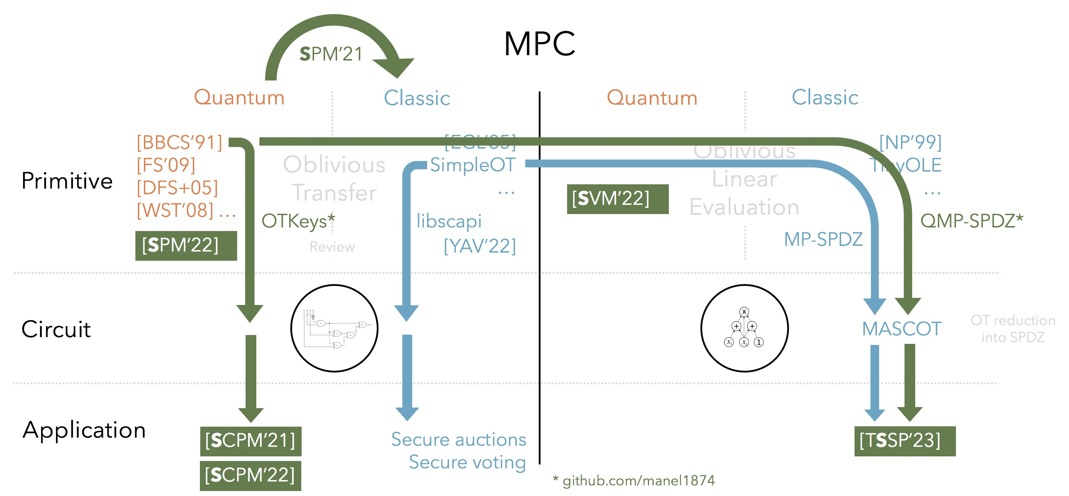
Oblivious Transfer
Alice
m₀
Bob
b
m₁
OT
m_{b}
Notes:
The motivation is Secure Multiparty Computation and there are currently
MPC protocols can be devided through several perspectives but here we will look from the point of view of its circuit architecture.
MPC protocols are based in either Boolean circuits or Arithmetic circuits

Slide 44
Quantum and classical OT
Quantum
Classic
[BBCS’91]
[DFS+05] [WST’08]
[FS’09]
…
[EGL’85]
[BM’89]
[NP’01]
SimpleOT
…
No previous work
How can we compare?
Notes:
From a security perspective it is easier to compare both approaches. And this is the main motivation to perform QOT. [Todo: Desenrolar esta ideia um pouco só por paralavras] intercept now decipher later attack
There is not benchmark work to compare these two approaches.
Does that comparison makes sense from a practical perspective?
Any practical gain? Experimentally, can we assess if there is a best approach? Simply comparable?

Slide 45
Quantum and classical OT
Quantum
Classic
[BBCS’91]
[DFS+05] [WST’08]
[FS’09]
…
[EGL’85]
[BM’89]
[NP’01]
SimpleOT
…
No previous work
How can we compare?
Comparable structure?
Corresponding phases with same technology?
Any practical insight?
Notes:
From a security perspective it is easier to compare both approaches. And this is the main motivation to perform QOT. [Todo: Desenrolar esta ideia um pouco só por paralavras] intercept now decipher later attack
There is not benchmark work to compare these two approaches.
Does that comparison makes sense from a practical perspective?
Any practical gain? Experimentally, can we assess if there is a best approach? Simply comparable?

Slide 46

Quantum and classical OT
Quantum
Classic
[BBCS’91]
Base OT OT Extension
Offline phase
(Oblivious) key
Key
Offline phase
Online phase
Online phase
Comparable structure?
Corresponding phases with same technology?
Any practical insight?
Notes:
There is not benchmark work to compare these two approaches.
Does that comparison makes sense from a practical perspective?
Any practical gain? Experimentally, can we assess if there is a best approach? Simply comparable?

Slide 47

Quantum and classical OT
Quantum
Classic
[BBCS’91]
Base OT OT Extension
Offline phase
(Oblivious) key
Key
Offline phase
Online phase
Online phase
Comparable structure?
Corresponding phases with same technology?
Any practical insight?
Notes:
There is not benchmark work to compare these two approaches.
Does that comparison makes sense from a practical perspective?
Any practical gain? Experimentally, can we assess if there is a best approach? Simply comparable?

Slide 48

Quantum and classical OT
Quantum
Classic
[BBCS’91]
Base OT OT Extension
Input independent
Offline phase
(Oblivious) key
Key
Offline phase
Online phase
Online phase
Input dependent
Comparable structure?
Corresponding phases with same technology?
Any practical insight?

Slide 49
Quantum and classical OT
Quantum
Classic
”No” time constraint
[BBCS’91]
Base OT OT Extension
Input independent
Offline phase
(Oblivious) key
Key
Offline phase
Online phase
Online phase
Input dependent
Comparable structure?
Corresponding phases with same technology?
Any practical insight?
Time
constraint

Slide 50
Quantum and classical OT
Classic
Quantum
Base OT
OT Extension
[BBCS’91]
Notes:
SimpleOT estimation done by [OT Based on NTRUEncrypt] paper

Slide 51
Quantum and classical OT
Classic
Quantum
Base OT
OT Extension
[BBCS’91]
Issue: PK operations
Notes:
SimpleOT estimation done by [OT Based on NTRUEncrypt] paper

Slide 52
Quantum and classical OT
Classic
Quantum
Base OT
OT Extension
[BBCS’91]
Issue: PK operations
Sym
128
Base OT
~10M
OT
Notes:
SimpleOT estimation done by [OT Based on NTRUEncrypt] paper

Slide 53
Quantum and classical OT
Classic
Quantum
Base OT
OT Extension
[BBCS’91]
OT/s
10M OT
[NP’01]
SimpleOT
NTRU-OT
Kyber-OT
56
1 375
728
41
<
[ALSZ’13]
[KOS’15]
2.68 s
3.35 s
Notes:
SimpleOT estimation done by [OT Based on NTRUEncrypt] paper

Slide 54

Quantum and classical OT
Classic
Quantum
Base OT
OT Extension
[BBCS’91]
OT/s
10M OT
[NP’01]
SimpleOT
NTRU-OT
Kyber-OT
56
1 375
728
41
<
[ALSZ’13]
[KOS’15]
2.68 s
3.35 s
Online phase for m OTs
Computation
Communication
[ALSZ’13]
O^{ALSZ} – O^{BBCS} > m log m
C^{ALSZ} – C^{BBCS} = 0
BBCS
[KOS’15]
O^{KOS} – O^{BBCS} > m log m + 5ml
C^{KOS} – C^{BBCS} $≳$ 0
Notes:
SimpleOT estimation done by [OT Based on NTRUEncrypt] paper

Slide 55
Quantum and classical OT
SMC
SPM’21
Quantum
Classic
Quantum
Classic
[BBCS’91]
[FS’09]
[DFS+05] [WST’08] …
[EGL’85] SimpleOT
…
Oblivious Linear Evaluation
[NP’99]
TinyOLE
…
Oblivious Transfer
Primitive
[SVM’22]
OTKeys*
libscapi
QMP-SPDZ*
[SPM’22]
Review
[YAV’22]
MP-SPDZ
Circuit
MASCOT
OT reduction
into SPDZ
Application
[SCPM’21]
Secure auctions
Secure voting
[TSSP’23]
[SCPM’22]
* github.com/manel1874
Notes:
Based on this comparison, let us see what are the consequences of using BBCS based protocol into an MPC system.

Slide 56
Private phylogenetic trees
SMC
SPM’21
Quantum
Classic
Quantum
Classic
[BBCS’91]
[FS’09]
[DFS+05] [WST’08] …
[EGL’85] SimpleOT
…
Oblivious Linear Evaluation
[NP’99]
TinyOLE
…
Oblivious Transfer
Primitive
[SVM’22]
OTKeys*
libscapi
QMP-SPDZ*
[SPM’22]
Review
[YAV’22]
MP-SPDZ
Circuit
MASCOT
OT reduction
into SPDZ
Application
[SCPM’21]
Secure auctions
Secure voting
[TSSP’23]
[SCPM’22]
* github.com/manel1874
Notes:
The motivation is Secure Multiparty Computation and there are currently
MPC protocols can be devided through several perspectives but here we will look from the point of view of its circuit architecture.
MPC protocols are based in either Boolean circuits or Arithmetic circuits

Slide 57
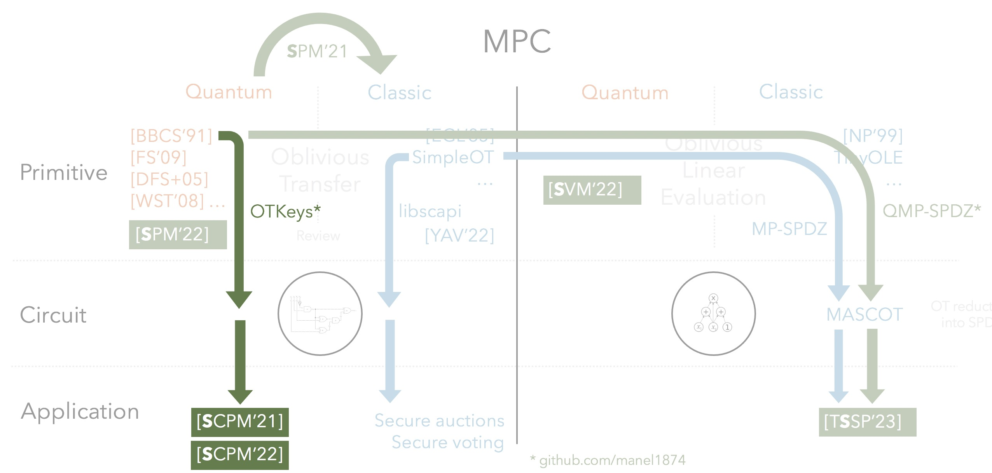
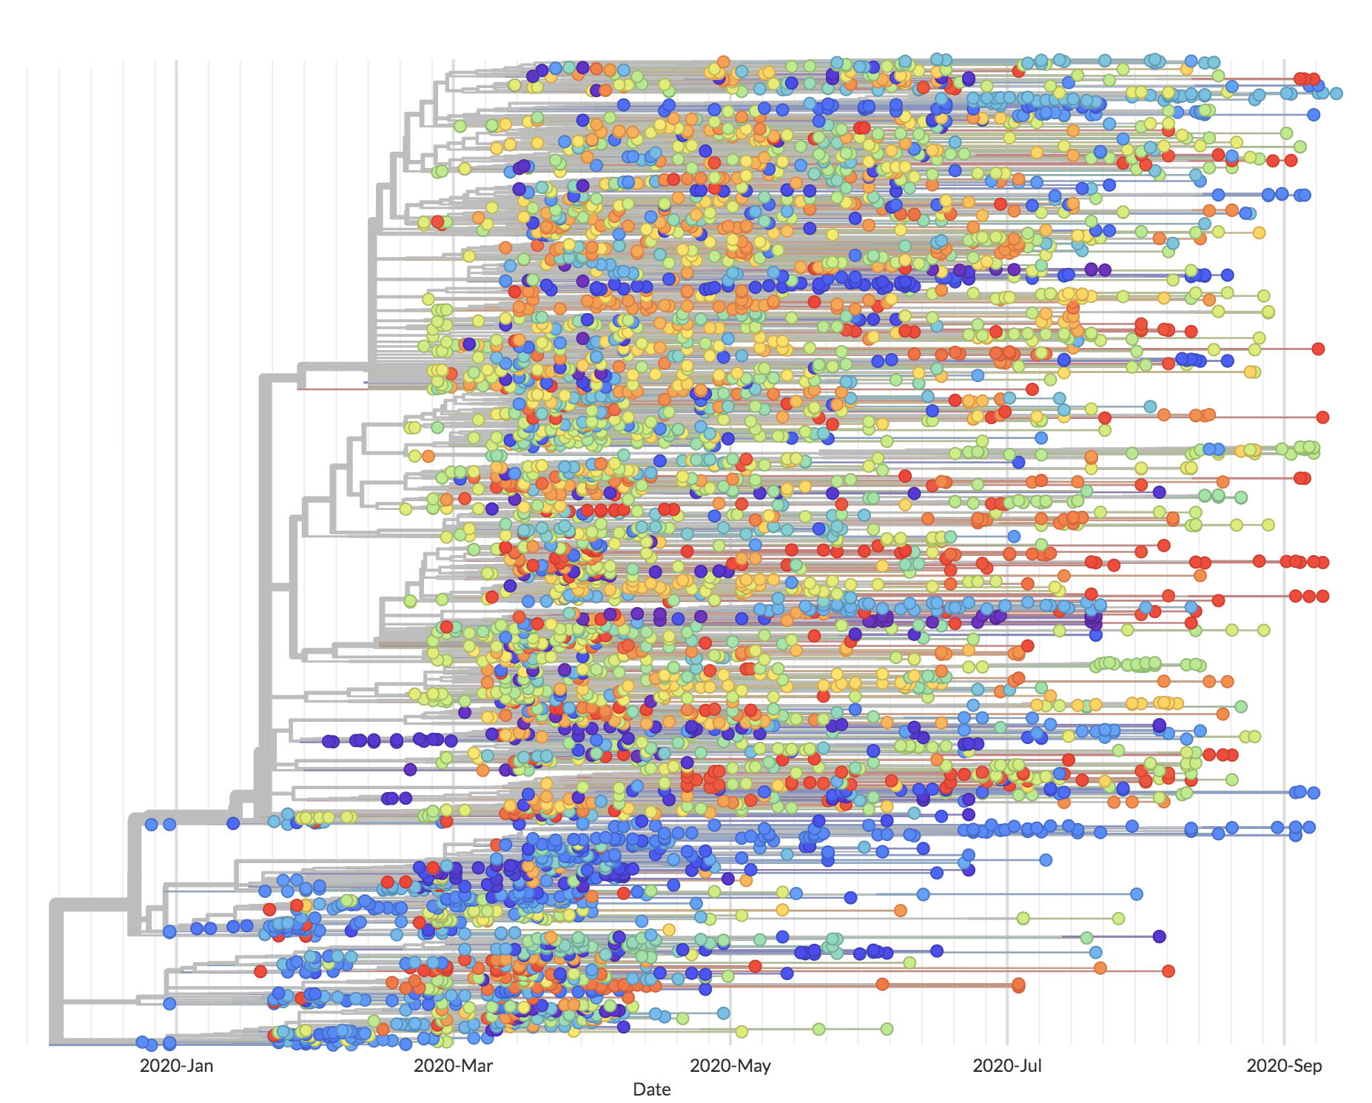
Private phylogenetic trees
Shows the evolutionary relationship between DNA sequences in a tree.
Notes:
The motivation is Secure Multiparty Computation and there are currently
MPC protocols can be devided through several perspectives but here we will look from the point of view of its circuit architecture.
MPC protocols are based in either Boolean circuits or Arithmetic circuits

Slide 58
Private phylogenetic trees
Results summary
Tailored SMC protocol for phylogenetic trees algorithms
Notes:
The motivation is Secure Multiparty Computation and there are currently
MPC protocols can be devided through several perspectives but here we will look from the point of view of its circuit architecture.
MPC protocols are based in either Boolean circuits or Arithmetic circuits

Slide 59
Private phylogenetic trees
Results summary
Tailored SMC protocol for phylogenetic trees algorithms
Classical implementation
CBMC-GC: circuit generation
MPC-Benchmark: yao protocol based on Libscapi
PHYLIP: phylogeny analysis
Notes:
The motivation is Secure Multiparty Computation and there are currently
MPC protocols can be devided through several perspectives but here we will look from the point of view of its circuit architecture.
MPC protocols are based in either Boolean circuits or Arithmetic circuits

Slide 60
Private phylogenetic trees
Results summary
Tailored SMC protocol for phylogenetic trees algorithms
Classical implementation
CBMC-GC: circuit generation
MPC-Benchmark: yao protocol based on Libscapi
PHYLIP: phylogeny analysis
Integrate BBCS based protocol into Libscapi
Notes:
The motivation is Secure Multiparty Computation and there are currently
MPC protocols can be devided through several perspectives but here we will look from the point of view of its circuit architecture.
MPC protocols are based in either Boolean circuits or Arithmetic circuits

Slide 61
Private phylogenetic trees
Results summary
Tailored SMC protocol for phylogenetic trees algorithms
Classical implementation
CBMC-GC: circuit generation
MPC-Benchmark: yao protocol based on Libscapi
PHYLIP: phylogeny analysis
Integrate BBCS based protocol into Libscapi
Benchmark classical and quantum approaches
Notes:
The motivation is Secure Multiparty Computation and there are currently
MPC protocols can be devided through several perspectives but here we will look from the point of view of its circuit architecture.
MPC protocols are based in either Boolean circuits or Arithmetic circuits

Slide 62
Performance evaluation
Setup:
3 parties: VMs running Ubuntu 16.04.3
30 SARS-CoV-2 genome sequences* with 32 000 length
Boolean circuit:
~3 minutes (CBMC-GC)
~2.2 million gates
128 000 input wires
*GISAID database
Notes:
Comentar que a comparação entre o sistema quântico e clássico não é completamente fair porque o quântico tem a gestão das chaves enquanto queo clássico tem a geração das chaves on the fly (incluimos as duas fases). Mas não faria muito sentido estar a desintegrar uma biblioteca eficiente para efeitos de comparação e é perferível comparar sistemas novos com sistemas existentes na sua máxima eficiência.

Slide 63
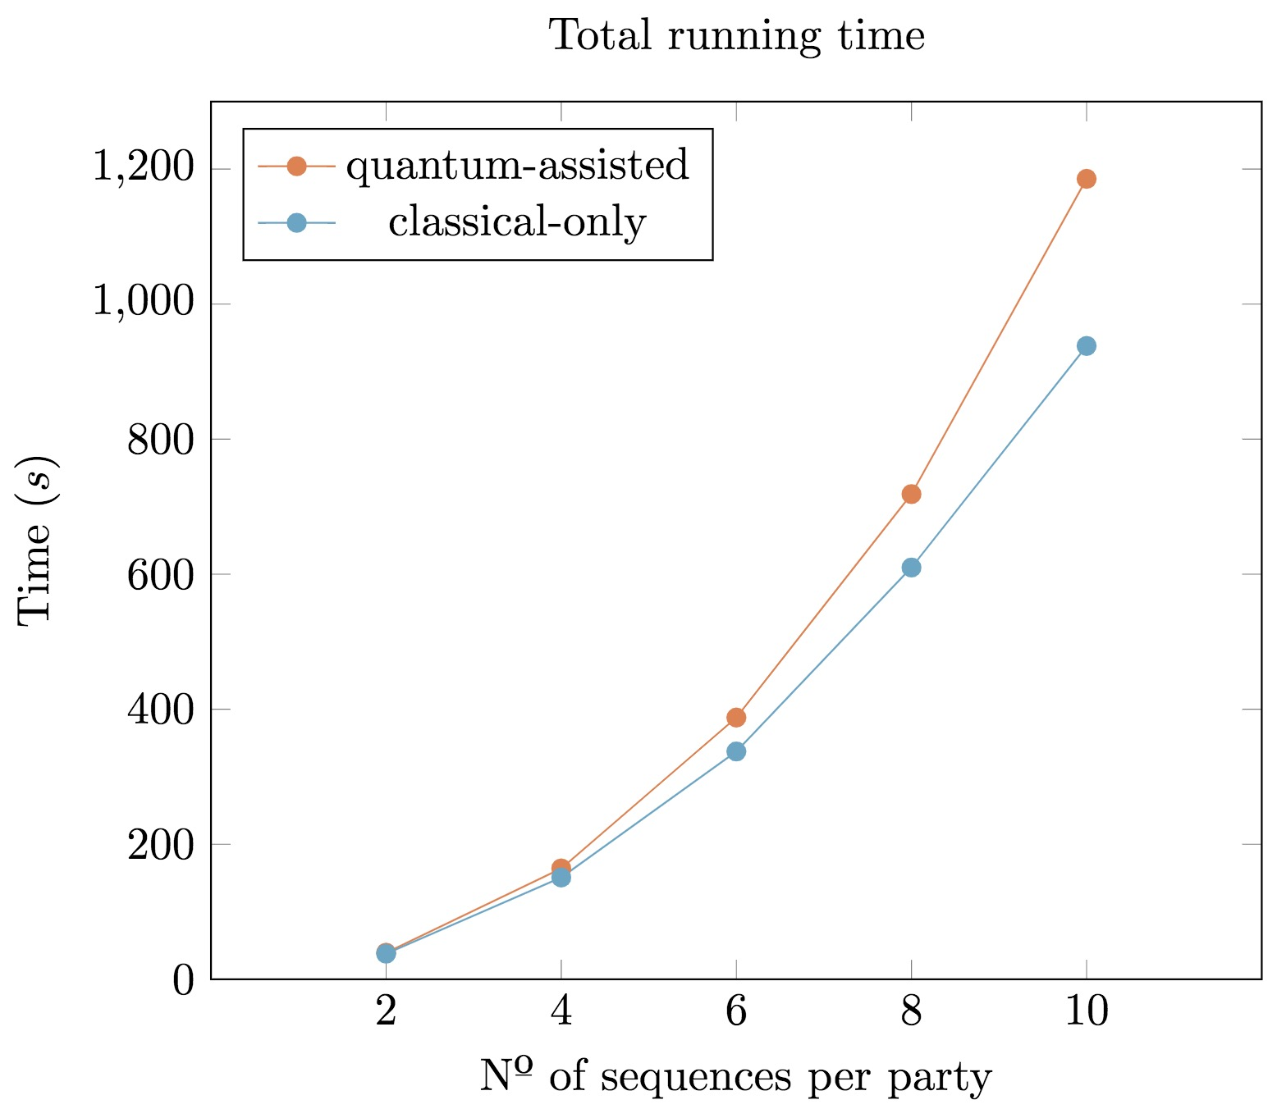
Performance evaluation
Setup:
3 parties: VMs running Ubuntu 16.04.3
30 SARS-CoV-2 genome sequences* with 32 000 length
Notes:
Comentar que a comparação entre o sistema quântico e clássico não é completamente fair porque o quântico tem a gestão das chaves enquanto queo clássico tem a geração das chaves on the fly (incluimos as duas fases). Mas não faria muito sentido estar a desintegrar uma biblioteca eficiente para efeitos de comparação e é perferível comparar sistemas novos com sistemas existentes na sua máxima eficiência.

Slide 64
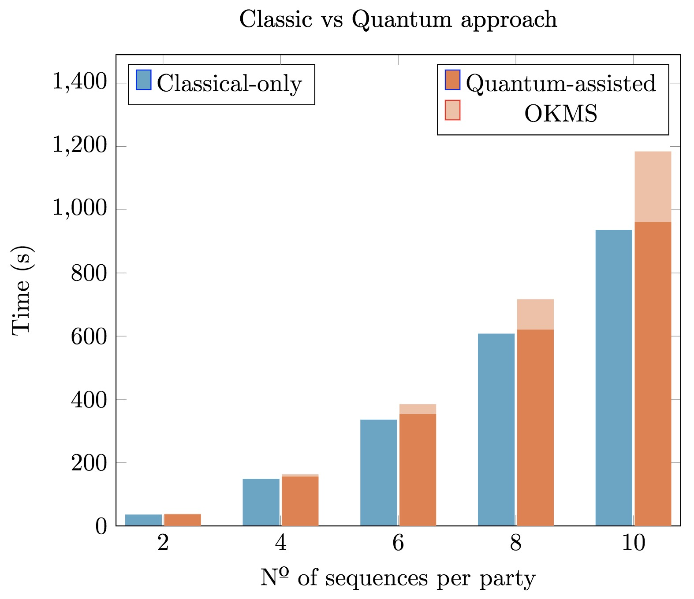
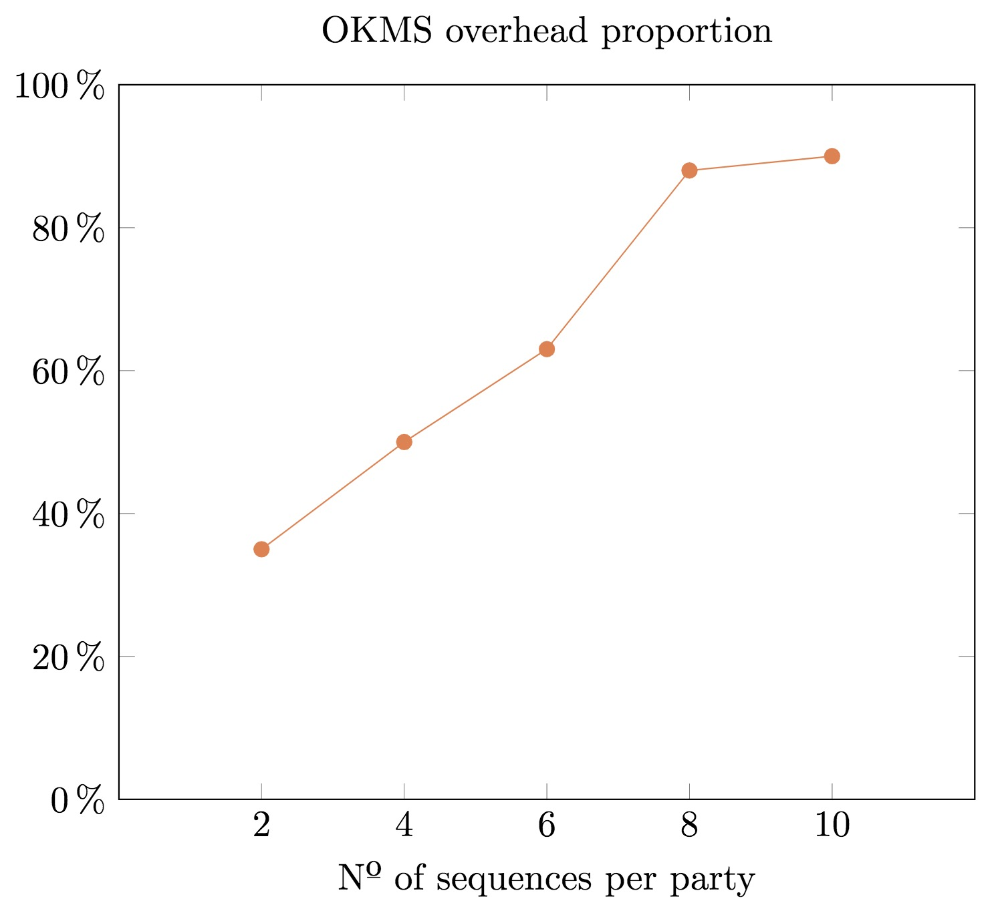
Performance evaluation
Setup:
3 parties: VMs running Ubuntu 16.04.3
30 SARS-CoV-2 genome sequences* with 32 000 length
Notes:
Comentar que a comparação entre o sistema quântico e clássico não é completamente fair porque o quântico tem a gestão das chaves enquanto queo clássico tem a geração das chaves on the fly (incluimos as duas fases). Mas não faria muito sentido estar a desintegrar uma biblioteca eficiente para efeitos de comparação e é perferível comparar sistemas novos com sistemas existentes na sua máxima eficiência.

Slide 65
Private phylogenetic trees
SMC
SPM’21
Quantum
Classic
Quantum
Classic
[BBCS’91]
[FS’09]
[DFS+05] [WST’08] …
[EGL’85] SimpleOT
…
Oblivious Linear Evaluation
[NP’99]
TinyOLE
…
Oblivious Transfer
Primitive
[SVM’22]
OTKeys*
libscapi
QMP-SPDZ*
[SPM’22]
Review
[YAV’22]
MP-SPDZ
Circuit
MASCOT
OT reduction
into SPDZ
Application
[SCPM’21]
Secure auctions
Secure voting
[TSSP’23]
[SCPM’22]
* github.com/manel1874
Notes:
The motivation is Secure Multiparty Computation and there are currently
MPC protocols can be devided through several perspectives but here we will look from the point of view of its circuit architecture.
MPC protocols are based in either Boolean circuits or Arithmetic circuits

Slide 66
Quantum OLE
SMC
SPM’21
Quantum
Classic
Quantum
Classic
[BBCS’91]
[FS’09]
[DFS+05] [WST’08] …
[EGL’85] SimpleOT
…
Oblivious Linear Evaluation
[NP’99]
TinyOLE
…
Oblivious Transfer
Primitive
[SVM’22]
OTKeys*
libscapi
QMP-SPDZ*
[SPM’22]
Review
[YAV’22]
MP-SPDZ
Circuit
MASCOT
OT reduction
into SPDZ
Application
[SCPM’21]
Secure auctions
Secure voting
[TSSP’23]
[SCPM’22]
* github.com/manel1874
Notes:
The motivation is Secure Multiparty Computation and there are currently
MPC protocols can be devided through several perspectives but here we will look from the point of view of its circuit architecture.
MPC protocols are based in either Boolean circuits or Arithmetic circuits

Slide 67
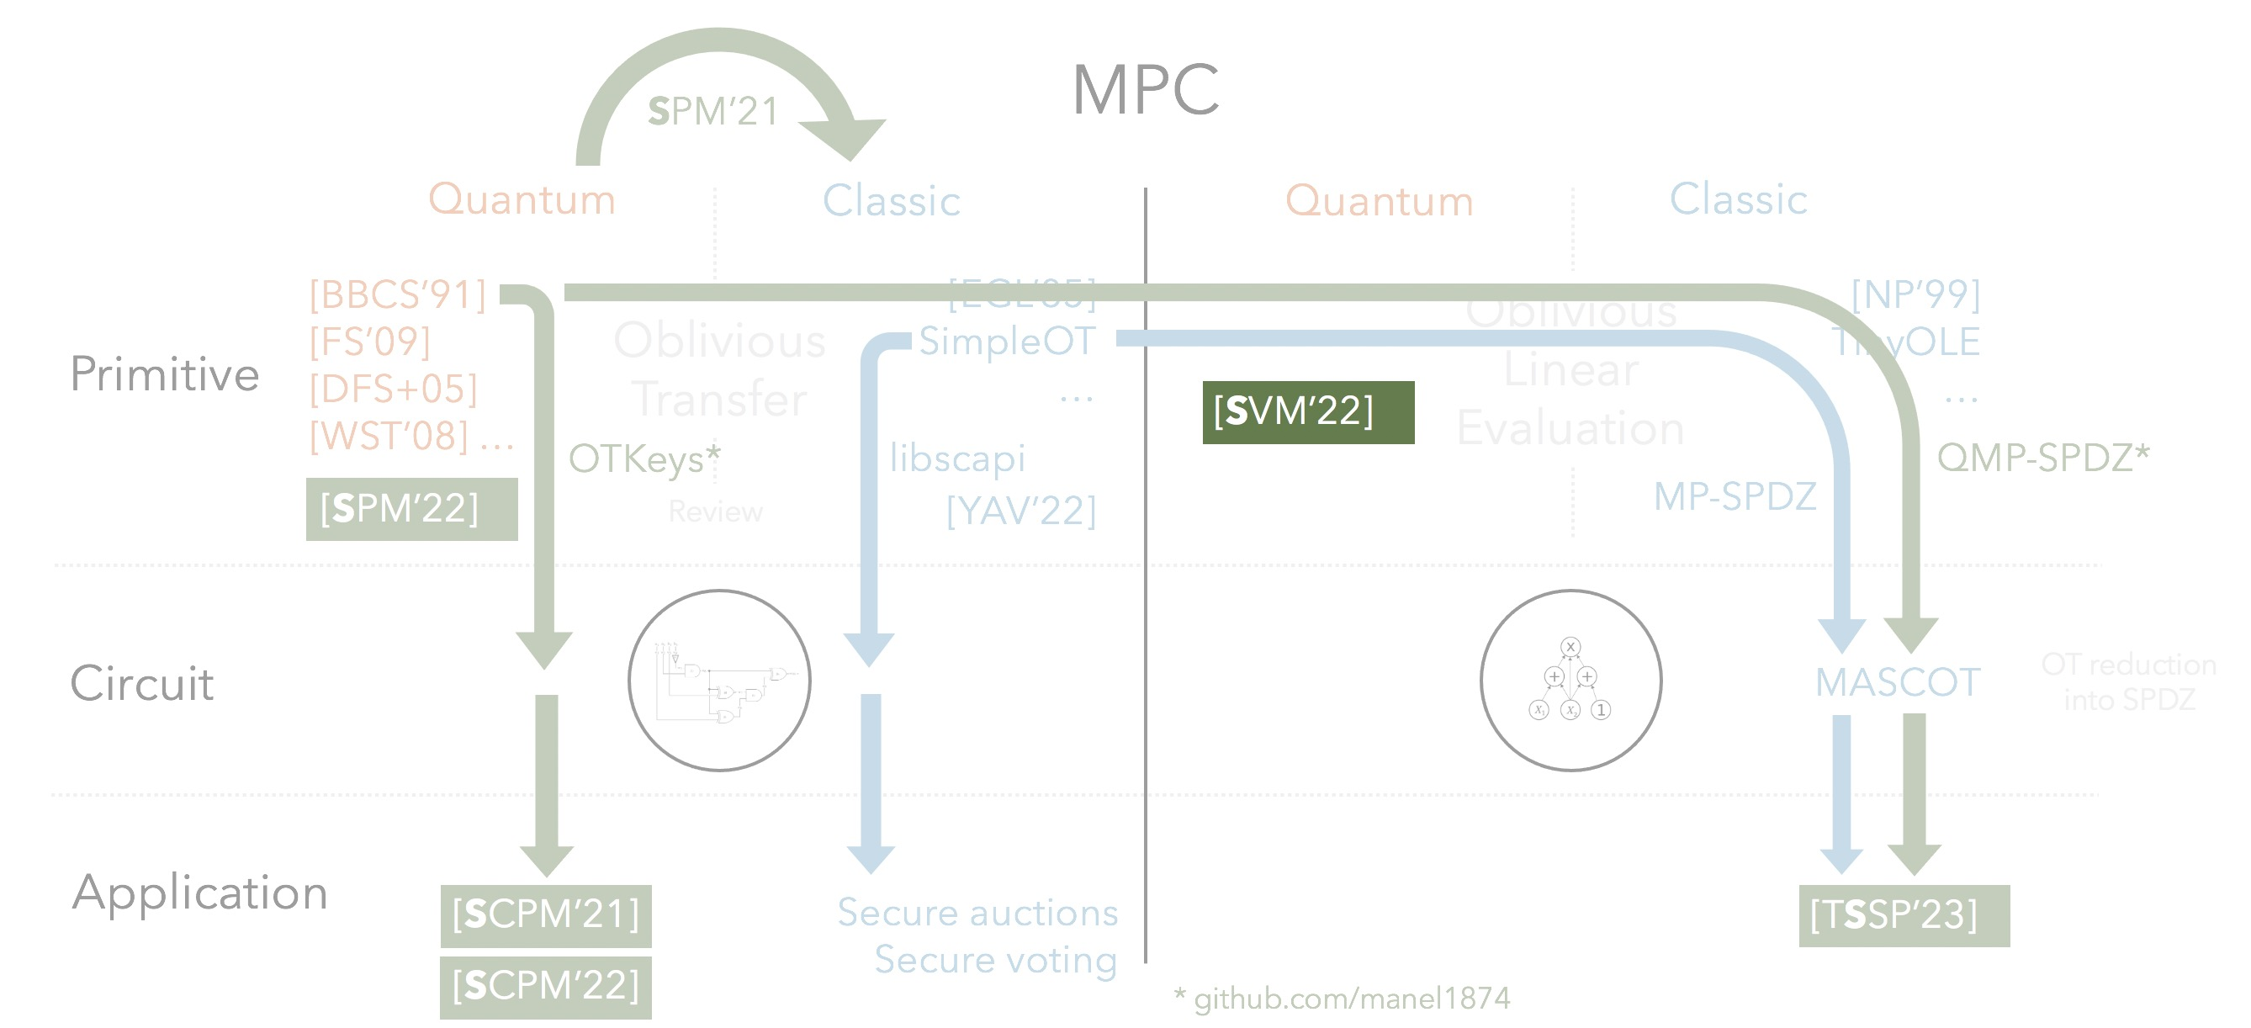
Quantum OLE
Results summary
Oblivious Linear Evaluation (OLE)
Vector OLE
Notes:
Examples taken from compressing Vector OLE

Slide 68
Quantum OLE
Results summary
Oblivious Linear Evaluation (OLE)
Vector OLE
Multiplication
triples
OLE
SPDZ
PSI
Notes:
Examples taken from compressing Vector OLE

Slide 69
Quantum OLE
Results summary
Oblivious Linear Evaluation (OLE)
Vector OLE
Multiplication
triples
OLE
SPDZ
PSI
VOLE
Matrix-vector multiplication
Nearest neighbor search
OT extension
Notes:
Examples taken from compressing Vector OLE
VOLE -> OT Ext from here https://eprint.iacr.org/2022/192.pdf

Slide 70
Quantum OLE
Results summary
Oblivious Linear Evaluation (OLE)
Vector OLE
Alice
a
Bob
x
b
OLE
f(x) = ax + b
Notes:
The motivation is Secure Multiparty Computation and there are currently
MPC protocols can be devided through several perspectives but here we will look from the point of view of its circuit architecture.
MPC protocols are based in either Boolean circuits or Arithmetic circuits

Slide 71
Quantum OLE
Results summary
Oblivious Linear Evaluation (OLE)
Vector OLE
Alice
a
Bob
x
b
VOLE
f(x) = ax + b
Notes:
I will just focus on the the OLE protocol because the generalizations I presented in the PhD work are heavely based on OLE and I want to give a highlevel overview of the UC proof.

Slide 72
Quantum OLE | Main tool
In an Hilbert space of dimension d
Notes:
The motivation is Secure Multiparty Computation and there are currently
MPC protocols can be devided through several perspectives but here we will look from the point of view of its circuit architecture.
MPC protocols are based in either Boolean circuits or Arithmetic circuits

Slide 73
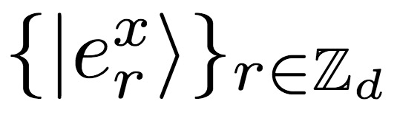
Quantum OLE | Main tool
In an Hilbert space of dimension d, there exists a set of MUBs
Notes:
The motivation is Secure Multiparty Computation and there are currently
MPC protocols can be devided through several perspectives but here we will look from the point of view of its circuit architecture.
MPC protocols are based in either Boolean circuits or Arithmetic circuits

Slide 74



Quantum OLE | Main tool
In an Hilbert space of dimension d, there exists a set of MUBs
Definition:
Notes:
The motivation is Secure Multiparty Computation and there are currently
MPC protocols can be devided through several perspectives but here we will look from the point of view of its circuit architecture.
MPC protocols are based in either Boolean circuits or Arithmetic circuits

Slide 75
Quantum OLE | Main tool
In an Hilbert space of dimension d, there exists a set of MUBs
Definition:
Notes:
The motivation is Secure Multiparty Computation and there are currently
MPC protocols can be devided through several perspectives but here we will look from the point of view of its circuit architecture.
MPC protocols are based in either Boolean circuits or Arithmetic circuits

Slide 76
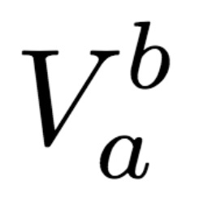
Quantum OLE | Main tool
In an Hilbert space of dimension d, there exists a set of MUBs
which, upon the action of the Heisenberg-Weyl operators,
Definition:
Notes:
The motivation is Secure Multiparty Computation and there are currently
MPC protocols can be devided through several perspectives but here we will look from the point of view of its circuit architecture.
MPC protocols are based in either Boolean circuits or Arithmetic circuits

Slide 77
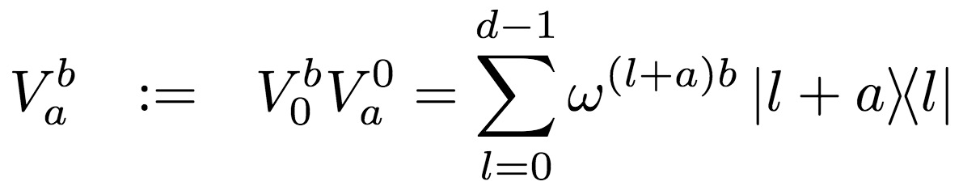
Quantum OLE | Main tool
In an Hilbert space of dimension d, there exists a set of MUBs
which, upon the action of the Heisenberg-Weyl operators,
Definition:
Definition:
Notes:
The operators are a combination of shift operators in the computational basis and in the dual basis.

Slide 78
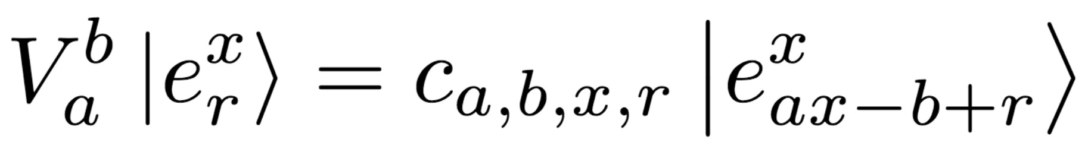
Quantum OLE | Main tool
In an Hilbert space of dimension d, there exists a set of MUBs
which, upon the action of the Heisenberg-Weyl operators,
Definition:
Definition:
Notes:
Each basis element r is shifted by the linear factor ax-b inside the same basis x

Slide 79
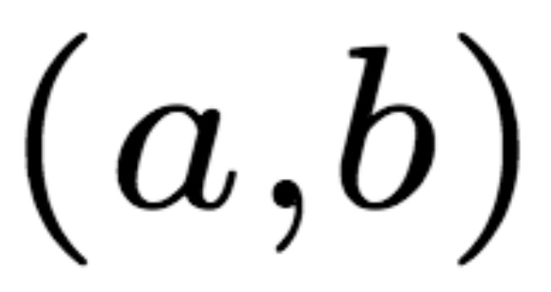

Quantum OLE | Main tool
In an Hilbert space of dimension d, there exists a set of MUBs
which, upon the action of the Heisenberg-Weyl operators,
Definition:
Definition:
Alice,
Bob,
Notes:
Each basis element r is shifted by the linear factor ax-b inside the same basis x

Slide 80
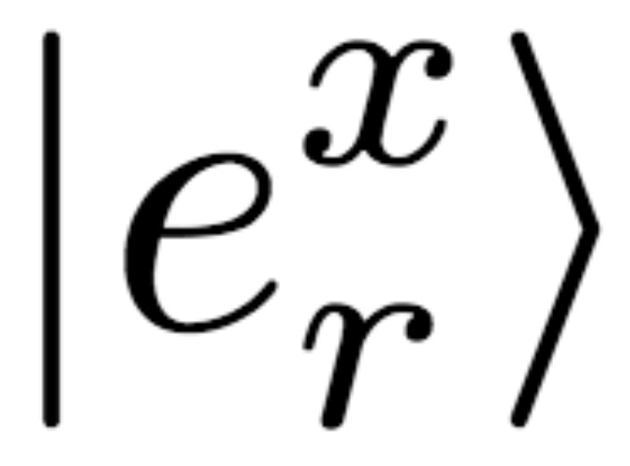
Quantum OLE | Main tool
In an Hilbert space of dimension d, there exists a set of MUBs
which, upon the action of the Heisenberg-Weyl operators,
Definition:
Definition:
Alice,
Bob,
Notes:
Each basis element r is shifted by the linear factor ax-b inside the same basis x

Slide 81
Quantum OLE | Main tool
In an Hilbert space of dimension d, there exists a set of MUBs
which, upon the action of the Heisenberg-Weyl operators,
Definition:
Definition:
Alice,
Bob,
Notes:
Each basis element r is shifted by the linear factor ax-b inside the same basis x

Slide 82
Quantum OLE | Main tool
In an Hilbert space of dimension d, there exists a set of MUBs
which, upon the action of the Heisenberg-Weyl operators,
Definition:
Definition:
Alice,
Bob,
Notes:
Each basis element r is shifted by the linear factor ax-b inside the same basis x

Slide 83
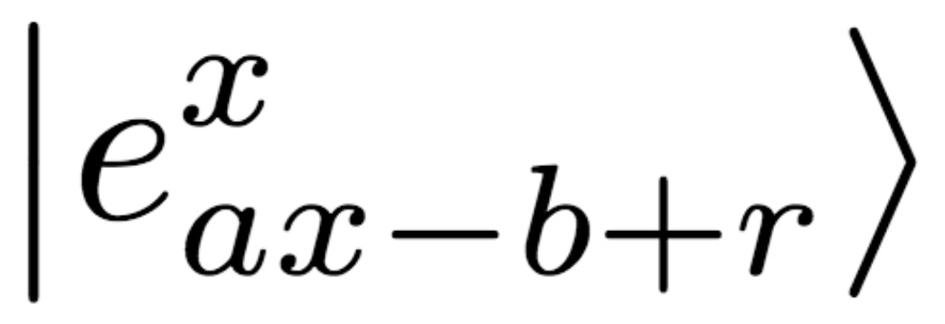
Quantum OLE | Main tool
In an Hilbert space of dimension d, there exists a set of MUBs
which, upon the action of the Heisenberg-Weyl operators,
Definition:
Definition:
Alice,
Bob,
Notes:
Each basis element r is shifted by the linear factor ax-b inside the same basis x

Slide 84
Quantum OLE | Main tool
In an Hilbert space of dimension d, there exists a set of MUBs
which, upon the action of the Heisenberg-Weyl operators,
Definition:
Definition:
Alice,
Bob,
Notes:
Each basis element r is shifted by the linear factor ax-b inside the same basis x

Slide 85
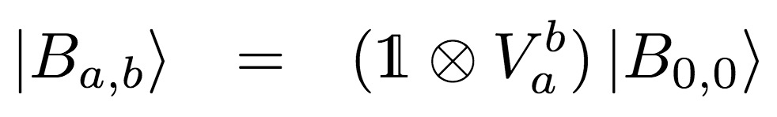
Quantum OLE | Main tool
In an Hilbert space of dimension d, there exists a set of MUBs
which, upon the action of the Heisenberg-Weyl operators,
Definition:
Definition:
Alice,
Bob,
Attack:
Notes:
Each basis element r is shifted by the linear factor ax-b inside the same basis x

Slide 86
Quantum OLE | Main tool
In an Hilbert space of dimension d, there exists a set of MUBs
which, upon the action of the Heisenberg-Weyl operators,
Definition:
Definition:
Alice,
Bob,
Attack:
Commit-and-open phase
Notes:
Each basis element r is shifted by the linear factor ax-b inside the same basis x

Slide 87
Quantum OLE | Protocol
Alice,
Bob,
Quantum phase
Classical phase
Notes:
Each basis element r is shifted by the linear factor ax-b inside the same basis x

Slide 88
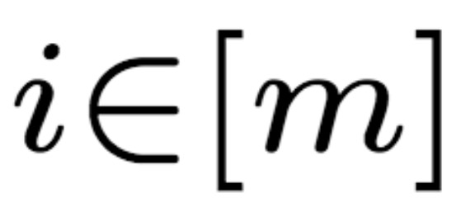
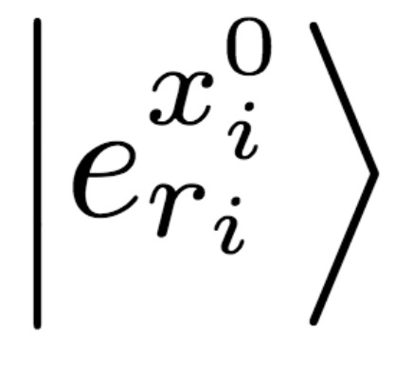
Quantum OLE | Protocol
Alice,
Bob,
Quantum phase
Classical phase
Notes:
Each basis element r is shifted by the linear factor ax-b inside the same basis x

Slide 89
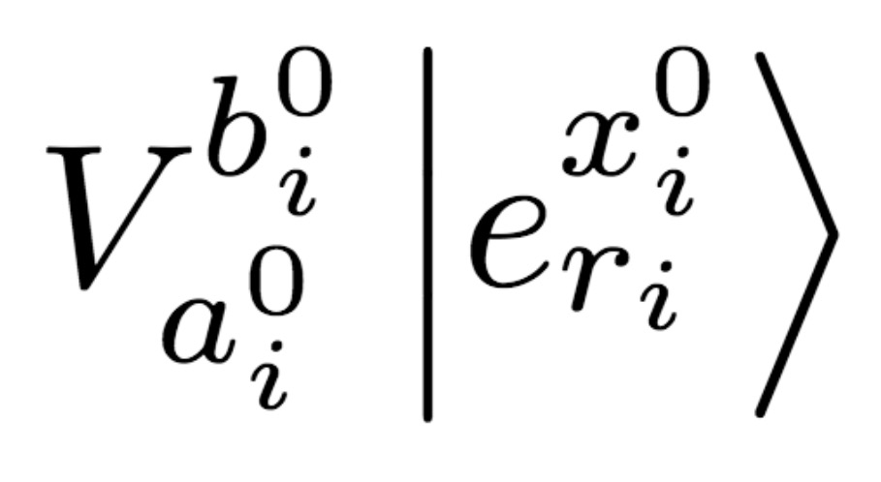
Quantum OLE | Protocol
Alice,
Bob,
Quantum phase
Classical phase
Notes:
Each basis element r is shifted by the linear factor ax-b inside the same basis x

Slide 90
Quantum OLE | Protocol
Alice,
Bob,
Quantum phase
Classical phase
Notes:
Each basis element r is shifted by the linear factor ax-b inside the same basis x

Slide 91
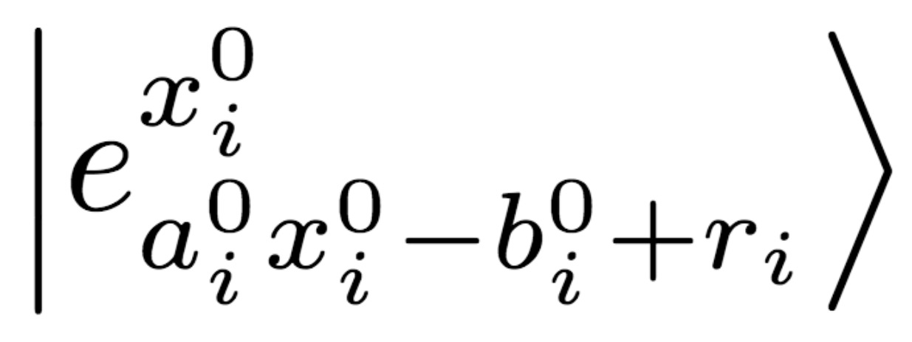
Quantum OLE | Protocol
Alice,
Bob,
Quantum phase
Classical phase
Notes:
Each basis element r is shifted by the linear factor ax-b inside the same basis x

Slide 92
Quantum OLE | Protocol
Alice,
Bob,
Quantum phase
Commit-and-open phase
Classical phase
Notes:
Each basis element r is shifted by the linear factor ax-b inside the same basis x

Slide 93

Quantum OLE | Protocol
Alice,
Bob,
Quantum phase
Commit-and-open phase
Classical phase
Notes:
Each basis element r is shifted by the linear factor ax-b inside the same basis x

Slide 94
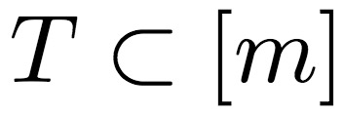
Quantum OLE | Protocol
Alice,
Bob,
Quantum phase
Commit-and-open phase
Classical phase
Notes:
Each basis element r is shifted by the linear factor ax-b inside the same basis x

Slide 95

Quantum OLE | Protocol
Alice,
Bob,
Quantum phase
Commit-and-open phase
Classical phase
Notes:
Each basis element r is shifted by the linear factor ax-b inside the same basis x

Slide 96
Quantum OLE | Protocol
Alice,
Bob,
Quantum phase
Commit-and-open phase
Classical phase
Notes:
Each basis element r is shifted by the linear factor ax-b inside the same basis x

Slide 97
Quantum OLE | Protocol
Alice,
Bob,
Quantum phase
Commit-and-open phase
Classical phase
Notes:
Each basis element r is shifted by the linear factor ax-b inside the same basis x

Slide 98
Quantum OLE | Protocol
Alice,
Bob,
Quantum phase
Commit-and-open phase
Derandomization:
n ROLE
n OLE
Classical phase
Notes:
Each basis element r is shifted by the linear factor ax-b inside the same basis x

Slide 99
Quantum OLE | Protocol
Alice,
Bob,
Quantum phase
Commit-and-open phase
Derandomization:
n ROLE
n OLE
Classical phase
Extraction: Privacy amplification + Combiner
n OLE
1 OLE
Notes:
Each basis element r is shifted by the linear factor ax-b inside the same basis x

Slide 100
Future work
SMC
SPM’21
Quantum
Classic
Quantum
Classic
[BBCS’91]
[FS’09]
[DFS+05] [WST’08] …
[EGL’85] SimpleOT
…
Oblivious Linear Evaluation
[NP’99]
TinyOLE
…
Oblivious Transfer
Primitive
[SVM’22]
OTKeys*
libscapi
QMP-SPDZ*
[SPM’22]
Review
[YAV’22]
MP-SPDZ
Circuit
MASCOT
OT reduction
into SPDZ
Application
[SCPM’21]
Secure auctions
Secure voting
[TSSP’23]
[SCPM’22]
* github.com/manel1874
Notes:
The motivation is Secure Multiparty Computation and there are currently
MPC protocols can be devided through several perspectives but here we will look from the point of view of its circuit architecture.
MPC protocols are based in either Boolean circuits or Arithmetic circuits

Slide 101
Future work
SMC
SPM’21
Quantum
Classic
Quantum
Classic
[BBCS’91]
[FS’09]
[DFS+05] [WST’08] …
[EGL’85] SimpleOT
…
Oblivious Linear Evaluation
[NP’99]
TinyOLE
…
Oblivious Transfer
Primitive
[SVM’22]
OTKeys*
libscapi
QMP-SPDZ*
[SPM’22]
Review
[YAV’22]
MP-SPDZ
Circuit
MASCOT
OT reduction
into SPDZ
Application
[SCPM’21]
Secure auctions
Secure voting
[TSSP’23]
[SCPM’22]
* github.com/manel1874
Notes:
The motivation is Secure Multiparty Computation and there are currently
MPC protocols can be devided through several perspectives but here we will look from the point of view of its circuit architecture.
MPC protocols are based in either Boolean circuits or Arithmetic circuits

Slide 102
Future work
SMC
SPM’21
Quantum
Classic
Quantum
Classic
[BBCS’91]
[FS’09]
[DFS+05] [WST’08] …
[EGL’85] SimpleOT
…
Oblivious Linear Evaluation
[NP’99]
TinyOLE
…
Oblivious Transfer
Primitive
[SVM’22]
OTKeys*
libscapi
QMP-SPDZ*
[SPM’22]
Review
[YAV’22]
Noise-resistant
MP-SPDZ
Circuit
MASCOT
OT reduction
into SPDZ
Application
[SCPM’21]
Secure auctions
Secure voting
[TSSP’23]
[SCPM’22]
* github.com/manel1874
Notes:
The motivation is Secure Multiparty Computation and there are currently
MPC protocols can be devided through several perspectives but here we will look from the point of view of its circuit architecture.
MPC protocols are based in either Boolean circuits or Arithmetic circuits

Slide 103
Future work
SMC
SPM’21
Quantum
Classic
Quantum
Classic
[BBCS’91]
[FS’09]
[DFS+05] [WST’08] …
[EGL’85] SimpleOT
…
Oblivious Linear Evaluation
[NP’99]
TinyOLE
…
Oblivious Transfer
Primitive
[SVM’22]
OTKeys*
libscapi
QMP-SPDZ*
[SPM’22]
Review
[YAV’22]
Noise-resistant
MP-SPDZ
Circuit
MASCOT
OT reduction
into SPDZ
Application
[SCPM’21]
Secure auctions
Secure voting
[TSSP’23]
[SCPM’22]
* github.com/manel1874
Notes:
The motivation is Secure Multiparty Computation and there are currently
MPC protocols can be devided through several perspectives but here we will look from the point of view of its circuit architecture.
MPC protocols are based in either Boolean circuits or Arithmetic circuits

Slide 104
Thank you
I acknowledge Fundação para a Ciência e a Tecnologia (FCT, Portugal) for its support through the PhD grant SFRH/BD/ 144806/2019 in the context of the Doctoral Program in the Information Security (IS).

