Slide 1


Quantum assisted Secure Multiparty Computation
Manuel Batalha dos Santos
Thesis defence
17 October 2023

Slide 2

Outline
Motivation and results
Quantum and classical oblivious transfer
Quantum assisted MPC protocol for phylogenetic trees
Quantum Oblivious Linear Evaluation
Notes:
Outline:
Background: here we will discuss important primitives for MPC protocols. In particular, Oblivious Transfer, which is a very important primitive in boolean-based apprach, and Oblivious Linear Evaluation which is a generalization of Oblivious Transfer and can be used in the context of arithmetic-based MPC protocols.
Quantum and classical oblivious transfer: a comparison
Phylogenetic Trees
Oblivious Linear El

Slide 3
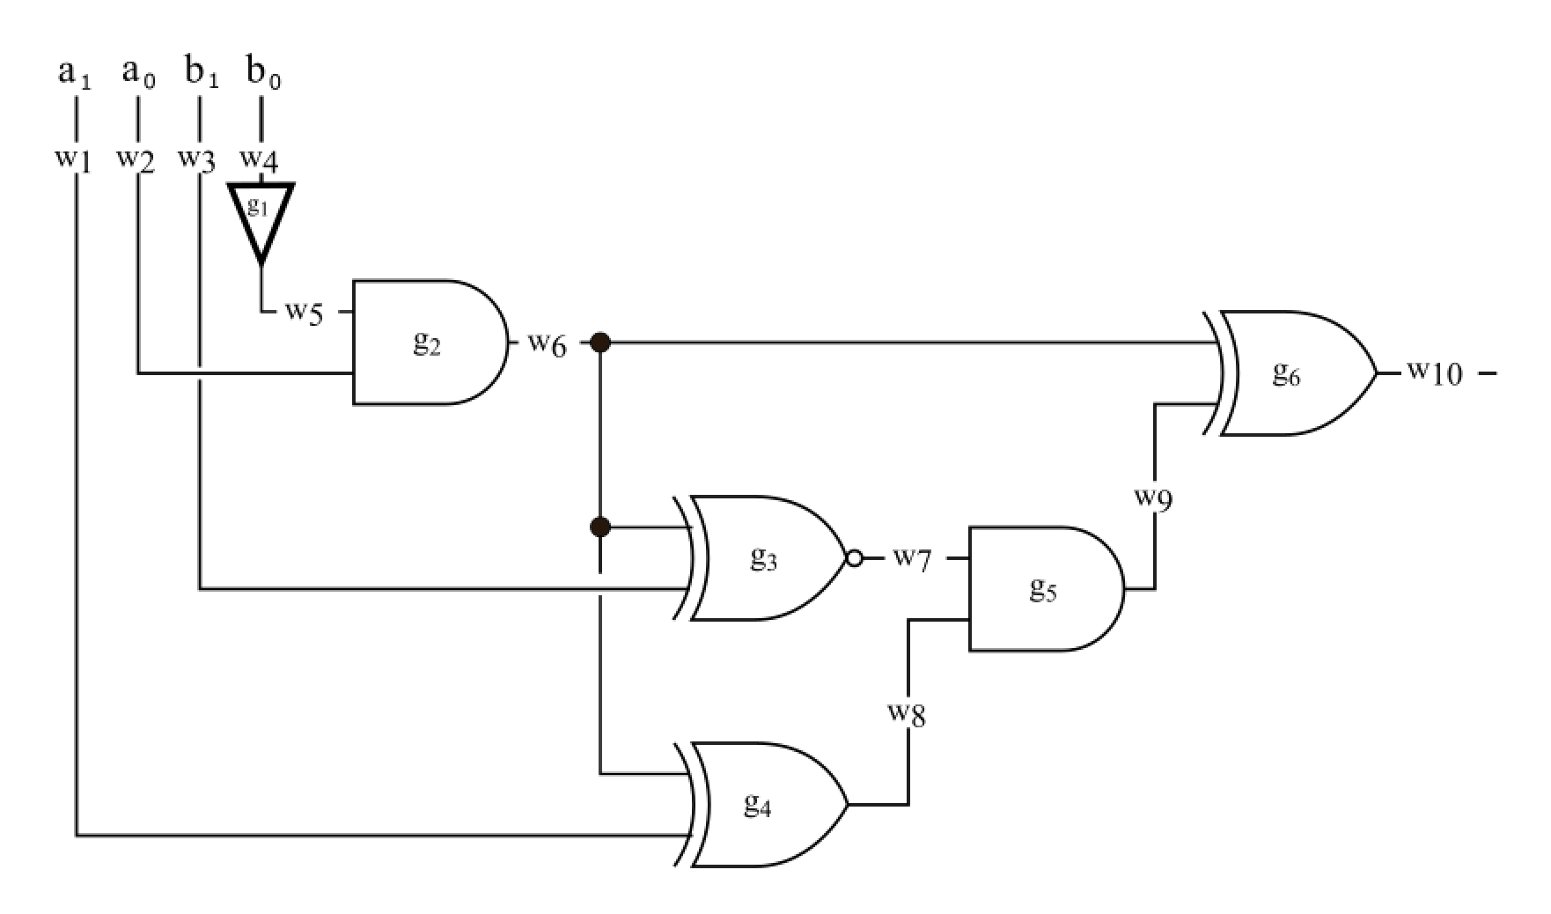
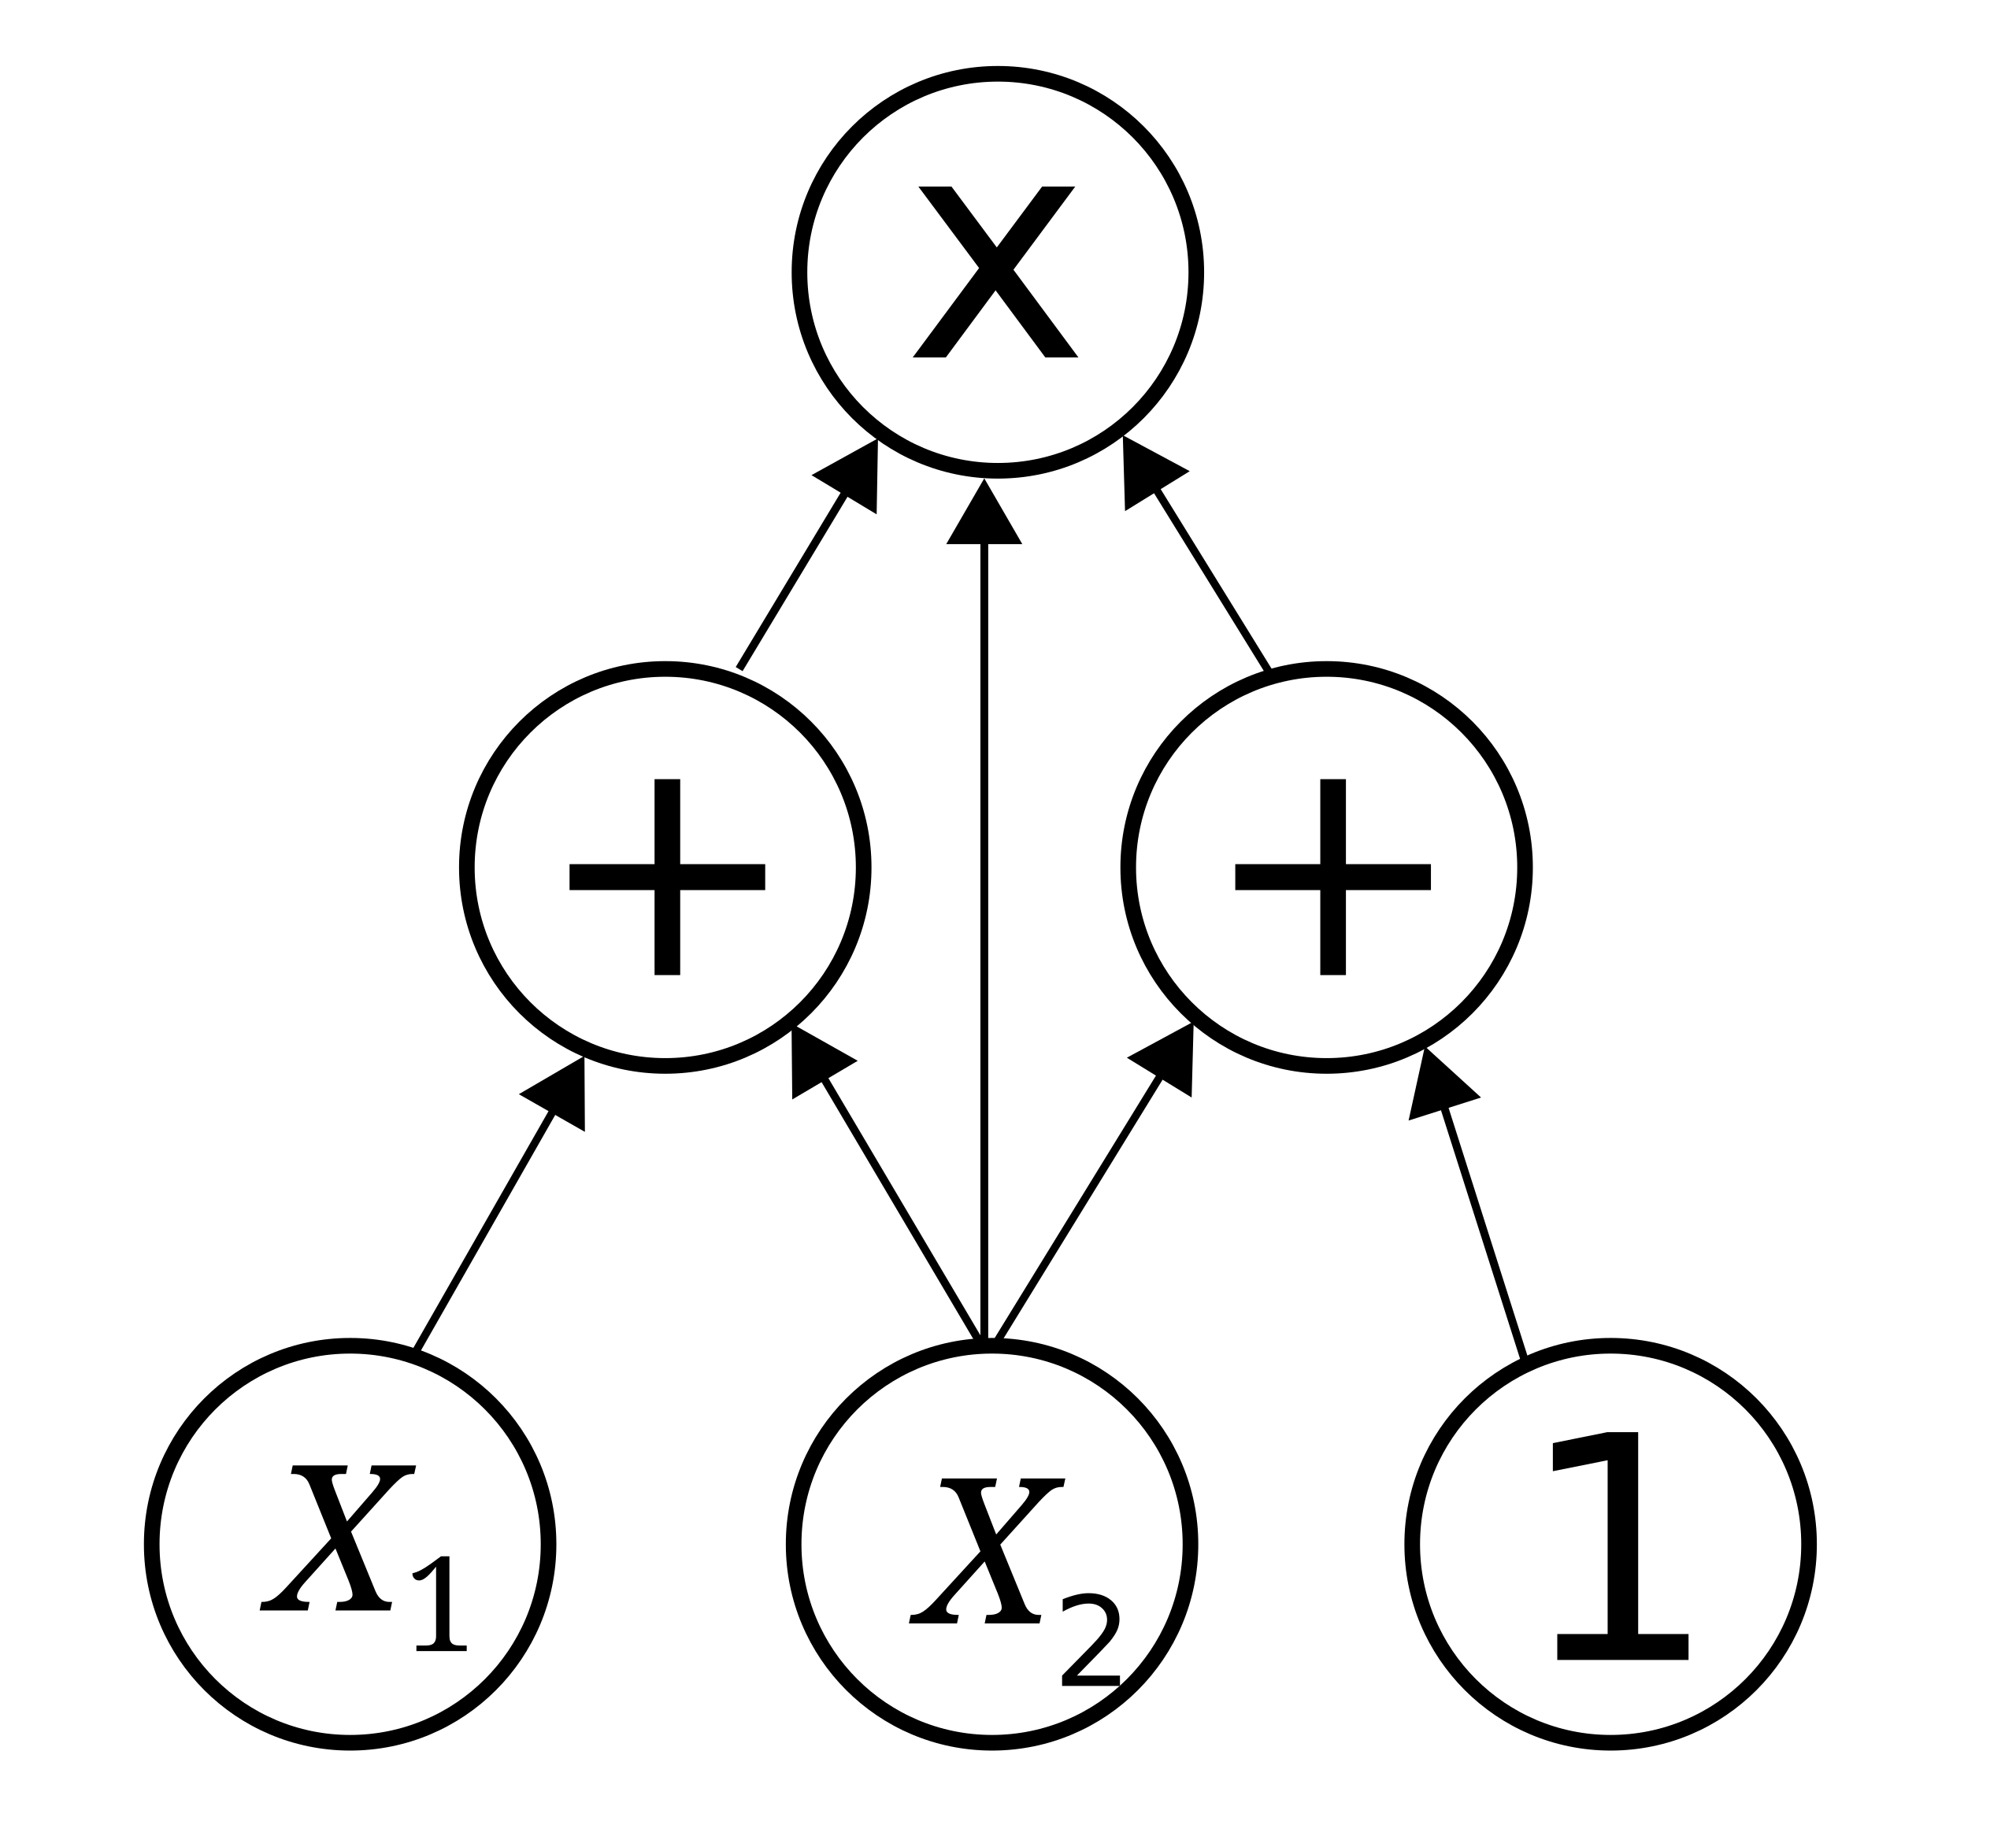
Motivation
MPC
Boolean
Arithmetic
Notes:
The motivation is Secure Multiparty Computation and there are currently
MPC protocols can be devided through several perspectives but here we will look from the point of view of its circuit architecture.
MPC protocols are based in either Boolean circuits or Arithmetic circuits

Slide 4
Motivation
MPC
Oblivious Linear Evaluation
Oblivious Transfer
Primitive
Circuit
Notes:
The motivation is Secure Multiparty Computation and there are currently
MPC protocols can be devided through several perspectives but here we will look from the point of view of its circuit architecture.
MPC protocols are based in either Boolean circuits or Arithmetic circuits

Slide 5
Motivation
MPC
Quantum
Classic
Quantum
Classic
[BBCS’91]
[FS’09]
[DFS+05] [WST’08] …
[EGL’85] SimpleOT
…
Oblivious Linear Evaluation
[NP’99]
TinyOLE
…
Oblivious Transfer
Primitive
libscapi
Review
[YAV’22]
MP-SPDZ
Circuit
MASCOT
OT reduction
into SPDZ
Application
Secure auctions
Secure voting
Notes:
The motivation is Secure Multiparty Computation and there are currently
MPC protocols can be devided through several perspectives but here we will look from the point of view of its circuit architecture.
MPC protocols are based in either Boolean circuits or Arithmetic circuits

Slide 6
Results
MPC
Quantum
Classic
Quantum
Classic
[BBCS’91]
[FS’09]
[DFS+05] [WST’08] …
[EGL’85] SimpleOT
…
Oblivious Linear Evaluation
[NP’99]
TinyOLE
…
Oblivious Transfer
Primitive
libscapi
[SPM’22]
Review
[YAV’22]
MP-SPDZ
Circuit
MASCOT
OT reduction
into SPDZ
Application
Secure auctions
Secure voting
Notes:
The motivation is Secure Multiparty Computation and there are currently
MPC protocols can be devided through several perspectives but here we will look from the point of view of its circuit architecture.
MPC protocols are based in either Boolean circuits or Arithmetic circuits

Slide 7
Results
MPC
SPM’21
Quantum
Classic
Quantum
Classic
[BBCS’91]
[FS’09]
[DFS+05] [WST’08] …
[EGL’85] SimpleOT
…
Oblivious Linear Evaluation
[NP’99]
TinyOLE
…
Oblivious Transfer
Primitive
libscapi
[SPM’22]
Review
[YAV’22]
MP-SPDZ
Circuit
MASCOT
OT reduction
into SPDZ
Application
Secure auctions
Secure voting
Notes:
The motivation is Secure Multiparty Computation and there are currently
MPC protocols can be devided through several perspectives but here we will look from the point of view of its circuit architecture.
MPC protocols are based in either Boolean circuits or Arithmetic circuits

Slide 8
Results
MPC
SPM’21
Quantum
Classic
Quantum
Classic
[BBCS’91]
[FS’09]
[DFS+05] [WST’08] …
[EGL’85] SimpleOT
…
Oblivious Linear Evaluation
[NP’99]
TinyOLE
…
Oblivious Transfer
Primitive
OTKeys*
libscapi
[SPM’22]
Review
[YAV’22]
MP-SPDZ
Circuit
MASCOT
OT reduction
into SPDZ
Application
Secure auctions
Secure voting
* github.com/manel1874
Notes:
The motivation is Secure Multiparty Computation and there are currently
MPC protocols can be devided through several perspectives but here we will look from the point of view of its circuit architecture.
MPC protocols are based in either Boolean circuits or Arithmetic circuits

Slide 9
Results
MPC
SPM’21
Quantum
Classic
Quantum
Classic
[BBCS’91]
[FS’09]
[DFS+05] [WST’08] …
[EGL’85] SimpleOT
…
Oblivious Linear Evaluation
[NP’99]
TinyOLE
…
Oblivious Transfer
Primitive
OTKeys*
libscapi
[SPM’22]
Review
[YAV’22]
MP-SPDZ
Circuit
MASCOT
OT reduction
into SPDZ
Application
[SCPM’21]
Secure auctions
Secure voting
[SCPM’22]
* github.com/manel1874
Notes:
The motivation is Secure Multiparty Computation and there are currently
MPC protocols can be devided through several perspectives but here we will look from the point of view of its circuit architecture.
MPC protocols are based in either Boolean circuits or Arithmetic circuits

Slide 10
Results
MPC
SPM’21
Quantum
Classic
Quantum
Classic
[BBCS’91]
[FS’09]
[DFS+05] [WST’08] …
[EGL’85] SimpleOT
…
Oblivious Linear Evaluation
[NP’99]
TinyOLE
…
Oblivious Transfer
Primitive
[SVM’22]
OTKeys*
libscapi
[SPM’22]
Review
[YAV’22]
MP-SPDZ
Circuit
MASCOT
OT reduction
into SPDZ
Application
[SCPM’21]
Secure auctions
Secure voting
[SCPM’22]
* github.com/manel1874
Notes:
The motivation is Secure Multiparty Computation and there are currently
MPC protocols can be devided through several perspectives but here we will look from the point of view of its circuit architecture.
MPC protocols are based in either Boolean circuits or Arithmetic circuits

Slide 11
Results
MPC
SPM’21
Quantum
Classic
Quantum
Classic
[BBCS’91]
[FS’09]
[DFS+05] [WST’08] …
[EGL’85] SimpleOT
…
Oblivious Linear Evaluation
[NP’99]
TinyOLE
…
Oblivious Transfer
Primitive
[SVM’22]
OTKeys*
libscapi
QMP-SPDZ*
[SPM’22]
Review
[YAV’22]
MP-SPDZ
Circuit
MASCOT
OT reduction
into SPDZ
Application
[SCPM’21]
Secure auctions
Secure voting
[SCPM’22]
* github.com/manel1874
Notes:
The motivation is Secure Multiparty Computation and there are currently
MPC protocols can be devided through several perspectives but here we will look from the point of view of its circuit architecture.
MPC protocols are based in either Boolean circuits or Arithmetic circuits

Slide 12
Results
MPC
SPM’21
Quantum
Classic
Quantum
Classic
[BBCS’91]
[FS’09]
[DFS+05] [WST’08] …
[EGL’85] SimpleOT
…
Oblivious Linear Evaluation
[NP’99]
TinyOLE
…
Oblivious Transfer
Primitive
[SVM’22]
OTKeys*
libscapi
QMP-SPDZ*
[SPM’22]
Review
[YAV’22]
MP-SPDZ
Circuit
MASCOT
OT reduction
into SPDZ
Application
[SCPM’21]
Secure auctions
Secure voting
[TSSP’23]
[SCPM’22]
* github.com/manel1874
Notes:
The motivation is Secure Multiparty Computation and there are currently
MPC protocols can be devided through several perspectives but here we will look from the point of view of its circuit architecture.
MPC protocols are based in either Boolean circuits or Arithmetic circuits

Slide 13
Results
MPC
SPM’21
Quantum
Classic
Quantum
Classic
[BBCS’91]
[FS’09]
[DFS+05] [WST’08] …
[EGL’85] SimpleOT
…
Oblivious Linear Evaluation
[NP’99]
TinyOLE
…
Oblivious Transfer
Primitive
[SVM’22]
OTKeys*
libscapi
QMP-SPDZ*
[SPM’22]
Review
[YAV’22]
MP-SPDZ
Circuit
MASCOT
OT reduction
into SPDZ
Application
[SCPM’21]
Secure auctions
Secure voting
[TSSP’23]
[SCPM’22]
* github.com/manel1874
Notes:
The motivation is Secure Multiparty Computation and there are currently
MPC protocols can be devided through several perspectives but here we will look from the point of view of its circuit architecture.
MPC protocols are based in either Boolean circuits or Arithmetic circuits

Slide 14
Quantum and classical OT
MPC
SPM’21
Quantum
Classic
Quantum
Classic
[BBCS’91]
[FS’09]
[DFS+05] [WST’08] …
[EGL’85] SimpleOT
…
Oblivious Linear Evaluation
[NP’99]
TinyOLE
…
Oblivious Transfer
Primitive
[SVM’22]
OTKeys*
libscapi
QMP-SPDZ*
[SPM’22]
Review
[YAV’22]
MP-SPDZ
Circuit
MASCOT
OT reduction
into SPDZ
Application
[SCPM’21]
Secure auctions
Secure voting
[TSSP’23]
[SCPM’22]
* github.com/manel1874
Notes:
The motivation is Secure Multiparty Computation and there are currently
MPC protocols can be devided through several perspectives but here we will look from the point of view of its circuit architecture.
MPC protocols are based in either Boolean circuits or Arithmetic circuits

Slide 15
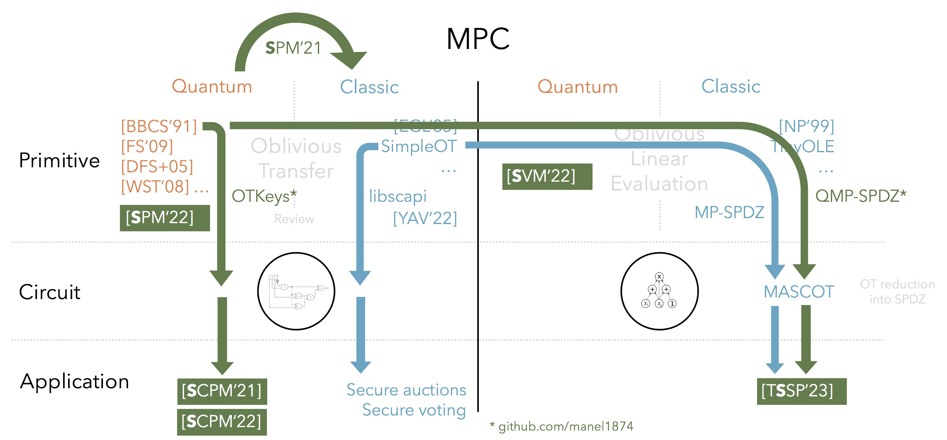
Oblivious Transfer
Alice
m₀
Bob
b
m₁
OT
m_{b}
Notes:
The motivation is Secure Multiparty Computation and there are currently
MPC protocols can be devided through several perspectives but here we will look from the point of view of its circuit architecture.
MPC protocols are based in either Boolean circuits or Arithmetic circuits

Slide 16
Quantum and classical OT
Quantum
Classic
[BBCS’91]
[DFS+05] [WST’08]
[FS’09]
…
[EGL’85]
[BM’89]
[NP’01]
SimpleOT
…
No previous work
How can we compare?
Comparable structure?
Corresponding phases with same technology?
Any practical gain?
Notes:
From a security perspective it is easier to compare both approaches. And this is the main motivation to perform QOT. [Todo: Desenrolar esta ideia um pouco só por paralavras] intercept now decipher later attack
There is not benchmark work to compare these two approaches.
Does that comparison makes sense from a practical perspective?
Any practical gain? Experimentally, can we assess if there is a best approach? Simply comparable?

Slide 17

Quantum and classical OT
Quantum
Classic
[BBCS’91]
Base OT OT Extension
Offline phase
(Oblivious) key
Key
Offline phase
Online phase
Online phase
Comparable structure?
Corresponding phases with same technology?
Any practical gain?
Notes:
There is not benchmark work to compare these two approaches.
Does that comparison makes sense from a practical perspective?
Any practical gain? Experimentally, can we assess if there is a best approach? Simply comparable?

Slide 18

Quantum and classical OT
Quantum
Classic
[BBCS’91]
Base OT OT Extension
Offline phase
(Oblivious) key
Key
Offline phase
Online phase
Online phase
Comparable structure?
Corresponding phases with same technology?
Any practical gain?
Notes:
There is not benchmark work to compare these two approaches.
Does that comparison makes sense from a practical perspective?
Any practical gain? Experimentally, can we assess if there is a best approach? Simply comparable?

Slide 19

Quantum and classical OT
Quantum
Classic
”No” time constraint
[BBCS’91]
Base OT OT Extension
Input independent
Offline phase
(Oblivious) key
Key
Offline phase
Online phase
Online phase
Input dependent
Comparable structure?
Corresponding phases with same technology?
Any practical gain?
Time
constraint

Slide 20
Quantum and classical OT
Classic
Quantum
Base OT
OT Extension
[BBCS’91]
Issue: PK operations
Sym
128
Base OT
~10M
OT
Notes:
SimpleOT estimation done by [OT Based on NTRUEncrypt] paper

Slide 21
Quantum and classical OT
Classic
Quantum
Base OT
OT Extension
[BBCS’91]
OT/s
10M OT
[NP’01]
SimpleOT
NTRU-OT
Kyber-OT
56
1 375
728
41
<
[ALSZ’13]
[KOS’15]
2.68 s
3.35 s
Notes:
SimpleOT estimation done by [OT Based on NTRUEncrypt] paper

Slide 22

Quantum and classical OT
Classic
Quantum
Base OT
OT Extension
[BBCS’91]
OT/s
10M OT
[NP’01]
SimpleOT
NTRU-OT
Kyber-OT
56
1 375
728
41
<
[ALSZ’13]
[KOS’15]
2.68 s
3.35 s
Online phase for m OTs
Computation
Communication
[ALSZ’13]
O^{ALSZ} – O^{BBCS} > m log m
C^{ALSZ} – C^{BBCS} = 0
BBCS
[KOS’15]
O^{KOS} – O^{BBCS} > m log m + 5ml
C^{KOS} – C^{BBCS} $≳$ 0
Notes:
SimpleOT estimation done by [OT Based on NTRUEncrypt] paper

Slide 23
Quantum and classical OT
MPC
SPM’21
Quantum
Classic
Quantum
Classic
[BBCS’91]
[FS’09]
[DFS+05] [WST’08] …
[EGL’85] SimpleOT
…
Oblivious Linear Evaluation
[NP’99]
TinyOLE
…
Oblivious Transfer
Primitive
[SVM’22]
OTKeys*
libscapi
QMP-SPDZ*
[SPM’22]
Review
[YAV’22]
MP-SPDZ
Circuit
MASCOT
OT reduction
into SPDZ
Application
[SCPM’21]
Secure auctions
Secure voting
[TSSP’23]
[SCPM’22]
* github.com/manel1874
Notes:
Based on this comparison, let us see what are the consequences of using BBCS based protocol into an MPC system.

Slide 24
Private phylogenetic trees
MPC
SPM’21
Quantum
Classic
Quantum
Classic
[BBCS’91]
[FS’09]
[DFS+05] [WST’08] …
[EGL’85] SimpleOT
…
Oblivious Linear Evaluation
[NP’99]
TinyOLE
…
Oblivious Transfer
Primitive
[SVM’22]
OTKeys*
libscapi
QMP-SPDZ*
[SPM’22]
Review
[YAV’22]
MP-SPDZ
Circuit
MASCOT
OT reduction
into SPDZ
Application
[SCPM’21]
Secure auctions
Secure voting
[TSSP’23]
[SCPM’22]
* github.com/manel1874
Notes:
The motivation is Secure Multiparty Computation and there are currently
MPC protocols can be devided through several perspectives but here we will look from the point of view of its circuit architecture.
MPC protocols are based in either Boolean circuits or Arithmetic circuits

Slide 25
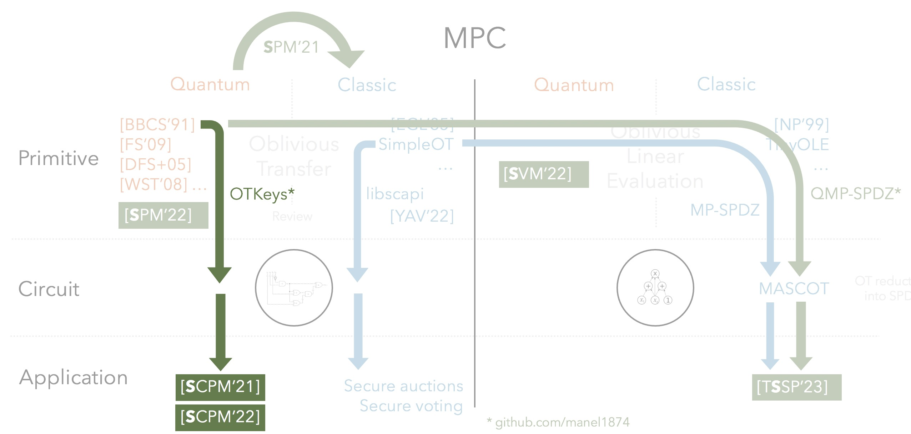
Private phylogenetic trees
Summary results
Tailored SMC protocol for phylogenetic trees algorithms
Classical implementation
CBMC-GC: circuit generation
MPC-Benchmark: yao protocol based on Libscapi
Integrate BBCS based protocol into Libscapi
Benchmark classical and quantum approaches
Notes:
The motivation is Secure Multiparty Computation and there are currently
MPC protocols can be devided through several perspectives but here we will look from the point of view of its circuit architecture.
MPC protocols are based in either Boolean circuits or Arithmetic circuits

Slide 26
Private phylogenetic trees
Summary results
Tailored SMC protocol for phylogenetic trees algorithms
Classical implementation
CBMC-GC: circuit generation
MPC-Benchmark: yao protocol based on Libscapi
Integrate BBCS based protocol into Libscapi
Benchmark classical and quantum approaches
Notes:
The motivation is Secure Multiparty Computation and there are currently
MPC protocols can be devided through several perspectives but here we will look from the point of view of its circuit architecture.
MPC protocols are based in either Boolean circuits or Arithmetic circuits

