Slide 1

Quantum assisted Secure Multiparty Computation
Manuel Batalha dos Santos
Thesis defence
17 October 2023

Slide 2

Outline
Motivation and outcomes
Quantum and classical oblivious transfer
Private Phylogenetic trees
Quantum Oblivious Linear Evaluation
Notes:
Outline:
Background: here we will discuss important primitives for MPC protocols. In particular, Oblivious Transfer, which is a very important primitive in boolean-based apprach, and Oblivious Linear Evaluation which is a generalization of Oblivious Transfer and can be used in the context of arithmetic-based MPC protocols.
Quantum and classical oblivious transfer: a comparison
Phylogenetic Trees
Oblivious Linear El

Slide 3
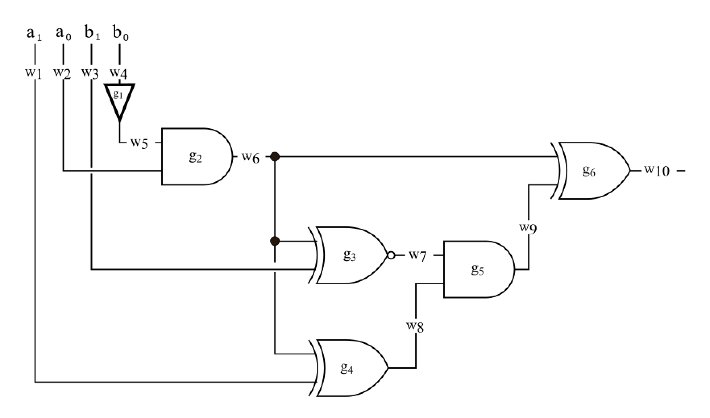
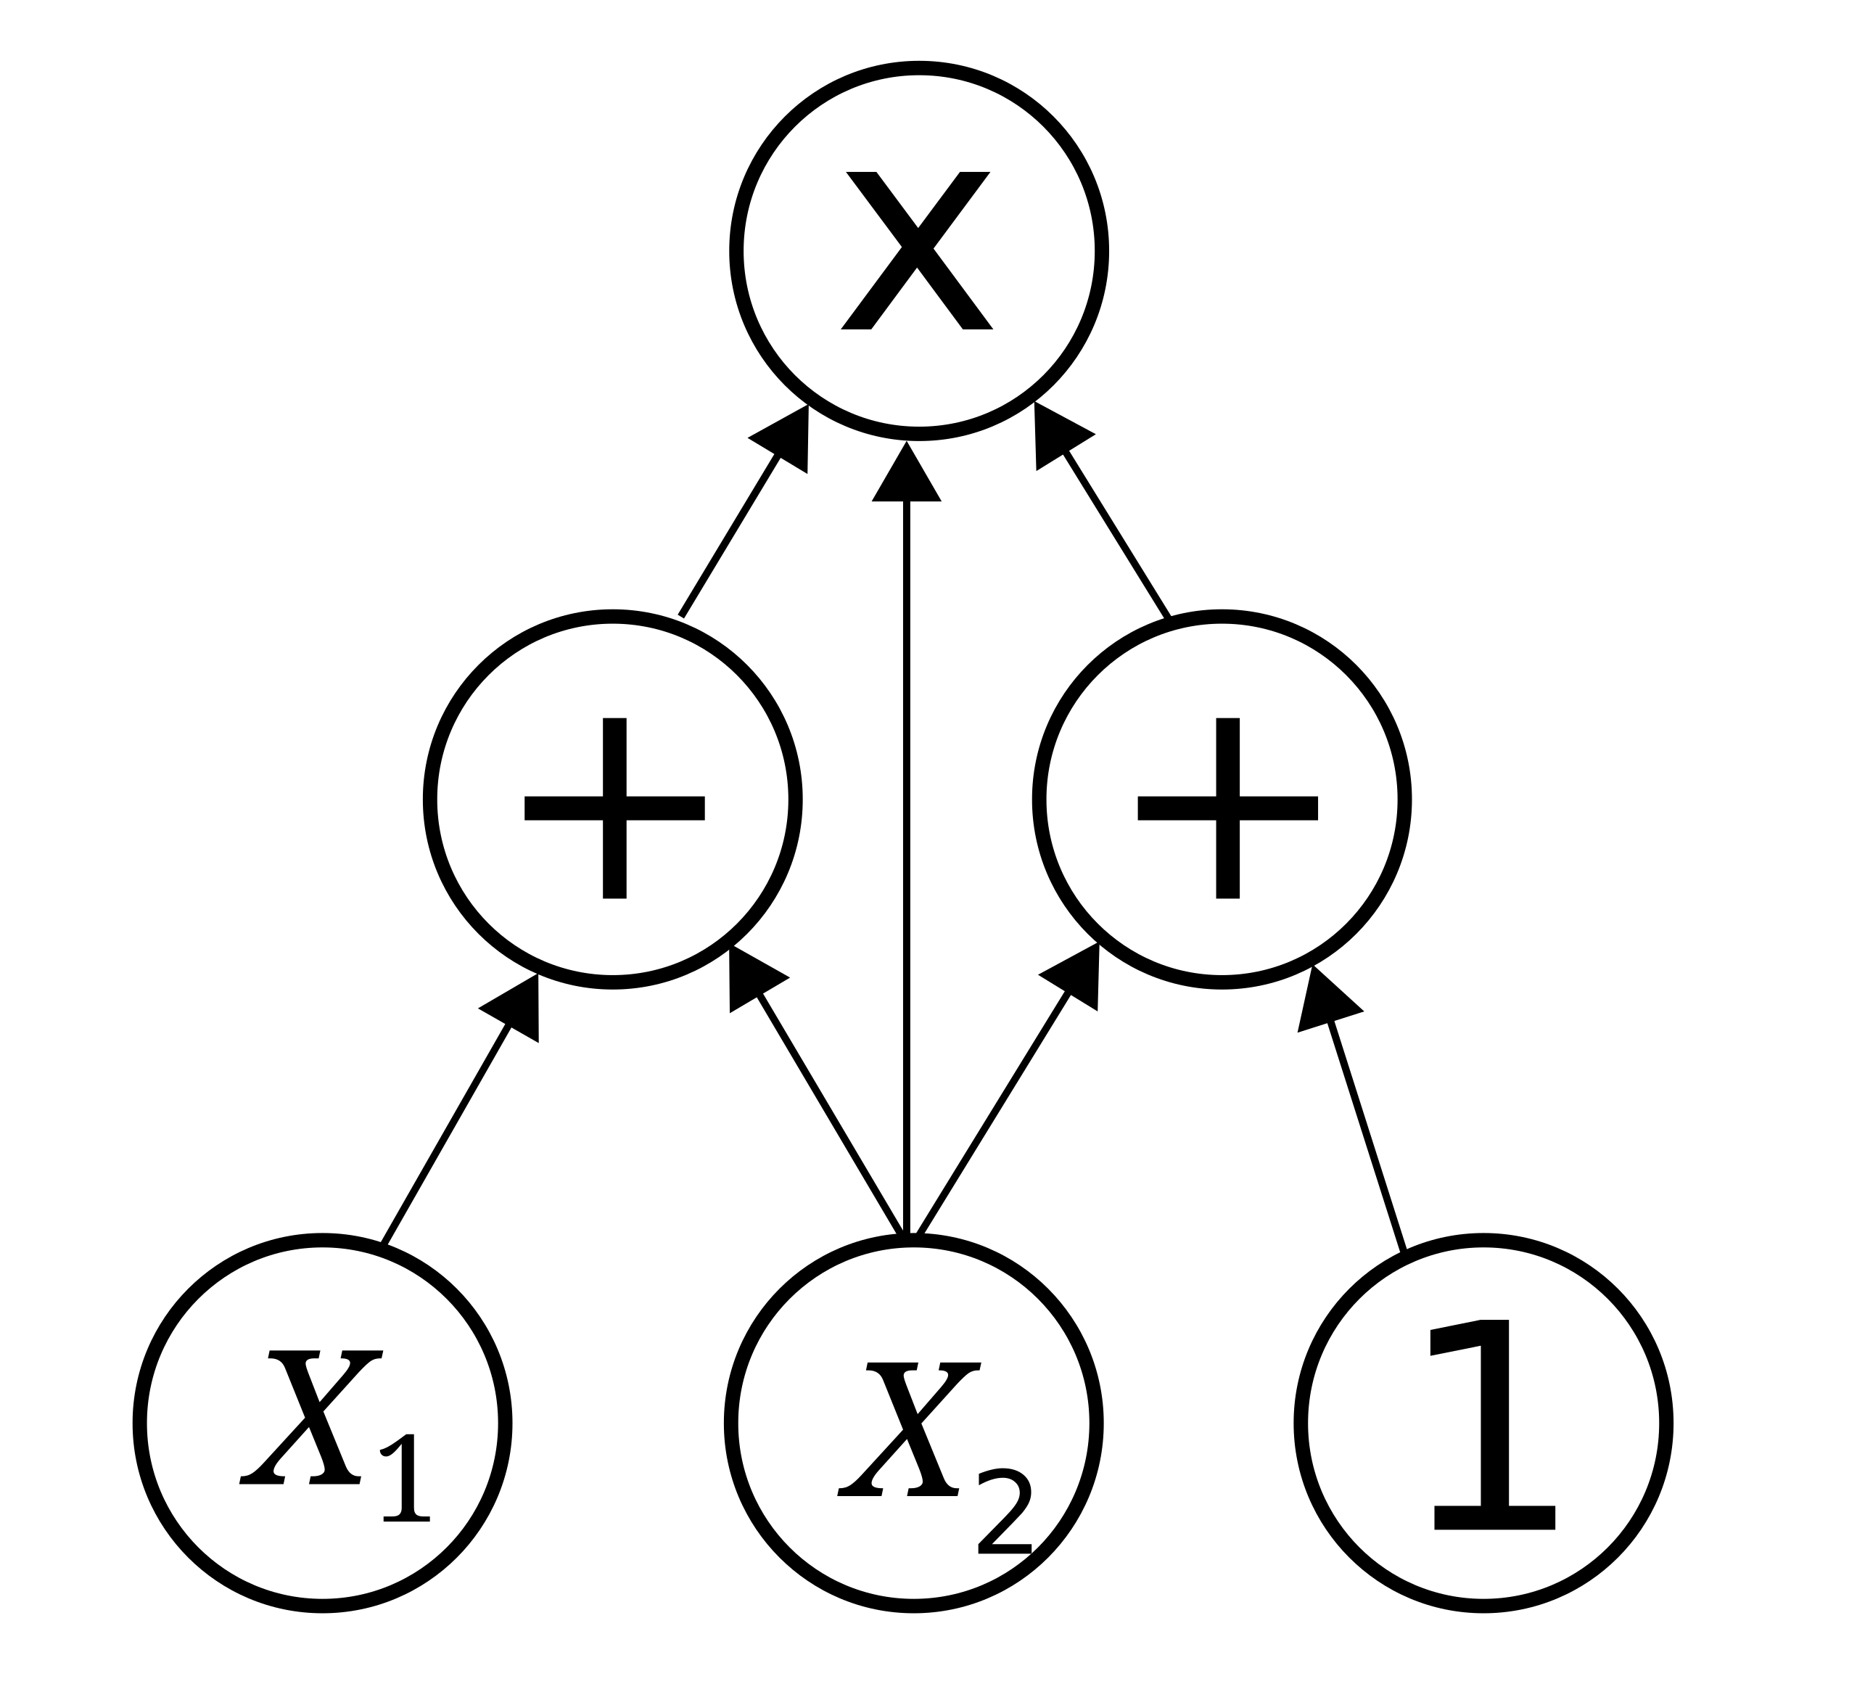
Motivation
MPC
Boolean
Arithmetic
Notes:
The motivation is Secure Multiparty Computation and there are currently
MPC protocols can be devided through several perspectives but here we will look from the point of view of its circuit architecture.
MPC protocols are based in either Boolean circuits or Arithmetic circuits

Slide 4
Motivation
MPC
Circuit
Notes:
The motivation is Secure Multiparty Computation and there are currently
MPC protocols can be devided through several perspectives but here we will look from the point of view of its circuit architecture.
MPC protocols are based in either Boolean circuits or Arithmetic circuits

Slide 5
Motivation
MPC
Oblivious Linear Evaluation
Oblivious Transfer
Primitive
Circuit
Notes:
The motivation is Secure Multiparty Computation and there are currently
MPC protocols can be devided through several perspectives but here we will look from the point of view of its circuit architecture.
MPC protocols are based in either Boolean circuits or Arithmetic circuits

Slide 6
Motivation
MPC
Quantum
Classic
Quantum
Classic
[BBCS’91]
[FS’09]
[DFS+05] [WST’08] …
[EGL’85] SimpleOT
…
Oblivious Linear Evaluation
[NP’99]
TinyOLE
…
Oblivious Transfer
Primitive
libscapi
Review
[YAV’22]
MP-SPDZ
Circuit
MASCOT
OT reduction
into SPDZ
Application
Secure auctions
Secure voting
Notes:
The motivation is Secure Multiparty Computation and there are currently
MPC protocols can be devided through several perspectives but here we will look from the point of view of its circuit architecture.
MPC protocols are based in either Boolean circuits or Arithmetic circuits

Slide 7
Outcomes
MPC
Quantum
Classic
Quantum
Classic
[BBCS’91]
[FS’09]
[DFS+05] [WST’08] …
[EGL’85] SimpleOT
…
Oblivious Linear Evaluation
[NP’99]
TinyOLE
…
Oblivious Transfer
Primitive
libscapi
[SPM’22]
Review
[YAV’22]
MP-SPDZ
Circuit
MASCOT
OT reduction
into SPDZ
Application
Secure auctions
Secure voting
Notes:
The motivation is Secure Multiparty Computation and there are currently
MPC protocols can be devided through several perspectives but here we will look from the point of view of its circuit architecture.
MPC protocols are based in either Boolean circuits or Arithmetic circuits

Slide 8
Outcomes
MPC
SPM’21
Quantum
Classic
Quantum
Classic
[BBCS’91]
[FS’09]
[DFS+05] [WST’08] …
[EGL’85] SimpleOT
…
Oblivious Linear Evaluation
[NP’99]
TinyOLE
…
Oblivious Transfer
Primitive
libscapi
[SPM’22]
Review
[YAV’22]
MP-SPDZ
Circuit
MASCOT
OT reduction
into SPDZ
Application
Secure auctions
Secure voting
Notes:
The motivation is Secure Multiparty Computation and there are currently
MPC protocols can be devided through several perspectives but here we will look from the point of view of its circuit architecture.
MPC protocols are based in either Boolean circuits or Arithmetic circuits

Slide 9
Outcomes
MPC
SPM’21
Quantum
Classic
Quantum
Classic
[BBCS’91]
[FS’09]
[DFS+05] [WST’08] …
[EGL’85] SimpleOT
…
Oblivious Linear Evaluation
[NP’99]
TinyOLE
…
Oblivious Transfer
Primitive
OTKeys*
libscapi
[SPM’22]
Review
[YAV’22]
MP-SPDZ
Circuit
MASCOT
OT reduction
into SPDZ
Application
Secure auctions
Secure voting
* github.com/manel1874
Notes:
The motivation is Secure Multiparty Computation and there are currently
MPC protocols can be devided through several perspectives but here we will look from the point of view of its circuit architecture.
MPC protocols are based in either Boolean circuits or Arithmetic circuits

Slide 10
Outcomes
MPC
SPM’21
Quantum
Classic
Quantum
Classic
[BBCS’91]
[FS’09]
[DFS+05] [WST’08] …
[EGL’85] SimpleOT
…
Oblivious Linear Evaluation
[NP’99]
TinyOLE
…
Oblivious Transfer
Primitive
OTKeys*
libscapi
[SPM’22]
Review
[YAV’22]
MP-SPDZ
Circuit
MASCOT
OT reduction
into SPDZ
Application
[SCPM’21]
Secure auctions
Secure voting
[SCPM’22]
* github.com/manel1874
Notes:
The motivation is Secure Multiparty Computation and there are currently
MPC protocols can be devided through several perspectives but here we will look from the point of view of its circuit architecture.
MPC protocols are based in either Boolean circuits or Arithmetic circuits

Slide 11
Outcomes
MPC
SPM’21
Quantum
Classic
Quantum
Classic
[BBCS’91]
[FS’09]
[DFS+05] [WST’08] …
[EGL’85] SimpleOT
…
Oblivious Linear Evaluation
[NP’99]
TinyOLE
…
Oblivious Transfer
Primitive
[SVM’22]
OTKeys*
libscapi
[SPM’22]
Review
[YAV’22]
MP-SPDZ
Circuit
MASCOT
OT reduction
into SPDZ
Application
[SCPM’21]
Secure auctions
Secure voting
[SCPM’22]
* github.com/manel1874
Notes:
The motivation is Secure Multiparty Computation and there are currently
MPC protocols can be devided through several perspectives but here we will look from the point of view of its circuit architecture.
MPC protocols are based in either Boolean circuits or Arithmetic circuits

Slide 12
Outcomes
MPC
SPM’21
Quantum
Classic
Quantum
Classic
[BBCS’91]
[FS’09]
[DFS+05] [WST’08] …
[EGL’85] SimpleOT
…
Oblivious Linear Evaluation
[NP’99]
TinyOLE
…
Oblivious Transfer
Primitive
[SVM’22]
OTKeys*
libscapi
QMP-SPDZ*
[SPM’22]
Review
[YAV’22]
MP-SPDZ
Circuit
MASCOT
OT reduction
into SPDZ
Application
[SCPM’21]
Secure auctions
Secure voting
[SCPM’22]
* github.com/manel1874
Notes:
The motivation is Secure Multiparty Computation and there are currently
MPC protocols can be devided through several perspectives but here we will look from the point of view of its circuit architecture.
MPC protocols are based in either Boolean circuits or Arithmetic circuits

Slide 13
Outcomes
MPC
SPM’21
Quantum
Classic
Quantum
Classic
[BBCS’91]
[FS’09]
[DFS+05] [WST’08] …
[EGL’85] SimpleOT
…
Oblivious Linear Evaluation
[NP’99]
TinyOLE
…
Oblivious Transfer
Primitive
[SVM’22]
OTKeys*
libscapi
QMP-SPDZ*
[SPM’22]
Review
[YAV’22]
MP-SPDZ
Circuit
MASCOT
OT reduction
into SPDZ
Application
[SCPM’21]
Secure auctions
Secure voting
[TSSP’23]
[SCPM’22]
* github.com/manel1874
Notes:
The motivation is Secure Multiparty Computation and there are currently
MPC protocols can be devided through several perspectives but here we will look from the point of view of its circuit architecture.
MPC protocols are based in either Boolean circuits or Arithmetic circuits

Slide 14
Outcomes
MPC
SPM’21
Quantum
Classic
Quantum
Classic
[BBCS’91]
[FS’09]
[DFS+05] [WST’08] …
[EGL’85] SimpleOT
…
Oblivious Linear Evaluation
[NP’99]
TinyOLE
…
Oblivious Transfer
Primitive
[SVM’22]
OTKeys*
libscapi
QMP-SPDZ*
[SPM’22]
Review
[YAV’22]
MP-SPDZ
Circuit
MASCOT
OT reduction
into SPDZ
Application
[SCPM’21]
Secure auctions
Secure voting
[TSSP’23]
[SCPM’22]
* github.com/manel1874
Notes:
The motivation is Secure Multiparty Computation and there are currently
MPC protocols can be devided through several perspectives but here we will look from the point of view of its circuit architecture.
MPC protocols are based in either Boolean circuits or Arithmetic circuits

Slide 15
Quantum and classical OT
MPC
SPM’21
Quantum
Classic
Quantum
Classic
[BBCS’91]
[FS’09]
[DFS+05] [WST’08] …
[EGL’85] SimpleOT
…
Oblivious Linear Evaluation
[NP’99]
TinyOLE
…
Oblivious Transfer
Primitive
[SVM’22]
OTKeys*
libscapi
QMP-SPDZ*
[SPM’22]
Review
[YAV’22]
MP-SPDZ
Circuit
MASCOT
OT reduction
into SPDZ
Application
[SCPM’21]
Secure auctions
Secure voting
[TSSP’23]
[SCPM’22]
* github.com/manel1874
Notes:
The motivation is Secure Multiparty Computation and there are currently
MPC protocols can be devided through several perspectives but here we will look from the point of view of its circuit architecture.
MPC protocols are based in either Boolean circuits or Arithmetic circuits

Slide 16
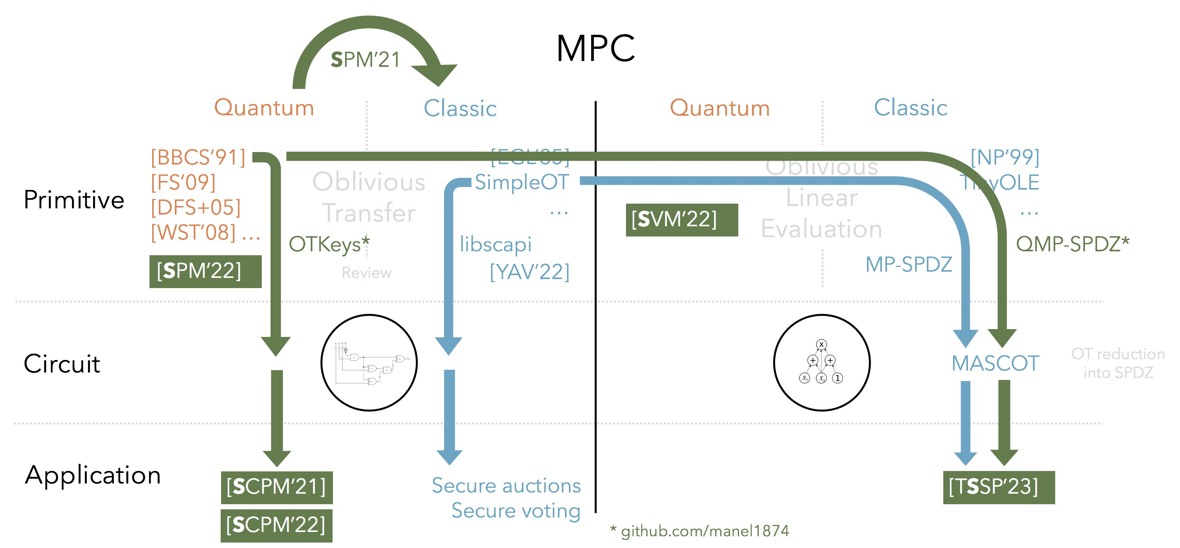
Oblivious Transfer
Alice
m₀
Bob
b
m₁
OT
m_{b}
Notes:
The motivation is Secure Multiparty Computation and there are currently
MPC protocols can be devided through several perspectives but here we will look from the point of view of its circuit architecture.
MPC protocols are based in either Boolean circuits or Arithmetic circuits

Slide 17
Quantum and classical OT
Quantum
Classic
[BBCS’91]
[DFS+05] [WST’08]
[FS’09]
…
[EGL’85]
[BM’89]
[NP’01]
SimpleOT
…
No previous work
How can we compare?
Comparable structure?
Corresponding phases with same technology?
Any practical gain?
Notes:
From a security perspective it is easier to compare both approaches. And this is the main motivation to perform QOT. [Todo: Desenrolar esta ideia um pouco só por paralavras] intercept now decipher later attack
There is not benchmark work to compare these two approaches.
Does that comparison makes sense from a practical perspective?
Any practical gain? Experimentally, can we assess if there is a best approach? Simply comparable?

Slide 18

Quantum and classical OT
Quantum
Classic
[BBCS’91]
Base OT OT Extension
Offline phase
(Oblivious) key
Key
Offline phase
Online phase
Online phase
Comparable structure?
Corresponding phases with same technology?
Any practical gain?
Notes:
There is not benchmark work to compare these two approaches.
Does that comparison makes sense from a practical perspective?
Any practical gain? Experimentally, can we assess if there is a best approach? Simply comparable?

Slide 19

Quantum and classical OT
Quantum
Classic
[BBCS’91]
Base OT OT Extension
Offline phase
(Oblivious) key
Key
Offline phase
Online phase
Online phase
Comparable structure?
Corresponding phases with same technology?
Any practical gain?
Notes:
There is not benchmark work to compare these two approaches.
Does that comparison makes sense from a practical perspective?
Any practical gain? Experimentally, can we assess if there is a best approach? Simply comparable?

Slide 20

Quantum and classical OT
Quantum
Classic
”No” time constraint
[BBCS’91]
Base OT OT Extension
Input independent
Offline phase
(Oblivious) key
Key
Offline phase
Online phase
Online phase
Input dependent
Comparable structure?
Corresponding phases with same technology?
Any practical gain?
Time
constraint

Slide 21
Quantum and classical OT
Classic
Quantum
Base OT
OT Extension
[BBCS’91]
Issue: PK operations
Sym
128
Base OT
~10M
OT
Notes:
SimpleOT estimation done by [OT Based on NTRUEncrypt] paper

Slide 22
Quantum and classical OT
Classic
Quantum
Base OT
OT Extension
[BBCS’91]
OT/s
10M OT
[NP’01]
SimpleOT
NTRU-OT
Kyber-OT
56
1 375
728
41
<
[ALSZ’13]
[KOS’15]
2.68 s
3.35 s
Notes:
SimpleOT estimation done by [OT Based on NTRUEncrypt] paper

Slide 23

Quantum and classical OT
Classic
Quantum
Base OT
OT Extension
[BBCS’91]
OT/s
10M OT
[NP’01]
SimpleOT
NTRU-OT
Kyber-OT
56
1 375
728
41
<
[ALSZ’13]
[KOS’15]
2.68 s
3.35 s
Online phase for m OTs
Computation
Communication
[ALSZ’13]
O^{ALSZ} – O^{BBCS} > m log m
C^{ALSZ} – C^{BBCS} = 0
BBCS
[KOS’15]
O^{KOS} – O^{BBCS} > m log m + 5ml
C^{KOS} – C^{BBCS} $≳$ 0
Notes:
SimpleOT estimation done by [OT Based on NTRUEncrypt] paper

Slide 24
Quantum and classical OT
MPC
SPM’21
Quantum
Classic
Quantum
Classic
[BBCS’91]
[FS’09]
[DFS+05] [WST’08] …
[EGL’85] SimpleOT
…
Oblivious Linear Evaluation
[NP’99]
TinyOLE
…
Oblivious Transfer
Primitive
[SVM’22]
OTKeys*
libscapi
QMP-SPDZ*
[SPM’22]
Review
[YAV’22]
MP-SPDZ
Circuit
MASCOT
OT reduction
into SPDZ
Application
[SCPM’21]
Secure auctions
Secure voting
[TSSP’23]
[SCPM’22]
* github.com/manel1874
Notes:
Based on this comparison, let us see what are the consequences of using BBCS based protocol into an MPC system.

Slide 25
Private phylogenetic trees
MPC
SPM’21
Quantum
Classic
Quantum
Classic
[BBCS’91]
[FS’09]
[DFS+05] [WST’08] …
[EGL’85] SimpleOT
…
Oblivious Linear Evaluation
[NP’99]
TinyOLE
…
Oblivious Transfer
Primitive
[SVM’22]
OTKeys*
libscapi
QMP-SPDZ*
[SPM’22]
Review
[YAV’22]
MP-SPDZ
Circuit
MASCOT
OT reduction
into SPDZ
Application
[SCPM’21]
Secure auctions
Secure voting
[TSSP’23]
[SCPM’22]
* github.com/manel1874
Notes:
The motivation is Secure Multiparty Computation and there are currently
MPC protocols can be devided through several perspectives but here we will look from the point of view of its circuit architecture.
MPC protocols are based in either Boolean circuits or Arithmetic circuits

Slide 26
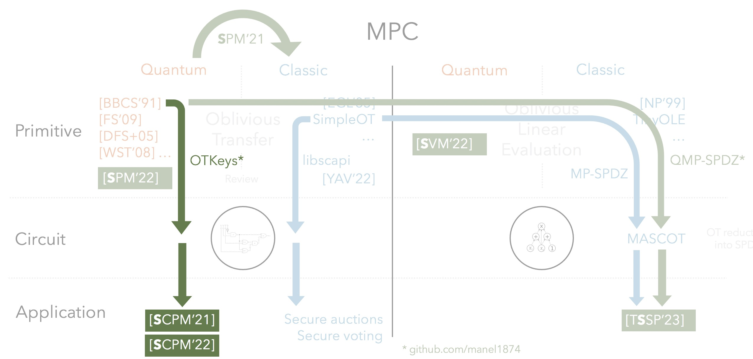
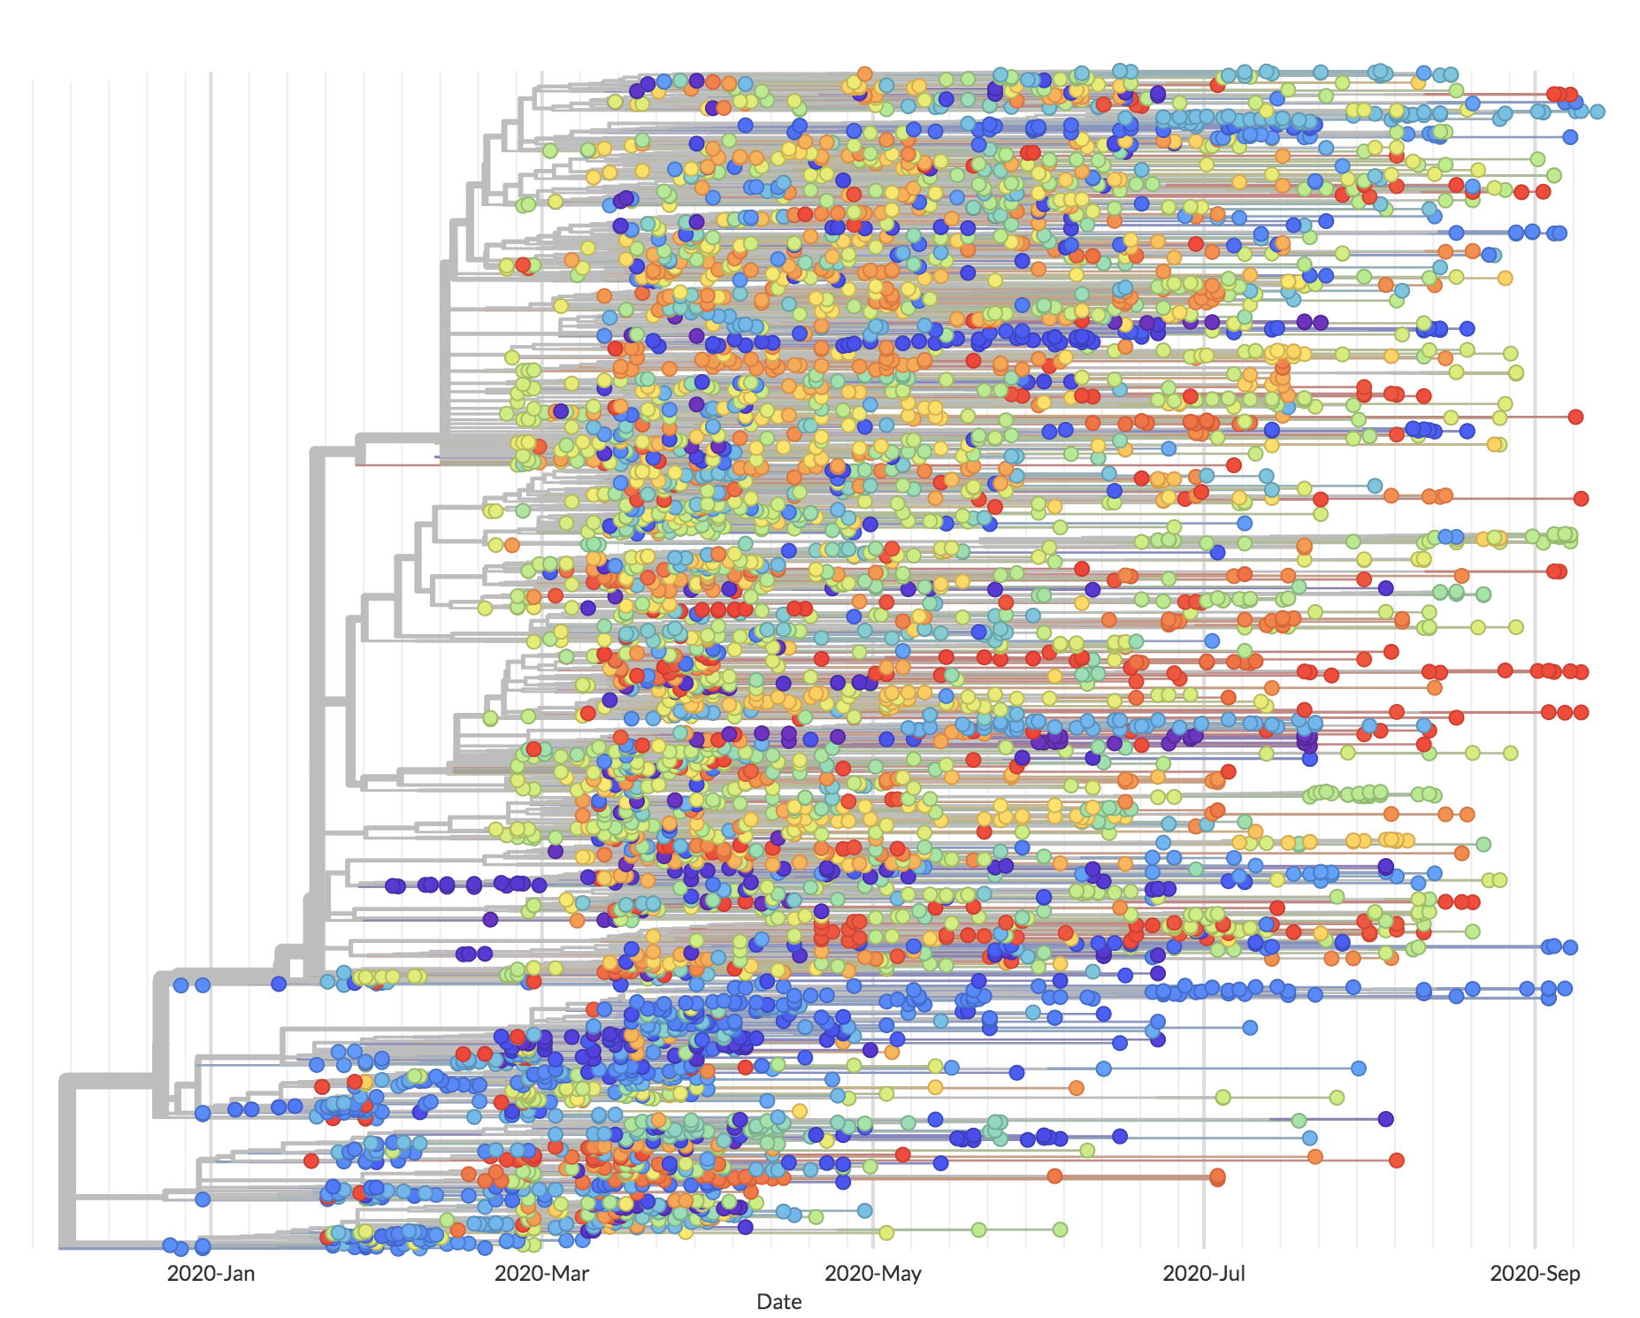
Private phylogenetic trees
Shows the evolutionary relationship between DNA sequences in a tree.
Notes:
The motivation is Secure Multiparty Computation and there are currently
MPC protocols can be devided through several perspectives but here we will look from the point of view of its circuit architecture.
MPC protocols are based in either Boolean circuits or Arithmetic circuits

Slide 27
Private phylogenetic trees
Results summary
Tailored SMC protocol for phylogenetic trees algorithms
Classical implementation
CBMC-GC: circuit generation
MPC-Benchmark: yao protocol based on Libscapi
PHYLIP: phylogeny analysis
Integrate BBCS based protocol into Libscapi
Benchmark classical and quantum approaches
Notes:
The motivation is Secure Multiparty Computation and there are currently
MPC protocols can be devided through several perspectives but here we will look from the point of view of its circuit architecture.
MPC protocols are based in either Boolean circuits or Arithmetic circuits

Slide 28
Private phylogenetic trees
Distance based: trees depend on the matrix distance of genes
Character based: search for the tree that optimizes the evolution the most
Computation: simple
Algorithms:
UPGMA
NJ
FM
Computation: complex
Algorithms:
Maximum Parsimony
Maximum Likelihood
Notes:
The motivation is Secure Multiparty Computation and there are currently
MPC protocols can be devided through several perspectives but here we will look from the point of view of its circuit architecture.
MPC protocols are based in either Boolean circuits or Arithmetic circuits

Slide 29
Private phylogenetic trees
Distance based: trees depend on the matrix distance of genes
Character based: search for the tree that optimizes the evolution the most
Computation: simple
Algorithms:
UPGMA
NJ
FM
Computation: complex
Algorithms:
Maximum Parsimony
Maximum Likelihood
Notes:
The motivation is Secure Multiparty Computation and there are currently
MPC protocols can be devided through several perspectives but here we will look from the point of view of its circuit architecture.
MPC protocols are based in either Boolean circuits or Arithmetic circuits

Slide 30
Private phylogenetic trees
Algorithms:
UPGMA
NJ
FM
Distances:
JC
K2P
F84
LogDet
Notes:
So we have three distance based algorithms and each of them can use one of several distances.
The key insight in the protocol is to realize that all these distance based protocols can be devided into two parts.

Slide 31




Private phylogenetic trees
CBMC-GC
Libscapi
Part 1: Compute the distance matrix
Part 2: Iteratively group the genes through some specific method
Notes:
So we have three distance based algorithms and each of them can use one of several distances.
The key insight in the protocol is to realize that all these distance based protocols can be devided into two parts.

Slide 32

Private phylogenetic trees
CBMC-GC
Libscapi
Part 1: Compute the distance matrix
Part 2: Iteratively group the genes through some specific method
SMC for distances
Notes:
So we have three distance based algorithms and each of them can use one of several distances.
The key insight in the protocol is to realize that all these distance based protocols can be devided into two parts.

Slide 33


Private phylogenetic trees
CBMC-GC
Libscapi
Part 1: Compute the distance matrix
Part 2: Iteratively group the genes through some specific method
SMC for distances
No interaction
Notes:
So we have three distance based algorithms and each of them can use one of several distances.
The key insight in the protocol is to realize that all these distance based protocols can be devided into two parts.

Slide 34
Quantum-assisted system
[BBCS’91]
Offline phase
Online phase
Notes:
So we have three distance based algorithms and each of them can use one of several distances.
The key insight in the protocol is to realize that all these distance based protocols can be devided into two parts.

Slide 35
Quantum-assisted system
[BBCS’91]
Offline phase
Oblivious key
Online phase
OT
Notes:
Comentar que a comparação entre o sistema quântico e clássico não é completamente fair porque o quântico tem a gestão das chaves enquanto queo clássico tem a geração das chaves on the fly (incluimos as duas fases). Mas não faria muito sentido estar a desintegrar uma biblioteca eficiente para efeitos de comparação e é perferível comparar sistemas novos com sistemas existentes na sua máxima eficiência.

Slide 36
Quantum-assisted system
[BBCS’91]
Offline phase
Oblivious key
Online phase
OT
Alice
Bob
OK_{A}= 011001100101
OK_{B}= 001101100011
X = 010110010110
Notes:
Comentar que OK é diferente de ROT porque Alice não tem a mesagem definida. De qualquer forma redução de OT a OK e a bit-ROT tem os mesmos passos (é igual em tudo).

Slide 37
Quantum-assisted system
[BBCS’91]
Offline phase
Oblivious key
Online phase
OT
Yao protocol
Notes:
Comentar que a comparação entre o sistema quântico e clássico não é completamente fair porque o quântico tem a gestão das chaves enquanto queo clássico tem a geração das chaves on the fly (incluimos as duas fases). Mas não faria muito sentido estar a desintegrar uma biblioteca eficiente para efeitos de comparação e é perferível comparar sistemas novos com sistemas existentes na sua máxima eficiência.

Slide 38
Performance evaluation
Setup:
3 parties: VMs running Ubuntu 16.04.3
30 SARS-CoV-2 genome sequences* with 32 000 length
Boolean circuit:
~3 minutes (CBMC-GC)
~2.2 million gates
128 000 input wires
*GISAID database
Notes:
Comentar que a comparação entre o sistema quântico e clássico não é completamente fair porque o quântico tem a gestão das chaves enquanto queo clássico tem a geração das chaves on the fly (incluimos as duas fases). Mas não faria muito sentido estar a desintegrar uma biblioteca eficiente para efeitos de comparação e é perferível comparar sistemas novos com sistemas existentes na sua máxima eficiência.

Slide 39
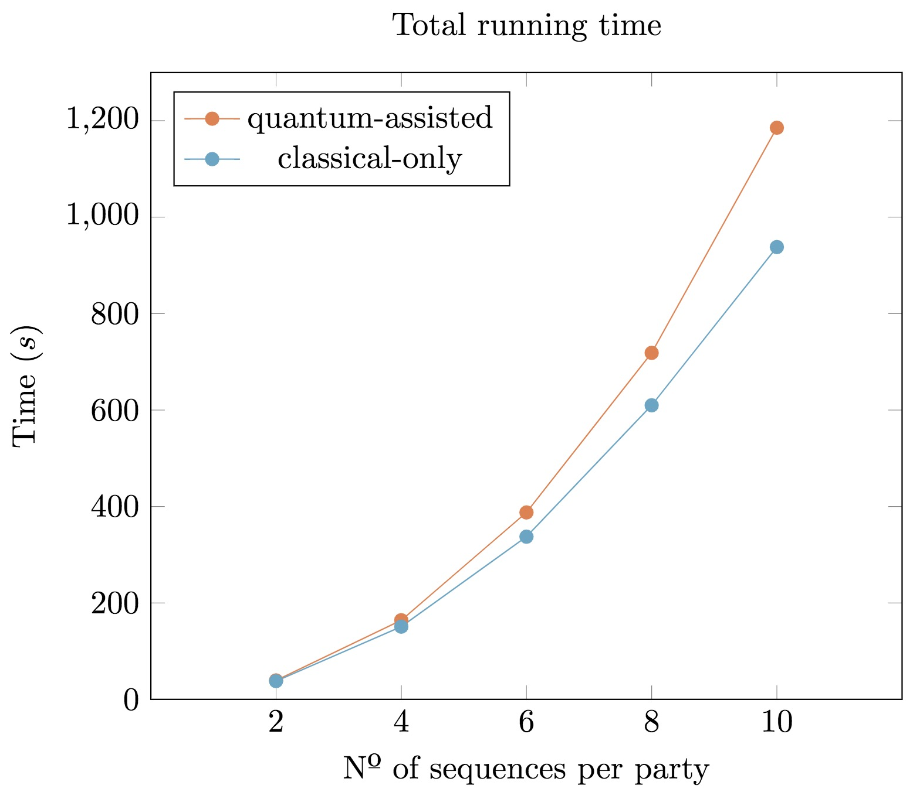
Performance evaluation
Setup:
3 parties: VMs running Ubuntu 16.04.3
30 SARS-CoV-2 genome sequences* with 32 000 length
Notes:
Comentar que a comparação entre o sistema quântico e clássico não é completamente fair porque o quântico tem a gestão das chaves enquanto queo clássico tem a geração das chaves on the fly (incluimos as duas fases). Mas não faria muito sentido estar a desintegrar uma biblioteca eficiente para efeitos de comparação e é perferível comparar sistemas novos com sistemas existentes na sua máxima eficiência.

Slide 40
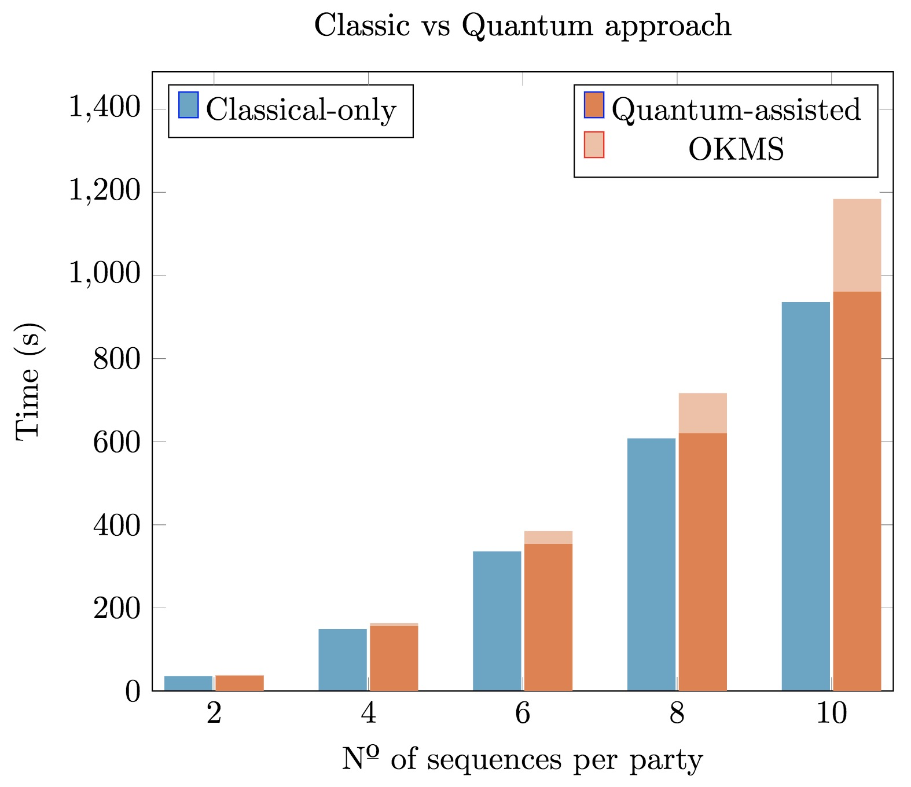
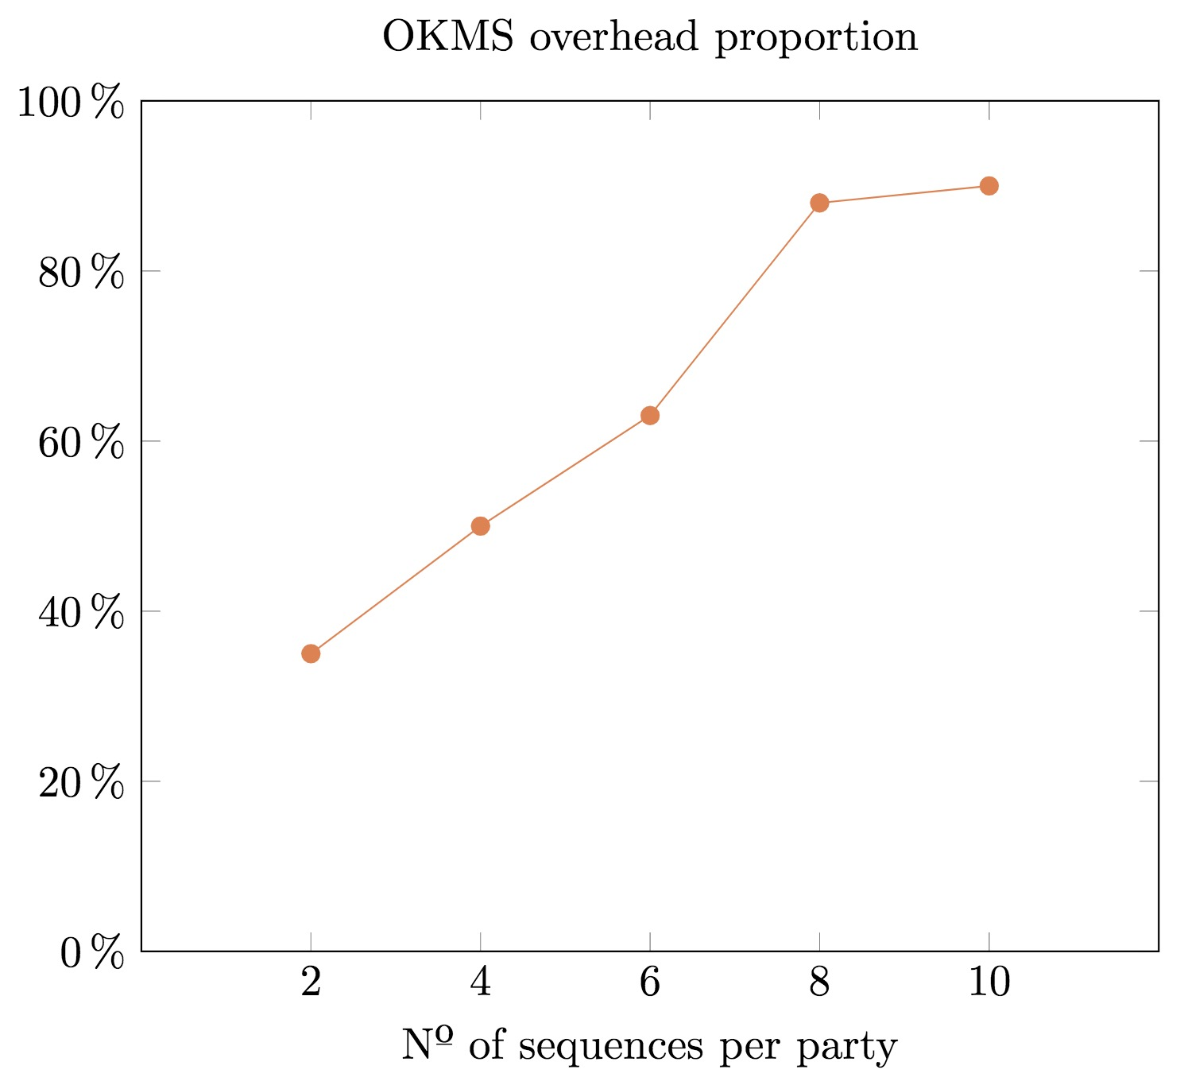
Performance evaluation
Setup:
3 parties: VMs running Ubuntu 16.04.3
30 SARS-CoV-2 genome sequences* with 32 000 length
Notes:
Comentar que a comparação entre o sistema quântico e clássico não é completamente fair porque o quântico tem a gestão das chaves enquanto queo clássico tem a geração das chaves on the fly (incluimos as duas fases). Mas não faria muito sentido estar a desintegrar uma biblioteca eficiente para efeitos de comparação e é perferível comparar sistemas novos com sistemas existentes na sua máxima eficiência.

Slide 41
Private phylogenetic trees
MPC
SPM’21
Quantum
Classic
Quantum
Classic
[BBCS’91]
[FS’09]
[DFS+05] [WST’08] …
[EGL’85] SimpleOT
…
Oblivious Linear Evaluation
[NP’99]
TinyOLE
…
Oblivious Transfer
Primitive
[SVM’22]
OTKeys*
libscapi
QMP-SPDZ*
[SPM’22]
Review
[YAV’22]
MP-SPDZ
Circuit
MASCOT
OT reduction
into SPDZ
Application
[SCPM’21]
Secure auctions
Secure voting
[TSSP’23]
[SCPM’22]
* github.com/manel1874
Notes:
The motivation is Secure Multiparty Computation and there are currently
MPC protocols can be devided through several perspectives but here we will look from the point of view of its circuit architecture.
MPC protocols are based in either Boolean circuits or Arithmetic circuits

Slide 42
Quantum OLE
MPC
SPM’21
Quantum
Classic
Quantum
Classic
[BBCS’91]
[FS’09]
[DFS+05] [WST’08] …
[EGL’85] SimpleOT
…
Oblivious Linear Evaluation
[NP’99]
TinyOLE
…
Oblivious Transfer
Primitive
[SVM’22]
OTKeys*
libscapi
QMP-SPDZ*
[SPM’22]
Review
[YAV’22]
MP-SPDZ
Circuit
MASCOT
OT reduction
into SPDZ
Application
[SCPM’21]
Secure auctions
Secure voting
[TSSP’23]
[SCPM’22]
* github.com/manel1874
Notes:
The motivation is Secure Multiparty Computation and there are currently
MPC protocols can be devided through several perspectives but here we will look from the point of view of its circuit architecture.
MPC protocols are based in either Boolean circuits or Arithmetic circuits

Slide 43
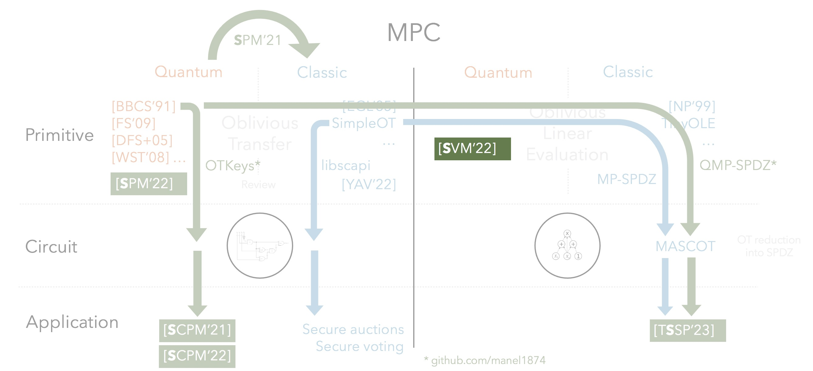
Quantum OLE
Results summary
Oblivious Linear Evaluation (OLE)
Vector OLE
Notes:
Examples taken from compressing Vector OLE

Slide 44
Quantum OLE
Results summary
Oblivious Linear Evaluation (OLE)
Vector OLE
Multiplication
triples
OLE
SPDZ
PSI
Notes:
Examples taken from compressing Vector OLE

Slide 45
Quantum OLE
Results summary
Oblivious Linear Evaluation (OLE)
Vector OLE
Multiplication
triples
OLE
SPDZ
PSI
VOLE
Matrix-vector multiplication
Nearest neighbor search
OT extension
Notes:
Examples taken from compressing Vector OLE
VOLE -> OT Ext from here https://eprint.iacr.org/2022/192.pdf

Slide 46
Quantum OLE
Results summary
Oblivious Linear Evaluation (OLE)
Vector OLE
Alice
a
Bob
x
b
OLE
f(x) = ax + b
Notes:
The motivation is Secure Multiparty Computation and there are currently
MPC protocols can be devided through several perspectives but here we will look from the point of view of its circuit architecture.
MPC protocols are based in either Boolean circuits or Arithmetic circuits

Slide 47
Quantum OLE
Results summary
Oblivious Linear Evaluation (OLE)
Vector OLE
Alice
a
Bob
x
b
VOLE
f(x) = ax + b
Notes:
I will just focus on the the OLE protocol because the generalizations I presented in the PhD work are heavely based on OLE and I want to give a highlevel overview of the UC proof.

Slide 48
Quantum OLE | Main tool
In an Hilbert space of dimension d
Notes:
The motivation is Secure Multiparty Computation and there are currently
MPC protocols can be devided through several perspectives but here we will look from the point of view of its circuit architecture.
MPC protocols are based in either Boolean circuits or Arithmetic circuits

Slide 49
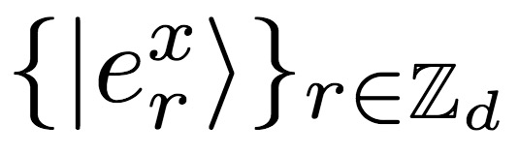
Quantum OLE | Main tool
In an Hilbert space of dimension d, there exists a set of MUBs
Notes:
The motivation is Secure Multiparty Computation and there are currently
MPC protocols can be devided through several perspectives but here we will look from the point of view of its circuit architecture.
MPC protocols are based in either Boolean circuits or Arithmetic circuits

Slide 50



Quantum OLE | Main tool
In an Hilbert space of dimension d, there exists a set of MUBs
Definition:
Notes:
The motivation is Secure Multiparty Computation and there are currently
MPC protocols can be devided through several perspectives but here we will look from the point of view of its circuit architecture.
MPC protocols are based in either Boolean circuits or Arithmetic circuits

Slide 51
Quantum OLE | Main tool
In an Hilbert space of dimension d, there exists a set of MUBs
Definition:
Notes:
The motivation is Secure Multiparty Computation and there are currently
MPC protocols can be devided through several perspectives but here we will look from the point of view of its circuit architecture.
MPC protocols are based in either Boolean circuits or Arithmetic circuits

Slide 52
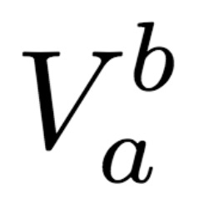
Quantum OLE | Main tool
In an Hilbert space of dimension d, there exists a set of MUBs
which, upon the action of the Heisenberg-Weyl operators,
Definition:
Notes:
The motivation is Secure Multiparty Computation and there are currently
MPC protocols can be devided through several perspectives but here we will look from the point of view of its circuit architecture.
MPC protocols are based in either Boolean circuits or Arithmetic circuits

Slide 53
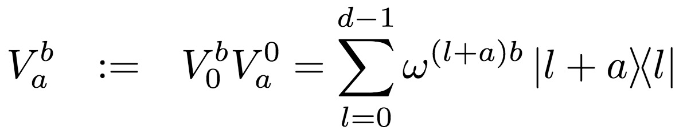
Quantum OLE | Main tool
In an Hilbert space of dimension d, there exists a set of MUBs
which, upon the action of the Heisenberg-Weyl operators,
Definition:
Definition:
Notes:
The operators are a combination of shift operators in the computational basis and in the dual basis.

Slide 54
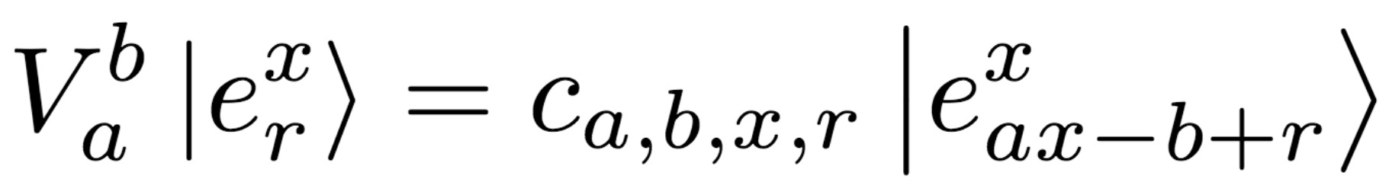
Quantum OLE | Main tool
In an Hilbert space of dimension d, there exists a set of MUBs
which, upon the action of the Heisenberg-Weyl operators,
Definition:
Definition:
Notes:
Each basis element r is shifted by the linear factor ax-b inside the same basis x

Slide 55
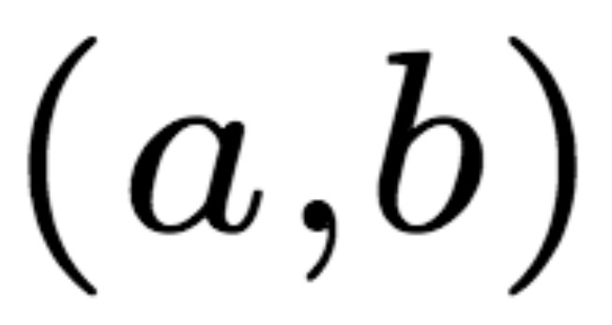

Quantum OLE | Main tool
In an Hilbert space of dimension d, there exists a set of MUBs
which, upon the action of the Heisenberg-Weyl operators,
Definition:
Definition:
Alice,
Bob,
Notes:
Each basis element r is shifted by the linear factor ax-b inside the same basis x

Slide 56
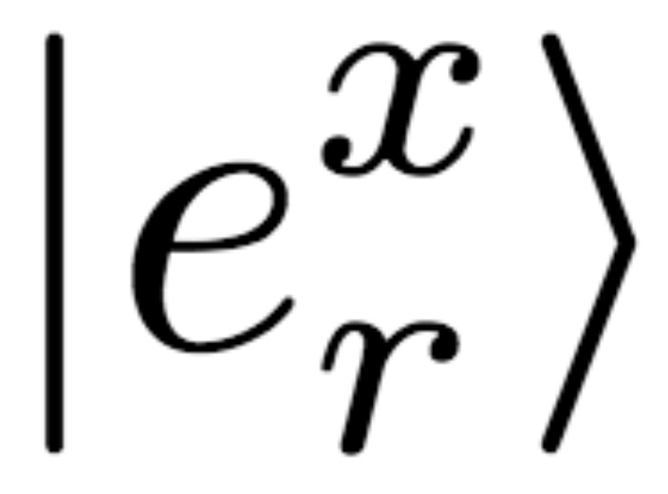
Quantum OLE | Main tool
In an Hilbert space of dimension d, there exists a set of MUBs
which, upon the action of the Heisenberg-Weyl operators,
Definition:
Definition:
Alice,
Bob,
Notes:
Each basis element r is shifted by the linear factor ax-b inside the same basis x

Slide 57
Quantum OLE | Main tool
In an Hilbert space of dimension d, there exists a set of MUBs
which, upon the action of the Heisenberg-Weyl operators,
Definition:
Definition:
Alice,
Bob,
Notes:
Each basis element r is shifted by the linear factor ax-b inside the same basis x

Slide 58
Quantum OLE | Main tool
In an Hilbert space of dimension d, there exists a set of MUBs
which, upon the action of the Heisenberg-Weyl operators,
Definition:
Definition:
Alice,
Bob,
Notes:
Each basis element r is shifted by the linear factor ax-b inside the same basis x

Slide 59
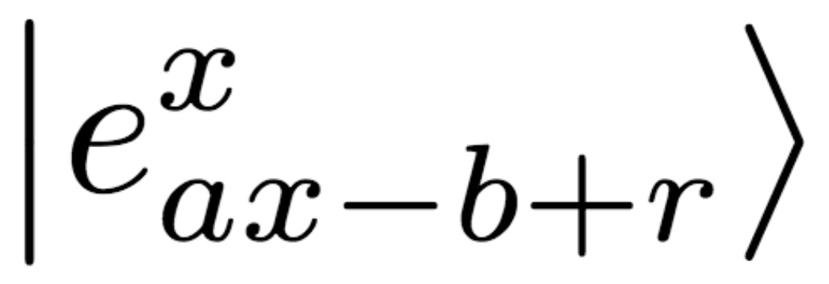
Quantum OLE | Main tool
In an Hilbert space of dimension d, there exists a set of MUBs
which, upon the action of the Heisenberg-Weyl operators,
Definition:
Definition:
Alice,
Bob,
Notes:
Each basis element r is shifted by the linear factor ax-b inside the same basis x

Slide 60
Quantum OLE | Main tool
In an Hilbert space of dimension d, there exists a set of MUBs
which, upon the action of the Heisenberg-Weyl operators,
Definition:
Definition:
Alice,
Bob,
Notes:
Each basis element r is shifted by the linear factor ax-b inside the same basis x

Slide 61
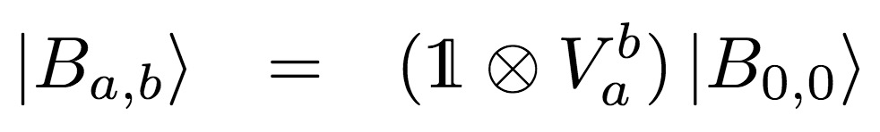
Quantum OLE | Main tool
In an Hilbert space of dimension d, there exists a set of MUBs
which, upon the action of the Heisenberg-Weyl operators,
Definition:
Definition:
Alice,
Bob,
Attack:
Notes:
Each basis element r is shifted by the linear factor ax-b inside the same basis x

Slide 62
Quantum OLE | Main tool
In an Hilbert space of dimension d, there exists a set of MUBs
which, upon the action of the Heisenberg-Weyl operators,
Definition:
Definition:
Alice,
Bob,
Attack:
Commit-and-open phase
Notes:
Each basis element r is shifted by the linear factor ax-b inside the same basis x

Slide 63
Quantum OLE | Protocol
Alice,
Bob,
Quantum phase
Classical phase
Notes:
Each basis element r is shifted by the linear factor ax-b inside the same basis x

Slide 64
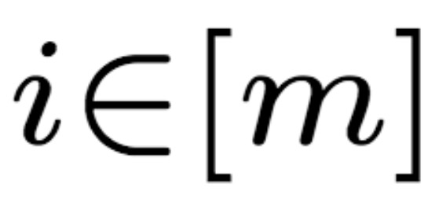
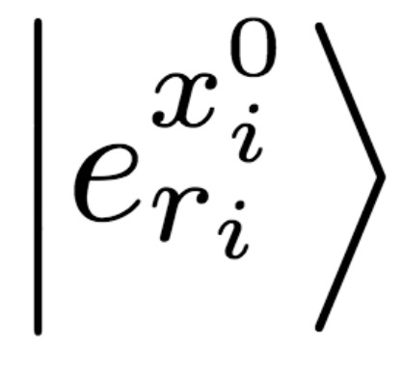
Quantum OLE | Protocol
Alice,
Bob,
Quantum phase
Classical phase
Notes:
Each basis element r is shifted by the linear factor ax-b inside the same basis x

Slide 65
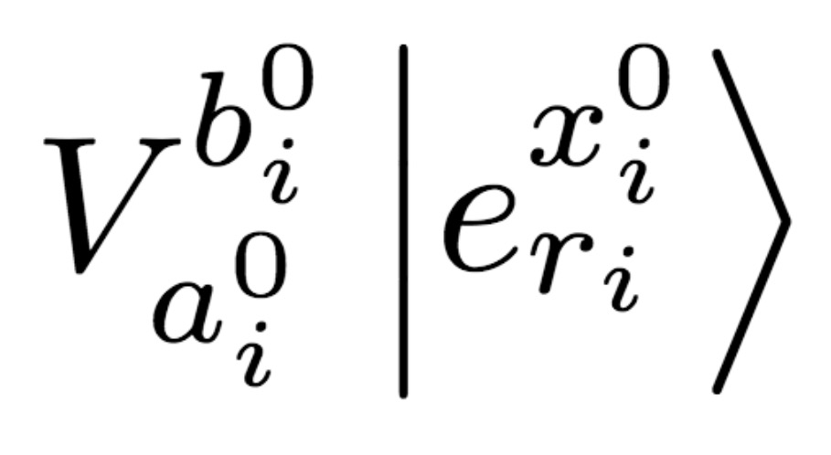
Quantum OLE | Protocol
Alice,
Bob,
Quantum phase
Classical phase
Notes:
Each basis element r is shifted by the linear factor ax-b inside the same basis x

Slide 66
Quantum OLE | Protocol
Alice,
Bob,
Quantum phase
Classical phase
Notes:
Each basis element r is shifted by the linear factor ax-b inside the same basis x

Slide 67
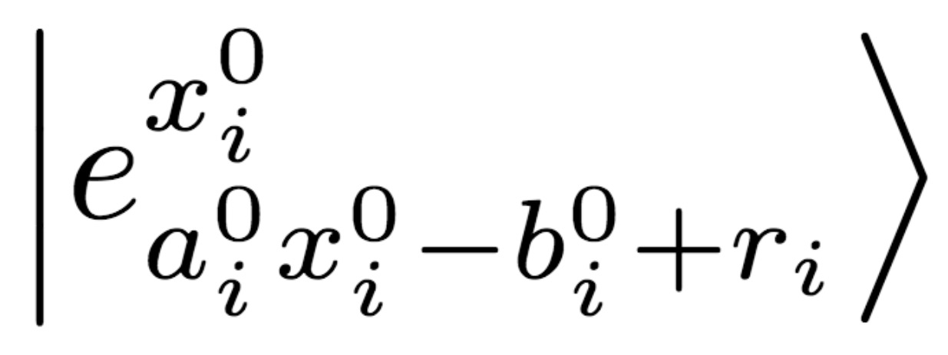
Quantum OLE | Protocol
Alice,
Bob,
Quantum phase
Classical phase
Notes:
Each basis element r is shifted by the linear factor ax-b inside the same basis x

Slide 68
Quantum OLE | Protocol
Alice,
Bob,
Quantum phase
Commit-and-open phase
Classical phase
Notes:
Each basis element r is shifted by the linear factor ax-b inside the same basis x

Slide 69

Quantum OLE | Protocol
Alice,
Bob,
Quantum phase
Commit-and-open phase
Classical phase
Notes:
Each basis element r is shifted by the linear factor ax-b inside the same basis x

Slide 70
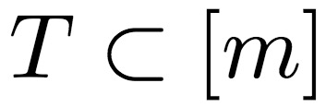
Quantum OLE | Protocol
Alice,
Bob,
Quantum phase
Commit-and-open phase
Classical phase
Notes:
Each basis element r is shifted by the linear factor ax-b inside the same basis x

Slide 71

Quantum OLE | Protocol
Alice,
Bob,
Quantum phase
Commit-and-open phase
Classical phase
Notes:
Each basis element r is shifted by the linear factor ax-b inside the same basis x

Slide 72
Quantum OLE | Protocol
Alice,
Bob,
Quantum phase
Commit-and-open phase
Classical phase
Notes:
Each basis element r is shifted by the linear factor ax-b inside the same basis x

Slide 73
Quantum OLE | Protocol
Alice,
Bob,
Quantum phase
Commit-and-open phase
Classical phase
Notes:
Each basis element r is shifted by the linear factor ax-b inside the same basis x

Slide 74

Quantum OLE | Protocol
Alice,
Bob,
Quantum phase
Security:
Commit-and-open phase
Classical phase
Notes:
Each basis element r is shifted by the linear factor ax-b inside the same basis x

Slide 75
Quantum OLE | Protocol
Alice,
Bob,
Quantum phase
Security:
Commit-and-open phase
Derandomization:
n ROLE
n OLE
Classical phase
Notes:
Each basis element r is shifted by the linear factor ax-b inside the same basis x

Slide 76
Quantum OLE | Protocol
Alice,
Bob,
Quantum phase
Security:
Commit-and-open phase
Derandomization:
n ROLE
n OLE
Classical phase
Extraction: Privacy amplification + Combiner
n OLE
1 OLE
Notes:
Each basis element r is shifted by the linear factor ax-b inside the same basis x

Slide 77
Quantum OLE | UC security
Notes:
The difficult thing about UC framework is that the environment has access to all inputs/outputs and transcript of the parties. This is to model any environment in which the protocol is running.

Slide 78
Quantum OLE | UC security
Ideal
Real
E
E
Notes:
The difficult thing about UC framework is that the environment has access to all inputs/outputs and transcript of the parties. This is to model any environment in which the protocol is running.

Slide 79
Quantum OLE | UC security
Ideal
Real
E
E
A
B
Notes:
The difficult thing about UC framework is that the environment has access to all inputs/outputs and transcript of the parties. This is to model any environment in which the protocol is running.

Slide 80
Quantum OLE | UC security
Ideal
Real
E
E
Inputs &
Outputs
A
Transcript
B
Inputs &
Outputs
Notes:
The difficult thing about UC framework is that the environment has access to all inputs/outputs and transcript of the parties. This is to model any environment in which the protocol is running.

Slide 81

Quantum OLE | UC security
Ideal
Real
E
E
Inputs &
Outputs
A
E
A
$$≈$$
Transcript
B
B
Inputs &
Outputs
Notes:
The difficult thing about UC framework is that the environment has access to all inputs/outputs and transcript of the parties. This is to model any environment in which the protocol is running.

Slide 82
Quantum OLE | UC security
Ideal
Real
E
E
Inputs &
Outputs
A
E
A
$$≈$$
F_{OLE}
Transcript
B
B
Inputs &
Outputs
Notes:
The difficult thing about UC framework is that the environment has access to all inputs/outputs and transcript of the parties. This is to model any environment in which the protocol is running.

Slide 83
Quantum OLE | UC security
Ideal
Real
E
E
Inputs &
Outputs
A
E
A
No
Transcript
$$≈$$
F_{OLE}
Transcript
B
B
Inputs &
Outputs
Notes:
This is obviously not indistinguishable because there is no trnascript between the parties.

Slide 84
Quantum OLE | UC security
Ideal
Real
E
Indistinguishability:
E
Transcript
S
Inputs &
Outputs
Inputs &
Outputs
A
Extractability:
C
Transcript
B
F_{OLE}
Inputs &
Outputs
H
Inputs &
Outputs
Notes:
The difficult thing about UC framework is that the environment has access to all inputs/outputs and transcript of the parties. This is to model any environment in which the protocol is running.

Slide 85
Quantum OLE | UC security
Ideal
Alice
Real
E
Indistinguishability:
E
Transcript
S
Inputs &
Outputs
Inputs &
Outputs
A
Extractability:
A
Transcript
B
F_{OLE}
Inputs &
Outputs
B
Inputs &
Outputs
Notes:
The difficult thing about UC framework is that the environment has access to all inputs/outputs and transcript of the parties. This is to model any environment in which the protocol is running.

Slide 86
Quantum OLE | UC security
Ideal
Alice
Real
E
Indistinguishability:
Fake commitments
E
Transcript
S
Inputs &
Outputs
Inputs &
Outputs
A
Extractability:
A
Transcript
B
F_{OLE}
Inputs &
Outputs
B
Inputs &
Outputs
Notes:
The difficult thing about UC framework is that the environment has access to all inputs/outputs and transcript of the parties. This is to model any environment in which the protocol is running.

Slide 87
Quantum OLE | UC security
Ideal
Alice
Real
E
Indistinguishability:
Fake commitments
E
Transcript
S
Inputs &
Outputs
Inputs &
Outputs
A
Extractability:
A
Transcript
B
F_{OLE}
Inputs &
Outputs
B
Inputs &
Outputs
Notes:
The difficult thing about UC framework is that the environment has access to all inputs/outputs and transcript of the parties. This is to model any environment in which the protocol is running.

Slide 88
Quantum OLE | UC security
Ideal
Bob
Real
E
Indistinguishability:
E
Transcript
S
Inputs &
Outputs
Inputs &
Outputs
A
Extractability:
B
Transcript
B
F_{OLE}
Inputs &
Outputs
A
Inputs &
Outputs
Notes:
The difficult thing about UC framework is that the environment has access to all inputs/outputs and transcript of the parties. This is to model any environment in which the protocol is running.

