Slide 1
Shell Scripting
Manal Lamine

Slide 2
Our Track
History
Basics to know
Variables
User Input
Bash Arithmetics
Conditional Statements
Loops
Functions
Example

Slide 3
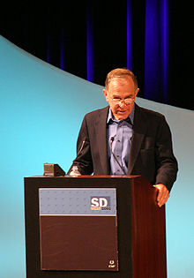
History
Wrote by Steve Bourne for the Unix 7th version
Named Bourne shell(sh) than Bourne Shell again (Bash)

Slide 4
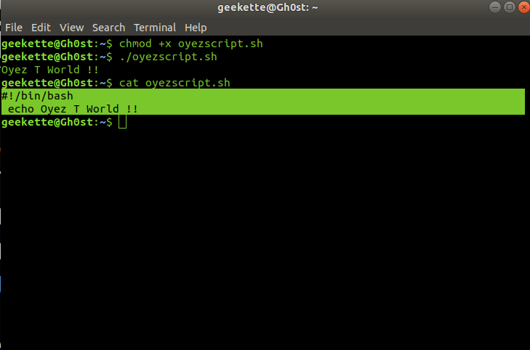
Basics to know
Shebang
Bash script is a bunch of commands that you used everyday in your Linux terminal but in the same file.
A file with .sh extension.
Executed with ./

Slide 5
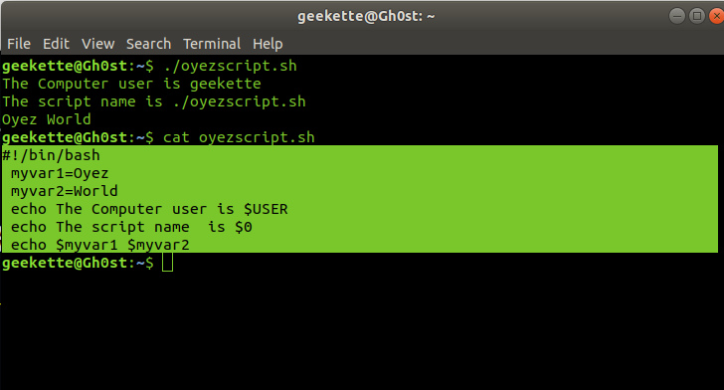
Variables
Special variables like
$0, $$, $USER, $HOSTNAME, $BASH_VERSION…
User variables
variable = value
myvar=oyez
and we called like this $myvar

Slide 6
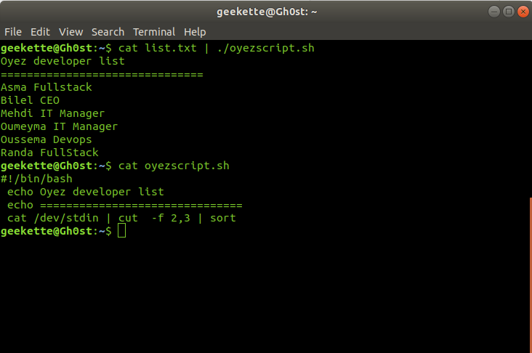
User Input
Command line argument
Input with read
Input via STDIN

Slide 7
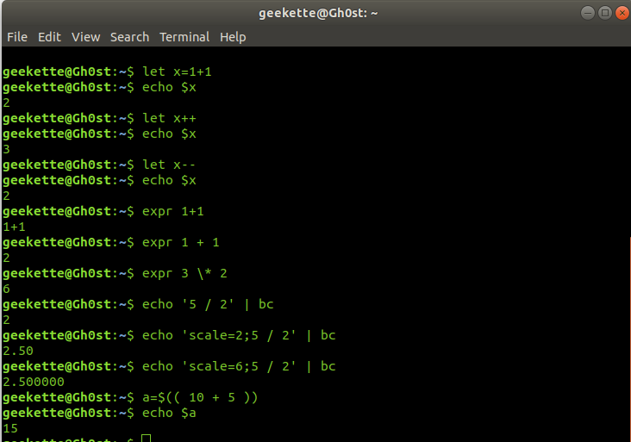
Bash Arithmetics
Let
Expr
Bc (decimal number)
Expansion

Slide 8
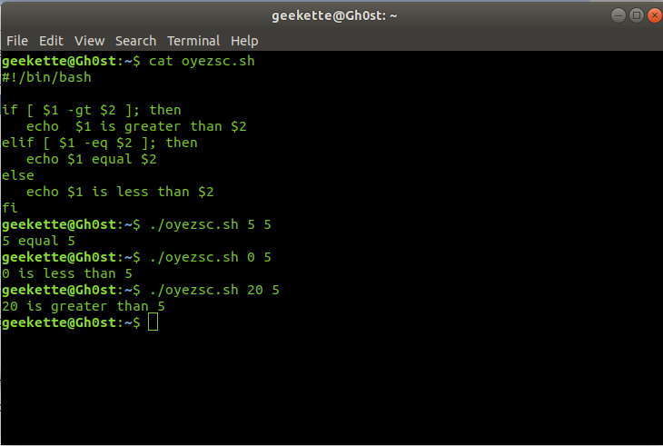
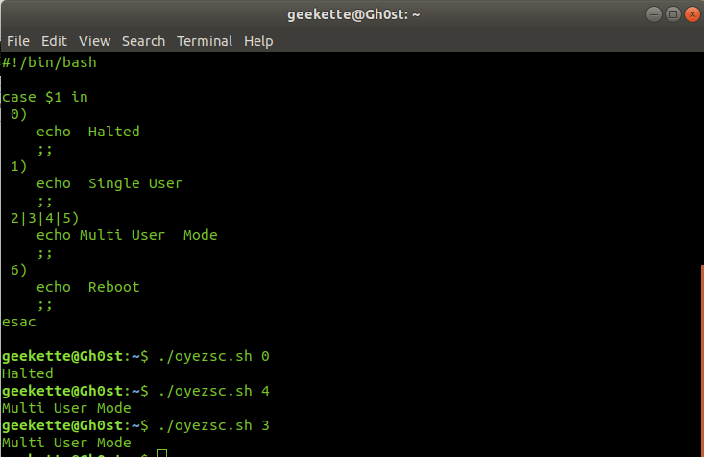
Conditional Statements

Slide 9
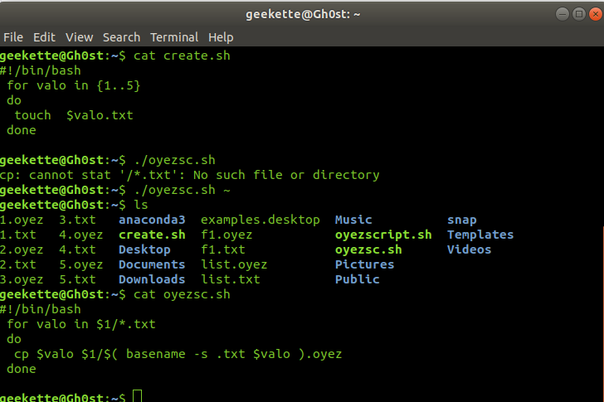
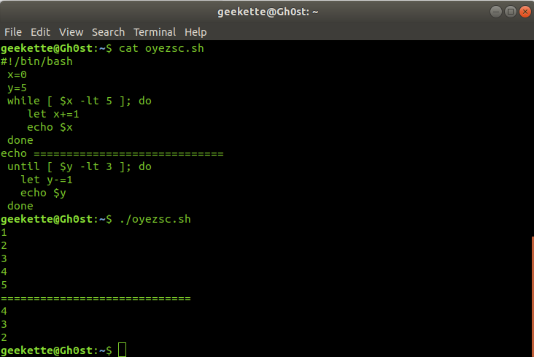
Loops

Slide 10
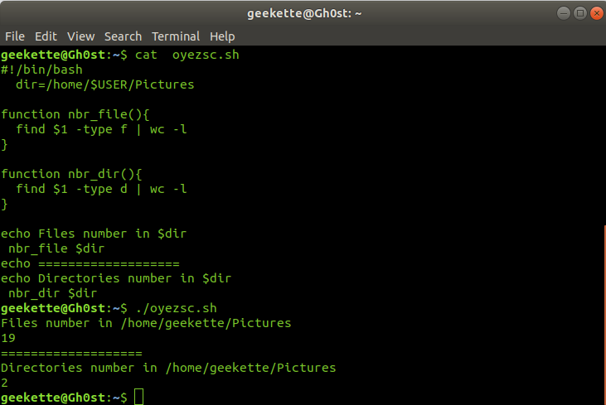
Functions
function function_name {
<commands>
}
function_name () {
<commands>
}

