Slide 1
Geomec 3.0
Architecture
Boris van Luipen
Notes:
Geomec 3.0
- New realease
- Totally rebuild
Presentation
- not functional design
- focus on generic solutions
- focus on resuse of software

Slide 2
Contents
Introduction
Introduction
Design Goals
Package Overview
Document / View
Directed Acyclic Graph
OpenGL
Filos
Ascii files
Notes:
Introduction
* About new release geomec
Design goals
* What do we want?
Package overview
* Modular construction
Document / View
* MFC Architecture
DAG
* Basics of the application
OpenGL
* Visualisation of Geometry
Filos
* Some words about the interface
* Not finished yet
Asscii files
* Generic handling of textfiles

Slide 3
Introduction
Introduction
Geomec 3D
  Build in Visual Basic
  Stores in Access database
  Frozen after 2.6 release
Geomec 2D
  Build in Visual C++
  Analyses cross sections of 3D
  Stores in Access database
Notes:
Geomec 3D
* Frozen
Geomec 2D
* Not frozen
* Connection to 3.0

Slide 4
Improvements of Geomec 3.0
Introduction
OpenGL visualisation
Stores directly in Filos
Tree driven
Supports faults
Supports windows GUI guidelines
Notes:
Introduction
* Geometry is widely used in a TNO
* Everyone has own implementation
* Support
Solution
* Make a library
* In first place for the Geomec project

Slide 5
Design Goals
Design Goals
Separation of specific and reuseable code
Expandable
Embedded messaging between objects
Supporting multiple models
Document / View
Notes:
Reusable library
* Other can use themAnalysis
Expandable
* Easy to add functionality
* Still the supporting the old interface
* Add a class
* Derive from a class
* Add interface of a class
Object oriented
* Using C++ in Geomec
Ansi C++ based
* For usage on other platforms
Visualisation is seperated
* Various visualistation methodes
* Platform independable
Implemeted as a static library
* Class access
* Prevent allocation problems due to STL

Slide 6
Package Overview
Packages
Geomec
GM40
MFC
Geometry
TextFile
Filos
DAG
Notes:
Division of library in packages
* Each package provides functionality
Dependency
- Divide an conquer

Slide 7
Document View architecture
Document View
Geomec is Single Document Interface SDI application
Geomec has a tree view (2x)
Geomec has an OpenGL view (2x)
Geomec support multiple models (Document types)
Tree View
Document
OpenGL View
Shell User
Notes:
Rootclass

Slide 8
SDI Application
Document View
CWinApp
CFrameWnd
CDocument
CView
MFC Layer
CNotepadApp
CMainFrame
CNotepadDoc
CNotepadView
1
n
Client Layer
Notes:
Rootclass

Slide 9
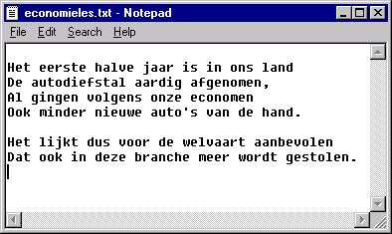
SDI Application
Document View
CMainFrame
CNotepadApp
Text in CNotepadDoc
CNotepadView
Notes:
Rootclass

Slide 10
Document View Hierarchy
Document View
MFC Layer
CView
CDocument
Reusable Layer
CGraphTreeView
COpenGLView
CGraphDoc
CDataTreeView
CModelTreeView
CModelView
CGeoDoc
Geomec Layer
Notes:
Rootclass

Slide 11
Document Hierarchy
Document View
CDocument
Document acts like a facade
CGraphDoc
CGraphModel
CGeoDoc
CHorizonModel
CGoCadModel
CEclipseModel
Notes:
Rootclass

Slide 12
Directed Acyclic Graph (DAG)
DAG
Document is designed in terms of the DAG
Integrated (acyclic) messaging for
  Insertion
  Modification
  Deletion
MFC independent GUI support
Generic interface for copy, paste and drag and drop
Notes:
Rootclass

Slide 13
Graph Hierarchy
DAG
CGraphNode
CDocObserver
CGraphEntry
CTreeObserver
CGeometricNode
Notes:
Filtering properties of an object we don’t need.
Example of the car - Mechanic
- User

Slide 14
CGraphEntry
DAG
Nodes to access sections of the graph
Model and document supply graph entries to access the data
Horizon Entry
Surface Entry
Horizon I
Surface I
Surface II
CDagModel
Notes:
Filtering properties of an object we don’t need.
Example of the car - Mechanic
- User

Slide 15
CDocObserver
DAG
Observes the messages of nodes of the model
  Insertion
  Modification
  Deletion
Every node of the model is observed
The CDocObserver is located in the document
The CDocObserver passes changes of the nodes to the views
Notes:
Reusable library
* Other can use themAnalysis
Expandable
* Easy to add functionality
* Still the supporting the old interface
* Add a class
* Derive from a class
* Add interface of a class
Object oriented
* Using C++ in Geomec
Ansi C++ based
* For usage on other platforms
Visualisation is seperated
* Various visualistation methodes
* Platform independable
Implemeted as a static library
* Class access
* Prevent allocation problems due to STL

Slide 16
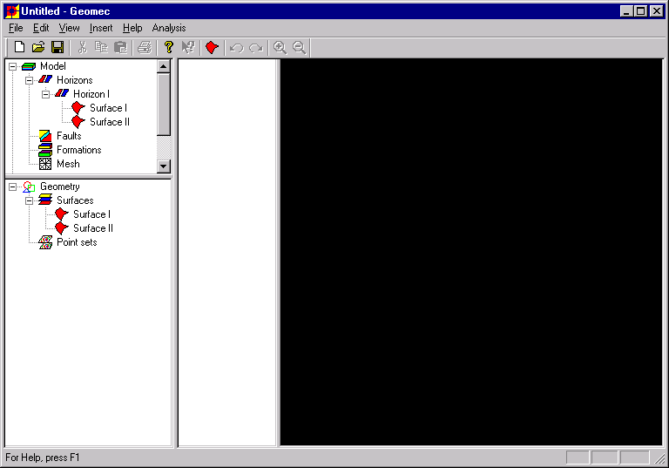
CDocObserver
DAG
Views
OnUpdate()
OnUpdate()
Horizon Entry
Model
DocObserver
Horizon I
Surface I
Surface II
Document
Notes:
Reusable library
* Other can use themAnalysis
Expandable
* Easy to add functionality
* Still the supporting the old interface
* Add a class
* Derive from a class
* Add interface of a class
Object oriented
* Using C++ in Geomec
Ansi C++ based
* For usage on other platforms
Visualisation is seperated
* Various visualistation methodes
* Platform independable
Implemeted as a static library
* Class access
* Prevent allocation problems due to STL

Slide 17
CTreeObserver
DAG
Handles the operations of tree node
  Selection
  Deletion
  Context menu
  Properties
  Label edit
  Drag and drop
Encapsulates the entry or node in the graph
Take care of updating the nodes in the treeview
Notes:
Reusable library
* Other can use themAnalysis
Expandable
* Easy to add functionality
* Still the supporting the old interface
* Add a class
* Derive from a class
* Add interface of a class
Object oriented
* Using C++ in Geomec
Ansi C++ based
* For usage on other platforms
Visualisation is seperated
* Various visualistation methodes
* Platform independable
Implemeted as a static library
* Class access
* Prevent allocation problems due to STL

Slide 18
CTreeObserver
DAG
CTreeEntryObserver encapsulates the a CGraphEntry
CTreeItemObserver encapsulates an object of the entry
CGraphNode
CTreeObserver
CTreeEntryObserver
CTreeItemObserver
Notes:
Reusable library
* Other can use themAnalysis
Expandable
* Easy to add functionality
* Still the supporting the old interface
* Add a class
* Derive from a class
* Add interface of a class
Object oriented
* Using C++ in Geomec
Ansi C++ based
* For usage on other platforms
Visualisation is seperated
* Various visualistation methodes
* Platform independable
Implemeted as a static library
* Class access
* Prevent allocation problems due to STL

Slide 19
CTreeObserver
DAG
CTreeEntryObserver
CTreeItemObserver
Horizon Entry
Horizon I
Surface I
Surface II
Notes:
Reusable library
* Other can use themAnalysis
Expandable
* Easy to add functionality
* Still the supporting the old interface
* Add a class
* Derive from a class
* Add interface of a class
Object oriented
* Using C++ in Geomec
Ansi C++ based
* For usage on other platforms
Visualisation is seperated
* Various visualistation methodes
* Platform independable
Implemeted as a static library
* Class access
* Prevent allocation problems due to STL

Slide 20
CGeometricNode
DAG
All nodes that contain geometric objects
Interface exports CGeoObjects used by OpenGL
CGeometricNode
CGeoObject
*See Geometry Library
Extend
CHorizon
CFormation
Notes:
Reusable library
* Other can use themAnalysis
Expandable
* Easy to add functionality
* Still the supporting the old interface
* Add a class
* Derive from a class
* Add interface of a class
Object oriented
* Using C++ in Geomec
Ansi C++ based
* For usage on other platforms
Visualisation is seperated
* Various visualistation methodes
* Platform independable
Implemeted as a static library
* Class access
* Prevent allocation problems due to STL

Slide 21
Open Geometry Library
OpenGL
Implements 3D visualisation
Building a models in real world coordinates
OpenGL is standard on Unix and Windows machines
Hardware support
Notes:
Reusable library
* Other can use themAnalysis
Expandable
* Easy to add functionality
* Still the supporting the old interface
* Add a class
* Derive from a class
* Add interface of a class
Object oriented
* Using C++ in Geomec
Ansi C++ based
* For usage on other platforms
Visualisation is seperated
* Various visualistation methodes
* Platform independable
Implemeted as a static library
* Class access
* Prevent allocation problems due to STL

Slide 22
OpenGL Hierarchy
OpenGL
CView
COpenGLView
COpenGLScene
*See Geometry Library
CGeoObject
COpenGLPlayList
CDrawDef
Notes:
Filtering properties of an object we don’t need.
Example of the car - Mechanic
- User

Slide 23
COpenGLView
OpenGL
COpenGLView displays COpenGLScenes
COpenGLView implements
  Zooming
  Rotation of the scene
  Selection
Notes:
Filtering properties of an object we don’t need.
Example of the car - Mechanic
- User

Slide 24
COpenGLScene
OpenGL
COpenGLScene defines the global settings of the view
The objects in the scene are defined by playlists
COpenGLView defines
  3D / 2D view
  Shading
  Light sources
  Background
Notes:
Filtering properties of an object we don’t need.
Example of the car - Mechanic
- User

Slide 25
COpenGLPlayList
OpenGL
COpenGLPlayList defines the geometrical objects in the scene
Supplies manipulation of collection of objects
Playlists are supported in native OpenGL
Notes:
Filtering properties of an object we don’t need.
Example of the car - Mechanic
- User

Slide 26
CDrawDef
OpenGL
CDrawDef defines how the CGeoObject is painted
All features a (x, y, z) depended
CDrawDef defines
  Fill colour
  Line colour
  Line width
  Fill patterns
Notes:
Filtering properties of an object we don’t need.
Example of the car - Mechanic
- User

Slide 27
OpenGL in Geomec
OpenGL
Scenes in terms of viewable graph nodes
  Line views (Wellpaths)
  Birdeye views (Horizons, formations etc)
  Planar views (Cross sections)
Draw definition in terms of results
Colors in terms of hotspots and gradients
Notes:
Filtering properties of an object we don’t need.
Example of the car - Mechanic
- User

Slide 28
OpenGL in Geomec
OpenGL
COpenGLView
COpenGLScene
COpenGLPlaylist
CDrawDef
CDagNode
CModelView
CGeomecScene
CViewableObject
CResult
Notes:
Filtering properties of an object we don’t need.
Example of the car - Mechanic
- User

Slide 29
OpenGL Post Processing
OpenGL
CGraphNode
CViewableNode
CGeomecScene
CResult
CColorScale
CSurface
CBirdeyeScene
CDepthRes
CGradient
CHotspot
Notes:
Filtering properties of an object we don’t need.
Example of the car - Mechanic
- User

Slide 30
Results
OpenGL
A Geomec scene couples a result to viewable nodes
CResult
CFilosResult
CPressure
CDepthResult
CDistributedPressure
CGWCPressure
CConstantPressure
Notes:
Filtering properties of an object we don’t need.
Example of the car - Mechanic
- User

Slide 31
Results in Geomec
OpenGL
CResult
  Implements CDrawDef for all exported CGeoObjects by CViewableNode
  ColorScale defines the color definition
CFilosResult
  Implements results from the filos database
  Closely related to the Filos interface
CDepthResult
  Implements color as function from depth
  Default result
Notes:
Filtering properties of an object we don’t need.
Example of the car - Mechanic
- User

Slide 32
Pressure results
OpenGL
CPressure
  Defines the pressure in a certain area
CConstantPressure
  Defined by gradient, ref. depth and ref. pressure
CDistributedPressure
  Defined by a cloud of points with a pressure
CGWCPressure
  Defines Gas/Water contact
Notes:
Filtering properties of an object we don’t need.
Example of the car - Mechanic
- User

Slide 33
Filos
Filos
Filos database is used by Diana
Geomec stores data directly on filos
Implemented as a library of generic use
Schema extension for Geomec use
Extended with a Geomec library
  Node support
  Result support
  Material support
Notes:
Filtering properties of an object we don’t need.
Example of the car - Mechanic
- User

Slide 34
Text files
Text files
Generic implementation of text interpretation
Standard file handling
  File opening
  Error handling
  Progress measurement
  Cancel handling
A keyword in the textfile is linked to a read function
Notes:
Filtering properties of an object we don’t need.
Example of the car - Mechanic
- User

Slide 35
Text files
Text files
Textfile object maps token names on functions
CTokenTemp executes the token function on class T
CTextFile
CToken
Read()
“NODES” ReadNodes()
“TRI” ReadTriangles()
“…..” ………()
T
CTokenTemp
Read()
Notes:
Filtering properties of an object we don’t need.
Example of the car - Mechanic
- User

