Slide 1
Projects
Grau Enginyeria Biomèdica
Universitat de Barcelona
Dr. Manel Puig i Vidal
GEB- Projects: Engineering Tools

Slide 2
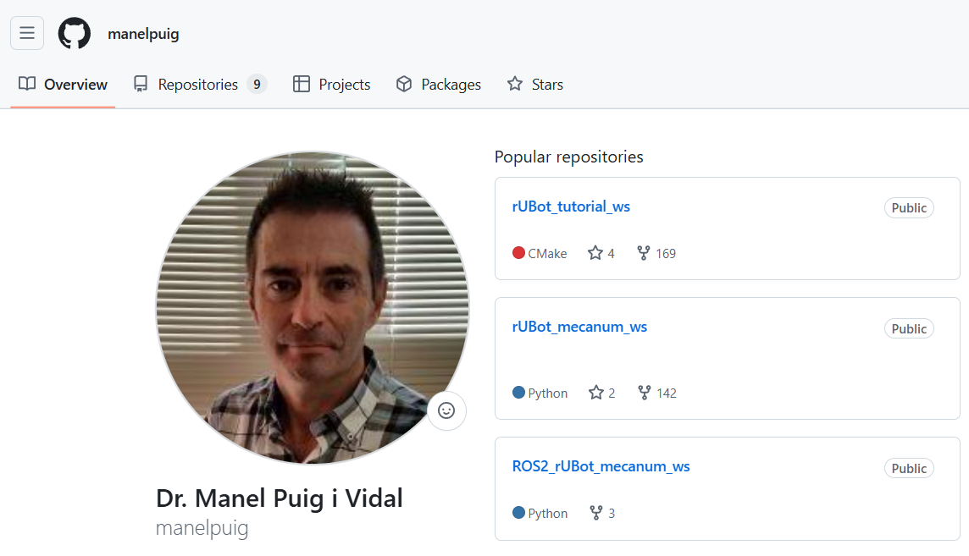
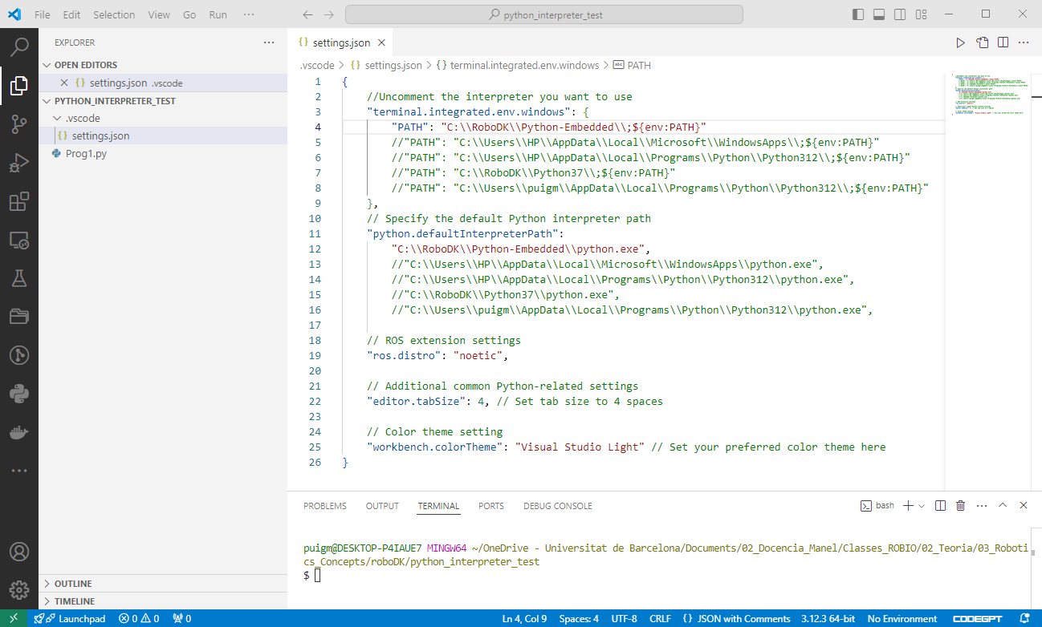

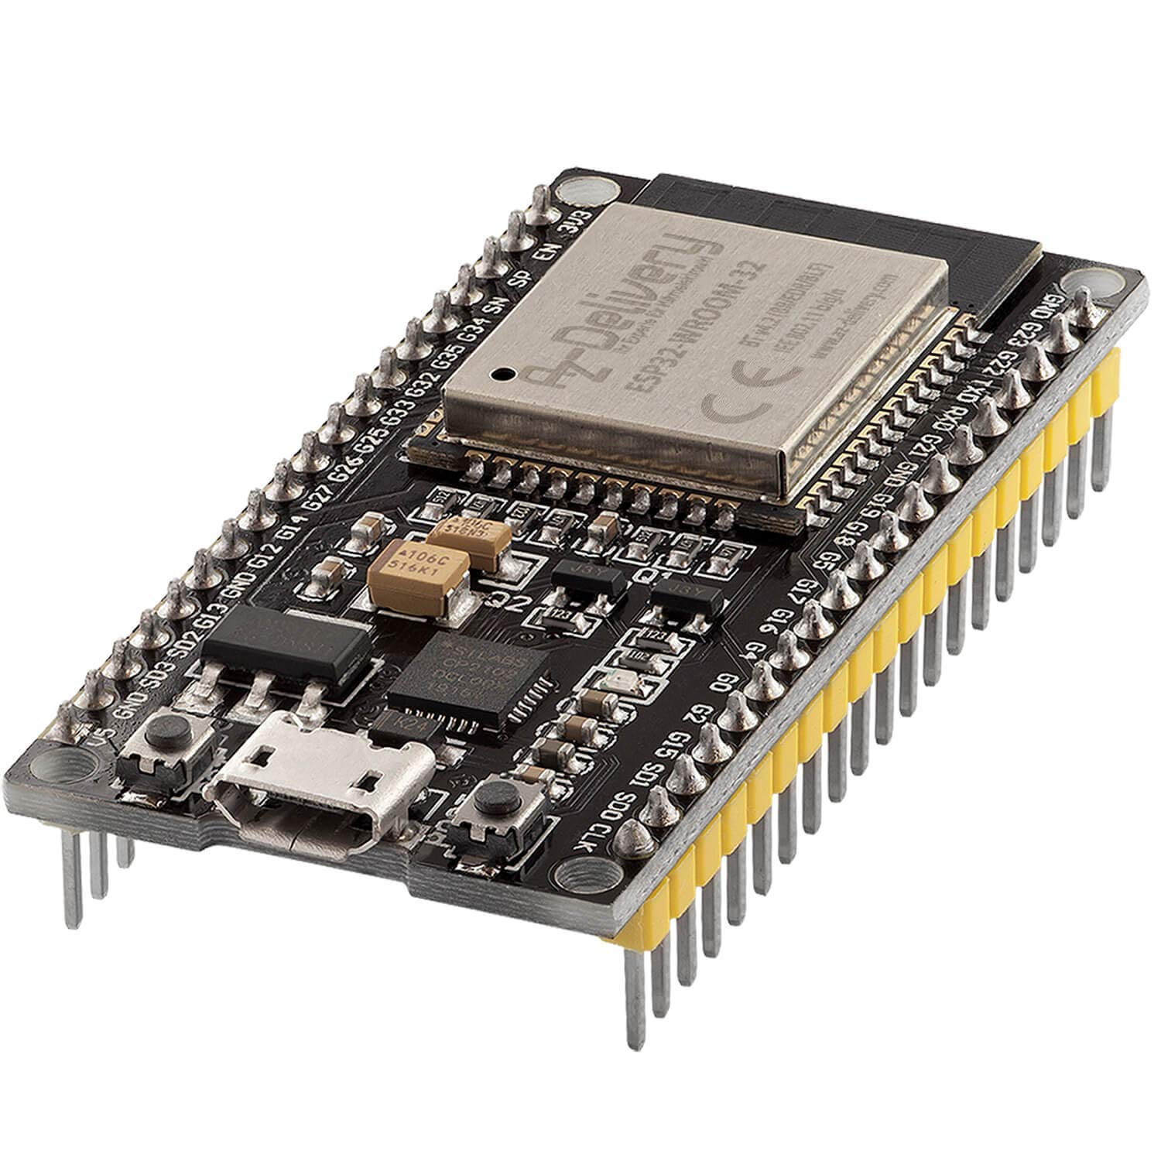
Engineering Tools
github
VScode
PlatformIO
ESP32

Slide 3
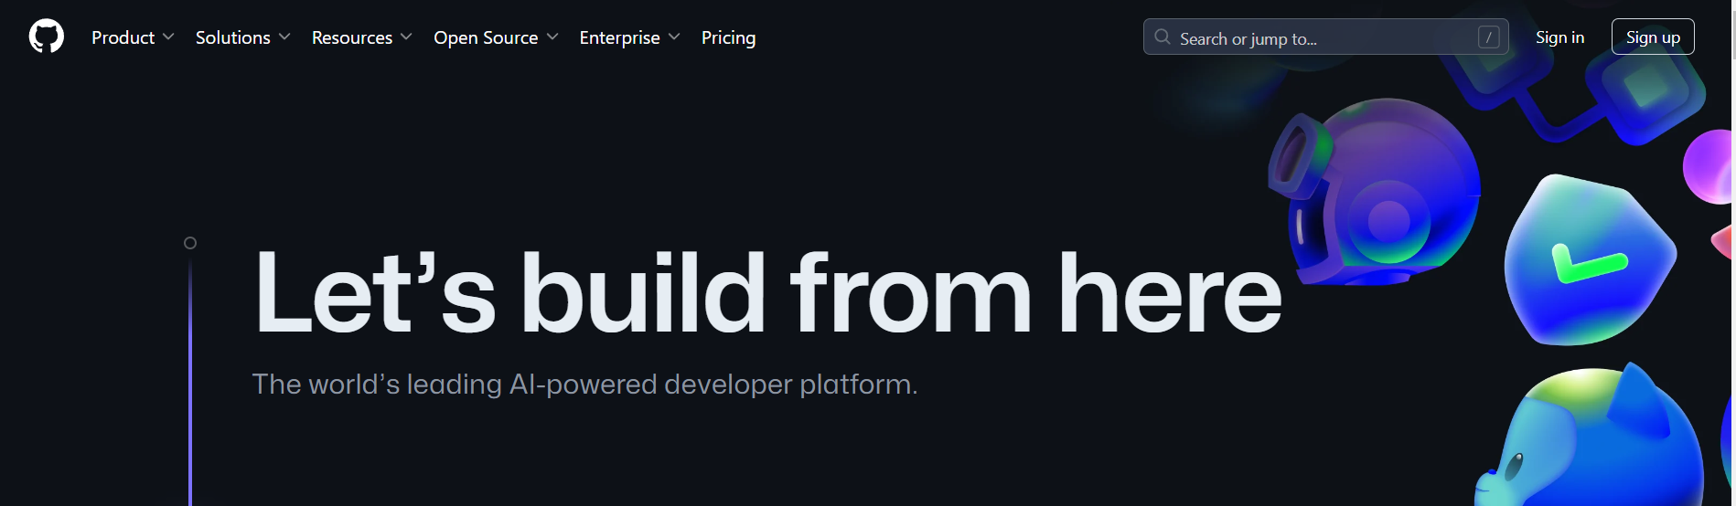
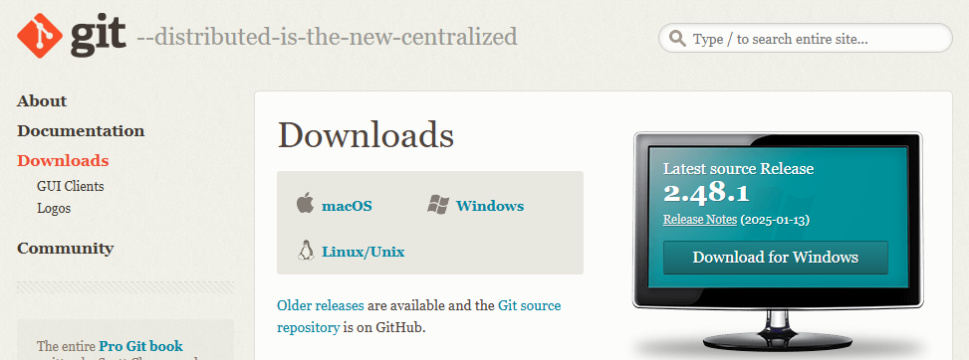
GitHub account
https://github.com/
Git for Windows/Mac
https://git-scm.com/downloads

Slide 4
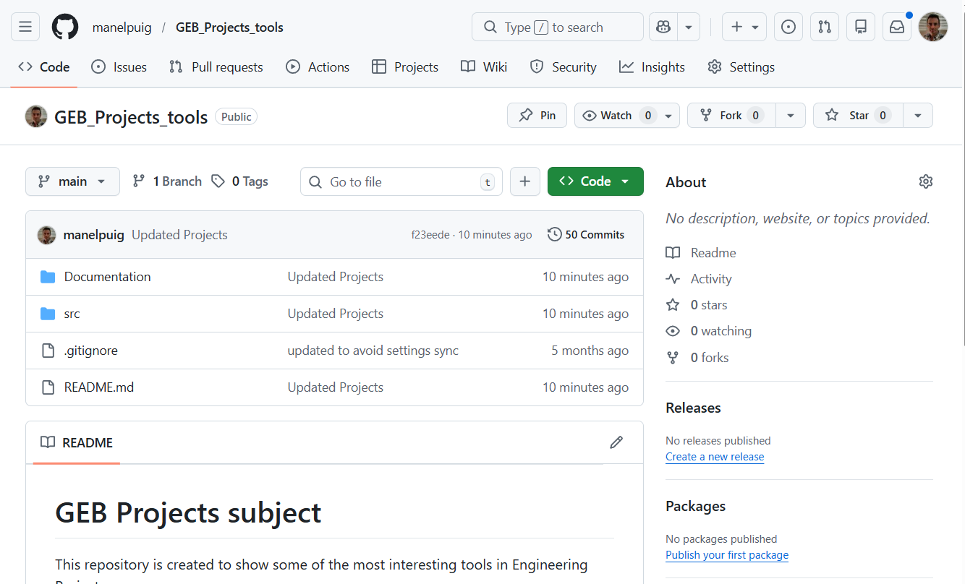
Fork my repository to your github account:
https://github.com/manelpuig/GEB_Projects_tools.git

Slide 5
ESP32

Slide 6
ESP32
The ESP32 is a popular and versatile microcontroller development board that is widely used for various Internet of Things (IoT) applications.
Some key features of the ESP32 board include:
Dual-Core Processor:
  Xtensa LX6 Microprocessor
  High processing power (up to 240 MHz clock speed)
Integrated Wi-Fi (802.11 b/g/n):
  2.4 GHz frequency band.
  Supports various Wi-Fi modes
    Station,
    Access Point,
    Station+AP.
  Enables perfect internet connectivity.
  3. Integrated Bluetooth (v4.2 BR/EDR and BLE):
    Bluetooth Classic and Bluetooth Low Energy support.
    Suitable for short-range communication and IoT applications.

Slide 7
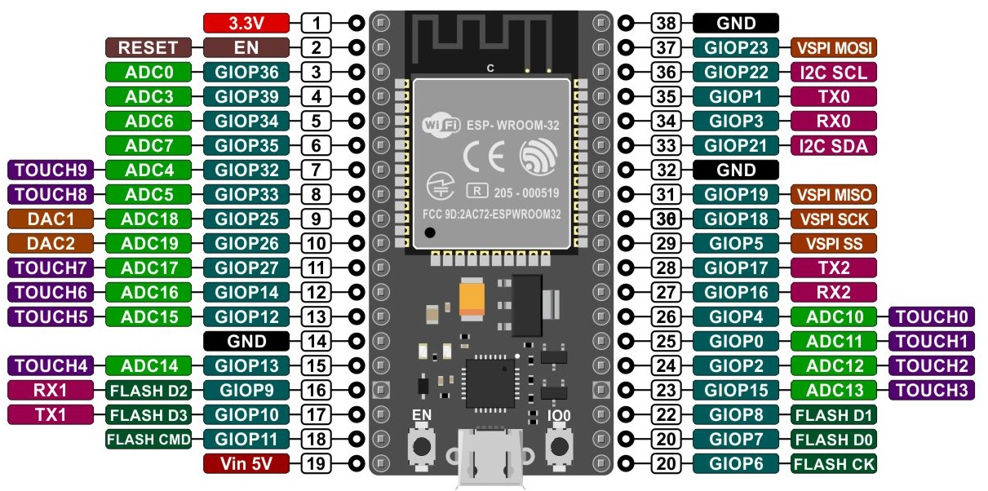
ESP32
Integrated Peripherals:
  ADC (Analog-to-Digital Converter), DAC (Digital-to-Analog Converter).
  I2C (Inter-Integrated Circuit), SPI (Serial Peripheral Interface), UART (Universal Asynchronous Receiver-Transmitter) communication interfaces.
  PWM (Pulse Width Modulation), Timers, Capacitive Touch Sensors.
  GPIO (General Purpose Input/Output) pins for versatile interfacing.
Memory:
  SRAM (working memory): 520KB
  Flash memory (for storing the program code and data): 4MB, 8MB or 16MB

Slide 8
ESP32
https://docs.espressif.com/projects/arduino-esp32/en/latest/installing.html
Low Power Consumption:
  making it suitable for battery-powered applications.
Rich Development Ecosystem:
  Well-supported by Espressif's ESP-IDF (IoT Development Framework).
  Arduino IDE compatibility for easier programming.
  Large community and extensive documentation.
Cost-Effective:
  Relatively low cost makes it accessible for hobbyists and professionals.

Slide 9
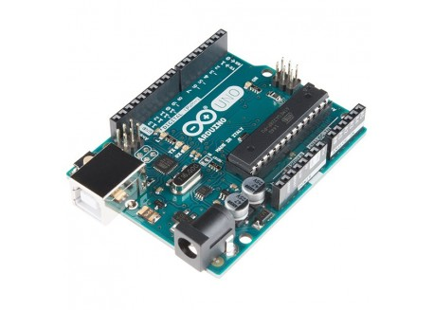
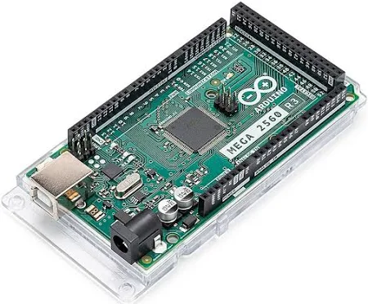
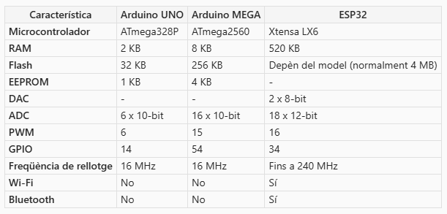

Slide 10
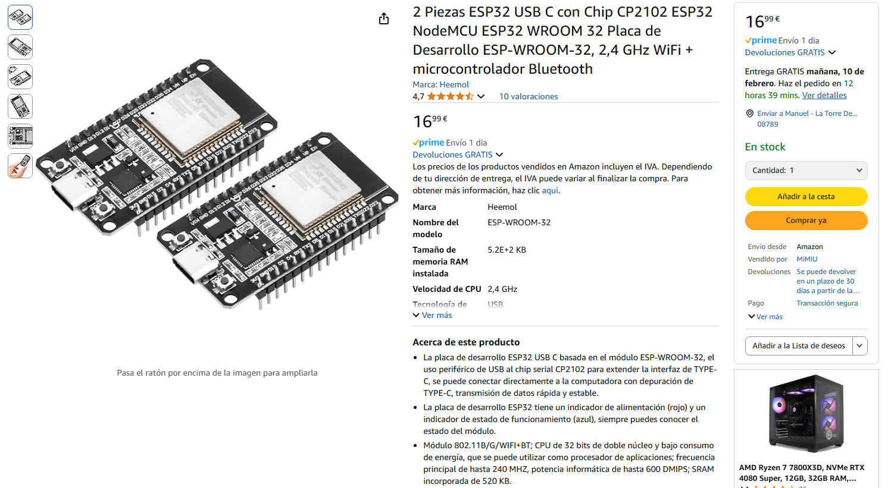
Low cost!
https://www.amazon.es/gp/product/B0D4QZ9CKD

Slide 11
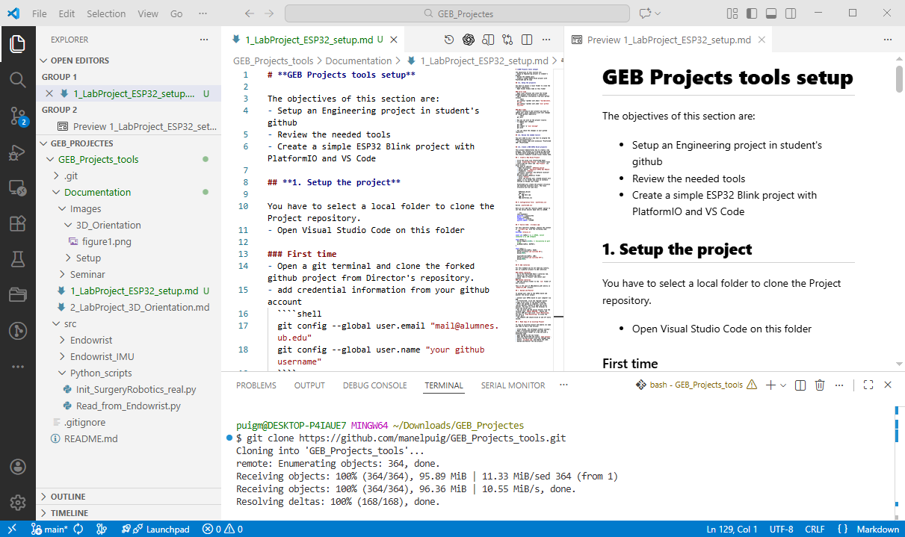
ESP32 projects within VScode
Clone your forked Repository using a VScode terminal:
git clone https://github.com/your_user/GEB_Projects_tolos.git
Important: Be sure you are using a Git bash terminal!
Make This terminal the default terminal for This project
In VScode, Open your cloned folder

Slide 12
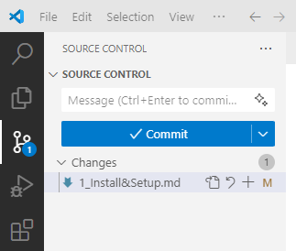
ESP32 projects within VScode
You will be able to work with Vscode for:
  ESP32 programming
  Python code execution
Once you have finished, you syncronize the changes in your github
Select “Source control” in left lateral menu bar
  Press Add to synchronize all the changes
  Add a commit comment
  Push the changes
the first time you will be asked to link the repository to your github account:
Open a terminal in and type the first time:
  git config --global user.email "mail@alumnes.ub.edu"
  git config --global user.name "your github username"
for succesive times, you only need to select changes, Commit message and Push

Slide 13
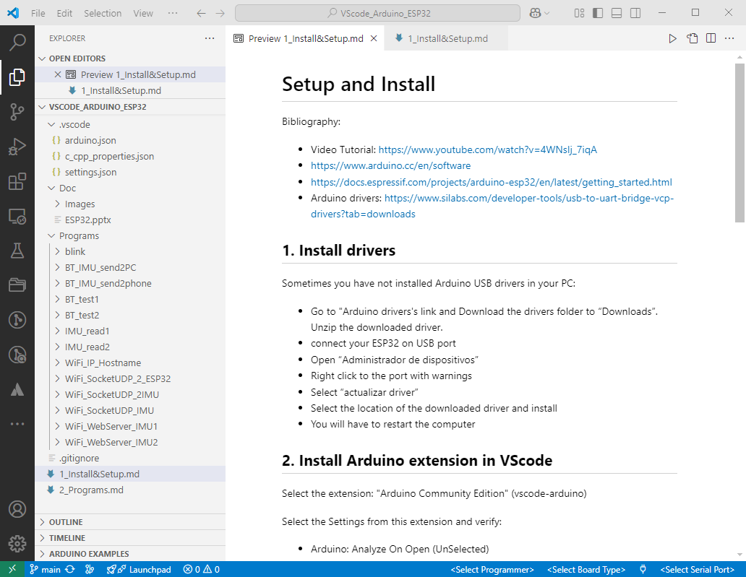

Slide 14
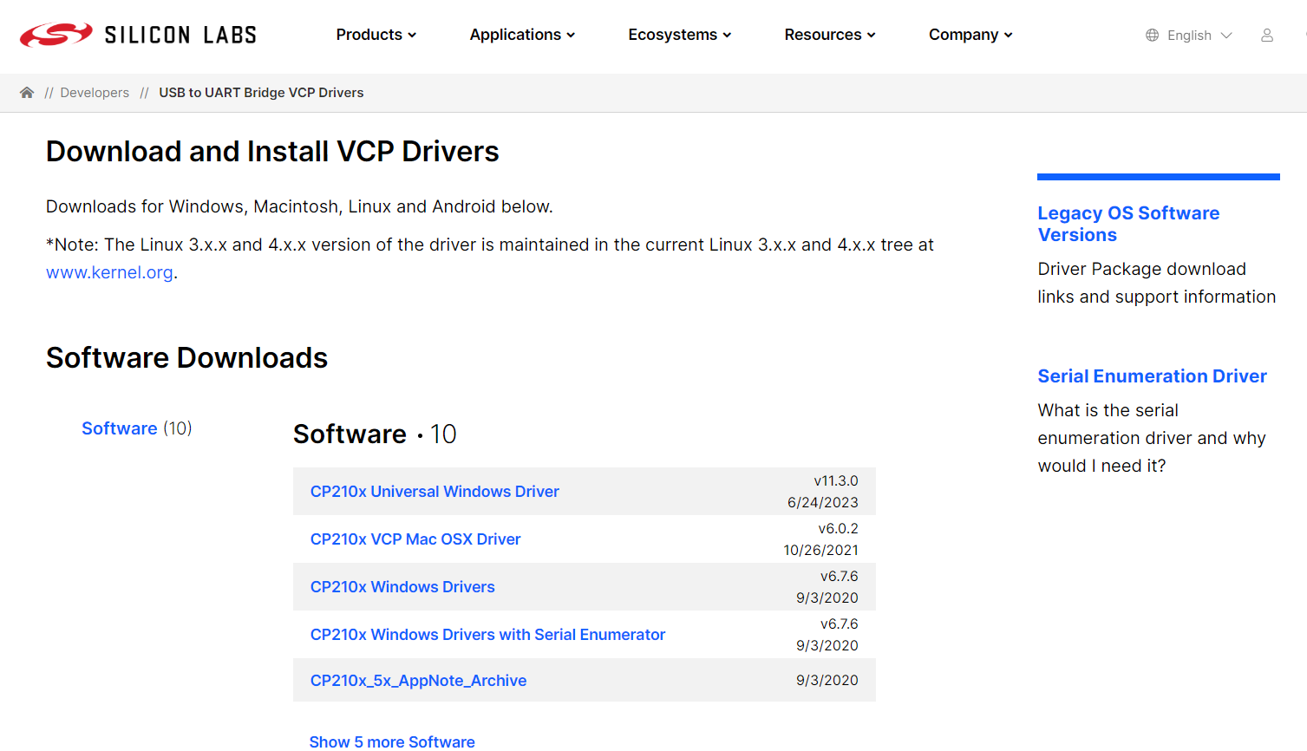
Install drivers ports ESP32: CP210x Universal Windows Driver
https://www.silabs.com/developers/usb-to-uart-bridge-vcp-drivers?tab=downloads

Slide 15
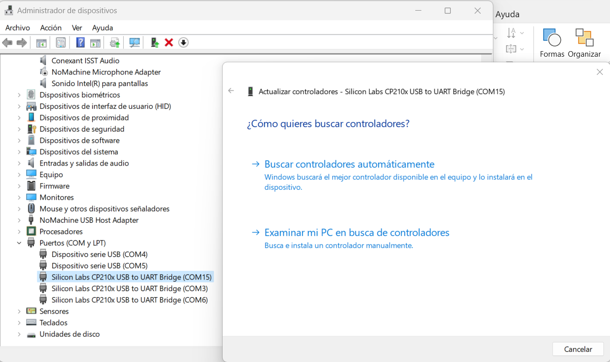
Download the driver folder to “Descargas”. Unzip downloaded driver
Open “Administrador de dispositivos”
Right click to the port with warnings
Select “actualizar controlador” → select location of downloaded driver and install
You will have to restart the computer

Slide 16
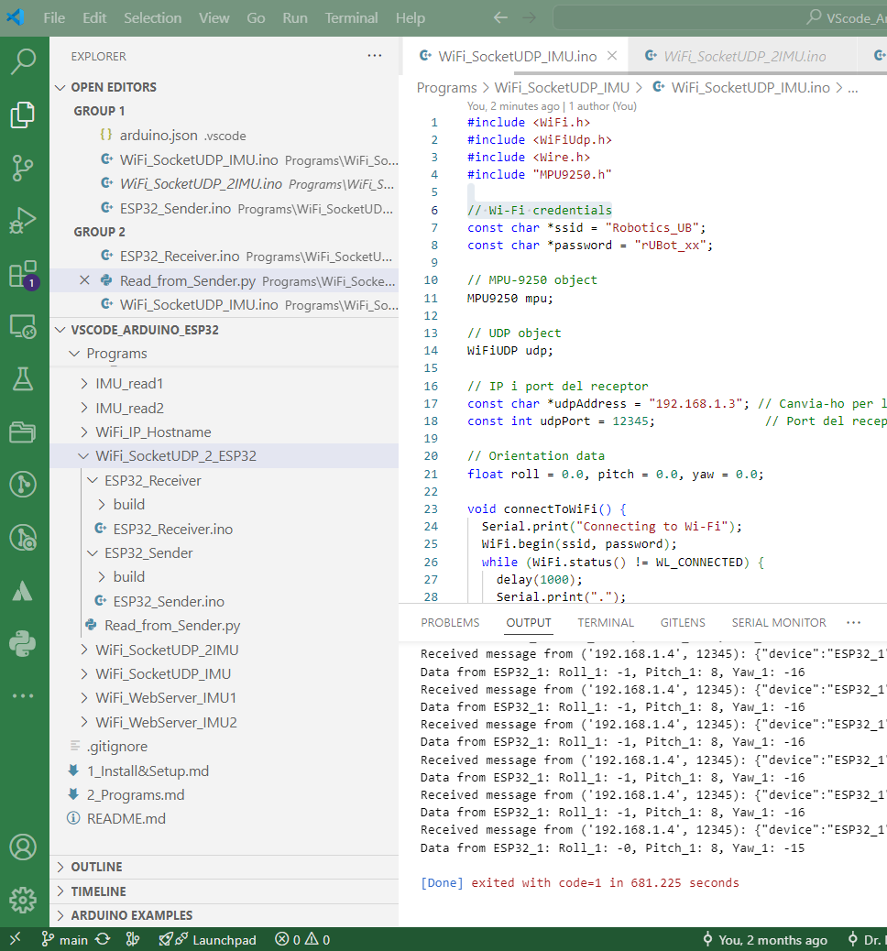
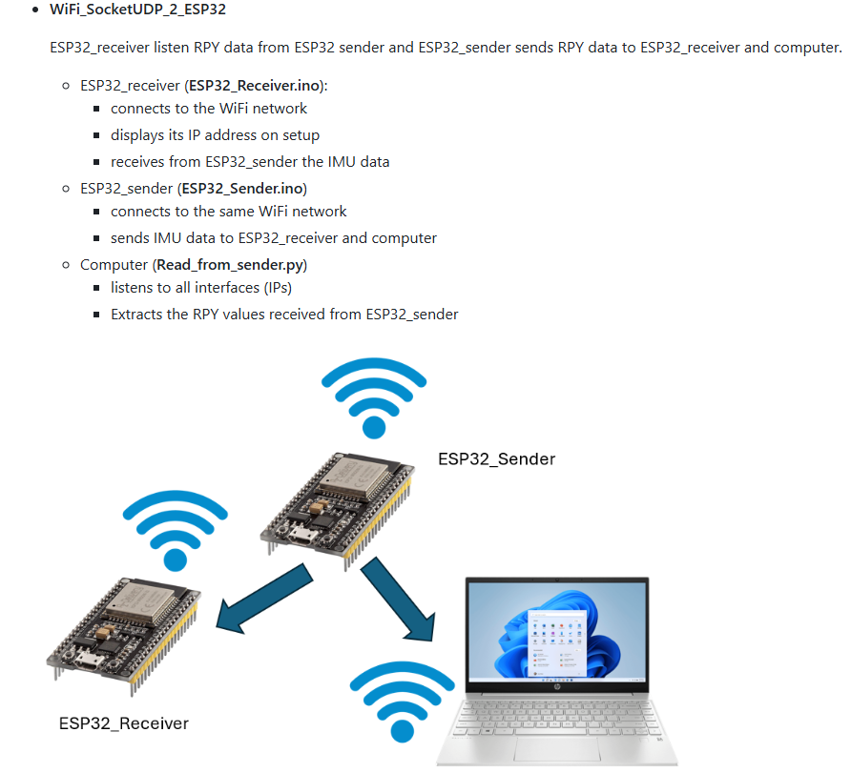

Slide 17
Use the sample code in function of your application!
Home work:
Make all the installations
Test the code with 2 ESP32 simples
In your Project:
  Implement a github repository
  Use ESP32 microprocessor
  Use the Engineering tols you have learned

