Slide 1
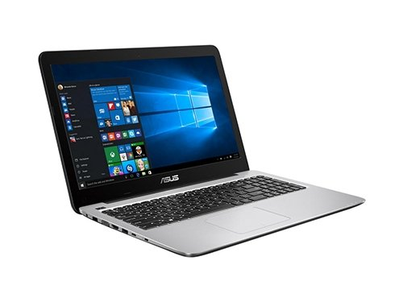
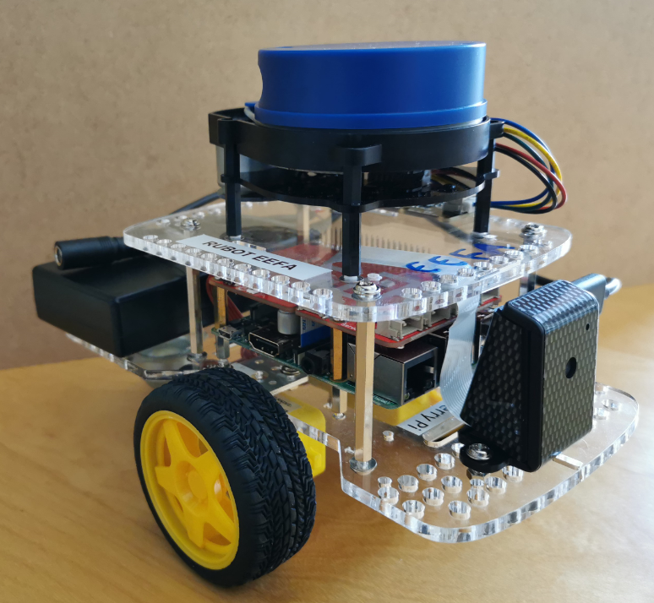
ROS Master
IP: 192.168.4.xx
IP: 192.168.4.1
Gopigo3
Lidar
raspicam
Slam
Navigation
Follow route

Slide 2
/raspicam/image_raw
/raspicam_node
sensor_msgs/Image
/scan
/rplidarNode
sensor_msgs/LaserScan
Node
/cmd_vel
/rUBot_nav
/gopigo3
geometry_msgs/Twist
/odom
nav_msgs/Odometry

Slide 3
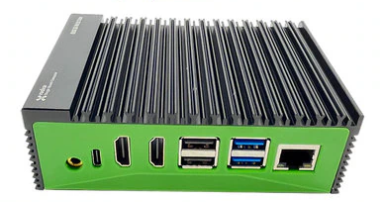
/gopigo/camera1/image_raw
sensor_msgs/Image
/scan
sensor_msgs/LaserScan
Node
Node
/cmd_vel
/rUBot_nav
/gazebo
geometry_msgs/Twist
/odom
nav_msgs/Odometry

Slide 4

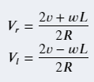
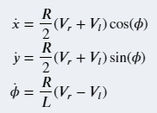
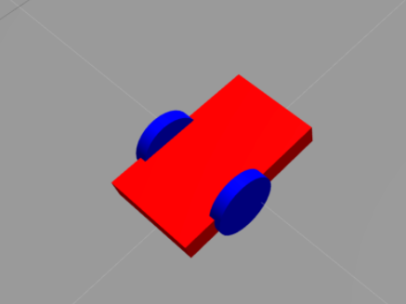
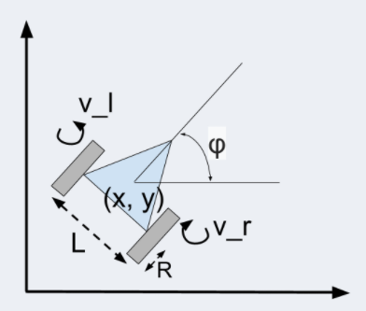

Slide 5
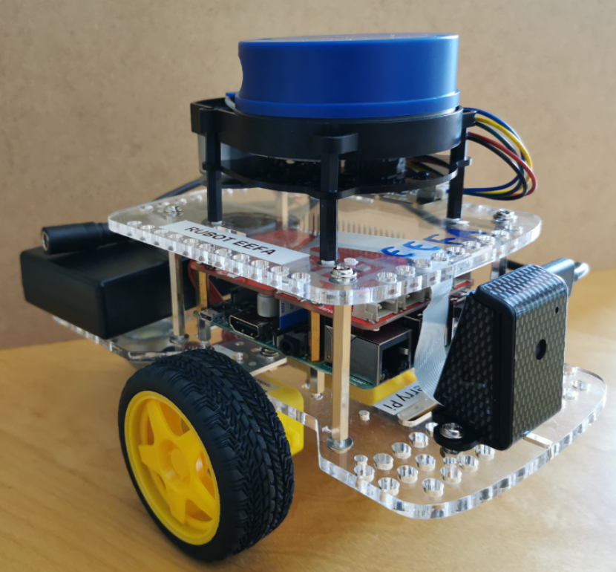
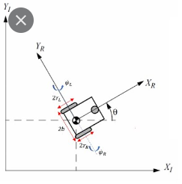
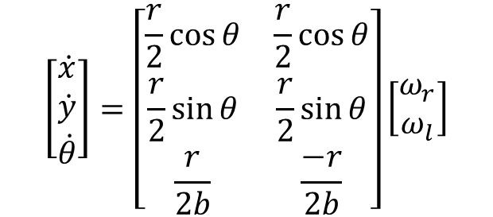
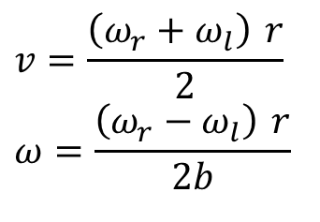
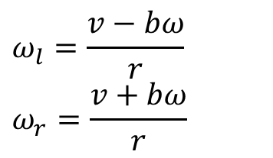
Forward and inverse kinematics
Differential drive robot
Forward kinematics:
$$\left[\begin{matrix}\dot{x} \\ \dot{y} \\ \dot{θ}\end{matrix}\right]=\left[\begin{matrix}\frac{r}{2}\cos{θ} & \frac{r}{2}\cos{θ} \\ \frac{r}{2}\sin{θ} & \frac{r}{2}\sin{θ} \\ \frac{r}{2b} & \frac{−r}{2b}\end{matrix}\right]\left[\begin{matrix}ω_{r} \\ ω_{l}\end{matrix}\right]$$
Inverse kinematics:
$$v=\frac{\left(ω_{r}+ω_{l}\right) r}{2} \\ ω=\frac{\left(ω_{r}−ω_{l}\right) r}{2b}$$
$$ω_{l}=\frac{v−bω}{r} \\ ω_{r}=\frac{v+bω}{r}$$

Slide 6
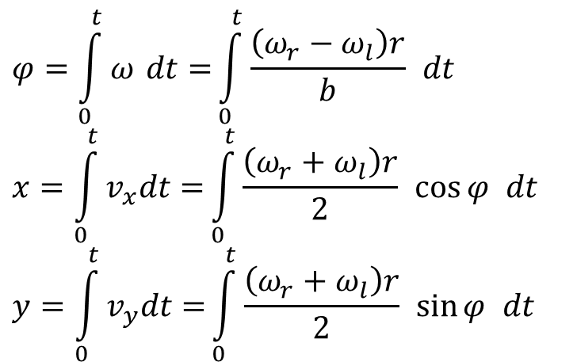
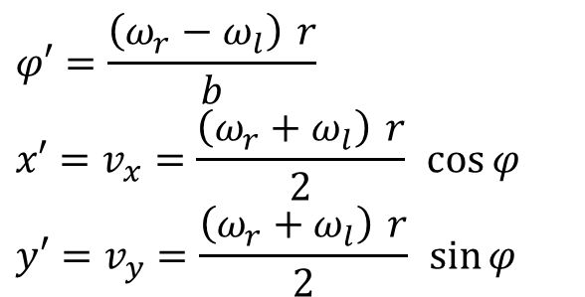
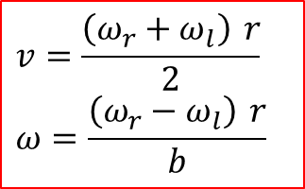
Forward Kinematics: Trajectory representation
$$φ=\int_{0}^{t}{ω dt=}\int_{0}^{t}{\frac{\left(ω_{r}−ω_{l}\right)r}{b} dt} \\ x=\int_{0}^{t}{v_{x}dt=}\int_{0}^{t}{\frac{\left(ω_{r}+ω_{l}\right)r}{2} \cos{φ} dt} \\ y=\int_{0}^{t}{v_{y}dt=}\int_{0}^{t}{\frac{\left(ω_{r}+ω_{l}\right)r}{2} \sin{φ} dt}$$
v
ωl
φο
yo
R
ωr
ω
$$v=\frac{\left(ω_{r}+ω_{l}\right) r}{2} \\ ω=\frac{\left(ω_{r}−ω_{l}\right) r}{b}$$
xo
$$φ′=\frac{\left(ω_{r}−ω_{l}\right) r}{b} \\ x′=v_{x}=\frac{\left(ω_{r}+ω_{l}\right) r}{2} \cos{φ} \\ y′=v_{y}=\frac{\left(ω_{r}+ω_{l}\right) r}{2} \sin{φ}$$

Slide 7
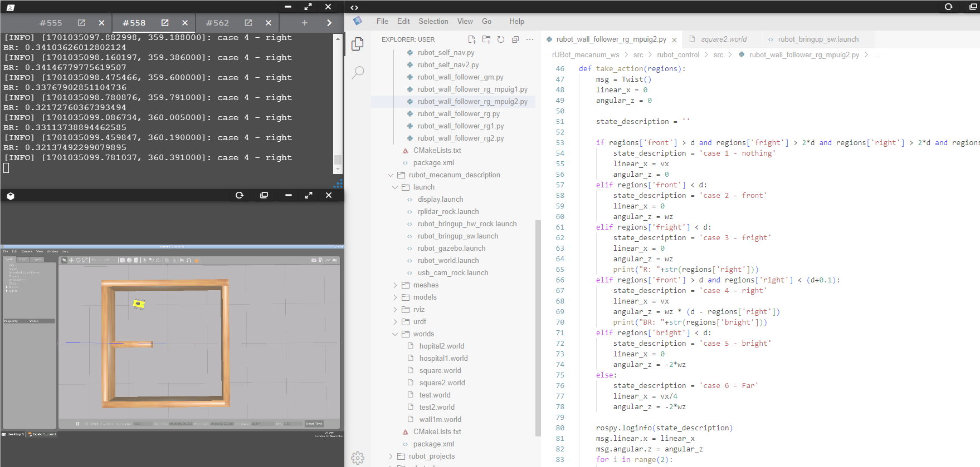
front
fright
right
bright

