Slide 1

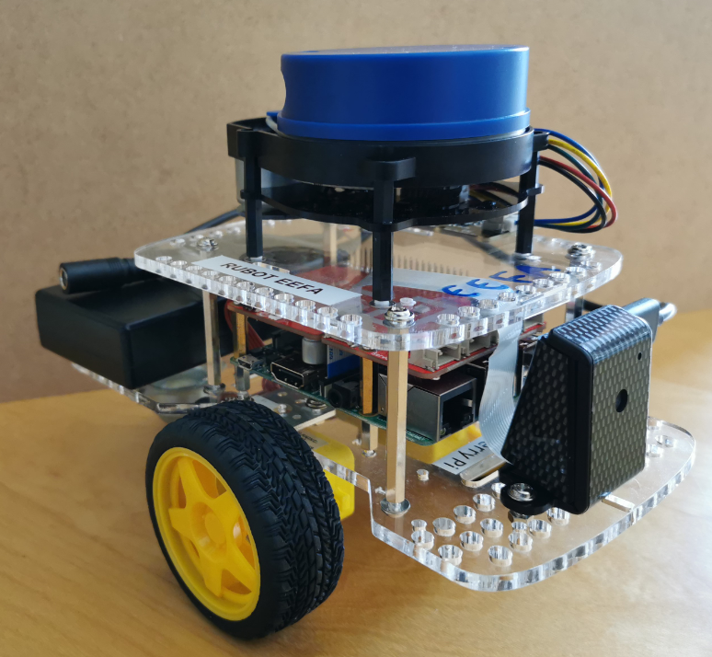
ROS Master
IP: 192.168.4.xx
IP: 192.168.4.1
Gopigo3
Lidar
raspicam
Slam
Navigation
Follow route

