Slide 1
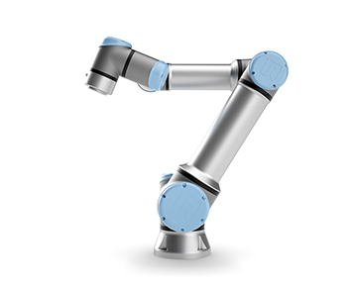

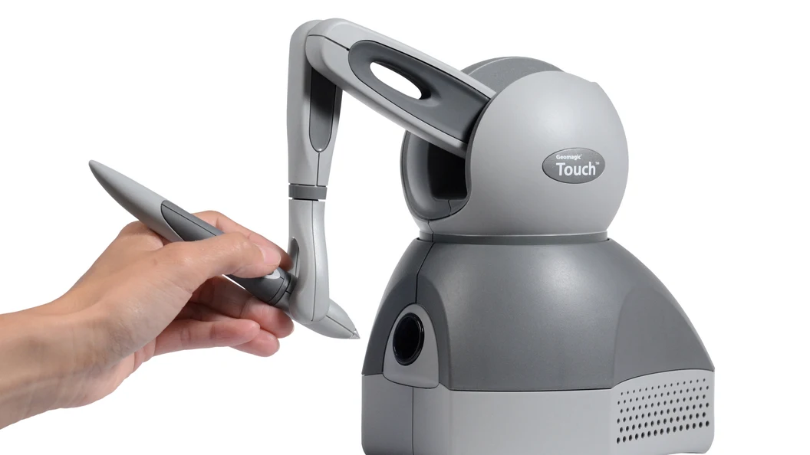
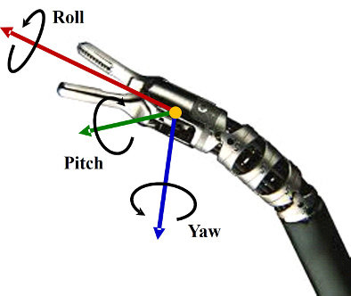
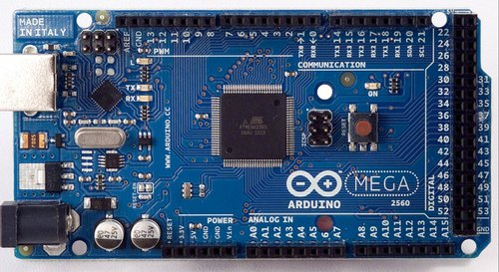
(x,y,z)
Y
P
roscore
Node
R
R,P,W
Node
/ur5e
/omni_pose
x,y,z
/haptic
geometry_msgs/PoseStamped
/arduino
Node
R,P,W
/force
geometry_msgs/OmniFeedback

Slide 2
Node
/omni_pose
/haptic
geometry_msgs/PoseStamped
/force
geometry_msgs/OmniFeedback

Slide 3
Node
/omni_pose (x,y,z,R,P,Y)
/arduino
geometry_msgs/PoseStamped
/force (f_{R},f_{P},f_{Y})
(x,y,z)
Y
geometry_msgs/OmniFeedback
P
R

