Slide 1


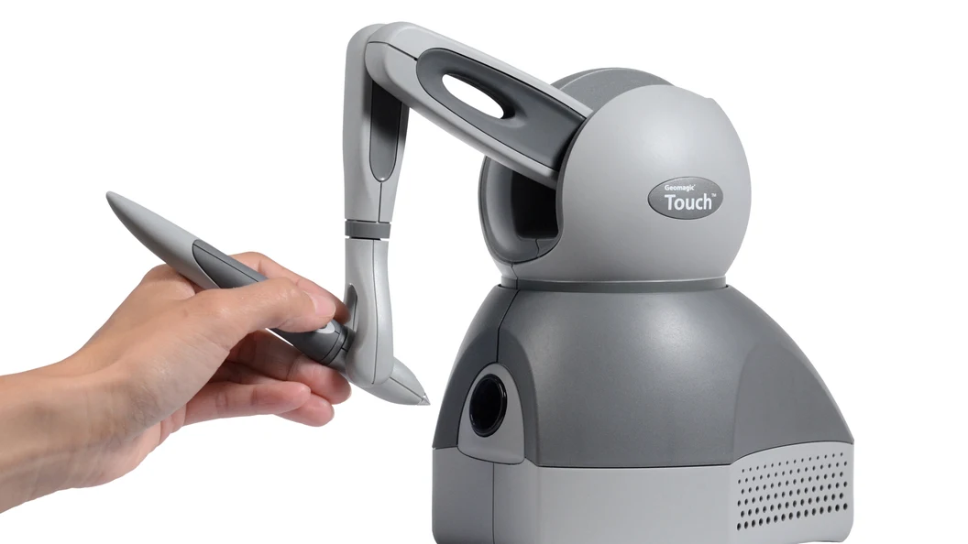
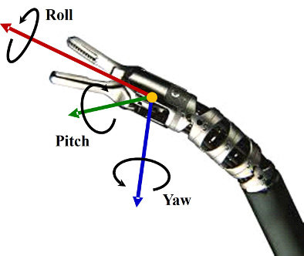
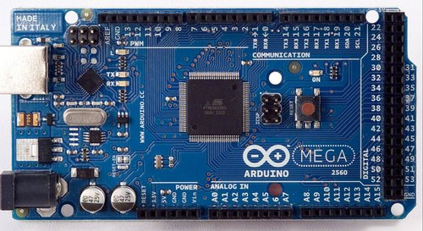
(x,y,z)
Y
P
roscore
Node
R
/pose
/haptic
/arduino
geometry_msgs/PoseStamped
Node
/force
geometry_msgs/OmniFeedback

Slide 2
Node
/pose
/haptic
geometry_msgs/PoseStamped
/force
geometry_msgs/OmniFeedback

Slide 3
Node
/pose (x,y,z,R,P,Y)
/arduino
geometry_msgs/PoseStamped
/force (f_{R},f_{P},f_{Y})
(x,y,z)
Y
geometry_msgs/OmniFeedback
P
R

