Slide 1
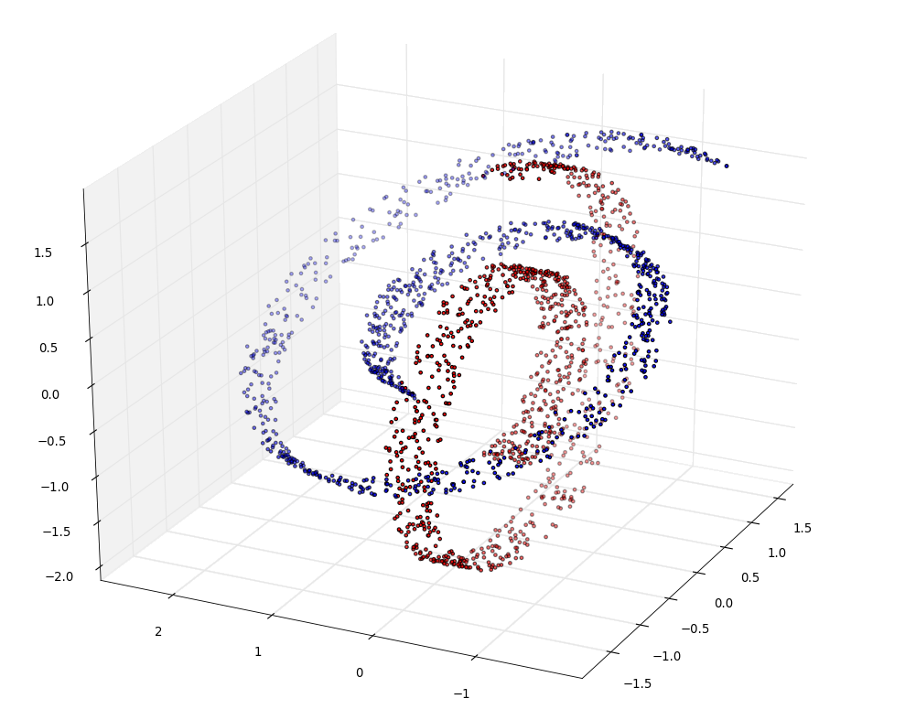
Python in a Nutshell
By Manel Velasco and Alexandre Perera
{manel.velasco,aperera}@gmail.com
Programa de Doctorat,
Universitat de Barcelona
Febrer 2013
Part 0: Presentation
Part I. Python, ipython, language and OOP
Part II: NumPy and MatplotlibPart III: Introduction to SciPy and SimPyPart IV: Scikits and sklearn

