Slide 1



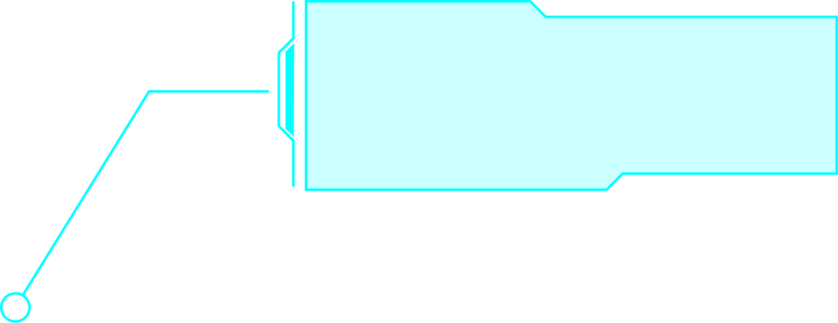
RTS
ASSIGNEMENT

Slide 2
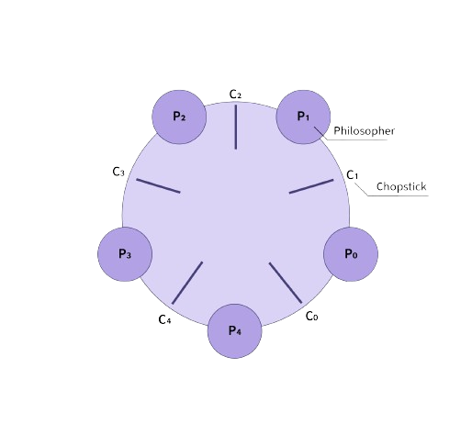
DINING PHILOSOPHER PROBLEM
Five philosophers sit at a round table.
Each has a plate of food and a fork on either side.
Objective: Philosophers alternate between thinking and eating.
Constraint: A philosopher needs both forks (left and right) to eat.

Slide 3

Mutual Exclusion: Only one philosopher can use a fork at a time.
Deadlock: Occurs when all philosophers pick up their left fork simultaneously.
Starvation: Some philosophers might never get a chance to eat if others monopolize the forks.
CHALLENGES

Slide 4




CONCEPTUAL REPRESENTATION
Philosophers
Forks
Philosopher state
P1
P2
P3
P4
P5
F1
F2
F3
F4
F5
Thinking
Hungry
Eating

Slide 5
SEMAPHORES?

Slide 6
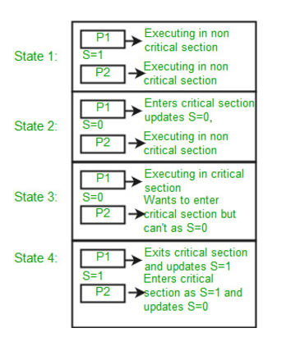
Semaphores are a tool used in computer science to help manage how different processes (or programs) share resources
Semaphores are just normal variables used to coordinate the activities of multiple processes in a computer system.
They are used to enforce mutual exclusion, avoid race conditions, and implement synchronization between processes.

Slide 7
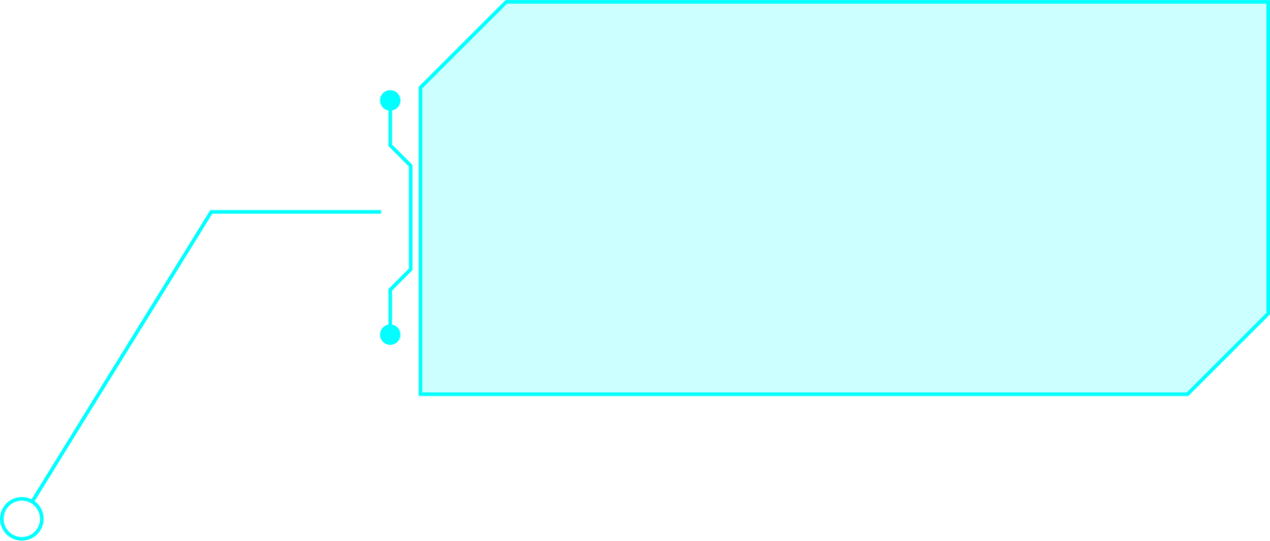
HOW CODE WORKS
SEMAPHHORE VARIABLES
HOW IT WORKS
Each fork is represented by a semaphore.
If there are 5 philosophers, there are 5 semaphore variables: S[0], S[1], ..., S[4].
Each semaphore is initialized to 1, representing that the fork is available.
When a philosopher wants to eat, they:
Perform wait(S[i]) on their left fork.
Perform wait(S[(i+1) % 5]) on their right fork.
After eating, they:
Perform signal(S[i]) to release the left fork.
Perform signal(S[(i+1) % N]) to release the right fork.

Slide 8
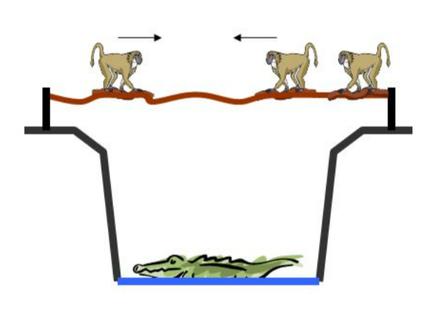
BABOON PROBLEM
Baboons can cross the canyon by swinging hand-over-hand on the rope, but if two baboons going in
opposite directions meet in the middle, they will fight and drop to their deaths.
Furthermore, the rope is only strong enough to hold 5 baboons. If there are
more baboons on the rope at the same time, it will break.

Slide 9
if two baboon cross in opposite direction it can be a deadlock
CHALLENGES

Slide 10
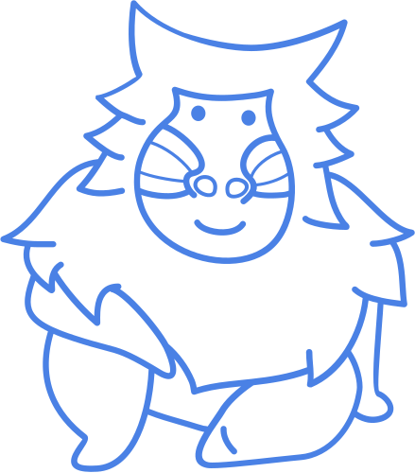
CONSTRAINT
SIMULATION PROCESS:
The program uses variables to track the number of baboons on the rope and their direction.
Left and right crossing functions handle each baboon, ensuring they wait if the rope is at capacity.
A randomized order of baboons simulates real-world unpredictability.
The rope holds a maximum of 5 baboons at a time.
Baboons cannot move in opposite directions simultaneously.
No group (left or right) is starved indefinitely from crossing.

Slide 11
EXECUTION FLOW:
OUTCOME
Input the number of baboons from the left and right.
A random selection determines which baboon crosses next.
Crossing is simulated with print statements indicating whether a baboon is crossing or waiting.
Maximum rope capacity is respected.
Each baboon safely completes the crossing.
The problem's constraints are visually represented.

Slide 12


LIMITED TICKETS ON SALE
AConstraints:
Only one customer can interact with the counter at any moment (use a mutex-like approach to simulate mutual exclusion).
Tickets should not be oversold (use a semaphore-like concept to track remaining tickets).
Objective: Simulate a real-time ticket booking scenario, ensuring no race conditions and proper handling of the ticket count.

Slide 13
SCENARIO:
A small event with a limited number of tickets (e.g., 10 tickets) is sold through a single booking counter. Customers randomly arrive and book tickets one at a time. If tickets are sold out, the customers are informed.

Slide 14
HOW CODE WORKS
This problem models a real-time ticket booking scenario with limited availability, solved using simulated mutex and semaphore mechanisms.
Simulation of Mutex: A flag (isCounterAvailable) ensures only one customer interacts with the counter at a time.
Limited Tickets: A counter tracks available tickets, simulating a semaphore to prevent overselling.
Customer Arrival: Customers arrive randomly (rand()), try booking tickets, and handle "sold-out" conditions.
Dynamic Process: The system locks/unlocks the counter per booking and stops when all tickets are sold.

Slide 15
THANK YOU
manel ben hassine

