Slide 1
Interpreting RL Trading Agent
Visualization Infrastructure for RL-based Trading Strategies
Hariom Tatsat & Bryan Yekelchik

Slide 2
Agenda
Machine Learning for Trading
Reinforcement Learning for Trading
Need for interpretability
Interpretability approaches
Interpretability and Reinforcement Learning
Visual approach
Demo
Takeaways
Future ideas/work

Slide 3
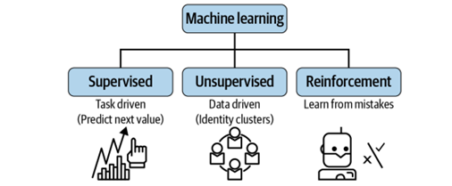
Machine Learning for Trading
Supervised Learning:
Predict price or if price will go up/down → use for trading strategy
Unsupervised Learning:
Reduce dimension or perform clustering while building a trading strategy
Reinforcement Learning:
“Trading-bots” making trading decision of their own
Notes:
Hariom

Slide 4
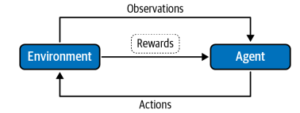
Reinforcement Learning for Trading
RL Components:
Pros:
No need to specify any rules or “strategy”
Cons:
Lack of interpretability
Data requirement
RL Components in Trading:
Agent: Trading agent
Action: Buy, sell, or hold
Reward function:
PnL
Sharpe Ratio
State:
Stock Prices
Volume
Sentiments
Environment: Stock exchange or the stock market
Notes:
Hariom

Slide 5
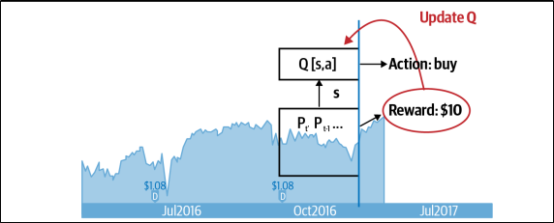
Reinforcement Learning for Trading
Training - Deep Q-Learning based
Steps:
Get the state
Perform action
Get the reward
Update Q-table
Notes:
Hariom

Slide 6
Need for interpretability
Significant amount of monetary and reputation risk in finance
A small model error can lead to big events (i.e. flash crash, subprime crisis)
Black-Box models inherently difficult to “sell” to investors.
Challenging to optimize without transparency in the model.
Notes:
Hariom

Slide 7
Interpretability approaches
Data exploration and visual approach
Scatter plots, correlation plots
Feature importance
Quantitative approach - “contribution of each feature has in the model.”
SHAP
LIME
Global surrogate
Notes:
Bryan

Slide 8
Interpretability and Reinforcement Learning
Why interpretability is so difficult in RL
Knowing where to extract data for interpretation
Computationally taxing training
Data changes as the agent interacts with its environment
Goal: Visualization aspect of Interpretability
Notes:
Bryan - Make in

Slide 9
Approach
Q-Value Extraction
Training and testing
Three Module Visualization Approach
Inter-Episode
Intra-Episode
Testing
Tech Stack:
Backend and Algorithm: Python
Front End: Dash Framework (Python)
DB: BigQuery
GPU: Google Collab
Notes:
Hariom

Slide 10
Module Structure
RLInterp
Testing
Training
Intra-Episode
Inter-Episode
BigQuery and Google Collab Connection

Slide 11
Case Study
Traded Security: VOO between 2017 Q1 - 2018 Q4
Features:
Price & Volume Change
Hyperparameters Explored:
Gamma
NN Layers
Episodes
Batch Size
Problem Statement: Can we use heatmaps of features vs trading decisions to derive interpretation?
Notes:
Bryan - Using heatmap/

Slide 12

Demo
Notes:
Bryan

Slide 13
Takeaways
RL outcomes are very sensitive to # of layers in DNN
One layer increase resulted in all ‘sell’ decisions
Visual interpretation allows for easy confirmation of:
Desired trading strats (Does the algo indeed “buy low, sell high”?)
Intended effects of the HP changes
Visualization infrastructure tool for RL-Based trading
Sensitivity of HP to trading decisions
Notes:
Hariom?

Slide 14
Further Work
Online model tuning
Incorporation of more features
Technical indicators (RSI, MACD, etc.)
Sentiment data via NLP → NLP/RL integration
Quantitative Approach
How does the DNN effect the estimated Q-value?
Interpretation of DNN in the context of Q-values
Notes:
Bryan

Slide 15
Thank You

Slide 16
About US
Hariom Tatsat
VP, Quantitative Analytics, Barclays, NY
Co-Author “Machine Learning and Data Science Blueprints for Finance”
UC Berkeley, M.S. Financial Engineering
Contact Info:
https://www.linkedin.com/in/hariomtatsat/
hariom_tatsat@mfe.berkeley.edu
Bryan Yekelchik
Lehigh ‘22, M.S. Financial Engineering
Bucknell, B.S. Mathematical Economics
Incoming Data Scientist @ BASF (FRA:BAS)
Contact Info:
https://www.linkedin.com/in/bryan-yekelchik/
Biy320@Lehigh.edu
Zach Coriarty
Lehigh ‘22, B.S. Computer Science and Business
Contact Info:
https://www.linkedin.com/in/zachary-coriarty/
zac222@Lehigh.edu

