Slide 1

Data Analysis
Portfolio Project Challenge
Presented By – Prerana Mane

Slide 2
📌 Problem Statement
Lung cancer is one of the leading causes of mortality worldwide, and early detection plays a crucial role in improving survival rates. However, identifying high-risk patients and understanding key contributing factors (such as smoking habits, passive smoking, and cancer stage) remain critical challenges.
This project aims to analyze a lung cancer dataset to uncover patterns in patient demographics, risk factors, and disease progression. By leveraging data analysis techniques, we seek to provide insights that can help in early detection, risk assessment, and potential prevention strategies all over world.

Slide 3
🎯 Objectives
✅ Analyzed the distribution of lung cancer stages across different patient groups. ✅ Identify key risk factors (e.g., smoking, passive smoking) associated with lung cancer severity. ✅ Find correlations between lifestyle factors and cancer stage using data visualization techniques. ✅ Use SQL, Power BI or Excel to transform raw data into meaningful insights. ✅ Provide actionable recommendations for healthcare professionals and policymakers to improve early detection efforts.

Slide 4
📊About Data
This project leverages two key datasets: ‘Lung Cancer Dataset’ conduct a comprehensive analysis of lung cancer risk, survival rates, and healthcare accessibility. These datasets contain 220633 rows and 24 columns, providing detailed insights into patient demographics, lifestyle factors, smoking habits, environmental exposures, medical diagnoses, treatment types, and country-level lung cancer statistics.
This dataset contains Country details, medical history, cancer diagnosis, and treatment progress. It helps in identifying risk factors and survival trends among lung cancer patients.

Slide 5
📊 Data Cleaning & Handling Missing Values
The dataset initially contained a significant number of missing values, particularly in two key columns:
Cancer Stage – Over 211,671 missing values out of 220,632, replaced with the placeholder "Unknown" to ensure consistency.
Treatment Type – Contained a large proportion of missing values, which were replaced with "No Treatment" to indicate patients who may not have received treatment or whose treatment data was unavailable.(213968)
Aside from these two columns, the dataset was harshly 1 or 2 null values otherwise clean with no additional missing values. This ensures that the analysis remains reliable and minimizes bias due to missing data

Slide 6
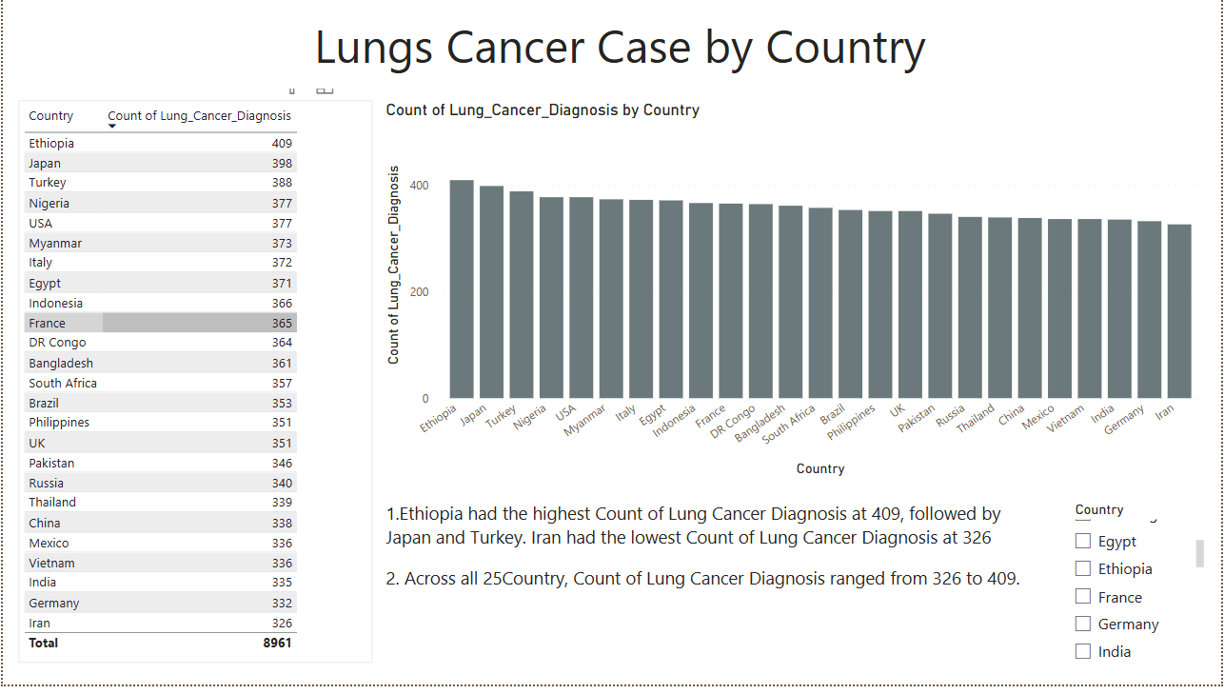
🔍 Key Insights
1. Lung Cancer Diagnosis by Country
1️. Ethiopia recorded the highest number of lung cancer diagnoses at 409 cases, followed by Japan and Turkey.
2️. Iran had the lowest number of lung cancer diagnoses at 326 cases.
3️. Along of 25 countries, the number of lung cancer diagnoses ranged between 326 and 409 cases, indicating a moderate variation in reported cases across different regions.

Slide 7
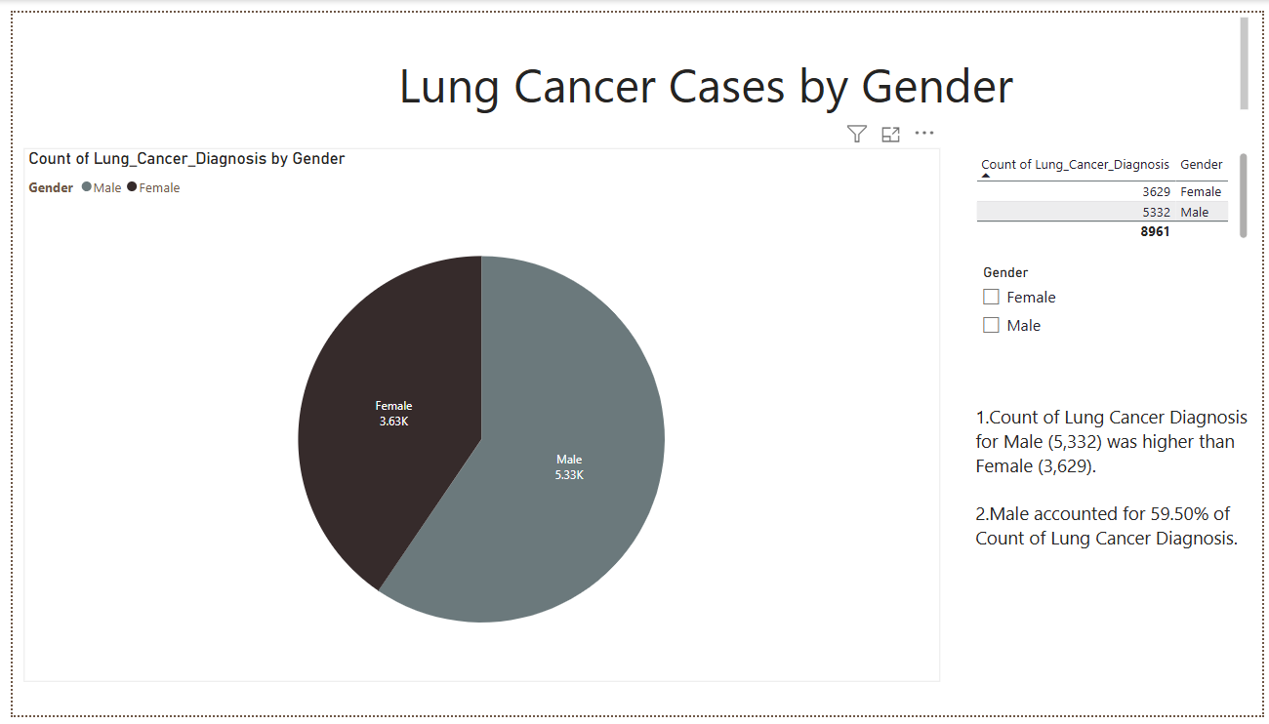
🔍 Key Insights
2.Lung Cancer Cases by Gender
1️. Higher Lung Cancer Cases in Males
Males (5,332 cases) had a higher count of lung cancer diagnoses compared to females (3,629 cases).
2️. Gender Distribution of Lung Cancer Cases
Males accounted for 59.5% of total lung cancer diagnoses, indicating a higher risk factor compared to females.

Slide 8
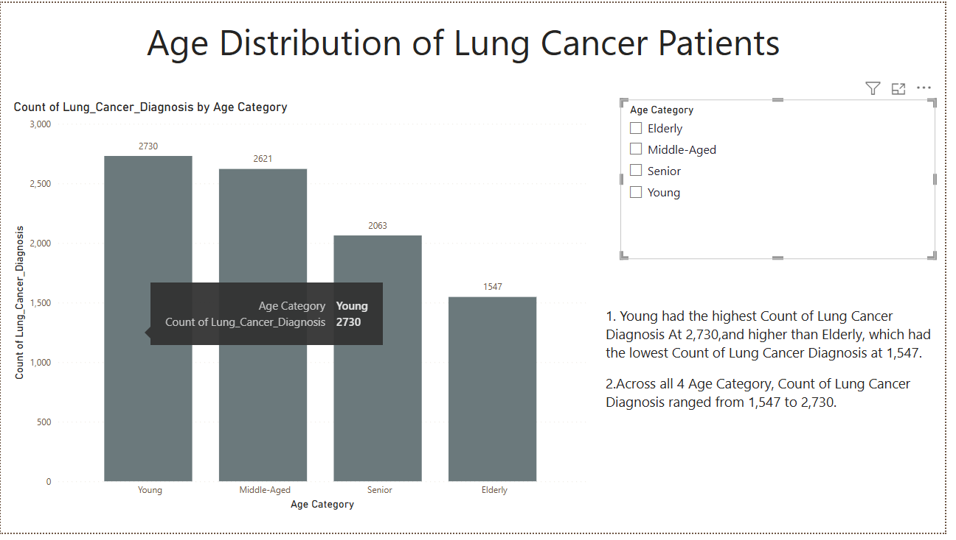
🔍 Key Insights
3. Age Distribution of Lung Cancer Patients
1.Across all four age categories (Young, Young Senior, Middle-Aged, Elderly), Young (2,730 cases) recorded the highest lung cancer diagnoses, indicating a rising trend in early-age cases.
2.Elderly had the lowest count (1,547 cases), possibly due to lower survival rates or fewer diagnoses.

Slide 9
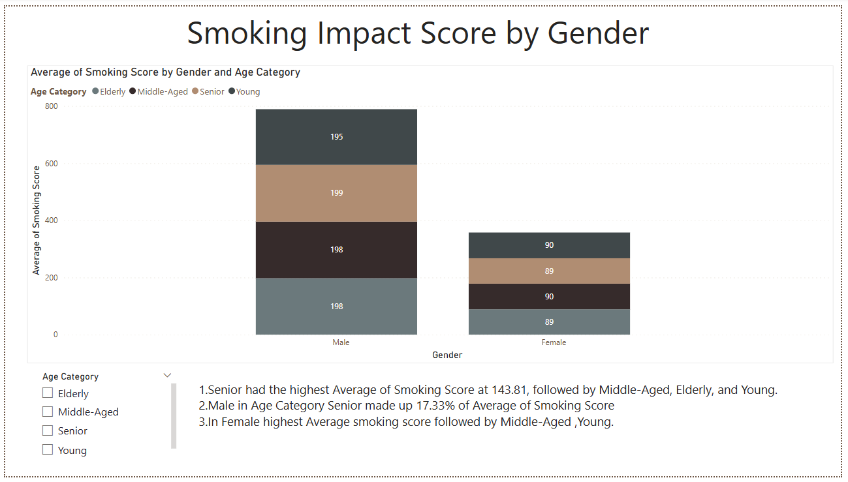
🔍 Key Insights
4.Smoking Impact Score By Gender
1.Seniors recorded the highest average smoking score (143.81), followed by Middle-Aged, Elderly, and Young
2. Among females, Middle-Aged had the highest smoking score, followed by Young, suggesting shifting smoking patterns among women.

Slide 10
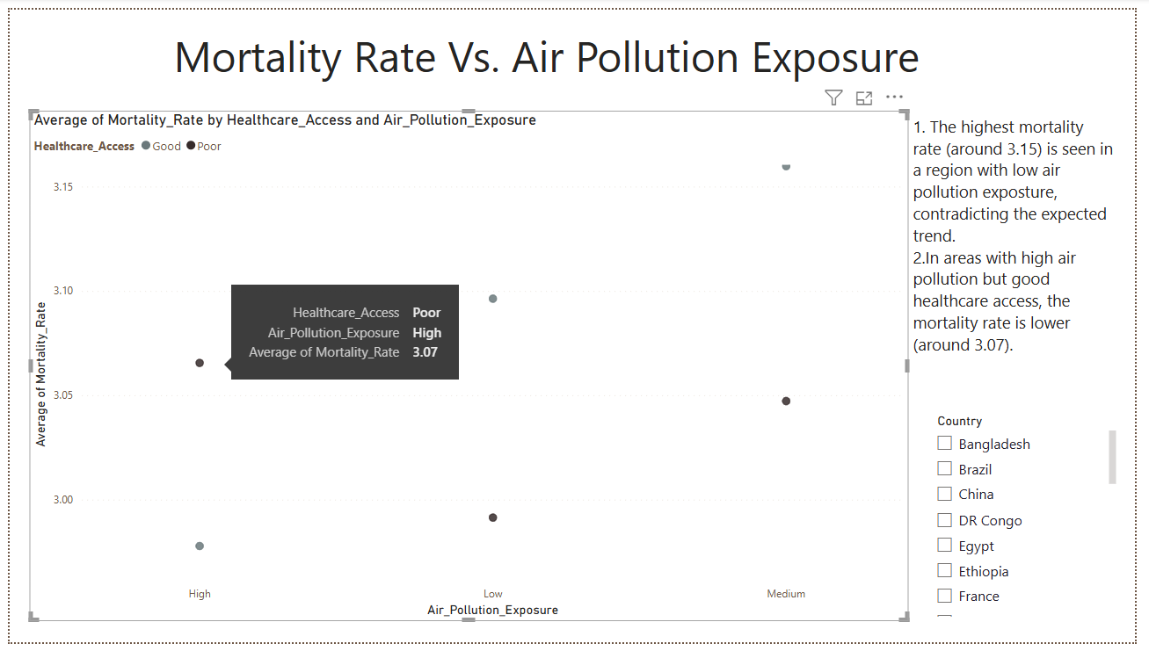
🔍 Key Insights
5. Mortality Rate vs. Air Pollution Exposure
The highest mortality rate (around 3.15) is seen in a region with low air pollution exposure, contradicting the expected trend.
Countries with poor healthcare access show higher mortality rates across all air pollution levels.
In areas with high air pollution but good healthcare access, the mortality rate is lower (around 3.00).
Higher Air Pollution Doesn't Always Mean Higher Mortality

Slide 11
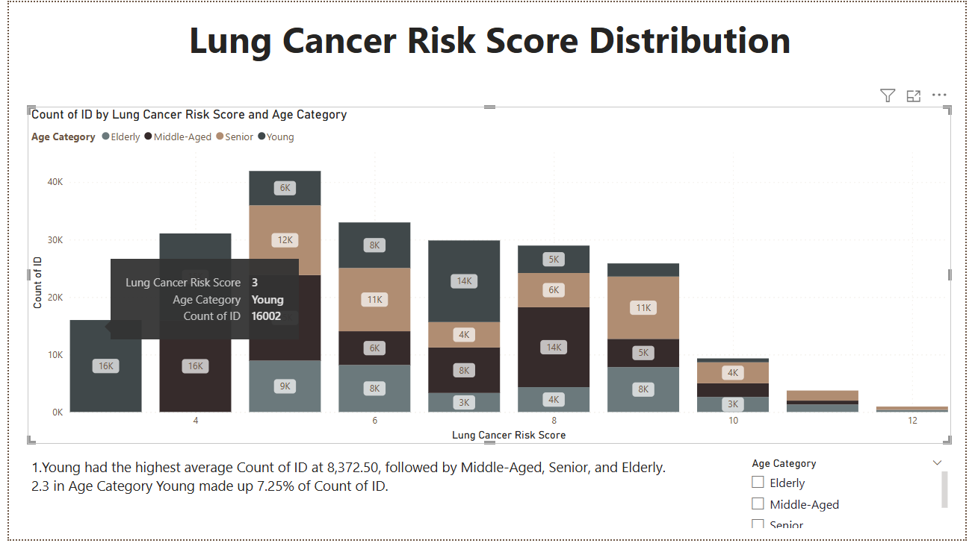
🔍 Key Insights
6. Lung Cancer Risk Score Distribution
1.The Young group has the highest average Count of ID at 8,372.50.
2.Young individuals, even with a lower age-based score, could have higher risk scores if they smoke or have family histories of cancer.
3.Middle-Aged, Senior, and Elderly individuals start with a higher score due to their age and might have additional risk factors (smoking, pollution, family history) contributing to an even higher total score.

Slide 12
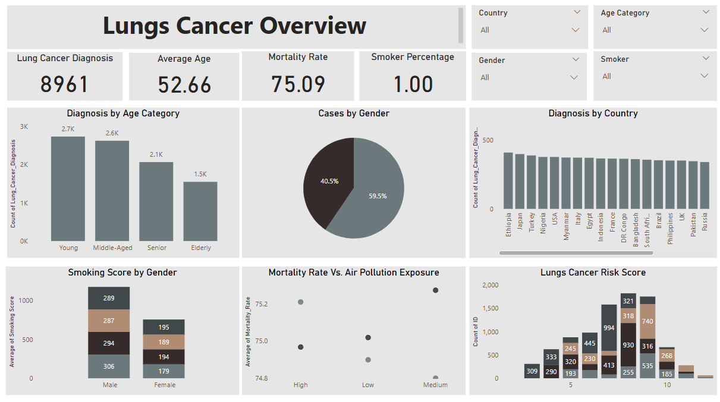
1ST Dashboard

Slide 13
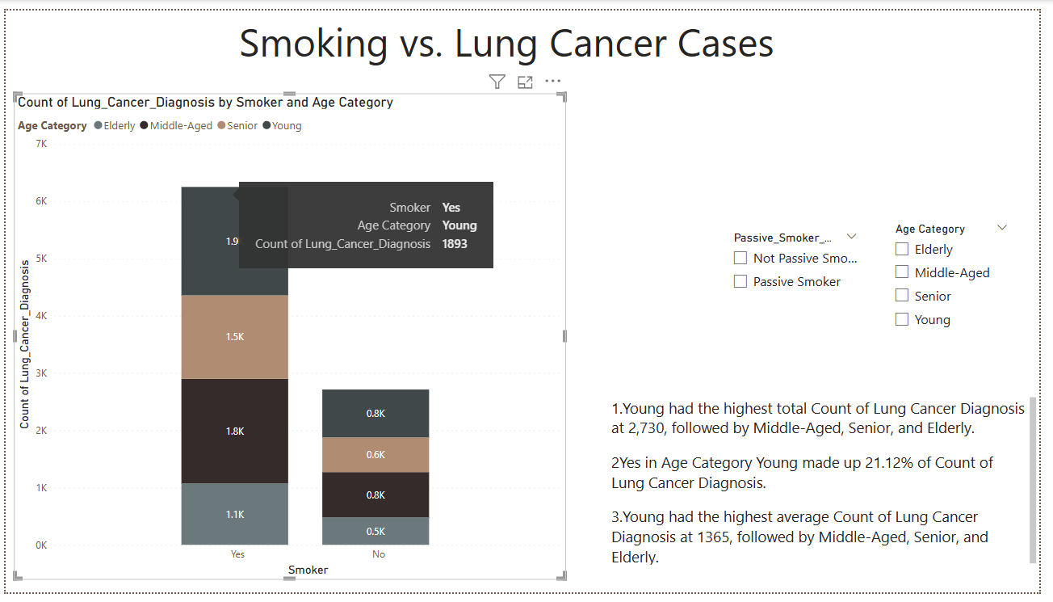
🔍 Key Insights
7. Smoking vs. Lung Cancer Cases
1.The Young group has an unexpectedly high count of lung cancer diagnoses among active smokers.
2.Elderly and Middle-Aged groups have the highest lung cancer diagnoses among passive smokers, indicating long-term exposure effects.
3.The Young category has the highest average count of lung cancer diagnoses (1,365), followed by older age groups.

Slide 14
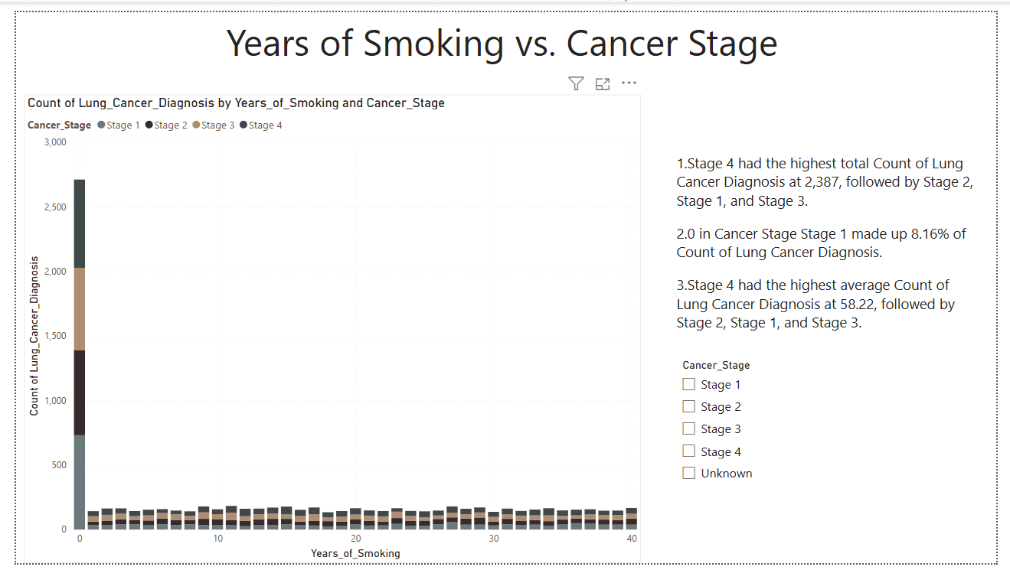
🔍 Key Insights
8. Lung Cancer Diagnosis by cancer stages:
1.In individuals with 0 years of smoking, lung cancer is diagnosed at all stages (1-4), highlighting that smoking is not the sole cause of the disease. Other factors like passive smoking, environmental carcinogens, and genetic predisposition play a major role.
2.The highest percentage of diagnoses (33.36%) occur at Stage 1, indicating that many non-smokers are diagnosed with cancer at an early stage.
3.Stage 2 (30.03%), Stage 3 (29.15%), and Stage 4 (28.66%) are also significant, showing that lung cancer in non-smokers progresses through various stages, with some reaching more advanced stages despite no smoking history.

Slide 15
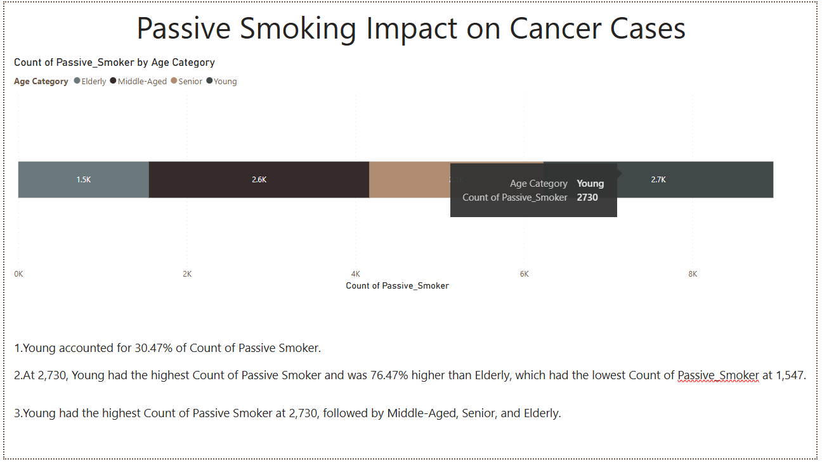
🔍 Key Insights
9.Passive Smoking Impact on Cancer Cases
Young accounts for 30.47% of passive smokers.
Young had the highest count of passive smokers (2,730), 76.47% higher than the Elderly.
The order of passive smokers by count: Young > Middle-Aged > Senior > Elderly.

Slide 16
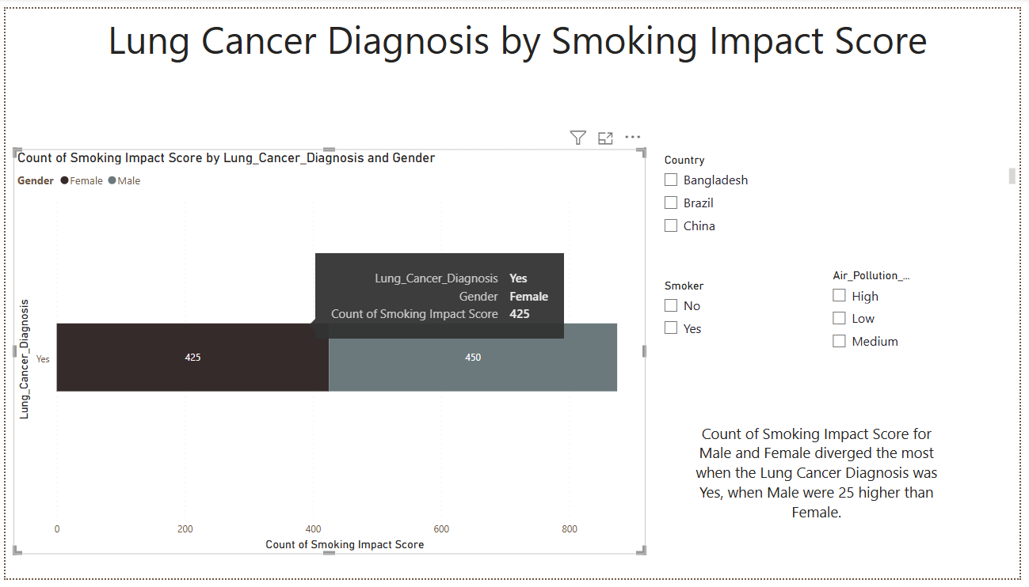
🔍 Key Insights
10. Lung Cancer Diagnosis by Smoking Impact Score
1.Male Dominates Smoking Impact:
Male made up 51.43% of the total count of smoking impact scores, indicating a higher proportion of male individuals affected by smoking in the data.
2.Gender Divergence in Lung Cancer Diagnosis:
The difference in smoking impact scores between Male and Female was most pronounced when Lung Cancer Diagnosis was Yes. In this case, Males had 25 more diagnoses than Females, showing a higher smoking-related cancer impact among men.

Slide 17
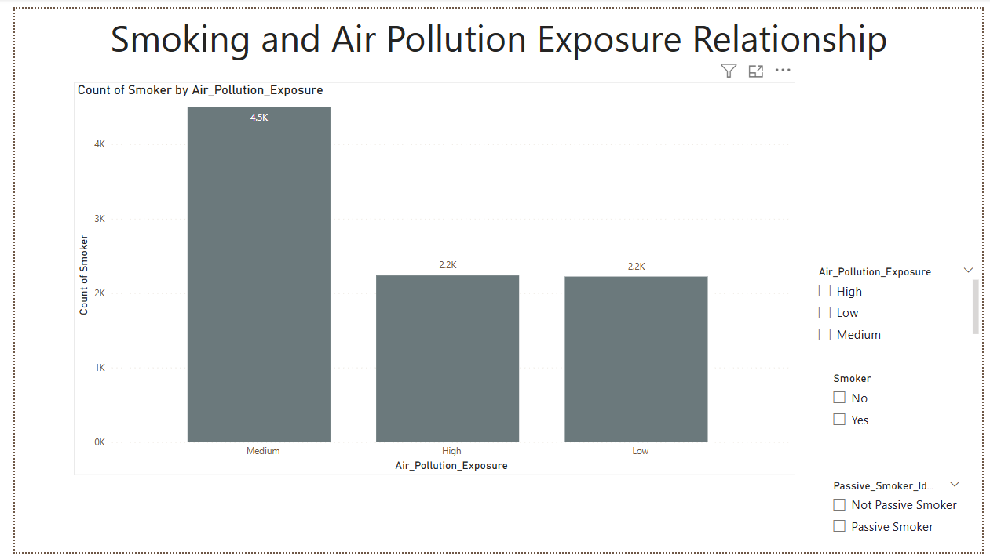
🔍 Key Insights
11.Smoking and Air Pollution Exposure Relationship
1️. Medium Air Exposure has the highest smokers (4,498, 50.20%). 2️.Low Air Exposure has the least smokers (2,224, 102.25% lower than medium). 3️.High Air Exposure (2,239 smokers) is slightly above low but far below medium. 4️.Smoking is most common in medium air exposure, suggesting other factors may influence the trend.

Slide 18
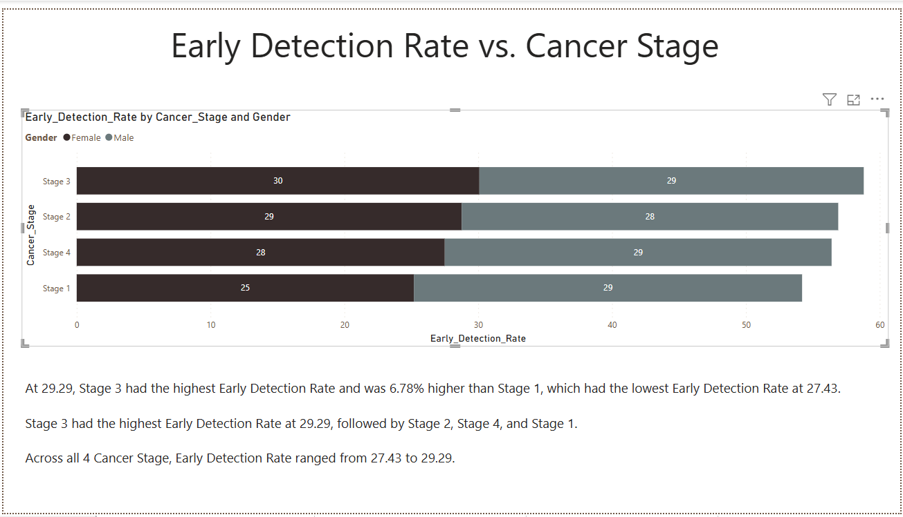
🔍 Key Insights
12.Early Detection Rate Vs. Cancer stage
Stage 3 has the highest early detection rate at 29.29, leading all stages.
Stage 1 has the lowest early detection rate at 27.43.
Stage 3 is 6.78% higher than Stage 1 in early detection.

Slide 19
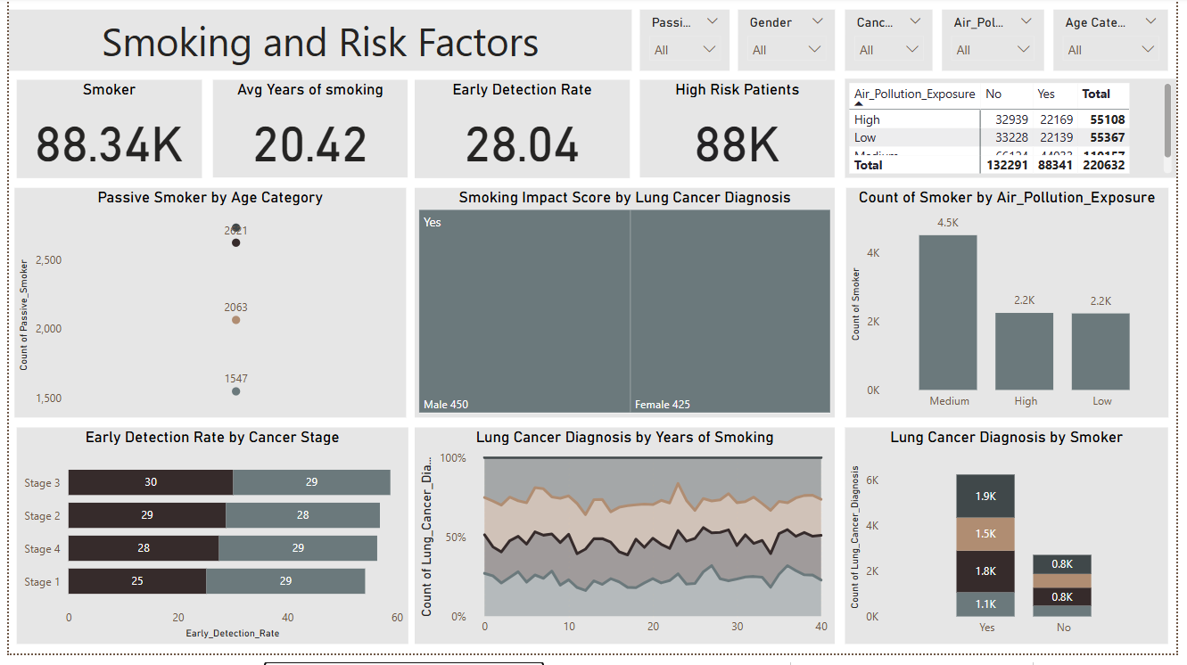
2nd Dashboard

Slide 20
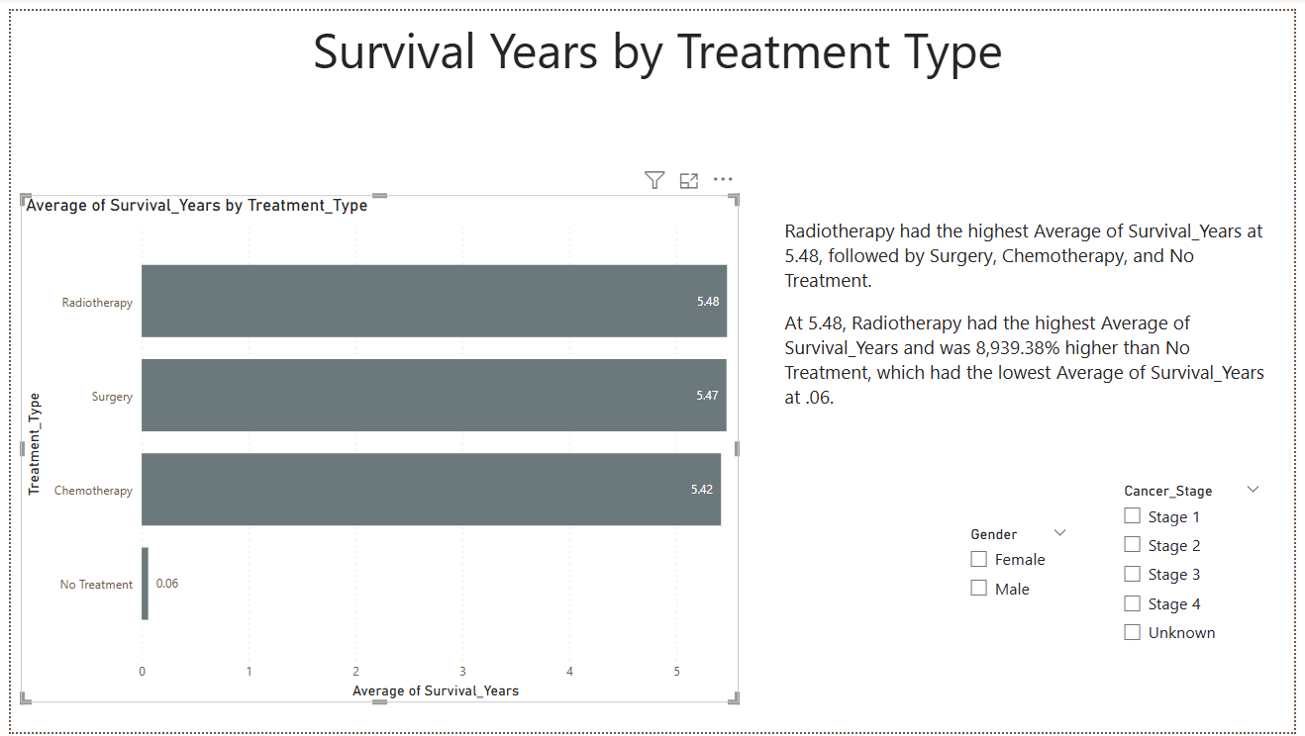
🔍 Key Insights
13.Survival Years by Treatment Type
Radiotherapy has the highest average survival years at 5.48, indicating it is the most effective treatment option.
Radiotherapy is significantly more effective than No Treatment, with an 8,939.38% higher average survival rate.
No Treatment has the lowest average survival years at 0.06, suggesting minimal benefit.
Surgery and Chemotherapy have lower survival rates than Radiotherapy, but they still offer better survival outcomes than No Treatment.

Slide 21
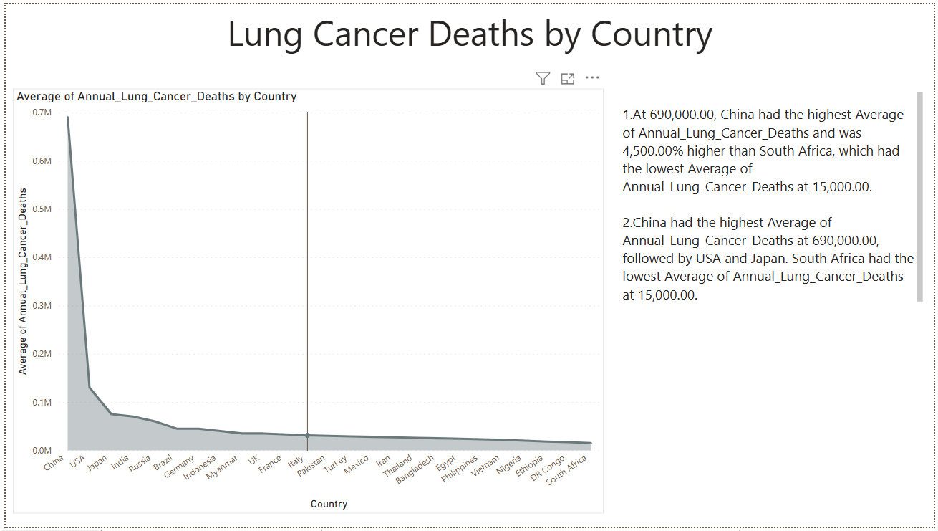
🔍 Key Insights
14. Lung Cancer Deaths by Country
China has the highest average annual lung cancer deaths at 690,000, which is 4,500% higher than South Africa, with the lowest at 15,000.
China leads in annual lung cancer deaths, followed by the USA and Japan. South Africa reports the lowest average annual lung cancer deaths.

Slide 22
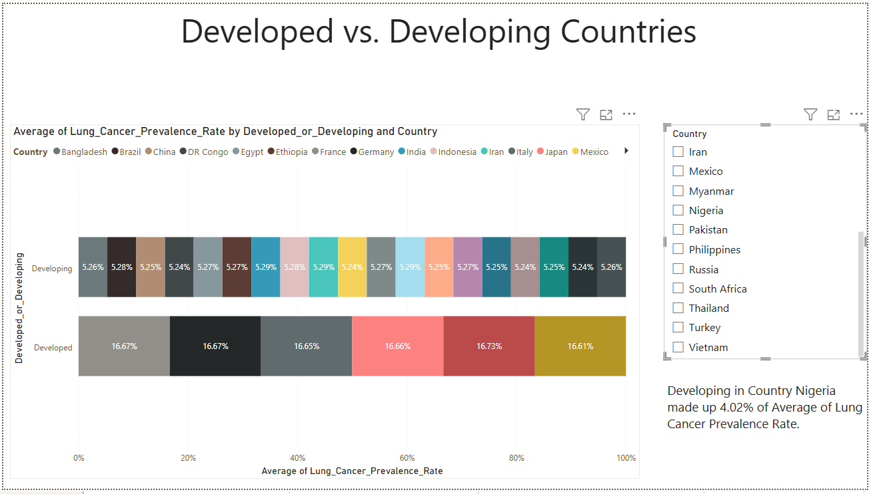
🔍 Key Insights
15.Developed vs. Developing Countries
Nigeria accounted for 4.02% of the average lung cancer prevalence rate in developing countries, highlighting its contribution to the overall lung cancer burden within that category.

Slide 23
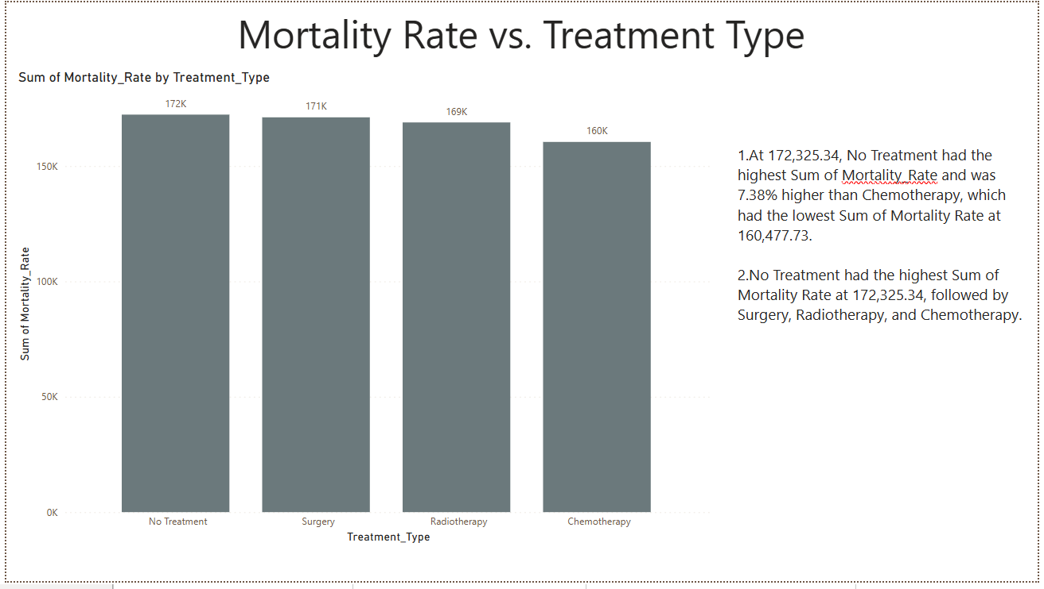
🔍 Key Insights
16.Mortality rate Vs. Treatment Type
No Treatment leads to the highest mortality rate, with a sum of 172,325.34, surpassing other treatments by 7.38%.
Chemotherapy shows the lowest mortality rate at 160,477.73, indicating its effectiveness in reducing fatalities.
The treatment order, from highest to lowest mortality rate, is: No Treatment, Surgery, Radiotherapy, and Chemotherapy, emphasizing the crucial role of medical interventions in reducing cancer mortality.

Slide 24
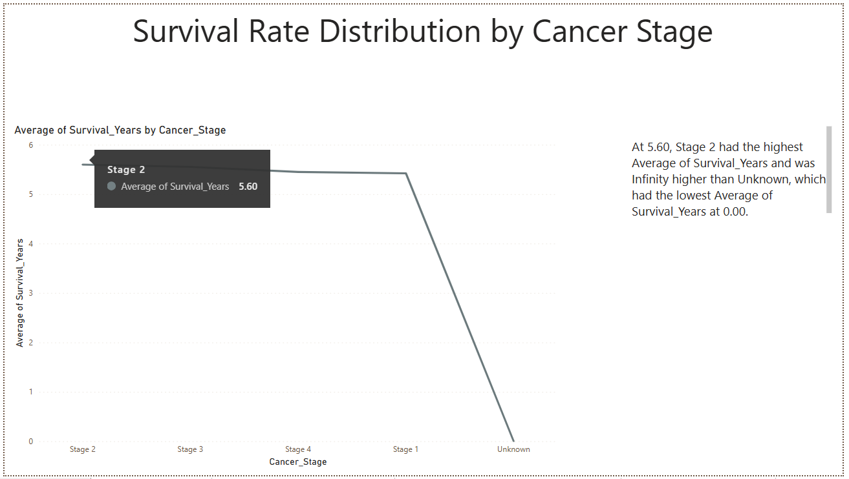
🔍 Key Insights
17.Survival Rate Distribution by Cancer Stage
Stage 2 has the highest average survival years at 5.60, significantly outperforming the Unknown category, which has an average of 0.00 years.
The contrast between Stage 2 and Unknown underscores the importance of early diagnosis in improving survival outcomes.

Slide 25
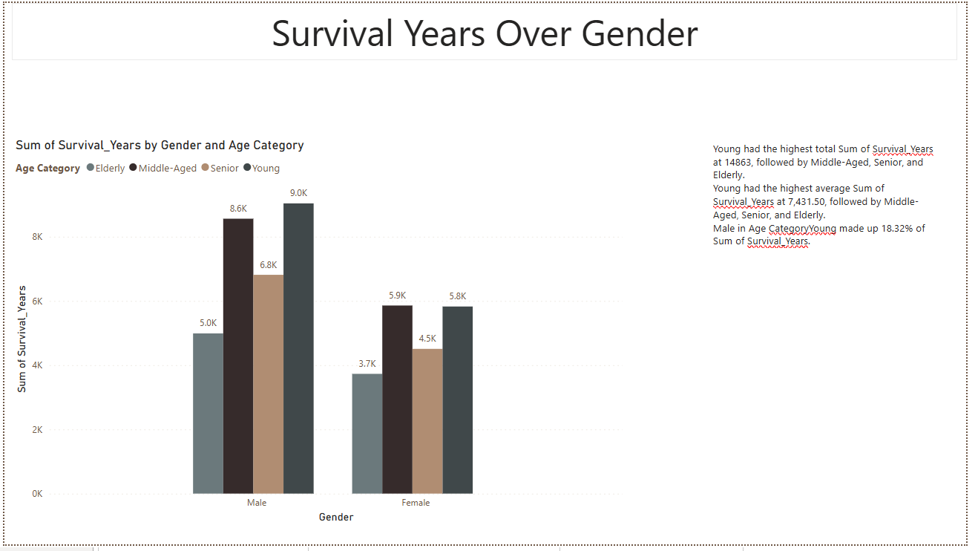
🔍 Key Insights
18.Survival Years Over Gender
Male Young contributes 18.32% to the total Survival Years for males.
Young has the highest Sum of Survival Years at 7,431.50, followed by Middle-Aged, Senior, and Elderly.

Slide 26
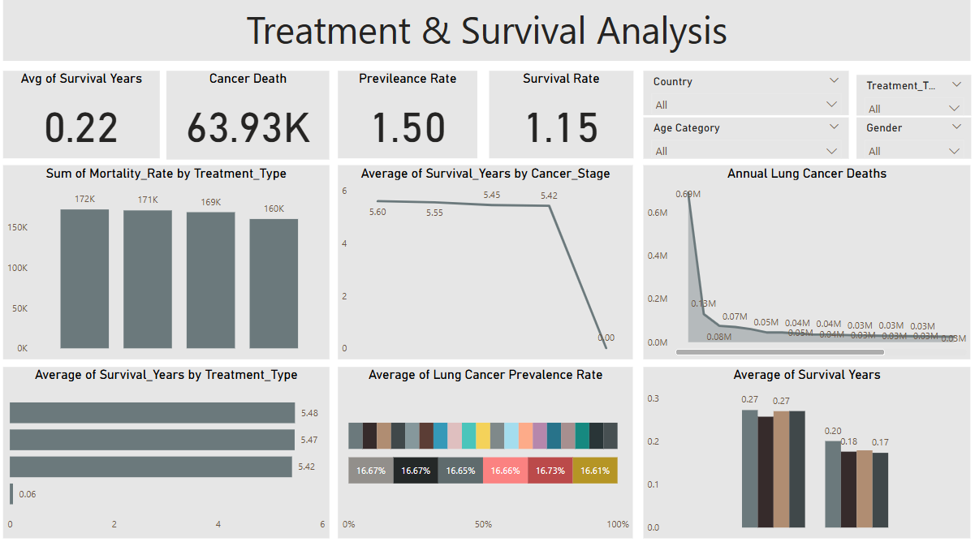
3rd Dashboard

Slide 27
Overall Insights
1.Lung Cancer Diagnosis Trends: Ethiopia records the highest diagnoses; males Are more affected (59.5%).
2.Age Factor: Young individuals have the highest diagnoses, while the elderly have the lowest.
3.Smoking Influence: Seniors have the highest smoking impact; males dominate smoking-related diagnoses.
4.Passive Smoking: Young individuals show the highest count of passive smokers.
5.Air Pollution & Mortality: High pollution areas with good healthcare show lower mortality.
6.Lung Cancer Stages: 33.36% of non-smokers are diagnosed at Stage 1, proving other risk factors matter.
7.Early Detection & Survival: Stage 3 has the highest early detection rate; Stage 2 shows the best survival.
8.Treatment Effectiveness: Radiotherapy yields the highest survival (5.48 years); no treatment leads to highest mortality.
9.Country-Level Mortality: China has the highest lung cancer deaths annually.
10.Developed vs. Developing: Nigeria has the highest prevalence rate among developing countries.

Slide 28
🎯 Business Recommendations
1.Enhance Early Detection Programs: Invest in screening, especially in high-risk regions.
Smoking Cessation Initiatives: Implement stricter anti-smoking policies and awareness campaigns.
Improve Healthcare Access: Strengthen medical infrastructure in developing countries to lower mortality.
Targeted Air Pollution Control: Reduce industrial and vehicular emissions in affected regions.
Passive Smoking Awareness: Educate young individuals on passive smoking risks.
Boost Treatment Accessibility: Promote radiotherapy and chemotherapy as the most effective treatments.
Country-Specific Strategies: Implement regional action plans based on prevalence and mortality rates.

Slide 29
Thank you

