Slide 1
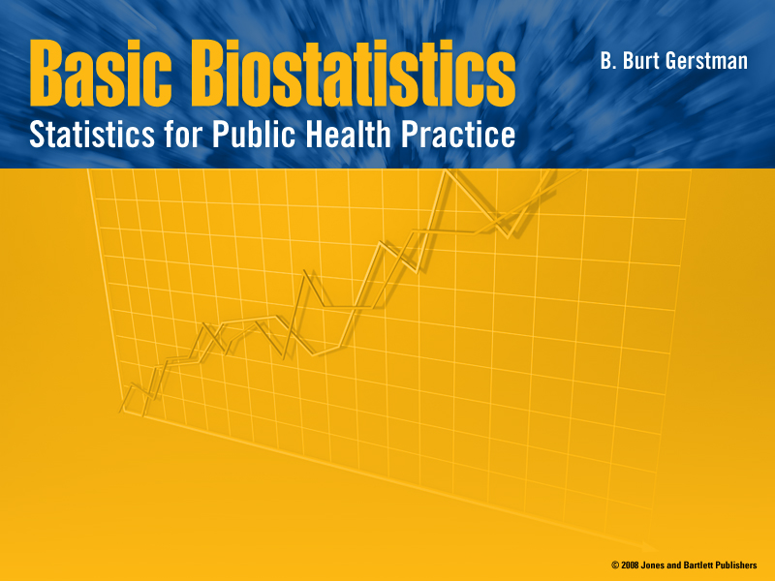
Chapters 9 (NEW)
Intro to Hypothesis Testing

Slide 2

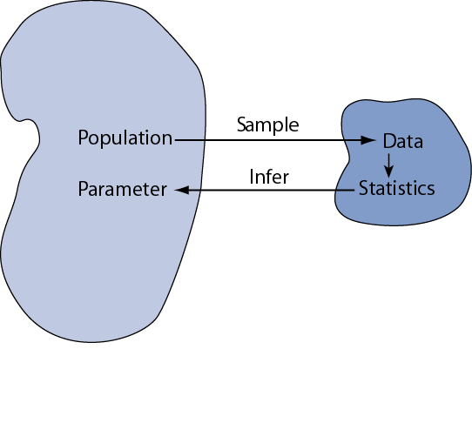
Statistical Inference
Statistical inference is the act of generalizing from a sample to a population with calculated degree of certainty.
using statistics calculated in the sample
We want to learn about population parameters…
Notes:
Statistical inference is the logical process by which we make sense of numbers. It is how we generalize from the particular to the general. This is an important scientific activity.
Consider a study that wants to learn about the prevalence of a asthma in a population. We draw a SRS from the population and find that 3 of the 100 individuals in the sample have asthma. The prevalence in the sample is 3%. However, are still uncertain about the prevalence of asthma in the population; the next SRS from the same population may have fewer or more cases. How do we deal with this element of chance introduced by sampling?
A similar problem occurs when we do an experiment Each time we do an experiment, we expect different results due to chance. How do we deal with this chance variability?
Our first task is to distinguish between parameters and statistics. Parameters are the population value. Statistics are from the sample. The statistics will vary from sample to sample: they are random variables. In contrast, the parameters are invariable; they are constants.
To help draw this distinction, we use different symbols for parameters and statistics. For example, we use “mu” to represent the population mean (parameter) and “xbar” to represent the sample mean (statistic).

Slide 3
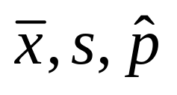
Parameters and Statistics
We MUST draw a distinction between
parameters and statistics
 | Parameters | Statistics
Source | Population | Sample
Calculated? | No | Yes
Constants? | Yes | No
Examples | μ, σ, p

Slide 4
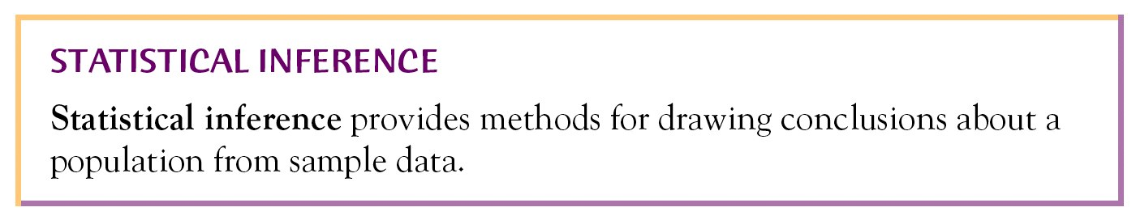
Statistical Inference
There are two forms of statistical inference:
Hypothesis testing
Confidence interval estimation
We introduce hypothesis testing concepts with the most basic testing procedure: the one-sample z test

Slide 5

One Sample z Test
Objective: to test a claim about population mean µ
Study conditions:
Simple Random Sample (SRS)
Population Normal or sample large
The value of σ is known
The value of μ is NOT known

Slide 6
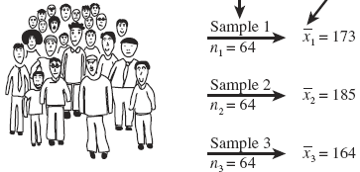
Sampling distribution of a mean
What is the mean weight µ of a population of men?
Sample n = 64 and calculate sample mean “x-bar”
If we sampled again, we get a different x-bar
Repeated samples from the same population yield different sample means

Slide 7
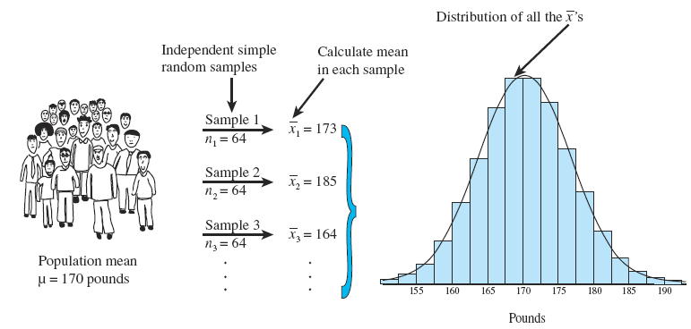
Sampling distribution of the Mean (SDM)
We form a hypothetical probability model based on the differing sample means. This distribution is called the sampling distribution of the mean
i.e., the sampling distribution model used for inference

Slide 8
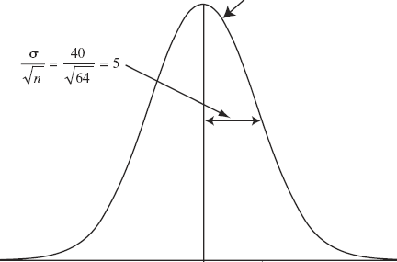
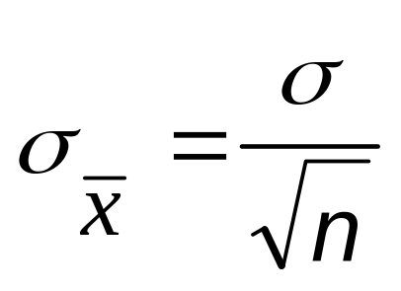
The nature of the SDM (probability model) is predictable
We use this Normal model when making inference about population mean µ when σ is known
Will tend to be Normal
Will be centered on population mean µ
Will have standard deviation
µ

Slide 9
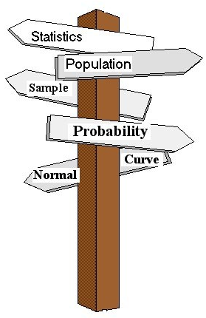
Hypothesis Testing
Objective: To test a claim about a population parameter
Hypothesis testing steps
  Hypothesis statements
  Test statistic
  P-value and interpretation
  Significance level (optional)
Notes:
Chapter 9
Basic Biostat
Hypothesis testing (also called significance testing) uses a quasi-deductive procedure to judge claims about parameters. Before testing a statistical hypothesis it is important to clearly state the nature of the claim to be tested. We are then going to use a four step procedure (as outlined in the last bullet) to test the claim.

Slide 10
Step A: Hypotheses
Convert research question to null and alternative hypotheses
The null hypothesis (H₀) is a claim of “no difference”
The alternative hypothesis (H_{a}) says “H₀ is false”
The hypotheses address the population parameter (µ), NOT the sample statistic (x-bar)
Notes:
Chapter 9
Basic Biostat
The first step in the procedure is to state the hypotheses null and alternative forms. The null hypothesis (abbreviate “H naught”) is a statement of no difference. The alternative hypothesis (“H sub a”) is a statement of difference. Seek evidence against the claim of H₀ as a way of bolstering H_{a.}
The next slide offers an illustrative example on setting up the hypotheses.

Slide 11

Step A: Hypotheses
Research question: Is mean body weight of a particular population of men higher than expected?
Expected norm: Prior research (before collecting data) has established that the population should have mean μ = 170 pounds with standard deviation σ = 40 pounds.
Beware : Hypotheses are always based on research questions and expected norms, NOT on data!
Null hypothesis H₀: μ = 170
Alternative hypothesis :
H_{a}: μ > 170 (one-sided) OR
H_{a}: μ ≠ 170 (two-sided)
Notes:
Chapter 9
Basic Biostat
In the late 1970s, the weight of U.S. men between 20- and 29-years of age had a log-normal distribution with a mean of 170 pounds and standard deviation of 40 pounds. As you know, the overweight and obese conditions seems to be more prevalent today, constituting a major public health problem. To illustrate the hypothesis testing procedure, we ask if body weight in this group has increased since 1970. Under the null hypothesis there is no difference in the mean body weight between then and now, in which case μ would still equal 170 pounds.
Under the alternative hypothesis, the mean weight has increased Therefore, H_{a:} μ > 170. This statement of the alternative hypothesis is one-sided. That is, it looks only for values larger than stated under the null hypothesis.
There is another way to state the alternative hypothesis. We could state it in a “two-sided” manner, looking for values that are either higher- or lower-than expected. For the current illustrative example, the two-sided alternative is H_{a:} μ ≠ 170. Although for the current illustrative example, this seems unnecessary, two-sided alternative offers several advantages and are much more common in practice.

Slide 12
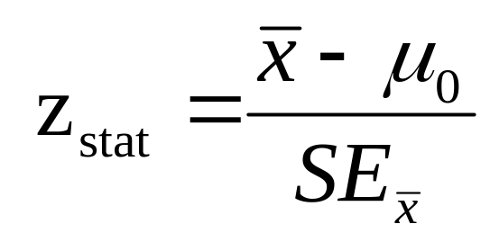
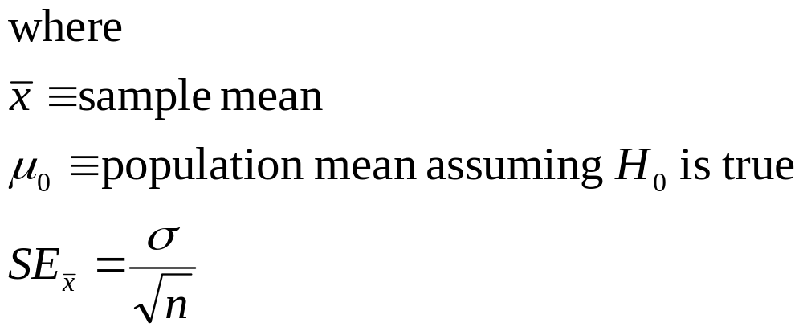
Step B: Test Statistic
For one sample test of µ when σ is known, use this test statistic:
Notes:
Chapter 9
Basic Biostat

Slide 13
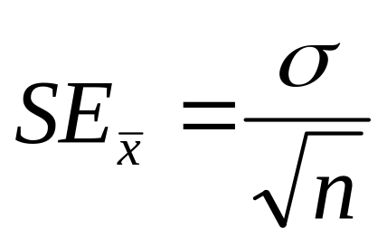
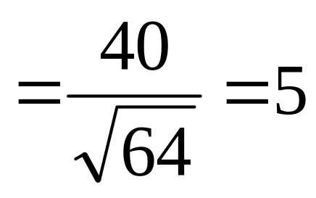
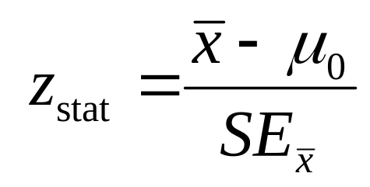
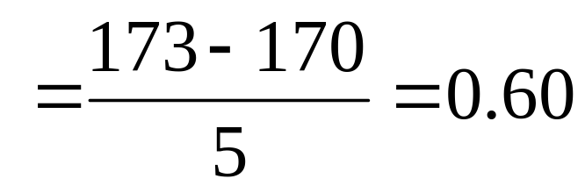
Step B: Test Statistic
For our example, μ₀ = 170 and σ = 40
Take an SRS of n = 64
Calculate a sample mean (x-bar) of 173

Slide 14
Step C: P-Value
Convert z statistics to a P-value:
For H_{a}: μ > μ₀
P-value = Pr(Z > z_{stat}) = right-tail beyond z_{stat}
For H_{a}: μ < μ₀
P-value = Pr(Z < z_{stat}) = left tail beyond z_{stat}
For H_{a}: μ ≠ μ₀
P-value = 2 × one-tailed P-value

Slide 15
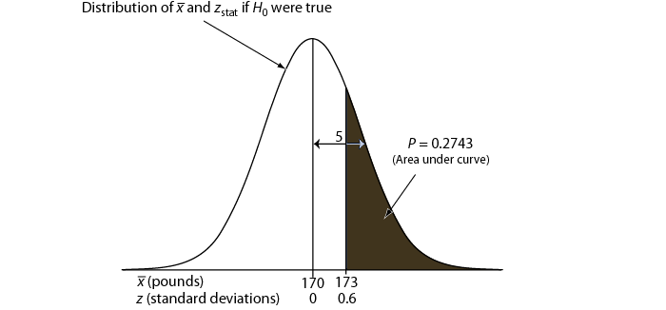
Step C: P-value (example)
Use Table B to determine the tail area associated with the z_{stat} of 0.6
One-tailed P = .2743
Two-tailed P
= 2 × one-tailed P
= 2 × .2743 = .5486

Slide 16

Step C: P-values
P-value answer the question: What is the probability of the observed test statistic … when H₀ is true?
Smaller and smaller P-values provide stronger and stronger evidence against H₀

Slide 17
Step C: P-values
Conventions*
P > 0.10 ⇒ poor evidence against H₀
0.05 < P ≤ 0.10 ⇒ marginally evidence against H₀
0.01 < P ≤ 0.05 ⇒ good evidence against H₀
P ≤ 0.01 ⇒ very good evidence against H₀
Examples
  P =.27 ⇒ poor evidence against H₀
  P =.01 ⇒ very good evidence against H₀
* It is unwise to draw firm borders for “significance”

Slide 18
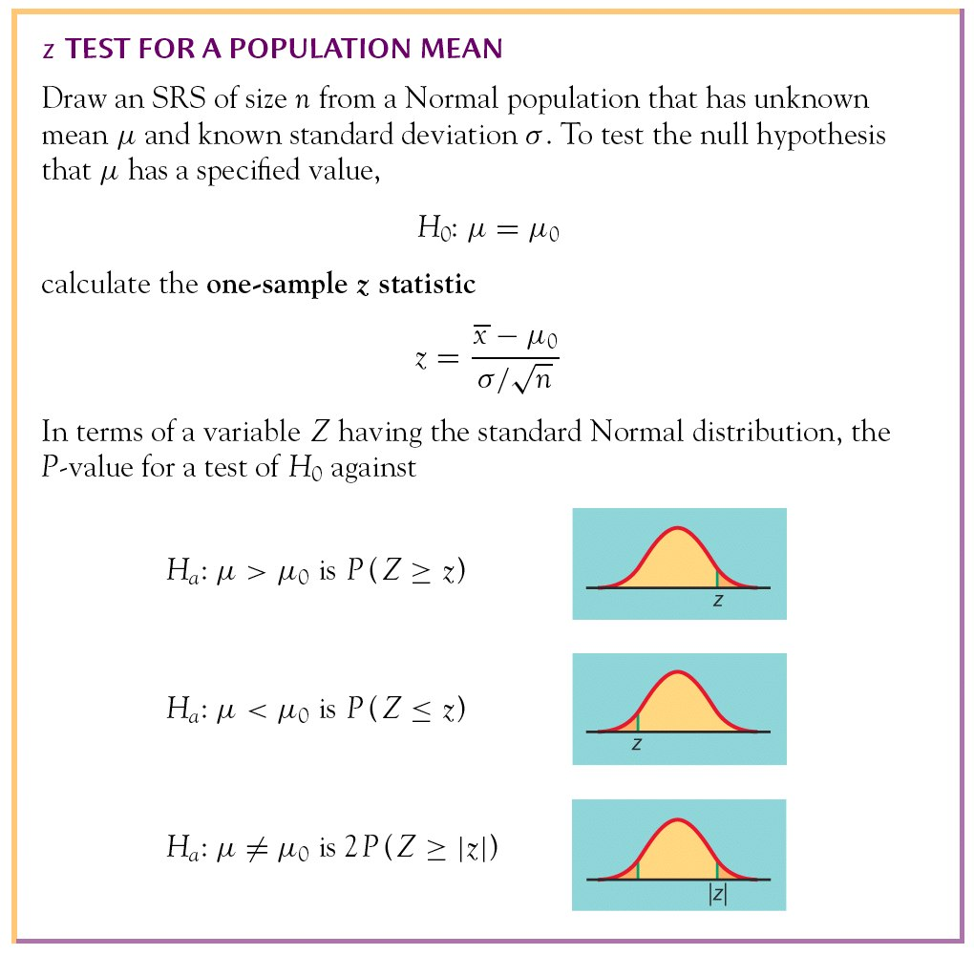
Summary
Basics of Significance Testing

Slide 19
Step D (optional) Significance Level
Let α ≡ threshold for “significance”
If P-value ≤ α ⇒ evidence is significant
If P-value > α ⇒ evidence not significant
Example:
If α = 0.01 and P-value = 0.27 ⇒ evidence not significant
If α = 0.01 and P-value = 0.0027 ⇒ evidence is significant

Slide 20
§9.6 Power and Sample Size
Two types of decision errors:
Type I error = erroneous rejection of true H₀
Type II error = erroneous retention of false H₀
 | Truth
Decision | H₀ true | H₀ false
Retain H₀ | Correct retention | Type II error
Reject H₀ | Type I error | Correct rejection
α ≡ probability of a Type I error
β ≡ Probability of a Type II error

Slide 21
Power
β ≡ probability of a Type II error
  β = Pr(retain H₀ | H₀ false)
  (the “|” is read as “given”)
1 – β = “Power” ≡ probability of avoiding a Type II error
1– β = Pr(reject H₀ | H₀ false)

Slide 22
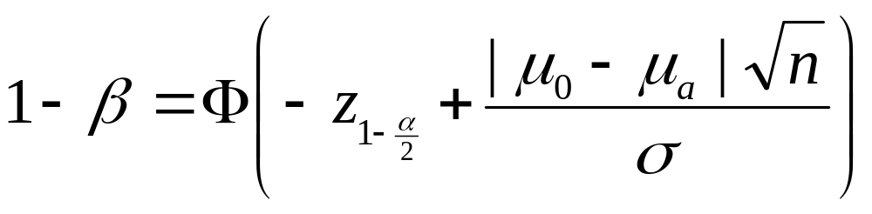


Power of a z test
where
Φ(z) ≡ cumulative probability of Standard Normal value z
μ₀ ≡ population mean under H₀
μ_{a} ≡ population mean under H_{a}
with
.

Slide 23
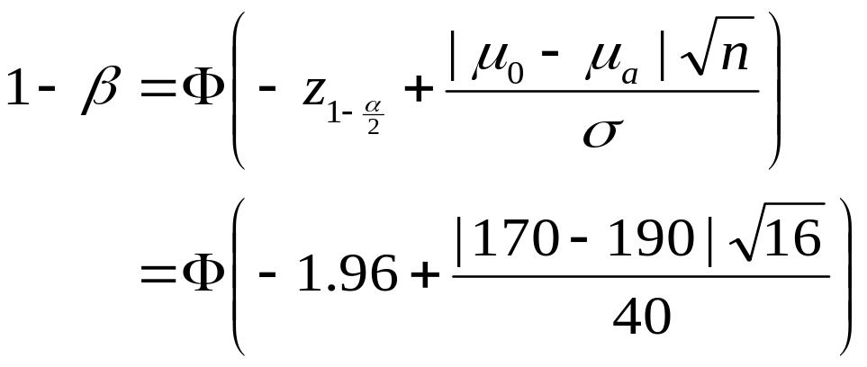
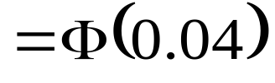

Calculating Power: Example
A study of n = 16 retains H₀: μ = 170 at α = 0.05 (two-sided); σ is 40. What was the power of test to identify a population mean of 190?
⇒ look up cumulative probability on Table B ⇒

Slide 24
Reasoning of Power Calculation
Competing “theories”
  Top curve (next page) assumes H₀ is true
  Bottom curve assumes H_{a} is true
  α set to 0.05 (two-sided)
Reject H₀ when sample mean exceeds 189.6 (right tail, top curve)
Probability of a value greater than 189.6 on the bottom curve is 0.5160, corresponding to the power of the test

Slide 25
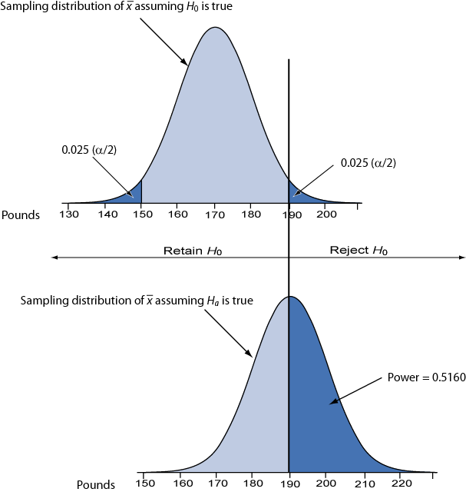

Slide 26
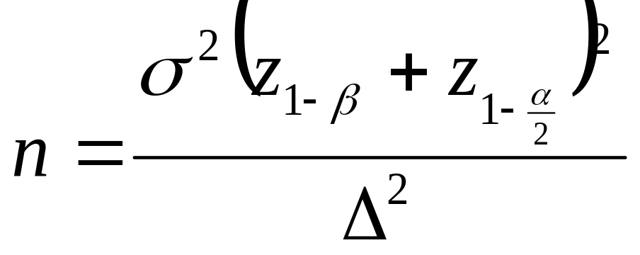
Sample Size Requirements
Sample size for one-sample z test:
where
1 – β ≡ desired power
α ≡ desired significance level (two-sided)
σ ≡ population standard deviation
Δ = μ₀ – μ_{a} ≡ the difference worth detecting

Slide 27
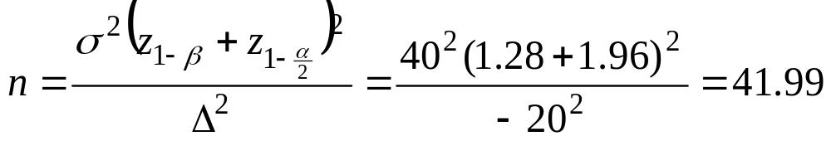
Example: Sample Size Requirement
How large a sample is needed to test H₀: μ = 170 versus H_{a}: μ = 190 with 90% power and α = 0.05 (two-tailed) when σ = 40?
Note: Δ = μ₀ − μ_{a} = 170 – 190 = −20
Round up to 42 to ensure adequate power.

Slide 29
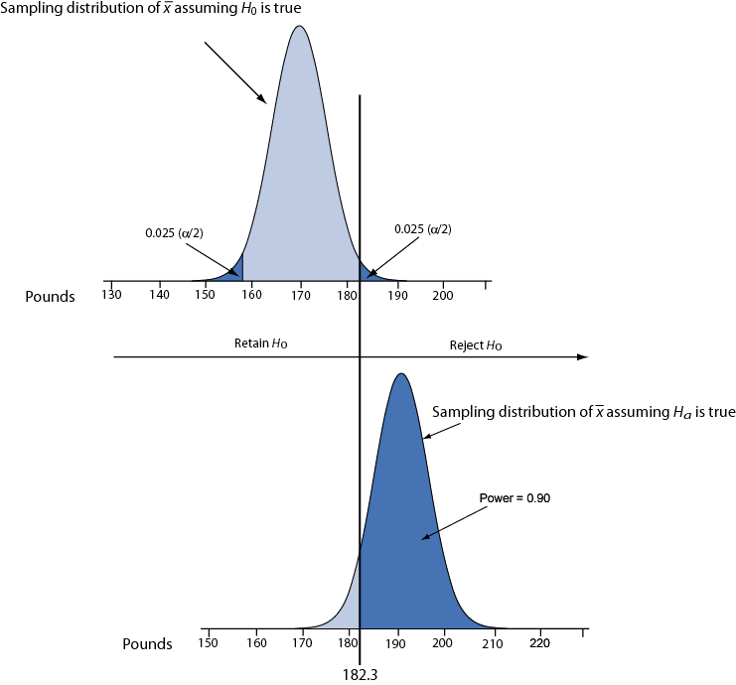
Illustration: conditions for 90% power.

