Slide 1


K.RAMAKRISHNAN COLLEGE OF TECHNOLOGY
(AUTONOMOUS), TRICHY.
DEPARTMENT OF
COMPUTER SCIENCE AND ENGINEERING
20CS5501 DESIGN PROJECT-1
Batch No. : 06
Date : 06.12.2024

Slide 2
BRAIN-TUMOR DETECTION USING MRI IMAGES
Guided by Team
Mr. P. Devan Karolina A (811721104069)
Assistant Professor, CSE Maneshaw S (811721104086)
Ramisha Parveen K(811721104120)

Slide 3
OBJECTIVE OF THE PROJECT
The objective of this project is to develop an automated system for detecting brain tumors from MRI scans using a Convolutional Neural Network (CNN).
It aims to provide accurate tumor detection, manage patient details efficiently, and recommend relevant doctors for follow-up.
The system enhances accessibility, especially in remote areas, by offering a reliable and user-friendly solution for early tumor detection.

Slide 4
ABSTRACT
Develops an automated system for detecting brain tumors in MRI scans using a Convolutional Neural Network (CNN).
Accurately identifies tumors, provides a percentage and offers doctor recommendations based on the results.
The system simplifies the diagnostic process, making it accessible and efficient, especially in areas with limited access to radiologists.

Slide 5
LITERATURE SURVEY
TITLE OF THE PAPER | AUTHOR (S) | PUBLISHER | PAPER GIST | TECHNOLOGY USED
Fully automated brain tumor segmentation system in 3D-MRI using symmetry analysis of brain and level sets | Kermi et al.,2018 | IET Image Processing | Focuses an automated method for segmenting brain tumors in 3D MRI scans. | 3D MRI Image Processing
Brain tumour classification using two-tier classifier with adaptive segmentation technique | technique(Anita & Murugavalli, 2016) | IET Computer Vision | A method for classifying brain tumors based on medical imaging | Machine Learning Algorithms,Feature extraction
Detection of brain tumor in MRI images, using combination of fuzzy c-means and SVM | Singh, 2015 | IEEE Xplore | Focuses on a hybrid method for detecting brain tumors in MRI scans. | Support Vector Machine (SVM), Fuzzy c-means
Manifold embedding and semantic segmentation for intraoperative guidance with hyperspectral brain imaging | Ravì et al., 2017 | National Library of Medicine | Examines a method that uses hyperspectral imaging (HSI) during brain surgeries to assist surgeons | Hyperspectral Imaging (HSI)
Towards a computer aided prognosis for brain glioblastomas tumor growth estimation | Sallemi et al., 2015 | IEEE Xplore | Examines on developing a computer-aided system for estimating the growth of glioblastoma tumors | MRI Data Analysis, Computer vision
MRI brain cancer classification using hybrid classifier. | Machhale et al., 2015 | IEEE Xplore | Focuses on classifying brain cancer types from MRI images using a hybrid classification approach. | Hybrid Machine Learning Models

Slide 6
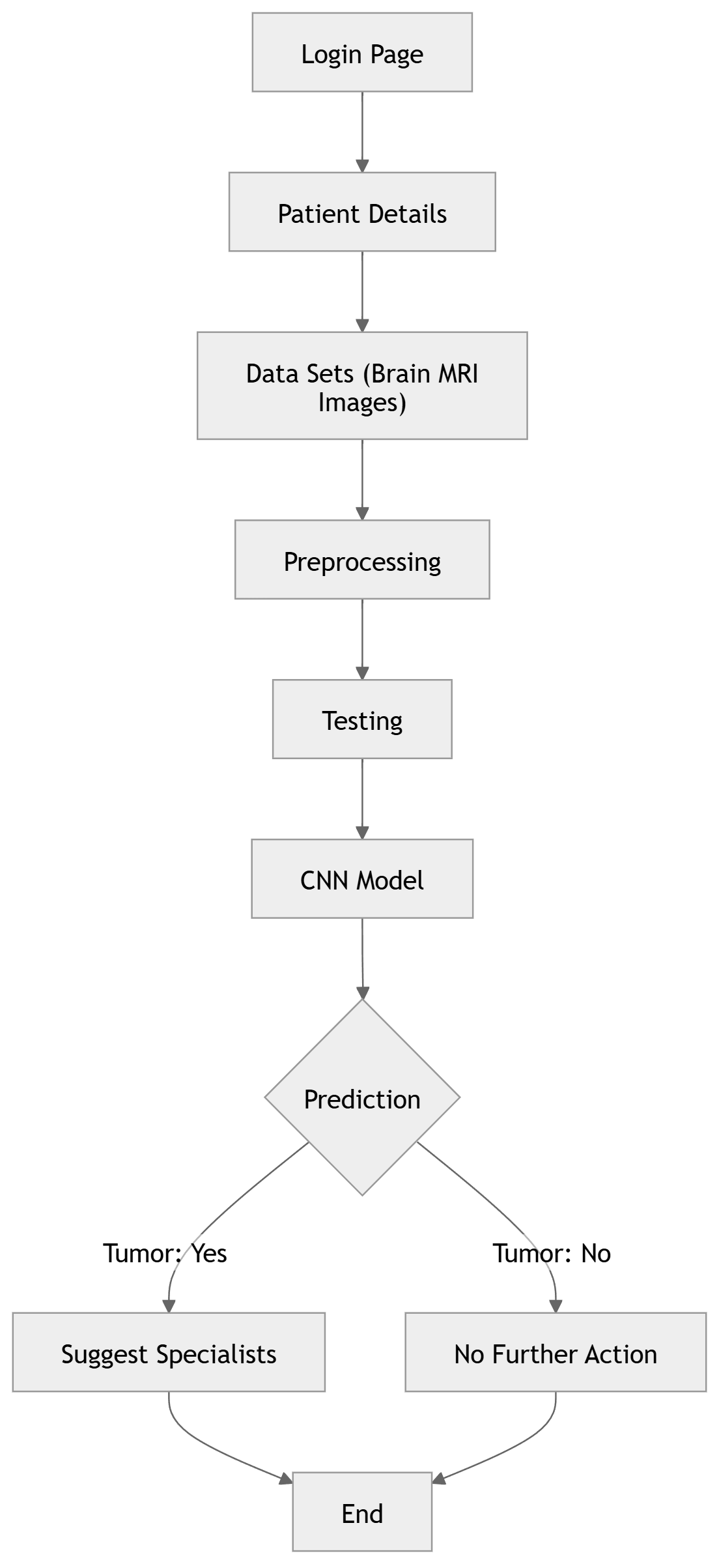
PROPOSED SYSTEM ARCHITECTURE

Slide 7
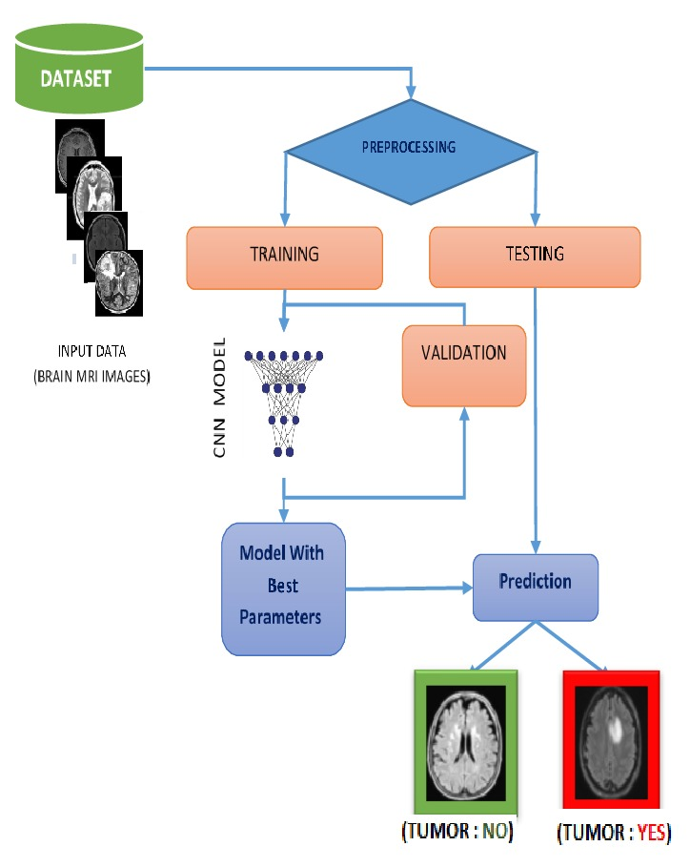
EXISTING SYSTEM ARCHITECTURE

Slide 8
SOFTWARE AND HARDWARE REQUIREMENTS
HARDWARE
SOFTWARE
Processor – min intel i5, max intel i7
RAM – min 8GB recommend 16GB
Storage – 256GB
Graphis card – Nvidia GTX 1050 or
Higher (for Visual presentation)
OS - Windows 11
Python
HTML
CSS
JavaScript

Slide 9
MODULES
Patient login and Authentication
Patient Details Management
MRI Image Upload and Preprocessing
Tumor Detection and Analysis
Doctor Recommendation

Slide 10
SUMMARY OF MODULE-1
Patient login and Authentication:
This module ensures secure access to the system by validating patient credentials.
Patients log in using their Patient ID and Name, which are checked for correctness before proceeding to the next step.
It prevents unauthorized access and establishes a personalized session for each patient, ensuring the integrity of the data flow throughout the system.

Slide 11
SUMMARY OF MODULE-2
Patient Details Management :
This module collects and manages complete patient information, such as Name, Age, Gender, and Medical History.
It ensures data validation for accuracy and stores the details securely for further processing.
The module serves as the foundation for associating patient data with their MRI scan and tumor analysis results.

Slide 12
SUMMARY OF MODULE-3
MRI Image Upload and Preprocessing:
This module allows patients to upload their MRI scans securely. It validates the uploaded file format (e.g., .jpg, .png, .dcm).
These steps ensure the MRI image is standardized and ready for accurate tumor detection by the CNN(Convolutional Neural Network) model.
The module also provides feedback on successful uploads and transitions smoothly to the detection process.

Slide 13
SUMMARY OF MODULE-4
Tumor Detection and Analysis:
This module processes the uploaded MRI image using a pre-trained Convolutional Neural Network (CNN) model to detect and analyze potential brain tumors. Key features include:
1.Tumor Detection: Identifies and highlights abnormal regions in the image.
2.Analysis Results: Displays the likelihood of a tumor as a percentage.
3.Visualization: Shows processed images with marked tumor areas.
4.Efficiency: Ensures fast and accurate diagnosis to assist medical professionals.

Slide 14
SUMMARY OF MODULE-5
Doctor Recommendation:
This module provides a list of suggested radiologists for follow-up based on tumor detection results. Key features include:
Radiologist Database: Displays doctor’s name, specialities, address and contact details.
Dynamic Suggestions: Recommends doctors based on the patient's location or diagnosis severity.
User-Friendly Interface: Allows patients to view, print, or save the recommendations for consultation.
Next Steps Guidance: Helps patients connect with specialists for treatment.

Slide 15
RESULTS AND DISCUSSION
Testing Outcomes:
User Feedback:
High tumor detection accuracy (CNN model).
User-friendly interface for patient details and uploads.
Secure handling of user data.
Enhanced User Experience with seamless navigation
Users recommended more detailed doctor profiles and location-based suggestions.
Requests for additional tumor types and image format support.

Slide 16
CONCLUSION
This project provides an automated and efficient solution for brain tumor detection using AI, offering accurate results and recommendations.
It simplifies the diagnostic process by managing patient data and suggesting relevant doctors for follow-up.
The system enhances accessibility, especially in unreserved areas, and can be easily expanded for other medical conditions.
It aims to assist healthcare professionals in diagnosing brain tumors.

Slide 17
THANK YOU

