Slide 1
21AIE304 - Big Data and Database Management arXiv Streaming using Spark, Kafka
Team 14

Slide 2
What is streaming?
Streaming data is data that is generated and made available in near real-time, typically measured in milliseconds or seconds. Streaming data is a flow of data that can be collected and processed simultaneously rather than waiting to complete the collection process and then analyzing it.

Slide 3
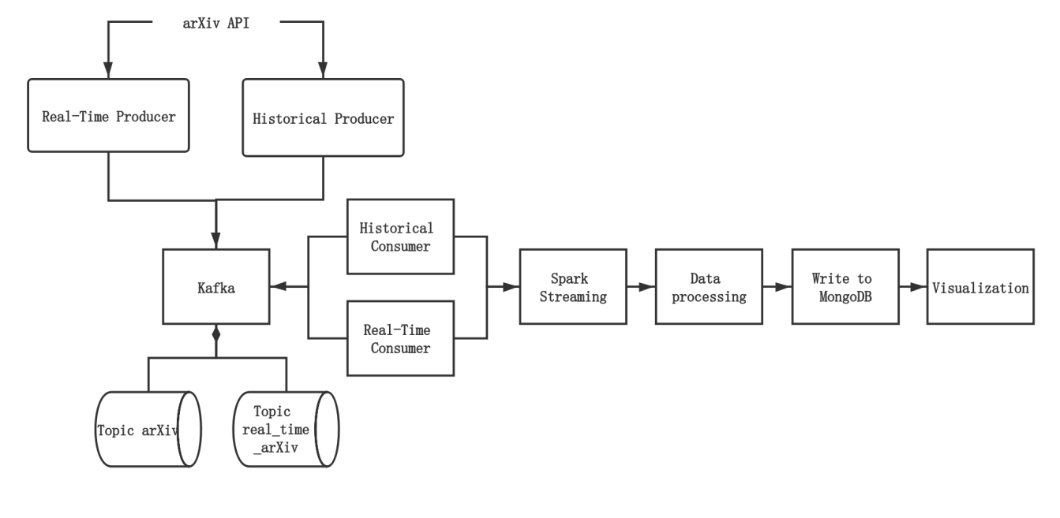
Our Data Pipeline

Slide 4
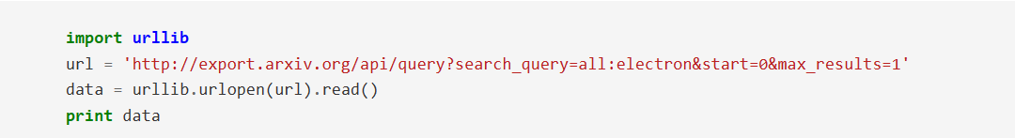
ArXiv API
The data source of this project is retrieved from arXiv API. It offers programmatic access to all the papers on arXiv.org and contains information related to each paper such as its title, authors, summary, etc.​
-> calling the API via HTTP - Python

Slide 5
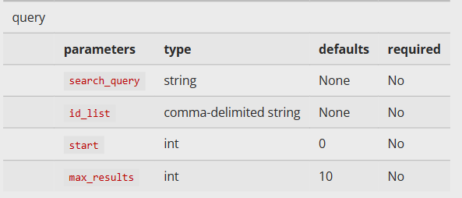
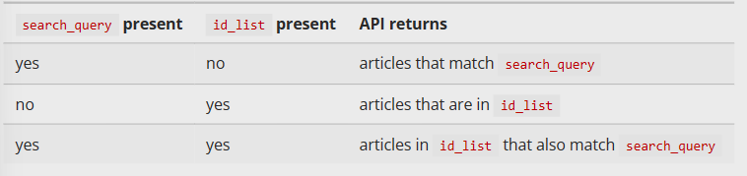
Query Interface

Slide 6
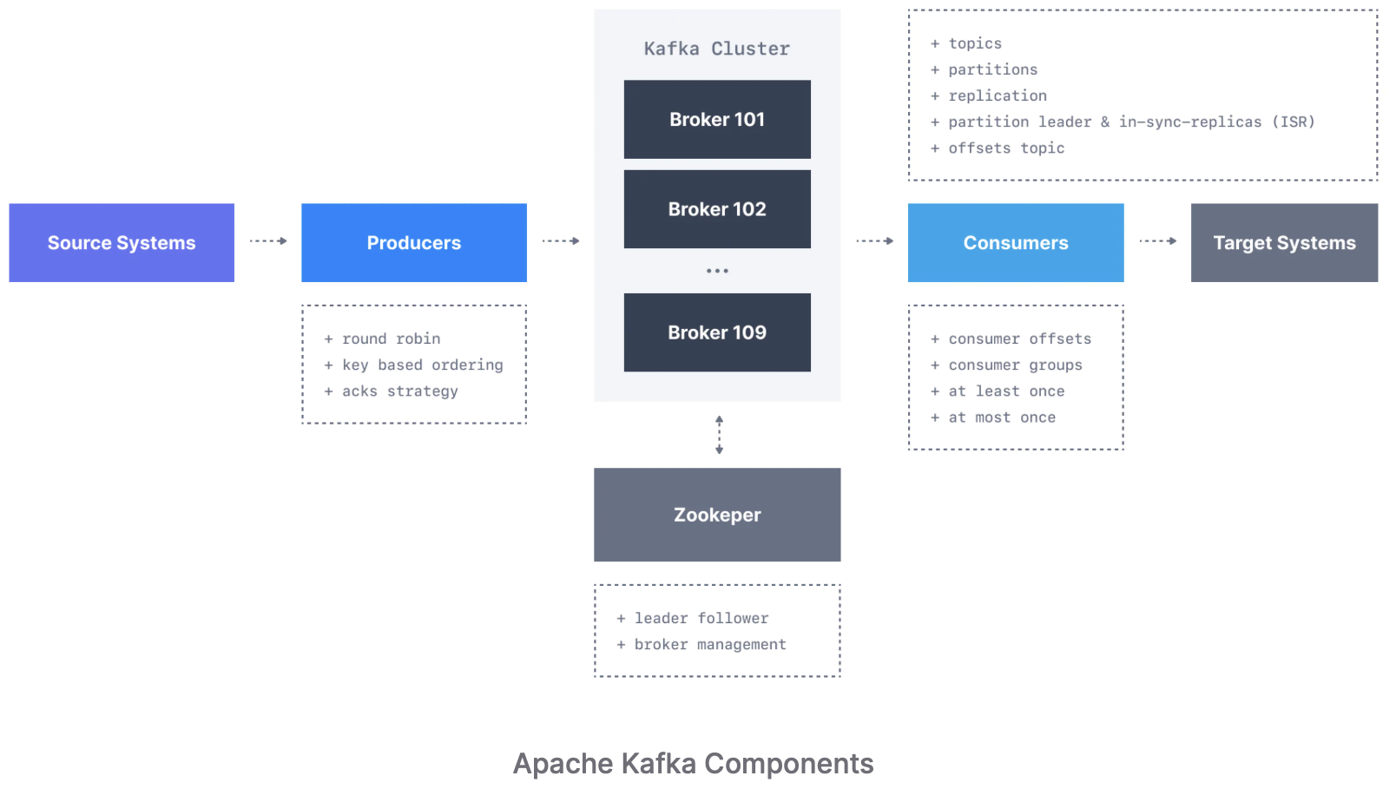
KAFKA

Slide 7
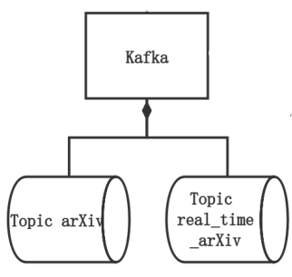
TOPIC
A topic is identified by its name.

Slide 8
KAFKA CMD LINE
After starting the zookeeper server and kafka server, it's time for us to create the aforementioned topics.
kafka-topics.sh --create –bootstrap-server localhost:9092 --replication-factor 1 --partitions 1 --topic arXiv
kafka-topics.sh --create –bootstrap-server localhost:9092 --replication-factor 1 --partitions 1 --topic real_time_arXiv

Slide 9
Producer
Get papers’ data from the arXiv API in XML format.
Send each paper to Kafka as a tuple of (key, value). The value contains paper’s fields in JSON format.
Do some basic preprocessing. We compared the published time and the updated time of the paper to see if this paper is version 1. We also extracted the common words in the title and the abstract, used python nltk package to remove the stop words to get a more detailed idea of the paper’s topic.

Slide 10

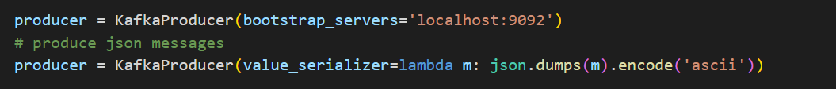
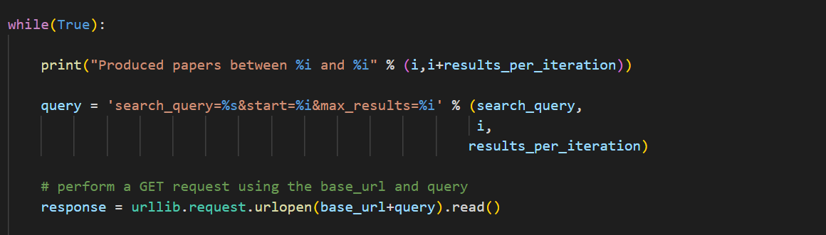
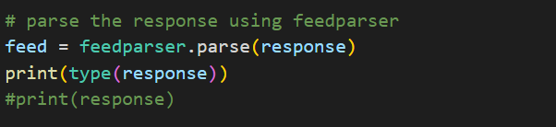
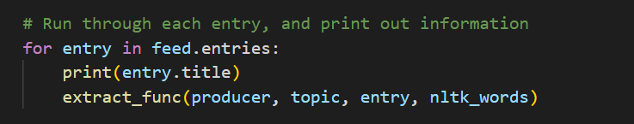
Producer.py

Slide 11
Consumer
Pull data from Kafka
Exploit Spark Streaming to process the incoming data from Kafka.
They save it in a Spark DataFrame that takes the schema from the JSON format of the received value.
Perform some Data Processing tasks.
Write data to MongoDB.

Slide 12
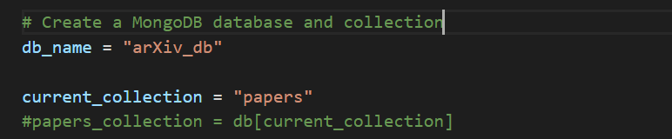
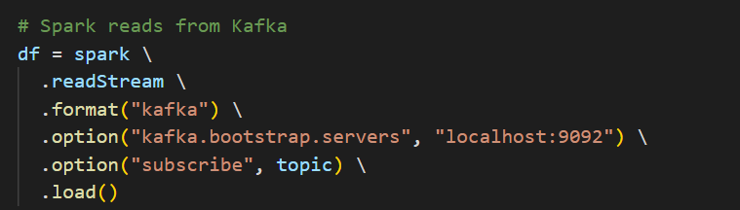
Consumer.py

Slide 13
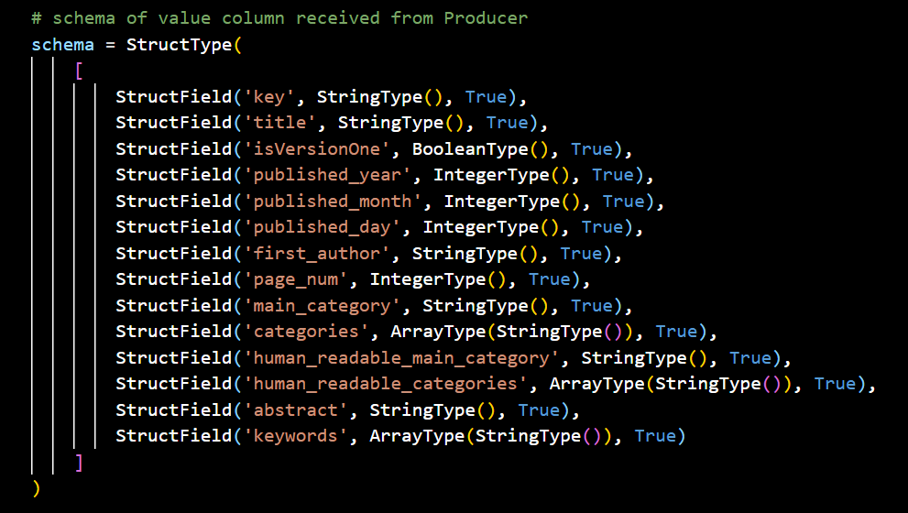
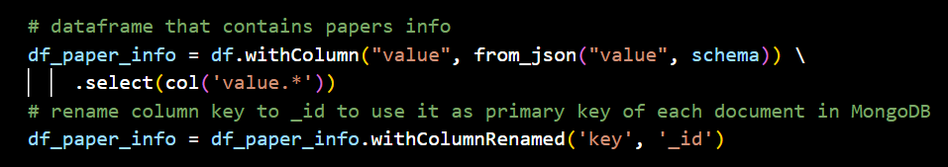

Slide 14
MongoDB
Scalable
High Performance
Rich query language
Real-time analytics
Open-source

Slide 15
MongoDB:
Visualization
Store all the papers’ original and processed information, whereby the primary key of paper id was used.
Users can visualize data in one or multiple dashboards with MongoDB Charts. We created multiple graphs and charts for users to visualize, both on historical and real-time data

Slide 16
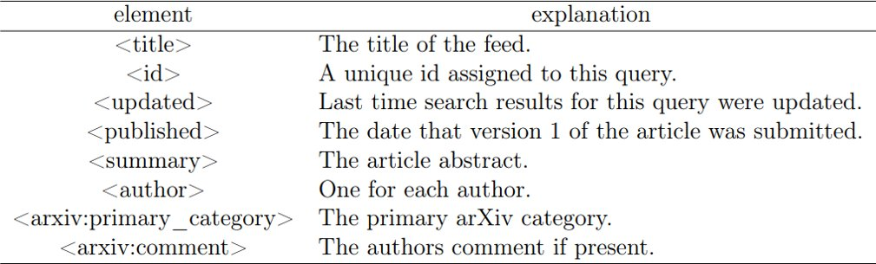
DATASET

Slide 17
Visualization – MongoDB Charts

Slide 18
REFERENCES:
[1] arXiv. arXiv API Access. url: https://arxiv.org/help/api/.

Slide 19
THANK YOU!

