Slide 1
Movie System Database
Xingyao Wu / Li Cai / Jiayuan Chen

Slide 2
Background
People are always updating their lifestyles. Just years ago, people were more used to walk into the cinema and look up their favorite movie through the screening schedule board. And for now, users retrieve movie schedules, trailers, description and purchase movie tickets just by websites and mobile applications. In order to support these applications, we designed a relational database to provide the data service.

Slide 3
Architecture
Person Catalog
User
Employee
Movie Catalog
Movie
Movie Genre
Theatre Catalog
Theatre
Screening Schedule
Movie Director
Movie Actor
Movie News
Trailer
Rating
Award
Movie Distributor
Showroom
Theatre Address
Ticket
User watch list

Slide 4

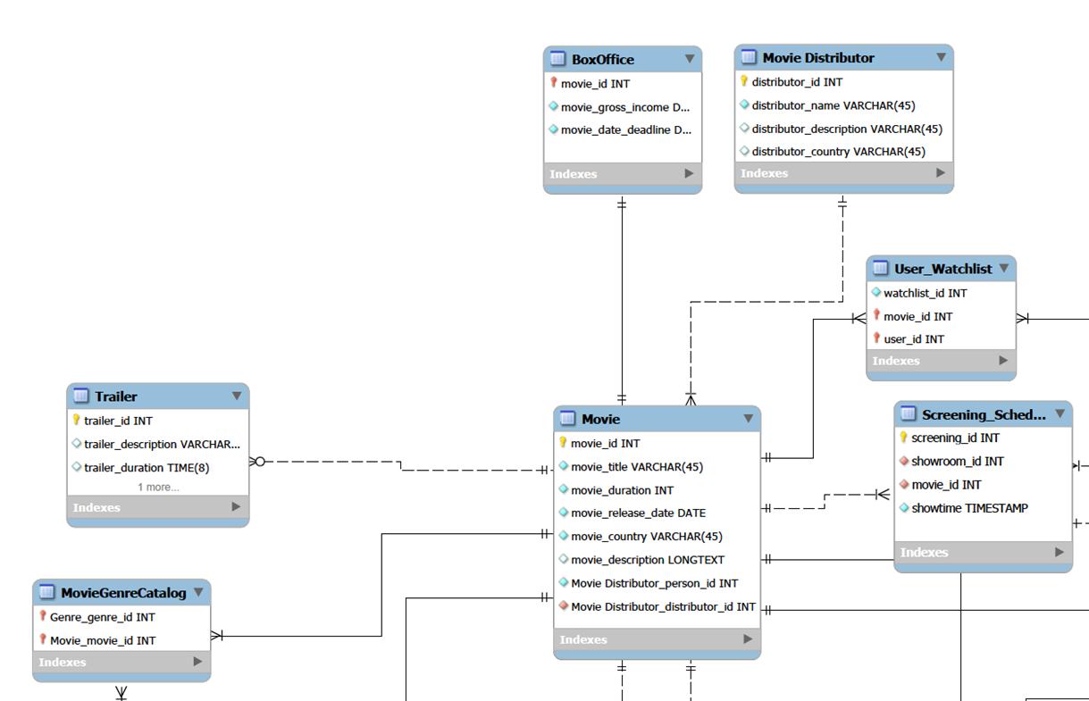
Entity Relational Diagram

Slide 5
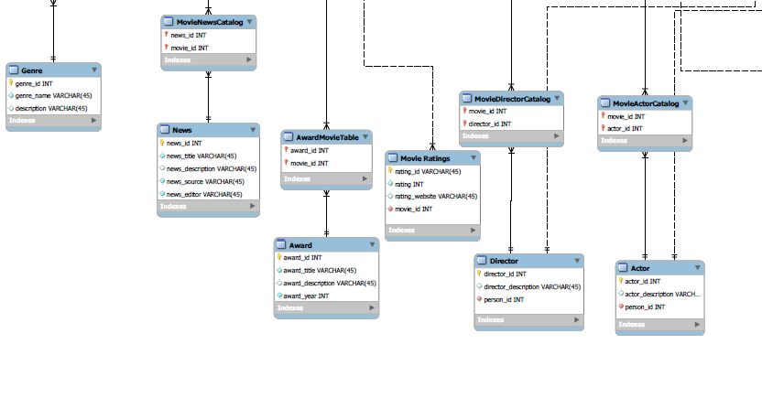
Entity Relational Diagram

Slide 6
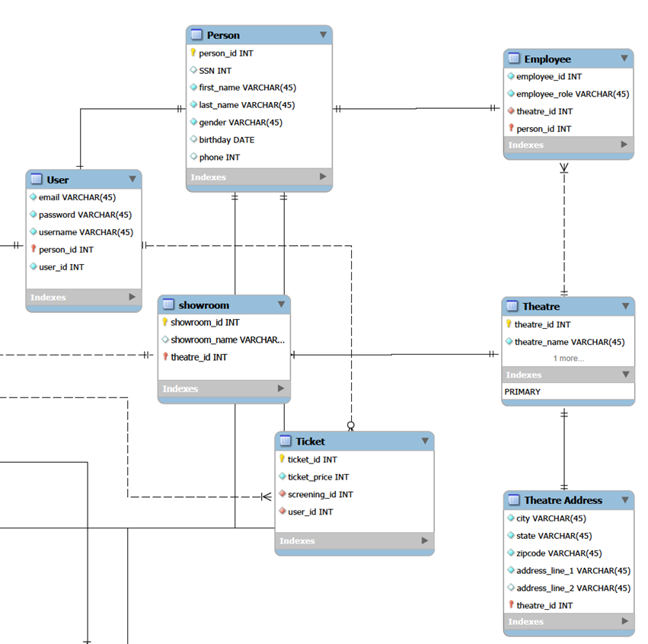
Entity Relational Diagram

Slide 7
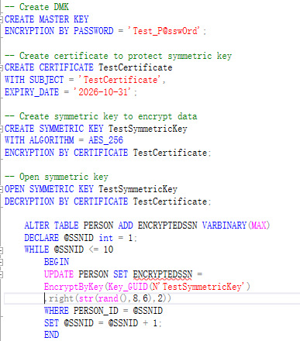
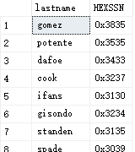
Highlight
Column Data Encryption

Slide 8
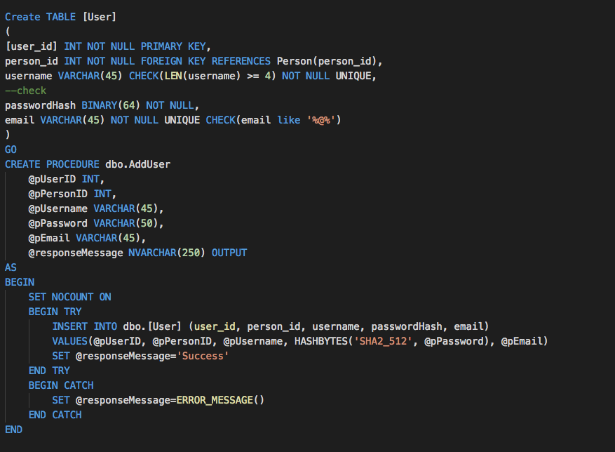

Highlight
Column Data Encryption

Slide 9
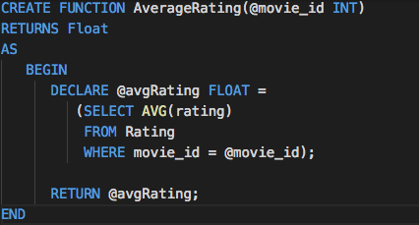
Highlight
Table-level Check Constraints
Checking length of the username should greater than 4 characters
Email address validation
Implementing PG13 check to ensure movie tickets are sold to right person

Slide 10

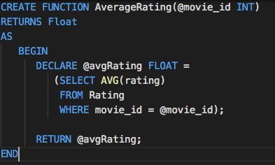
Highlights
Computed columns based on a function

Slide 11
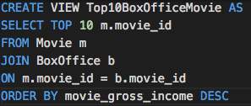
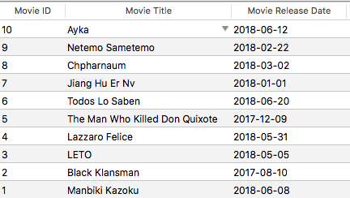
SQL Views
Viewing the top 10 movie of the box office

Slide 12
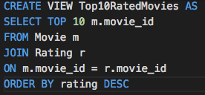
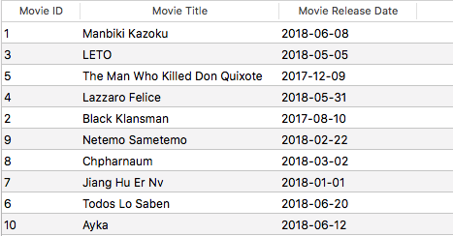
SQL Views
Viewing the top 10 rated movie by user

Slide 13
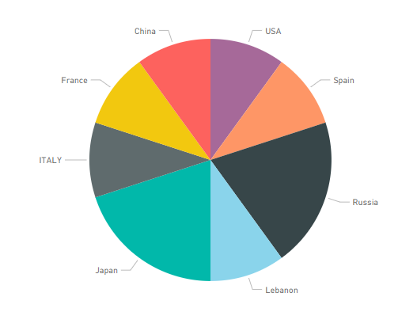
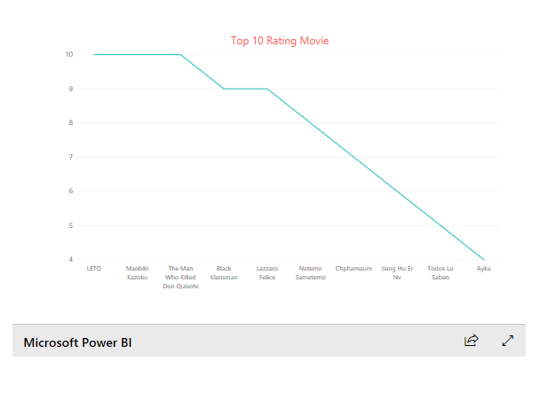
PowerBI Reports
Top 10 rated movie and origin distribution

Slide 14
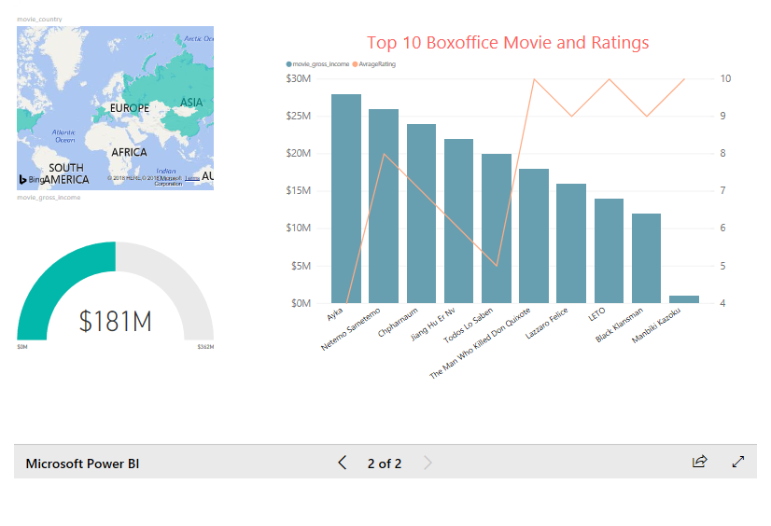
PowerBI Reports
The report of Top 10 movies ,ratings and it’s region.

Slide 15
Future Enhancement
Implement our design with different databases like MySQL,Oracel ect.

Slide 16
Q&A

